Slide 1
Multiplexor
A multiplexor is a combinational circuit that passes one of multiple data inputs through to a single output, selecting which one based on additional control inputs.
Mux is short for multiplexor.
A mux's control inputs are called select lines.

Slide 2
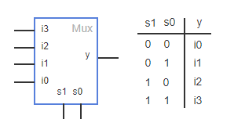
A 4x1 Mux
A 4x1 mux, spoken as "4 to 1 mux", has 4 data inputs, 1 data output, and requires 2 select inputs.
Y = s1’s0’i0 + s1’s0i1 + s1s0’i2 + s1s0i3

Slide 3
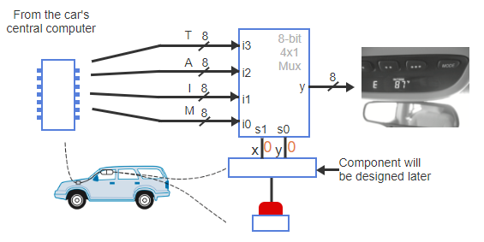
A 4x1 Mux Example
Many cars have an above-mirror display.
A driver can press a button and select one of several options.
A mux can be used to design and above-mirror display to reduce the number of wires that need to be connected to the display.
Notes:
A display above a car's rear view mirror shows the temperature (T), average miles per gallon (A), instantaneous miles per gallon (I), and miles remaining (M).
Sensors in the car measure and send the values to the car's central computer. Each data input is eight bits wide.
A driver presses a button to select what value to display from T, A, I, and M. An 8-bit 4x1 mux selects the desired value, and the mux output connects to the display.
Additional inputs x and y follow a sequence of 11, 10, 01, 00 when the button is pressed. xy = 11 displays T, xy = 10 displays A, xy = 01 displays I, and xy = 00 displays M.

Slide 4
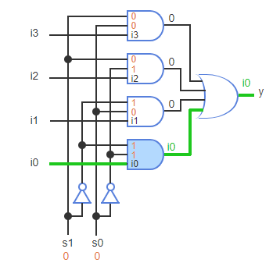
A 4x1 Mux Circuit
Y = s1’s0’i0 + s1’s0i1 + s1s0’i2 + s1s0i3

Slide 5
Decoders
A decoder is a combinational circuit that converts N inputs to 1 on one of 2^{N} outputs.

Slide 6
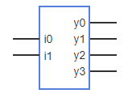
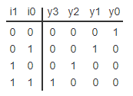
A 2x4 Decoder
A 2x4 decoder, spoken as “2 to 4 decoder” converts two inputs to a 1 on exactly one of four outputs.
y0 = i1'i0'
y1 = i1'i0
y2 = i1i0'
y3 = i1i0

Slide 7
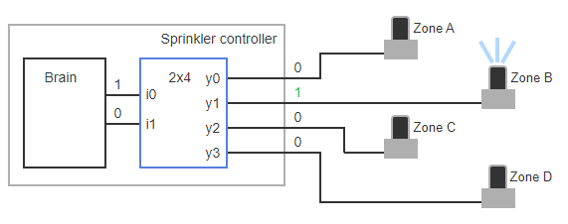
A 2x4 Decoder Example
A Lawn Sprinkler Controller using a 2x4 Decoder
Notes:
A lawn sprinkler system has multiple zones. Due to limited incoming water, only one zone should be activated at a time.
The controller's brain has two outputs, encoding the active zone in binary: 00, 01, 10, or 11. Those two outputs should activate one corresponding zone.
A decoder easily implements the desired behavior, converting two inputs to a 1 on exactly one of four outputs.

Slide 8
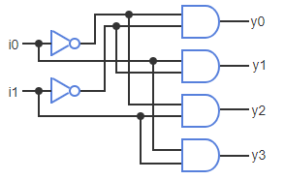
A 2x4 Decoder Circuit
y0 = i1'i0'
y1 = i1'i0
y2 = i1i0'
y3 = i1i0

