Slide 1


Take-Home Technical Assessment
Denis Kalyan

Slide 2
Task
The loan is one of the most important products of the banking world. Banks are trying to figure out how to get more customers to subscribe to their loan, however even when a customer is approved they can still default on a loan. To prevent this banks would like to develop a method to predict customers’ behaviours.
British Challenger Bank gave me data based on the performance of their loan issued from 2009 to 2015.
Use the data to build a model to help their credit analyst assess new loan applications. The model will be able to predict if a loan would be defaulted on(Charged Off).

Slide 3
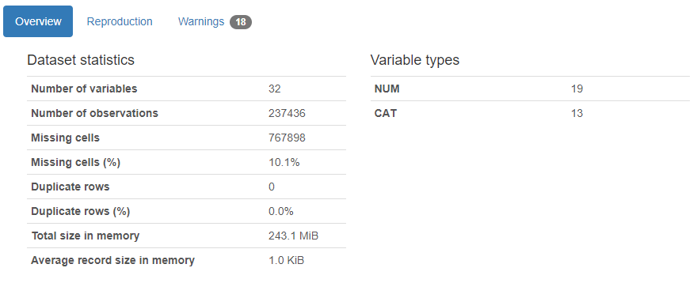
Initial Findings
Pandas Profiling is a library made for carrying out simple analysis on the data for machine learning.
I used it to produce a report on the Bank data
Straightaway we can see that 10.1% of the data is missing, which is a large chunk of the data.
I will only been keeping the features that have less than 5% of missing data.

Slide 4
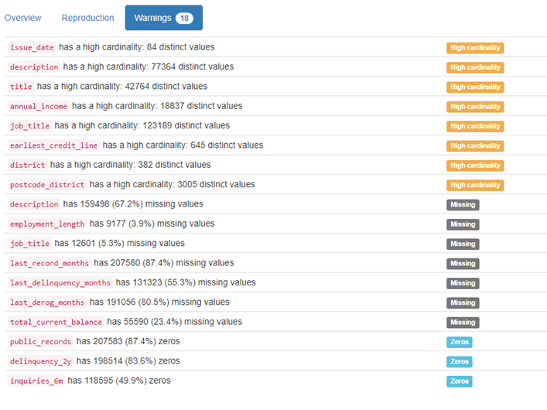
Warnings
High Cardinality: Refers to columns with values that are very uncommon or unique.
Removed Features:
description
last_record_months
last_delinquency_months
last_derog_months
total_current_balance
postcode_district
district
job_title
earliest_credit_line
title

Slide 5
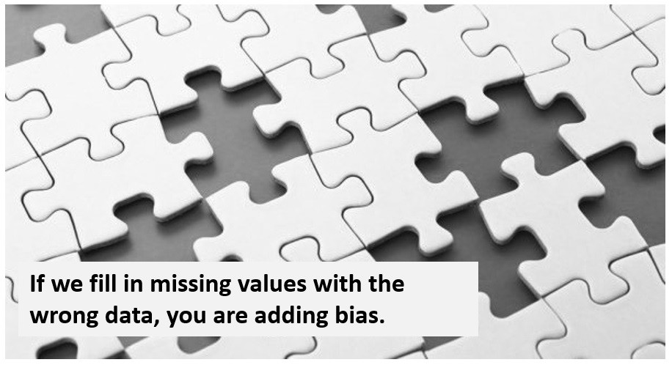
Dropped features due to missing values
description: Loan description provided by the borrower. (67.2% Missing)
last_record_months: The number of months since the last public record. (87.4% Missing)
last_delinquency_months: The number of months since the borrower's last delinquency. (55.3% Missing)
last_derog_months: Months since most recent 90-day or worse rating. (80.5% Missing)
total_current_balance: Total current balance of all accounts. (23.4% Missing)

Slide 6
Other dropped features
postcode_district: The postcode of the borrower's address. (High Cardinality)
job_title: The job title supplied by the borrower when applying for the loan. (Very high cardinality of 123,189)
earliest_credit_line: The month the borrower's earliest reported credit line was opened. (High cardinality and doesn’t add much significance to the model)
district: The geographic district of the borrower's address. (High Cardinality and wont help the model)
title: The loan title provided by the borrower. (Very high cardinality and very similar to ‘purpose’ feature)

Slide 7
Feature Engineering

Slide 8
Editing Features
annual_income : Removed non numeric characters from the feature (‘GBP’)
public_records, delinquency_2y, inquiries_6m,: creating new features called ‘delinq_2yrs_cat’ , ’inq_last_6mths_cat’ and ‘pub_rec_cat’, turning all values above a 0 to a 'yes’ and values that are 0 into 'no' and then dropping the old ones.
issue_date: Removed the numerical values from issue date so only months are left e.g. ‘Sep’, ‘Oct’.
loan_status: Created a new feature called ‘loan_condition’ and added ‘Good Loan’ and ‘Bad Loan’ into it, Good Loan contains [‘Fully Paid’ , ‘Ongoing’] and Bad Loan contains [‘Charged Off’ , ‘Default’ , ‘Late (> 90 days)’]

Slide 9
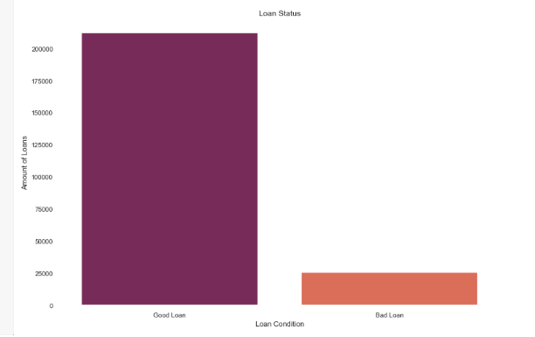
Imbalanced dependent variable
After converting the ‘loan_status’ to ‘loan_condition’, it was clear that there was a massive imbalance in the data.
I used a method called SMOTE, this helps by producing more data based on the already existing data.
This was able to help me balance the training data.

Slide 10
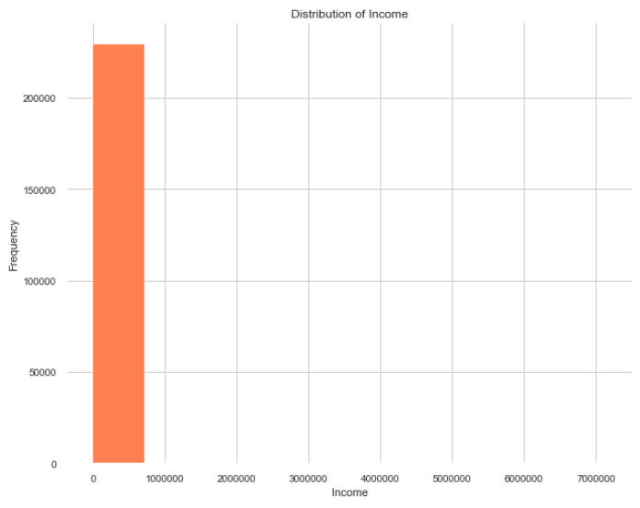
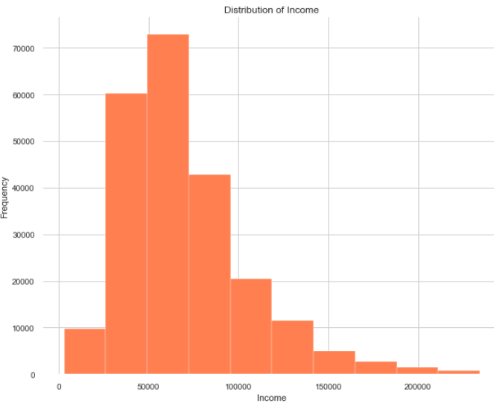
Removing Outliers from features
There were 5 features that had really skewed data, they were: ‘open_accounts’, ‘credit_card_usage’, ‘credit_card_balance’, ‘nr_accounts’ and ‘annual_income’.
Outliers skew the data and skewed data is bad for a machine learning model as it will train the model on features which have much larger numbers than they should have, this will lead to the model being less accurate and provide wrong predictions.

Slide 11


Exploratory data analysis

Slide 12
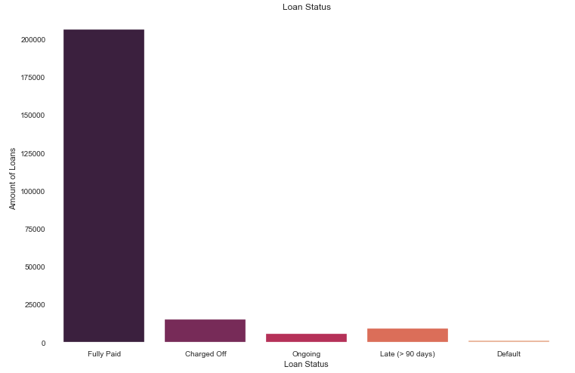
Loan Status
This will be the dependent variable in this model.
We can see that this is already an unbalanced dataset.
As we can see the three bars that are negative are ‘Charged off’, ‘Late (> 90 days) and ‘Default
Charged off: a declaration by a creditor that an amount of debt is unlikely to be collected.
Default: the failure to repay a debt including interest or principal on a loan or security.

Slide 13
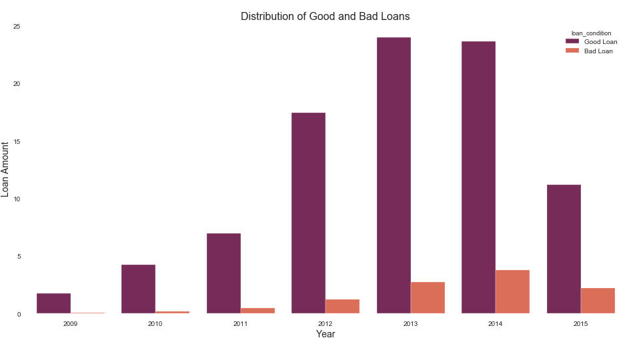
Distribution of good and bad loans
I made a new feature called ‘loan_condition’ which has 2 variables of ‘Good Loan’ and ‘Bad Loan’.
This was derived from the ‘loan_status’ feature where ‘Fully Paid’ and ‘Ongoing’ were marked as good loans and the rest are bad loans.
This distribution shows the amount of good and bad loans taken out each year.
There is a clear increase in the amount of loans taken out each year.

Slide 14
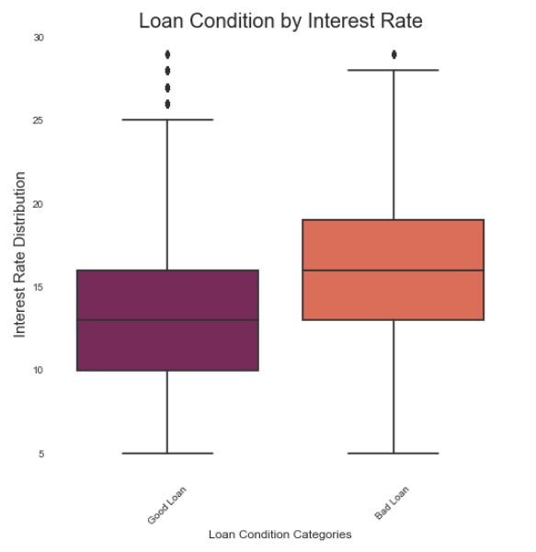
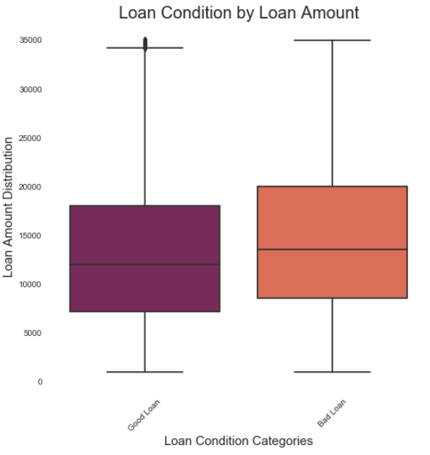
Loan status by interest rate/loan amount
Looking at the two graphs, ‘Bad Loan’ is overall higher on both.

Slide 15
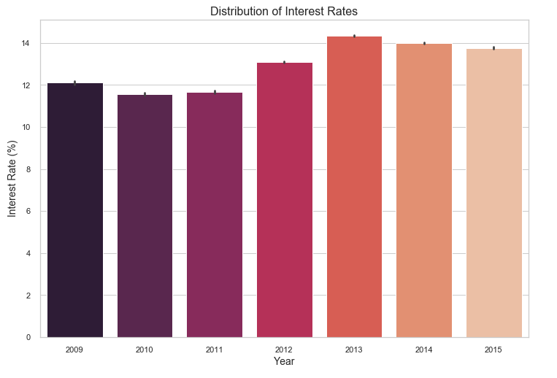
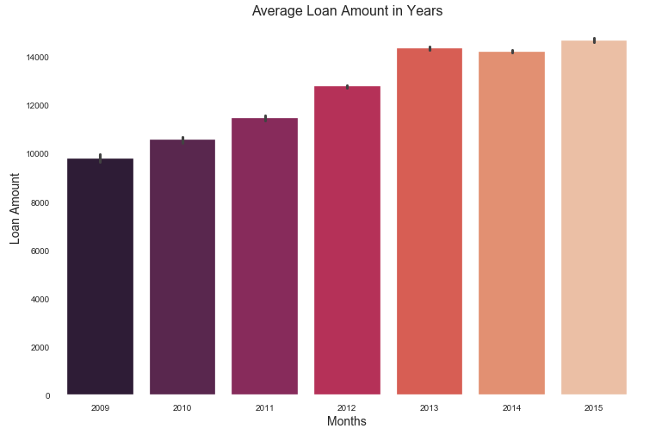
Distribution of loan amount and interest rate per year
The average loan amount is higher each year but it looks like it is starting to level off.
Interest Rates seem to have reached the peak in 2013 and have dipped lower from that year.

Slide 16
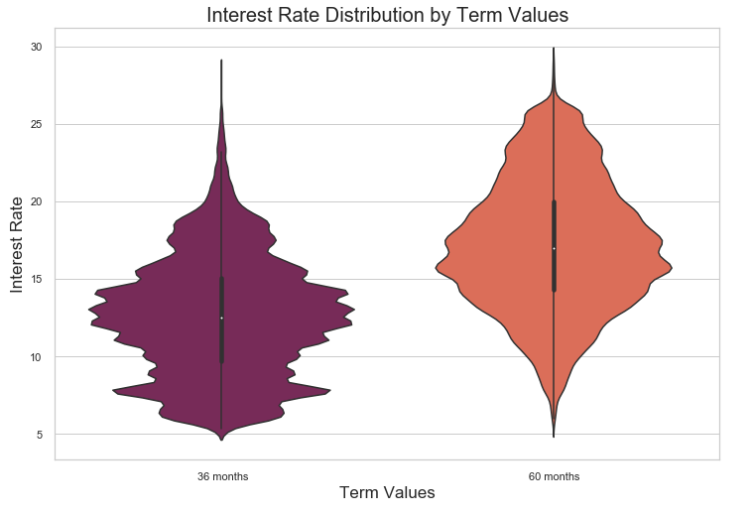
Interest rate distribution by term
Interest rates tend to be higher for the longer term loan rather than the short term loan.

Slide 17
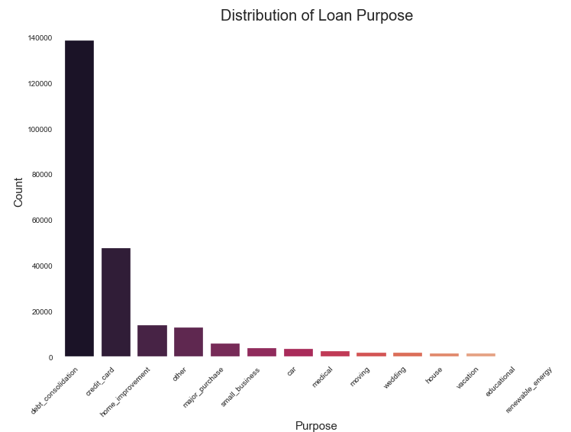
Distribution of loan purpose
Here we can see that most of the loans were taken out because of loan consolidation followed by paying off their credit card.

Slide 18
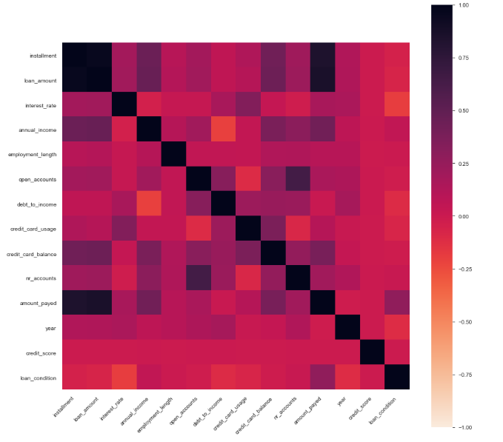
Correlation Matrix
Looking at the Correlation Matrix, we can see that ‘credit_score’ has come out to have the least correlation with the rest of the variables, therefore it would be able to be the most predictable feature and it will not skew the model.
‘loan amount’ and ‘instalment’ are very highly correlated
‘amount_payed’ and ‘loan_amount’

Slide 19
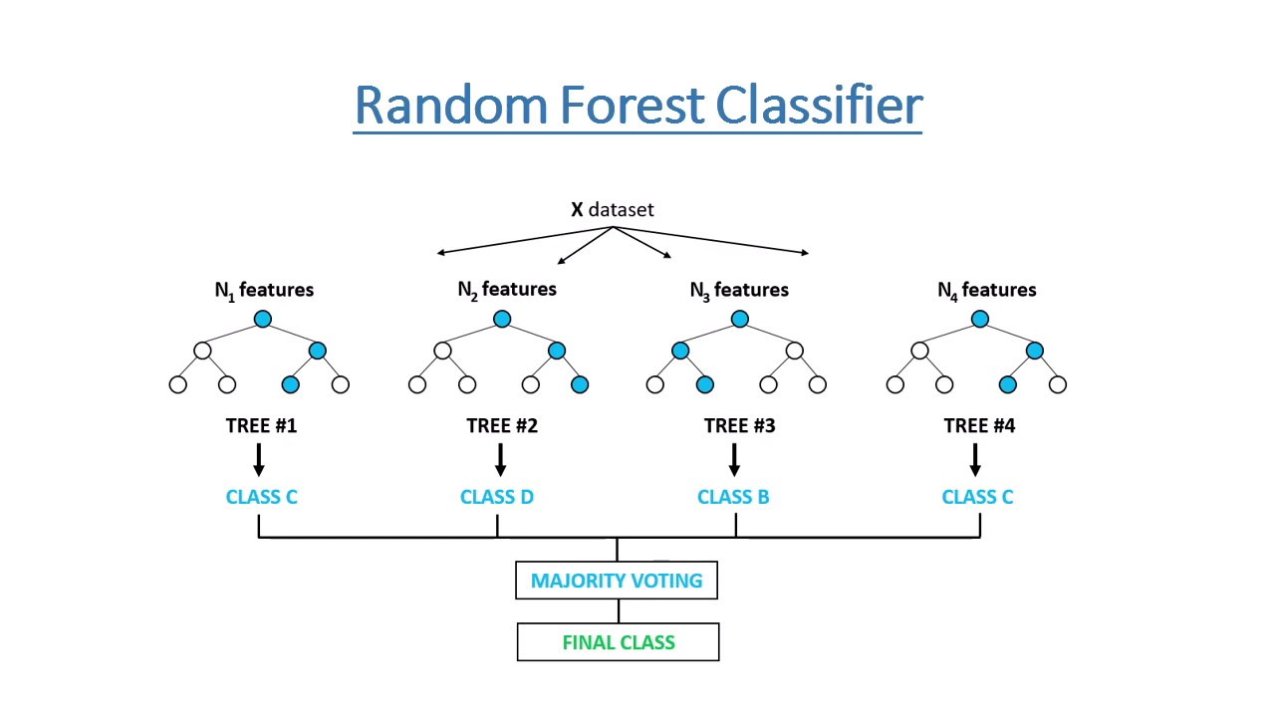
Model #1
Out of all the different machine learning algorithms that I ran on the dataset after I finished feature engineering and cleaning, the best performing model was the Random Forest Classifier
The hyper parameters that I chose to use are: ‘n_estimators’ , ‘max_depth’ and ‘max_features’
n_estimators: The number of trees in the forest
max_depth: The maximum depth of the tree
max_features: The number of features to consider when looking for the best split
I used a grid search to find the best inputs for each parameter to help get better scoring for the model n_estimators=300, max_depth=9, max_features='auto'

Slide 20
Results for model #1
Precision: 0.9072925368359313
Recall: 0.8387886555588419
Accuracy: 0.7798112709902412
We are predicting which loans will be defaulted on therefore we are looking at reducing the number of false positives so at the amount of people that the model predicts as eligible for the loan but they will still default.
Percision has a really high result and as I'm using the RandomForestClassifier it is highly unlikely that the data overfit.
Actual
Predictive
 | Negative | Positive
Negative | 2172 (TN) | 5216 (FP)
Positive | 9811 (FN) | 51047 (TP)
This value is the main focus for this model.

Slide 21
Recursive feature elimination
Recursive feature elimination (RFE) is a feature selection method that fits a model and removes the weakest feature (or features) until the specified number of features is reached.
I used RFE to find both the most important feature and the top 5 features to use in the new model.
The top feature was ‘interest_rate’
And the top 5 features were 'credit_card_balance’, 'credit_card_usage’, 'debt_to_income’, 'interest_rate’, 'loan_amount'

Slide 22
Results from model #2
Precision: 0.9324192921042396
Recall: 0.6301815493304855
Accuracy: 0.6294434838671864
The new model has lower accuracy and lower recall however it has a higher precision score which is what was needed. On the other hand the recall score is lower which means that the model has classified more people as ‘Bad Loan’ but they were actually ‘Good Loan’ therefor it has made the bank lose more money this way.
So the second model is actually worst for profit for the bank
Actual
Predictive
 | Negative | Positive
Negative | 4601 (TN) | 2780 (FP)
Positive | 22509 (FN) | 38356 (TP)

