Slide 1
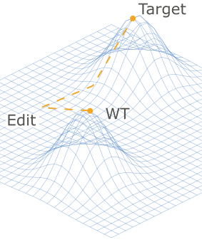
EpiGen
Denny Trimcev, PostDoc @ AndinoLab, UCSF
Aru Singh @arubikscube

Slide 2
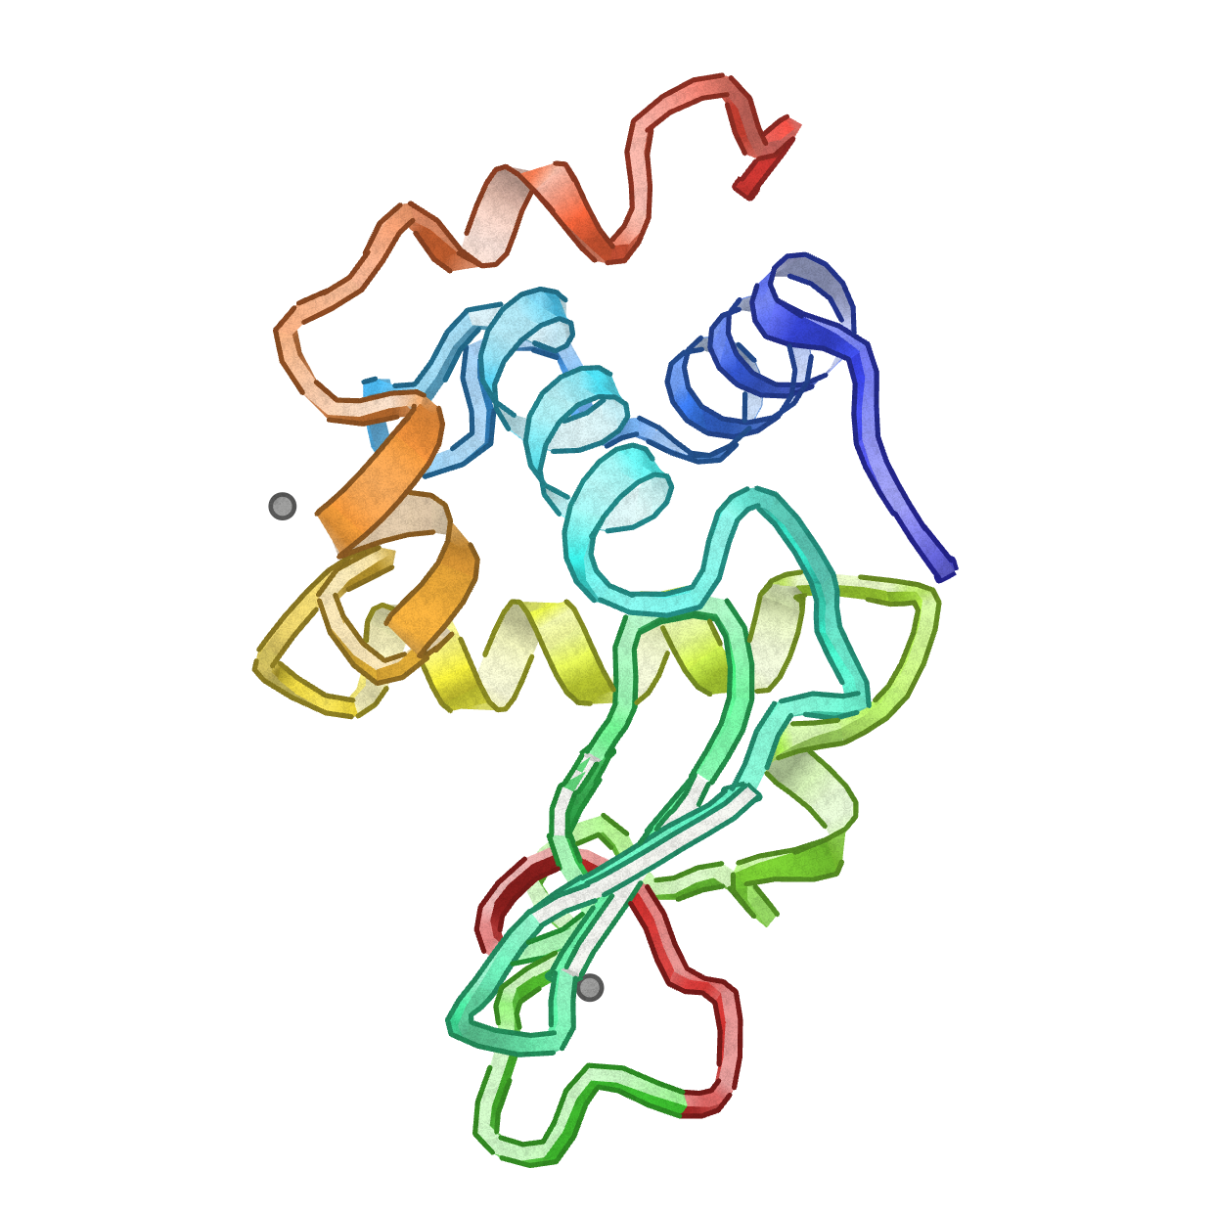
EpiGen: the Goal

Slide 3
EpiGen: the Goal
Given
A protein
An edit (ie subs XXX->WHS)
Most mutations are deleterious!
Find compensatory mutations to lock the edit in!
Why?
@AndinoLab: engineer loss of function in viruses to create new vaccines. Talk to me if you’re interested!

Slide 4
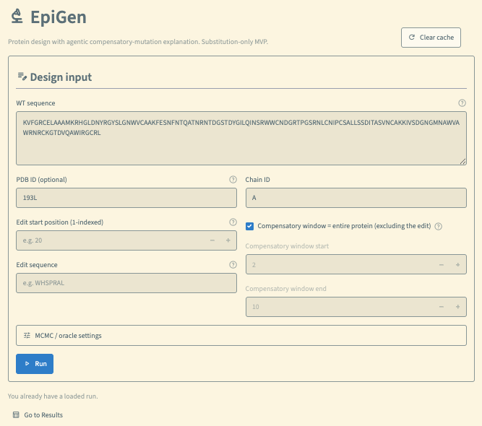
Pipeline
Streamlit app

Slide 5
Optimizer
Proto
Proto
Constraint: Retain Edit
Optimizer: MOE (ESM2 + PMPNN + EVO2)

Slide 6
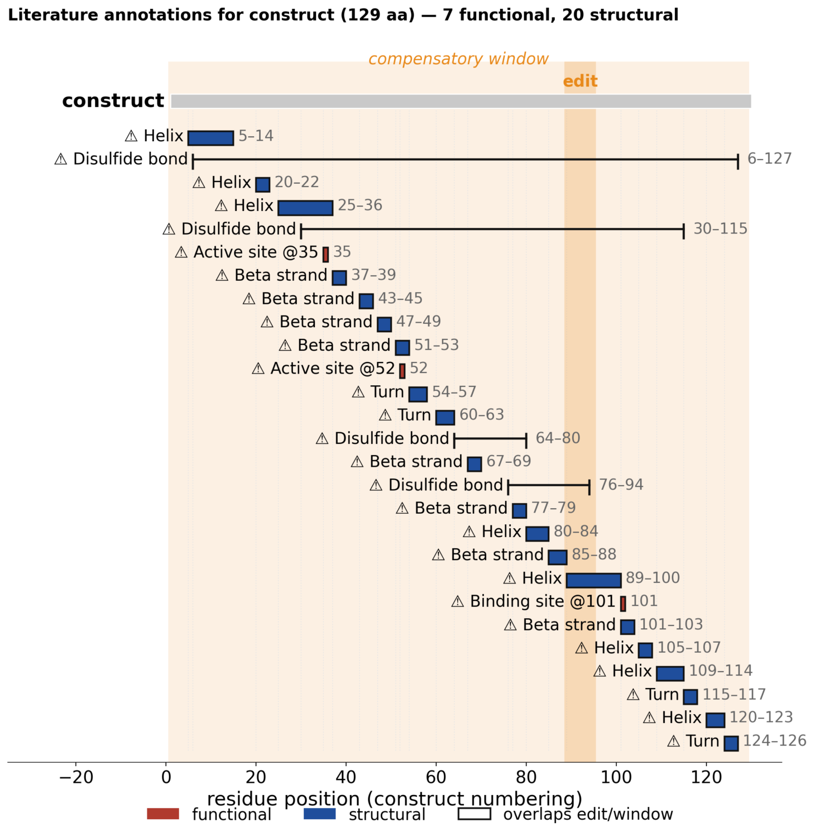
Interpretability
Paperclip
Search PDB in the literature for
Structural features
Functional features

Slide 7
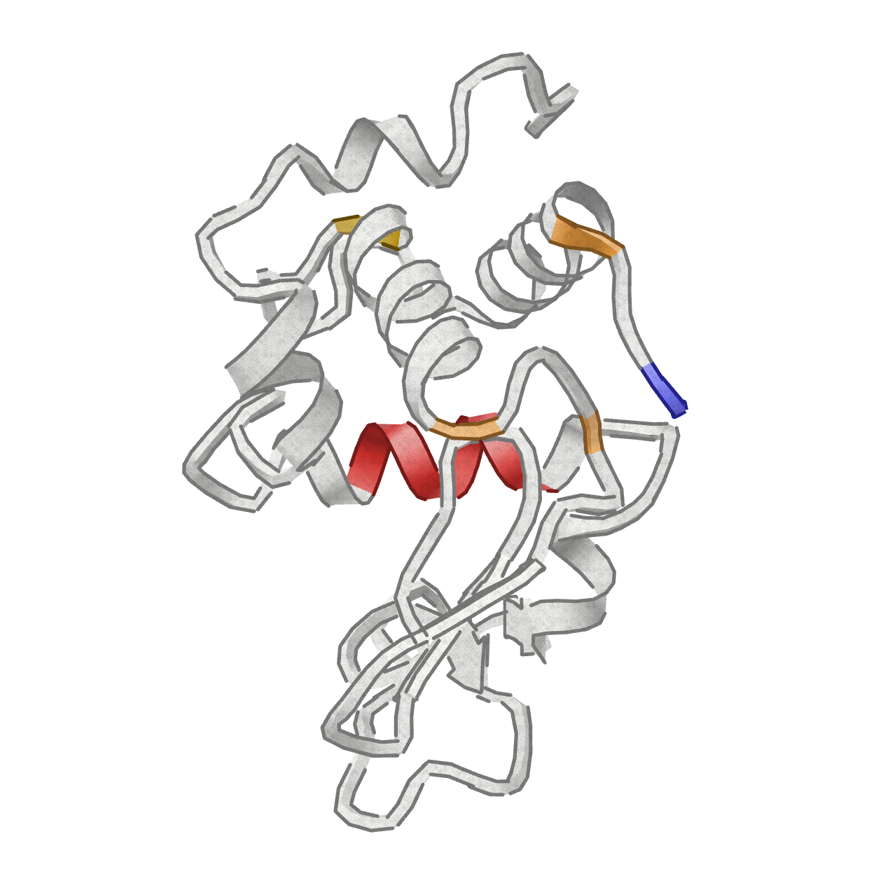
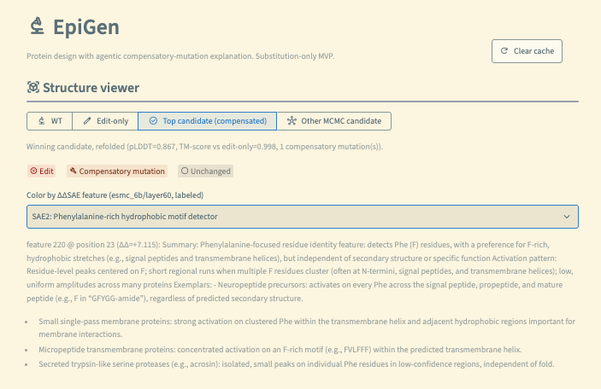

Interpretability
ESM-SAE
Search SAE components with $$ΔΔSAE=SAE\left(μ_comp\right)−SAE\left(wt\right)$$

Slide 8
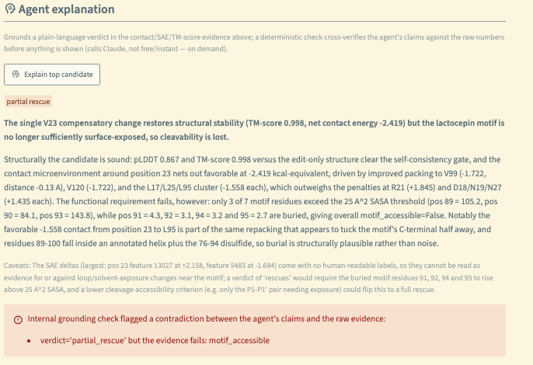
Interpretability
Physical Cross Check
Compute physical interaction energy between diff’d AA & old AA

