Slide 2
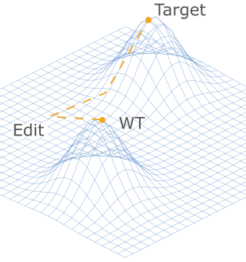
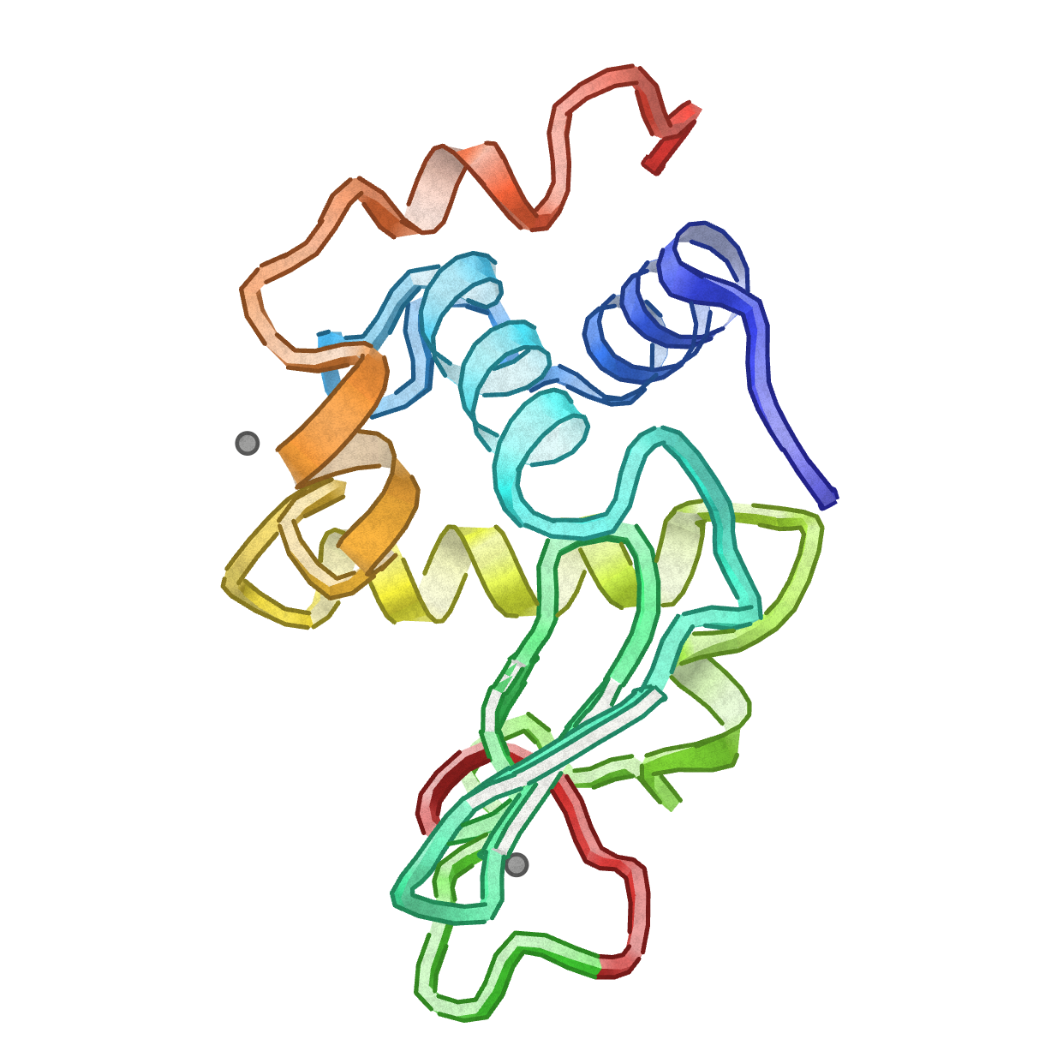
EpiGen: the Goal
Given
A protein
An edit (ie subs XXX->WHS)
Most mutations are deleterious!
Find compensatory mutations to lock the edit in!
Why?
@AndinoLab: engineer loss of function in viruses to create new vaccines. Talk to me if you’re interested!

