Slide 1


Improving relevance prediction by addressing biases and sparsity in web search click data
Qi Guo, Dmitry Lagun, Denis Savenkov, Qiaoling Liu
[qguo3,dlagun,denis.savenkov,qiaoling.liu]@emory.edu
Mathematics & Computer Science, Emory University

Slide 2
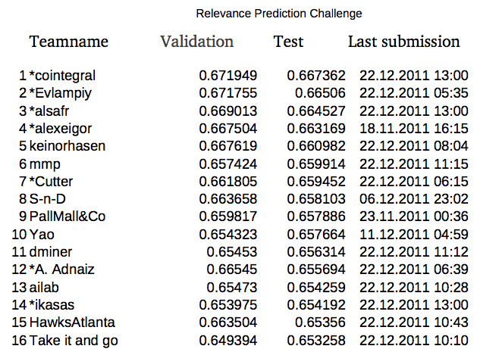
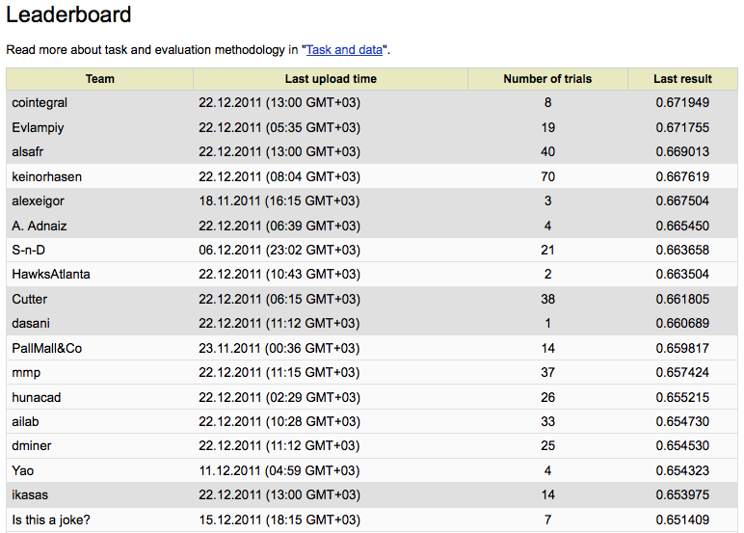
Relevance Prediction Challenge

Slide 3
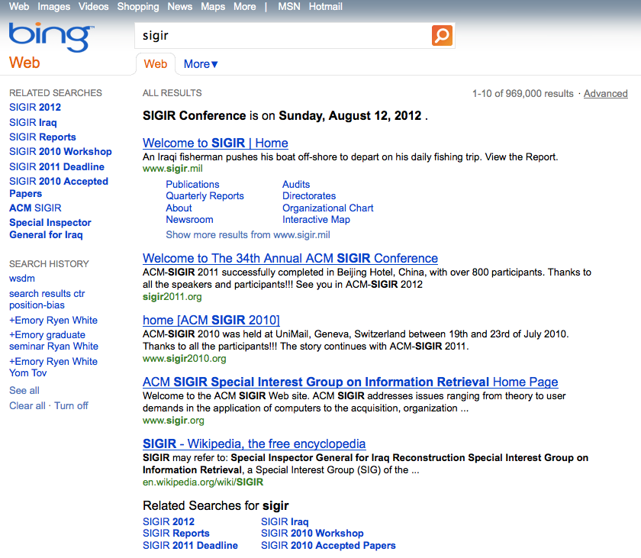
Web Search Click Data

Slide 4
Relevance prediction problems
Position-bias
Perception-bias
Query-bias
Session-bias
Sparsity

Slide 5
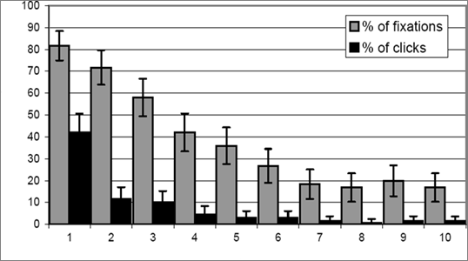
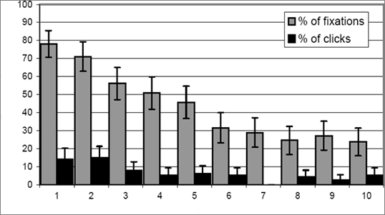
Relevance prediction problems: position-bias
CTR is a good indicator of document relevance
search results are not independent
different positions – different attention [Joachims+07]
Percentage
Percentage
Normal Position
Reversed Impression

Slide 6

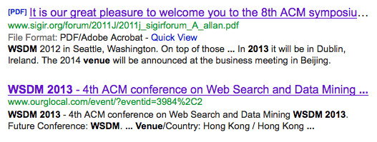
Relevance prediction problems: perception-bias
User decides to click or to skip based on snippets
“Perceived” relevance may be inconsistent with “intrinsic” relevance

Slide 7
Relevance prediction problems: query-bias
queries are different
Ctr for difficult queries might not be trustworthy
For infrequent queries we might not have enough data
Navigational vs informational
Different queries – different time to get the answer
Queries:
P versus NP
how to get rid of acne
What is the capital of Honduras
grand hyatt seattle zip code
Why am I still single
why is hemp illegal

Slide 8
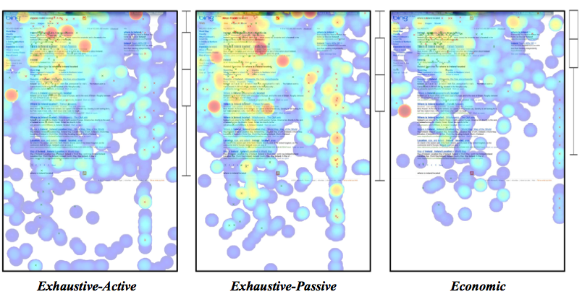
Relevance prediction problems: session-bias
Users are different
Query ≠ Intent
30s dwell time might not indicate relevance for some types of users [Buscher et al. 2012]

Slide 9
Relevance prediction problems: sparsity
1 show – 1 clicks means relevant document?
What about 1 show – 0 clicks, non-relevant?
For tail queries (non-frequent doc-query-region) we might not have enough clicks/shows to make robust relevance prediction

Slide 10
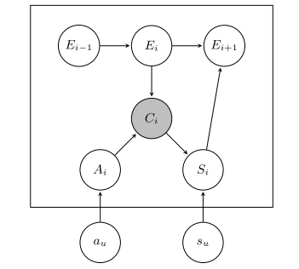
Click Models
User browsing probability models
DBN, CCM, UBM, DCM, SUM, PCC
Don’t work well for infrequent queries
Hard to incorporate different kind of features

Slide 11
Our approach
Click Models are good
But we have different types of information we want to combine in our model
Let’s use Machine Learning
ML algorithms:
AUCRank
Gradient Boosted Decision Trees (pGBRT implementation) – regression problem

Slide 12
Dataset
Yandex Relevance Prediction Challenge data:
Unique queries: 30,717,251
Unique urls: 117,093,258
Sessions: 43,977,859
4 Regions:
Probably: Russia, Ukraine, Belarus & Kazakhstan
Quality measure
AUC - Area Under Curve
Public and hidden test subsets
Hidden subset labels aren’t currently available

Slide 13
Features: position-bias
per position CTR
“Click-SkipAbove” and similar behavior patterns
DBN (Dynamic Bayesian Network)
“Corrected” shows: shows with clicks on the current position or below (cascade hypothesis)

Slide 14
Features: perception-bias
Post-click behavior
Average/median/min/max/std dwell-time
Sat[Dissat] ctr (clicks with dwell >[<] threshold)
Last click ctr (in query/session)
Time before click

Slide 15
Features: query-bias
Query features: ctr, no click shows, average click position, etc.
Url features normalization:
>average query dwell time
# clicks before click on the given url
The only click in query/shows
Url dwell/total dwell

Slide 16
Features: session-bias
Url features normalization
>average session dwell time
#clicks in session
#longest clicks in session/clicks
dwell/session duration

Slide 17
Features: sparsity
Pseudo-counts for sparsity
Prior information: original ranking (average show position; shows on i-th pos / shows)
Back-offs (more data – less precise):
url-query-region
url-query
url-region
url
query-region
query

Slide 18
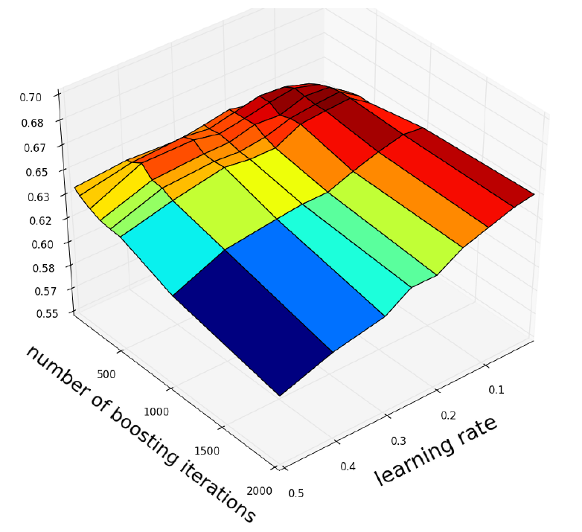
Parameter tuning
Later experiments:
5-fold CV
Tree height h=3
Iterations: ~250
Learning rate: 0.1

Slide 19
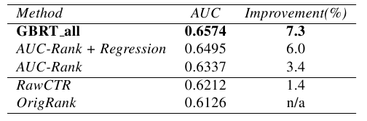
Results (5-fold CV)
Baselines:
Original ranking (average show position): 0.6126
Ctr: 0.6212
Models:
AUC-Rank: 0.6337
AUC-Rank + Regression: 0.6495
Gradient Boosted Regression Trees: 0.6574

Slide 20
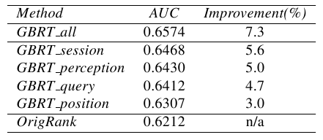
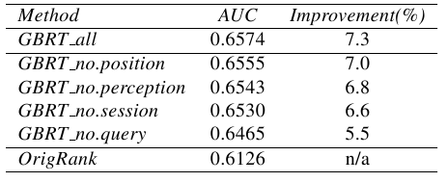
Results (5-fold CV)
session and perception-bias features are the most important relevance signals
Query-bias features don’t work well by itself but provide important information to other feature groups

Slide 21
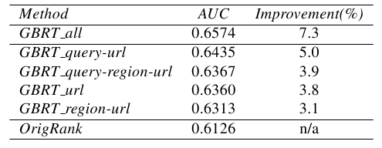
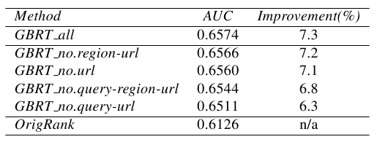
Results (5-fold CV)
query-url level features are the best trade-off between precision and sparsity
region-url features have both problems: sparse and not precise

Slide 22
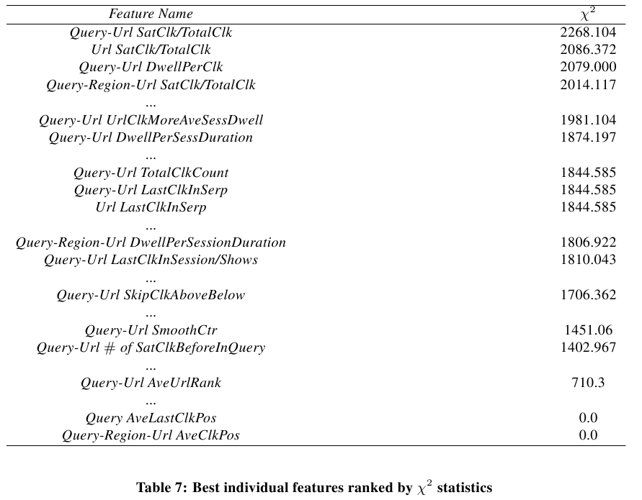
Feature importance

Slide 23
Conclusions
Sparsity: Back-off strategy to address data sparsity = +3.1% AUC improvement
Perception-bias: dwell-time is the most important relevance signal (who would’ve guessed ☺)
Session-bias: session-level normalization helps to improve relevance prediction quality
Query-bias: query-level information gives an important additional information that helps predict relevance
Position-bias features are useful

Slide 24
THANK YOU
Thanks to the organizers for such an interesting challenge & open dataset!
Thank you for listening!
P.S. Do not overfit ☺

