Slide 1

Detecting Search Engine Switching Based on User Preferences, Search Tasks, and Behavior Patterns
“Out of mEmory”
(Denis Savenkov, Dmitry Lagun, Qiaoling Liu)
{dsavenk, dlagun, qiaoling.liu}@emory.edu
Notes:
Introduction: names and affiliation

Slide 2
Talk Outline
Task Description
Data Preprocessing
Feature Design
Session Features
Overall historical statistics
Per-user historical statistics
Model
Summary
Notes:
Plan of the talk:
Task description
Data Preprocessing
Feature Design
Model and Summary

Slide 3
Team progress
0.849415
Notes:
Here is plot of AUC of our submissions. The best AUC was obtained by the last submission and is 0.849415

Slide 4
Task Description
Goal: predict for each test session how likely the user switched to another search engine during the search task.
Dataset:
train file (d1-27), each user switched at least once
test file (d28-30), all sessions from these users
Quality metric
AUC for a ranked list of session IDs
Notes:
Sometimes users switch search engine during a search task. Only a fraction can be monitored. Detecting switching is important and has economic importance as well.
Goal of the challenge is predict how likely a given session contain a switching actions. 30 days of search logs with special filtering. AUC as a quality metric.

Slide 5
Data for Model Testing
Statistics for validation
Statistics
Training
Validation
Test
time
Day 1
Day 21
Day 24
Day 27
Day 30
Training
Statistics for Training
Notes:
To test our hypothesis we used the following splits of data, Training on 3 days (tried more, didn’t get improvement, but longer training). Some of the features we used are based on aggregated statistics, so these statistics were calculated on a separate period.
- Mention that just this improves AUC by 0.02 (from 0.8 to 0.82 )

Slide 6
Data Preprocessing
3 day split, similar sessions filtering
Period | Days | # Sessions | # Switches (%)
0 | 1-3 | 538’506 | 49’882 (9.2%)
1 | 4-6 | 608’598 | 63’590 (10.4%)
2 | 7-9 | 644’265 | 66’263 (10.28%)
3 | 10-12 | 613’752 | 61’579 (10.03%)
4 | 13-14 | 588’497 | 60’286 (10.24%)
5 | 15-18 | 493’880 | 49’117 (9.94%)
6 | 19-21 | 542’917 | 56’728 (10.44%)
7 | 22-24 | 556’502 | 55’490 (9.97%)
8 | 25-27 | 737’421 | 78’789 (10.68%)
Training + statistics
validation
Notes:
We removed users who don’t switch in the “statistics” (all the training set except current training split) period. These are some statistics over periods (actually noticed that on weekends higher switching rate).

Slide 7
Data for Model Training
Statistics for Testing
Test
Statistics for Training
Training
time
Day 1
Day 24
Day 27
Day 30
Training
Statistics for Training
Notes:
But the actual submission the scheme was different, we trained on what was the validation period. And the rest were used for statistics.

Slide 8
Talk Outline
Task Description
Data Preprocessing
Feature Design
Session Features
Overall historical statistics
Per-user historical statistics
Model
Summary
Notes:
Now we we talk about models.

Slide 9
Machine learning based approach
We started from simple statistics as predictors
It was clear a lot of information can be useful
Binary classification problem
Offline settings (given the whole session)
Probabilistic output (sort sessions by probability)
The key was to design good features
Notes:
Simple statistics were shown to be useful (as baseline was likely user switching frequency, duration was useful). Finally switched to machine learning based approach with probabilitstic output.

Slide 10
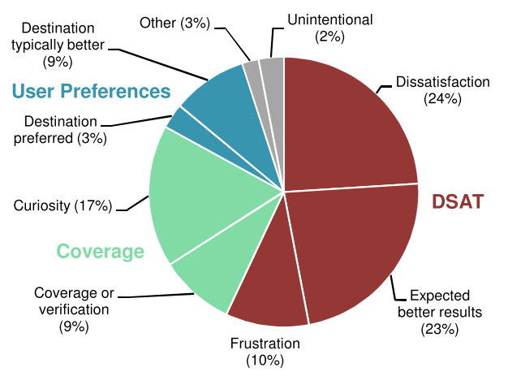
Reasons for switching
* Q.Guo, R.White – “Why searchers switch: understanding and predicting engine switching rationales”, SIGIR 2011
Notes:
We studied some papers about switching detection. The most popular reason for switching is dissatisfaction, then need for coverage (which is also kind of dissatisfaction), then user preferences.

Slide 11
Feature Design
Dissatisfaction
duration
#queries
#clicks
% abandoned queries
ave/max/min click dwell time
ave/max/min pause (after query or click)
ave click pos
last action (query or click)
…
Notes:
We started with features which can be useful for dissatisfaction prediction.

Slide 12
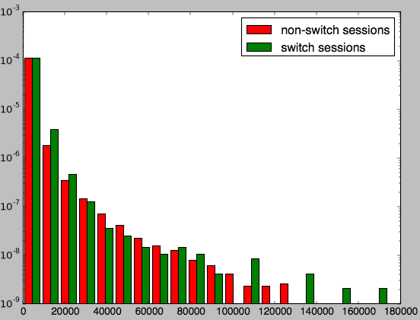
Session duration density
Notes:
A normalized histogram of duration for switch and non-switch sessions (log scale). We see that given a long session we are likely to have session with switch.

Slide 13
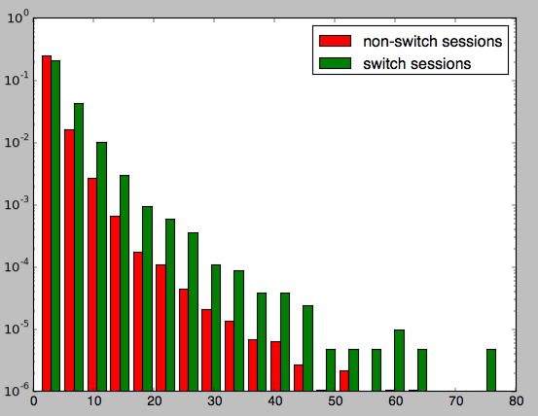
# Queries density
Notes:
Histogram for number of queries in a session is even better. The more queries we have, the more likely there is also a switch.

Slide 14
Feature Design
Coverage
#queries
#clicks
ave click pos
Query/Url switching frequency
…
Preferences
User switching frequency
…
Notes:
For coverage as a reason of switching it might be useful to consider task-based features (queries, urls), though this is sparse.
User switching frequency is a very good predictor.

Slide 15
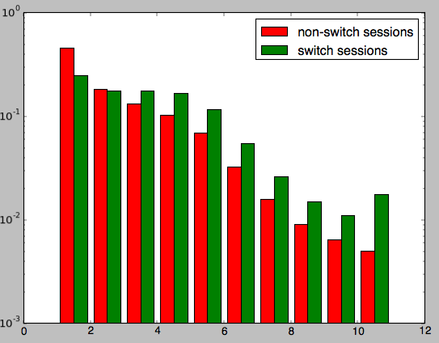
Average click position density
Notes:
Average click position shows that the lower users click the more chances we will have a switch in a session. This can explain dissatisfaction as well as desire for better coverage.

Slide 16
Aggregated statistics
Separate log period
Calculate statistics for all session features
For all switch and non-switch sessions separately
Produce 2 new features:
session_feature / ave_session_feature_switch
session_feature / ave_session_feature_nonswitch
Notes:
Then we decided to add features which are based on statistics for all switch and non-switch sessions from a separate period (first tried on the same period, but the problem of overfitting). This way we added 2*session features.

Slide 17
Aggregated statistics: sequences
Q
Q
C
C
3 types of sequences:
Type-I: Query, Click
Type-II: Query, Dsat click (<200), Psat click, Sat click(>500)
Type-III: Query with short pause, medium pause and long pause (q,K,Q), Dsat click (<200), Psat click, Sat click(>500)
Features:
Probability(seq|switch/non-switch)
Probability of sequence under Markov assumption
ave {2,3,4}-gram odds (frequency in non-switch / frequency in switch)
Notes:
Using aggregated statistics we could also introduce some new features. For example sequence based features.

Slide 18
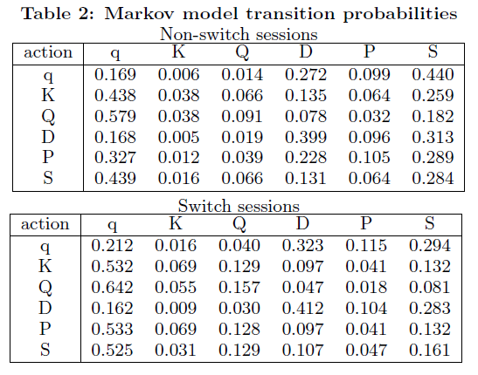
Markov Model transitions probability
Notes:
Markov model transition probabilities: interesting -> in switch we are more likely to query back to query, and SAT clicks happens less often.

Slide 19
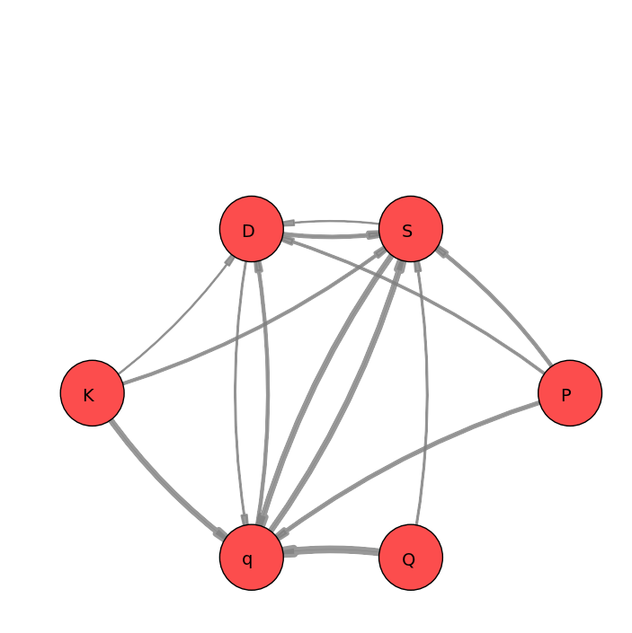
Markov Model: Non-Switch

Slide 20
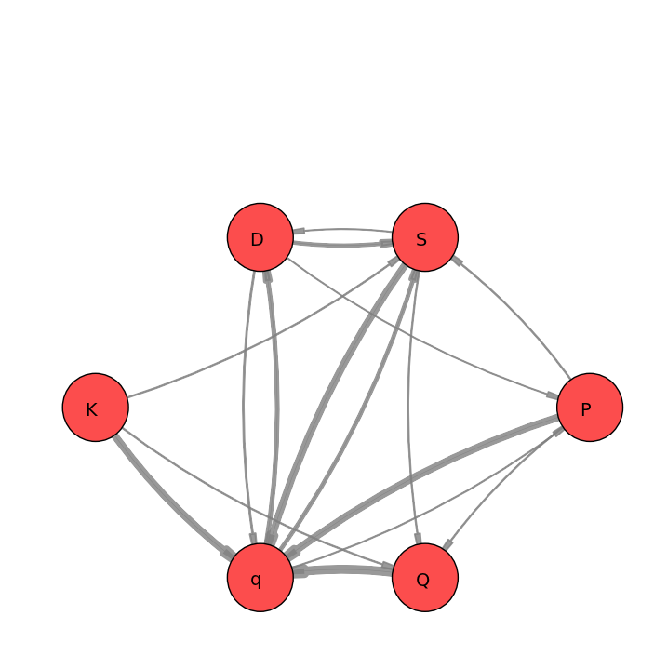
Markov Model: Switch
Notes:
P – D : changes direction to opposite
S-Q, becomes Q-S
K-D becomes dominated by K-Q

Slide 21
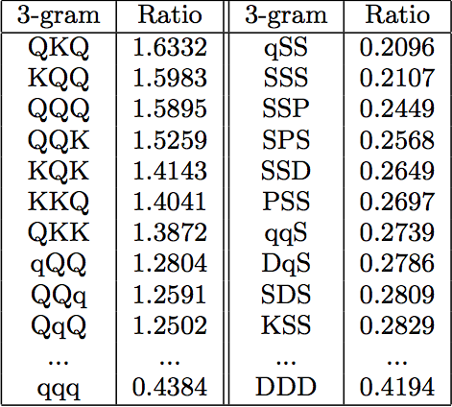
N-Gram Features
Switch sessions
Non-switch sessions
Notes:
N-gram features: we used average ratio of frequencies in switch and non-switch sessions. Here, for switch we have more queries, for non-switch – SAT clicks.

Slide 22
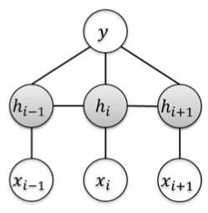
CRF (hCRF)
Features:
is query/click
time elapsed
queries before
query: url ctrs
query: clicked positions
click: clicked position
Notes:
We also built hCRF model over simple features (to avoid overfitting).

Slide 23
Query and Url switch frequency
Switching depends on a search task
Tasks defines Queries and clicked Urls
For each query: frequency of sessions, which contain switch after (later or immediately) this query
For each url: frequency of sessions, which contain switch after (later or immediately) click on this url
Notes:
To account for task difficulty, we included query and url switching statistics. (As well as CTRs in the last version)

Slide 24
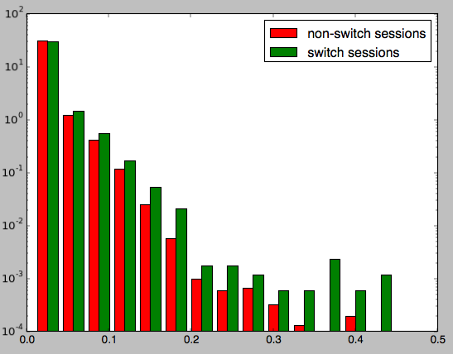
Query switch frequencies
Notes:
Query switching frequency shows that more switching on statistics period – more likely on training.

Slide 25
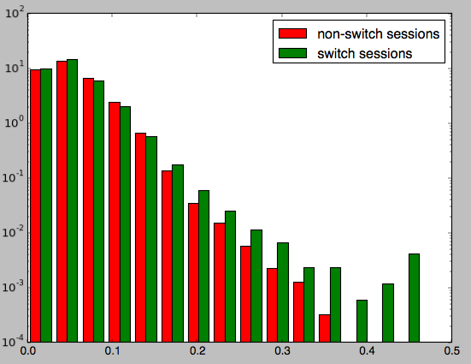
Url switch frequencies
Notes:
The same for url switch frequencies.

Slide 26
Aggregated statistics: each user
Separate log period
Calculate statistics for all session features
For all switch and non-switch sessions separately
For each user independently
Produce 4 new features:
ave_user_session_feature_switch
ave_user_session_feature_nonswitch
session_feature / ave_user_session_feature_switch
session_feature / ave_user_session_feature_nonswitch
+ Sequence features for each user
+ Query/Url switch frequencies
+ User statistics (switch frequency, sessions count)
Notes:
Now we decided to add some personalization in our training and since it was easy we calculated also statistics for each user independently. This gave us 4 more features for each original feature.

Slide 27
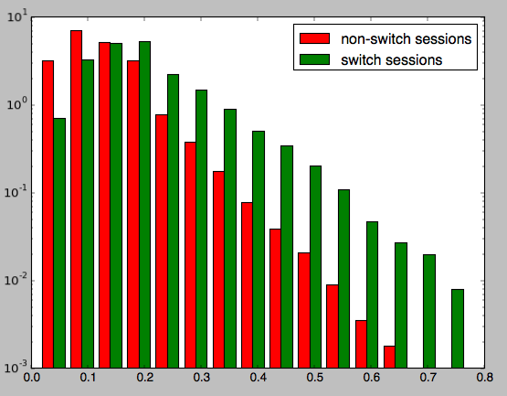
User switching frequency
Notes:
User switching frequency is one of the strongest features.

Slide 28
Features: summary
414 features in total
“Out of mEmory” => 50Gb of RAM for feature generation ☺
Most of the features are very similar
Only 291 were included in the model
Didn’t do any feature selection, etc.
Notes:
A lot of memory to generate the features, and a lot of features. Not all of them are useful.

Slide 29
Talk Outline
Task Description
Data Preprocessing
Feature Design
Session Features
Overall historical statistics
Per-user historical statistics
Model
Summary
Notes:
We need to answer the question what was the key for winning the challenge:
Summary of major gains we had:
- separate splits: 0.8 -> 0.82
- statistics features:
- …
We will summarize utility of each component

Slide 30
Model
Gradient Boosting Classification/Regression Trees
pGBRT implementation
Scikit-learn (Python) implementation
Better, but much slower
Parameters:
400 iterations
depth = 5
learning rate = 0.1
Notes:
Tried pGBRT and scikit-learn. First used squred loss, second logistic. Scikit showed better results, but much much slower.

Slide 31
Feature importance
Rank | Feature | Score (Gini index for trees)
1 | user_typeIII_2gram | 0.0230
2 | user_switches_count | 0.0222
4 | user_switch_probability | 0.0184
12 | time to 1 click | 0.0129
14 | abandoned_to_ave_abandoned | 0.0114
15 | unique_queries | 0.0114
21 | ave_clicked_url_switch_prob | 0.0103
22 | min_pause_user_switch | 0.0101
39 | crf | 0.0070
More in report…
Notes:
Sequence features are very useful, n-gram is the most useful feature. Also user statistics are at the top.

Slide 32
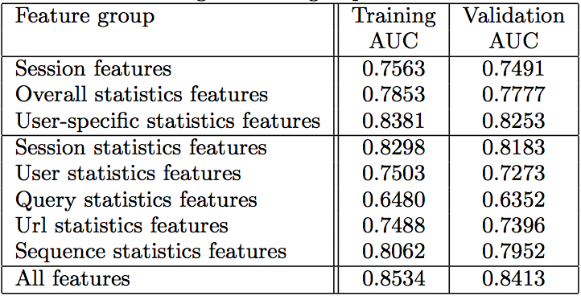
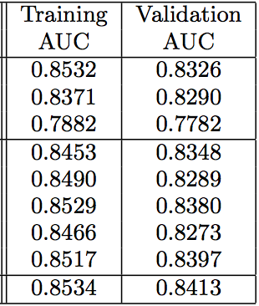
Feature Ablation
Single feature group
Without feature group
Notes:
Highlight important runs. Discuss different feature groups and emphasize the important details.
User statistics is most important group. Surprisingly, url statistics are also very good. Sequence not bad. Second half of the table – groups duplicate information, even removing a group doesn’t change anything much.

Slide 33
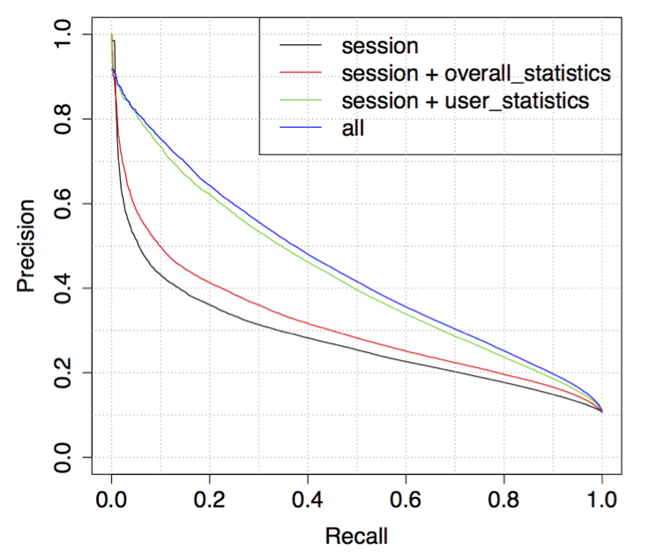
Feature ablation: ROC
Notes:
Precision – Recall plot shows how important user features are.

Slide 34
Averaging/Balancing
Dataset isn’t balanced (~10-20% sessions with switches)
Balancing:
Increase weight of positive class examples
Subsampling
Model trains on 3 days only
Train models on different 3 day periods and average prediction
Notes:
To improve results a little more, we did balancing and model averaging.

Slide 35
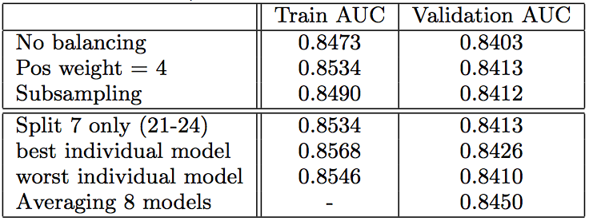
Averaging / Balancing
Notes:
As you see, balancing are equivalent (but we chose class weight as the major as it is a little better). Averaging helps indeed.

Slide 36
Team progress
Logistic regression
New features (including user aggregated)
More features
Session statistics
Separate statistics period
0.849415
Notes:
Here are all our major steps.

Slide 37
Best submission
414 features
Training (pGBRT - 400 iterations; depth = 5; learning rate = 0.1)
Period 8 (25-27) – pos weight = 4
Period 7 (22-24) – pos weight = 4
Period 6 (19-21) – subsampling
Period 3 (7-9) – subsampling
Average prediction of 4 models
Notes:
Best submission. Weird setup because of lack of time. Still did good.

Slide 38

BugZZZ
Unfortunately, feature generation code had/has bugs
Some features were calculated incorrectly (average click position, 3,4-grams)
Splitting: statistics period contained sessions of users without switches (sessions of these users were removed from training)
Notes:
We had some bugs in features ☹

Slide 39
Summary
Rich set of features
Session features
Aggregated statistics
Per-user statistics
Separate period for statistics collection
Algorithm: gradient boosting tree (pGBRT)
Pre/post-processing
weight of switch sessions = 4
Average predictions of models built on different 3 day periods
Notes:
Major steps

Slide 40

Questions?
Notes:
Emphasize gains.

