Slide 1
PROJECT 2
Ayan Guha
Ben Pollock
Mirgadir Alakbarov
Odill Rodrigues
Sarah Parzyck
Umar Farooq

Slide 2
PROJECT BRIEF
Topic: Analysis of US land fires between 2013 and 2017
Datasets used:
https://data.world/collinsreports/all-fires-on-u-s-federal-land-2013-june-27-2017
https://www.purpleair.com/
Inspired by: https://www.kaggle.com/captcalculator/wildfire-exploratory-analysis
Visualizations: Plotly Charts: Bar, Bubble, Pie & Stacked
Plotly Data table
Choropleth Map
Marker Cluster Group GeoMap
GitHub: https://github.com/TheGreekGoddess/Project_2
Heroku: https://datavisproject2.herokuapp.com/

Slide 3
Process
Steps in Data Extraction, Transformation and Load:
Load raw data into Postgres
Clean data in Python and SQL
APIs: Causes, Locations, State, Year
Interactive Data Visualizations:
Index html and CSS
Choropleth by State with a color gradient by count of fires
Plotly Pie chart: Filter by State and Year
Data table using Plotly
GeoMap with a marker cluster group layer: Filter by Year
Plotly Charts: Bar, Bubble and Stacked Bar

Slide 4
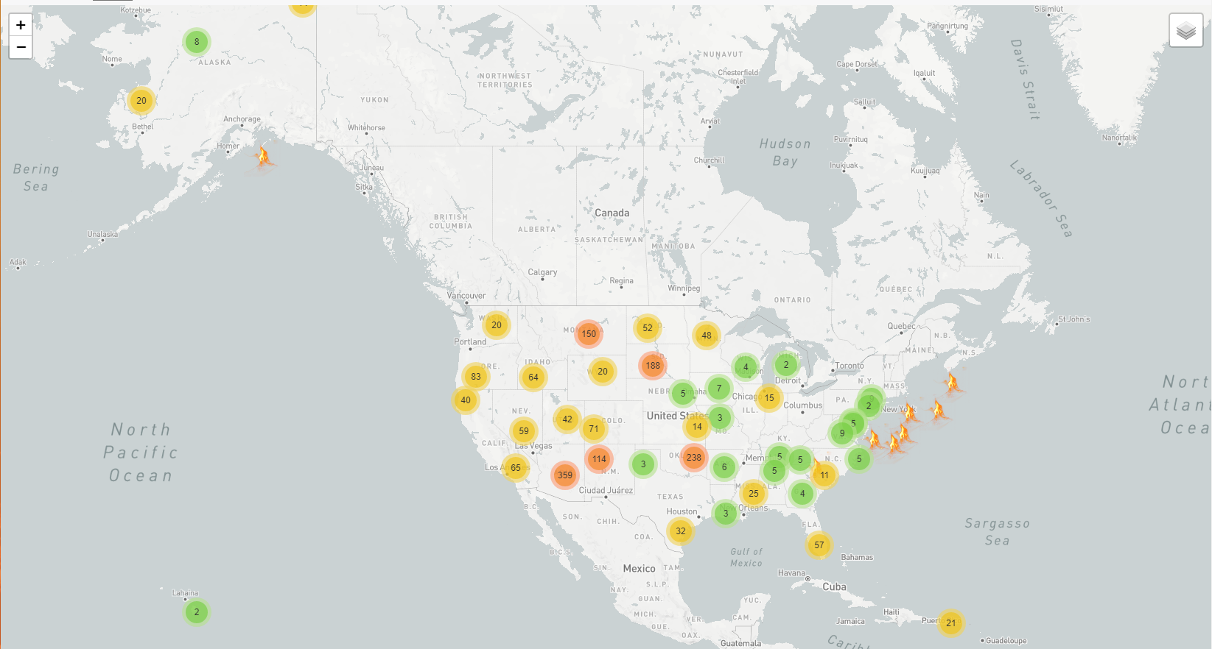

Slide 5
Project Outcomes
In the states most affected by fires, humans are the major contributor with 68%, followed by Undetermined 19% and Natural 13%
The West coast has significantly higher counts of fires than the East cost which could be a result of drought in certain areas
Top 5 states with high count of fires: Arizona, California, Montana, Oregon and Minnesota
New Hampshire and Vermont did not have any reported fires and hence are excluded from the dataset
Fires tend to be the highest in the summer months
2013 recorded the highest count of land fires

