Slide 1
PROJECT 2
Ayan Guha
Ben Pollock
Mirgadir Alakbarov
Odill Rodrigues
Sarah Parzyck
Umar Farooq

Slide 2
PROJECT BRIEF
Topic: Analysis of US land fires between 2013 and 2017
Datasets used:
https://data.world/collinsreports/all-fires-on-u-s-federal-land-2013-june-27-2017
https://www.purpleair.com/
Inspired by: https://www.kaggle.com/captcalculator/wildfire-exploratory-analysis
Visualizations: Plotly Charts: Bar, Bubble, Pie & Stacked
Plotly Data table
Choropleth Map
Marker Cluster Group GeoMap
GitHub: https://github.com/TheGreekGoddess/Project_2
Heroku: https://datavisproject2.herokuapp.com/

Slide 3
Tasks
Data extraction and cleansing:
BP - Load raw data into Postgres
BP - Clean data in Python and SQL
BP - APIs: Causes, Locations, State, Year
Web visualizations containing:
AG - Map: Geomap with a marker cluster group layer by year
AG – Plotly Charts: Bar, Bubble, & Stacked Bar
MA & UF - Index html and CSS
MA - Interactive Data table using Plotly
SP & OR - Interactive Pie-chart: Filter by State and Year
UF - Map: Choropleth by State with a color gradient by count of fires

Slide 4
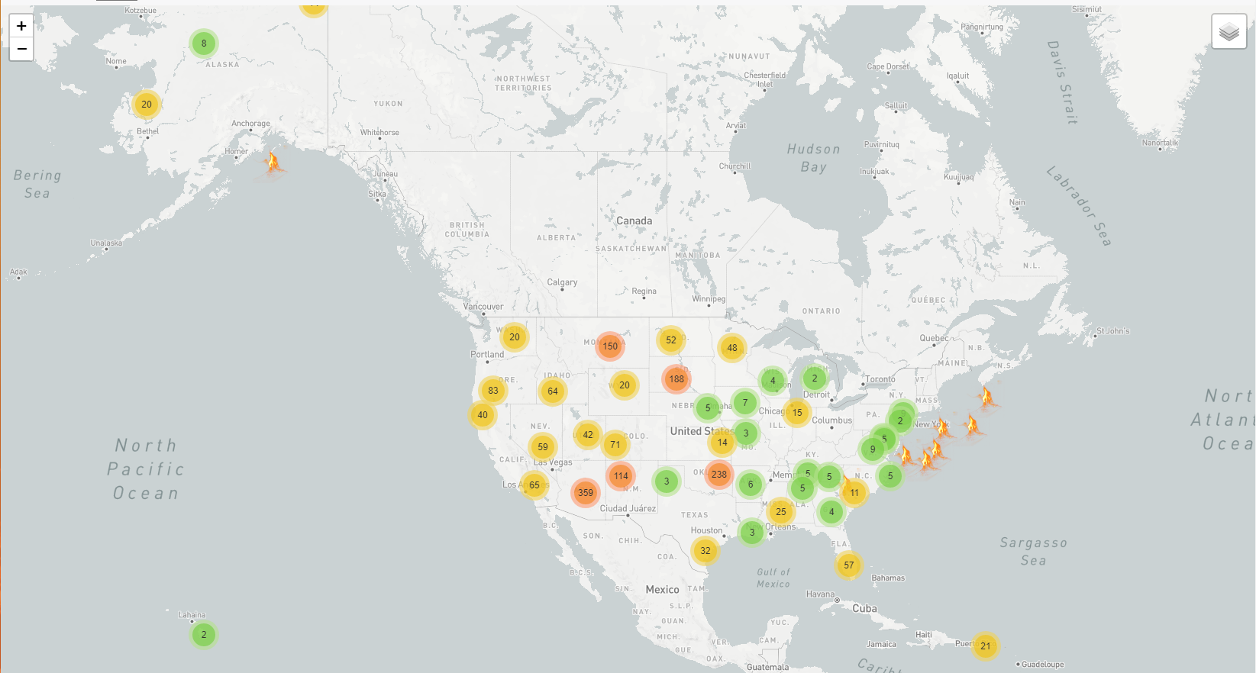

Slide 5
Project Findings
In the states most affected by fires, humans are the major contributor

