Slide 1
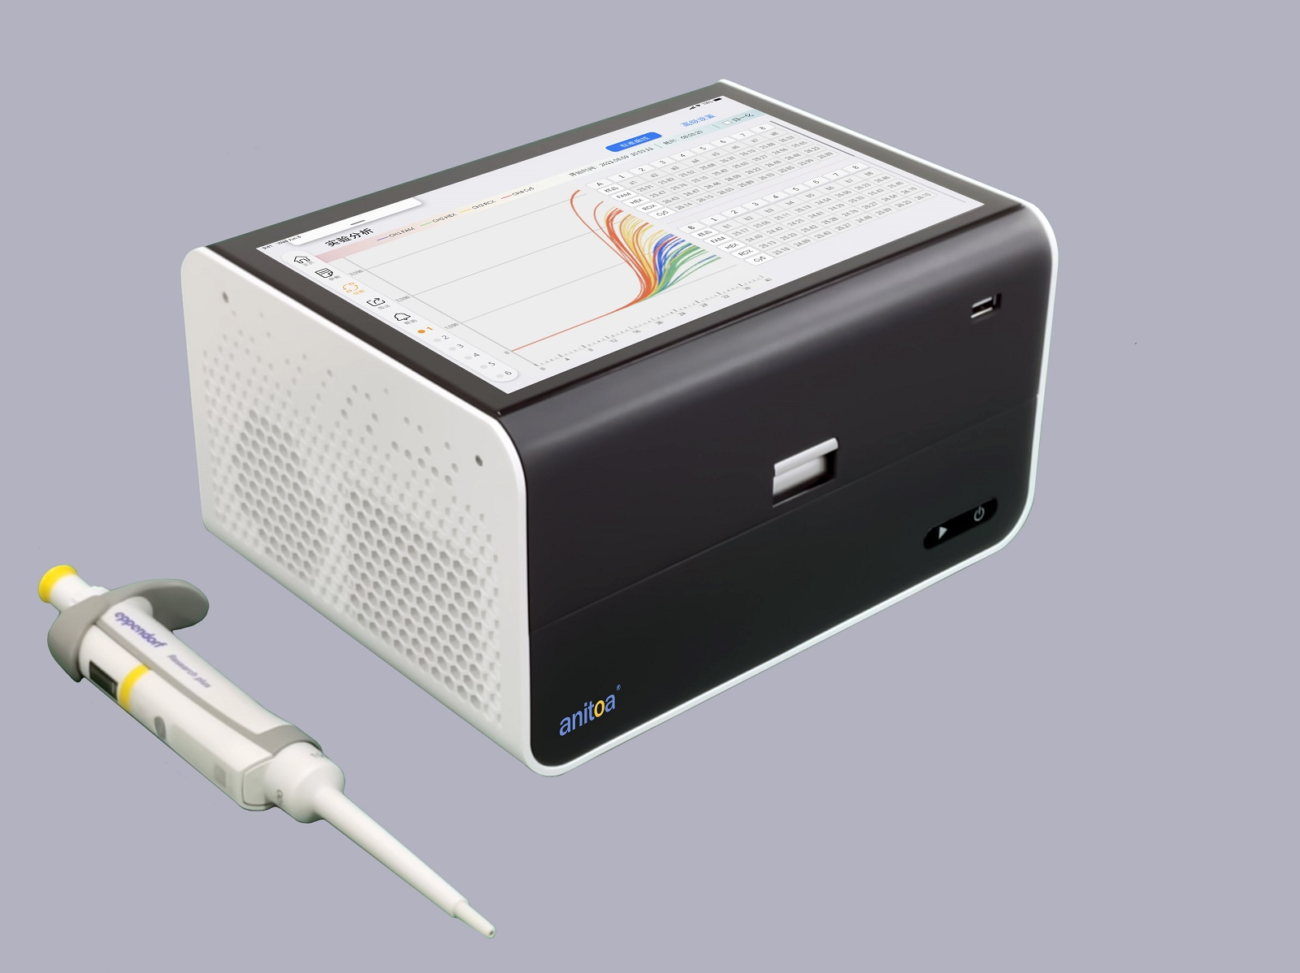
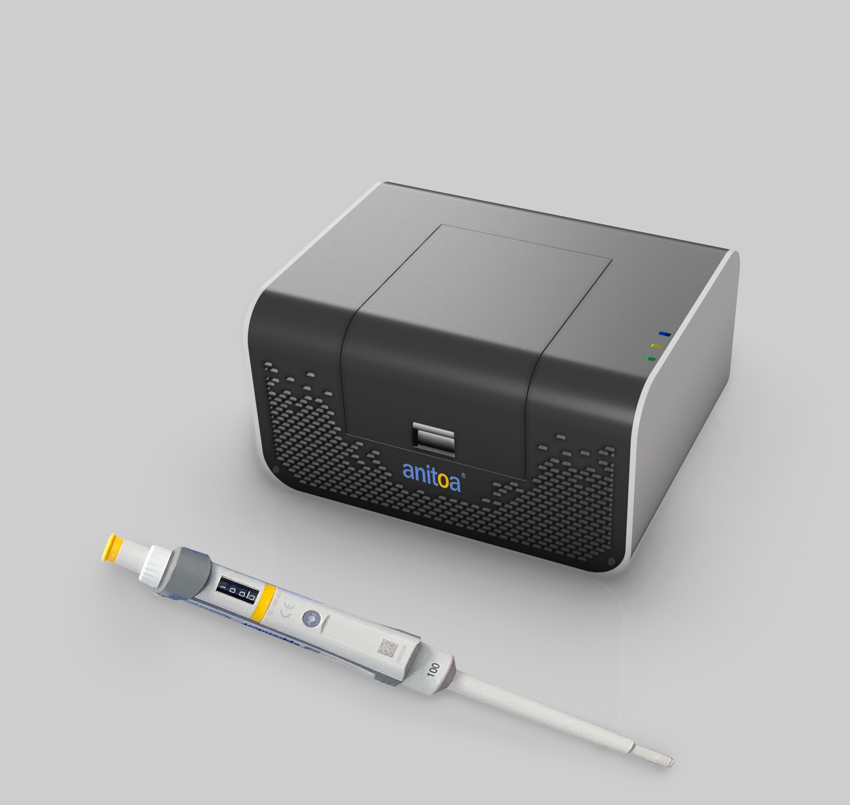
MQ x16 16-well Maverick Real Time qPCR Instrument
MQ x8 8-well or MQ x4 4-well Maverick Real Time qPCR Instrument

