Slide 1
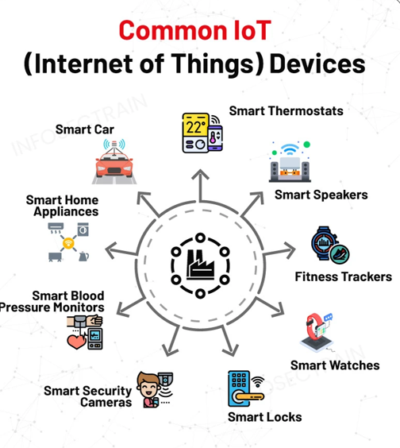
INTERNET of THINGS (IoT)
Presented by:
ODORA STEPHEN.
OTIM AMOS.
KUSENA JIMMY.
DENG YAK DENG ATER.
NAMUGANZA MARIA GORRET.
KIBI DARIUS.
JAKIRA JUMA FAHAD
Definition:
Internet of things is a network of interrelated devices that connect and exchange data with other IoT devices and cloud.

Slide 2
HISTORY AND EVOLUTION OF IoT
The foundation of internet of things begun with the inversion of the internet itself in 1960s (ARPANET) which demonstrated how computers could exchange data across networks.
IoT begun to gain popularity among early adopters and technology enthusiasts in the late 1990s and early 2000s. The first step in developing a commercial internet system was characterised by Amazon entry into online in 1995. The emergency EPAY online communication information discovery and safe transactions of further enhanced by innovations like hot mail, google search.
The 2000s saw explosive growth with IPv6 addressing low-power protocols like ZigBee, and Cisco’s 2008 declaration of IoT’s “birth” as devices outnumbered people.
From 2010 onwards, adoption surged via cloud platforms, 5G, and AI integration powering applications like predictive maintenance and remote monitoring accelerated by COVID-19 pandemic. Yet challenges persist, cyber security vulnerable, and privacy risks. Looking ahead, IoT’s fusion with edge computing, 6G and block chain promises trillions of autonomous devices by 2030, fostering sustainable, intelligent ecosystem.

Slide 3
HOW IoT WORKS.
IoT works by gathering data from sensors embedded in IoT devices which is then transmitted through an IoT gateway for analysis by an application or back-end system.
Sensors or devices;
An IoT ecosystem consists of web-enabled smart devices that use embedded devices such as processors to collect, send and act on data acquired from their environments.
Connectivity;
IoT devices can communicate with one another through a network over the internet. These devices share sensor data by connecting to an IoT gateway, which acts a central hub where IoT devices can send data.

Slide 4
Contn...
Data analysis;
Only the relevant data is used to identify patterns, offer recommendation s and identify potential issues before they escalate.
Graphical User Interface;
A graphical user interface is typically used to manage IoT devices for example a website can be used as a UI to manage, control and register smart devices

Slide 5
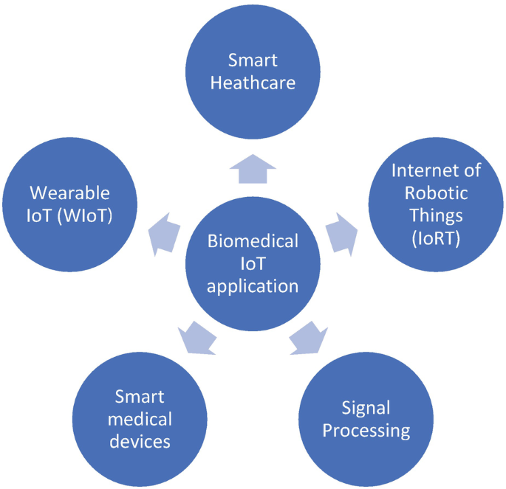
APPLICATIONS OF IoT.
Smart homes: Automated lighting, climate control and security system enhance convenience, efficiency and safety.
Wearable technology; Devices like fitness trackers and medical sensors monitor personal health data.
Industrial automation: In manufacturing, ioT is used for machine monitoring quality, control and asset tracking.
Retail; IoT sensors track customer behaviours, optimise inventory and personalise marketing.
Healthcare; remote patient monitoring, smart medical devices and medication trackers allow for continuous health management.
Energy management; Smart grids and smart lighting systems help monitor and reduce energy consumption.

Slide 6
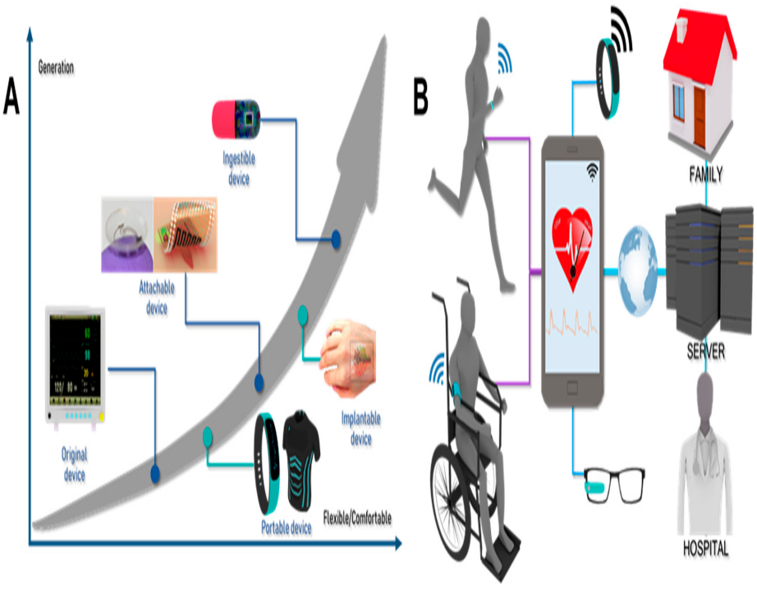
Advantages of IoT.
Easy access
Quick operation
Monitoring data
Following new standards
Better time management
Automation and control.
Cost saving.

Slide 7
DISADVANTAGES OF IoT.
Dependency on technology
Loss of data
Operation complexity
Inter compatibility
Less employment of low educated workers
More control of technology

Slide 8
RELEVANCE AND POTENTIAL IMPACTS.
IoT enabled biomedical devices:
IoT has enabled the development of sophisticated biomedical systems that play a vital role in monitoring, diagnosing and treating medical conditions.
Devices such as wearable health monitors, smart medical implants and remote patient monitoring systems have made it possible to track patient’s health and diagnosis to early detection of anomalies and intervention.
Data analytics and predictive health care:
The influx of data generated by IoT devices in health care has presented an enormous opportunity for data analytics and predictive modelling. By engaging A.I and machine learning algorithms health care provides an analysed large data sets to identify patterns, correlations and potential health risks.
Predictive analytics can anticipate diseases or complications before they occur allowing for early intervention and preventive measures.

Slide 9
Contn….
IoT patient care:
It has made health care multifaceted, more personalised, accessible and efficient. Telemedicine and remote patient monitoring have gained prominence due to IoT’s integration (e.g. COVID-19) pandemic.
It has also enabled the concept of connected care where various medical devices and wearables communicate with each other providing a comprehensive picture of patient’s health status. This interconnected approach focuses better collaboration among health care providers leading to more accurate diagnosis and tailored treatment plans.

Slide 10
Conclusion.
IoT has gradually brought about many technological challenges in our daily life which in turn helps make our lives simpler and more comfortable through various technology and applications. There is an infinite benefit to IoT applications in all fields. The IoT holds an important promise to provide social and economic benefits to the emerging and developing economy. This includes sustainable agriculture, water quality.

