Slide 1


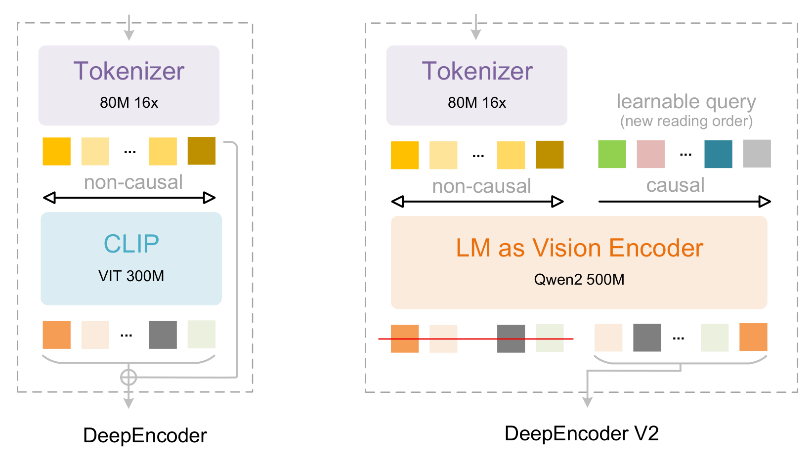
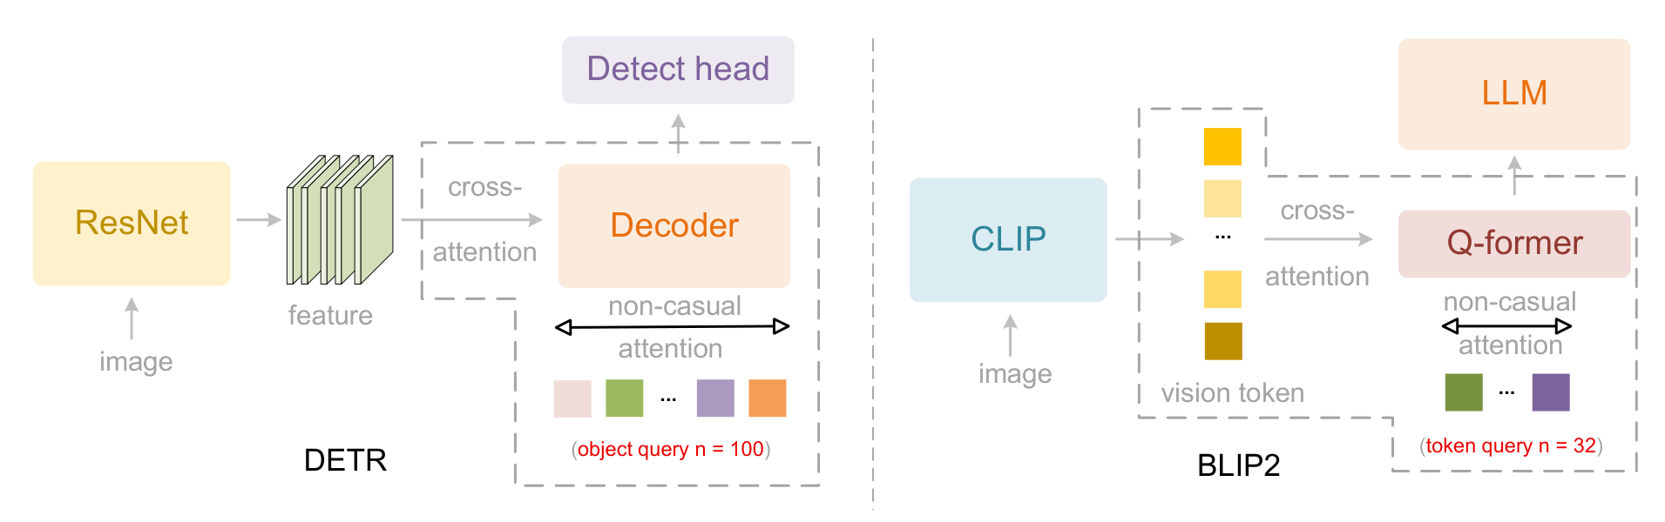
Contents
DeepSeek-OCR 2: Leveraging Visual Causal Flow for Advanced Text Recognition
DeepSeek 2024
▶ Problem & Motivation
  ▢ Limitations of VLMs for OCR
    • Standard VLMs use indiscriminate token prediction without reading direction
    • High computational cost for practical text recognition tasks
  ▢ Key Challenge
    • Need for directional visual feature propagation to guide text decoding
    • Alignment between visual tokens and text tokens should follow reading order (LTR/RTL)
▶ Visual Causal Flow (VCF)
  ▢ Core Innovation
    • Novel uni-directional attention mechanism: visual tokens attend to text tokens sequentially
    • Establishes directional information flow aligned with reading direction
  ▢ Architecture Components
    • Multiscale visual encoder: Extracts features at multiple scales
    • Cross-modal decoder: Implements visual causal flow with directional attention
    • Sequential position encoding: Maintains reading order in both modalities
Notes:
大家好，今天我介绍 DeepSeek-OCR 2 这篇工作。这篇论文解决的核心问题是：现有的视觉-语言模型虽然强大，但在 OCR 任务上并不优化。因为标准的 VLM 预测所有 token 是无差别的，没有考虑阅读方向。
论文提出了一种新的机制叫 Visual Causal Flow（视觉因果流），其核心创新是建立从视觉 token 到文本 token 的单向信息流。具体来说，视觉 token 会按照阅读顺序依次关注文本 token，这样就能保证解码时遵循正确的阅读方向。
架构包括一个多尺度视觉编码器，提取不同尺度的特征；一个交叉模态解码器，实现了视觉因果流；还有位置编码来保持阅读顺序。

Slide 2
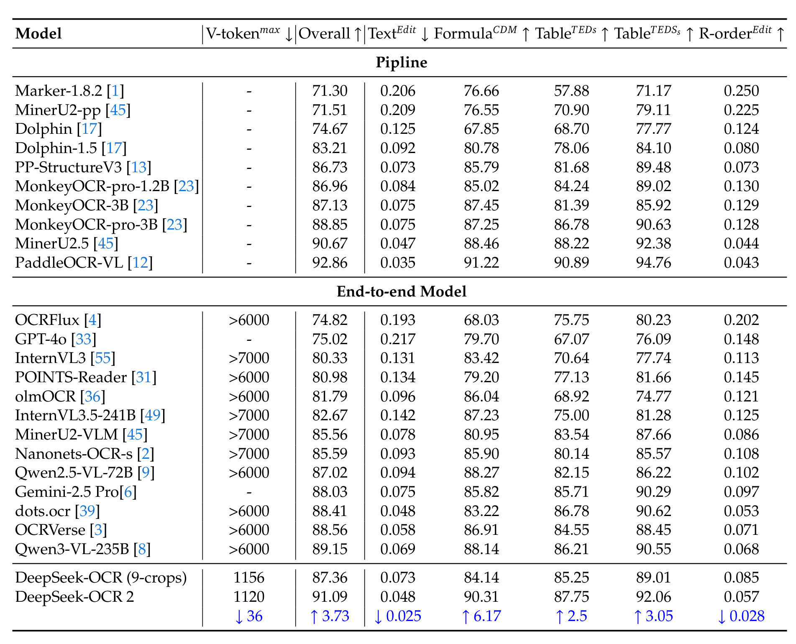
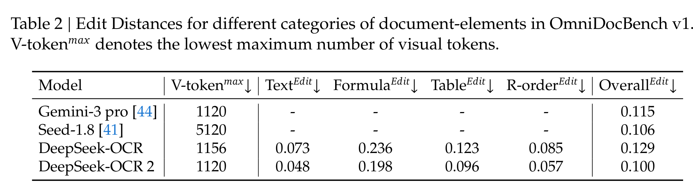
Contents
▶ Key Advantages
  ▢ Methodological Innovation
    • First to explicitly model directional visual-to-text flow for OCR
    • Supports both left-to-right and right-to-left reading directions
    • More efficient than full VLM approaches while maintaining accuracy
  ▢ Practical Benefits
    • Multilingual support: Handles multiple scripts through flexible tokenization
    • Balanced trade-off: Better accuracy than traditional OCR, more efficient than VLMs
▶ Performance & Results
  ▢ State-of-the-art Results
    • Strong performance on English, Chinese, and multilingual benchmarks
    • Significantly outperforms traditional OCR methods (CRNN, attention-based)
    • Competitive with VLM-based approaches at lower computational cost
  ▢ Ablation Analysis
    • Visual Causal Flow shows substantial contribution over baseline
    • Directional attention crucial for text recognition accuracy
Notes:
现在讲关键优势和性能结果。
方法上的主要创新：这是第一个为 OCR 显式建模方向性视觉到文本流的工作。支持从左到右和从右到左的阅读方向，比完整 VLM 方法更高效但保持准确率。
实践上支持多语言，通过灵活的分词处理多种文字系统。在准确率和效率之间取得了更好的平衡。
性能方面：在英文、中文和多语言基准测试上表现强劲。明显优于传统 OCR 方法如 CRNN，在较低计算成本下与 VLM 方法竞争力强。
消融实验显示：视觉因果流相比基线有显著贡献，方向性注意力对文字识别准确率至关重要。
这个工作的启示是：OCR 任务需要专门的架构设计，而不是直接套用通用的视觉-语言模型。Visual Causal Flow 提供了一种有效的建模方法。

