Slide 1
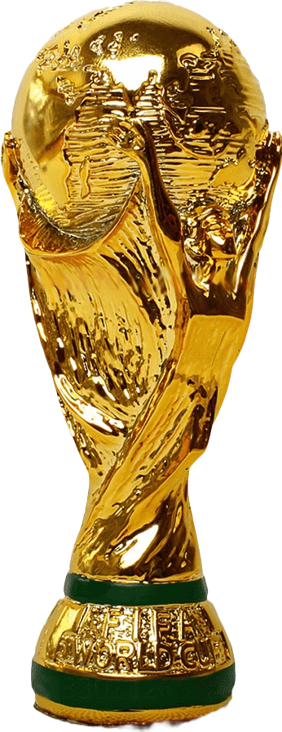
ANALYSIS OF WORLD CUP RESULTS
A COMPREHENSIVE ANALYSIS OF HISTORICAL WORLDCUP
PRESENTER; GALUAK DANIEL DENG
22ND of July 24
Enjoy!!!

Slide 2








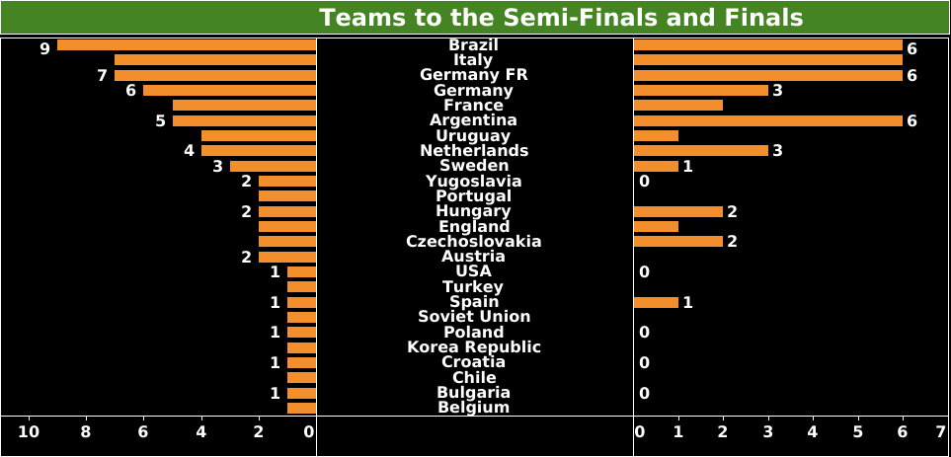
COUNTRIES THAT WON THE WORLDCUP 1930-2014
Brazil | Italy | Germany FR | Uruguay | Argentina | Spain | Germany | France | England
5 | 4 | 3 | 2 | 2 | 1 | 1 | 1 | 1
In the first presentation above, represent 2 bar chart sorted in descending by counts of countries that had gone for the Semi-finals (25 ) countries and countries that had gone for the finals(13) countries, 12 countries had not gone for the finals.

Slide 3
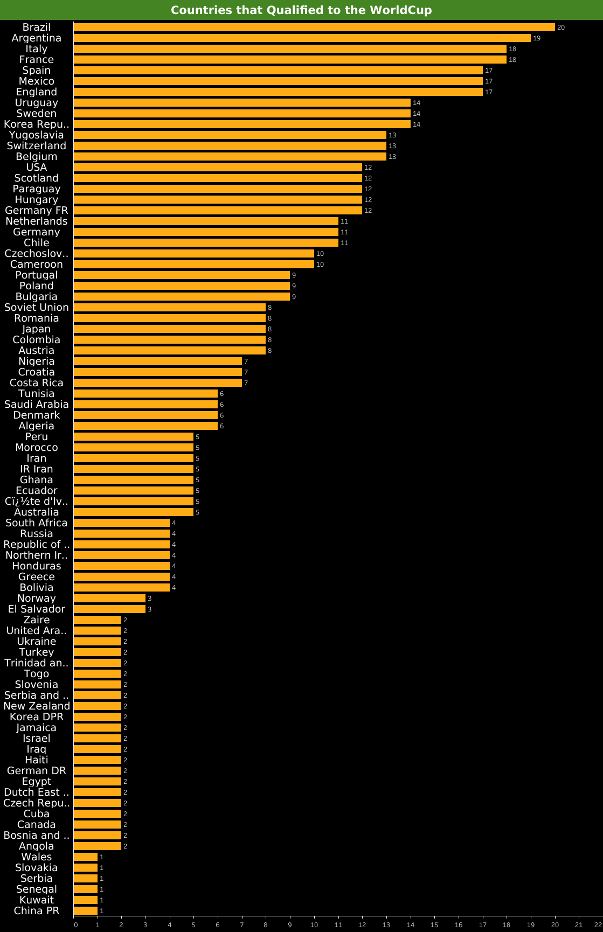
In the second presentation, represent a bar graph of all the (83) countries that had qualified to
the worldcup in all years of worldcup. Sorted in descending according to how many times each country has qualified through all years of worldcup. Brazil has qualified 20 times and the last 6 terms have qualified once in all the years of worldcup.

Slide 4
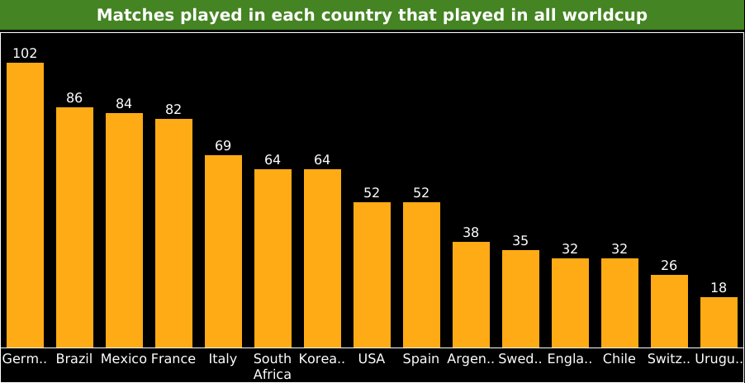
In the third presentation above, represent a bar graph of matches played by each country that participated in all the worldcup where, Germany has the highest number of matches(102 ) played in all the worldcup. Uruguay has the lowest matches(18) in all the worldcups

Slide 5
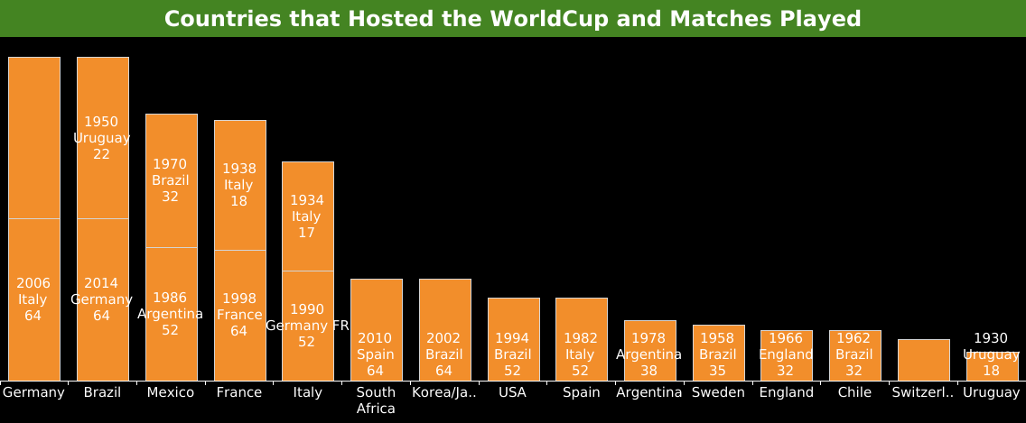
In the fourth presentation, represent a bar graph of countries that have hosted the worldcup and matches played. 15 countries have hosted the worldcup in all years of worldcup. The first five countries, have hosted twice in all the years of worldcup.
Germany(1974[Germany FR], 2006[Italy])
Brazil(1950[Uruguay], 2014[Germany])
Mexico(1970[Brazil], 1976[Argentina])
France(1938[France], 1998[Italy]
Italy(1934[Italy], 1990[Germany FR])
The bar graph is sorted in descending order according to the number of matches played in those hosting countries, where Germany had (102 matches in those 2 year they have hosted the worldcup).

Slide 6
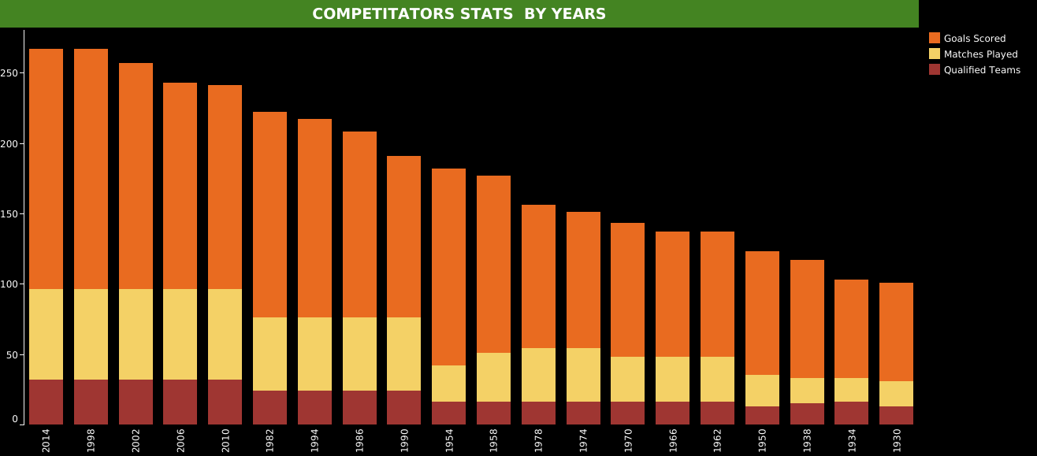
In the fifth presentation, represent a bar graph of goal scored, matches played and qualified teams to the worldcup respectively. In 1998, 32 teams qualified for the worldcup which had the highest number of goals scored(171) and highest number of matches played (102). In 2014, 32 teams qualified for the worldcup which also had the same highest number of goals scored(171).

Slide 7
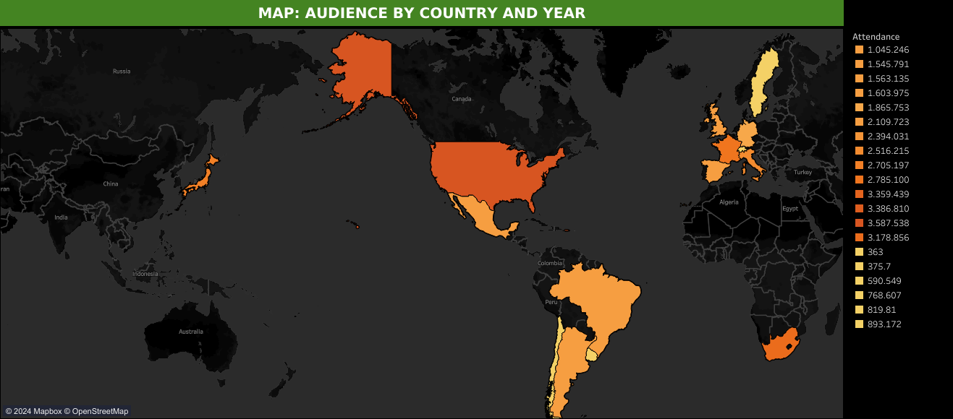
In the sixth presentation, represent a map of the hosting countries of worldcup in there respective continents with the number of attendence.

Slide 8
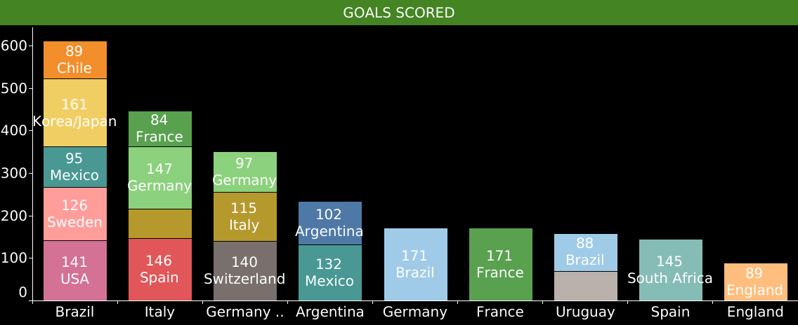
EIGHTH PRESENTATION;
In the seventh presentation, represent a bar graph of worldcup winners in all years where Brazil had the highest number of goals scored in the following hosting countries;
USA(141 goals scored)
Sweden(126)
Mexico(95)
Korea/Japan(161)
Chile(89)
England has the lowest number of goals scored(89)

Slide 9
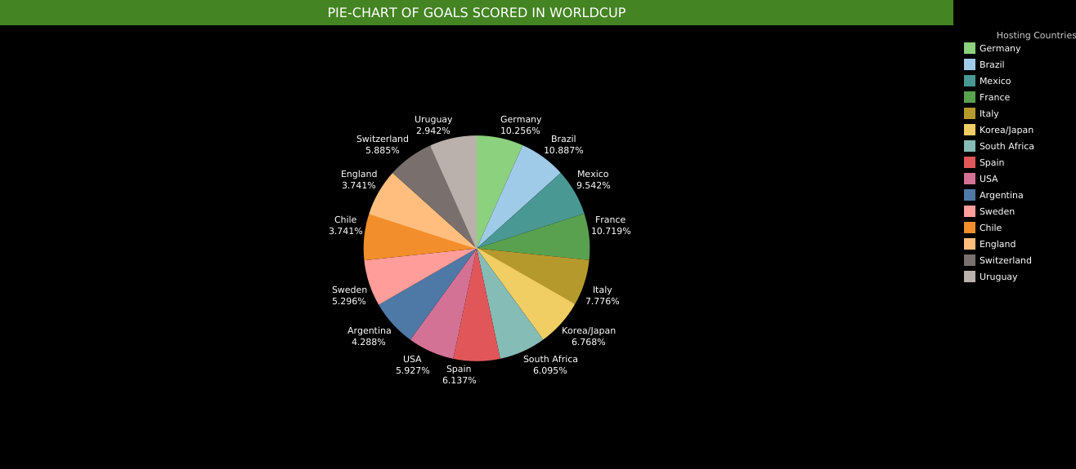
NINTH PRESENTATION;
In the above presentation, represent a pie chart of total percentage of all goals scored in the worldcup in their respective hosting countries.

Slide 10
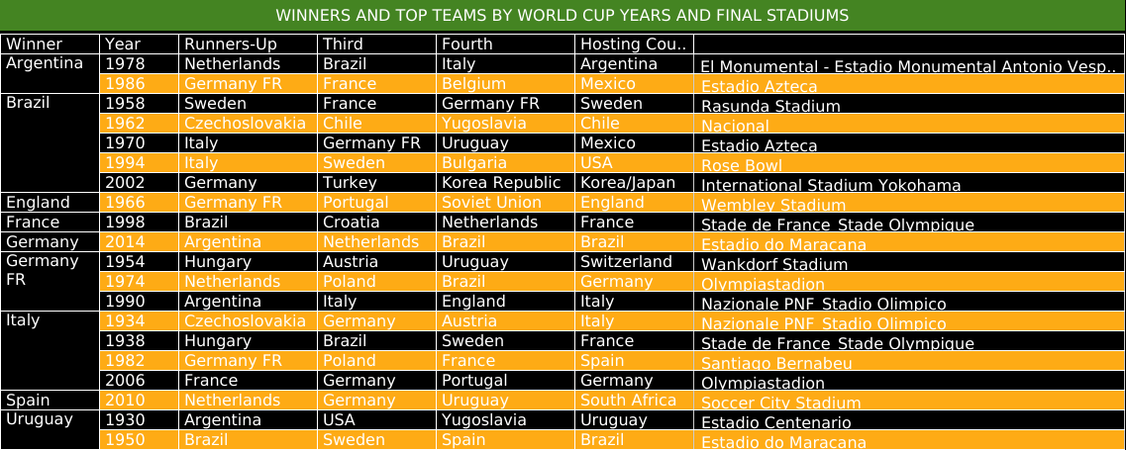
In the table above represents, worldcup winners with years, runners-Up, third rounds, Fourth rounds, Hosting Countries and the final stadiums for the finals respectively

Slide 11
Thank you.
The Eng!!!

