Slide 1
Truth Discovery with Multiple Conflicting Information Providers on the Web.

Slide 2
Abstract
The world-wide web has become the most important information source for most of us. Unfortunately, there is no guarantee for the correctness of information on the web. Moreover, different web sites often provide conflicting in-formation on a subject, such as different specifications for the same product. In this paper we propose a new problem called Veracity that is conformity to truth, which studies how to find true facts from a large amount of conflicting information on many subjects that is provided by various web sites. We design a general framework for the Veracity problem, and invent an algorithm called Truth Finder, which utilizes the relationships between web sites and their information, i.e., a web site is trustworthy if it provides many pieces of true information, and a piece of information is likely to be true if it is provided by many trustworthy web sites. Our experiments show that Truth Finder successfully finds true facts among conflicting information, and identifies trustworthy web sites better than the popular search engines.

Slide 3
Introduction:
THE World Wide Web has become a necessary part of our lives and might have become the most important information source for most people.
Everyday, people retrieve all kinds of information from the Web. For example ,when shopping online, people find product specifications from websites like Amazon .com or Shop Zilla .com.
When looking for interesting DVDs, they get information and read movie reviews on websites such as Net Flix .com or IMDB .com.

Slide 4
Data flow diagram:
Web sites
Facts
Objects
w₁
f₁
o₁
w₂
f₂
w₃
f₃
o₂
w₄
f₄

Slide 5
Existing System
  Page Rank and Authority-Hub analysis to utilize the hyperlinks to find pages with high authorities.
  These two approaches identifying important web pages that users are interested in, Unfortunately, the popularity of web pages does not necessarily lead to accuracy of information

Slide 6
De-Merits In Existing System
        The popularity of web pages does not necessarily lead to accuracy of information.
        Even the most popular website may contain many errors.
        Where as some comparatively not-so-popular websites may provide more accurate information.

Slide 7
Proposed System
We formulate the Veracity problem about how to discover true facts from conflicting information.
Second, we propose a framework to solve this problem, by defining the trustworthiness of websites, confidence of facts, and influences between facts.
Finally, we propose an algorithm called TRUTHFINDER for identifying true facts using iterative methods.

Slide 8
Merits
    Our experiments show that TRUTHFINDER achieves very high accuracy in discovering true facts.
    It can select better trustworthy websites than authority-based search engines such as Google

Slide 9
Modules:
Collection of data
First we have to collect the specific data about an object and it is stored in related database. Create table for specific object and store the facts about a particular object.
Data search
Searching the related data link according to user input. In this module user retrieve the specific data about an object.

Slide 10
Truth algorithm
We design a general framework for the Veracity problem, and invent an algorithm called Truth Finder, which utilizes the relationships between web sites and their information, i.e., a web site is trustworthy if it provides many pieces of true information, and a piece of information is likely to be true if it is provided by many trustworthy web sites.
Result calculation
For each response of the query we are calculating the Performance. Using the count calculated find the best link and show as the out put.

Slide 11
System Requirements
Hardware:
PROCESSOR : PENTIUM IV 2.6 GHz
HARD DISK : 20 GB
MOUSE : 3 BUTTONS
Software:
FRONT END : Java
TOOL USED : JFrame Builder
OPERATING SYSTEM : Window’s Xp
BACK END : Sql Server2000

Slide 12
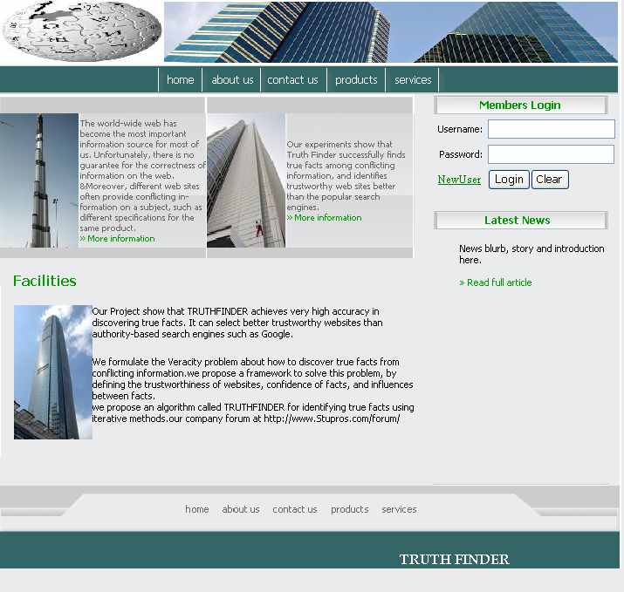

Slide 13
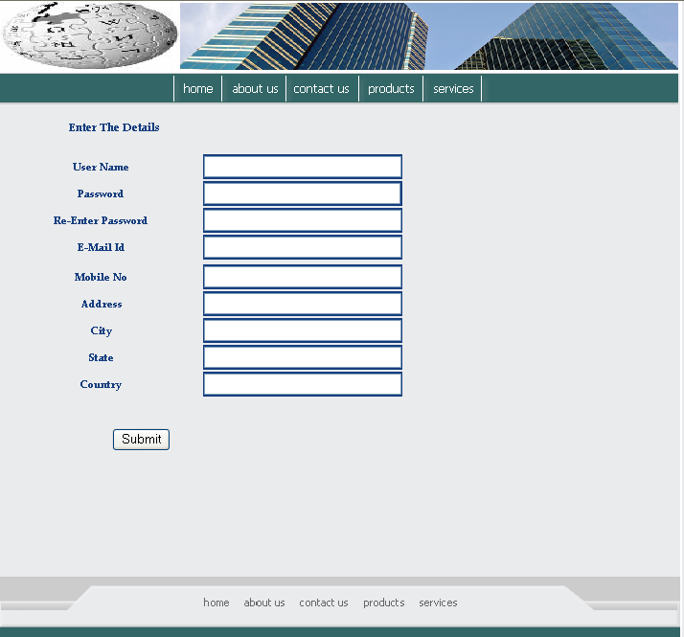

Slide 14
