Slide 1
CS3230 Tutorial 8 Group: T15
(AY2025/26 Semester 1)

Slide 2
Lecture Review – Amortization
Finding the average cost/performance per operation in the worst case
Commonly used to analyze the runtime of algorithms that perform many cheap operations + very few expensive operations.
NOT expected value computation
NOT average case analysis

Slide 3
Lecture Review – Amortization
For example, suppose we perform N operations.
Each operation has a ¹/_{N} chance to take N time, otherwise it will take Θ(1) time.
Expected time per operation: ¹/_{N} * N + ^{(N – 1)}/_{N} * 1 ∈ Θ(1)
Amortized time per operation: Θ(N)

Slide 4
Lecture Review – Amortization
Aggregate Method
Accounting Method
Potential Method

Slide 5
Lecture Review – Aggregate Method
Suppose for n operations, a sequence of n operations take T(n) cost in the worst case (i.e. we are taking max cost over all sequences of n operations).
Worst case amortized cost is then T(n)/n.
Not usually used: it is similar to proving things from definition.

Slide 6
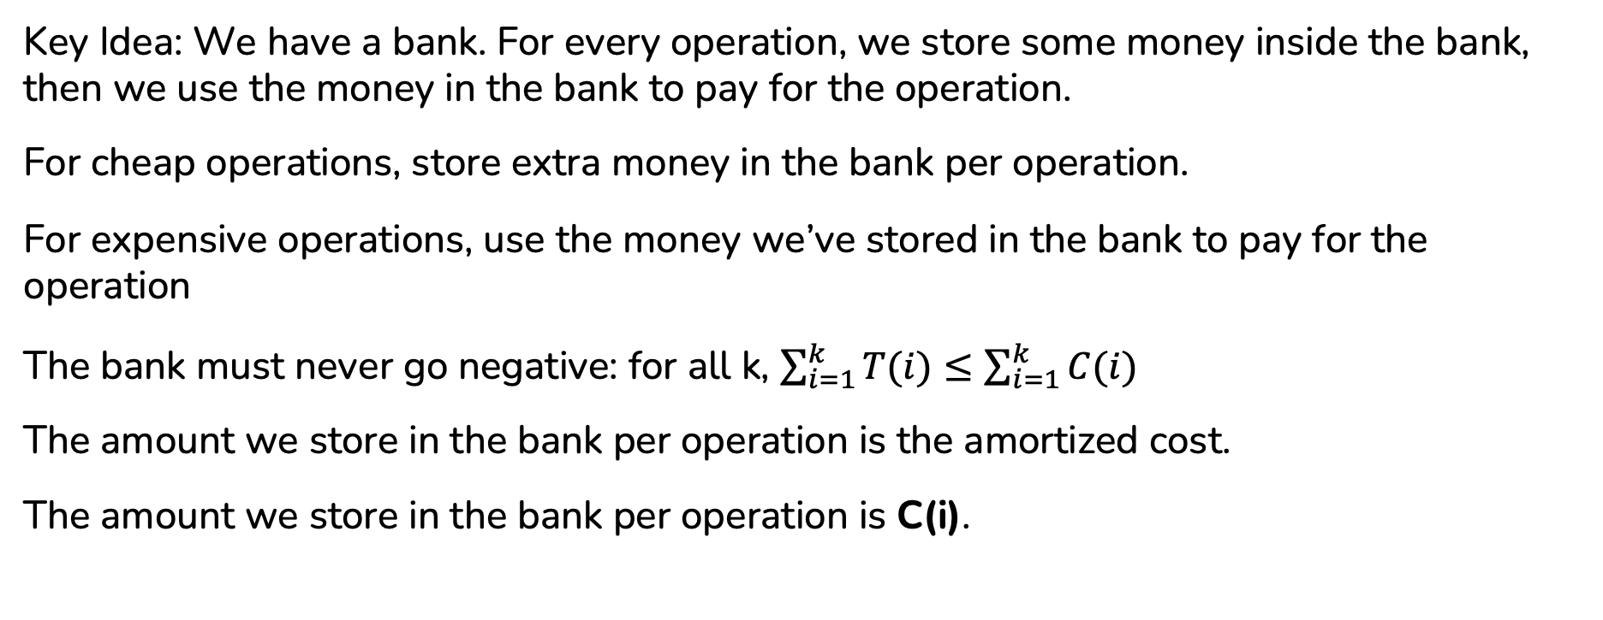
Lecture Review – Accounting Method
Key Idea: We have a bank. For every operation, we store some money inside the bank, then we use the money in the bank to pay for the operation.
For cheap operations, store extra money in the bank per operation.
For expensive operations, use the money we’ve stored in the bank to pay for the operation
The bank must never go negative: for all k, $\sum_{i=1}^{k}{T(i)}≤\sum_{i=1}^{k}{C(i)}$
The amount we store in the bank per operation is the amortized cost.
The amount we store in the bank per operation is C(i).

Slide 7
Lecture Review – Potential Method
Design a potential function 𝛷 with:
𝛷(0) = 0
𝛷(i) ≥ 0
C(i) = T(i) + (𝛷(i) – 𝛷(i – 1))
Key Idea: When T(i) is large, we want (𝛷(i) – 𝛷(i – 1)) to be very negative
Equivalently, when an operation is expensive, we want the potential 𝛷 to decrease by a lot.
Then, since ∑_{N}C(i) = ∑_{N}T(i) + (𝛷(N) – 𝛷(N – 1)) + (𝛷(N – 1) – 𝛷(N – 2)) + … + (𝛷(2) – 𝛷(1)) + (𝛷(1) – 𝛷(0)) = ∑_{N}T(i) + 𝛷(N) – 𝛷(0) ≥ ∑_{N}T(i)
Remark: it is easy to find a valid 𝛷 but it is often not easy to find a 𝛷 that is useful i.e gives a good C(i).

Slide 8
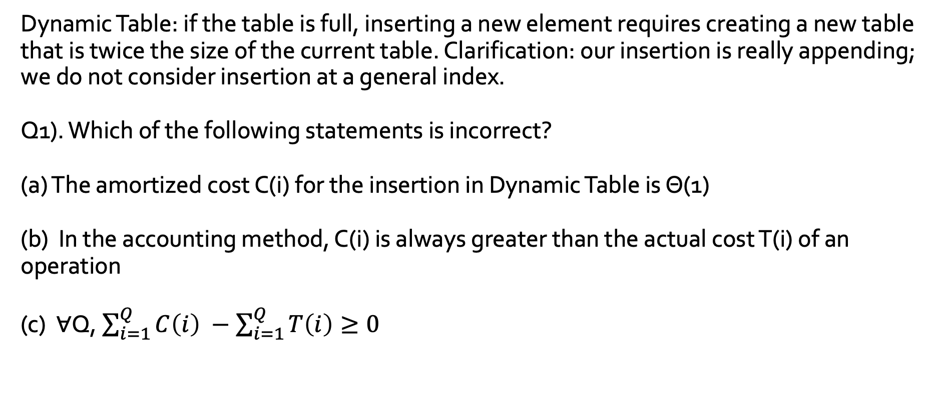
Question 1&2 – Dynamic Table
Dynamic Table: if the table is full, inserting a new element requires creating a new table that is twice the size of the current table. Clarification: our insertion is really appending; we do not consider insertion at a general index.
Q1). Which of the following statements is incorrect?
(a) The amortized cost C(i) for the insertion in Dynamic Table is Θ(1)
(b) In the accounting method, C(i) is always greater than the actual cost T(i) of an operation
(c) ∀Q, $\sum_{i=1}^{Q}{C\left(i\right) −\sum_{i=1}^{Q}{T\left(i\right)≥0}}$

Slide 9
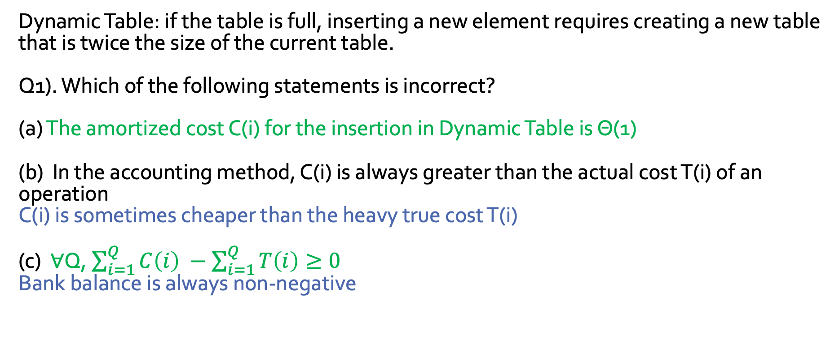
Question 1&2 – Dynamic Table
Dynamic Table: if the table is full, inserting a new element requires creating a new table that is twice the size of the current table.
Q1). Which of the following statements is incorrect?
(a) The amortized cost C(i) for the insertion in Dynamic Table is Θ(1)
(b) In the accounting method, C(i) is always greater than the actual cost T(i) of an operation
C(i) is sometimes cheaper than the heavy true cost T(i)
(c) ∀Q, $\sum_{i=1}^{Q}{C\left(i\right) −\sum_{i=1}^{Q}{T\left(i\right)≥0}}$
Bank balance is always non-negative

Slide 10

Question 1&2 – Dynamic Table
Q2 Prove that insertion in Dynamic Table is amortized Θ$(1)$ using Accounting Method.

Slide 11
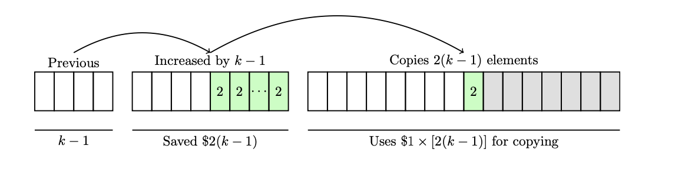
Question 1&2 – Dynamic Table
Q2 We pay $3 for each insertion2, which is Θ(1).
• Use $1 for normal insertion.
• Save $2 for later, when the array is doubled (note that saving $1 is not enough).

Slide 12
Question 3&4 - Queue
You are given a data structure based on the Queue ADT with the following operations:
ENQUEUE(x): Put element x to the back of the queue Just set v = x (a single integer) in the ‘Enqueue’ menu
DEQUEUE(): Remove one element from the front of the queue Just select ‘1x’ in the ‘Dequeue’ menu
DELETE(k): Remove the first k elements from the queue Set the value of K = k before selecting ‘Kx’ in the ‘Dequeue’ menu
ADD(A): Put all elements in array A to the queue Set v = A (put A as comma separated integers) in the ‘Enqueue’ menu

Slide 13
Question 3&4 - Queue
Q3 Prove the following claims using Accounting Method (stating the amortized costs/the bank charges of each operation), assuming that the queue is initially empty: “All operations run in amortized O(1) time, except ADD which runs in amortized O(|A|) time”.

Slide 14
Question 3&4 - Queue
Q3 Prove the following claims using Accounting Method (stating the amortized costs/the bank charges of each operation), assuming that the queue is initially empty: “All operations run in amortized O(1) time, except ADD which runs in amortized O(|A|) time”.
• ENQUEUE(x): $2; O(1); $1 to enqueue x, and $1 is saved for future dequeue of x. • DEQUEUE(): $0 (free); O(1); using the saved $1 from ENQUEUE/ADD already in the bank.
• DELETE(k): $0 (also free); O(1); each of the k deletions is using the saved $1 in the bank • ADD(A): $2|A|; O(|A|); $|A| to put them, and $|A| is saved for future dequeue operations.

Slide 15
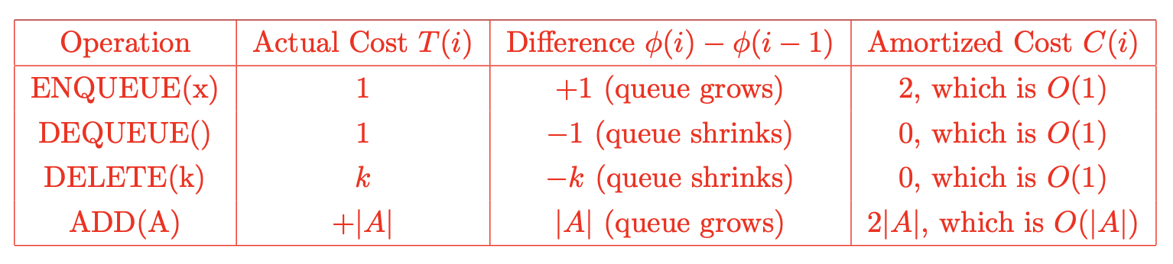
Question 3&4 - Queue
Q4 Prove the same claims, but using Potential Method instead. State your potential function.
The usual heuristic for determining potential function φ is to find “something which decreases a lot after the expensive operations”. A possible φ is thus the size of the queue. φ(0) = 0 as the queue is initially empty.

Slide 16
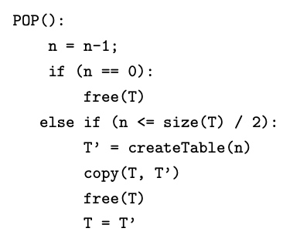
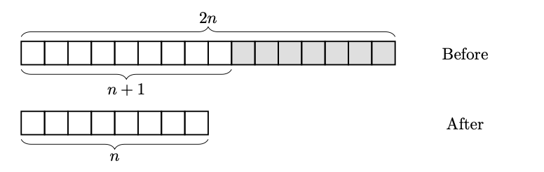
Question 5
Q5 Consider another version of Dynamic Table with only deletion of the last element (POP()), i.e., there is no insertion involved.
The pseudo-code:

Slide 17
Question 5
Assuming n is initially equal to size(T), prove using Potential Method that POP() runs in amortized O(1). State your potential function.

Slide 18
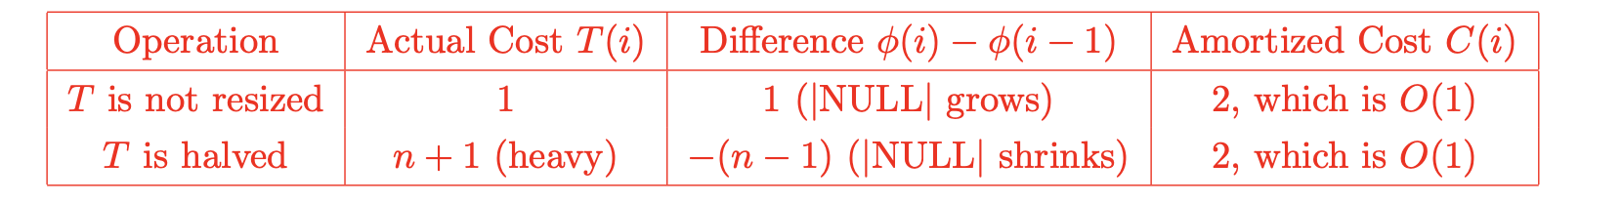
Question 5
Assuming n is initially equal to size(T), prove using Potential Method that POP() runs in amortized O(1). State your potential function.
A possible φ: The number of empty cells (i.e. grey/NULL)

Slide 19
Question 5 Extension
Of course, a table with only deletion is nonsensical. The goal is to combine Q2&5 to a table with both insertion and deletion.
Preliminary idea: double when exceeded, halve when half full.
Problem: high cost in the worst case: suppose we go n -> n+1 -> n -> n+1…
Cost of each operation is Θ(n)

Slide 20

Question 5 Extension
Of course, a table with only deletion is nonsensical. The goal is to combine Q2&5 to a table with both insertion and deletion.
A corrected version: allow load factor to drop to 1/4.
Naturally, the potential function will be more complicated: let $α$ be the load factor, S be the size of table and N be the number of occupied places, then
Notes:
\phi(T) = \begin{cases} 2(N-S) \quad \text{if $\alpha \ge 1/2$}\\ S/2-N \quad \text{if $\alpha<1/2$} \end{cases}

Slide 21
Question 5 Extension
We have to check a few cases (not hard) to see that in all cases C(i) is constant. Please refer to 16.4.2 of CLRS for more details.
Brief motivation: load factor >= ½ iff 2N >=S; for doubling, it drops from N to 0; for halving, also drops from N to 0.
Notes:
\phi(T) = \begin{cases} 2(N-S/2) \quad \text{if $\alpha \ge 1/2$}\\ S/2-N \quad \text{if $\alpha<1/2$} \end{cases}

