Slide 1
CS3230 Tutorial 6 Group: T15
(AY2025/26 Semester 1)

Slide 2
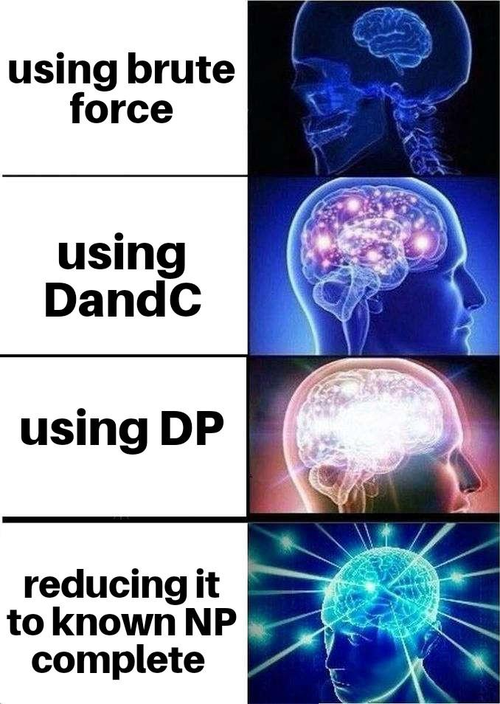
Lecture Review – Dynamic Programming
Break the problem into sub-problems of the same type.
Similar to Divide & Conquer, but DP takes advantage of the many overlapping subproblems.
Key idea: Store the result of each subproblem instead of recomputing them! (Memoization)

Slide 3
Lecture Review – Optimal Substructure
Optimal Substructure – An optimal solution of the subproblem can be used to combine with the decision to form the final optimal solution.
Prove Optimal Substructure:
Prove by contradiction – Let X be an optimal solution that combines a choice D with a suboptimal solution S to the subproblem. (Where X = D + S)
Consider the optimal solution to the subproblem, denote it as T.
We “cut-and-paste” T in place of S to arrive at a new solution X’ = D + T.
This X’ is a better solution than X
Contradiction! X is supposed to be optimal!

Slide 4
Lecture Review – Fibonacci
Fibonacci (Naive Solution)
int FIBO(int n) {
if (n <= 2) return 1;
int res = FIBO(n-1) + FIBO(n-2);
return res;
}

Slide 5
Lecture Review – Fibonacci
Fibonacci (Top Down Solution)
Define memo[n] = [-1,-1, ….]
int FIBO(int n) {
if (n <= 2) return 1;
if (memo[n] != -1) return memo[n];
memo[n] = FIBO(n-1) + FIBO(n-2);
return memo[n];
}

Slide 6
Lecture Review – Fibonacci
Fibonacci (Bottom Up Solution)
memo[1] = memo[2] = 1;
for (int i = 3; i <= n; i++) {
memo[i] = memo[i-1] + memo[i-2];
}

Slide 7
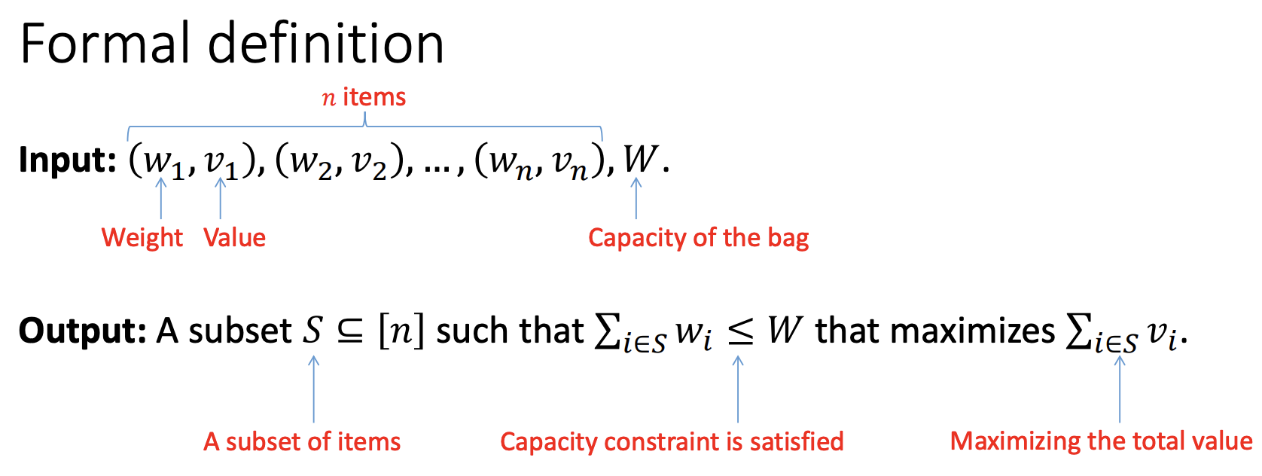
Lecture Review – Knapsack

Slide 8
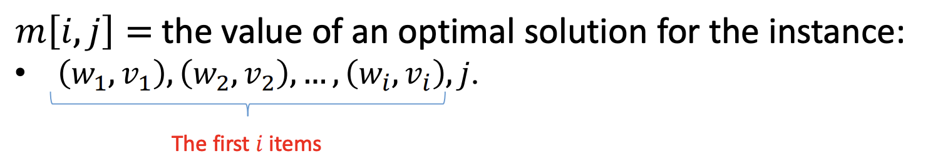
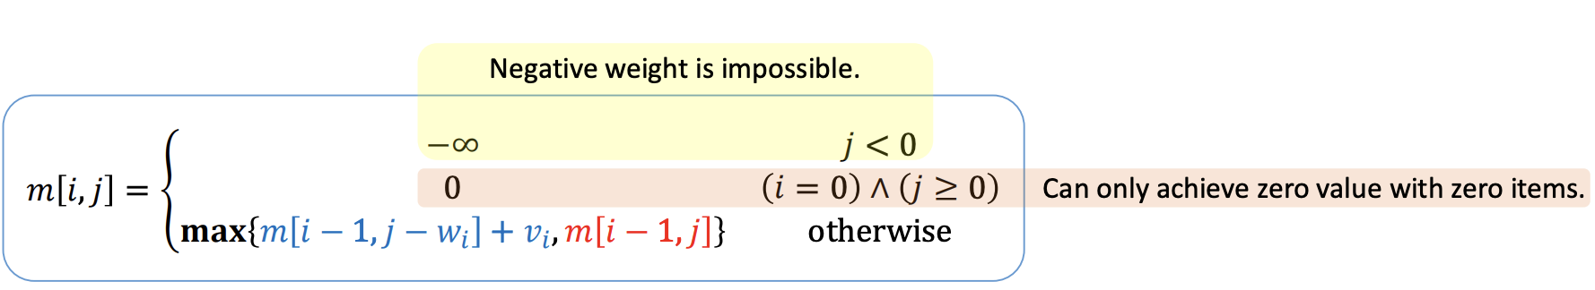
Lecture Review – Knapsack

Slide 9
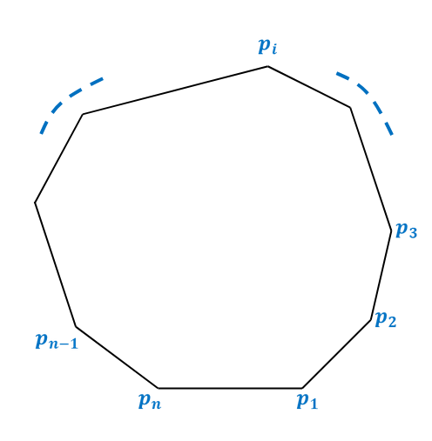
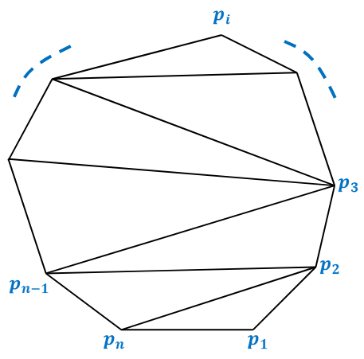
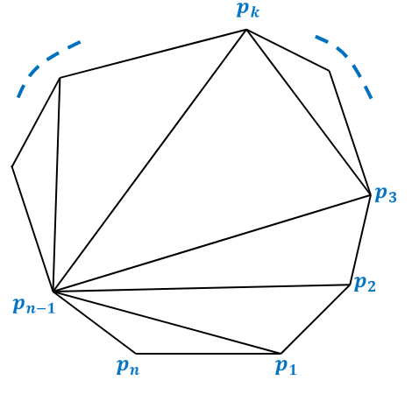
Dynamic Programming Example
You have a convex polygon with n vertices, (labeled 1, 2, 3, …, n)
Triangulate the polygon into triangles.
Define some fancy weight function w(i, j, k) to measure the triangles
Find the triangulation that results in the smallest total weight of all the triangles!

Slide 10
Question 1
Denote a function TRI(x, y) that finds the smallest weight triangulation using only vertices from x to y (i.e. vertices x, x + 1, x + 2, …, y – 1, y)
Our original problem is simply TRI(1, n)
What are the base cases?
The base cases are TRI(x, x+1) = 0.

Slide 11
Question 1
Denote a function TRI(x, y) that finds the smallest weight triangulation using only vertices from x to y (i.e. vertices x, x + 1, x + 2, …, y – 1, y)
Our original problem is simply TRI(1, n)
Write TRI(x, y) as a recursive formula of other TRI(x’, y’) function calls!

Slide 12
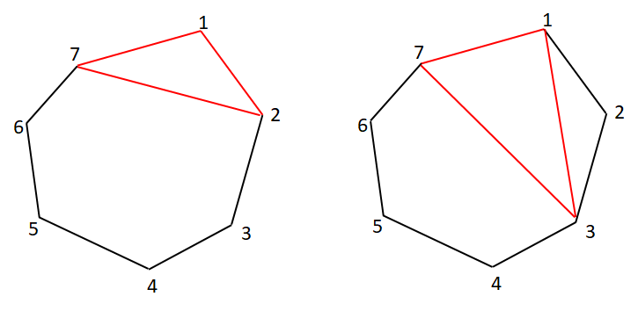
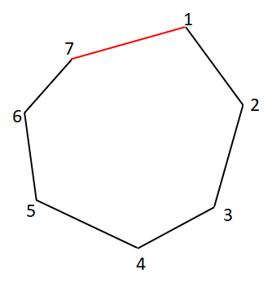
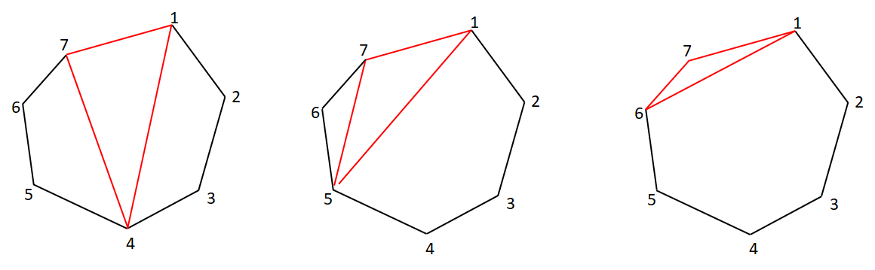
Question 1
Example: x = 1, y = 7

Slide 13
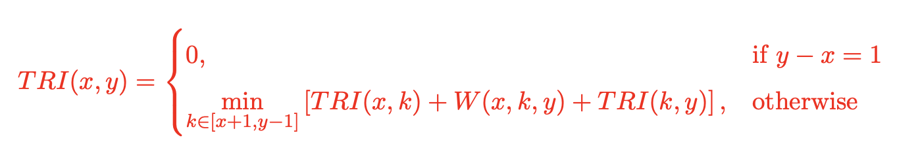
Question 1
Recursive formula:
TRI(1,n) = min{(TRI(2, n) + TRI(1, 2) + W(1,2,n)) + (TRI(3, n) + TRI(1, 3) + W(1,3,n)) + … + (TRI(n-1, n) + TRI(1, n-1) + W(1,n-1,n))
TRI(1,n-1) = (TRI(2, n-1) + TRI(1, 2) + W(1,2,n-1)) + (TRI(3, n-1) + TRI(1, 3) + W(1,3,n-1)) + … + (TRI(n-2, n-1) + TRI(1, n-2) + W(1,n-2,n-1))
What is the time complexity of TRI(1,n)?

Slide 14

Question 1
What is the time complexity of TRI(1,n)?
For simplicity, let T(n) = TRI(x, x-1+n) (e.g.: T(n-1) = TRI(1,n-1)
So:
T(n) = (T(n-1) + T(2) + c) + (T(n-2) + T(3) + c) + … + (T(2) + T(n-1) + c)
T(n-1) = (T(n-2) + T(2) + c) + (T(n-3) + T(3) + c) + … + (T(2) + T(n-2) + c)
T(n) – T(n-1) = 2*T(n-1) + c
So: T(n) = 3*T(n-1) + c

Slide 15
Question 3
Which one is the correct explanation regarding this?
It has 3^{n} non-overlapping subproblems and each call runs in Ө(1)
It has n² non-overlapping subproblems and each call runs in Ө(3^{n} / n²)
It has n² subproblems but there are many overlaps

Slide 16
Question 4
int TRI(int x, int y) {
if (y – x == 1) return 0;
if (memo[x][y] != INF) return memo[x][y];
for (int i = x + 1; i <= y – 1; i++) {
memo[x][y] = min(memo[x][y], w(x, i, y) + TRI(x, i) + TRI(i, y));
}
return memo[x][y];
}
Now design a Bottom Up solution!

Slide 17
Question 4
Idea, let d = y – x. (Denoting the size of the polygon)
for (int d = 2; d < n; d++) {
for (int x = 1; x <= n – d; x++) {
int y = x + d;
for (int i = x + 1; i <= y – 1; i++) {
memo[x][y] = min(memo[x][y], w(x, i, y) + memo[x][i] + memo[i][y]);
}
}
}

Slide 18
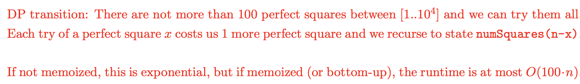
Question 5
Given an integer n, return the least number of perfect square numbers that sum to n.
A perfect square is an integer that is the square of an integer; in other words, it is the product of some integer with itself. For example, 1, 4, 9, and 16 are perfect squares while 3 and 11 are not.
We'll build a DP array where:
dp[i] = minimum number of perfect squares that sum to i
Initialize:
dp[0] = 0
Others with a large number (e.g., inf)
For each i from 1 to n, try all perfect squares j*j ≤ i and update:
dp[i]=min{dp[i], dp[i−j²]+1}

