Slide 1
CS3230 Tutorial 4 Group: T15
(AY2025/26 Semester 1)

Slide 2
Lecture Review – Divide & Conquer
Divide & Conquer works as follows:
Divide the problem into sub-problems that are of the same type as the original problem
Conquer the sub-problems by solving them recursively (until you reach trivial states)
Combine the solutions of the sub-problems to create a solution to the original problem

Slide 3
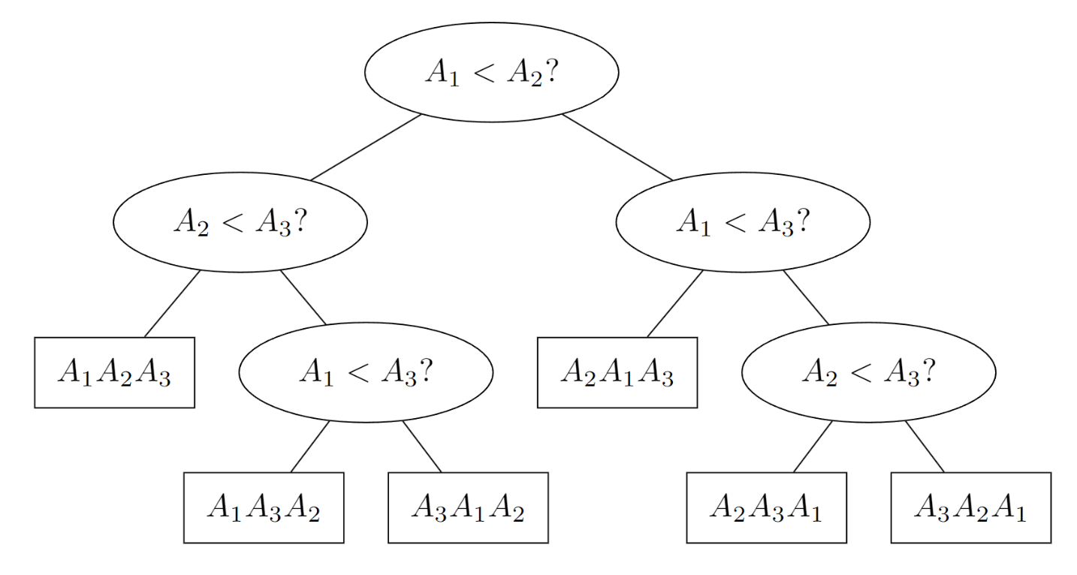
Lecture Review – Decision Trees
Decision Tree to sort 3 elements:
Height is worst case

Slide 4
Question 1
Let A(x) = a_{n}x^{n} + … + a₂x² + a₁x + a₀
and B(x) = b_{n}x^{n} + … + b₂x² + b₁x + b₀ be polynomials with integer coefficients
We wish to compute C(x) = A(x) * B(x)
C(x) = A(x) * B(x) = c_{2n}x^{2n} + … + c₂x² + c₁x + c₀
All a_{i} and b_{i} are integers, and assume integer operations (like addition and multiplication take O(1) time)

Slide 5
Question 1 – Naive Solution
Let A(x) = a_{n}x^{n} + … + a₂x² + a₁x + a₀
and B(x) = b_{n}x^{n} + … + b₂x² + b₁x + b₀
For every term in A(x), multiply it with each term in B(x) and add the results together.
This takes O(n²) time

Slide 6
Question 1
A(10) = 352 = 3 * 10² + 5 * 10 + 2 B(10) = 221 = 2 * 10² + 2 * 10 + 1
10⁴ term: (3 * 10²) (2 * 10²) = 6 * 10⁴ 10³ term: (3 * 10²) (2 * 10) + (5 * 10) (2 * 10²) = 16 * 10³ 10² term: (3 * 10²) (1) + (5 * 10) (2 * 10) + (2) (2 * 10²) = 17 * 10² 10¹ term: (5 * 10) (1) + (2) (2 * 10) = 9 * 10 10⁰ term: (2) (1) = 2
C(10) = 6 * 10⁴ + 16 * 10³ + 17 * 10² + 9 * 10 + 2 = 60,000 + 16,000 + 1,700 + 90 + 2 = 77,792

Slide 7
Question 2 – a D&C solution
Let A(x) = a_{n}x^{n} + … + a₂x² + a₁x + a₀ = x^{n/2} A₁(x) + A₂(x)
and B(x) = b_{n}x^{n} + … + b₂x² + b₁x + b₀ = x^{n/2} B₁(x) + B₂(x)
Observe that A₁(x), A₂(x), B₁(x), B₂(x) are now polynomials of degree (up to) n/2
Compute the 4 smaller multiplications: A₁(x) * B₁(x), A₂(x) * B₁(x), A₁(x) * B₂(x), A₂(x) * B₂(x)
Observe that C(x) = A(x) * B(x) = (x^{n/2} A₁(x) + A₂(x)) * (x^{n/2} B₁(x) + B₂(x)) = x^{n} (A₁(x) * B₁(x)) + x^{n/2} (A₂(x) * B₁(x) + A₁(x) * B₂(x)) + A₂(x) * B₂(x)

Slide 8
Question 3 – a D&C solution
Let A(x) = a_{n}x^{n} + … + a₂x² + a₁x + a₀ = x^{n/2} A₁(x) + A₂(x)
and B(x) = b_{n}x^{n} + … + b₂x² + b₁x + b₀ = x^{n/2} B₁(x) + B₂(x)
Observe that A₁(x), A₂(x), B₁(x), B₂(x) are now polynomials of degree (up to) n/2
Compute the 4 smaller multiplications: A₁(x) * B₁(x), A₂(x) * B₁(x), A₁(x) * B₂(x), A₂(x) * B₂(x)
Observe that C(x) = A(x) * B(x) = (x^{n/2} A₁(x) + A₂(x)) * (x^{n/2} B₁(x) + B₂(x)) = x^{n} (A₁(x) * B₁(x)) + x^{n/2} (A₂(x) * B₁(x) + A₁(x) * B₂(x)) + A₂(x) * B₂(x)
What is the time complexity of this algorithm?
4 T(n/2)
O(n) combination

Slide 9
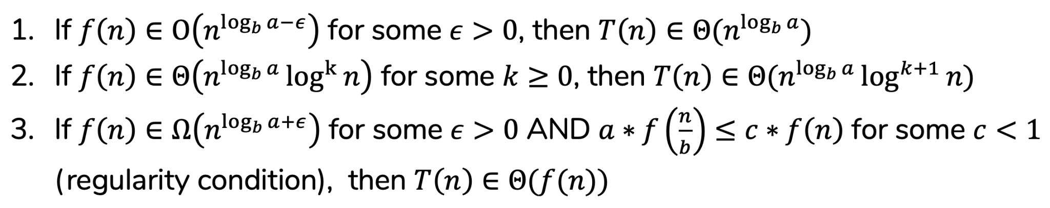
Question 3 – a D&C solution
T(n) = 4T(n/2) + O(n)
⇒ T(n) ∈ Θ(n²) (Master theorem case 1)

Slide 10
Question 4 – Karatsuba’s Algorithm
Let A(x) = a_{n}x^{n} + … + a₂x² + a₁x + a₀ = x^{n/2} A₁(x) + A₂(x)
and B(x) = b_{n}x^{n} + … + b₂x² + b₁x + b₀ = x^{n/2} B₁(x) + B₂(x)
Compute the 3 smaller multiplications: A₁(x) * B₁(x), (A₁(x) + A₂(x)) * (B₁(x) + B₂(x)), A₂(x) * B₂(x)
Observe that C(x) = A(x) * B(x) = (x^{n/2} A₁(x) + A₂(x)) * (x^{n/2} B₁(x) + B₂(x)) = x^{n} (A₁(x) * B₁(x)) + x^{n/2} ((A₁(x) + A₂(x)) * (B₁(x) + B₂(x)) – A₁(x) * B₁(x) – A₂(x) * B₂(x)) + A₂(x) * B₂(x)
What is the time complexity of Karatsuba’s Algorithm?
3 T(n/2)
O(n) combination

Slide 11
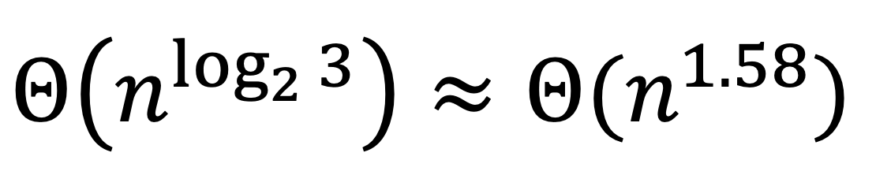
Question 4 – Karatsuba’s Algorithm
T(n) = 3T(n/2) + O(n)
⇒ T(n) ∈
Python’s large integer multiplication actually uses this algorithm!
There is actually a way to solve polynomial multiplication in T(n) = 2T(n/2) + Θ(n)
T(n) = Θ(n log n) (Masters Theorem Case 2).
That algorithm is known as Fast Fourier Transform.

Slide 12
Question 5 – h-index
Basically, each paper has a certain number of citations (a citation is a quotation from or reference to a book, paper, or author, especially in a scholarly work). Your H-index is the largest number H such that you have written and published H papers with at least H citations. Given the number of citations ci on each of the n papers you have published in non-increasing (decreasing or plateau), what is your H-index?

Slide 13

Question 5 – h-index
You are given an array A[1..n] that is sorted in non-increasing order. Your task is to find the largest index i such that A[i] ≥ i. Design an efficient algorithm to solve this problem.

Slide 14
Question 5 – h-index
The array has the following properties:
• If A[j]≥j, then it must hold that A[j−1] ≥ j−1, unless j = 1.
• If A[j]<j, then it must follow that A[j+1] < j+1, unless j=n. For ease of notation, assume that the array is extended such that A[0] > 0 and A[n + 1] < n + 1.
Thus, there is a unique i such that A[i] ≥ i but A[i + 1] < i + 1.

Slide 15
Question 5 – h-index
Method 1: Do a linear search i ∈ [1..n] to find the largest i such that A[i] ≥ i. Take O(n) time.
Linear search + sorted array?
Binary Search!

Slide 16
Question 5 – h-index
Can we do faster?
First search for the least k such that A[2^{k}] < 2^{k}, by trying k = 0,1,2.... If k = 0, then we are already done. Otherwise, this would give that A[2^{k}] < 2^{k}, but A[2^{k}−1] > 2^{k}−1. Now we can use binary search between i = 2^{k}−1 and 2^{k}, to get the largest i such that A[i] ≥ i. This takes O(logi) time, where i is the final answer.

Slide 17
Question 6
You have 243 balls, all of which have the same weight except for 1 which is heavier.
Determine which ball is the heavier ball.
Your friend has a balance scale, but they will charge you for each use.
What’s the minimum number of weighings needed?

Slide 18
Question 6
In “information theory”-esque problems, consider what the query result tells you.
Consider putting set A on the left and set B on the right of the scale and denote the remaining set as C.
If the scale tilts to the left, we conclude the heavier ball is in set A
If the scale tilts to the right, we conclude the heavier ball is in set B
Otherwise, the heavier ball is in set C

Slide 19
Question 6
To minimize the worst case, we choose |A| = |B| = |C| = n / 3.
After each weighing, we reduce the number of candidates for the heavy ball from n to n/3.
Hence, this takes 243 → 81 → 27 → 9 → 3 → 1, ⌈log₃(243)⌉ = 5 weighings
What is the lower bound of ANY algorithm to solve this problem?

Slide 20
Question 6
To show something is “minimum”, you also have to show that it cannot be done with less than 5 queries.
Suppose you only have 4 queries.
Consider a full ternary decision tree with a height of 4, such a tree only has 81 leaves.
Hence, any algorithm can only have at most 81 different outputs, insufficient to determine 243 balls → 5 queries is minimum.

