Slide 1
CS3230 Tutorial 2 Group: T15
(AY2025/26 Semester 1)

Slide 2
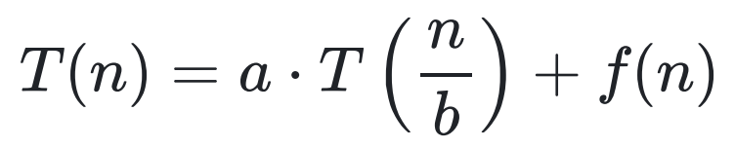
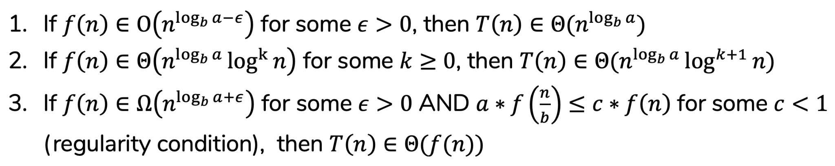
Lecture Review – Master Theorem
Given a recurrence relation of the form:
Where a ≥ 1, b > 1.
We can find a tight asymptotic bound (Θ) for the following cases:

Slide 3
Lecture Review – Master Theorem
1 total
f(n)
a total
f(n / b)
f(n / b)
f(n / b)
…
a² total
f(n / b²)
f(n / b²)
f(n / b²)
f(n / b²)
…
k = log_{b}n layers
…
a^{k} total
…
Each of size f(n / b^{k}) = f(1), assumed to be constant
Work done in the top layer: 1 node, each node ‘costs’ f(n)
Work done in the bottom layer: a^(log_{b}n) = n^(log_{b}a) nodes, each node ‘costs’ 1.

Slide 4
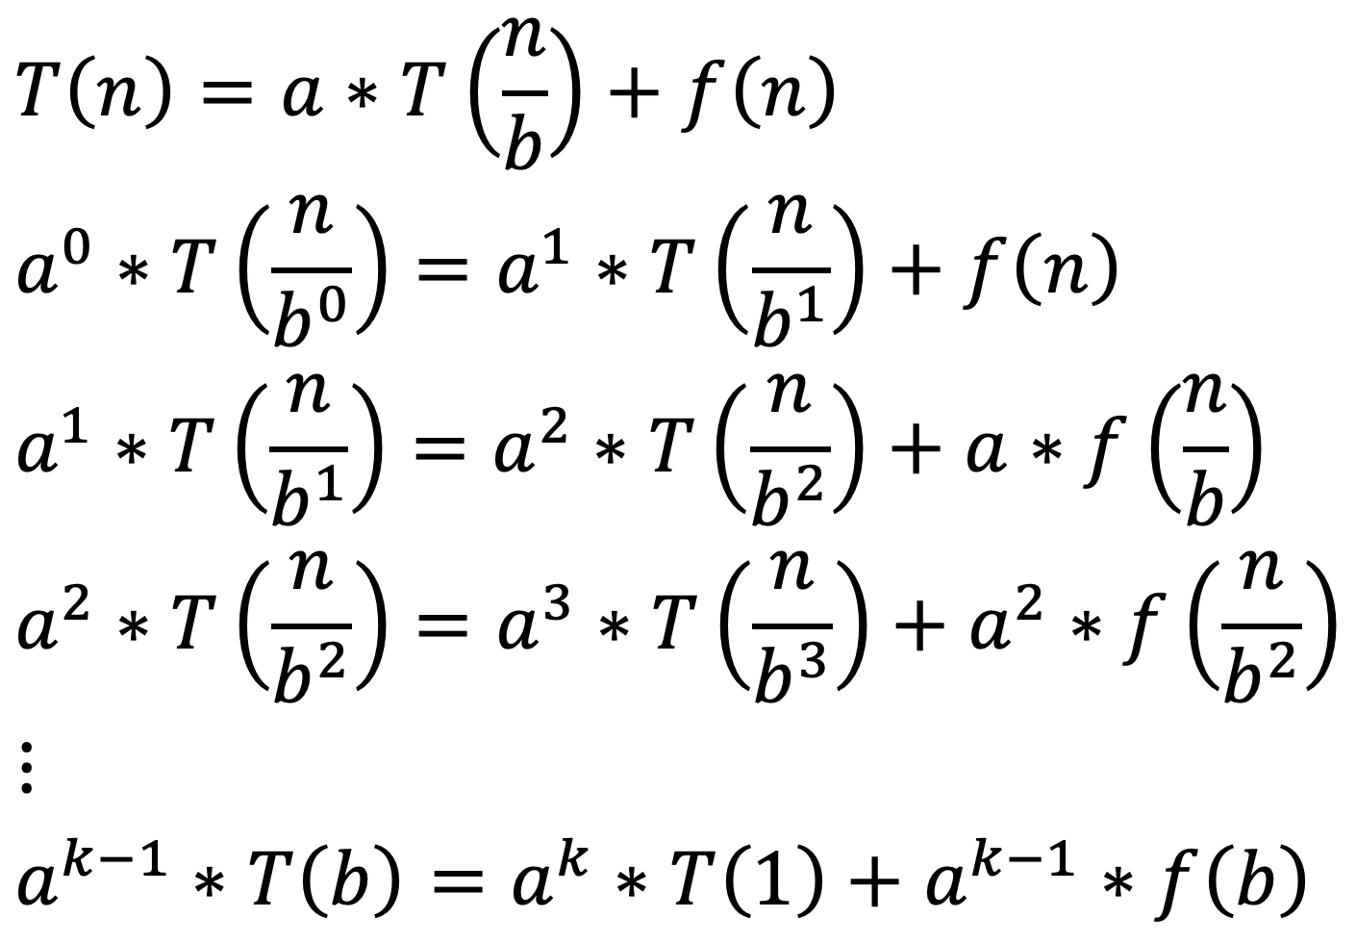
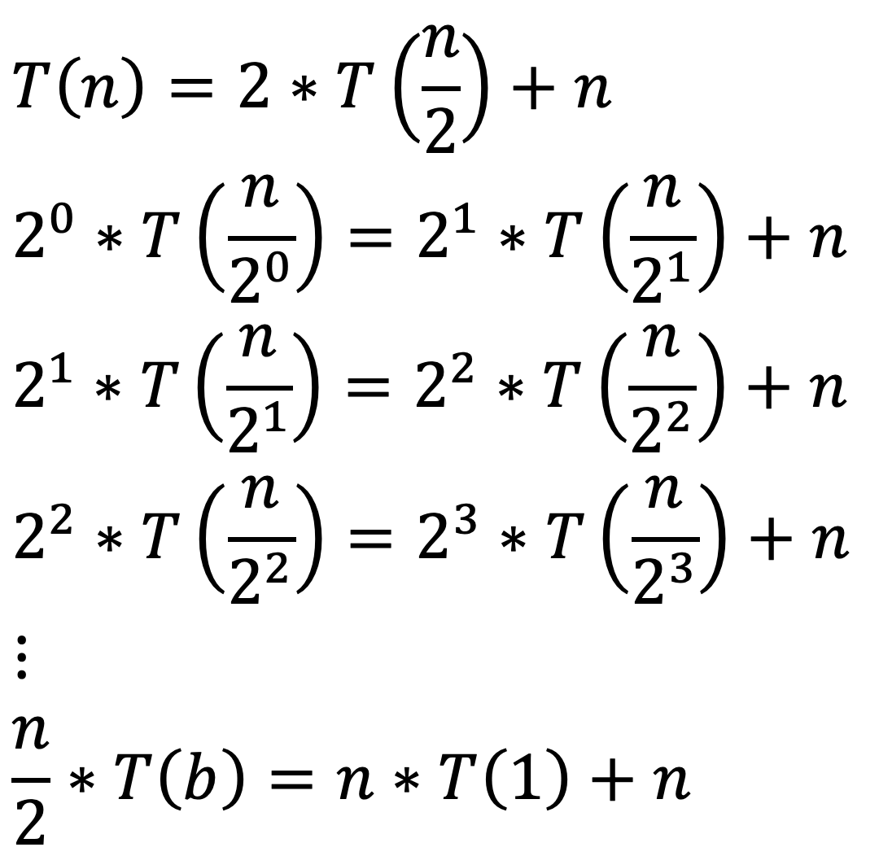
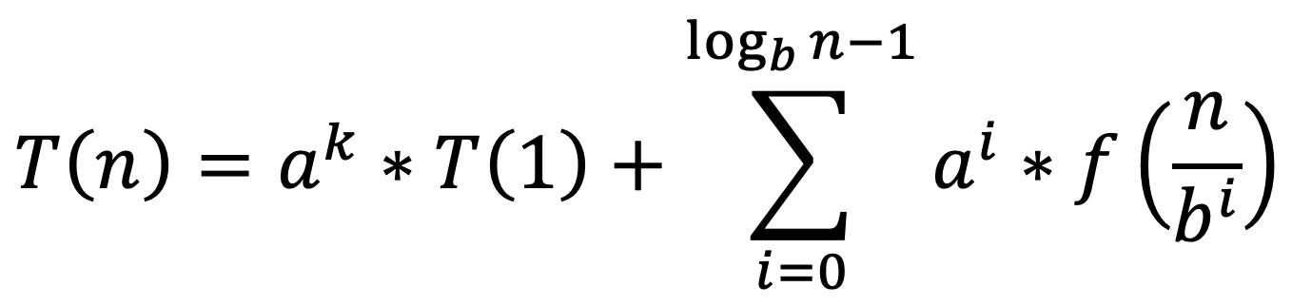
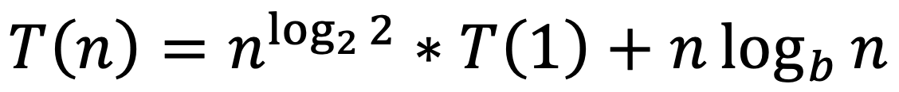
Lecture Review – Telescoping Method

Slide 5
Lecture Review – Substitution Method
Key Idea: Start with a guess, then prove your guess via Strong Induction
Guess that T(n) ∈ O(f(n)).
You need to prove that T(n) ≤ c * f(n) for all n
You may assume T(n) is constant for some small n values usually.
Assume T(k) ≤ c * f(k) for all k < n
Using the assumption, prove T(n) ≤ c * f(n)

Slide 6
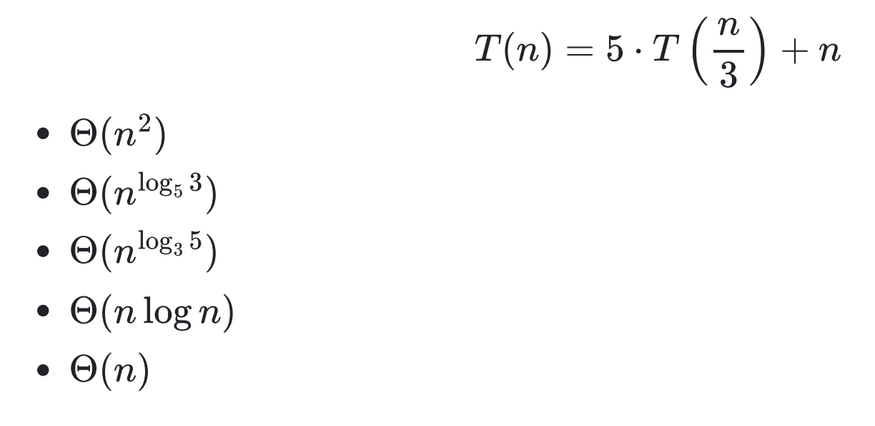
Q2 (hidden)
Give a tight asymptotic bound for:
satisfies Case 1 of Master Theorem.
Observe how log_{b}a = log₃5 ≈ 1.46, f(n) = n ∈ O(n^{1.46 – ε})
Hence, T(n) ∈

Slide 7
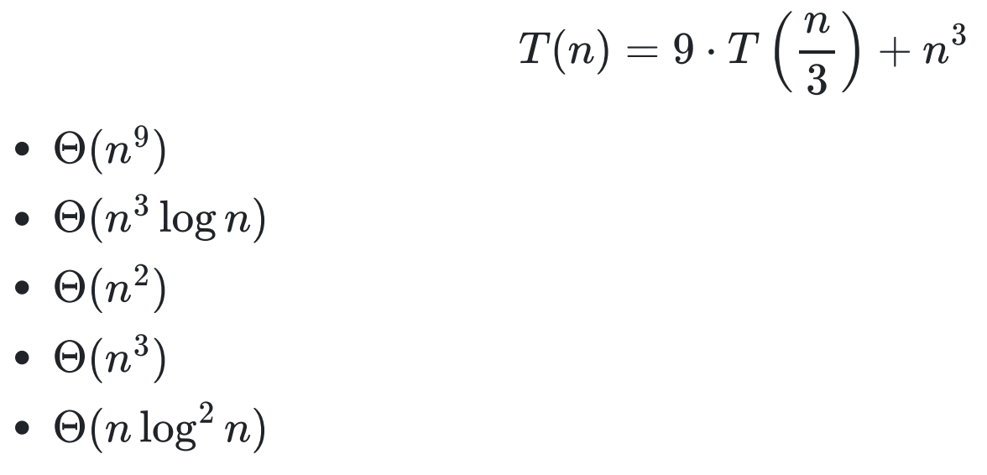
Q3 (hidden)
Give a tight asymptotic bound for:
log_{b}a = log₃9 = 2. Since n³ = Ω(n^{2 + ε}):
Since
The regularity condition holds true, and we can conclude T(n) ∈ Θ(n³)

Slide 8
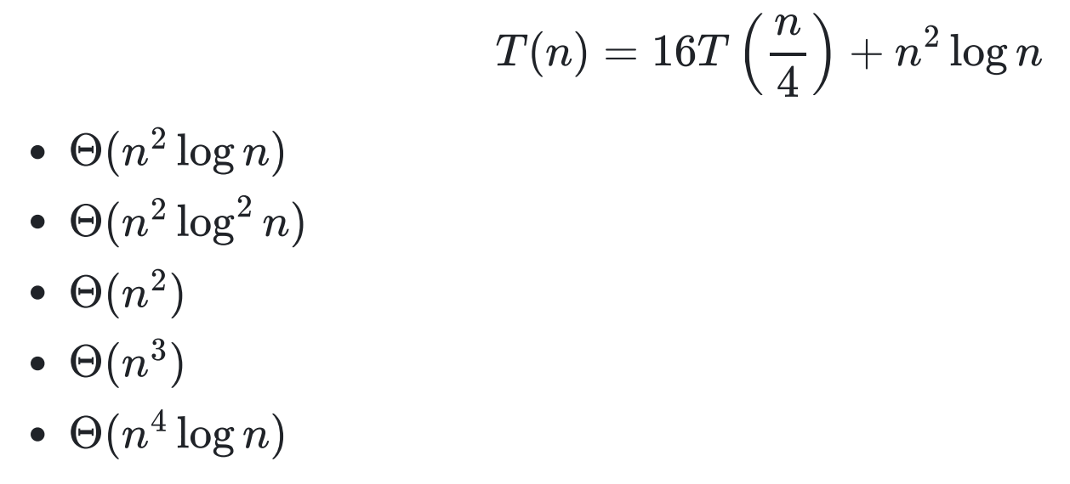
Q4 (hidden)
Give a tight asymptotic bound for:
log_{b}a = log₄16 = 2
T(n) ∈ Θ(n² log² n)

Slide 9
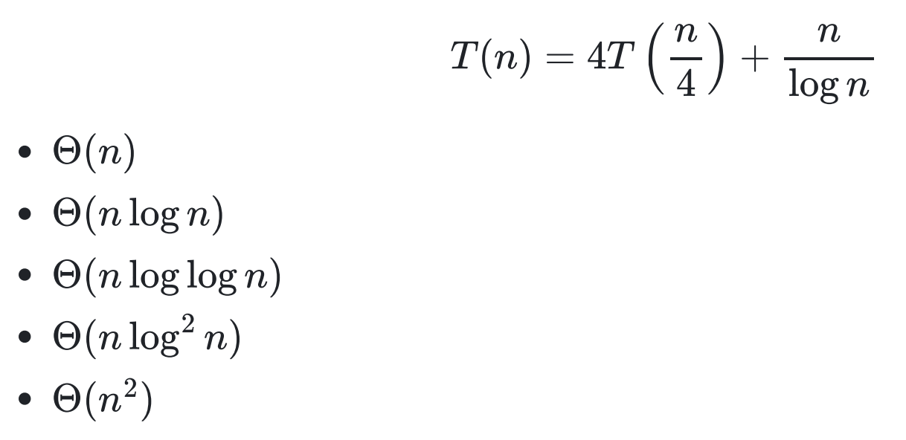
Tutorial Q1
Use telescoping sums to obtain a tight bound for:

Slide 10
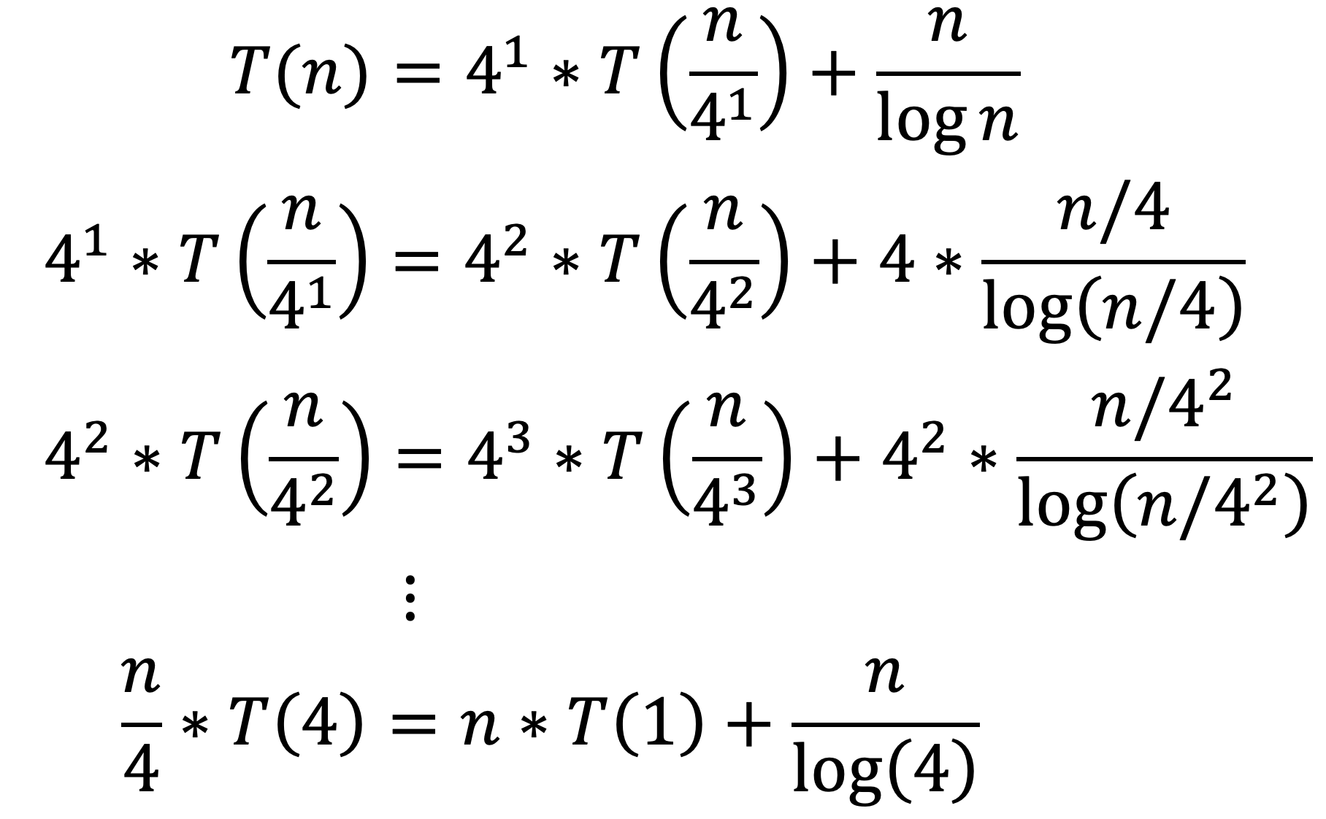
Tutorial Q1
Apply the telescoping sum technique:

Slide 11
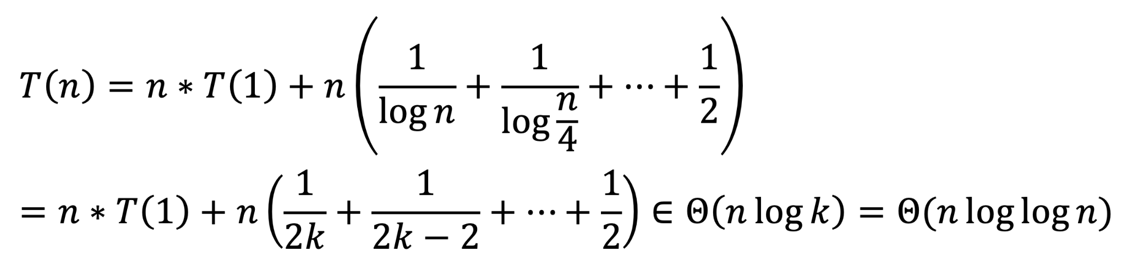
Tutorial Q1
Apply the telescoping sum technique:
Substitute n = 4^{k}

Slide 12
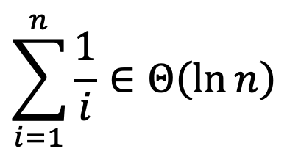
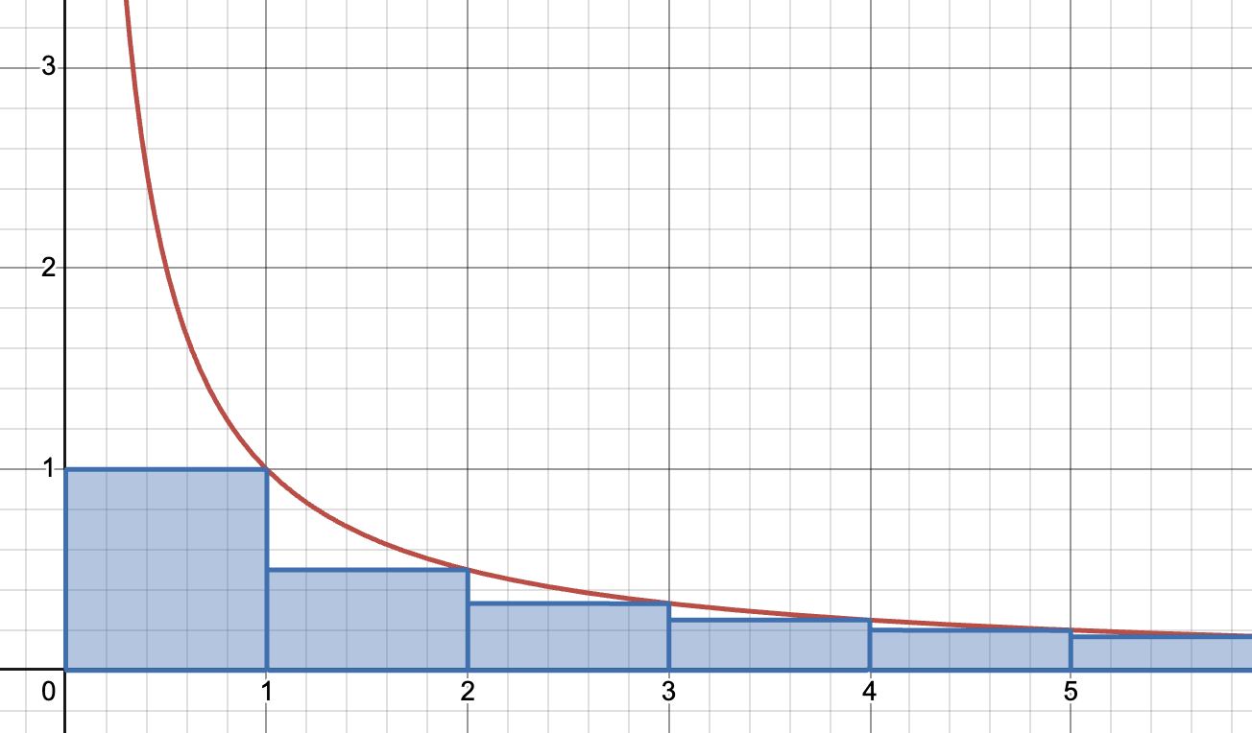
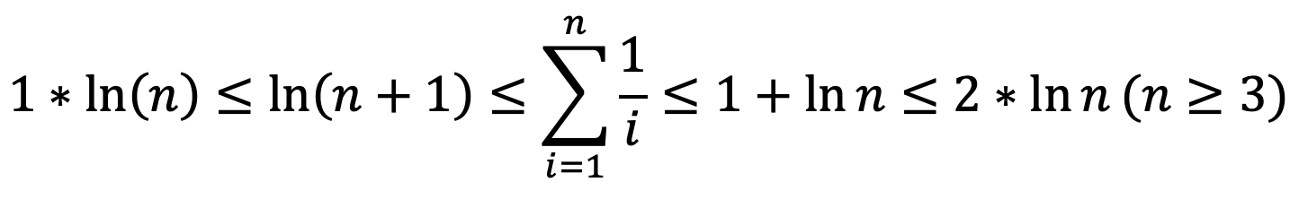
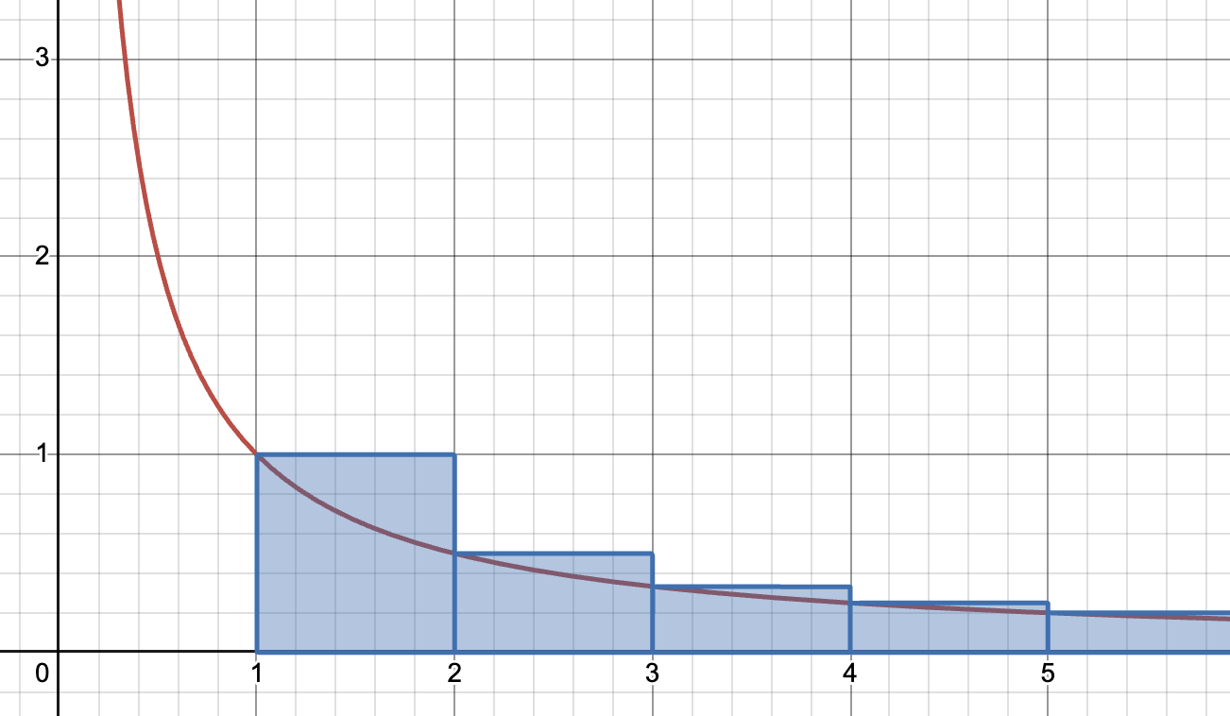
Tutorial Q1
Harmonic Series:

Slide 13
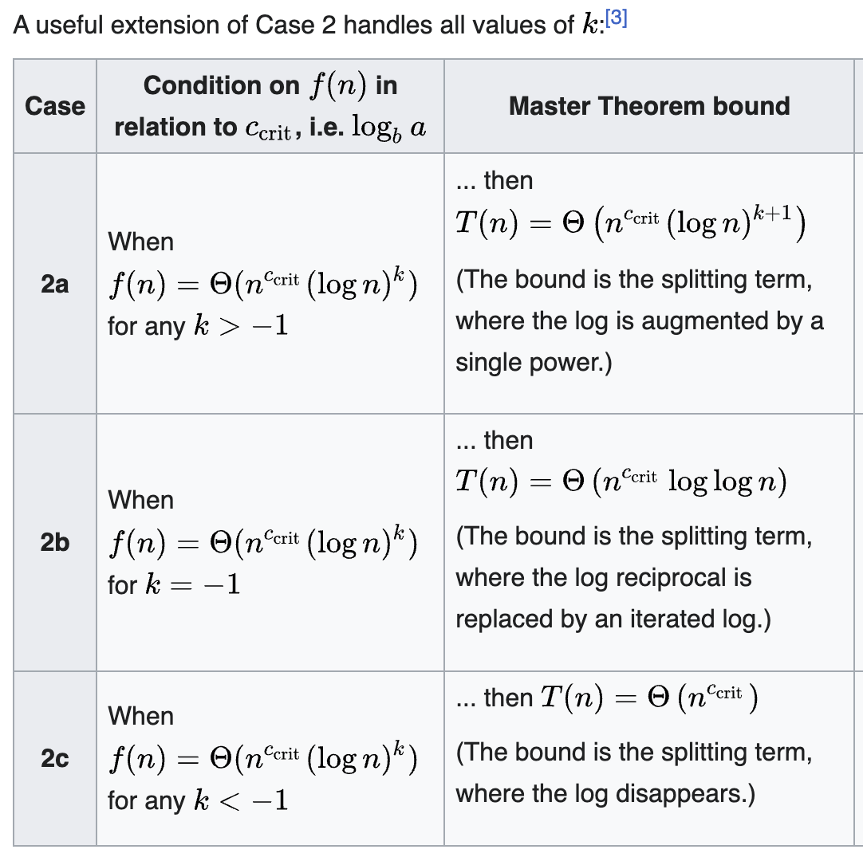
Tutorial Q1
Can we use Master theorem?

Slide 14
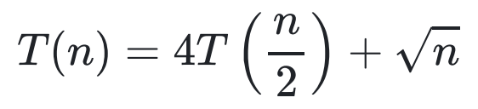
Tutorial Q5
Using the substitution method, give a tight asymptotic bound for:

Slide 15
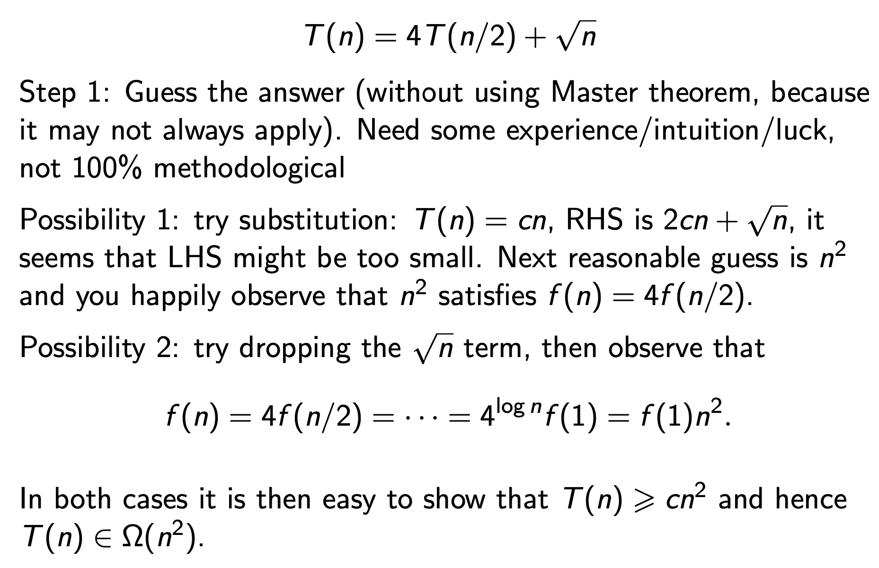
Tutorial Q5

Slide 16
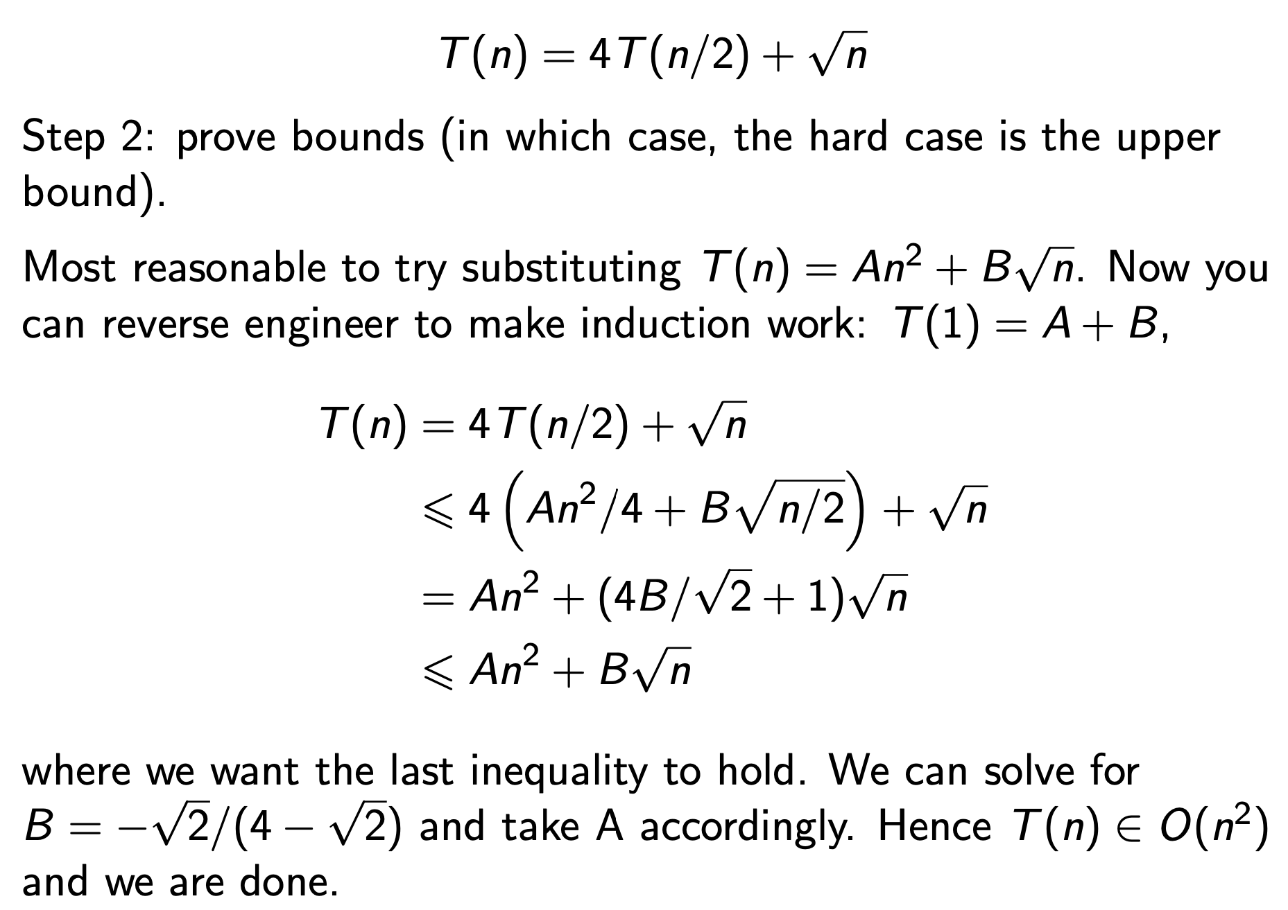
Tutorial Q5

Slide 17
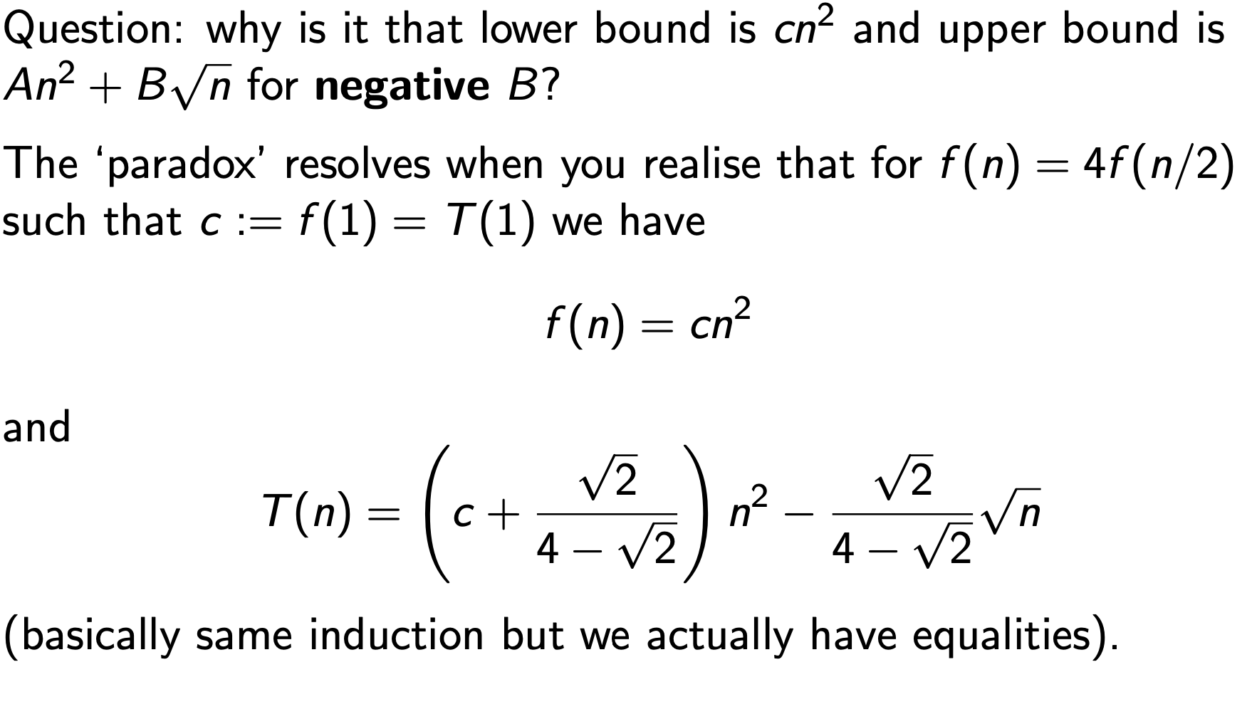
Tutorial Q5

Slide 18
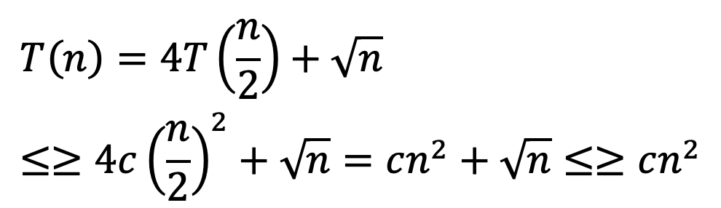

Tutorial Q5
Guess T(n) ∈ Θ(n²)
Need to show: T(n) ≤ c * n² AND T(n) ≥ c * n².
Usually, one of these is *much* easier than the other.
We try to formulate the inductive step first.
≥ true for all c ≤ false for all c

Slide 19
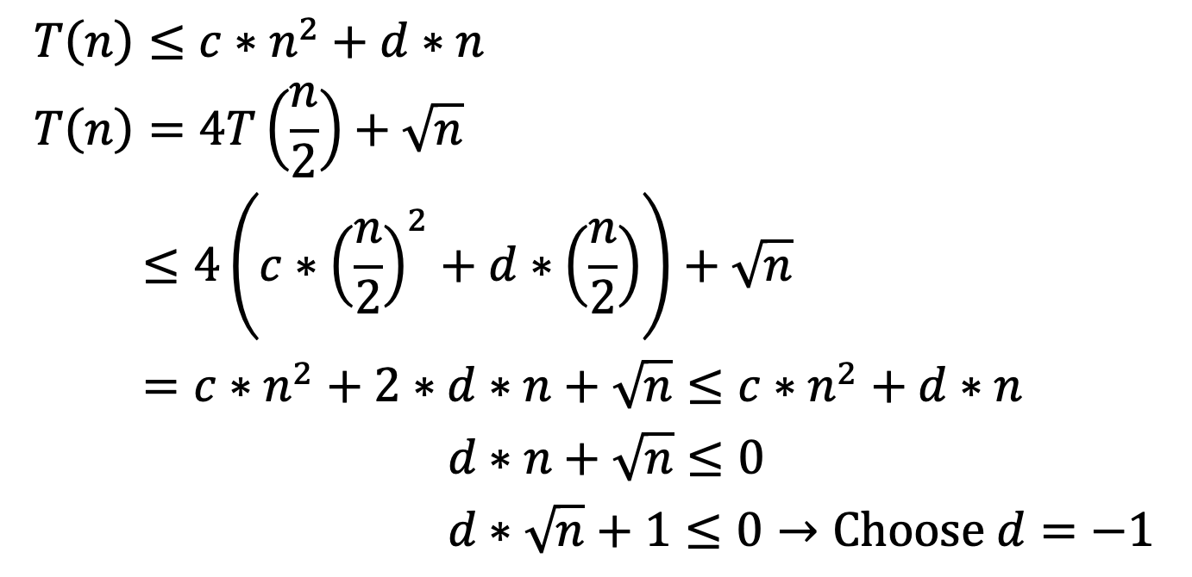
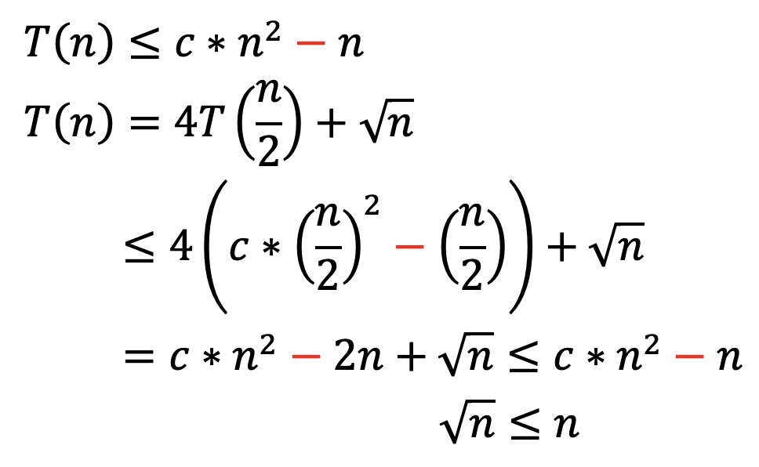
Tutorial Q5

Slide 20

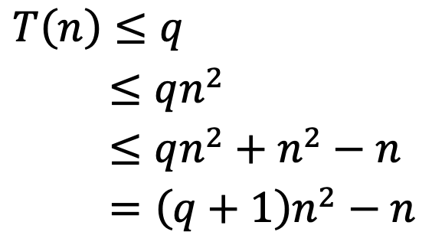
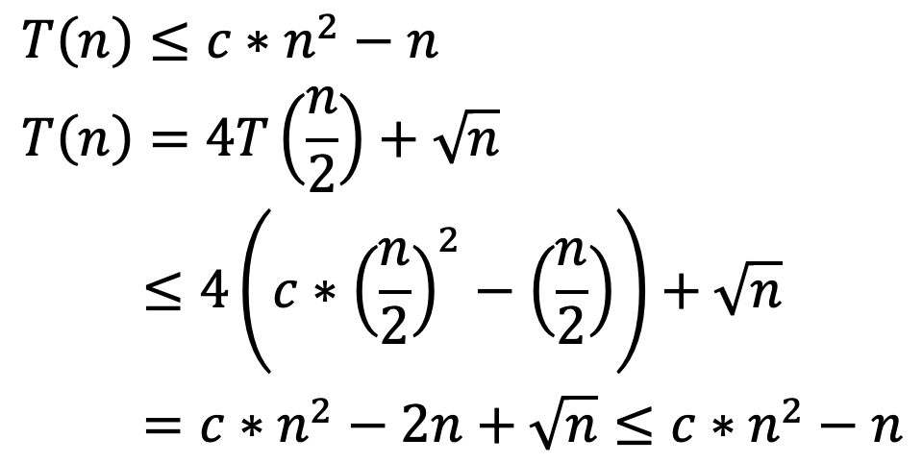
Tutorial Q5
Assume T(n) ≤ q for n ≤ 10. (i.e. T(n) is constant for small n)
Set c = q + 1
We wish to show
By Strong Induction, T(n) ∈ O(n²)
Base Case (n ≤ 2)
Inductive Case

Slide 21
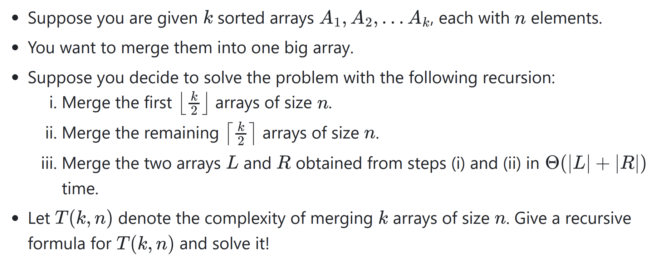
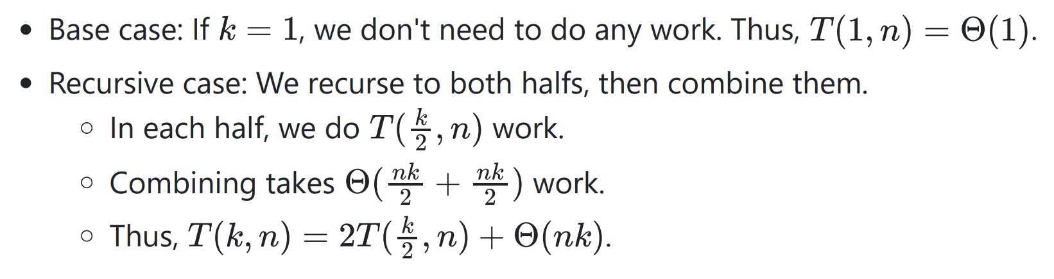
Tutorial Q6

Slide 22
Tutorial Q6

Slide 23
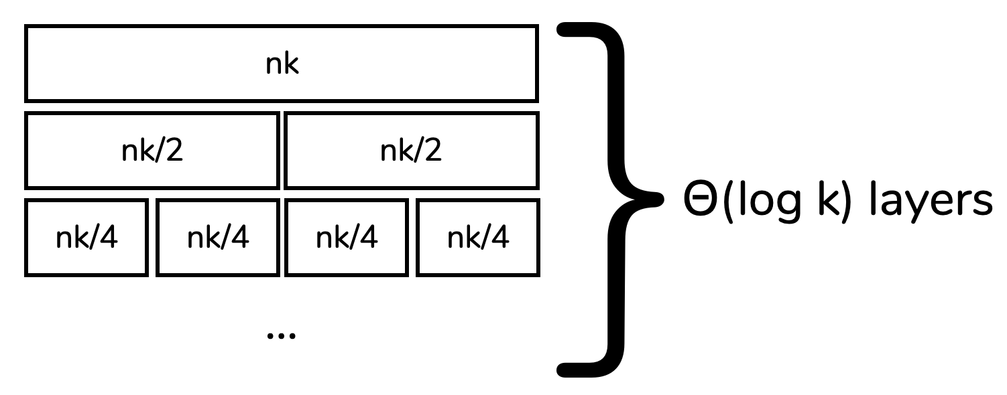
Tutorial Q6
One way to solve this is via the recursion tree:
Each layer is Θ(nk)
There are Θ(log k) layers
Total is Θ(nk log k)

Slide 24
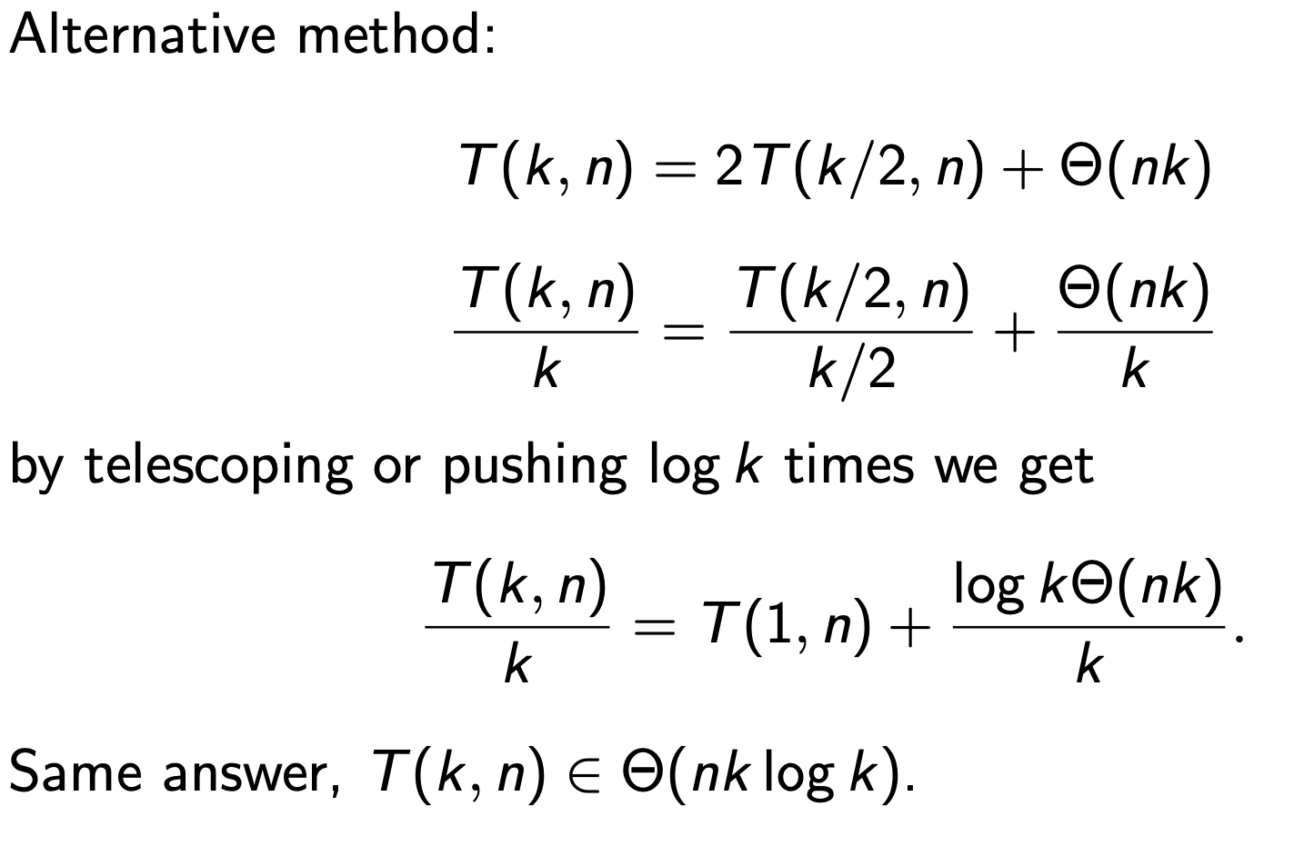
Tutorial Q6

Slide 25

You are given two positive integer arrays spells and potions, of length n and m respectively, where spells[i] represents the strength of the i^{th} spell and potions[j] represents the strength of the j^{th} potion.
You are also given an integer success. A spell and potion pair is considered successful if the product of their strengths is at least success.
Return an integer array pairs of length n where pairs[i] is the number of potions that will form a successful pair with the i^{th} spell.

