Slide 1
P
R
O
G
R
A
M
M
I
N
G
第10讲 多态
一脉相承 各有千秋
计算机与信息学院
Notes:
同根相连 各表芬芳
周二下午

Slide 2
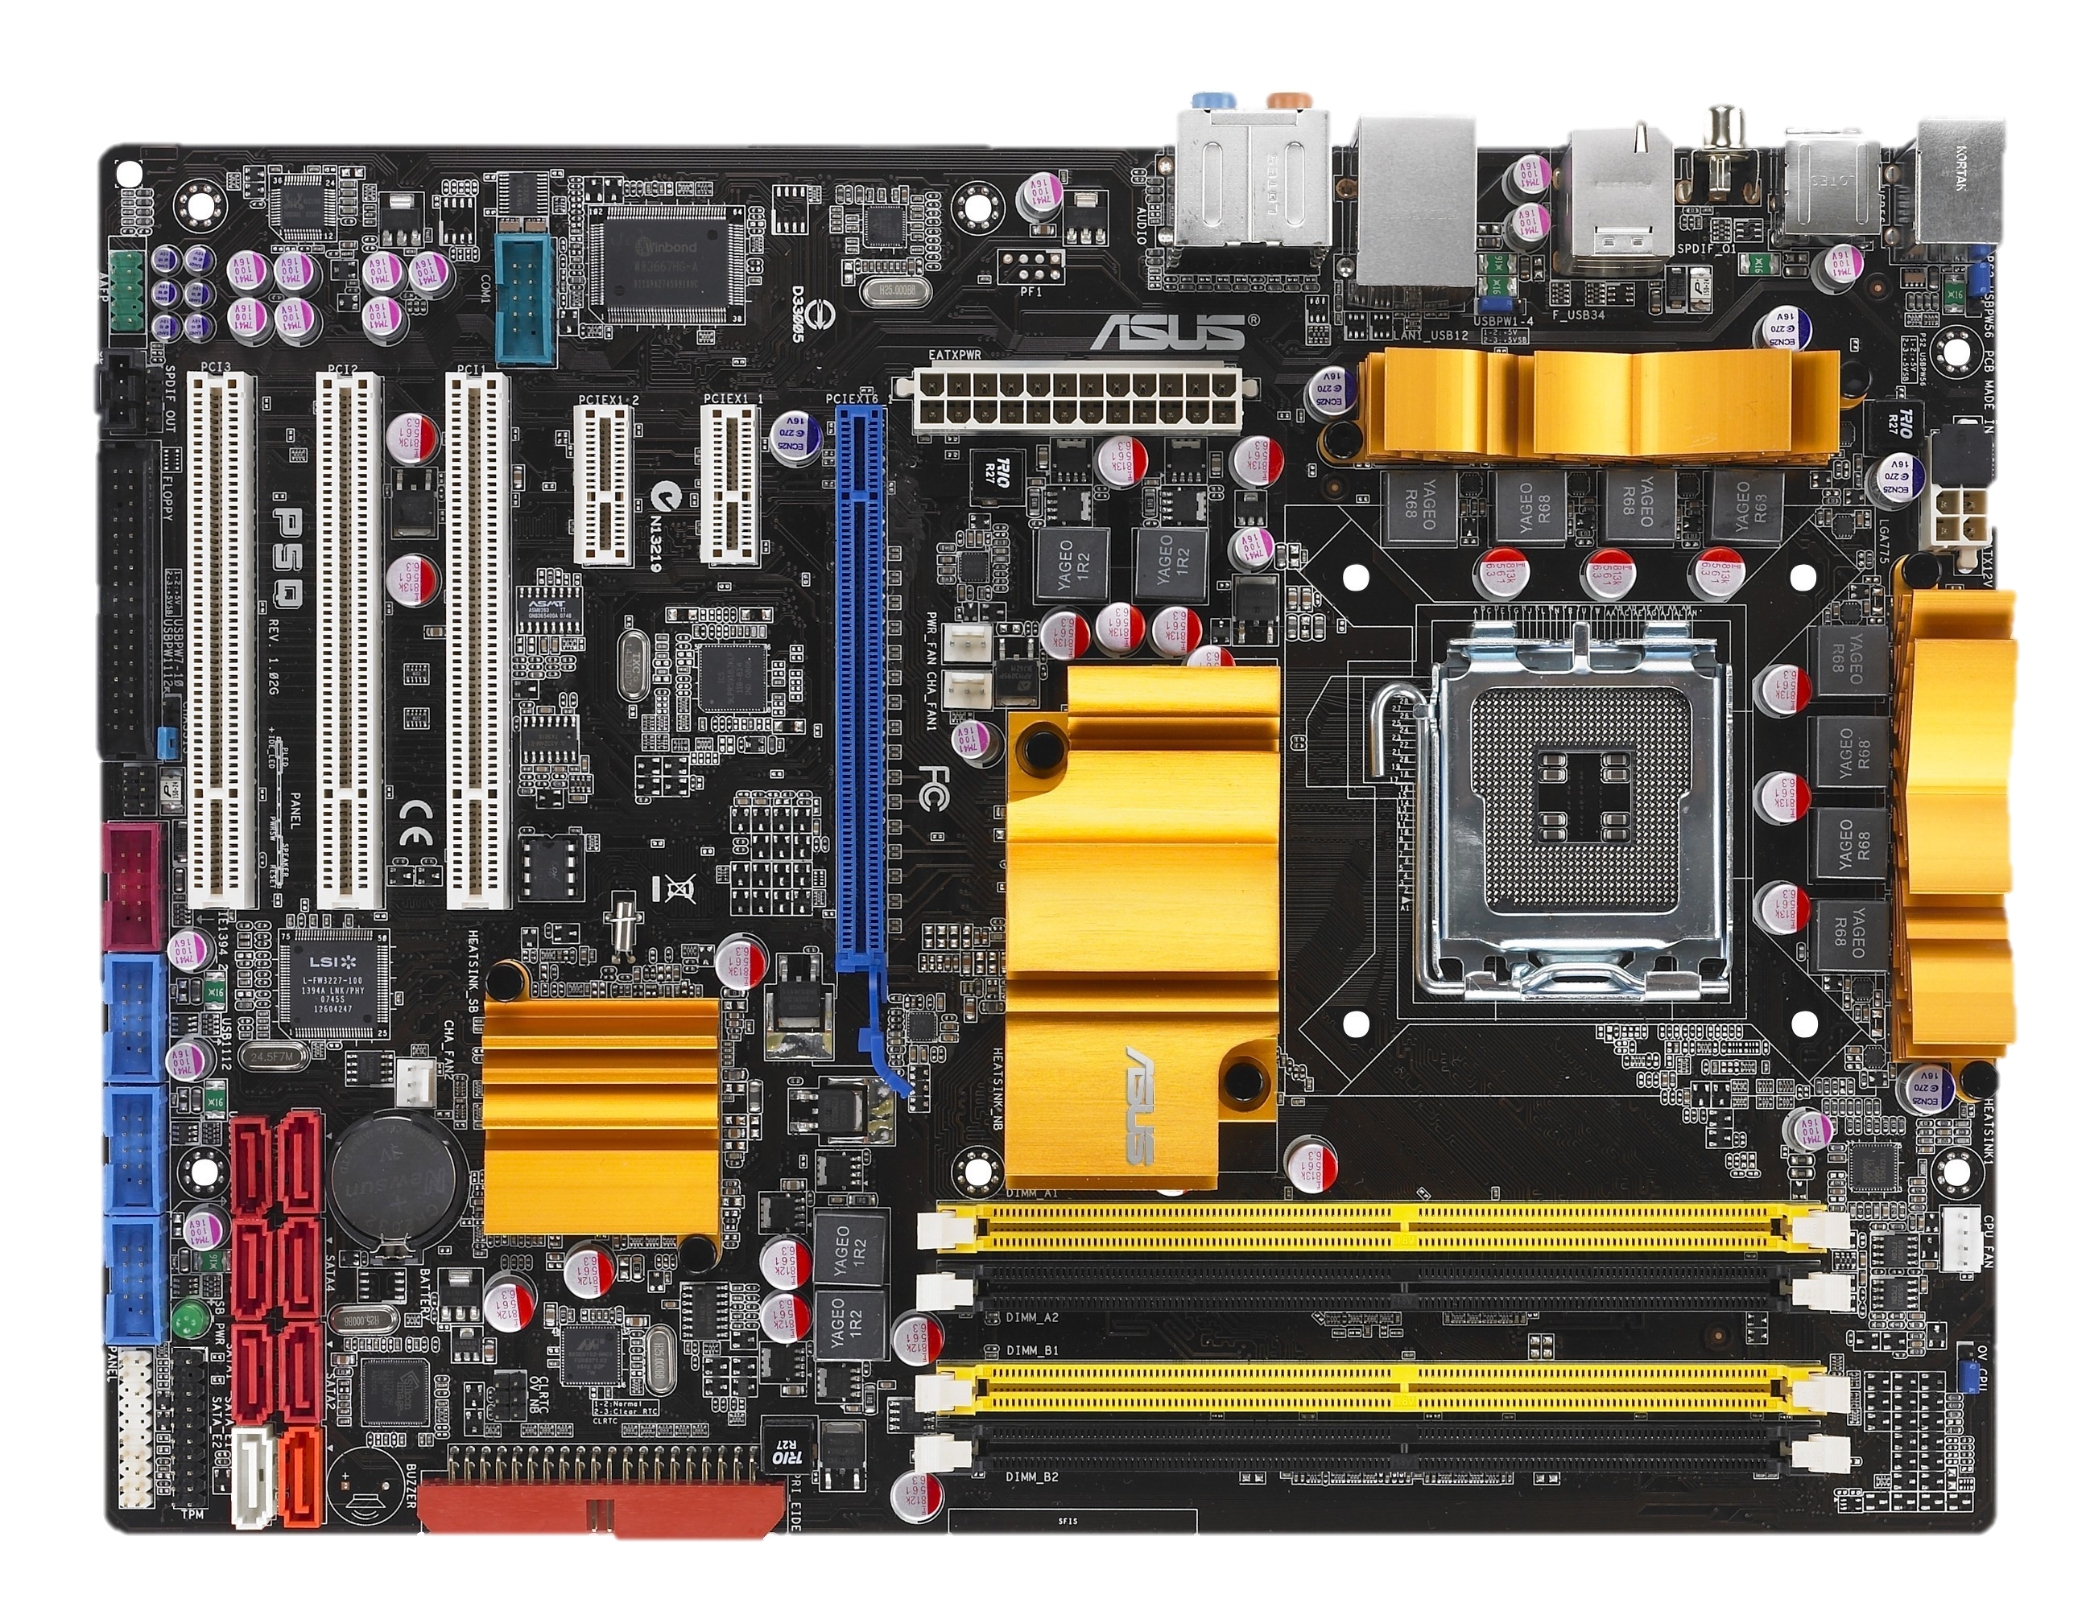
目录
1
多态性
2
运算符重载
3
虚函数
4
抽象类——纯虚函数
5
案例
6
本章作业

Slide 3
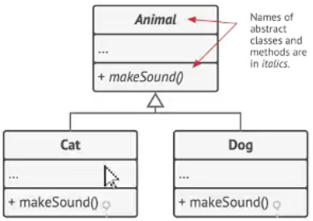
10.1多态性
多态性：同样的消息被不同的对象接收时导致不同的行为，所谓消息是指成员函数的调用，不同行为是指不同的实现，也就是调用了不同的函数。
🐱
🐶
(1)编译时多态性(静态多态)：
指在程序编译阶段即可确定下来的多态性
实现——函数重载和运算符重载
(2)运行时多态性(动态多态)：
指必须等到程序动态运行时才可确定的多态性
实现——由共同基类结合虚函数的动态绑定实现
我们以前接触过的多态：
运算符：
+ - / *
函数重载
普通函数重载
成员函数重载

Slide 4
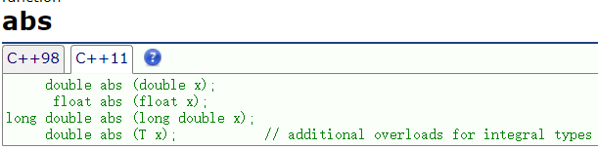
10.1多态性
int abs(int x) // 整数类型数据的绝对值函数
{ cout << "Using integer version of abs().\n";
return (x >= 0 ? x : -x);
}
long abs(long x) // 长整数类型数据的绝对值函数
{ cout << "Using long integer version of abs().\n";
return (x >= 0 ? x : -x);
}
double abs(double x) // 浮点类型数据的绝对值函数
{ cout << "Using floating-point version of abs().\n";
return (x >= 0.0 ? x : -x);
}
int main()
{ cout << abs(-5) << "\n";// 调用abs()的整数版本
cout << abs(-5L) << "\n";// 调用abs()的长整数版本
cout << abs(3.14) << "\n";// 调用abs()的浮点版本
return 0;
}

Slide 5
10.2 运算符重载——本质是函数重载
类----允许定义新的数据类型
C++预定义运算符的操作对象只能是基本数据类型
如果用户自定义的类型也需要类似的操作？
运算符重——载创建运算符函数,使自定义类型,像c++基本类型一样进行各种操作运算
可重载的操作符
不能重载的操作符
new new[] delete delete[]
+ - * / % ^ & | ~ !
= < > += -= *= /= %=
^ = &= | = << >> <<=
>>= = = != <= >= &&
|| ++ -- ' ->* -> ( ) []
:: . * ?: sizeof

Slide 6
10.2 运算符重载——本质是函数重载
不能改变运算符运算对象(即操作数)个数、优先级和结合性
重载运算符函数不能有默认的参数
运算符重载时,如果参数类型都是基本类型时,不允许重载. 即重载运算符必须和用户定义的自定义类型的对象一起使用，其参数至少应有一个是类对象.
用于类对象的运算符一般必须重载，但运算符“=”和“&”不必用户重载
重载运算符函数的名称是由关键字operator和其后要重载的运算符符号构成的。

Slide 7
10.2 运算符重载——本质是函数重载
运算符的重载有两个方式(以双目为例):
成员函数 ：
返回类型 operator+ (const ClaName &);
友元函数：
friend 返回类型 operator+ (ClaName &op1, ClaName &op2);
重载为类成员函数：参数个数=原操作数个数-1(后置++、--除外)
重载为非成员函数(友元)：参数个数=原操作数个数

Slide 8
10.2 运算符重载——本质是函数重载
函数参数个数比运算符操作数要少一个,因为成员函数是通过类对象调用的，调用成员函数的类对象，充当了运算符函数最左边的操作数。 (后置++、--除外)
class point{
public:
point(float px=0.0, float py=0.0){ x=px; y=py; }
private:
float x, y;
};
point p1, p2(1,2);
cout<<(p1==p2)<<endl;
bool operator==(const point& s) const;
编译程序解释为函数调用：
p1. operator==(p2);
bool point::operator==(const point & s) const
{return ((this->x==s.x) && (this->y==s.y));}
Notes:
1)若操作符是一元的,则参数表为空,当前对象作为操作符的单操作数；
2)若操作符是二元的,则参数表中有一个操作数,当前对象作为此操作符的左操作数,参数表中的操作数作为此操作符的右操作数.
#include <iostream>
#include <string>
using namespace std;
class point{
public:
point(float px=0.0, float py=0.0){ x=px; y=py; }
bool operator==(const point& s) const;
private:
float x, y;
};
bool point::operator==(const point & s) const{
return ((this->x==s.x) && (this->y==s.y));
}
int main()
{
point p1, p2(1,2);
cout<<(p1==p2)<<endl;
return 0;
}

Slide 9
10.2 运算符重载——成员函数
示例程序：复数类
问题：实现一个表示复数的类，并且完成以下操作：
• 重载+、-、*、/、-取负、=，==，!=以支持复数的算术运算
• 设计一个print函数，输出一个复数。
构造函数，析构函数，以及配合数据私有属性的数据读取等功能
数据抽象：double real, image;
代码抽象：构造函数,读取实部，读取虚部，输出复数，计算复数模，运算符重载

Slide 10
class COMPLEX {
double real, image;
public:
COMPLEX(double r = 0, double i = 0);
COMPLEX(const COMPLEX& other);
double getImage();
double getReal();
double getModuls();
COMPLEX operator+(const COMPLEX& other);
COMPLEX operator -(const COMPLEX& other);
COMPLEX operator*( const COMPLEX& );
COMPLEX operator/(const COMPLEX&);
COMPLEX operator-();
COMPLEX& operator=(const COMPLEX& other);
bool operator==(const COMPLEX& other);
bool operator!=(const COMPLEX& other);
void print();
};
10.2 运算符重载——成员函数
COMPLEX::COMPLEX(double r, double i)
{ real=r; image=i;}
COMPLEX::COMPLEX(const COMPLEX& other)
{ real=other.real; image=other.image;
}
如果形参仅仅作为操作数不会被改变，形参被定义为const 引用
double COMPLEX::getImage()
{return image;}
double COMPLEX::getReal()
{return real;}
double COMPLEX::getModuls()
{return sqrt(image*image+real*real);}

Slide 11
COMPLEX COMPLEX::operator + (const COMPLEX& other)
{ COMPLEX temp;
temp.real=real+other.real;
temp.image=image+other.image;
return temp;
}
COMPLEX COMPLEX::operator - (const COMPLEX& other)
{COMPLEX temp;
temp.real=real-other.real;
temp.image=image-other.image;
return temp;
}
COMPLEX COMPLEX::operator*(const COMPLEX& other)
{ COMPLEX temp;
temp.real=real*other.real-image*other.image;
temp.image=image*other.real+real*other.image;
return temp;
}
COMPLEX& COMPLEX::operator=(const COMPLEX& other)
{ real=other.real;
image=other.image;
return *this;
}
COMPLEX COMPLEX::operator/(const COMPLEX& other)
{ COMPLEX temp;
double t=(other.image*other.image+other.real*other.real);
temp.real=(real*other.real+image*other.image)/t;
temp.image=(real*other.real+image*other.image)/t;
return temp;
}
COMPLEX COMPLEX::operator - ( )
{ COMPLEX temp;
temp.real=-real;
temp.image=-image;
return temp;
}

Slide 12
bool COMPLEX::operator==(const COMPLEX& other)
{return ((this->real==other.real) && (this->image==other.image));}
bool COMPLEX::operator!=(const COMPLEX& other)
{return !(*this==other);}
int main()
{ COMPLEX c1(1, 2);
COMPLEX c2(2);
COMPLEX c3(c1);
c1.print();
c2.print();
c3.print();
c1 = c1 + c2 + c3;
c2 = -c3;
c3 = c2 - c1;
c1.print();
c2.print();
c3.print();
return 0;
}
void COMPLEX::print()
{ if(real!=0) cout << real;
else if(image==0) { cout<<0<<'\n'; return; }
if (image > 0)
{ if(image!=1) cout << "+" << image << "i";
else cout << "+" << "i";
}
else if (image < 0)
{ if(image!=-1) cout << image << "i";
else cout << "-" << "i";
}
cout << "\n";
}
Notes:
#include <iostream>
#include <iomanip>
#include <string.h>
#include <cmath>
using namespace std;
class COMPLEX {
public:
COMPLEX(double r = 0, double i = 0);
COMPLEX(const COMPLEX& other);
COMPLEX operator+(const COMPLEX& other);
COMPLEX operator -(const COMPLEX& other);
COMPLEX operator*( const COMPLEX& );
COMPLEX operator/(const COMPLEX&);
COMPLEX operator-();
COMPLEX& operator=(const COMPLEX& other);
bool operator==(const COMPLEX& other);
bool operator!=(const COMPLEX& other);
double getImage();
double getReal();
double getModuls();
void print();
private: double real, image;
};
COMPLEX::COMPLEX(double r, double i)
{ real=r; image=i;}
COMPLEX::COMPLEX(const COMPLEX& other)
{ real=other.real; image=other.image;
}
COMPLEX COMPLEX::operator + (const COMPLEX& other)
{ COMPLEX temp;
temp.real=real+other.real;
temp.image=image+other.image;
return temp;
}
COMPLEX COMPLEX::operator - (const COMPLEX& other)
{COMPLEX temp;
temp.real=real-other.real;
temp.image=image-other.image;
return temp;
}
COMPLEX COMPLEX::operator - ( )
{ COMPLEX temp;
temp.real=-real;
temp.image=-image;
return temp;
}
COMPLEX COMPLEX::operator*(const COMPLEX& other)
{ COMPLEX temp;
temp.real=real*other.real-image*other.image;
temp.image=image*other.real+real*other.image;
return temp;
}
COMPLEX COMPLEX::operator/(const COMPLEX& other)
{ COMPLEX temp;
double t=(other.image*other.image+other.real*other.real);
temp.real=(real*other.real+image*other.image)/t;
temp.image=(real*other.real+image*other.image)/t;
return temp;
}
COMPLEX& COMPLEX::operator=(const COMPLEX& other)
{ real=other.real;
image=other.image;
return *this;
}
bool COMPLEX::operator==(const COMPLEX& other){
return ((this->real==other.real) && (this->image==other.image));
}
bool COMPLEX::operator!=(const COMPLEX& other){
return !(*this==other);
}
double COMPLEX::getImage(){
return image;
}
double COMPLEX::getReal(){
return real;
}
double COMPLEX::getModuls(){
return sqrt(image*image+real*real);
}
void COMPLEX::print()
{ if(real!=0) cout << real;
else if(image==0) { cout<<0<<'\n'; return; }
if (image > 0)
{ if(image!=1) cout << "+" << image << "i";
else cout << "+" << "i";
}
else if (image < 0)
{ if(image!=-1) cout << image << "i";
else cout << "-" << "i";
}
cout << "\n";
}
int main()
{ COMPLEX c1(1, 2);
COMPLEX c2(2);
COMPLEX c3(c1);
// c1.print();
// c2.print();
// c3.print();
// c1 = c1 + c2 + c3;
// c2 = -c3;
c3 = c2 = c1;
c1.print();
c2.print();
c3.print();
return 0;
}

Slide 13
10.2 运算符重载——赋值运算符重载operator=
Void COMPLEX::operator=(const COMPLEX& other)
{ real=other.real; image=other.image; }
COMPLEX COMPLEX::operator=(const COMPLEX& other)
{ real=other.real; image=other.image;
return *this;
}
赋值运算符重载格式：
参数类型—类类型的引用
返回值
无返回:不能连续赋值
值返回：效率低(调用拷贝构造函数)
引用返回：效率高
class COMPLEX {
double real, image;
public:
COMPLEX(double r = 0, double i = 0);
COMPLEX(const COMPLEX& other);
COMPLEX& operator=(const COMPLEX& other);
void print();
};
Notes:
#include <iostream>
#include <iomanip>
#include <string.h>
#include <cmath>
using namespace std;
class COMPLEX {
public:
COMPLEX(double r = 0, double i = 0);
COMPLEX(const COMPLEX& other);
COMPLEX& operator=(const COMPLEX& other);
void print();
private: double real, image;
};
COMPLEX::COMPLEX(double r, double i)
{ real=r; image=i;}
COMPLEX::COMPLEX(const COMPLEX& other)
{ real=other.real; image=other.image;
cout<<"hello\n";
}
COMPLEX& COMPLEX::operator=(const COMPLEX& other)
{ real=other.real;
image=other.image;
return *this;
}
void COMPLEX::print()
{ if(real!=0) cout << real;
else if(image==0) { cout<<0<<'\n'; return; }
if (image > 0)
{ if(image!=1) cout << "+" << image << "i";
else cout << "+" << "i";
}
else if (image < 0)
{ if(image!=-1) cout << image << "i";
else cout << "-" << "i";
}
cout << "\n";
}
int main()
{ COMPLEX c1(1, 2);
COMPLEX c2(2);
COMPLEX c3(c2);
c1.print();
c2.print();
c3 = c2 = c1;
c3.print();
return 0;
}

Slide 14
10.2 运算符重载——赋值运算符重载operator=
若用户没有为一个类重载赋值运算符时，编译程序将生成一个缺省的赋值运算符，把源对象逐位地赋值给目标对象
int main()
{ COMPLEX c1(1, 2);
COMPLEX c2(2);
COMPLEX c3(c2);
c1.print();
c2.print();
c3 = c2 = c1;
c3.print();
return 0;
}
class COMPLEX {
double real, image;
public:
COMPLEX(double r = 0, double i = 0);
COMPLEX(const COMPLEX& other);
void print();
};
Notes:
类的赋值运算符=可以被重载，但重载的赋值运算符不能被继承。

Slide 15
10.2 运算符重载——赋值运算符重载operator=
如果类中未涉及到内存资源管理，可以利用编译器提供的缺省的赋值运算符；
一旦涉及到内存资源管理，则必 须要实现
回顾一下复制构造函数——深浅拷贝
Name::Name(const Name &other)
{ if (other.p!=NULL){
p = new char[strlen(other.p) + 1];
if (p!=NULL) strcpy(p, other.p);
}
cout << "Copy constructing.\n";
}
class Name {
public:
Name(){p=NULL;}
Name(char *s);
Name(const Name &other );
~Name();
void set(char *s);
void show();
private:
char *p;
};
Name::Name(char *s)
{ if (s!=NULL){
p=new char[strlen(s)+1];
if (p!=NULL) strcpy(p,s);
}
}
Name::~Name()
{ cout<<"Destructing."<<endl;
if(p!=NULL) delete [] p;
}
void Name::set(char *s)
{strcpy(p,s);
}
void Name::show()
{cout<<p<<endl;}

Slide 16
10.2 运算符重载——赋值运算符重载operator=
myname: p
int main()
{char temp_str[20]="wang";
Name myname(temp_str) ;
Name yourname(myname); myname.show();
yourname.show();
return 0;
}
class Name {
public:
Name(){p=NULL;}
Name(char *s);
Name(const Name &other );
~Name();
void set(char *s);
void show();
private:
char *p;
};
2000H
“wang”
yourname: p
3300H
“wang”
Name::Name(const Name &other)
{ if (other.p!=NULL){
p = new char[strlen(other.p) + 1];
if (p!=NULL) strcpy(p, other.p);
}
cout << "Copy constructing.\n";
}

Slide 17

10.2 运算符重载——赋值运算符重载operator=
int main()
{Name myname(“zhang") ;
Name yourname(“wang");
myname = yourname ;
yourname.set("henhenhaha");
myname.show();
yourname.show();
return 0;
}
myname: p
1)赋值后myname数据成员p原来指向的内存块永久丢失.
2)内存被释放两次
解决方法：重载赋值运算符
3300H
2000H
“zhang”
yourname: p
3300H
“wang”
myname:p
class Name {
public:
Name(){p=NULL;}
Name(char *s);
Name(const Name &other );
Name& operator=(const Name &another);
~Name();
void set(char *s);
void show();
private:
char *p;
};
2000H
4000H
“wang”
“zhang”
yourname:p
3300H
“wang”
如果类包含指向动态存储空间指针类型的数据成员,则应为这个类重载赋值运算符
Name& Name::operator=(const Name &another)
{ if (p) delete []p;
p = new char[strlen(another.p)+1];
if (p!=NULL) strcpy(p,another.p);
return *this;
}
Notes:
#include <iostream>
#include <string.h>
using namespace std;
class Name {
public:
Name(){p=NULL;}
Name(char *s);
Name(const Name &other );
~Name();
Name& operator=(const Name &another);
void set(char *s);
void show();
private:
char *p;
};
Name::Name(char *s)
{ p=new char[strlen(s)+1];
strcpy(p,s);
}
Name::Name(const Name &other)
{ if (other.p!=NULL){
p = new char[strlen(other.p) + 1];
if (p!=NULL) strcpy(p, other.p);
}
cout << "Copy constructing.\n";
}
Name::~Name()
{ cout<<"Destructing."<<endl;
if(p!=NULL) delete [] p;
}
Name& Name::operator=(const Name &another)
{ if (p) delete []p;
p = new char[strlen(another.p)+1];
if (p!=NULL) strcpy(p,another.p);
return *this;
}
void Name::show()
{cout<<p<<endl;}
void Name::set(char *s)
{strcpy(p,s);
}
int main() {
Name myname("zhang") ;
Name yourname("wang"),s("fang");
myname = yourname =s;
yourname.set("henhenhaha");
myname.show();
yourname.show();
return 0;
}

Slide 18

10.2 运算符重载——赋值运算符重载operator=
class CExample{
int m_nTest;
public:
CExample(int x):m_nTest(x)
{cout << "constructor with argument\n";}
CExample(const CExample & ex)
{ m_nTest = ex.m_nTest;
cout << "copy constructor\n";}
CExample& operator = (const CExample &ex{
cout << "assignment operator\n";
m_nTest = ex.m_nTest;
return *this;
}
void myTestFunc(CExample ex)
{}
};
int main()
{CExample aaa(2);
CExample bbb(3);
bbb = aaa;
CExample ccc = aaa;
bbb.myTestFunc(aaa);
return 0;
}
Notes:
#include <iostream>
#include <cassert>
using namespace std;
class CExample{
int m_nTest;
public:
CExample(int x):m_nTest(x)
{cout << "constructor with argument\n";}
CExample(const CExample & ex)
{m_nTest = ex.m_nTest;
cout<<"copy constructor\n";}
CExample&operator = (const CExample& ex){
cout << "assignment operator\n";
m_nTest = ex.m_nTest;
return *this;
}
void myTestFunc(CExample ex){}
};
int main() {
CExample aaa(2);
CExample bbb(3);
bbb = aaa;
CExample ccc = aaa;
bbb.myTestFunc(aaa);
return 0;
}

Slide 19
10.2 运算符重载——自增自减运算符operator++
单目运算符 ++和--
class Clock {
public:
Clock(int hour = 0, int minute = 0, int second = 0);
void showTime() const;
private:
int hour, minute, second;
};
前置++和后置++重载为时钟类的成员函数。
前置++重载函数没有形参,后置++重载函数有一个整型形参。
操作数是时钟类的对象。
实现时间增加1秒钟。
Clock& operator++(); //前置
Clock operator++(int); //后置
Notes:
#include <iostream>
using namespace std;
class Clock {
public:
Clock(int hour = 0, int minute = 0, int second = 0);
void showTime() const;
Clock& operator ++ (); //前置单目运算符重载
Clock operator ++ (int); //后置单目运算符重载
private:
int hour, minute, second;
};
Clock::Clock(int hour, int minute, int second) {
if (0 <= hour && hour < 24 && 0 <= minute && minute < 60
&& 0 <= second && second < 60) {
this->hour = hour;
this->minute = minute;
this->second = second;
} else
cout << "Time error!" << endl;
}
void Clock::showTime() const {
cout << hour << ":" << minute << ":" << second << endl;
}
Clock & Clock::operator ++ () { //前置单目运算符重载函数
second++;
if (second >= 60) {
second -= 60;
minute++;
if (minute >= 60) {
minute -= 60;
hour = (hour + 1) % 24;
}
}
return *this;
}
Clock Clock::operator ++ (int) {//后置单目运算符重载
//注意形参表中的整型参数
Clock old = *this;
++(*this); //调用前置“++”运算符
return old;
}
int main() {
Clock myClock(23, 59, 59);
cout << "First time output: ";
myClock.showTime();
cout << "Show myClock++: ";
(myClock++).showTime();
cout << "Show ++myClock: ";
(++myClock).showTime();
return 0;
}

Slide 20
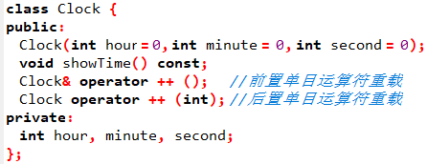
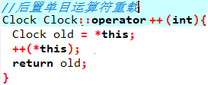
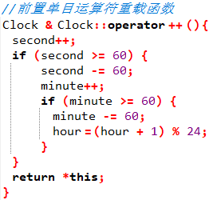
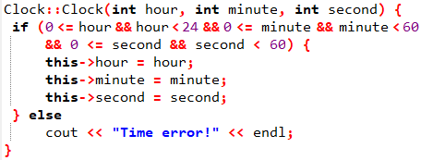
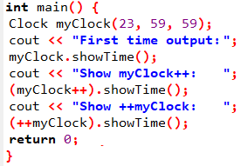
10.2 运算符重载——自增自减运算符operator++
Notes:
#include <iostream>
using namespace std;
class Clock {
public:
Clock(int hour = 0, int minute = 0, int second = 0);
void showTime() const;
Clock& operator ++ (); //前置单目运算符重载
Clock operator ++ (int); //后置单目运算符重载
private:
int hour, minute, second;
};
Clock::Clock(int hour, int minute, int second) {
if (0 <= hour && hour < 24 && 0 <= minute && minute < 60
&& 0 <= second && second < 60) {
this->hour = hour;
this->minute = minute;
this->second = second;
} else
cout << "Time error!" << endl;
}
void Clock::showTime() const {
cout << hour << ":" << minute << ":" << second << endl;
}
Clock & Clock::operator ++ () { //前置单目运算符重载函数
second++;
if (second >= 60) {
second -= 60;
minute++;
if (minute >= 60) {
minute -= 60;
hour = (hour + 1) % 24;
}
}
return *this;
}
Clock Clock::operator ++ (int) {//后置单目运算符重载
//注意形参表中的整型参数
Clock old = *this;
++(*this); //调用前置“++”运算符
return old;
}
int main() {
Clock myClock(23, 59, 59);
cout << "First time output: ";
myClock.showTime();
cout << "Show myClock++: ";
(myClock++).showTime();
cout << "Show ++myClock: ";
(++myClock).showTime();
return 0;
}

Slide 21
10.2 运算符重载——成员函数
一个不太合理的现象
INTEGER INTEGER::operator+(INTEGER other)
{ INTEGER temp;
temp.value=value+other.value;
return temp;
}
class INTEGER {
public:
INTEGER(int i=0) {value=i;}
void print_int() {cout<<value<<endl;}
INTEGER operator + (INTEGER other);
private:
int value;
};
int main()
{ INTEGER x(10);
INTEGER y=x; x.print_int();
x=x+2;
x=2+x;
x.print_int();
return 0;
}
x+2; 合法调⬄x.operator+(2)
2+x;不合法，因为左操作数不是该类的对象,无法调用该类重载的运算符
类成员函数的运算符重载,使用时二元运算符的左操作数必须为该类对象,否则出错。
Notes:
#include<iostream>
#include<string.h>
using namespace std;
class INTEGER {
public:
INTEGER(int i=0) {value=i;}
void print_int() {cout<<value<<endl;}
INTEGER operator+ (INTEGER other);
private:
int value;
};
INTEGER INTEGER :: operator + (INTEGER other)
{ INTEGER temp;
temp.value=value+other.value;
return temp;
}
int main()
{ INTEGER x(10);
x.print_int();
x=x+2;
// x=2+x;
x.print_int();
return 0;
}

Slide 22
10.2 运算符重载——成员函数
解决方案:
强制类型转换 z=INTEGER(2)+x;
友元运算符重载
int main()
{ INTEGER x(10);
INTEGER y=x; x.print_int();
x=x+2;
x=2+x;
x.print_int();
return 0;
}
Notes:
#include<iostream>
#include<string.h>
using namespace std;
class INTEGER {
public:
INTEGER(int i=0) {value=i;}
void print_int() {cout<<value<<endl;}
INTEGER operator+ (INTEGER other);
private:
int value;
};
INTEGER INTEGER :: operator + (INTEGER other)
{ INTEGER temp;
temp.value=value+other.value;
return temp;
}
int main()
{ INTEGER x(10);
x.print_int();
x=x+2;
// x=2+x;
x.print_int();
return 0;
}

Slide 23
10.2 运算符重载——非成员函数(友元函数)
重载为类成员函数：参数个数=原操作数个数-1
重载为非成员函数：参数个数=原操作数个数
函数的形参代表依自左至右次序排列的各操作数。
后置单目运算符 ++和--的重载函数，形参列表中要增加一个int，但不必写形参名。
如果在运算符的重载函数中需要操作某类对象的私有成员，可以将此函数声明为该类的友元。
友元运算符重载参数规则：
一元运算符必须显式声明一个参数
二元运算符必须显式声明二个参数
不能做友元重载的运算符:
= ( ) [ ] ->
Notes:
赋值运算符只能在类中重载。因为赋值运算符重载函数是类的默认成员函数，如果重载成全局函数，编译器会为类自动生成默认赋值运算符重载函数，此时就会和全局的冲突。

Slide 24
10.2 运算符重载——非成员函数(友元函数)
class INTEGER {
int value;
public:INTEGER(int i=0);
friend INTEGER operator+ (const INTEGER& left, const INTEGER& right);
void print_int();
};
int main()
{INTEGER x(10);
x.print_int();
x=x+2;
x=2+x;
x.print_int();
return 0;
}
INTEGER ::INTEGER(int i)
{value=i;}
void INTEGER :: print_int()
{cout<<value<<endl;}
INTEGER operator + (const INTEGER& left, const INTEGER& right)
{ INTEGER temp;
temp.value=left.value+right.value;
return temp;
}

Slide 25
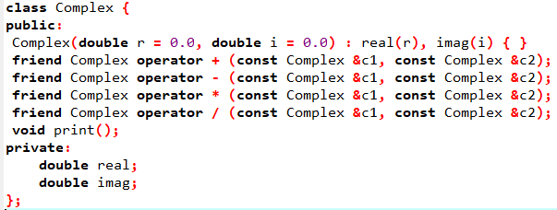
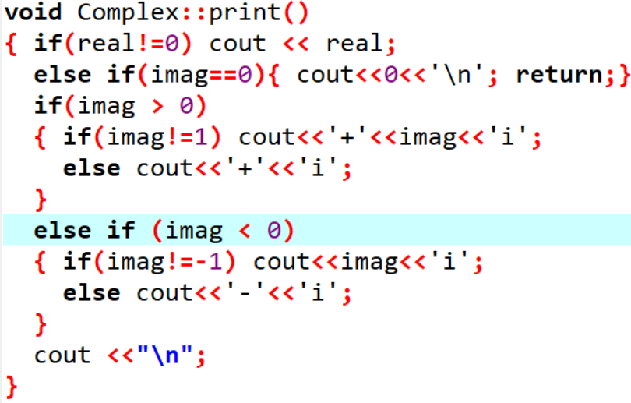
示例程序：
复数类
--非成员函数实现
10.2 运算符重载——非成员函数(友元函数)
Notes:
void Complex::print()
{ if(real!=0) cout << real;
else if(imag==0){ cout<<0<<'\n'; return;}
if(imag > 0)
{ if(imag!=1) cout<<'+'<<imag<<'i';
else cout<<'+'<<'i';
}
else if (imag < 0)
{ if(imag!=-1) cout<<imag<<'i';
else cout<<'-'<<'i';
}
cout <<"\n";
}

Slide 26
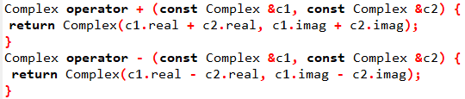
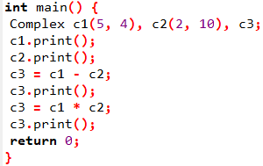
Notes:
#include<iostream>
#include<iomanip>
using namespace std;
class Complex {
public:
Complex(double r = 0.0, double i = 0.0) : real(r), imag(i) { }
friend Complex operator + (const Complex &c1, const Complex &c2);
friend Complex operator - (const Complex &c1, const Complex &c2);
friend Complex operator * (const Complex &c1, const Complex &c2);
friend Complex operator / (const Complex &c1, const Complex &c2);
void print();
private:
double real;
double imag;
};
void Complex::print()
{ cout << real;
if (imag > 0) cout << "+" << imag << "i";
else if (imag < 0) cout << imag << "i";
cout << "\n";
}
Complex operator + (const Complex &c1, const Complex &c2) {
return Complex(c1.real + c2.real, c1.imag + c2.imag);
}
Complex operator - (const Complex &c1, const Complex &c2) {
return Complex(c1.real - c2.real, c1.imag - c2.imag);
}
Complex operator * (const Complex &c1, const Complex &c2) {
return Complex(c1.real * c2.real-c1.imag * c2.imag, c1.imag* c2.real + c1.real*c2.imag);
}
Complex operator / (const Complex &c1, const Complex &c2) {
double t=(c2.imag*c2.imag + c2.real*c2.real);
return Complex((c1.real * c2.real+c1.imag * c2.imag)/t, (-c1.real * c2.imag+c1.imag * c2.real)/t);
}
int main() {
Complex c1(5, 4), c2(2, 10), c3;
c1.print();
c2.print();
c3 = c1 - c2;
c3.print();
c3 = c1 * c2;
c3.print();
return 0;
}

Slide 27
示例程序：
++，--
--非成员函数实现
10.2 运算符重载——非成员函数(友元函数)
class Clock {
public:
Clock(int hour = 0, int minute = 0, int second = 0);
void showTime() const;
private:
int hour, minute, second;
};
Clock& operator ++ (Clock &c) {
c.second++;
if (c.second >= 60) {
c.second -= 60;
c.minute++;
if (c.minute >= 60) {
c.minute -= 60;
c.hour = (hour + 1) % 24;
}
}
return c;
}
friend Clock& operator++(Clock &c); //前置
friend Clock operator++(Clock &c,int); //后置
Clock operator ++ (Clock &c) {
Clock old = *c;
++c;
return old;
}
Notes:
void Complex::print()
{ if(real!=0) cout << real;
else if(imag==0){ cout<<0<<'\n'; return;}
if(imag > 0)
{ if(imag!=1) cout<<'+'<<imag<<'i';
else cout<<'+'<<'i';
}
else if (imag < 0)
{ if(imag!=-1) cout<<imag<<'i';
else cout<<'-'<<'i';
}
cout <<"\n";
}

Slide 28
10.3 虚函数
虚函数：允许派生类重写父类的成员函数，并可使用基类指针调用派生类重写的成员函数
base
base
base
class Base{
public: void who()
{cout<<"base"<<endl;}
};
class Firstderived:public Base
{public: void who()
{cout<<"Firstderived"<<endl;}
};
class Secondderived:public Base
{public: void who()
{cout<<"Secondderived"<<endl;}
};
int main( )
{ Base b_obj;
Firstderived f_obj;
Secondderived s_obj;
Base *p;
p= &b_obj;
p->who();
p= &f_obj;
p->who();
p= &s_obj;
p->who();
return 0;
}
不管p指向什么对象，通过p三次调用的都是基类的who函数
原因：普通成员函数的调用采用的是静态绑定，通过指针引起的普通成员函数调用，仅仅与指针的类型有关，而与此刻该指针正在指向什么对象无关(也符合类的兼容性原则)
如何实现动态绑定？
Notes:
#include<iostream>
#include<string.h>
using namespace std;
class Base{
public: void who()
{cout<<"base"<<endl;}
};
class Firstderived:public Base
{public: void who()
{cout<<"Firstderived"<<endl;}
};
class Secondderived:public Base
{public: void who()
{cout<<"Secondderived"<<endl;}
};

Slide 29
10.3 虚函数
虚函数+公有继承+基类指针实现了动态绑定
虚函数是类中被冠以virtual的成员函数
虚函数在公有继承结构中在一个或多个派生类中被重定义，在被调用过程中，通过指向基类的指针实现动态绑定。
1.虚函数是用virtual修饰的成员函数，并在派生类中重新定义，以形成不同的版本。
1）必须在基类中声明虚函数。
2）派生类重新定义的虚函数必须与基类中的虚函数函数原型相同。（即使前面没有virtual修饰，也自动为虚函数）。
3）只有非静态成员函数可以声明为虚函数

Slide 30
10.3 虚函数
class Base{
public: virtual void who()
{cout<<"base"<<endl;}
};
class Firstderived:public Base
{public: virtual void who()
{cout<<"Firstderived"<<endl;}
};
class Secondderived:public Base
{public: virtual void who()
{cout<<"Secondderived"<<endl;}
};
引入了虚函数机制,实现在派生类中对基类中成员函数进行覆盖(重定义)
base
Firstderived
Secondderived
int main(){
Base base_obj, *p;
Firstderived first_obj;
Secondderived second_obj;
p=&base_obj;
p->who();
p=&first_obj;
p->who();
p=&second_obj;
p->who();
return 0 ;
}
“一个接口，多种实现”
Notes:
class Base{
public: virtual void who()
{cout<<"base"<<endl;}
};
class Firstderived:public Base
{public: virtual void who()
{cout<<"Firstderived"<<endl;}
};
class Secondderived:public Base
{public: virtual void who()
{cout<<"Secondderived"<<endl;}
};
int main()
{ Base base_obj, *p;
Firstderived first_obj;
Secondderived second_obj;
p=&base_obj;
p->who();
p=&first_obj;
p->who();
p=&second_obj;
p->who();
return 0;
}

Slide 31
把基类中的who函数定义成虚函数，实现动态绑定
Base
基类的虚函数定义了一种接口，在派生类中为此接口定义不同的实现版本，由于虚函数的解释机制，实现“一个接口、多种实现”的思想，在运行时刻才将函数与不同实现版本进行匹配
————运行时的多态性
1000
VTABLE
Base::who( ) 100
V + who
Firstderived
Secondderived
+ void who()
+ void who()
+ void who()
+ void who()
√
√
2000
VTABLE
3000
VTABLE
Firstderived::who( )200
Secondderived::who( ) 300

Slide 32
10.3 虚函数
运行期绑定实现机制
使用虚函数,系统要有一定的空间开销.当一个类带有虚函数时,编译系统会为该类构造一个虚函数表(virtual function table，简称vtable),它是一个指针数组,存放每个虚函数的入口地址。
当一个构造函数被调用时，先初始化该对象的VPTR使VPTR指向基类的VTABLE，而忽视后面是否有继承者
如无继承者，则这个对象的VPTR指向基类的VTABLE;
如有继承者，则这个对象的VPTR指向派生类的VTABLE,如此下去，直至派生的终结。
p->who( );
首先读取p指向对象的VPTR,然后调用VPTR所指向VTABLE中指定的函数who(),从而实现了不同类的虚函数的调用。

Slide 33
p = &b_obj
Base
p->who()
1000
VTABLE
vptr
Base::who( ) 100
1000
p = & f_obj
Firstderived
p->who()
vptr
2000
VTABLE
1000
Firstderived::who( ) 200
2000
p = & s_obj
Secondderived
p->who()
vptr
3000
VTABLE
1000
3000
Secondderived::who( ) 300

Slide 34
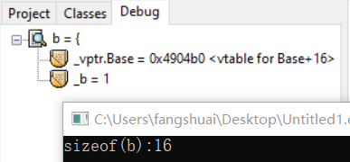
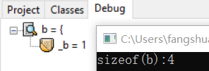
10.3 虚函数
运行期绑定实现机制
使用虚函数,系统要有一定的空间开销.当一个类带有虚函数时,编译系统会为该类构造一个虚函数表(virtual function table，简称vtable),它是一个指针数组,存放每个虚函数的入口地址。
class Base{
public:
virtual void who()
{cout<<"base"<<endl;}
private:
int _b = 1;
};
int main()
{ Base b;
cout << "sizeof(b):" << sizeof(b) << endl;
return 0;
}
对象中的这个指针是虚函数表指针
一个有虚函数的类

Slide 35
10.3 虚函数
class Base{
public:
virtual void Func1()
{cout << "Base::Func1()" << endl;}
virtual void Func2()
{ cout << "Base::Func2()" << endl;}
void Func3()
{cout << "Base::Func3()" << endl;}
private:
int _b = 1;
};
class Derive : public Base{
public:
virtual void Func1()
{cout << "Derive::Func1()" << endl;}
private:
int _d = 2;
};
int main()
{Base b;
Derive d;
return 0;
}

Slide 36
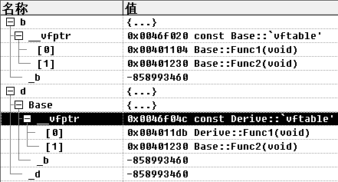
10.3 虚函数
class Base{
public:
virtual void Func1()
{cout << "Base::Func1()" << endl;}
virtual void Func2()
{ cout << "Base::Func2()" << endl;}
void Func3()
{cout << "Base::Func3()" << endl;}
private:
int _b = 1;
};
class Derive : public Base{
public:
virtual void Func1()
{cout << "Derive::Func1()" << endl;}
private:
int _d = 2;
};
基类和派生类对象都有虚函数表指针
在派生类中如果重写了基类虚函数，指针指向重写的虚函数
int main()
{Base b;
Derive d;
return 0;
}
派生类的虚函数表生成： 1)先将基类中的虚表内容拷贝一份到派生类虚表中； 2)如果派生类重写了基类中的某个虚函数，用派生类自己的虚函数覆盖虚表中基类的虚函数； 3)派生类自己新增加的虚函数按其在派生类中的声明次序增加到派生类的虚表的最后。
Notes:
#include<iostream>
using namespace std;
class Base{
public:
virtual void Func1(){
cout << "Base::Func1()" << endl;
}
virtual void Func2(){
cout << "Base::Func2()" << endl;
}
void Func3(){
cout << "Base::Func3()" << endl;
}
private:
int _b ;
};
class Derive : public Base{
public:
virtual void Func1(){
cout << "Derive::Func1()" << endl;
}
private:
int _d ;
};
int main()
{
Base b,*p;
Derive d;
p = &b;
p->Func1();
p = &d;
p->Func1();
return 0;
}

Slide 37
class Person
{public:
virtual void BuyTicket(){
cout << "买票-全价" << endl;
}
};
class Student : public Person{
public:
virtual void BuyTicket(){
cout << "买票-半价" << endl;
}
};
void Func(Person* p)
{ p->BuyTicket();
}
绑定(binding):将一个函数调用链接上相应的函数体代码的过程,绑定的两种形式：
静态绑定（早期绑定）：在编译阶段绑定
一般函数调用方式
动态绑定（晚期绑定）：在程序运行阶段绑定
基类指针+虚函数+公有继承
int main()
{Person Mike;
Func(&Mike);
Student John;
Func(&John);
return 0;
}
Notes:
#include<iostream>
using namespace std;
class Person
{
public:
virtual void BuyTicket()
{
cout << "买票-全价" << endl;
}
};
class Student : public Person
{
public:
virtual void BuyTicket(){
cout << "买票-半价" << endl;
}
};
void Func(Person& p)
{ p.BuyTicket();
}
int main()
{ Person Mike;
Func(Mike);
Student John;
Func(John);
return 0;
}

Slide 38

10.3 虚函数
class MEMBER {
public:
virtual void answer()
{cout<<" I am a member.\n";}
};
class TEACHER: public MEMBER {
public:
virtual void answer()
{cout<<" I am a teacher.\n";}
};
class STUDENT: public MEMBER {
public:
virtual void answer()
{cout<<" I am a student.\n";}
};
int main()
{ MEMBER member;
TEACHER teacher;
STUDENT student;
MEMBER *who;
who=&member;
who->answer();
who=&teacher;
who->answer();
who=&student;
who->answer();
return 0;
}
Notes:
#include <iostream>
#include<cstdlib>
#include<ctime>
using namespace std;
int main()
{ int lottery, lottery1, lottery2, guess,guess1,guess2;
cin>>guess;
srand(time(0));
lottery = rand()%100;
lottery1 = lottery/10;
lottery2 = lottery%10;
guess1 = guess/10;
guess2 = guess%10;
if(guess==lottery)
cout<<"奖金为10000美元\n";
else if((lottery1==guess2)&&(lottery2==guess1))
cout<<"奖金为3000美元\n";
else if(guess1==lottery1||guess1==lottery2||guess2==lottery1||guess2==lottery2)
cout<<"奖金为1000美元\n";
else cout<<"祝您好运\n";
return 0;
}

Slide 39
10.3 虚函数
int main( )
{ DERIVED d;
BASE *p = &d ; // 基类指针p指向派生类对象
p->f1( );//调用DERIVED::f1( ); 动态绑定
p->f2( );//调用BASE::f2( ); 静态绑定
p->f ( ); //调用BASE::f( ); 静态绑定
((DERIVED *)p)->f2(100);
return 0;
}
class BASE {
public: virtual void f1( ) {}
virtual void f2( ) {}
virtual void f3( ) {}
void f ( ) {}
};
class DERIVED:public BASE {
public: void f1( ) {}//虚函数的重定义,保持虚特性
void f2( int a ) {} // 函数重载,虚特性丢失
char f3( ) {} //编译式出错
void f ( ) {} //普通函数的重定义
};
1)基类中声明了虚函数,在派生类中函数原型保持不变,虚特性保持。
2)如果函数原型不同,仅函数名相同，这是一般的函数重载,虚特性丢失
3)当派生类没有重新定义虚函数时,则使用其基类定义的虚函数版本

Slide 40
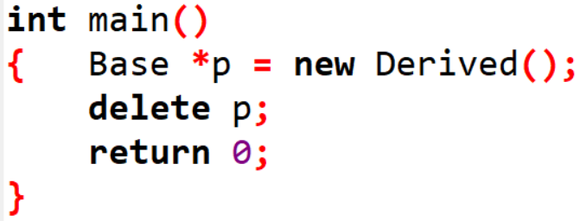

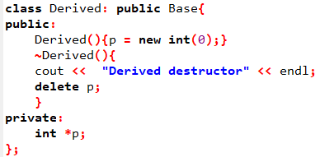
10.3 虚函数——虚析构函数
一个不太合理的现象
派生类析构函数没被执行
通过基类的指针删除派生类对象时, 只调用基类的析构函数。

Slide 41


10.3 虚函数——虚析构函数
务必将基类析构函数声明为虚函数，避免派生类实例未被妥善销毁的情况发生。
通过基类指针删除派生类对象
通过基类指针删除派生类对象，就需要让基类的析构函数成为虚函数
如果基类析构函数是虚函数,触发动态绑定,会调用派生类析构函数
调派生类析构函数时会自动调父类的析构函数

Slide 42
10.4 抽象类——纯虚函数
纯虚函数：在基类中声明的虚函数，但在基类中没有定义函数体，要求任何派生类都必须定义自己的版本。
纯虚函数作用:在基类中为其派生类保留一个函数的名字，以便派生类根据需要对它进行定义。
一般形式：virtual 函数类型 函数名称（参数表）=0；
抽象类：包含一个或一个以上纯虚函数的类。
抽象类不用来定义对象，因为包含纯虚函数的类是无法建立对象的。
抽象类作用：
抽象类为抽象和设计的目的而声明，将有关的数据和行为组织在一个继承层次结构中，保证派生类具有要求的行为。
对于暂时无法实现的函数，可以声明为纯虚函数，留给派生类去实现。

Slide 43
10.4 抽象类——纯虚函数
从抽象类派生出的新类,须重新定义其父类的每一个纯虚函数;如果在派生类中没有对所有纯虚函数进行定义,则此派生类仍然是抽象类,不能用来定义对象。
抽象类只能作为基类来使用。
不能声明抽象类的对象。
构造函数不能是虚函数，析构函数可以是虚函数。
虽然不能声明抽象类的实例，但可以声明抽象类的指针或引用；当派生类成为具体类之后，可以用指针指向派生类对象，然后通过该指针调用虚函数，实现多态性的操作。

Slide 44
const double PI=3.14159;
class FIGURE {
public:
void set_size(double x, double y=0)
{x_size=x; y_size=y;}
virtual double get_area( )=0;
protected: double x_size, y_size;
};
求平面图形的面积
int main()
{FIGURE *figure;
TRIANGLE triangle;
RECTANGLE rectangle;
CIRCLE circle;
figure=&triangle;
figure->set_size(15,8);
cout<<"Area of triangle is "<<figure->get_area();
figure=&rectangle;
figure->set_size(15,8);
cout<<"\nArea of rectangle is "<<figure->get_area();
figure=&circle;
figure->set_size(15);
cout<<"\nArea of circle is "<<figure->get_area();
return 0;
}
class TRIANGLE: public FIGURE {
public: virtual double get_area()
{return(x_size*y_size/2);}
};
class RECTANGLE: public FIGURE {
public:virtual double get_area()
{return(x_size*y_size);}
};
class CIRCLE: public FIGURE {
public:virtual double get_area()
{return(PI*x_size*x_size);}
};

Slide 45
虚函数与纯虚函数
虚函数的类用于”实体继承”,继承接口的同时也继承了父类的实现(当然派生类可以重写实现部分)。
纯虚函数用于”界面继承”在基类中没有定义，关注接口的统一性，实现由派生类完成。
FIGURE
# x_size, y_size
+ set_size(…)
+ get_area()=0
TRIANGLE
CIRCLE
RECTANGLE
# x_size, y_size
+ set_size(…)
+ get_area()=0
+ get_area()
# x_size, y_size
+ set_size(…)
+ get_area()=0
+ get_area()
# x_size, y_size
+ set_size(…)
+ get_area()=0
+ get_area()

Slide 46
10.5 案例
继承实例——小型公司人员信息管理
某小型公司有四类人员：经理、技术人员、销售经理和推销员。要求：
1)存储姓名、编号、级别、当月薪水，计算月薪总额、显示全部信息。
注：人员编号基数为1000，每输入一个人员的信息，编号顺序加1。
2) 有提升级别的功能。为简单起见，所有人员的初始级别均为1级，然后进行升级，经理升为4级，技术人员和销售经理升为3级，推销员仍为1级。
3)月薪计算办法是：
经理——固定月薪8000元；
技术人员——月薪计算100元/小时；
推销员——当月销售额的4%提成；
销售经理——固定月薪为5000元+销售提成(所管辖部门当月销售总额的5‰)

Slide 47
employee
Employee类
姓名
编号
级别
月薪水
计算月薪总额
提升级别
显示全部信息
char *name;
int individualEmpNo;
int grade;
float accumPay;
static int employeeNo;
char *name;
int individualEmpNo;
float accumPay;
float pay();
void displayStatus();
void promote(int);
void pay();
void displayStatus();
Manager类
Salesman类
technician
manager
salesman
float hourlyRate;
int workHours;
float monthlyPay;
float Commrate;
float sales;
void pay();
void displayStatus();
void pay();
void displayStatus();
void pay();
void displayStatus();
Salesmanager类
salesmanager
void pay();
void displayStatus();

Slide 48
class employee
{protected:
char *name;
int individualEmpNo;
int grade;
float accumPay;
static int employeeNo;
public:
employee();
~employee();
void promote(int); // 升级函数
void pay(); // 计算月薪函数
void displayStatus(); // 显示人员信息
};
class salesman: virtual public employee
{protected:
float CommRate;
float sales;
public:
salesman();
void pay();
void displayStatus();
};
//employee.h
virtual void pay( )=0;
virtual void displayStatus( )=0;
class salesmanager: public manager, public salesman
{ public:
salesmanager();
void pay(); // 计算月薪函数
void displayStatus(); // 显示人员信息
};
48

Slide 49
#include<iostream.h>
#include<string.h>
#include "employee.h"
int employee::employeeNo=1000;
employee::employee()
{ char str[30];
cout<<"please input employee's name: ";
cin>>str;
name=new char[strlen(str)+1];
strcpy(name,str);
individualEmpNo=++employeeNo;
grade=1;
accumPay=0;
}
//empfunc.cpp
employee::~employee()
{ delete [] name;
}
void employee::pay()
{
}
void employee::promote(int incre)
{ grade+=incre;
}
void employee::displayStatus() {
}

Slide 50
technician::technician()
{hourlyRate=100; // 每小时酬金100元
}
void technician::pay()
{ cout<<"input "<<name<<" the workHours of this month: ";
// 输入本月的工作时数
cin>>workHours;
accumPay=hourlyRate*workHours; // 计算月薪，按小时计酬
cout<<"Technician: "<<name<<" No: "<<individualEmpNo
<<" month salary: "<<accumPay<<endl;
}
void technician::displayStatus()
{
cout<<"Technician: "<<name<<" No: "<<individualEmpNo
<<" grade: "<<grade<<" this month salary: "<<accumPay<<endl;
}

Slide 51
manager::manager()
{ monthlyPay=8000;
}
void manager::pay()
{ accumPay=monthlyPay;
cout<<"Manager: "<<name<<" No: "<<individualEmpNo
<<" month salary: "<<accumPay<<endl;
}
void manager::displayStatus()
{ cout<<"Manager: "<<name<<" No: "<<individualEmpNo
<<" grade: "<<grade<<" this month salary: "<<accumPay<<endl;
}

Slide 52
salesman::salesman()
{CommRate=0.05; // 销售提成比例5%
}
void salesman::pay()
{cout<<"input "<<name<<" the sales of this month: ";
// 输入本月销售额
cin>>sales;
accumPay=sales*CommRate; // 月薪=销售提成
cout<<"Salesman: "<<name<<" No: "<<individualEmpNo
<<" month salary: "<<accumPay<<endl;
}
void salesman::displayStatus()
{ cout<<"Salesman: "<<name<<" No: "<<individualEmpNo
<<" grade: "<<grade<<" this month salary: "<<accumPay<<endl;
}

Slide 53
salesmanager::salesmanager()
{ monthlyPay=5000; // 固定月薪5000
CommRate=0.005; // 整个部门销售提成比例
}
void salesmanager::pay()
{ cout<<"input "<<employee::name
<<" the total sales of the department of this month: ";
cin>>sales;
accumPay=monthlyPay+CommRate*sales;
cout<<"salesman: "<<name<<" No: "<<individualEmpNo
<<" month salary: "<<accumPay<<endl;
}
void salesmanager::displayStatus()
{ cout<<"salesmanager: "<<name<<" No: "<<individualEmpNo
<<" grade: "<<grade<<" this month salary: "<<accumPay<<endl;
}

Slide 54
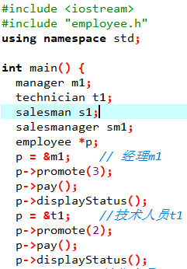
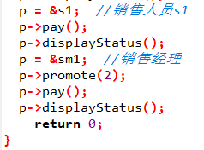

Slide 55
//APP.CPP
#include "employee.h"
int main()
{ manager m1; technician t1; salesman s1; salesmanager sm1;
m1.promote(3); // 经理m1升3级
m1.pay(); // 计算经理m1的月薪
m1.displayStatus();
t1.promote(2); // 技术人员t1升2级
t1.pay(); // 计算技术人员t1的月薪
t1.displayStatus();
s1.pay(); // 计算销售人员s1的月薪
s1.displayStatus();
sm1.promote(2); // 销售经理升2级
sm1.pay(); // 计算销售经理sm1月薪
sm1.displayStatus();
getch();
return 0;
}

Slide 56
作业
1）编写一个抽象类Shape，包含两个纯虚函数GetArea()计算面积，GetPerim()计算周长，在此基础上派生Rectangle类和circle类，给出纯虚函数的具体实现。通过继承Rectangle类，创建一个派生类Square。在主函数里创建类对象进行测试。
2）定义一个复数类Complex，实现+、-、*、/、++(前置)、++(后置)的运算符重载，在主函数里创建类对象进行测试。

