Slide 1

Assignment3
Fan wu
Tengfei wang
Bowen DEng

Slide 2
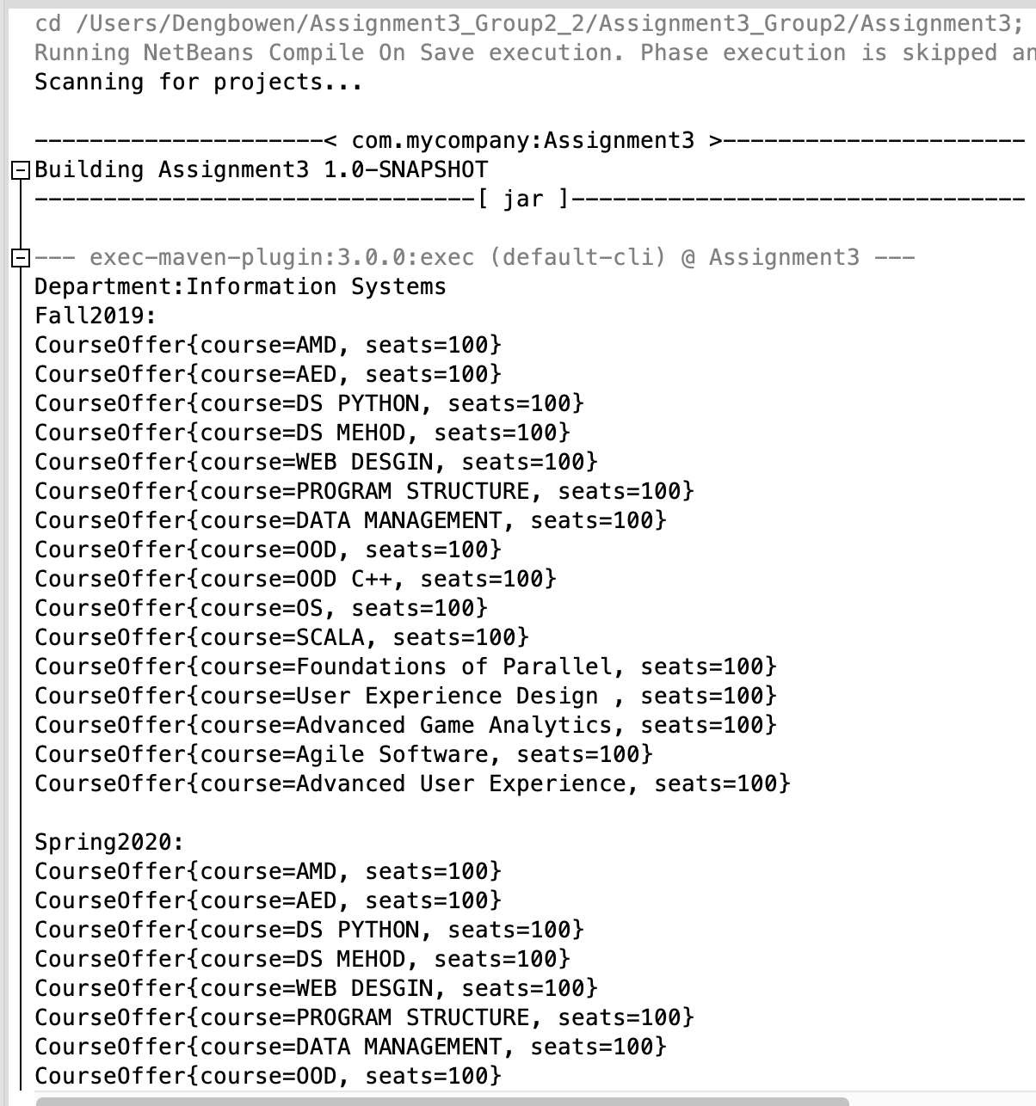
Deliverables 1
Running java code showing the implementation of a complete system at the department and college levels. The base java

Slide 3
Deliverables 2
create a performance measurement solution to enable universities to measure the quality of the education they deliver to their students.
Here is our solutions and implementations
1.Student Management System
2.Student Academic Performance System
3.Student Job Performance System
4.Ranking System
5.Relevance between Grade and Job Performance
6.Connection of courses and their relevance to graduates growth.

Slide 4
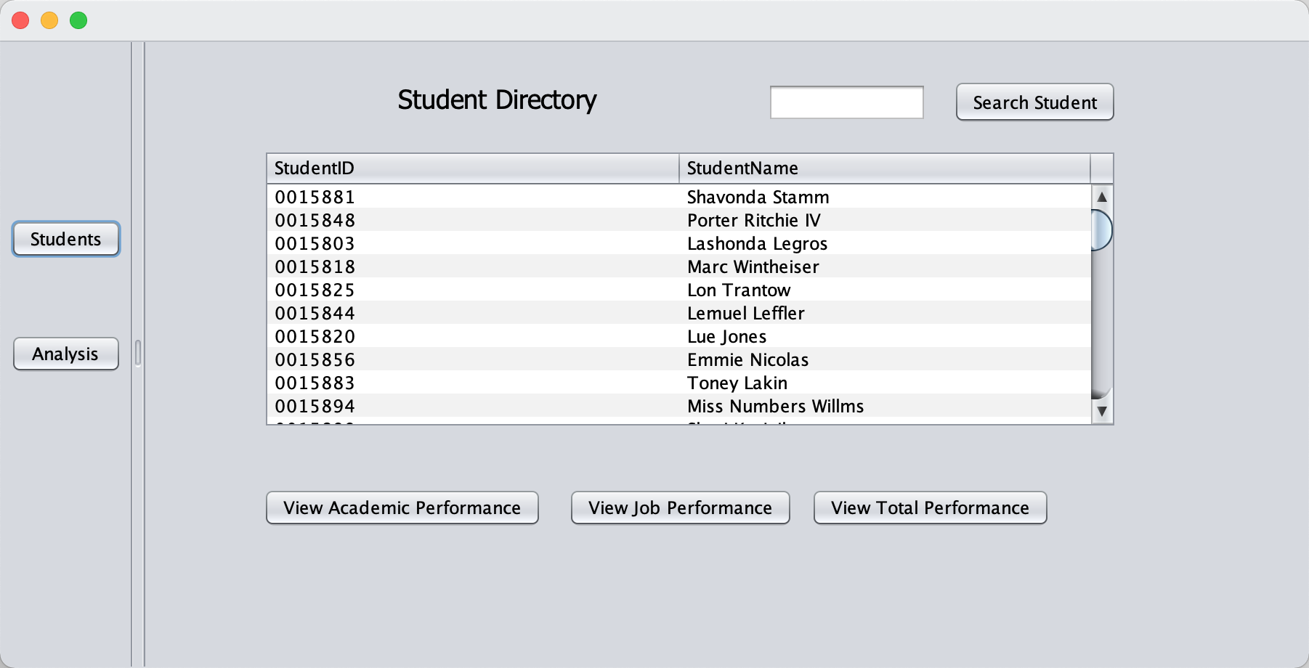
1.Student Management System
Show all the Student data we have and management them
We can select a student and view his academic performance and job performance
Total Performance and Analysis shows connections between academic performance and job performance
We created 100 students with their academic data and employment data

Slide 5
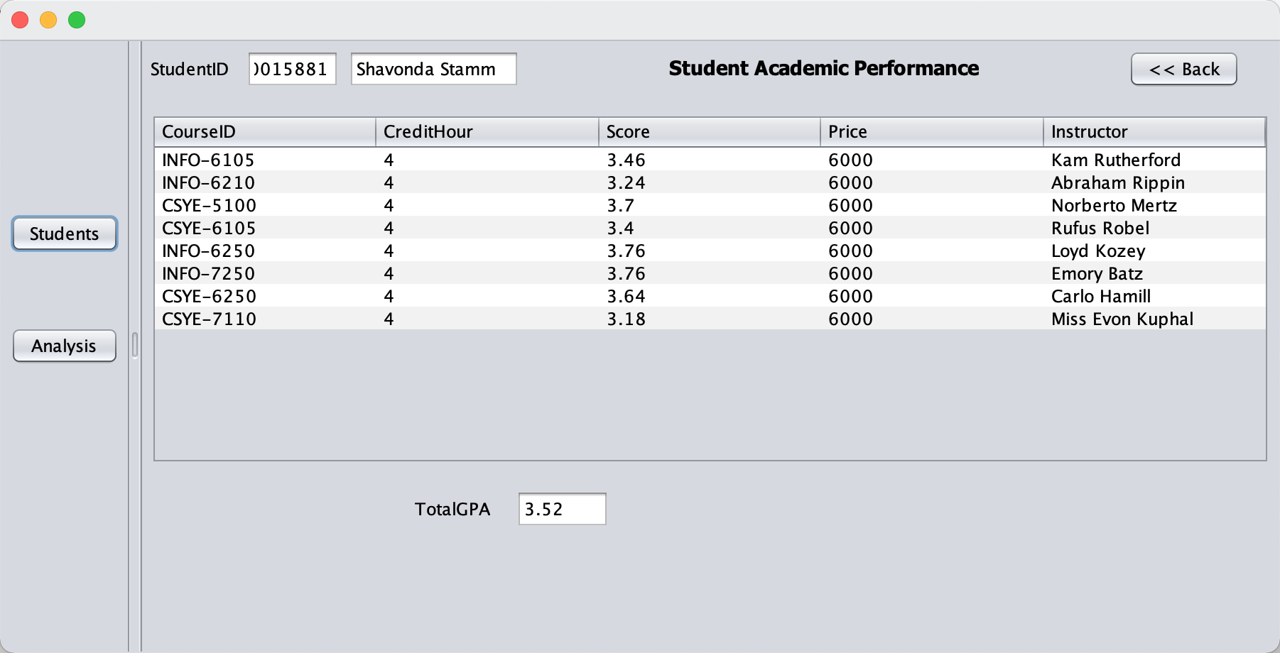
2.Student Academic Performance System
Select a student and show all the courses the student has taken in college
Show this student's grade in every courses and his GPA
Show every course's price and the instructor of this course.

Slide 6
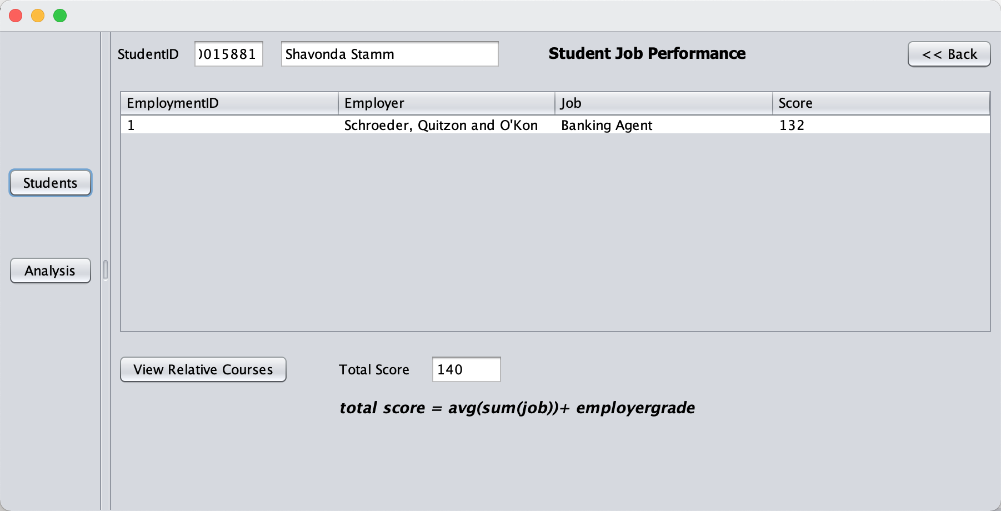
3.Student Job Performance System
Select a student and show his employment history in five years(job and employer)
Show the score of every employment and total score the student got.
View Relative Courses button to show the relative course of selected employment

Slide 7
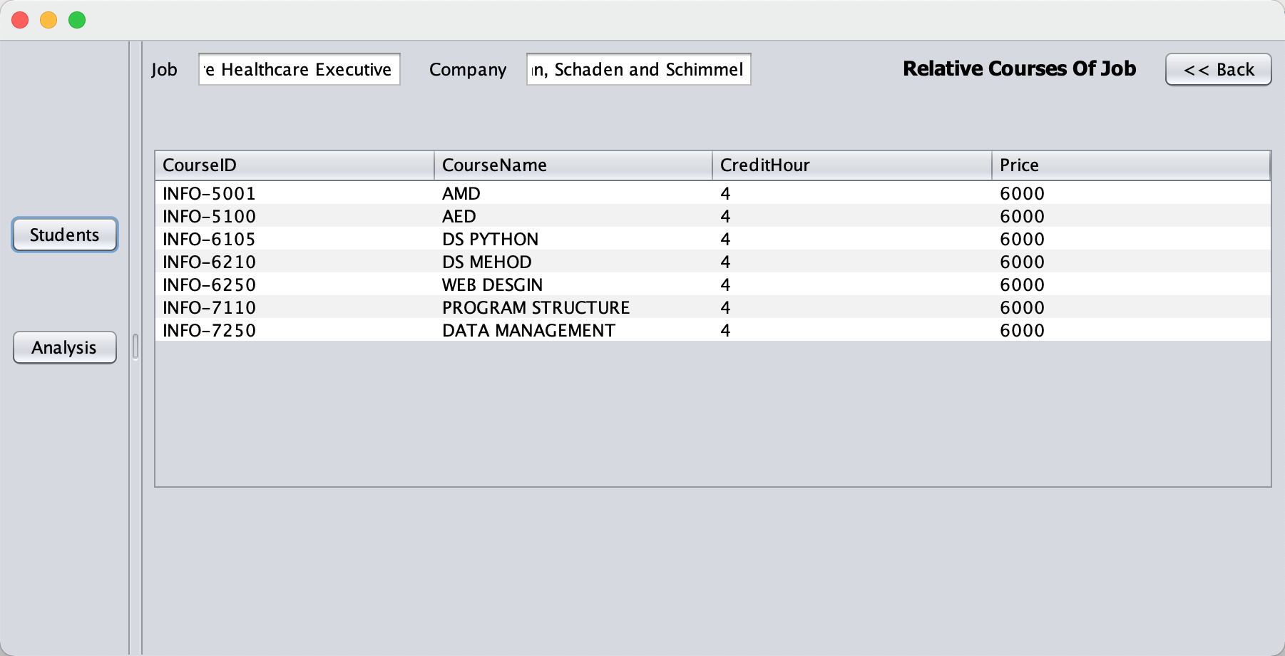
Show all the courses the college got and related to this job

Slide 8
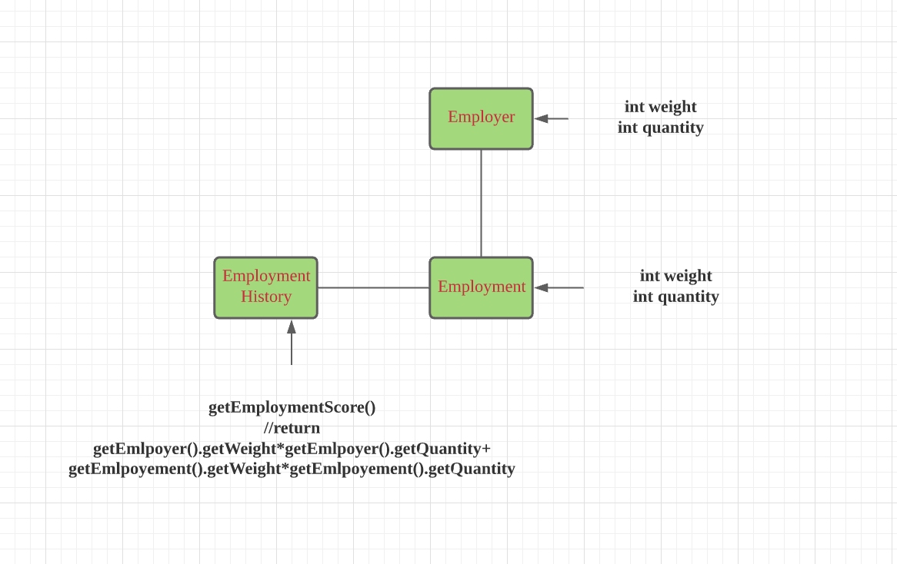
4.Ranking System
To access the quantity of a student's employment. We create parameters in employer and employment.
The higher the score, the better the student's work. In other words, the student has more potential job.
Total Score= avg(sum(job)+employergrade

Slide 9
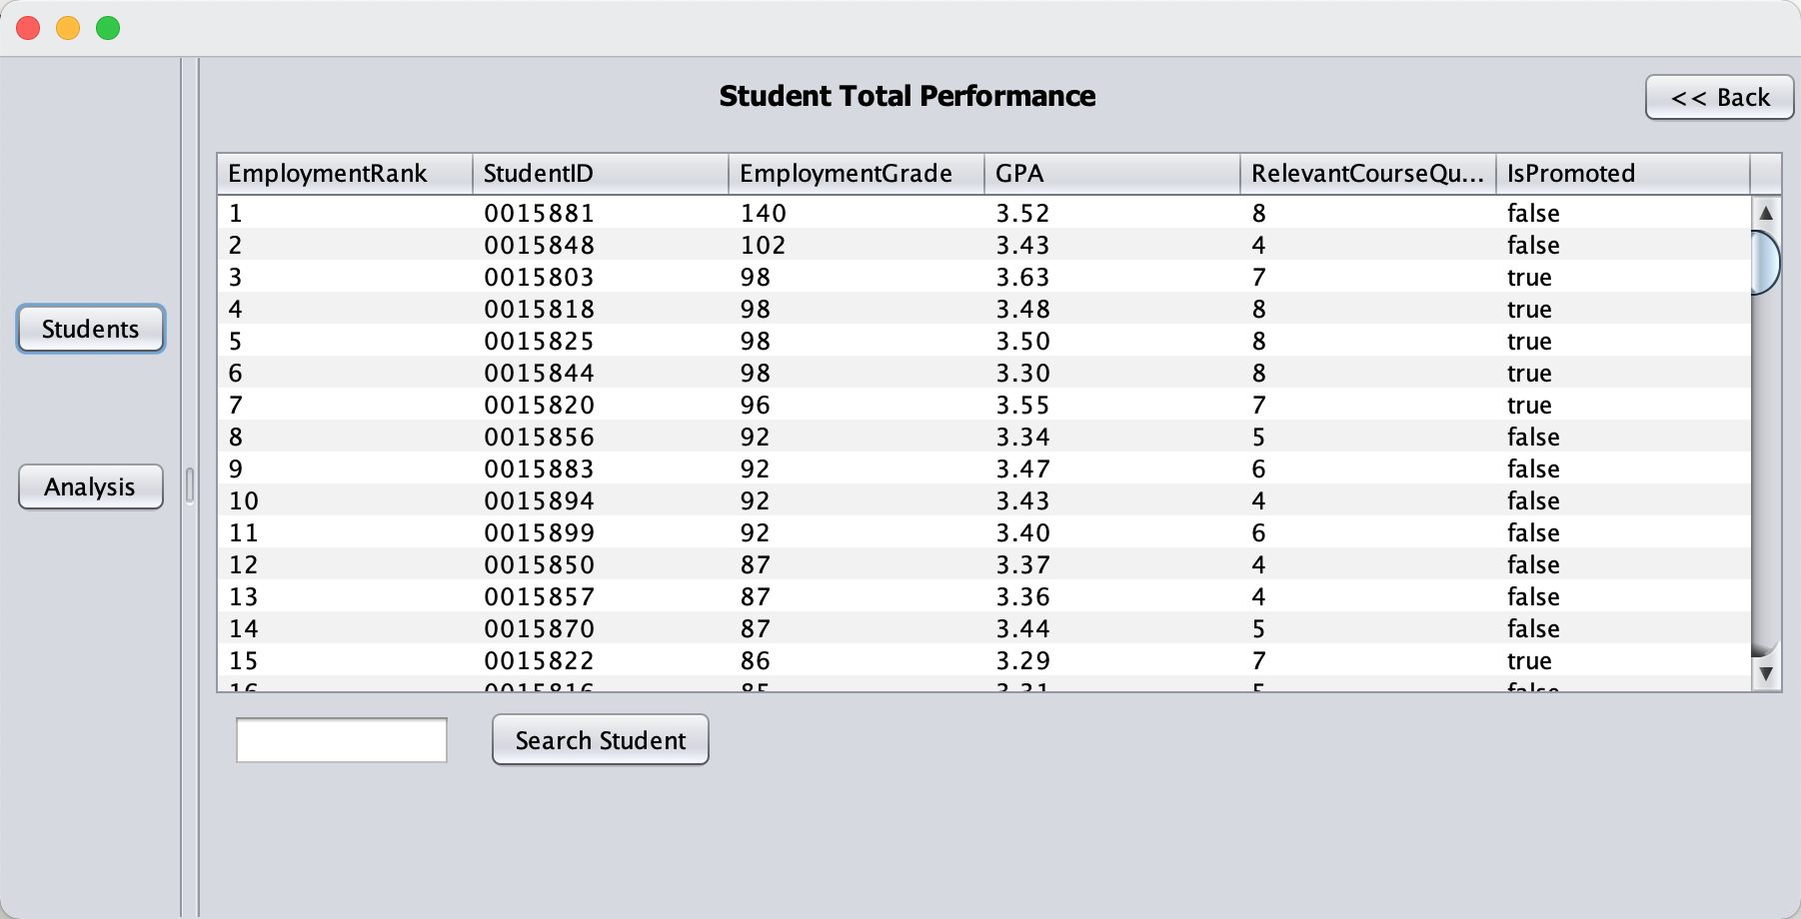
5.Relevance between Grade and Job Performance
Total Performance show all the student's EmploymentGrade and GPA, students are ranked by their EmploymentGrade
We can see that almost all students with high scores have relatively high GPA
To show the relationship more clearly, we create a line chart in Analysis function

Slide 10
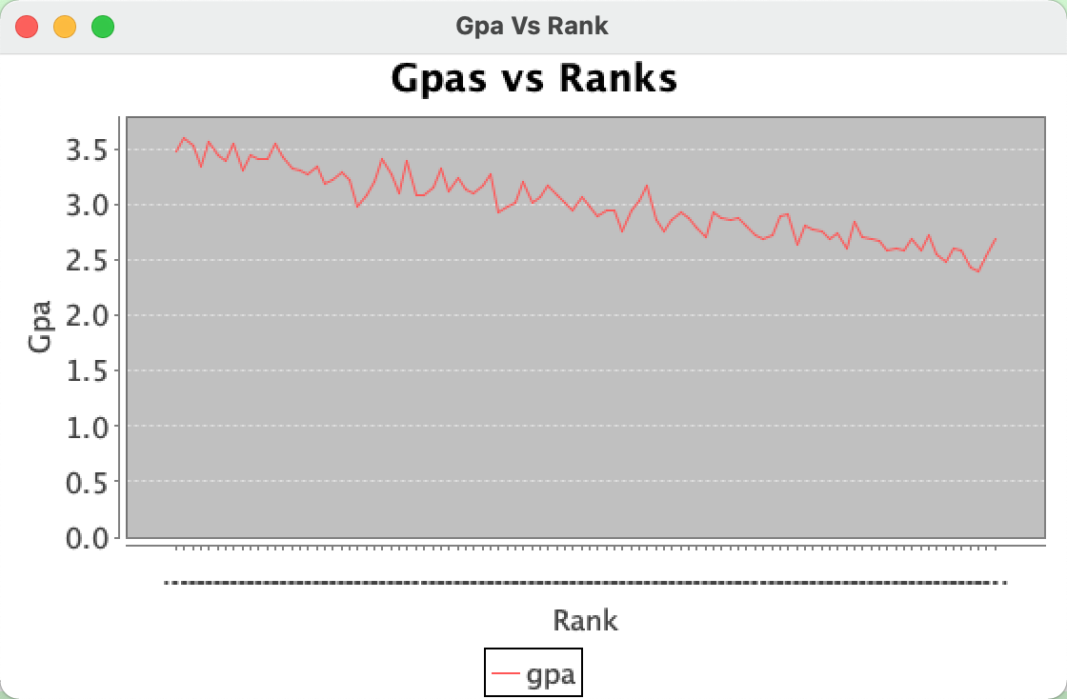

Slide 11
6. Connection of courses and their relevance to graduates growth.
In total performance, we show every student's employment score and the number of courses he studies related to his job
We can see that almost all students with high employment scores studied more related courses.
To show the relationship more clearly, we create two pie charts in Analysis function

Slide 12
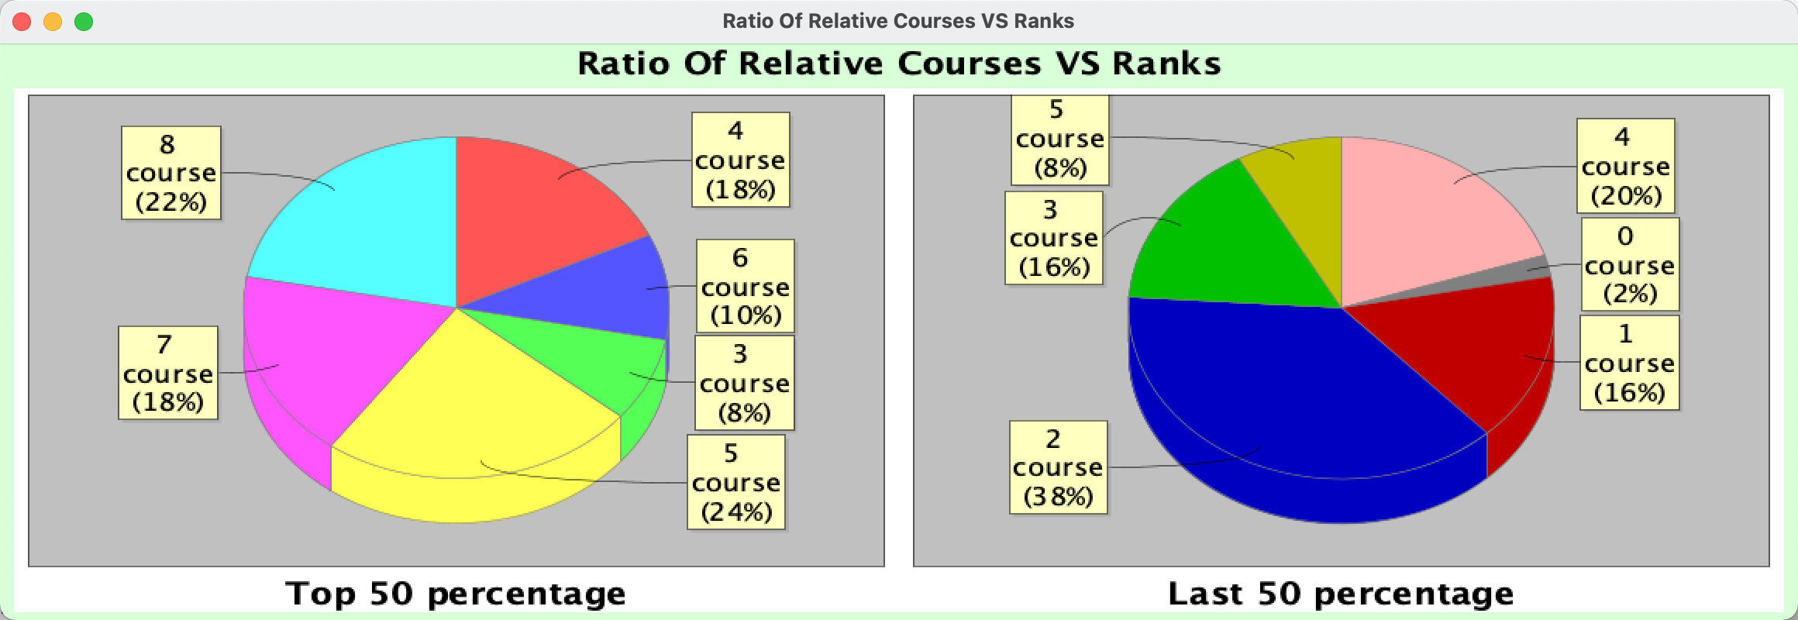
Ratio of Relative Courses VS Ranks
We can see the top 50 students took more work-related courses than the bottom 50 students, it proves relative courses do help student did better in their career

Slide 13
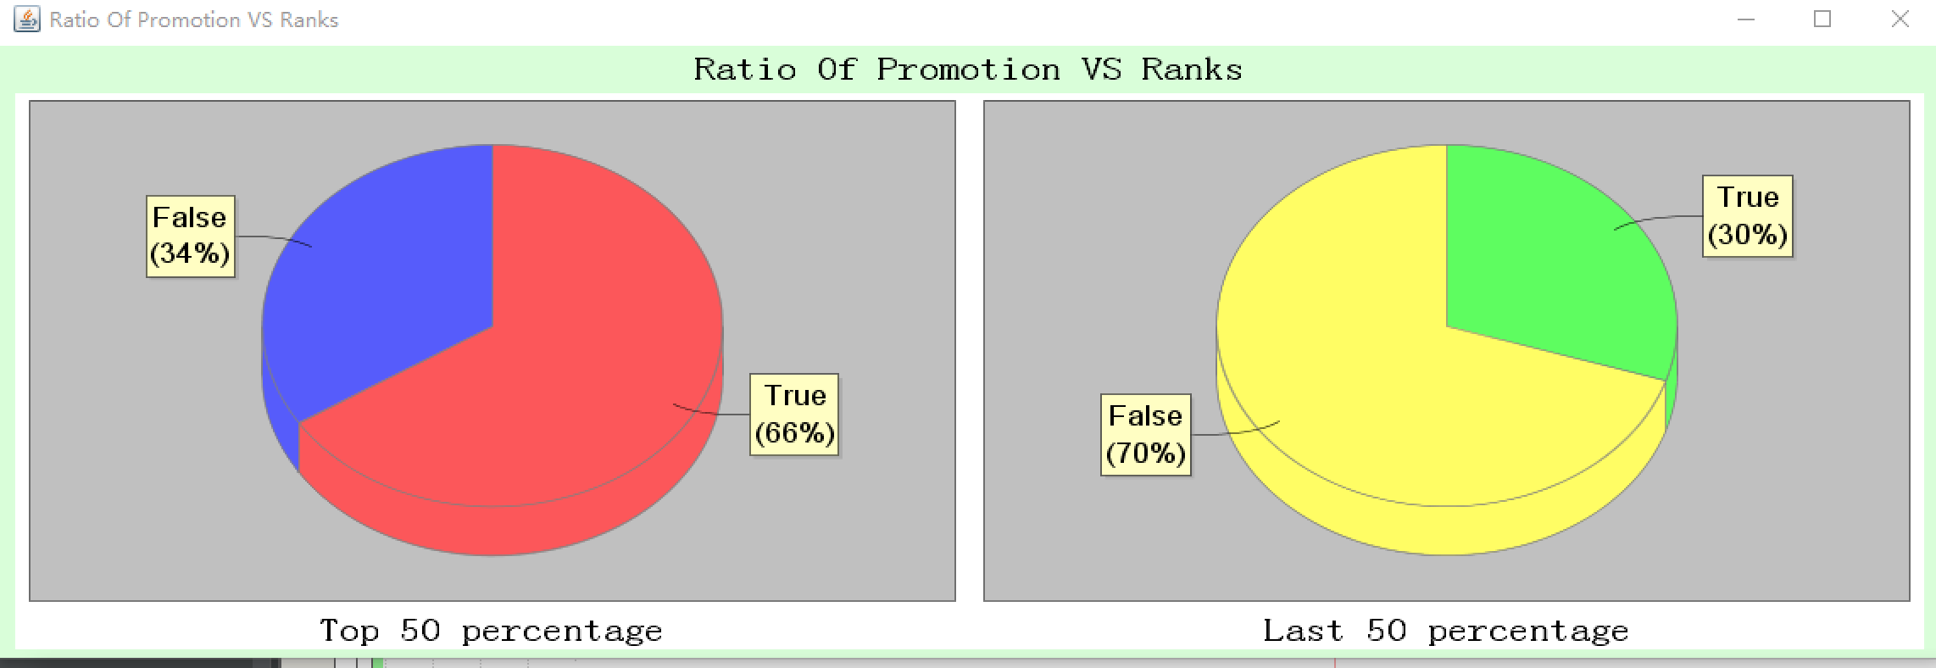
Ratio of Promotion VS Ranks
We can see more students in the top 50 get promoted than the bottom 50, it proves students with high GPA will get more promotion opportunities

Slide 14
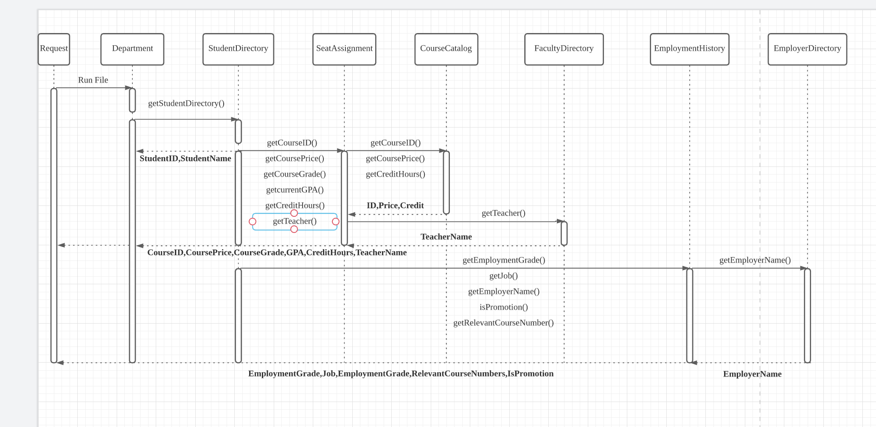
Deliverables 3
Sequence diagrams

Slide 15
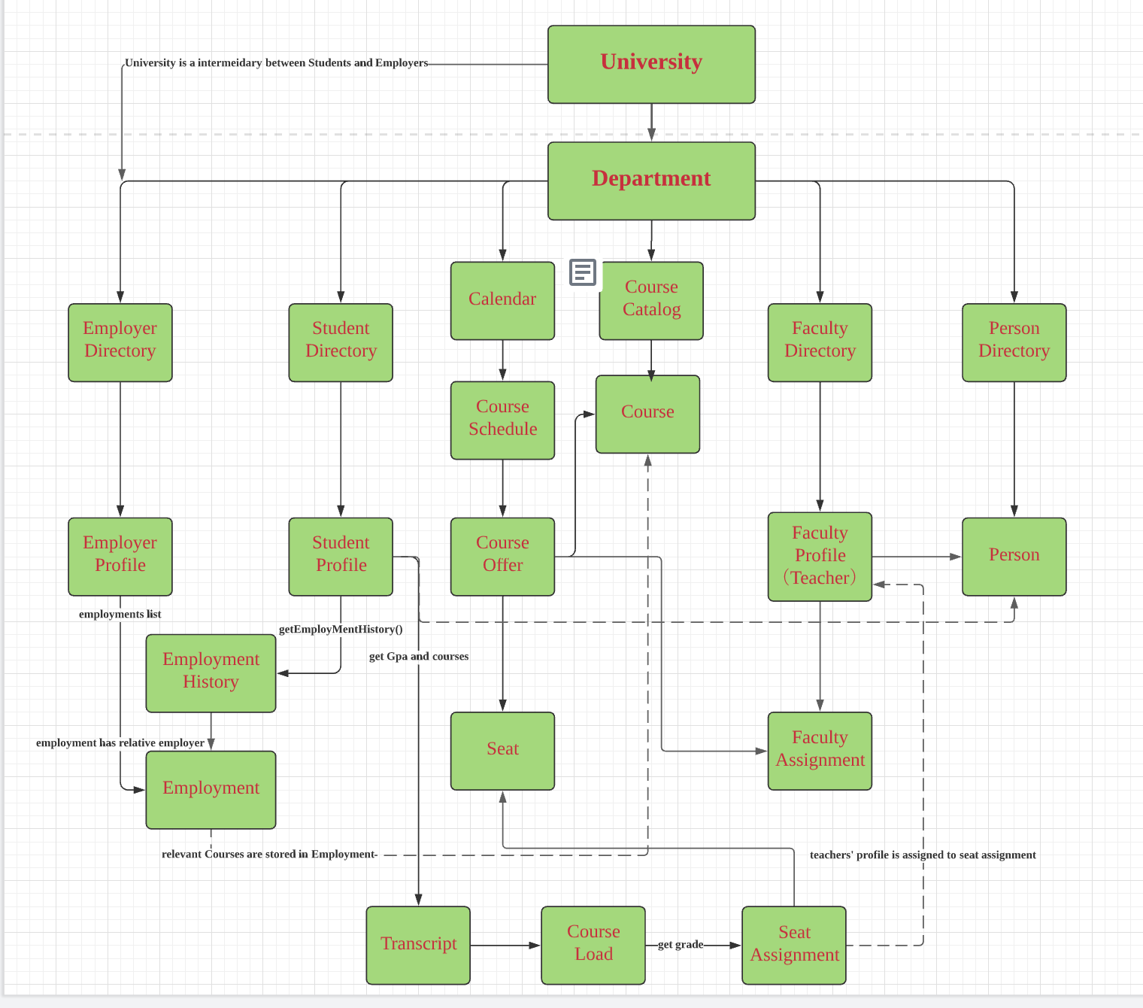
Deliverables 4
Object Model

Slide 16
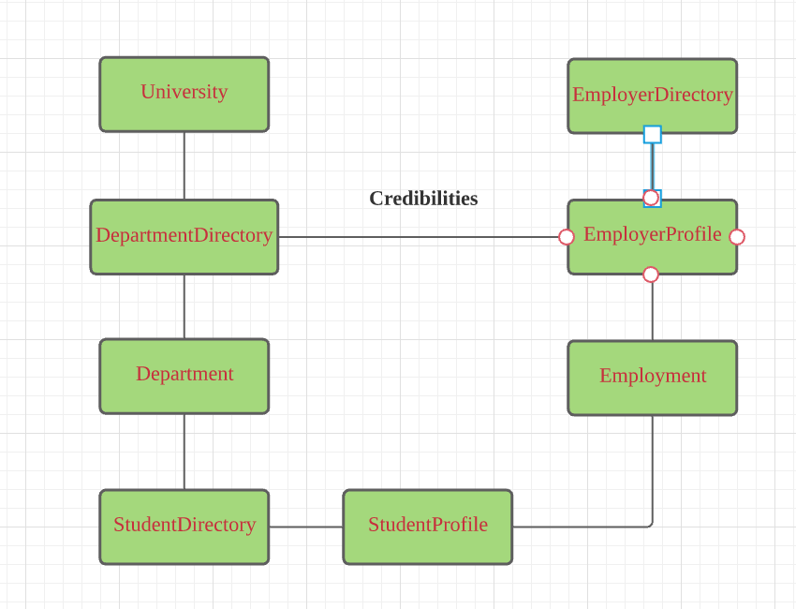
Deliverables 6
a university is an intermediary (broker) between students and employers
Under this assumption, the object model should change like this. University Class contains University Name and method to manage all the students in evey department.DepartmentDirectory class contains departmentlist to manage departments

Slide 17
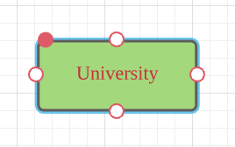
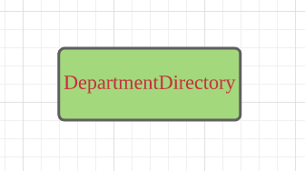
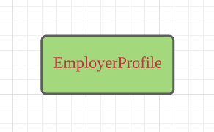
Add method
getDepartmentDirectory()
University can get job performance of all the students in evey Department
getDepartment()
Manage evey Department
getDepartmentDirectory()
Employers can get academic performence of all the students in evey Department

