Slide 1
DNA Fountain enables a robust and efficient storage architecture
DNA Fountain 实现了强大而高效的存储架构
Yaniv Erlich^{1,2,3*} and Dina Zielinski¹
Erlich et al., Science 355, 9 5 0–954 (2017) 3 March 2017
汇报人：邓铭

Slide 2
Abstract
DNA is an attractive medium to store digital information. Here we report a storage strategy, called DNA Fountain, that is highly robust and approaches the information capacity per nucleotide. Using our approach, we stored a full computer operating system, movie, and other files with a total of 2.14 × 10⁶ bytes in DNA oligonucleotides and perfectly retrieved the information from a sequencing coverage equivalent to a single tile of Illumina sequencing. We also tested a process that can allow 2.18 × 10¹⁵ retrievals using the original DNA sample and were able to perfectly decode the data. Finally, we explored the limit of our architecture in terms of bytes per molecule and obtained a perfect retrieval from a density of 215 petabytes per gram of DNA, orders of magnitude higher than previous reports.
DNA 是一种极具吸引力的存储数字信息的媒介。 在这里，我们报告了一种称为 DNA Fountain 的存储策略，该策略非常强大并且接近每个核苷酸的信息容量。 使用我们的方法，我们将完整的计算机操作系统、电影和其他文件存储在 DNA 寡核苷酸中，总大小为 2.14 × 10⁶ 字节，并从相当于单个 Illumina 测序的测序覆盖范围中完美地检索到信息。 我们还测试了一个可以使用原始 DNA 样本进行 2.18 × 10¹⁵ 次检索并能够完美解码数据的过程。 最后，我们探索了我们的架构在每个分子的字节数方面的限制，并从每克 DNA 215 PB 的密度中获得了完美的检索，比以前的报告高出几个数量级。
Notes:
Petabyte ->pb -> 1pb = 2¹⁵字节

Slide 3
Humanity is currently producing data at exponential rates, creating a demand for better storage devices. DNA is an excellent medium for data storage, owing to its demonstrated information density of petabytes of data per gram, high durability, and evolutionarily optimized machinery to faithfully replicate this information .Recently, a series of proof-of-principle experiments has demonstrated the value of DNA as a storage medium.
To better understand its potential, we explored the Shannon information capacity of DNA storage. This measure sets a tight upper bound on the amount of information that can be reliably stored in each nucleotide. In an ideal world, the information capacity of each nucleotide could reach 2 bits, as there are four possible options. However, DNA encoding faces several practical limitations. First, not all DNA sequences are created equal.
人类目前正以指数级的速度生产数据，从而产生了对更好存储设备的需求。 DNA 是一种极好的数据存储介质，因为它展示了每克 PB 级数据的信息密度、高耐用性以及经过进化优化的机制来忠实地复制这些信息。最近，一系列原理验证实验证明了它的价值 DNA 作为存储介质。
为了更好地了解其潜力，我们探索了 DNA 存储的香农信息容量。 该措施为每个核苷酸中可以可靠存储的信息量设定了严格的上限。 在理想的世界中，每个核苷酸的信息容量可以达到 2 位，因为有四种可能的选择。 然而，DNA 编码面临几个实际限制。 首先，并非所有的 DNA 序列都是一样的。

Slide 4
Biochemical constraints dictate that DNA sequences with high GC content or long homopolymer runs (e.g., AAAAAA…) are undesirable, as they are difficult to synthesize and prone to sequencing errors.
生化限制决定了具有高 GC 含量或长均聚物运行（例如，AAAAAA…）的 DNA 序列是不可取的，因为它们难以合成并且容易出现测序错误。
oligonucleotide (hereafter “oligo”) synthesis, polymerase chain reaction (PCR) amplification, and decay of DNA during storage can induce uneven representation of the oligos.This might result in dropout of a small fraction of oligos that will not be available for decoding.
寡核苷酸合成，多聚聚合酶链反应 (PCR) 扩增，以及储存过程中 DNA 的衰变会导致不均匀寡核苷酸的表示。 这有可能导致一小部分寡核苷酸脱落将不可用于解码。
oligos are sequenced in a pool and necessitate indexing to infer their order, which further limits the number of available nucleotides for encoding information. Quantitative analysis shows that the biochemical constraints reduce the coding potential of each nucleotide to 1.98 bits. After combining the expected dropout rates and barcoding demand, the overall Shannon information capacity of a DNA storage device is ~1.83 bits per nucleotide for a range of practical architectures.
寡核苷酸在池中进行测序并且需要索引来推断它们的顺序，这进一步限制了用于编码信息的可用核苷酸的数量。 定量分析表明，生化限制将每个核苷酸的编码潜力降低到 1.98 位。 在结合预期的丢失率和条形码需求后，对于一系列实际架构，DNA 存储设备的整体香农信息容量约为每核苷酸 1.83 位。

Slide 5
Previous studies of DNA storage realized about half of the Shannon information capacity of DNA molecules. In addition, most of the previous studies reported challenges in perfect information retrieval.
For example, two previous studies attempted to address oligo dropout by dividing the original file into overlapping segments so that each input bit is represented by multiple oligos. However, this repetitive coding procedure generates a loss of information content and is poorly scalable. In both cases, these studies reported small gaps in the retrieved information. Other studies explored the use of Reed-Solomon (RS) code on small blocks of the input data to recover dropouts . Although these studies were able to perfectly retrieve the data, they were still far from realizing the capacity. Moreover, testing this strategy on a large file size highlighted difficulties in decoding the data due to local correlations and large variations in the dropout rates within each protected block, which is a known issue of blocked RS codes. Only after employing a complex multistep procedure and high sequencing coverage was the study able to rescue a sufficient number of oligos. Taken together, these results inspired us to seek a coding strategy that can better utilize the information capacity of DNA storage devices while showing higher data-retrieval reliability.
以前对 DNA 存储的研究实现了 DNA 分子香农信息容量的一半左右。 此外，大多数先前的研究都报告了完美信息检索的挑战。
例如，之前的两项研究试图通过将原始文件分成重叠的段来解决oligo丢失，以便每个输入位由多个oligo表示。然而，这种重复的编码过程会产生信息内容的丢失并且可扩展性很差。在这两种情况下，这些研究都报告了检索到的信息存在小的差距。其他研究探索了在输入数据的小块上使用 Reed-Solomon (RS) 代码来恢复丢失。尽管这些研究能够完美地检索数据，但距离实现能力还差得很远。此外，在大文件大小上测试该策略突出显示了由于局部相关性和每个受保护块内丢失率的巨大变化而解码数据的困难，这是阻塞 RS 码的已知问题。只有在采用复杂的多步骤程序和高测序覆盖率后，该研究才能挽救足够数量的寡核苷酸。总之，这些结果启发我们寻求一种编码策略，该策略可以更好地利用 DNA 存储设备的信息容量，同时显示更高的数据检索可靠性。

Slide 6
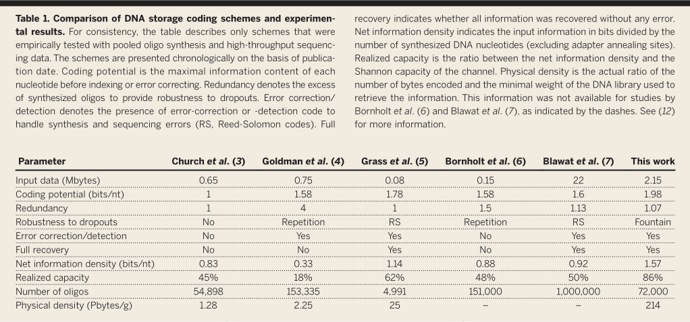
DNA 存储编码方案与实验结果对比
输入数据 (Mbytes)
编码潜力（比特/nt）
冗余
对丢失的鲁棒性
纠错/检测
完全恢复
净信息密度（比特/nt）
实现容量
寡核苷酸数量
物理密度 (Pbytes/g)

Slide 7
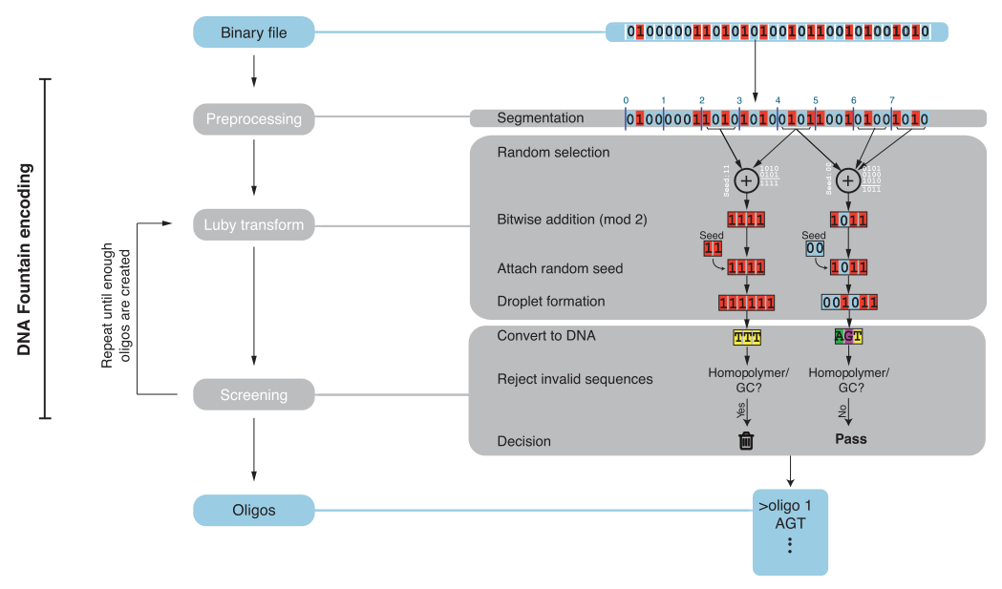
We devised a strategy for DNA storage, called DNA Fountain, that approaches the Shannon capacity while providing robustness against data corruption. In our design, we carefully adapted the power of fountain codes to overcome both oligo dropouts and the biochemical constraints of DNA storage. Our encoder works in three steps.
我们设计了一种 DNA 存储策略，称为 DNA Fountain，该策略接近香农容量，同时提供针对数据损坏的稳健性。 在我们的设计中，我们仔细调整了喷泉代码的能力，以克服寡核苷酸丢失和 DNA 存储的生化限制。 我们的编码器分三个步骤工作。
First, it preprocesses a binary file into a series of nonoverlapping segments of a certain length.
首先，它将二进制文件预处理为一系列具有一定长度的不重叠段。

Slide 8
Next, it iterates over two computational steps: Luby transform and screening. The Luby transform sets the basis for fountain codes. Basically, it packages data into any desired number of short messages, called droplets, by selecting a random subset of segments from the file using a special distribution and adding them bitwise together under a binary field. The droplet contains two pieces of information: a data payload part that holds the result of the addition procedure and a short, fixed-length seed. This seed corresponds to the state of the random-number generator of the transform during the droplet creation and allows the decoder algorithm to infer the identities of the segments in the droplet. Theoretically, it is possible to reverse the Luby transform using a highly efficient algorithm by collecting any subset of droplets as long as the accumulated size of droplets is slightly bigger than the size of the original file. For DNA Fountain, our algorithm applies one round of the transform in each iteration to create a single droplet.
接下来，它迭代两个计算步骤：Luby 变换和筛选。 Luby 变换为喷泉码奠定了基础。基本上，它通过使用特殊分布从文件中选择随机段子集并将它们按位添加到二进制字段下，将数据打包成任何所需数量的短消息，称为 droplets。液滴包含两条信息：一个包含添加过程结果的数据有效负载部分和一个短的、固定长度的种子。该种子对应于液滴创建期间变换的随机数生成器的状态，并允许解码器算法推断液滴中片段的身份。理论上，只要累积的液滴大小略大于原始文件的大小，就可以使用高效算法通过收集液滴的任何子集来反转 Luby 变换。对于 DNA 喷泉，我们的算法在每次迭代中应用一轮变换以创建单个液滴。

Slide 9
Next, the algorithm moves to the droplet screening stage. This stage is not part of the original fountain code design and allows us to completely realize the coding potential of each nucleotide. In screening, the algorithm translates the binary droplet to a DNA sequence by converting {00,01,10,11} to {A,C,G,T}, respectively. Then, it screens the sequence for the desired biochemical properties of GC content and homopolymer runs. If the sequence passes the screen, it is considered valid and added to the oligo design file; otherwise, the algorithm simply trashes the droplet. Since the Luby transform can create any desired number of droplets, we keep iterating over the droplet creation and screening steps until a sufficient number of valid oligos are generated. In practice, we recommend 5 to 10% more oligos than input segments. Searching for valid oligos scales well with the size of the input file and is economical for various oligo lengths within and beyond current synthesis limits.
接下来，算法进入液滴筛选阶段。这个阶段不是原始喷泉代码设计的一部分，它让我们可以完全实现每个核苷酸的编码潜力。在筛选中，该算法通过将 {00,01,10,11} 分别转换为 {A,C,G,T} 将二进制液滴转换为 DNA 序列。然后，它筛选序列以获得所需的 GC 含量和均聚物运行的生化特性。如果序列通过筛选，则认为有效并添加到寡核苷酸设计文件中；否则，该算法只会丢弃液滴。由于 Luby 变换可以创建任何所需数量的液滴，我们不断迭代液滴创建和筛选步骤，直到生成足够数量的有效寡核苷酸。在实践中，我们建议寡核苷酸比输入片段多 5% 到 10% 。搜索有效的寡核苷酸可以很好地适应输入文件的大小，并且对于当前合成限制范围内和之外的各种寡核苷酸长度是经济的。

Slide 10
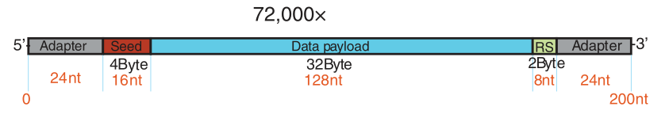
We used DNA Fountain to encode a single compressed file of 2,146,816 bytes in a DNA oligo pool.
We split the input tarball into 67,088 segments of 32 bytes and iterated over the steps of DNA Fountain to create valid oligos. Each droplet was 38 bytes (304 bits): 4 bytes of the random-number generator seed, 32 bytes for the data payload, and 2bytes for an RS error-correcting code, to reject erroneous oligos in low-coverage conditions. With this seed length, our strategy supports encoding files of up to 500 Mbytes. The DNA oligos had a length of 304/2 = 152 nucleotides (nt) and were screened for homopolymer runs of ≤3 nt and GC content of 45 to 55%. We instructed DNA Fountain to generate 72,000 oligos, yielding a redundancy of 72,000/67,088 – 1 = 7%.
Finally, we added upstream and downstream annealing sites for Illumina adapters, making our final oligos 200 nt long.We achieved an information density of 1.57 bits/nt, only 14% from the Shannon capacity of DNA storage and 60% more than previous studies with a similar scale of data (Table 1).
我们使用 DNA Fountain 在 DNA 寡核苷酸池中编码一个 2,146,816 字节的压缩文件。
我们将输入压缩包拆分为 67,088 个 32 字节的段，并迭代 DNA Fountain 的步骤以创建有效的寡核苷酸。每个液滴为 38 个字节（304 位）：4 个字节的随机数生成器种子，32 个字节用于数据有效负载，2 个字节用于 RS 纠错码，以在低覆盖率条件下拒绝错误的寡核苷酸。有了这个种子长度，我们的策略支持高达 500 MB 的编码文件。 DNA oligos 的长度为 304/2 = 152 个核苷酸 (nt)，并针对 ≤3 nt 的均聚物运行和 45% 至 55% 的 GC 含量进行筛选。我们指示 DNA Fountain 生成 72,000 个寡核苷酸，产生 72,000/67,088 – 1 = 7% 的冗余。
最后，我们为 Illumina 适配器添加了上游和下游退火位点，使我们的最终寡核苷酸长 200 nt。我们实现了 1.57 位/nt 的信息密度，仅小于 DNA 存储的 Shannon 容量的 14%，比以前的研究高 60%类似规模的数据（表 1）。

Slide 11
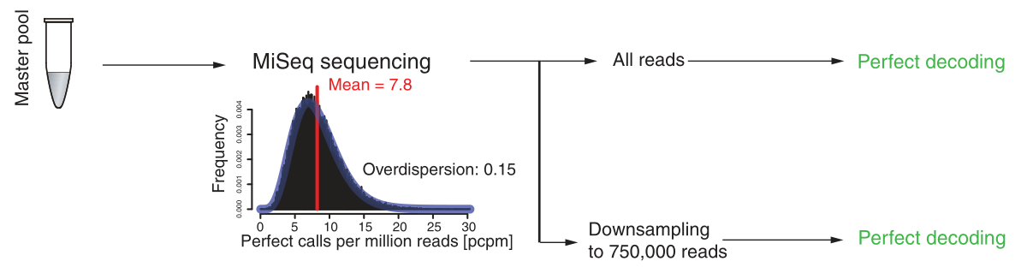
Sequencing and decoding the oligo pool fully recovered the entire input file with zero errors . To retrieve the information, we PCR-amplified the oligo pool and sequenced the DNA library on one Illumina MiSeq flow cell with 150 paired-end cycles, which yielded 32 million reads. We employed a preprocessing strategy that prioritizes reads that are more likely to represent high-quality oligos . Because not all oligos are required for the decoding due to redundancy, this procedure reduces the exposure to erroneous oligos. The decoder scans the reads, recovers the binary droplets, rejects droplets with errors based on the RS code, and employs a message-passing algorithm to reverse the Luby transform and obtain the original data.
对寡核苷酸池进行测序和解码，完全恢复了整个输入文件，且错误为零。 为了检索信息，我们对寡核苷酸池进行了 PCR 扩增，并在一个 Illumina MiSeq 流动槽上对 DNA 文库进行了测序，该流动槽具有 150 个双末端循环，产生了 3200 万个读数。 我们采用了一种预处理策略，优先考虑更可能代表高质量寡核苷酸的读取。 由于由于冗余，并非所有寡核苷酸都需要解码，因此该程序减少了对错误寡核苷酸的暴露。 解码器扫描读取，恢复二进制液滴，根据 RS 码拒绝有错误的液滴，并采用消息传递算法反转 Luby 变换并获得原始数据。

Slide 12
In practice, decoding took ~9 min with a Python script on a single CPU of a standard laptop . The decoder recovered the information with 100% accuracy after observing only 69,870 oligos out of the 72,000 in our library . To further test the robustness of our strategy, we down-sampled the raw Illumina data to 750,000 reads, equivalent to one tile of an Illumina MiSeq flow cell. This procedure resulted in 1.3% oligo dropout from the library. Despite these limitations, the decoder was able to perfectly recover the original 2.1 Mbytes in 20 of 20 random down-sampling experiments. These results indicate that beyond its high information density, DNA Fountain also reduces the amount of sequencing required for data retrieval, which is beneficial when storing large-scale information.
在实践中，使用 Python 脚本在标准笔记本电脑的单个 CPU 上进行解码大约需要 9 分钟。 在我们库中的 72,000 个寡核苷酸中仅观察到 69,870 个寡核苷酸后，解码器以 100% 的准确度恢复了信息。 为了进一步测试我们策略的稳健性，我们将原始 Illumina 数据下采样到 750,000 个读数，相当于一个 Illumina MiSeq 流动槽的瓦片。 该过程导致文库中有 1.3% 的寡核苷酸脱落。 尽管有这些限制，解码器还是能够在 20 次随机下采样实验中的 20 次中完美地恢复原始的 2.1 MB。 这些结果表明，除了高信息密度之外，DNA Fountain 还减少了数据检索所需的测序量，这在存储大规模信息时是有益的。

Slide 13
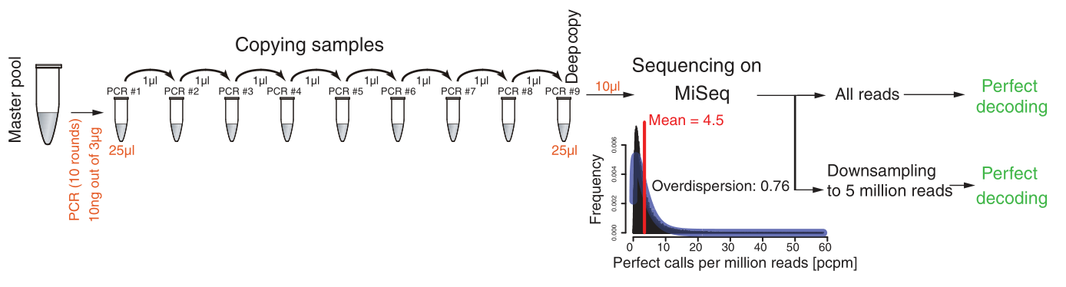
DNA Fountain can also perfectly recover the file after creating a deep copy of the sample. One of the caveats of DNA storage is that each retrieval of information consumes an aliquot of the material. Copying the oligo library with PCR is possible, but this procedure introduces noise and induces oligo dropout. To further test the robustness of our strategy, we created a deep copy of the file by propagating the sample through nine serial PCR amplifications . The first PCR reaction used 10 ng of material out of the 3-μg master pool. Each subsequent PCR reaction consumed 1 μl of the previous PCR reaction and employed 10 cycles in each 25-μl reaction. We sequenced the final library using one run on the Illumina MiSeq. These results suggest that with DNA Fountain, DNA storage can be copied virtually an unlimited number of times while preserving the data integrity of the sample.
DNA Fountain 还可以在创建样本的深层副本后完美恢复文件。 DNA 存储的一个警告是，每次检索信息都会消耗一部分材料。 可以使用 PCR 复制寡核苷酸库，但此过程会引入噪音并导致寡核苷酸丢失。 为了进一步测试我们策略的稳健性，我们通过九次串行 PCR 扩增传播样本来创建文件的深层副本。 第一个 PCR 反应使用 3-μg 主池中的 10 ng 材料。 每个后续 PCR 反应消耗 1 μl 先前的 PCR 反应，并在每个 25 μl 反应中使用 10 个循环。 我们在 Illumina MiSeq 上使用一次运行对最终文库进行了测序。 这些结果表明，使用 DNA Fountain，DNA 存储几乎可以无限次复制，同时保持样本的数据完整性。

Slide 14
Next, we explored the maximal achievable physical density using DNA Fountain. The pioneering study by Church et al. predicted that DNA storage could theoretically achieve an information density of 680 Pbytess (P: peta-; 1015) per gram of DNA, assuming the storage of 100 molecules per oligo sequence .
We were able to perfectly retrieve the information from a physical density of 215 Pbytes/g. This density is over two orders of magnitude higher than previous reports with a comparable number of oligos and is close to the theoretical prediction by Church et al.
接下来，我们使用 DNA Fountain 探索了可实现的最大物理密度。 Church 等人的开创性研究。 预测 DNA 存储理论上可以达到每克 DNA 680 Pbytess (P: peta-; 1015) 的信息密度，假设每个寡核苷酸序列存储 100 个分子 。
我们能够完美地从 215 Pbytes/g 的物理密度中检索信息。 这种密度比之前的报道高出两个数量级，具有相当数量的寡核苷酸，并且接近于 Church 等人的理论预测。

Slide 15
To summarize, in this work, we reported an efficient and robust coding strategy that enables virtually unlimited data retrieval and high physical density while approaching the Shannon capacity of DNA storage closer than any previous design. We tested our framework with a relatively large file compared with those used in previous studies and were able to perfectly recover the data under various tests. Implementing our approach in concert with long-term preservation techniques, such as DNA embedding in silica beads , might require further fine-tuning of the redundancy levels. We expect that such fine-tuning can benefit from the high flexibility of the DNA Fountain framework, which allows determination of virtually any redundancy level without changing the software or affecting the decoding time.
总而言之，在这项工作中，我们报告了一种高效且强大的编码策略，它可以实现几乎无限的数据检索和高物理密度，同时比任何以前的设计都更接近 DNA 存储的香农容量。 与之前研究中使用的文件相比，我们使用相对较大的文件测试了我们的框架，并且能够在各种测试下完美地恢复数据。 将我们的方法与长期保存技术相结合，例如将 DNA 嵌入二氧化硅珠，可能需要进一步微调冗余水平。 我们希望这种微调可以受益于 DNA Fountain 框架的高度灵活性，它允许在不更改软件或影响解码时间的情况下确定几乎任何冗余级别。

Slide 16
we envision that the cost issue of DNA storage could be addressed by two complementary approaches, the first of which is continuous improvements to the DNA synthesis chemistry, which have been estimated to exponentially reduce the cost by one to two orders of magnitude per decade . A second complementary approach to achieve cost reduction could rely on exploring quick-and-dirty oligo synthesis methods that consume less machine time and fewer reagents and, therefore, are more cost-effective.
我们设想 DNA 存储的成本问题可以通过两种互补的方法来解决，第一种是对 DNA 合成化学的持续改进，据估计，这将每十年以指数方式将成本降低一到两个数量级。实现降低成本的第二种补充方法可能依赖于探索快速而不纯净的寡核苷酸合成方法，这些方法消耗更少的机器时间和更少的试剂，因此更具成本效益。

Slide 17
Thank You！

