Slide 1
J2EE与中间件技术
——Servlet技术

Slide 2
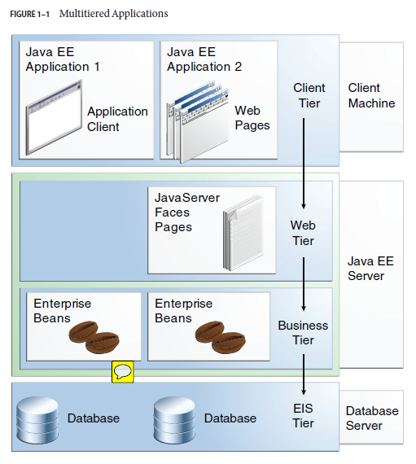
多层应用

Slide 3
Chapter 5, Packaging
Chapter 6, Getting Started with Web Applications
Chapter 17, Java Servlet Technology

Slide 4
Web应用
A web application is a dynamic extension of a web or application server. There are two types of web applications:
  Presentation-oriented: A presentation-oriented web application generates interactive web pages containing various types of markup language (HTML, XHTML, XML, and so on) and dynamic content in response to requests.
  Service-oriented: A service-oriented web application implements the endpoint of a web service.

Slide 5
Web组件
In the Java EE platform, web components provide the dynamic extension capabilities for a web server.
Web components can be Java servlets, web pages implemented with JavaServer Faces technology, web service endpoints, or JSP pages.

Slide 6
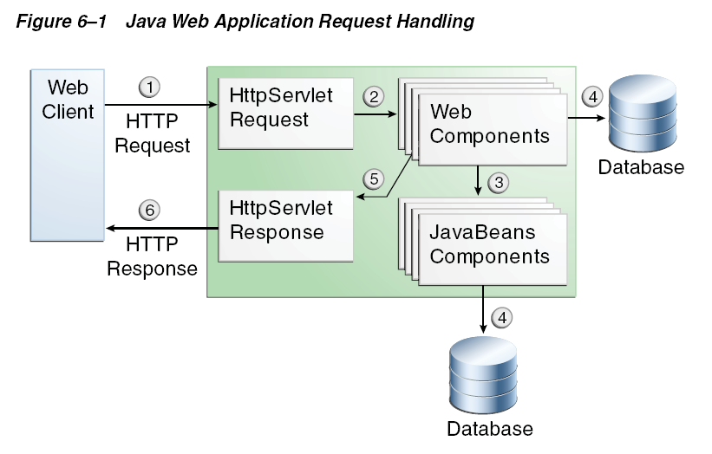
Java Web Application Request Handling
Interaction between a web client and a web application that uses a servlet:

Slide 7
Java Web Application Request Handling
The client sends an HTTP request to the web server.
A web server that implements Java Servlet and JavaServer Pages technology converts the request into an HTTPServletRequest object.
This object is delivered to a web component, which can interact with JavaBeans components or a database to generate dynamic content.
The web component can then generate an HTTPServletResponse or can pass the request to another web component.
A web component eventually generates a HTTPServletResponse object.
The web server converts this object to an HTTP response and returns it to the client.

Slide 8
Servlets/Java Server Faces
Servlets are best suited for service-oriented applications (web service endpoints can be implemented as servlets) and the control functions of a presentation-oriented application, such as dispatching requests and handling nontextual data.
JavaServer Faces and Facelets pages are more appropriate for generating text-based markup, such as XHTML, and are generally used for presentation–oriented applications.

Slide 9
Web容器
Web components are supported by the services of a runtime platform called a web container.
A web container provides such services as request dispatching, security, concurrency, and lifecycle management.
A web container also gives web components access to such APIs as naming, transactions, and email.

Slide 10
Web容器
Certain aspects of web application behavior can be configured when the application is installed, or deployed, to the web container.
The configuration information can be specified using Java EE annotations or can be maintained in a text file in XML format called a web application deployment descriptor (DD).
  A web application DD must conform to the schema described in the Java Servlet specification.

Slide 11
Web应用
A web application consists of web components, static resource files such as images and cascading style sheets (CSS); and helper classes and libraries.
The web container provides many supporting services that enhance the capabilities of web components and make them easier to develop.

Slide 12
开发Web应用
The process for creating, deploying, and executing a web application can be summarized as follows:
  1. Develop the web component code.
  2. Develop the web application deployment descriptor, if necessary.
  3. Compile the web application components and helper classes referenced by the components.
  4. Optionally, package the application into a deployable unit.
  5. Deploy the application into a web container.
  6. Access a URL that references the web application.

Slide 13
Web Modules
In the Java EE architecture, a web module is the smallest deployable and usable unit of web resources.
A web module contains web components and static web content files, such as images, which are called web resources.
A Java EE web module corresponds to a web application as defined in the Java Servlet specification.

Slide 14
Web Modules
A web module can contain
  web components and web resources
  Server-side utility classes (database beans, shopping carts, and so on).
  Client-side classes (applets and utility classes).

Slide 15
Web Modules structure
A web module has a specific structure.
The top-level directory of a web module is the document root of the application.
  The document root is where XHTML pages, client-side classes and archives, and static web resources, such as images, are stored.
The document root contains a subdirectory named WEB-INF.
You can also create application-specific subdirectories (that is, package directories) in either the document root or the WEB-INF/classes/ directory.

Slide 16
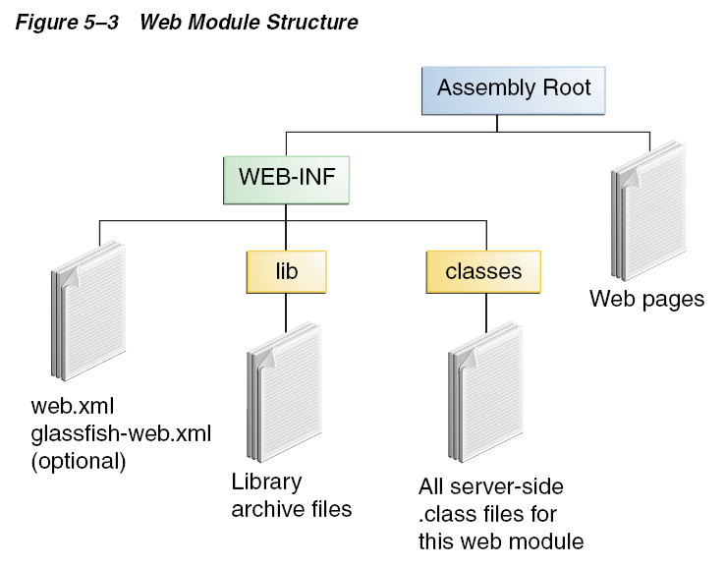
Web Modules structure

Slide 17
WEB-INF
WEB-INF contains the following files and directories:
  classes: A directory that contains server-side classes: servlets, enterprise bean class files, utility classes, and JavaBeans components
  tags: A directory that contains tag files, which are implementations of tag libraries
  lib: A directory that contains JAR files that contain enterprise beans, and JAR archives of libraries called by server-side classes
  Deployment descriptors, such as web.xml (the web application deployment descriptor) and ejb-jar.xml (an EJB deployment descriptor)

Slide 18
web.xml
A web module needs a web.xml file if it uses JavaServer Faces technology, if it must specify certain kinds of security information, or if you want to override information specified by web component annotations.

Slide 19
web module
A web module can be deployed as an unpacked file structure or can be packaged in a JAR file known as a Web Archive (WAR) file.
Because the contents and use of WAR files differ from those of JAR files, WAR file names use a .war extension.
The web module just described is portable; you can deploy it into any web container that conforms to the Java Servlet specification.

Slide 20
dynamic content
Shortly after the Web began to be used for delivering services, service providers recognized the need for dynamic content.
Applets, one of the earliest attempts toward this goal, focused on using the client platform to deliver dynamic user experiences.
At the same time, developers also investigated using the server platform for the same purpose.

Slide 21
CGI/Servlets
Initially, Common Gateway Interface (CGI) server-side scripts were the main technology used to generate dynamic content.
Although widely used, CGI scripting technology had many shortcomings, including platform dependence and lack of scalability.
To address these limitations, Java Servlet technology was created as a portable way to provide dynamic, user-oriented content.

Slide 22
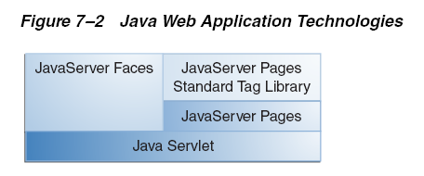
Servlet 技术
Java Servlet technology is the foundation of all the web application technologies.

Slide 23
Servlet 技术
A servlet is a Java programming language class used to extend the capabilities of servers that host applications accessed by means of a request-response programming model.
Although servlets can respond to any type of request, they are commonly used to extend the applications hosted by web servers. For such applications, Java Servlet technology defines HTTP-specific servlet classes.

Slide 24
javax.servlet and javax.servlet.http packages
The javax.servlet and javax.servlet.http packages provide interfaces and classes for writing servlets.
All servlets must implement the Servlet interface, which defines life-cycle methods.
When implementing a generic service, you can use or extend the GenericServlet class provided with the Java Servlet API.
The HttpServlet class provides methods, such as doGet and doPost, for handling HTTP-specific services.

Slide 25
javax.servlet and javax.servlet.http
javax.servlet.Servlet接口，定义：
  所有servlet类必需的一些公共方法
javax.servlet.ServletConfig接口：
  包含容器生成的Servlet配置信息
javax.servlet.GenericServlet抽象类：
  实现了Servlet接口和ServletConfig接口需要的许多方法；
  service()方法由具体的子类实现
javax.servlet.http.HttpServlet类，实现：
  init(ServletConfig config)方法
  service(HttpServletRequest requ, HttpServletResponse resp)方法
  destroy()方法

Slide 26
HTTP协议
HTTP(Hyper Text Transfer Protocol)是web应用的标准通信协议
HTTP协议采用“请求响应”模型
  HTTP defines the requests that a client can send to a server and responses that the server can send in reply.
  Each request contains a URL, which is a string that identifies a Web component or a static object such as an HTML page or image file.

Slide 27
HTTP request
a request method, a request URL, header fields, and a body.
request methods(HTTP 1.1):
  GET
  HEAD
  POST
  PUT
  DELETE
  OPTIONS
  TRACE

Slide 28
HTTP Responses
a result code, header fields, and a body
status codes ：
  404 - indicates that the requested resource is not available.
  401 - indicates that the request requires HTTP authentication.
  500 - indicates an error inside the HTTP server which prevented it from fulfilling the request.
  503 - indicates that the HTTP server is temporarily overloaded, and unable to handle the request

Slide 29
Servlet Life Cycle
The life cycle of a servlet is controlled by the container in which the servlet has been deployed.
When a request is mapped to a servlet, the container performs the following steps.
  1. If an instance of the servlet does not exist, the web container
    a. Loads the servlet class.
    b. Creates an instance of the servlet class.
    c. Initializes the servlet instance by calling the init method.
  2. Invokes the service method, passing request and response objects.
If the container needs to remove the servlet, it finalizes the servlet by calling the servlet’s destroy method.

Slide 30
javax.servlet.Servlet
void destroy( )
void init(ServletConfig config)
void service(ServletRequest req, ServletResponse res)
ServletConfig getServletConfig( )
  Returns a ServletConfig object, which contains initialization and startup parameters for this servlet.
String getServletInfo( )
  Returns information about the servlet, such as author, version, and copyright.

Slide 31
Creating a Servlet
Use the @WebServlet annotation to define a servlet component in a web application.
This annotation is specified on a class and contains metadata about the servlet being declared.
Classes annotated with @WebServlet must extend the javax.servlet.http.HttpServlet class.

Slide 32
@WebServlet
The annotated servlet must specify at least one URL pattern.
  This is done by using the urlPatterns or value attribute on the annotation.
  All other attributes are optional, with default settings.

Slide 33
Example
import javax.servlet.annotation.WebServlet;
import javax.servlet.http.HttpServlet;
@WebServlet("/report")
public class MoodServlet extends HttpServlet {
...

Slide 34
Initializing a Servlet
To customize this process to allow the servlet to read persistent configuration data, initialize resources, and perform any other one-time activities, you can either override the init method of the Servlet interface or specify the initParams attribute of the @WebServlet annotation.
A servlet that cannot complete its initialization process should throw UnavailableException.

Slide 35
Writing Service Methods
The service provided by a servlet is implemented in the service method of a GenericServlet, in the doMethod methods (whereMethod can take the value Get, Delete, Options, Post, Put, or Trace) of an HttpServlet object, or in any other protocol-specific methods defined by a class that implements the Servlet interface.
The general pattern for a service method is to extract information from the request, access external resources, and then populate the response based on that information.

Slide 36
Populating the response
For HTTP servlets, the correct procedure for populating the response is to do the following:
  1. Retrieve an output stream from the response.
  2. Fill in the response headers.
  3. Write any body content to the output stream.
Response headers must always be set before the response has been committed. The web container will ignore any attempt to set or add headers after the response has been committed.

Slide 37
Getting Information from Requests
A request contains data passed between a client and the servlet.
All requests implement the ServletRequest interface. This interface defines methods for accessing the following information:
  Parameters, which are typically used to convey information between clients and servlets
  Object-valued attributes, which are typically used to pass information between the servlet container and a servlet or between collaborating servlets
  Information about the protocol used to communicate the request and about the client and server involved in the request
  Information relevant to localization
You can also retrieve an input stream from the request and manually parse the data.
  To read character data, use the BufferedReader object returned by the request’s getReader method.
  To read binary data, use the ServletInputStream returned by getInputStream.

Slide 38
HTTP request object
HTTP servlets are passed an HTTP request object, HttpServletRequest, which contains the request URL, HTTP headers, query string, and so on.

Slide 39
HTTP request URL
An HTTP request URL contains the following parts:
  http://[host]:[port][request-path]?[query-string]
The request path is further composed of the following elements:
  Context path: A concatenation of a forward slash (/) with the context root of the servlet’s web application.
  Servlet path: The path section that corresponds to the component alias that activated this request. This path starts with a forward slash (/).
  Path info: The part of the request path that is not part of the context path or the servlet path.

Slide 40
request path
You can use the getContextPath, getServletPath, and getPathInfo methods of the HttpServletRequest interface to access this information.
Except for URL encoding differences between the request URI and the path parts, the request URI is always comprised of the context path plus the servlet path plus the path info.

Slide 41
Query strings
Query strings are composed of a set of parameters and values.
Individual parameters are retrieved from a request by using the getParameter method.
There are two ways to generate query strings.
  A query string can explicitly appear in a web page.
  A query string is appended to a URL when a form with a GET HTTP method is submitted.

Slide 42
Constructing Responses
A response contains data passed between a server and the client.
All responses implement the ServletResponse interface. This interface defines methods that allow you to:
  Retrieve an output stream to use to send data to the client.
    To send character data, use the PrintWriter returned by the response’s getWriter method.
    To send binary data in a MIME body response, use the ServletOutputStream returned by getOutputStream.
    To mix binary and text data (as in a multipart response), use a ServletOutputStream and manage the character sections manually.
  Indicate the content type (for example, text/html) being returned by the response with the setContentType(String) method. This method must be called before the response is committed.
  Indicate whether to buffer output with the setBufferSize(int) method. The method must be called before any content is written or before the response is committed.
  Set localization information such as locale and character encoding.

Slide 43
HTTP response objects
HTTP response objects, HttpServletResponse, have fields representing HTTP headers such as the following:
  Status codes, which are used to indicate the reason a request is not satisfied or that a request has been redirected.
  Cookies, which are used to store application-specific information at the client. Sometimes cookies are used to maintain an identifier for tracking a user’s session.

Slide 44
Finalizing a Servlet
When a servlet container determines that a servlet should be removed from service (for example, when a container wants to reclaim memory resources or when it is being shut down), the container calls the destroy method of the Servlet interface.
In this method, you release any resources the servlet is using and save any persistent state.

Slide 45
long-running threads
当服务器要卸载一个Servlet时，它会在所有的service都已经完成后再调用destroy()方法
  如果程序的操作运行需要很长时间，destroy()被调用时就可能还有其他线程在运行
  Servlet程序员必须保证所有的线程都已经完成

Slide 46
如何中断涉及的多线程
how to do the following:
  Keep track of how many threads are currently running the service method.
  Provide a clean shutdown by having the destroy method notify long-running threads of the shutdown and wait for them to complete.
  Have the long-running methods polleriodically to check for shutdown and, if necessary, stop working, clean up, and return.

Slide 47
开发HttpServlet步骤
1. 扩展HttpServlet类；
2. init(){super.init();}
3. 定制service()方法：处理收到的请求信息（封装在HttpServletRequest对象中），在HttpServletResponse对象中为客户机提供响应信息
  public void service(HttpServletRequest req, HttpServletResponse res) throws ServletException, IOException

Slide 48
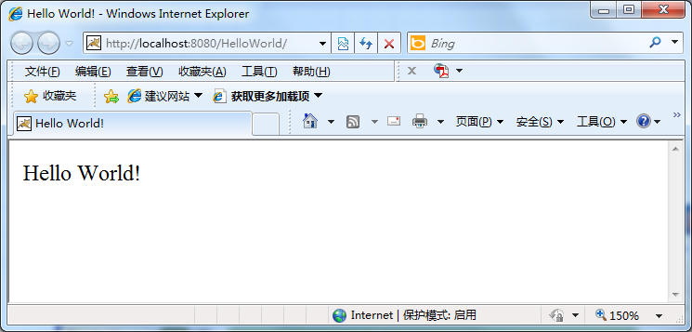
HelloWorld.java
http://localhost:port/HelloWorld

Slide 49
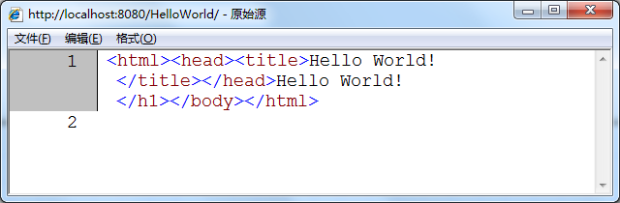
HelloWorld.java
查看源文件(HTTP响应)：

Slide 50
HelloWorld.java
package edu.nju.helloworld.servlets;
import javax.servlet.annotation.WebServlet;
import javax.servlet.http.HttpServlet;
import javax.servlet.http.HttpServletRequest;
import javax.servlet.http.HttpServletResponse;
import java.io.IOException;
import java.io.PrintWriter;

Slide 51
@WebServlet("/")
public class HelloWorld extends HttpServlet {
  public void service(HttpServletRequest request, HttpServletResponse response) throws IOException

Slide 52
  {
    response.setContentType("text/html");
    PrintWriter out = response.getWriter();
    out.println("<html><head><title>"+"Hello World!</title></head>"+"Hello World!</h1></body></html>");
  }
}

Slide 53
HelloWorld.java
public——允许任何Servlet容器访问
response.setContentType("text/html");
  设置HTTP响应标题的类型：HTML文本
PrintWriter out=response.getWriter();
  调用getWriter()方法，建立PrintWriter输出流
  getOutputStream()方法——二进制数据
out.println("<html><head><title>"+"Hello World! </title></head>"+"Hello World!</h1></body></html>");
  使用标准的print方法，把文本信息写到输出流中
  Server将写到该流的文本放入http响应体中，发送给客户端

Slide 54
@WebServlet("/“)
指定Servlet可以映射到哪种URL模式，http://host:port/webAppPrefix/URL模式
  /代表任意模式
  允许使用http://host:port/webAppPrefix代替http://host:port/webAppPrefix/ edu.nju.helloworld.servlets.HelloWorld

Slide 55
目录结构
D:\Java_ee\Lab\HelloWorld
  ——WEB-INF
    ————classes
      ——————edu
        ——————nju
        ————————helloworld
        ——————————servlets
        ————————————HelloWorld.class

Slide 56
Tomcat
Apache Jakarta软件组织的一个子项目
JSP/Servlet容器， JSP/Servlet规范的标准实现
工作模式：
  默认模式：作为独立的Servlet容器，是Java Web Server的一部分
  对现有服务器的扩展（支持Apache、IIS和Netscape服务等）

Slide 57
Tomcat的组织结构
基于组件的服务器，构成组件可配置
在<Tomcat_home>\conf\server.xml中配置组件

Slide 58
server.xml
<Server> 代表一个服务器，可包含多个Service
  <Service> 可包含一个Engine，多个Connector
    <Connector/> 代表通信接口
    <Engine> 可包含多个Host
      <Host> 可包含多个Context
        <Context>
        </Context>
      </Host>
    </Engine>
  </Service>
</Server>

Slide 59
Tomcat的组件
Server：代表一个服务器
Connector：在某个指定端口上侦听客户请求，并将获得的请求交给Engine来处理
  Java HTTP Connector在端口8080侦听来自客户Browser的http请求
  AJP 1.3 Connector在端口8009侦听来自其他Web Server(Apache)的JSP/Servlet代理请求
Engine：将获得的请求匹配到某个虚拟主机(Virtual Host)上，并把请求交给该Host来处理
Host：代表虚拟主机，每一个都和某个网络域名相匹配，每一个都可部署多个Web应用(对应不同的Context)

Slide 60
Tomcat的组件
Context：对应一个Web应用（由一些Servlet、HTML页面、Java类、JSP页面和一些其他的资源构成）。
  在创建时根据<Tomcat_home>\conf\web.xml和<Webapp_home>/WEB-INF/web.xml载入Servlet类
  在获得请求时，查询映射表，找到被请求的Servlet类，并执行以获得请求回应

Slide 61
Tomcat处理http请求
http://localhost:8080/HelloWorld/
1.请求被发送到本机端口8080，被Java HTTP Connector获得；
2. Connector将该请求交给它所在的Service的Engine来处理，并等待Engine的回应；
3. Engine获得请求，匹配所有虚拟主机；
4. Engine匹配到名为localhost的主机；
5. localhost主机获得请求，匹配所拥有的所有Context；
6. localhost主机匹配到路径为/HelloWorld的Context；

Slide 62
Tomcat处理http请求
7.路径为/HelloWorld的Context获得请求，在映射表中寻找对应的Servlet；
8.Context匹配到URL PATTERN为/的Servlet;
9.构造HttpServletRequest对象和HttpServletResponse对象，作为参数调用该Servlet的Service方法；
10. Context把执行完之后的HttpServletResponse对象返回给localhost主机；
11.Host把HttpServletResponse对象返回给Engine；
12. Engine把HttpServletResponse对象返回给Connector；
13. Connector把HttpServletResponse对象返回给客户Browser。

Slide 63
发布Tomcat应用程序
方法1：修改server.xml文件
  在<Host>元素和</Host>之间添加<Context>
      <Host>
        ……
        <Context crossContext=“true” debug=“5” docBase=“D:\Java_ee\Lab\HelloWorld” path=“/HelloWorld” reloadable=“true” workDir= “work\Catalina\localhost\Hello World” >
        </Context>
      </Host>
Context Path

Slide 65
发布Tomcat应用程序
方法2：使用Context片段
  在<Tomcat_home>\conf\Catalina\localhost目录下创建HelloWorld.xml文件
    <?xml version= "1.0" encoding= " UTF-8"?>
    <Context crossContext=“true” debug=“5” docBase=“D:\Java_ee\Lab\HelloWorld” path=“/HelloWorld” reload=“true” >
    </Context>

Slide 66
发布Tomcat应用程序
方法3：使用默认发布目录
  Tomcat_home
    webapps
      ——myapp (Context path)
        ——WEB-INF
        ————classes
        ——————…..

Slide 67
Eclipse+Tomcat
Lab-Tomcat-1.ppt

Slide 68
HelloServlet.java
package servlet;
import java.util.Date;
……
public class HelloServlet extends HttpServlet {
  static final private String CONTENT_TYPE = "text/html; charset=GBK";

Slide 69
HelloServlet.java
  public void service(HttpServletRequest req, HttpServletResponse resp)throws IOException {
    resp.setContentType(CONTENT_TYPE);
    PrintWriter out = resp.getWriter();
    out.println("<html>");
    out.println("<head><title>Hello</title></head>");
    out.println("<body>");
    out.println("<p>hello ,这是servlet的例子.at : "+new Date()+"</p>");
    out.println("</body></html>");
  }
}

Slide 70
web.xml
部署描述文件（Deployment Descriptor）,XML文件
应用程序的部署和运行信息，告诉应用服务器，对于给定的请求，应当怎样运行这些Java类

Slide 71
XML
Extensible Markup Language (XML)
XML is a text-based markup language that is fast becoming the standard for data interchange on the Web.
As with HTML, you identify data using tags (identifiers enclosed in angle brackets, like this: <...>). Collectively, the tags are known as “markup”.
But unlike HTML, XML tags identify the data, rather than specifying how to display it.

Slide 72
Basic Syntax
Required first line: <?xml version="1.0"?>——XML Declaration.
Single root element
Syntax of tags
Quoted tag attributes
Naming of tags and attributes
Nesting of tags

Slide 73
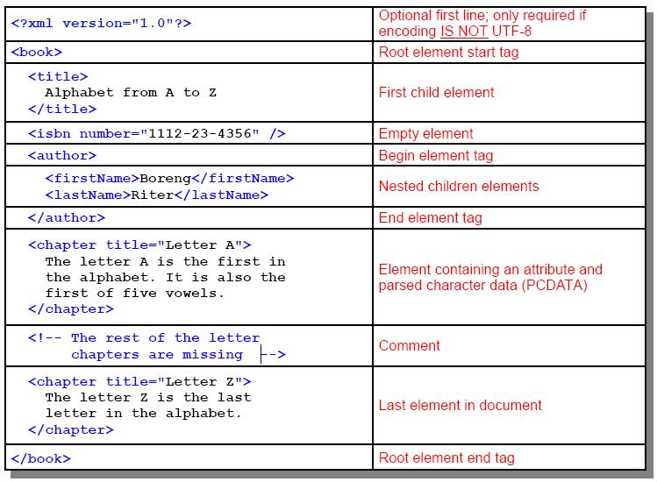
A Simple XML Document - Basic Structure

Slide 74
Tag Naming - Rules
Tag names must begin with a letter or underscore followed by any number of letters, numbers, dashes, periods, and underscore characters.
Tag names are case sensitive.
Names cannot contain spaces.
Names must not include W3C XML and Namespaces reserved words.

Slide 75
Element Attributes - Rules
Attributes provide additional information about an element by attaching characteristics to that element.
Consist of a name="value" pair.
Attributes are contained within an element's start tag.
An element may have multiple attributes.
Examples:
    <title type="section" number="1">XML overview</title>
    <title type="boat" state="FL">Yacht</title>
  Notice the different usage of the attribute "type" in the two elements; semantically they are not the same.
Attributes must have a value.
Attribute value must be quoted with either double or single quotes.
  Convention is to stick with one or the other.

Slide 76
DTD - Document Type Definition
Defines the structure and ordering of elements for an XML document.
Used to validate the contents of an XML document.
Enforces the concept of a valid document.
Parsers may or may not use the DTD file to test for validity.
  Based on the parser implementation and setup.
May be enclosed within the XML document or in a standalone file.
DTDs do not describe the data allowed within elements.
DTDs are not XML based.
Being slowly superseded by XML Schema.

Slide 77
XML Parsing
Provides an API for a program to access pieces of an XML document.
  Programming language independent specification.
  A programmer must write specific code to extend the parser.
Two API standards: DOM and SAX.
  Both perform processing of XML documents, but in distinct ways.
Parsers help with:
  Validation.
  Well formedness checking.
  Building a document tree (DOM).
  Notifying the application of errors.
Most parsers can handle files and streams.

Slide 78
web.xml
<?xml version="1.0" encoding="ISO-8859-1"?>
<!DOCTYPE web-app PUBLIC "-//Sun Microsystems, Inc.//DTD Web Application 2.3//EN" "http://java.sun.com/dtd/web-app_2_3.dtd">
<web-app>
  ……
  <servlet>
    <servlet-name>**</servlet-name>
    <servlet-class>**</servlet-class>
  </servlet>
  <servlet-mapping>
    <servlet-name>**</servlet-name>
    <url-pattern>**</url-pattern>
  </servlet-mapping>
  ……
</web-app>

Slide 79
web.xml
标题：DOCTYPE声明，告诉服务器适用的servlet规范的版本，指定DTD（Document Type Definition文档类型定义）
<!DOCTYPE web-app PUBLIC "-//Sun Microsystems, Inc.//DTD Web Application 2.3//EN" "http://java.sun.com/dtd/web-app_2_3.dtd">
主正文：根元素web-app
<web-app>
  ……
</web-app>

Slide 80
web.xml
<servlet>…… </servlet>:应包括的Servlet类
  <servlet>
    <servlet-name>Hello</servlet-name>
    <servlet-class>servlet.HelloServlet</servlet-class>
  </servlet>
  servlet-name的含义
    首先，初始化参数、定制的URL模式以及其他定制通过此注册名而不是类名引用此servlet
    其次,可在URL而不是类名中使用此名称
      可使用http://host:port/webAppPrefix/Hello代替http://host:port/webAppPrefix/servlet.HelloServlet (以Tomcat为例)
Context path
Servlet path

Slide 81
web.xml
<servlet-mapping>:指定Servlet可以映射到哪种URL模式，http://host:port/webAppPrefix/URL模式
  <servlet-mapping>
    <servlet-name>Hello</servlet-name>
    <url-pattern>/</url-pattern>
  </servlet-mapping>
  /代表任意模式
  允许使用http://host:port/webAppPrefix代替http://host:port/webAppPrefix/Hello

Slide 82
目录结构
D:\Java_ee\Lab\HelloServlet
  ——WEB-INF
    ————classes
      ——————servlet
        ————————HelloServlet.class
    ————web.xml

Slide 83
其他
url-pattern
Pattern | Servlet
/lawn/* | LawnServlet
/*.jsp | JSPServlet

Slide 84
其他
单线程和多线程：
  servlet默认是多线程的，Server创建一个实例，用它处理并发请求——编写线程安全的类，避免使用可以修改的类变量和实例变量；
  修改servlet类，实现SingleThreadMode1接口——单线程

Slide 85
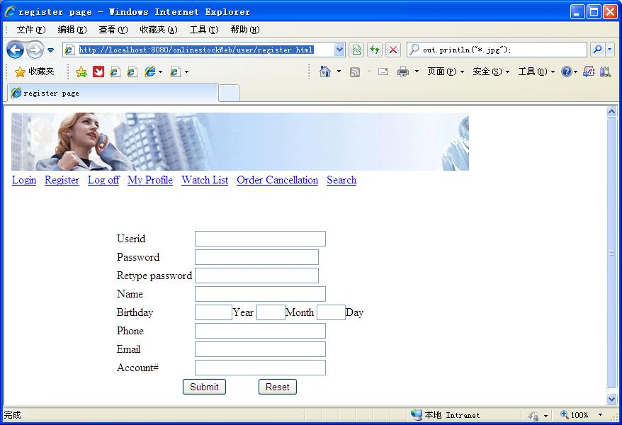
处理表单
编写HTML代码，建立Web表单，使用POST请求

Slide 86
HTTP request
POST - sends data of unlimited length to the Web server.
  在http请求体中包含附加数据，该数据在URL中不可见
  按Submit按钮，名称/值对被封装到http请求中
<form method="post" action=“../register.user">
  <table border="0“ align=center >
    <tr>
      <td>Userid:</td>
      <td>
        <input type=“text" name="userid“ size=25>
      </td>
    </tr>
    ……
    <tr>
    <td colspan="2" align="center">
    <input type="submit" value="Submit">&nbsp;&nbsp;&nbsp;&nbsp;&nbsp;&nbsp;&nbsp;&nbsp;&nbsp;&nbsp;
    <input type="reset" value="Reset">
    </td>
  </tr>
  </table>
</form>
/register.user为url-pattern
或/Contextpath/register.user

Slide 87
处理表单
Submit→Web浏览器使用POST请求，把数据发送给Server → Server把数据封装到HttpServletRequest的对象中
当Server收到POST请求后，其默认的service()方法基于请求的类型，自动的把请求分派给适当的方法：doPost()方法

Slide 88
处理表单
request.getParameterNames()方法，读取请求信息中的所有参数名字
request.getParameterValues(参数名字)方法，读取给定参数名字的值(值有多个)
request.getParameter(参数名字)方法，读取给定参数名字的值(返回一个值)

Slide 89
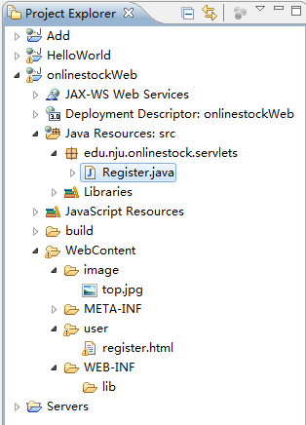
结构

Slide 90
Register.java----doPost()
String id=request.getParameter("userid");
……
if (id == null) id = "unknown";
……
response.setContentType("text/html");
PrintWriter pw=response.getWriter();
pw.println("<html>");
……
pw.println ("user with Userid "+id+" name "+name+" Phone "+phone+" Email "+email+" was added.");
……
pw.println("</body></html>")

Slide 91
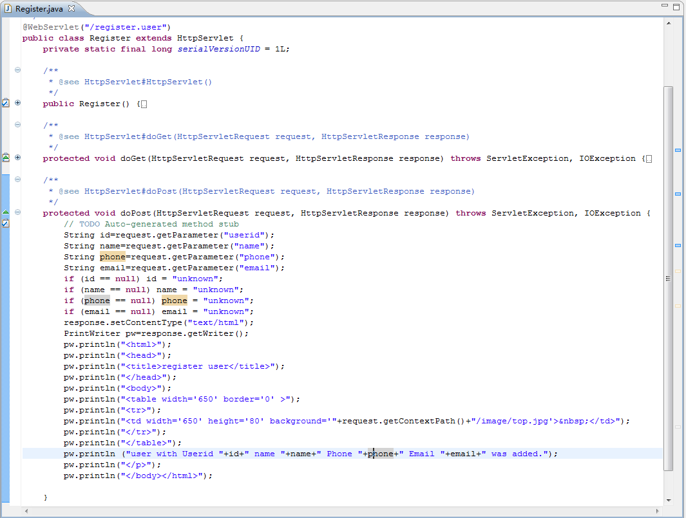

Slide 92
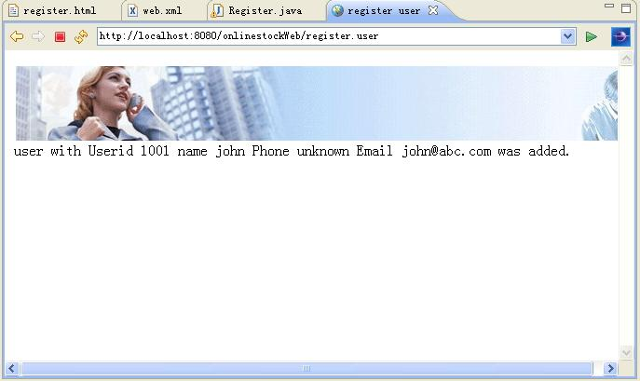
运行
http://localhost:8080/onlinestockWeb/user/register.html
提交表单

Slide 93
HttpServletRequest对象
request.getContextPath()
  /onlinestockWeb
HttpServletRequest对象封装了HTTP请求参数的详细内容
调用HttpServletRequest请求对象的方法，获取请求信息中的数据
  示例：调用HttpServletRequest请求对象的各种方法，显示其输出结果

Slide 94
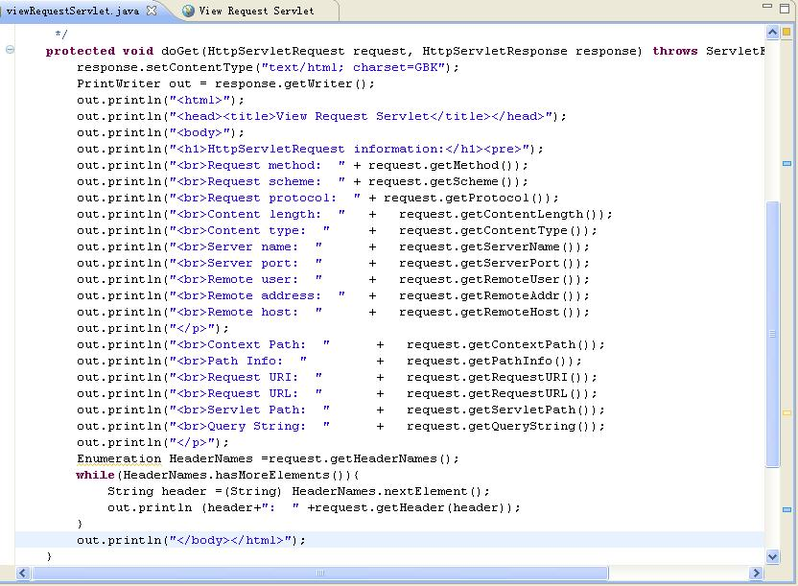
viewRequestServlet.java

Slide 95
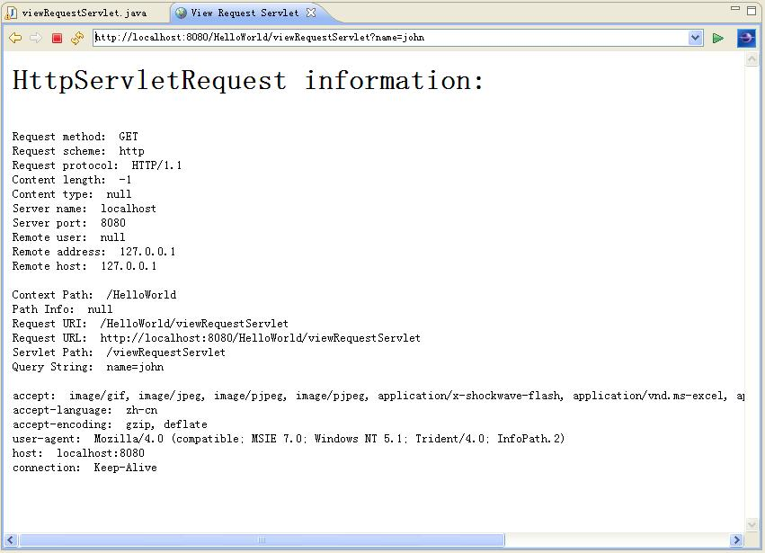

Slide 96
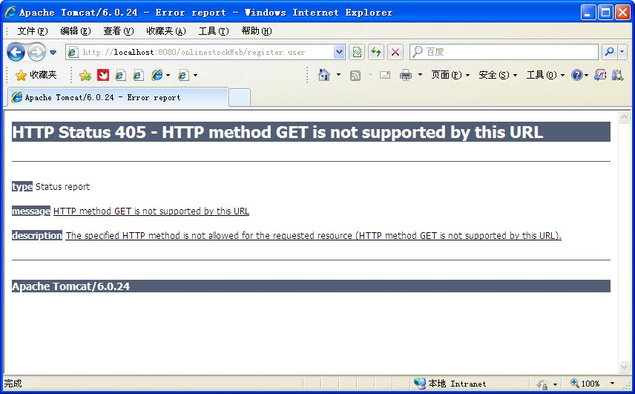
Get方法
http://localhost:8080/onlinestockWeb/register.user

Slide 97
HTTP request
GET请求指示web服务器将给定资源返回给客户端
GET - retrieves the resource identified by the request URL.
  GET请求可以包含参数，参数值在请求URL中可见
    http://www...com/pictures?id=12
  GET请求的长度和包含的信息数有限
当Server收到GET请求后，其默认的service()方法基于请求的类型，自动的把请求分派给适当的方法：doGet()方法

Slide 98
如果仍然包括一个定制的service()方法
  public void service(HttpServletRequest req,HttpServletResponse res)throws IOException,ServletException{
    res.setContentType("text/html");
    PrintWriter out=res.getWriter();
    out.println("<html>");
    … …
    out.println("</html>");
  }
无论收到的是get还是post请求，均执行service()方法，不执行doGet()或doPost()方法

Slide 99
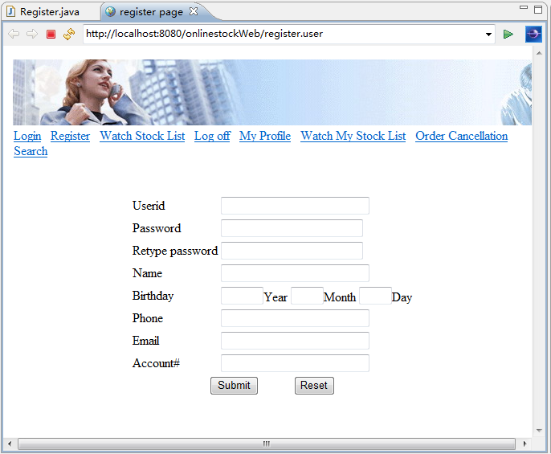
Include register.html

Slide 100
Invoking Other Web Resources
Web components can invoke other web resources in two ways: indirectly and directly.
  A web component indirectly invokes another web resource when it embeds a URL that points to another web component in content returned to a client.
  A web component can also directly invoke another resource while it is executing. There are two possibilities: The web component can include the content of another resource, or it can forward a request to another resource.

Slide 101
Invoking Other Web Resources
To invoke a resource available on the server that is running a web component, you must first obtain a RequestDispatcher object using the getRequestDispatcher("URL") method.
You can get a RequestDispatcher object from either a request or the web context; however, the two methods have slightly different behavior. The method takes the path to the requested resource as an argument.
  A request can take a relative path (that is, one that does not begin with a /), but the web context requires an absolute path.
If the resource is not available or if the server has not implemented a RequestDispatcher object for that type of resource, getRequestDispatcher will return null.

Slide 102
Including Other Resources in the Response
It is often useful to include another web resource in the response returned from a web component. To include another resource, invoke the include method of a RequestDispatcher object:
  include(request, response);
If the resource is static, the include method enables programmatic server-side includes.
If the resource is a web component, the effect of the method is to send the request to the included web component, execute the web component, and then include the result of the execution in the response from the containing servlet.

Slide 103
Including Other Resources in the Response
An included web component has access to the request object, but it is limited in what it can do with the response object:
  It can write to the body of the response and commit a response.
  It cannot set headers or call any method (for example, setCookie) that affects the headers of the response.

Slide 104
doGet()
RequestDispatcher dispatcher =request.getRequestDispatcher("/user/register.html");
if (dispatcher != null)
  dispatcher.include(request,response);
  //dispatcher.forward(request,response);

Slide 105
Transferring Control to Another Web Component
In some applications, you might want to have one web component do preliminary processing of a request and have another component generate the response. For example, you might want to partially process a request and then transfer to another component depending on the nature of the request.
To transfer control to another web component, you invoke the forward method of a RequestDispatcher. When a request is forwarded, the request URL is set to the path of the forwarded page.

Slide 106
Transferring Control to Another Web Component
The forward method should be used to give another resource responsibility for replying to the user. If you have already accessed a ServletOutputStream or PrintWriter object within the servlet, you cannot use this method; doing so throws an IllegalStateException.

Slide 107
HttpServletResponse响应对象
sendRedirect(String location): 将客户端重定向到location；
protected void doGet(HttpServletRequest request, HttpServletResponse response) throws ServletException, IOException {
  response.sendRedirect(request.getContextPath()+"/user/register.html");
}

Slide 108
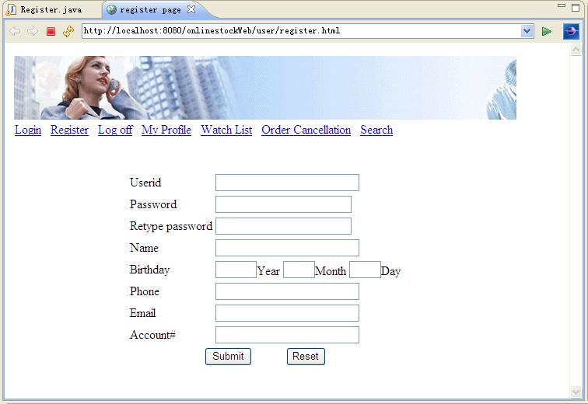
运行http://localhost:8080/onlinestockWeb/register.user

Slide 109
Servlet Application Architecture
Allowing the servlet container to serve static content is not preferable.
  Because the content is faster if served by a more robust HTTP server
    Such as Apache web server or Microsoft internet information server
It is common practice to put a web server at the front to handle all client requests.
  The web server serves static content and passes to the servlet containers all client requests for servlets.
Servlet
Container
Servlet
Http request
HTTP
Server
Browser
Http response
Static
Content

Slide 110
Tomcat
工作模式：
  默认模式：作为独立的Servlet容器，是Java Web Server的一部分
  对现有服务器的扩展（支持Apache、IIS和Netscape服务等）

Slide 111
Maintaining Client State
Many applications require that a series of requests from a client be associated with one another.
For example, the Duke’s Bookstore application saves the state of a user’s shopping cart across requests.
Web-based applications are responsible for maintaining such state, called a session, because HTTP is stateless. To support applications that need to maintain state, Java Servlet technology provides an API for managing sessions and allows several mechanisms for implementing sessions.

Slide 112
Accessing a Session
Sessions are represented by an HttpSession object. You access a session by calling the getSession method of a request object. This method returns the current session associated with this request, or, if the request does not have a session, it creates one.
javax.servlet.http.HttpSession

Slide 113
Request/Session
从HttpServletRequest对象中获得会话对象
  HttpSession session=request.getSession(true);
  true：如果会话对象不存在，一个新的会话对象将被创建——如果不断提交请求，一个人可以创建大量的会话对象，耗尽服务器上的内存资源
好的实践：
  HttpSession session=request.getSession(false);
  //如果会话对象不存在，不能创建新会话
  if(session==null){
    response.sendRedirect(“http://……/login”);
    //强迫用户登录，成功登录之后，才能创建新会话
    //当用户注销时，使会话失效--session.invalidate()
  }

Slide 114
Associating Objects with a Session
You can associate object-valued attributes with a session by name.
Such attributes are accessible by any web component that belongs to the same web context and is handling a request that is part of the same session.
The Duke’s Bookstore application stores a customer’s shopping cart as a session attribute. This allows the shopping cart to be saved between requests and also allows cooperating servlets to access the cart.

Slide 115
Session/Attribute
会话数据使用名称/值对存储在HttpSession对象中
使用指定的名字把对象捆绑到会话中
  session.setAttribute(name,attribute);
返回捆绑到会话中指定名字上的对象
  session.getAttribute(name);
session. removeAttribute(name)：删除绑定

Slide 116
Session Management
Because there is no way for an HTTP client to signal that it no longer needs a session, each session has an associated timeout so that its resources can be reclaimed.
The timeout period can be accessed by using a session’s [get|set]MaxInactiveInterval methods.
You can also set the timeout period in the deployment descriptor.
When a particular client interaction is finished, you use the session’s invalidate method to invalidate a session on the server side and remove any session data.

Slide 117
Session Tracking
A web container can use several methods to associate a session with a user, all of which involve passing an identifier between the client and the server. The identifier can be maintained on the client as a cookie, or the web component can include the identifier in every URL that is returned to the client.
If your application uses session objects, you must ensure that session tracking is enabled by having the application rewrite URLs whenever the client turns off cookies. You do this by calling the response’s encodeURL(URL) method on all URLs returned by a servlet. This method includes the session ID in the URL only if cookies are disabled; otherwise, it returns the URL unchanged.

Slide 118
Web会话——Cookie机制
1、当用户第一次访问站点→创建一个新的会话对象（Httpsession）， Server分配一个唯一的会话标识号(sessionID)；
  Servlet容器自动处理sessionID的分配
  尽可能长，确保安全
  把sessionID信息放到HttpSession对象中
2、Server创建一个暂时的HTTP cookie
  cookie存储这个sessionID（名:jsessionid）
  Server将cookie添加到HTTP响应中
  Cookie被放置到客户机浏览器中，存储到客户机硬盘

Slide 119
Web会话——Cookie机制
3、客户浏览器发送包含Cookie的请求；
4、根据客户机浏览器发送的sessionID信息（cookie），Server找到相应的HttpSession对象，跟踪会话
5、在会话超时间隔期间，如果没有接收到新的请求， Server将删除此会话对象
  用户又访问该站点，必须重新登录，确保安全

Slide 120
Web会话——URL重写
Cookie被客户禁用时，采用URL重写机制：
  调用reponse.encodeURL(URL)方法；
  http://…;jsessionid=….
1、5与Cookie机制相同
2、Server将sessionID放在返回给客户端的URL中；
3、客户浏览器发送的请求将包含sessionID；
4、根据包含请求的sessionID信息（URL），Server找到相应的HttpSession对象，跟踪会话

Slide 121
其他Session方法
session.isNew()
session.getId()
session.getCreationTime()
session.getLastAccessedTime()

Slide 122
示例
记录页面请求次数
  请求同一页面（SessionServlet），记录访问次数

Slide 123
SessionServlet.java
public void doGet(HttpServletRequest req,HttpServletResponse res)throws IOException,ServletException{
  HttpSession session=req.getSession(true);
  res.setContentType("text/html");
  PrintWriter out=res.getWriter();
  out.println("<head><title>"+"SessionServlet Output</title></head><body>");
  out.println("<h1>SessionServlet Output</h1>");

Slide 124
SessionServlet.java
  Integer ival = (Integer) session.getAttribute ("sessiontest.counter");
  if(ival==null)
    ival=new Integer(1);
  else
    ival=new Integer(ival.intValue()+1);
  session.setAttribute("sessiontest.counter",ival);
  out.println("You have hit this page <b>"+ival+"</b> times.<p>");
  out.println("Click <a href=" + res.encodeURL ("/Counter/SessionServlet") + ">here</a>");
  out.println(" to ensure that session tracking is working even if cookies aren't supported. ");

Slide 125
SessionServlet.java
  out.println("<h3>Session Data:</h3>");
  out.println("Session ID in Request: " + req.getRequestedSessionId());
  out.println("<br>Session ID in Request from Cookie: " + req.isRequestedSessionIdFromCookie());
  out.println("<br>Session ID in Request from URL: " + req.isRequestedSessionIdFromURL());

Slide 126
SessionServlet.java
  out.println("New Session: "+session.isNew());
  out.println("<br>Session ID: "+session.getId());
  out.println("<br>Creation Time: "+session.getCreationTime());
  out.println("<br>Last Accessed Time: "+session.getLastAccessedTime());
}

Slide 127
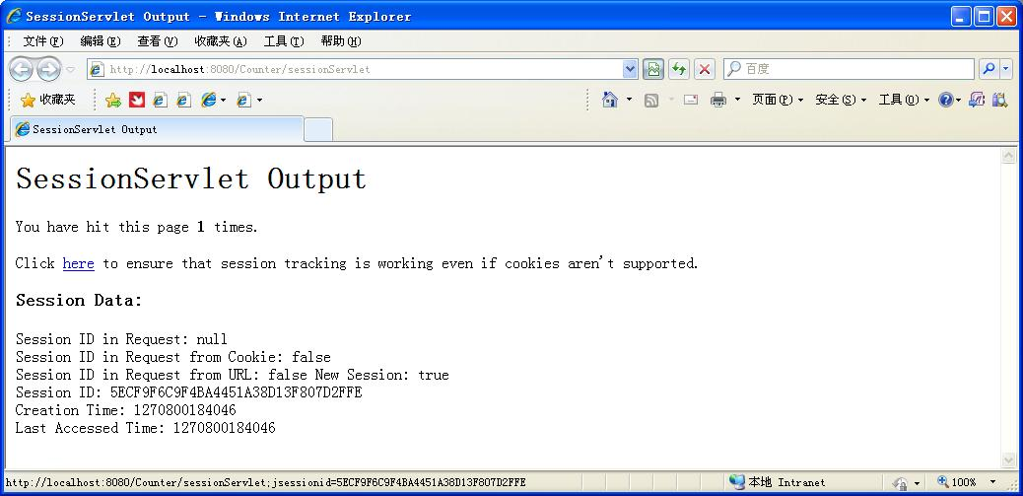

Slide 128
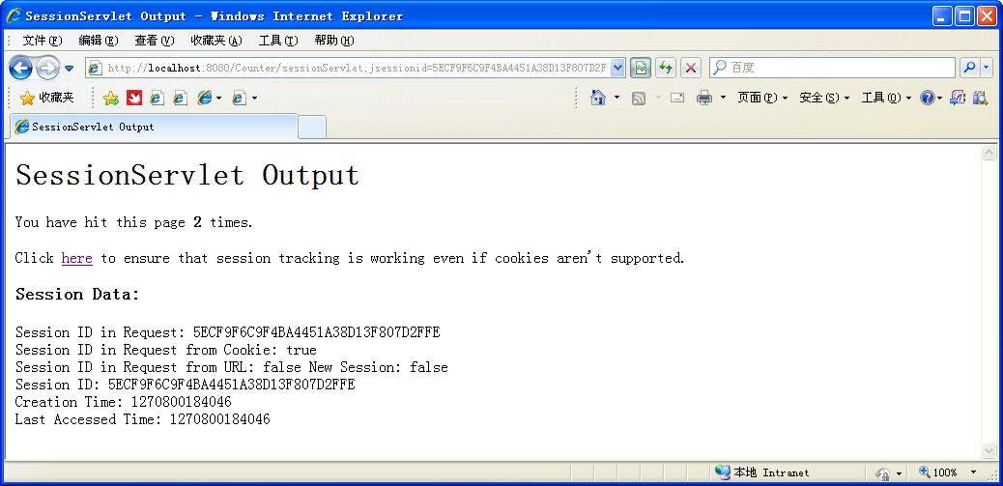

Slide 129
购物车
将客户的购物车作为会话属性保存，保证了购物车可以被保存以传给多个请求，还使得相互协作的多个servlet都可以访问购物车。

Slide 130
Cookie
跟踪会话，也可以独立于HTTP会话使用Cookie
长期“记住用户信息”
存储在本地计算机的硬盘上
  如：在线书店，按照用户的爱好，当用户再次访问站点时，向用户推荐书籍

Slide 131
创建Cookie
Cookie类是Servlet包的一部分
  Cookie myCookie=new Cookie(name,value);
加到HTTP响应信息中
  res.addCookie(myCookie);
Server自动把它加到客户机的浏览器中，当用户退出Browser时，cookie会被删除掉，而不会被存储在客户端的硬盘上。
如果要存储 cookie，需加一句myCookie.setMaxAge(int expiry) ，浏览器将把它存储在本地计算机的硬盘上

Slide 132
读取Cookie
当Server调用一个Servlet时，浏览器发送的Cookie将包含在HttpServletRequest对象中。
Cookie[] cookies=req.getCookies();
String foo= Cookie[0].getname();

Slide 133
示例
使用Cookie，记录用户id，预填充；
使用会话，跟踪登录状态

Slide 134
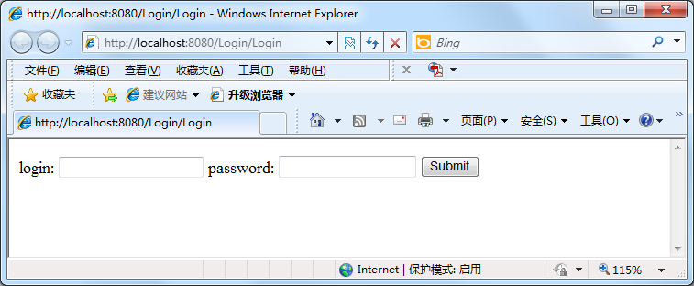
CookieServlet.java
初次访问http://localhost:8080/Login/CookieServlet
，doGet()，未创建session/cookie/login属性，转向登录表单

Slide 135
转向登录表单
String loginValue = request.getParameter("login");
boolean isLoginAction = (null == loginValue) ? false : true;
if (isLoginAction) {
  ……
else{
  response.sendRedirect("req.getContextPath() + "/Login”);
}

Slide 136
Login.java
初次访问，未创建session/cookie/login属性，显示登录表单；
提交请求，doPost() ，提交至/CookieServlet
  如：Login：Mary

Slide 137
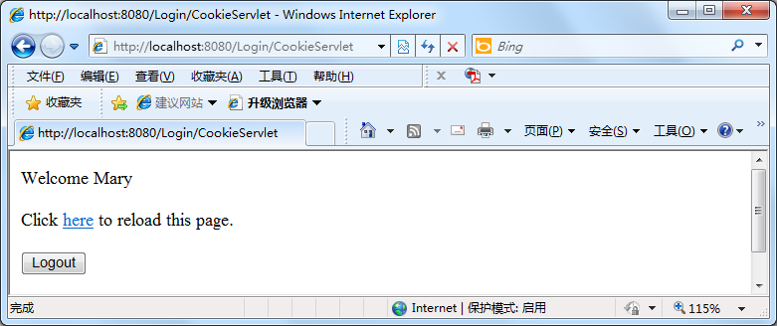
CookieServlet.java
用户已登录，创建会话，绑定login属性，创建loginCookie;

Slide 138
创建会话/Cookie
if (isLoginAction) {
  ……
  cookie = new Cookie("LoginCookie", loginValue);
  cookie.setMaxAge(Integer.MAX_VALUE);
  response.addCookie(cookie);
  ……
  session = request.getSession(true);
  session.setAttribute("login",loginValue);
  request.setAttribute("login",loginValue);
  displayLogoutPage(request, response);
}

Slide 139
public void displayLogoutPage(HttpServletRequest req,HttpServletResponse res) throws IOException {
  res.setContentType("text/html");
  PrintWriter out = res.getWriter();
  out.println("<html><body>");
  out.println("<p>Welcome " + req.getAttribute("login") + "</p>");
  //注销Logout
  out.println("<form method='GET' action=‘” + res.encodeURL(req.getContextPath()+"/Login“) + "'>");
  //点击here，会话有效
  out.println("Click <a href=‘” + res.encodeURL(req.getRequestURI()) + "'>here</a> to reload this page.<br>");
  ……
}

Slide 140
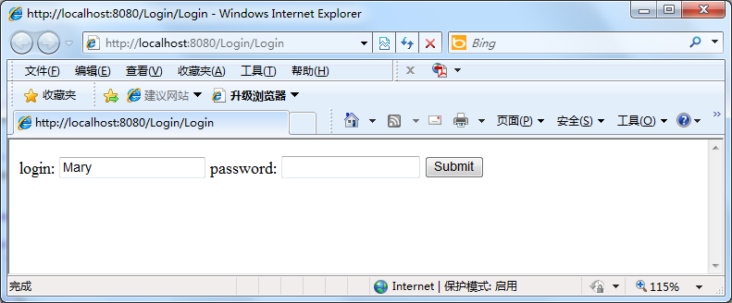
CookieServlet.java
提交注销请求
  <form method= ” GET ” action= ” + res.encodeURL(req.getContextPath()+“/Login” >

Slide 141
Login.java
注销请求，使会话失效，显示登录表单；
使用曾经填充的login值(cookie)进行预填充；
……
如再次访问http://localhost:8080/Login/Login ，根据Cookie，预填充用户的ID。

Slide 142
注销，会话失效
if (null != request.getParameter("Logout")) {
  if (null != session) {
    session.invalidate();
    session = null;
  }
}

Slide 143
Cookie预填充
Cookie cookie = null;
Cookie[] cookies = request.getCookies();
if (null != cookies) {
  for (int i = 0; i < cookies.length; i++) {
    cookie = cookies[i];
    if (cookie.getName().equals("LoginCookie")) {
      login=cookie.getValue();
      break;
    }
  }
}
……
out.println("login: <input type='text' name='login' value='" + login + "'>");

Slide 144
Cookie与Session
Session
  跟踪用户的购物车
  导航信息，登录状态
Cookie
  用户登录ID
  用户对语言和颜色的选择之类的偏好
  跟踪应用程序的使用情况
  cookie.txt文件

Slide 145
单线程和多线程
Servlet默认是多线程的
  实例变量是在堆中分配的，不是线程安全的；
  request，response是线程安全的
  局部变量是在栈中分配的，是线程安全的
    局部变量可作为参数传递

Slide 146
作业2：学生课程成绩查询应用
学生登录，跟据学生的ID，查询当前课程成绩（使用文件）
并根据成绩，确定返回结果
  有不及格课程：警示页面
  正常结果：标准页面
  未知的学生ID：错误页面

Slide 147
Sharing Information
Web components, like most objects, usually work with other objects to accomplish their tasks.
There are several ways they can do this
  they can use private helper objects (for example, JavaBeans components)
  they can share objects that are attributes of a public scope
  they can use a database
  they can invoke other web resources.

Slide 148
Using Scope Objects
Collaborating web components share information by means of objects that are maintained as attributes of four scope objects.
You access these attributes using the [get|set]Attribute methods of the class representing the scope.

Slide 149
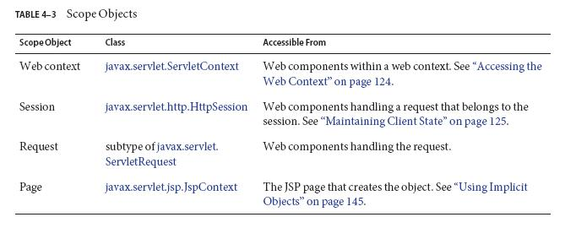

Slide 150
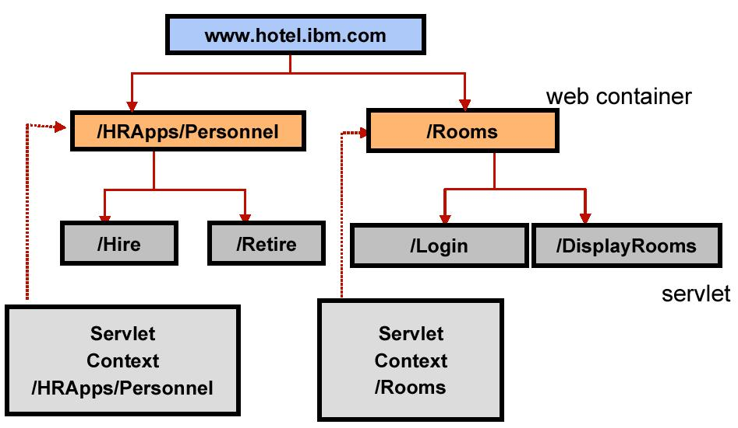
ServletContext

Slide 151
Accessing the Web Context
You retrieve the web context using the getServletContext method. The web context provides methods for accessing:
  Initialization parameters
  Resources associated with the web context
  Object-valued attributes
  Logging capabilities

Slide 152
ServletContext
ServletContext包含Web应用的配置信息，Servlet需要的某些外部资源的所在位置等信息
请求转发：将客户端定向到另一个资源
包括其他资源的输出

Slide 153
ServletContext
ServletContext sc=getServletContext();
sc.setAttribute("name", "value");
sc.getAttribute("name");
sc.removeAttribute("name");

Slide 154
Controlling Concurrent Access to Shared Resources
In a multithreaded server, it is possible for shared resources to be accessed concurrently. In addition to scope object attributes, shared resources include in-memory data (such as instance or class variables) and external objects such as files, database connections, and network connections.
Concurrent access can arise in several situations:
  Multiple web components accessing objects stored in the web context.
  Multiple web components accessing objects stored in a session.
  Multiple threads within a web component accessing instance variables. (implement the SingleThreadModel interface)

Slide 155
When resources can be accessed concurrently, they can be used in an inconsistent fashion. To prevent this, you must control the access using the synchronization techniques.

Slide 156
Filtering Requests and Responses
A filter is an object that can transform the header and content (or both) of a request or response.
Filters differ from web components in that filters usually do not themselves create a response. Instead, a filter provides functionality that can be “attached” to any kind of web resource.
a filter should not have any dependencies on a web resource for which it is acting as a filter; this way it can be composed with more than one type of web resource.

Slide 157
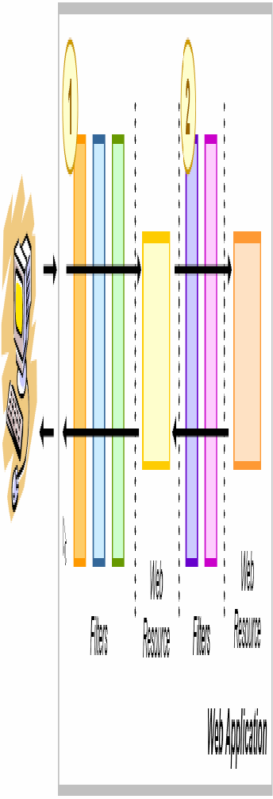
Servlet Filters in Web Applications

Slide 158
The main tasks that a filter can perform are as follows:
  Query the request and act accordingly.
  Block the request-and-response pair from passing any further.
  Modify the request headers and data.
  Modify the response headers and data.
  Interact with external resources.
Applications of filters include authentication, logging, image conversion, data compression, encryption, tokenizing streams, XML transformations, and so on.

Slide 159
Programming Filters
The filtering API is defined by the Filter, FilterChain, and FilterConfig interfaces in the javax.servlet package.
You define a filter by implementing the Filter interface.

Slide 160
define a filter
Use the @WebFilter annotation to define a filter in a web application.
The annotated filter must specify at least one URL pattern.
Classes annotated with the @WebFilter annotation must implement the javax.servlet.Filter interface.

Slide 161
doFilter, init and destroy
The most important method in the Filter interface is doFilter, which is passed request, response, and filter chain objects. This method can perform the following actions:
  Examine the request headers.
  Customize the request object if the filter wishes to modify request headers or data.
  Customize the response object if the filter wishes to modify response headers or data.
  Invoke the next entity in the filter chain.
  Examine response headers after it has invoked the next filter in the chain.
  Throw an exception to indicate an error in processing.
In addition to doFilter, you must implement the init and destroy methods. The init method is called by the container when the filter is instantiated. If you wish to pass initialization parameters to the filter, you retrieve them from the FilterConfig object passed to init.

Slide 162
javax.servlet.Filter接口
public void init(FilterConfig config) throws ServletException;
public void doFilter(ServletRequest req, ServletResponse res, FilterChain chain) throws IOException, ServletException;
public void destroy( );

Slide 163
Programming Customized Requests and Responses
There are many ways for a filter to modify a request or response. For example, a filter can add an attribute to the request or can insert data in the response.
A filter that modifies a response must usually capture the response before it is returned to the client. To do this, you pass a stand-in stream to the servlet that generates the response. The stand-in stream prevents the servlet from closing the original response stream when it completes and allows the filter to modify the servlet’s response.
To pass this stand-in stream to the servlet, the filter creates a response wrapper that overrides the getWriter or getOutputStream method to return this stand-in stream. The wrapper is passed to the doFilter method of the filter chain. Wrapper methods default to calling through to the wrapped request or response object.

Slide 164
Specifying Filter Mappings
A web container uses filter mappings to decide how to apply filters to web resources. A filter mapping matches a filter to a web component by name, or to web resources by URL pattern.
You specify a filter mapping list in its deployment descriptor.

Slide 165
过滤器
改善代码重用，在不修改servlet代码的情况下向servlet添加功能；
  如：身份认证
可用于跨多个servlet执行一些功能，创建可重复使用的功能

Slide 166
过滤器
在servlet处理请求之前，截获请求
  如：在调用servlet之前，截获请求，验证用户身份，未经授权的用户遭到拒绝，而servlet不知道曾经有过这样的请求

Slide 167
示例
限制对登录名以字母D开头的已登录用户的访问
public class OnlyDsFilter implements Filter{
  ……
}

Slide 168
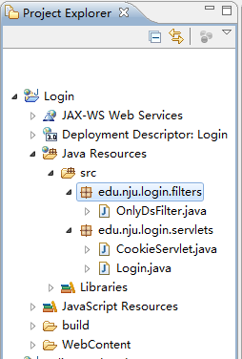
示例
限制对登录名以字母D开头的已登录用户的访问

Slide 169
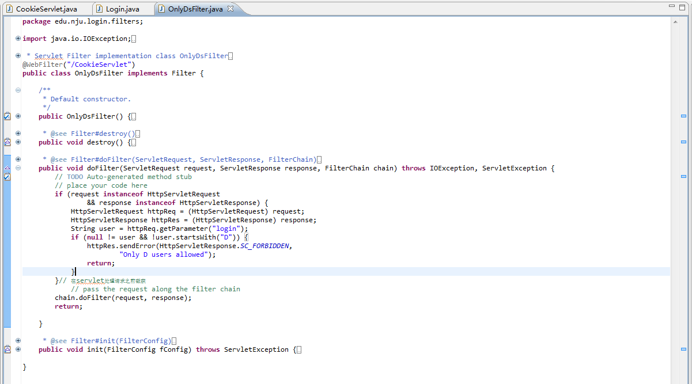
doFilter()

Slide 170
String user = httpReq.getParameter("login");
if(null != user && !user.startsWith("D")) {
  httpRes.sendError(HttpServletResponse.SC_FORBIDDEN, "Only D users allowed");
  return;
}
chain.doFilter(request, response);

Slide 171
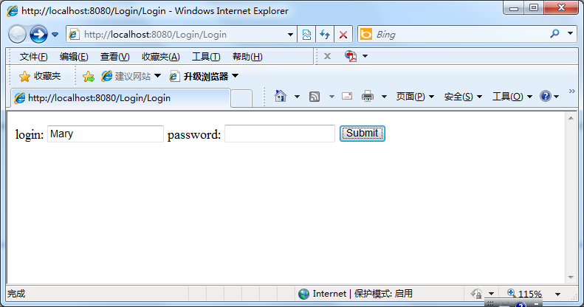

Slide 172
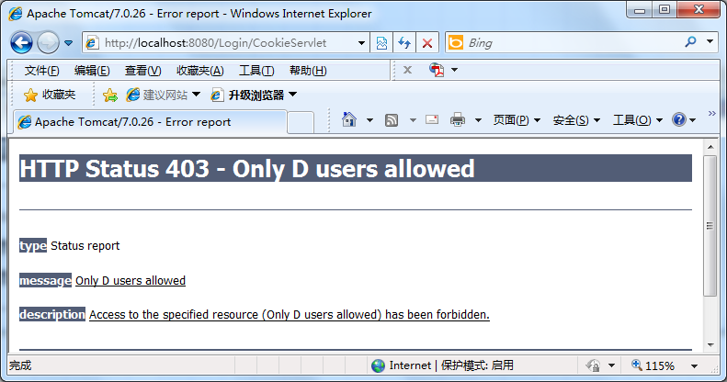

Slide 173
等价于web.xml
<filter>
  <display-name>OnlyDsFilter</display-name>
  <filter-name>OnlyDsFilter</filter-name>
  <filter-class>edu.nju.login.filters.OnlyDsFilter</filter-class>
</filter>
<filter-mapping>
  <filter-name>OnlyDsFilter</filter-name>
  <url-pattern>/CookieServlet</url-pattern>
</filter-mapping>

Slide 174
<filter-mapping>
或者
  <filter-mapping>
    <filter-name>OnlyDs</filter-name>
    <url-pattern>/D/*</url-pattern>
  </filter-mapping>
  ……
  <servlet-mapping>
    <servlet-name>SpecialServlet</servlet-name>
    <url-pattern>/D/SpecialServlet</url-pattern>
  </servlet-mapping>
/D/*为前缀匹配，可匹配/D, /D/, /D/b.c

Slide 175
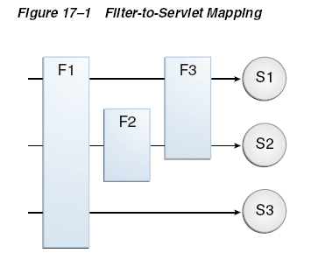

Filter-to-Servlet Mapping

Slide 176
多个filter的运行顺序
如果有多个filter与当前请求（URL-Pattern）匹配
  将 filter-mapping 元素按其在 web.xml 部署描述符中出现的顺序添加到链中
  即，按照web.xml中filter-mapping出现的顺序运行

Slide 177
注释与xml文件
注释往往是类级别的，因此，XML 配置则可以表现得更加灵活
在应用中，往往需要同时使用注释配置和 XML 配置
  对于类级别且不会发生变动的配置可以优先考虑注释配置
  而对于那些第三方类以及容易发生调整的配置则应优先考虑使用 XML 配置

Slide 178
过滤器
在servlet处理请求之后作出响应
在响应到达客户端之前捕获它
方法：编写自定义的响应
  传递替代流(stand-in stream)到产生响应的servlet，替代流防止servlet关闭原始的响应流，允许过滤器修改servlet的响应

Slide 179
将特殊标记放在http响应中
将响应中的@version@，替换为某个值
CookieServlet.java
  ……
  out.println("<p>Servlet is version @version@</p>");
  out.println("</form></body></html>");

Slide 180
包装器类
HttpServletResponseWrapper
为HttpServletResponse中的所有方法提供一个默认的实现
  getWriter(), getOutputStream(), toByteArray()
  flushBuffer(), resetBuffer(), reset()
  setContentType()
重写这些方法，以更新原始响应对象的输出缓冲区

Slide 181
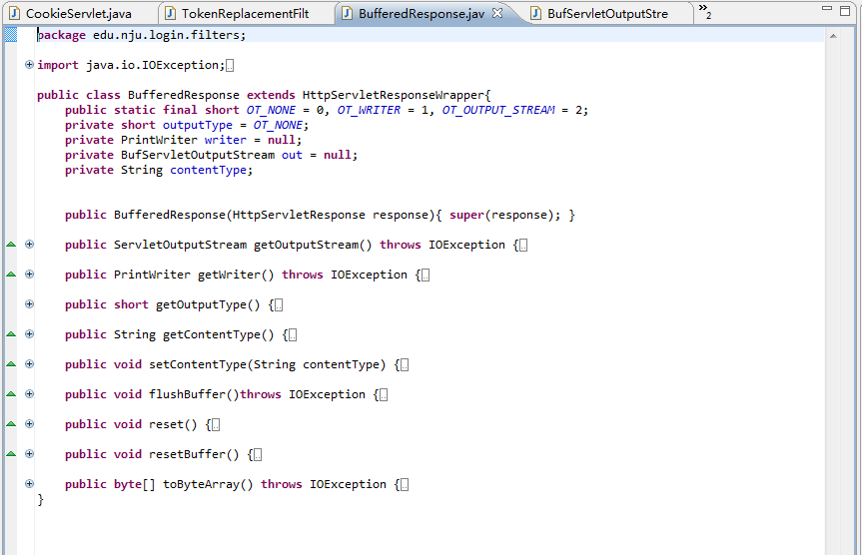

Slide 182
过滤器TokenReplacementFilter
import javax.servlet.annotation.WebFilter;
import javax.servlet.annotation.WebInitParam;
……
@WebFilter(urlPatterns="/CookieServlet",
filterName= "TokenReplacementFilter",
initParams={
@WebInitParam( name ="token.name", value="version"), @WebInitParam( name ="token.value", value="3.0") }
)
public class TokenReplacementFilter implements Filter {
  private String replToken, replValue;
  ……
}

Slide 183
init(FilterConfig fConfig)
replToken = fConfig.getInitParameter("token.name");
replValue = fConfig.getInitParameter("token.value");
if (null == replToken) {
  throw new ServletException("TokenReplacementFilter named " + fConfig.getFilterName() +" missing token.name init parameter.");
}
if (null == replValue) {
  throw new ServletException("TokenReplacementFilter named " + fConfig.getFilterName() +" missing token.value init parameter.");
}

Slide 184
doFilter()
BufferedResponse resWrapper = new BufferedResponse((HttpServletResponse)response);
chain.doFilter(request, resWrapper);
if (resWrapper.getOutputType() == BufferedResponse.OT_WRITER) {
  String resBody = new String(resWrapper.toByteArray(),resWrapper.getCharacterEncoding());

Slide 185
  if (resWrapper.getContentType().equals("text/html")) {
    //对字节数组进行处理：用replValue替换@replToken@
    resBody = resBody.replaceAll("@" + replToken + "@", replValue);
    //调整响应的content-Length
    response.setContentLength(resBody.length());
  }
  PrintWriter writer = response.getWriter();
  writer.println(resBody);//将数组写入实际响应对象中
} else if (resWrapper.getOutputType() == BufferedResponse.OT_OUTPUT_STREAM) {
  //不替换
  ServletOutputStream out = response.getOutputStream();
  out.write(resWrapper.toByteArray());
}

Slide 186
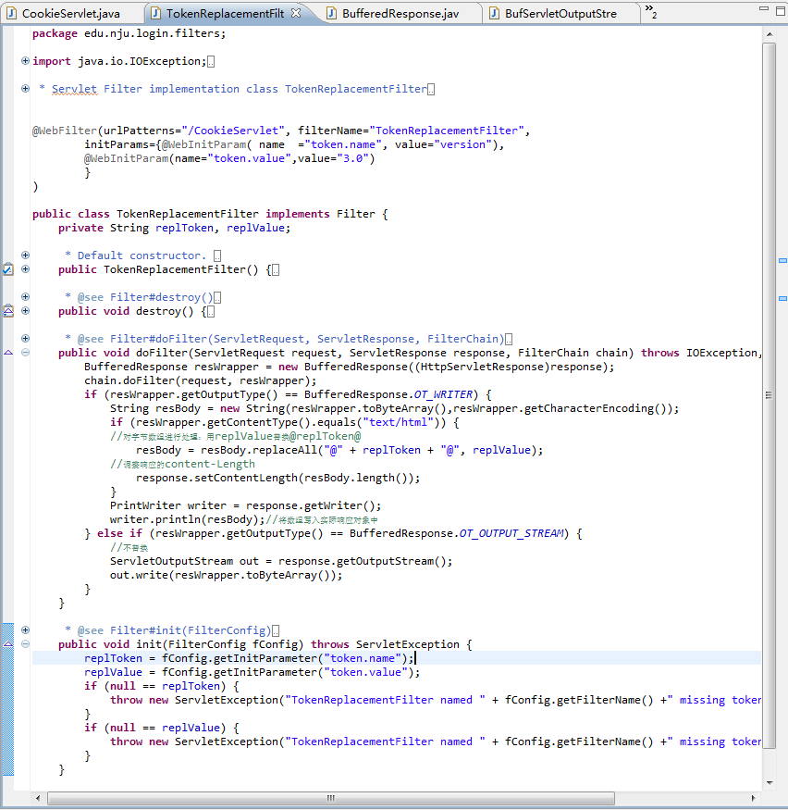

Slide 187
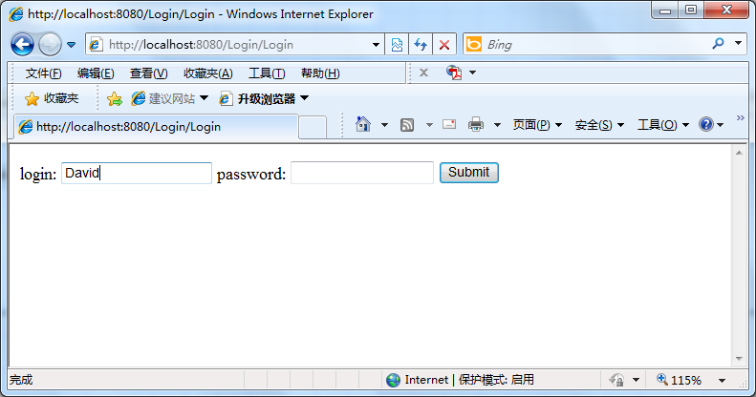

Slide 188
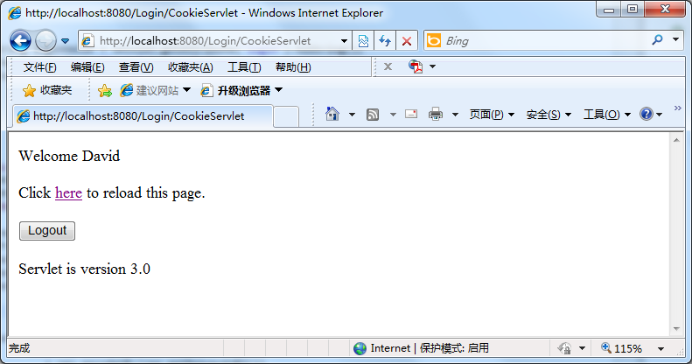

Slide 189
等价于web.xml——filter
<filter>
  <display-name>TokenReplacementFilter</display-name>
  <filter-name>TokenReplacementFilter</filter-name>
  <filter-class>edu.nju.login.filters.TokenReplacementFilter</filter-class>
  <init-param>
    <param-name>token.name</param-name>
    <param-value>version</param-value>
  </init-param>
  <init-param>
    <param-name>token.value</param-name>
    <param-value>3.0</param-value>
  </init-param>
</filter>
<filter-mapping>
  <filter-name>TokenReplacementFilter</filter-name>
  <url-pattern>/CookieServlet</url-pattern>
</filter-mapping>

Slide 190
过滤器的应用
代码重用
应用安全策略
日志
为特定目标浏览器传输XML输出
图像转换、加密
动态压缩输出

Slide 191
Struts2 filter应用

Slide 192
作业3（在作业2基础上完成）
使用过滤器解决表单中的中文请求后的乱码问题

Slide 193
常规解决方法
……
protected void doPost(HttpServletRequest request, HttpServletResponse response) throws ServletException, IOException {
  //对请求进行统一编码
  request.setCharacterEncoding("utf-8");
  String name=request.getParameter("name");
  System.out.println(name);
  response.setContentType("text/html; charset=utf-8");
  ……
}

Slide 194
问题
其他servlets，都需要修改代码

Slide 195
Handling Servlet Life-Cycle Events
You can monitor and react to events in a servlet’s life cycle by defining listener objects whose methods get invoked when life-cycle events occur.

Slide 196
Defining the Listener Class
You define a listener class as an implementation of a listener interface.
When a listener method is invoked, it is passed an event that contains information appropriate to the event.

Slide 197
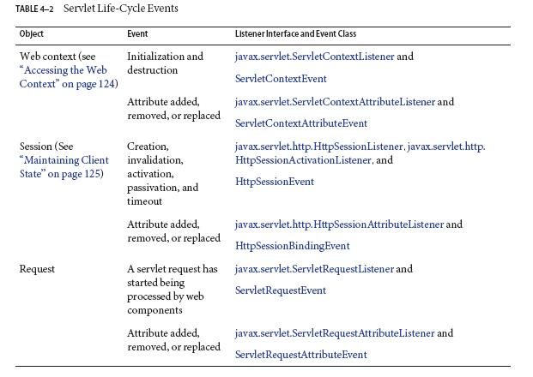

Slide 198
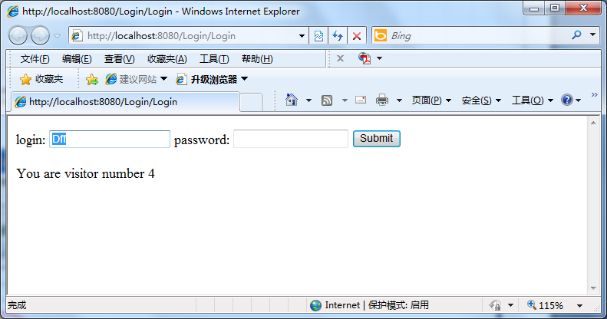
示例
访问web应用的次数

Slide 199
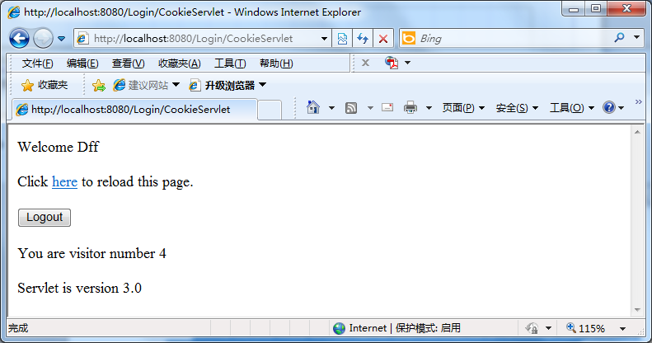

Slide 200
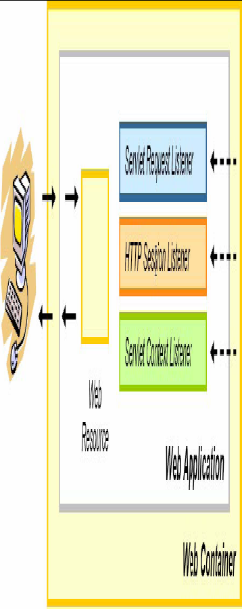

Slide 201
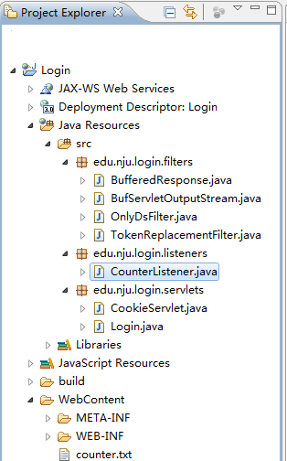

Slide 202
ServletContextListener, ServletContextAttributeListener
@WebListener
public class CounterListener implements ServletContextListener, ServletContextAttributeListener {
  int counter;
  String counterFilePath= "D:\\JEE\\2012\\workspace\\Login\\WebContent\\counter.txt";
  public void contextInitialized(ServletContextEvent cse) {
    try {
      BufferedReader reader = new BufferedReader(new FileReader(counterFilePath));
      counter = Integer.parseInt( reader.readLine() );
      reader.close();
      System.out.println("Reading" + counter);}
    catch (Exception e) {
      System.out.println(e.toString());
    }
    ServletContext servletContext= cse.getServletContext();
    servletContext.setAttribute("pageCounter", Integer.toString(counter));
    System.out.println("Application initialized");
  }

Slide 203
  public void attributeAdded(ServletContextAttributeEvent arg0) {
    System.out.println("ServletContextattribute added");
  }
  public void attributeReplaced(ServletContextAttributeEvent scae) {
    System.out.println("ServletContextattribute replaced");
    writeCounter(scae);
  }
  synchronized void writeCounter(ServletContextAttributeEvent scae) {
    ServletContext servletContext= scae.getServletContext();
    counter = Integer.parseInt((String) servletContext.getAttribute("pageCounter"));
    try {
      BufferedWriter writer = new BufferedWriter(new FileWriter(counterFilePath));
      writer.write(Integer.toString(counter));
      writer.close();
      System.out.println("Writing");
    }catch (Exception e) {
      System.out.println(e.toString());
    }
  }
  public void contextDestroyed(ServletContextEvent arg0) {
    System.out.println("Application shut down");
  }
  ……
}
Controlling Concurrent Access to Shared Resources

Slide 204
Login.java
……
ServletContext Context= getServletContext();
int pageCounter= Integer.parseInt((String) Context.getAttribute("pageCounter”));
if (null == request.getParameter("Logout")) {
  pageCounter++;
  Context.setAttribute("pageCounter", Integer.toString(pageCounter));
}
……
out.println("</p>You are visitor number " + pageCounter);
……
out.println("</body></html>");
……

Slide 205
CookieServlet.java
……
ServletContext Context= getServletContext();
int pageCounter= Integer.parseInt((String) Context.getAttribute("pageCounter”));
……
out.println("</p>You are visitor number " + pageCounter);
……
out.println("</body></html>");
……

Slide 206
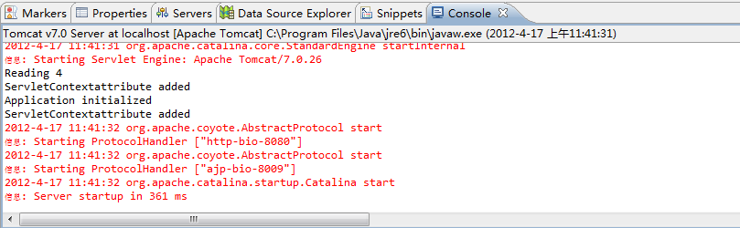
Console
重启Tomcat

Slide 207
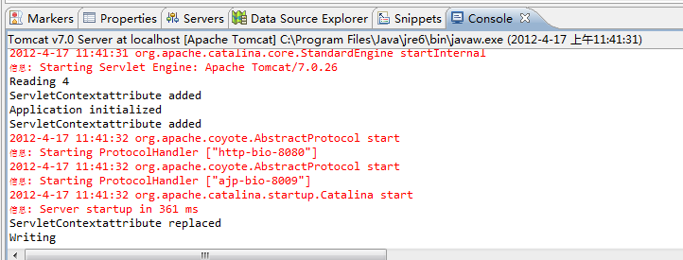
访问http://localhost:8080/Login/Login
或http://localhost:8080/Login/CookieServlet

Slide 208
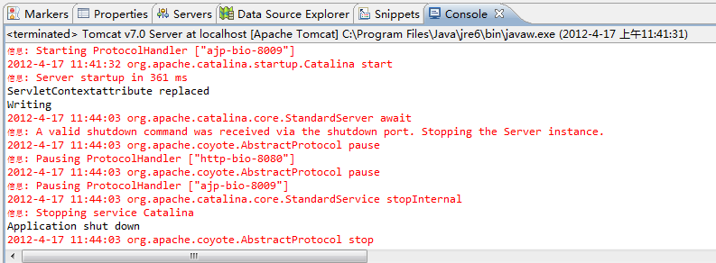
Stop Server

Slide 209
等价于web.xml
<listener>
  <listener-class>edu.nju.login.listeners.CounterListener</listener-class>
</listener>

Slide 210
Spring listener应用

Slide 211
作业4（在作业3基础上完成）
统计在线人数
  总人数
  已登录人数
  游客人数
思考：用户关闭浏览器，未点击“退出”，如何计算人数？

Slide 212
文件上传
Annotation
  javax.servlet.annotation.MultipartConfig
  multipart/form-data MIME type
Servlets that are annotated with @MultipartConfig can retrieve the Part components of a given multipart/form-data request by calling the request.getPart(String name) or request.getParts() method.

Slide 213
@MultipartConfig(location="/tmp", fileSizeThreshold=1024*1024, maxFileSize=1024*1024*5, maxRequestSize=1024*1024*5*5)
Collection<Part> getParts()
Part getPart(String name)

Slide 214
属性名 | 类型 | 是否可选 | 描述
fileSizeThreshold | int | 是 | 当数据量大于该值时，内容将被写入文件。
location | String | 是 | 存放生成的文件地址。
maxFileSize | long | 是 | 允许上传的文件最大值。默认值为 -1，表示没有限制。
maxRequestSize | long | 是 | 针对该 multipart/form-data 请求的最大数量，默认值为 -1，表示没有限制。

Slide 215
异步支持—背景
Web containers in application servers normally use a server thread per client request. 多线程
Under heavy load conditions, containers need a large amount of threads to serve all the client requests. Scalability limitations include running out of memory or exhausting the pool of container threads.
To create scalable web applications, you must ensure that no threads associated with a request are sitting idle, so the container can use them to process new requests.

Slide 216
异步支持—背景
There are two common scenarios where a thread associated with a request can be sitting idle:
  The thread needs to wait for a resource to become available or process data before building the response.
  The thread needs to wait for an event before generating the response.
Java EE provides asynchronous processing
  If a servlet or a filter reaches a potentially blocking operation when processing a request, it can assign the operation to an asynchronous execution context and return the thread associated with the request immediately to the container without generating a response.

Slide 217
异步支持
@WebServlet(urlPatterns={"/asyncservlet"}, asyncSupported=true)
request.startAsync()
  causes the request to be processed asynchronously; the response is not sent to the client at the end of the service method.
……

