Slide 1

Data Warehousing and OLAP Technology
Knowledge Discovery in Databases
School of Software, Nanjing University

Slide 2

Data Warehousing and OLAP Technology
What is a data warehouse?
A multi-dimensional data model
Data warehouse architecture
Data warehouse implementation
Further development of data cube technology
From data warehousing to data mining

Slide 3
What is Data Warehouse?
Defined in many different ways, but not rigorously.
  A decision support database that is maintained separately from the organization’s operational database
  Support information processing by providing a solid platform of consolidated, historical data for analysis.
“A data warehouse is a subject-oriented, integrated, time-variant, and nonvolatile collection of data in support of management’s decision-making process.”—W. H. Inmon
Data warehousing:
  The process of constructing and using data warehouses

Slide 4
Data Warehouse—Subject-Oriented
Organized around major subjects, such as customer, product, sales.
Focusing on the modeling and analysis of data for decision makers, not on daily operations or transaction processing.
Provide a simple and concise view around particular subject issues by excluding data that are not useful in the decision support process.

Slide 5
Data Warehouse—Integrated
Constructed by integrating multiple, heterogeneous data sources
  Relational databases, flat files, on-line transaction records
Data cleaning and data integration techniques are applied.
  Ensure consistency in naming conventions, encoding structures, attribute measures, etc. among different data sources
    E.g., Hotel price: currency, tax, breakfast covered, etc.
  When data is moved to the warehouse, it is converted.

Slide 6
Data Warehouse—Time Variant
The time horizon for the data warehouse is significantly longer than that of operational systems.
  Operational database: current value data.
  Data warehouse data: provide information from a historical perspective (e.g., past 5-10 years)
Every key structure in the data warehouse
  Contains an element of time, explicitly or implicitly
  But the key of operational data may or may not contain “time element”.

Slide 7
Data Warehouse—Non-Volatile
A physically separate store of data transformed from the operational environment.
Operational update of data does not occur in the data warehouse environment.
  Does not require transaction processing, recovery, and concurrency control mechanisms
  Requires only two operations in data accessing:
    initial loading of data and access of data.

Slide 8
Data Warehouse vs. Heterogeneous DBMS
Traditional heterogeneous DB integration:
  Build wrappers/mediators on top of heterogeneous databases
  Query driven approach
    When a query is posed to a client site, a meta-dictionary is used to translate the query into queries appropriate for individual heterogeneous sites involved, and the results are integrated into a global answer set
    Complex information filtering, compete for resources
Data warehouse: update-driven, high performance
  Information from heterogeneous sources is integrated in advance and stored in warehouses for direct query and analysis

Slide 9
Data Warehouse vs. Operational DBMS
OLTP (On-Line Transaction Processing)
  Major task of traditional relational DBMS
  Day-to-day operations: purchasing, inventory, banking, manufacturing, payroll, registration, accounting, etc.
OLAP (On-Line Analytical Processing)
  Major task of data warehouse system
  Data analysis and decision making
Distinct features (OLTP vs. OLAP):
  User and system orientation: customer vs. market
  Data contents: current, detailed vs. historical, consolidated
  Database design: ER + application vs. star + subject
  View: current, local vs. evolutionary, integrated
  Access patterns: update vs. read-only but complex queries

Slide 10

OLTP vs. OLAP

Slide 11
Why Separate Data Warehouse?
High performance for both systems
  DBMS— tuned for OLTP: access methods, indexing, concurrency control, recovery
  Warehouse—tuned for OLAP: complex OLAP queries, multidimensional view, consolidation.
Different functions and different data:
  missing data: Decision support requires historical data which operational DBs do not typically maintain
  data consolidation: DS requires consolidation (aggregation, summarization) of data from heterogeneous sources
  data quality: different sources typically use inconsistent data representations, codes and formats which have to be reconciled

Slide 12
Data Warehousing and OLAP Technology
What is a data warehouse?
A multi-dimensional data model
Data warehouse architecture
Data warehouse implementation
Further development of data cube technology
From data warehousing to data mining

Slide 13
From Tables and Spreadsheets to Data Cubes
A data warehouse is based on a multidimensional data model which views data in the form of a data cube
A data cube, such as sales, allows data to be modeled and viewed in multiple dimensions
  Dimension tables, such as item (item_name, brand, type), or time(day, week, month, quarter, year)
  Fact table contains measures (such as dollars_sold) and keys to each of the related dimension tables

Slide 14

Multi-Dimensional Data Model(Cube)
Date
Total annual sales
of TV in U.S.A.
1Qtr
2Qtr
3Qtr
4Qtr
sum
Product
TV
PC
U.S.A
VCR
sum
Canada
Country
Mexico
sum
All, All, All

Slide 15
Cube: A Lattice of Cuboids(I)
all
0-D(apex) cuboid
product
date
country
1-D cuboids
product,date
product,country
date, country
2-D cuboids
3-D(base) cuboid
product, date, country
In data warehousing literature, an n-D base cube is called a base cuboid. The top most 0-D cuboid, which holds the highest-level of summarization, is called the apex cuboid. The lattice of cuboids forms a data cube.

Slide 16
Cube: A Lattice of Cuboids(II)
all
0-D(apex) cuboid
time
item
location
supplier
1-D cuboids
time,item
time,location
item,location
location,supplier
2-D cuboids
time,supplier
item,supplier
time,item,location
time,location,supplier
3-D cuboids
time,item,supplier
item,location,supplier
4-D(base) cuboid
time, item, location, supplier

Slide 17
Conceptual Modeling of Data Warehouses
Modeling data warehouses: dimensions & measures
  Star schema: A fact table in the middle connected to a set of dimension tables
  Snowflake schema: A refinement of star schema where some dimensional hierarchy is normalized into a set of smaller dimension tables, forming a shape similar to snowflake
  Fact constellations: Multiple fact tables share dimension tables, viewed as a collection of stars, therefore called galaxy schema or fact constellation

Slide 18
Example of Star Schema
time
Definition
time_key
day
day_of_the_week
month
quarter
year
item
item_key
item_name
brand
type
supplier_type
Sales Fact Table
time_key
item_key
branch_key
branch
location
location_key
branch_key
branch_name
branch_type
location_key
street
city
province_or_state
country
units_sold
dollars_sold
avg_sales
Measures

Slide 19
Example of Snowflake Schema
time
Definition
item
time_key
day
day_of_the_week
month
quarter
year
item_key
item_name
brand
type
supplier_key
supplier
Sales Fact Table
supplier_key
supplier_type
time_key
item_key
branch_key
branch
location
location_key
location_key
street
city_key
branch_key
branch_name
branch_type
units_sold
city
dollars_sold
city_key
city
province_or_state
country
avg_sales
Measures

Slide 20
Example of Fact Constellation
time
item
Shipping Fact Table
time_key
day
day_of_the_week
month
quarter
year
item_key
item_name
brand
type
supplier_type
Sales Fact Table
time_key
time_key
item_key
item_key
shipper_key
branch_key
from_location
branch
location_key
to_location
location
branch_key
branch_name
branch_type
units_sold
location_key
street
city
province_or_state
country
dollars_cost
dollars_sold
units_shipped
avg_sales
shipper
Measures
shipper_key
shipper_name
location_key
shipper_type
Definition

Slide 21
A Data Mining Query Language, DMQL
Cube Definition (Fact Table)
  define cube <cube_name> [<dimension_list>]: <measure_list>
Dimension Definition ( Dimension Table )
  define dimension <dimension_name> as (<attribute_or_subdimension_list>)
Special Case (Shared Dimension Tables)
  First time as “cube definition”
  define dimension <dimension_name> as <dimension_name_first_time> in cube <cube_name_first_time>

Slide 22
Defining a Star Schema in DMQL
define cube sales_star [time, item, branch, location]:
    dollars_sold = sum(sales_in_dollars), avg_sales = avg(sales_in_dollars), units_sold = count(*)
define dimension time as (time_key, day, day_of_week, month, quarter, year)
define dimension item as (item_key, item_name, brand, type, supplier_type)
define dimension branch as (branch_key, branch_name, branch_type)
define dimension location as (location_key, street, city, province_or_state, country)
Figure

Slide 23
Defining a Snowflake Schema in DMQL
define cube sales_snowflake [time, item, branch, location]:
    dollars_sold = sum(sales_in_dollars), avg_sales = avg(sales_in_dollars), units_sold = count(*)
define dimension time as (time_key, day, day_of_week, month, quarter, year)
define dimension item as (item_key, item_name, brand, type, supplier(supplier_key, supplier_type))
define dimension branch as (branch_key, branch_name, branch_type)
define dimension location as (location_key, street, city(city_key, province_or_state, country))
Figure

Slide 24
Defining a Fact Constellation in DMQL
define cube sales [time, item, branch, location]:
    dollars_sold = sum(sales_in_dollars), avg_sales = avg(sales_in_dollars), units_sold = count(*)
define dimension time as (time_key, day, day_of_week, month, quarter, year)
define dimension item as (item_key, item_name, brand, type, supplier_type)
define dimension branch as (branch_key, branch_name, branch_type)
define dimension location as (location_key, street, city, province_or_state, country)
define cube shipping [time, item, shipper, from_location, to_location]:
    dollar_cost = sum(cost_in_dollars), unit_shipped = count(*)
define dimension time as time in cube sales
define dimension item as item in cube sales
define dimension shipper as (shipper_key, shipper_name, location as location in cube sales, shipper_type)
define dimension from_location as location in cube sales
define dimension to_location as location in cube sales
Figure

Slide 25
Measures: Three Categories
distributive: if the result derived by applying the function to n aggregate values is the same as that derived by applying the function on all the data without partitioning.
    E.g., count(), sum(), min(), max().
algebraic: if it can be computed by an algebraic function with M arguments (where M is a bounded integer), each of which is obtained by applying a distributive aggregate function.
    E.g., avg(), standard_deviation().
holistic: if there is no constant bound on the storage size needed to describe a subaggregate.
    E.g., median(), mode(), rank().

Slide 26
A Concept Hierarchy: Dimension (location)
all
all
region
Europe
...
North_America
country
Germany
...
Spain
Canada
...
Mexico
city
Frankfurt
...
Vancouver
...
Toronto
office
L. Chan
...
M. Wind

Slide 27
Multidimensional Data
Sales volume as a function of product, month, and region
Dimensions: Product, Location, Time
Hierarchical summarization paths
Region
Industry Region Year
Category Country Quarter
Product City Month Week
Office Day
Product
Month

Slide 28
A Sample Data Cube(I)
Date
Total annual sales
of TV in U.S.A.
1Qtr
2Qtr
3Qtr
4Qtr
sum
Product
TV
PC
U.S.A
VCR
sum
Canada
Country
Mexico
sum
All, All, All

Slide 29
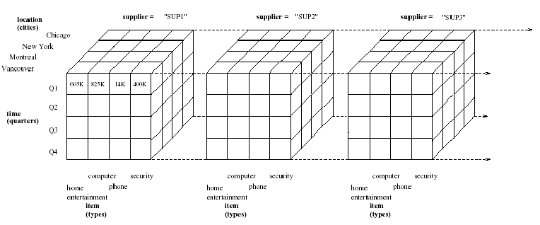
A Sample Data Cube(II)

Slide 30

Browsing a Data Cube
Visualization
OLAP capabilities
Interactive manipulation

Slide 31
Typical OLAP Operations
Roll up (drill-up): summarize data
  by climbing up hierarchy or by dimension reduction
Drill down (roll down): reverse of roll-up
  from higher level summary to lower level summary or detailed data, or introducing new dimensions
Slice and dice:
  project and select
Pivot (rotate):
  reorient the cube, visualization, 3D to series of 2D planes.
Other operations
  drill across: involving (across) more than one fact table
  drill through: through the bottom level of the cube to its back-end relational tables (using SQL)

Slide 32
Typical OLAP Operations—— Roll-up
Location
(Cities)
Location
(Countries)
Chicago
US
New York
Montreal
Canada
Vancouver
Roll up
on location
(from cities
to countries)
Q1
Q2
Q3
Q4
Q1
Q2
Q3
Q4
Time
(Quarters)
Time
(Quarters)
Home entertainment
phone
Home entertainment
phone
Item
(types)
Item
(types)
computer
security
computer
security

Slide 33
Typical OLAP Operations—— Drill-down
Location
(Cities)
Location
(Cities)
Chicago
Chicago
New York
New York
Montreal
Montreal
Vancouver
Vancouver
Jan
Feb
Mar
Apr
May
Jun
Jul
Aug
Sep
Oct
Nov
Dec
Drill down
on time
(from quaters
to months)
Q1
Q2
Q3
Q4
Time
(Quarters)
Time
(months)
Home entertainment
phone
Home entertainment
phone
Item
(types)
Item
(types)
computer
security
computer
security

Slide 34
Typical OLAP Operations—— Slice
Location
(Cities)
Location
(Cities)
New York
Vancouver
Chicago
New York
Chicago
Montreal
Montreal
Home entertainment
Vancouver
Q1
Q2
Q3
Q4
Slice for
time = ‘Q1’
computer
Time
(Quarters)
phone
security
Item
(types)
Home entertainment
phone
Item
(types)
computer
security

Slide 35
Typical OLAP Operations —— Dice
Location
(Cities)
Chicago
New York
Location
(Cities)
Montreal
Vancouver
Montreal
Q1
Q2
Q3
Q4
Vancouver
Time
(Quarters)
Q1
Q2
Dice for
(location = ‘Montreal’ or ‘Vancouver’)
and
(time=‘Q1’ or ‘Q2’)
and
(item=‘home entertainment’ or ‘computer’)
Home entertainment
computer
Item
(types)
Home entertainment
phone
Item
(types)
computer
security

Slide 36
Typical OLAP Operations —— Pivot(Rotate)
Location
(Cities)
Item
(types)
Home entertainment
Chicago
New York
computer
Montreal
phone
Vancouver
security
Item
(types)
Home entertainment
phone
New York
Vancouver
Location
(Cities)
computer
security
Chicago
Montreal

Slide 37
A Star-Net Query Model
Customer Orders
Shipping Method
Customer
CONTRACTS
AIR-EXPRESS
ORDER
TRUCK
PRODUCT LINE
Time
Product
ANNUALY
QTRLY
DAILY
PRODUCT ITEM
PRODUCT GROUP
CITY
SALES PERSON
COUNTRY
DISTRICT
REGION
Each circle is called a footprint
DIVISION
Location
Promotion
Organization

Slide 38
Data Warehousing and OLAP Technology
What is a data warehouse?
A multi-dimensional data model
Data warehouse architecture
Data warehouse implementation
Further development of data cube technology
From data warehousing to data mining

Slide 39
Multi-Tiered Architecture
Monitor
&
Integrator
OLAP Server
other
sources
Metadata
Analysis
Query
Reports
Data mining
Operational
DBs
Extract
Transform
Load
Refresh
Data
Warehouse
Serve
Data Marts
Data Sources
Data Storage
OLAP Engine
Front-End Tools

Slide 40
Three Data Warehouse Models
Enterprise warehouse
  collects all of the information about subjects spanning the entire organization
Data Mart
  a subset of corporate-wide data that is of value to a specific groups of users. Its scope is confined to specific, selected groups, such as marketing data mart
    Independent vs. dependent (directly from warehouse) data mart
Virtual warehouse
  A set of views over operational databases
  Only some of the possible summary views may be materialized

Slide 41
Data Warehouse Development:
A Recommended Approach
Multi-Tier Data Warehouse
Distributed Data Marts
Enterprise Data Warehouse
Data Mart
Data Mart
Model refinement
Model refinement
Define a high-level corporate data model

Slide 42
OLAP Server Architectures
Relational OLAP (ROLAP)
  Use relational or extended-relational DBMS to store and manage warehouse data and OLAP middleware to support missing pieces
  Include optimization of DBMS backend, implementation of aggregation navigation logic, and additional tools and services
  greater scalability
Multidimensional OLAP (MOLAP)
  Array-based multidimensional storage engine (sparse matrix techniques)
  fast indexing to pre-computed summarized data
Hybrid OLAP (HOLAP)
  User flexibility, e.g., low level: relational, high-level: array
Specialized SQL servers
  specialized support for SQL queries over star/snowflake schemas

Slide 43
Data Warehousing and OLAP Technology
What is a data warehouse?
A multi-dimensional data model
Data warehouse architecture
Data warehouse implementation
  Data Warehouse Design
  OLAP Modeling Methods
  Optimization of Logical Model/Physical Model
  Efficient Methods for Data Cube Computation
  Plan and Implementation of Data Warehouse
Further development of data cube technology
From data warehousing to data mining

Slide 44
数据仓库设计
数据仓库设计和数据库设计的差异
  面向需求不同：数据库面向具体应用，需求一开始就很明确，而数据仓库是一个渐进的过程
  设计目标不同：OLTP vs. OLAP
  处理类型不同：面向操作型应用 vs. 面向分析型应用
  数据来源不同：业务员输入 vs. 已存在的业务系统数据
  系统设计的方法不同：
    数据仓库可以采用“数据驱动”的设计方法
    数据仓库设计可以分为数据仓库模型设计和数据装载接口设计两部分

Slide 45
数据仓库的设计步骤
将企业模型映射到数据仓库系统的过程
分析建立企业模型并映射到
数据仓库概念模型
逻辑模型设计
物理模型设计
客观世界
客观世界到主观世界的映射
概念模型
关系模型
逻辑模型
物理实现的细节
物理模型

Slide 46
Data Warehousing and OLAP Technology
What is a data warehouse?
A multi-dimensional data model
Data warehouse architecture
Data warehouse implementation
  Data warehouse Design
  OLAP Modeling Methods
  Optimization of Logical Model/Physical Model
  Efficient Methods for Data Cube Computation
  Plan and Implementation of Data Warehouse
Further development of data cube technology
From data warehousing to data mining

Slide 47
OLAP建模方法
维表设计
  维的变化
  维表的共享
  层次信息和分类信息的位置
事实表设计
  事实表的特性
  通用数据和专用数据事实表

Slide 48
维表的变化（一）
维表通过记录因素的属性描述事件中包含的诸多因素
维表的本质是多维分析空间在某个角度上的投影
由于维表描述的是事物的属性，因此随着事物本身的变化，其属性也会产生改变
  如果该属性与决策没有太大关系，例如电话号码属性对于分析顾客购买行为没有什么作用，则此属性的变化可以忽略不计
  如果该属性与决策有关，例如某位顾客搬家后离超市更远了，我们试图分析其购买行为与家里距离变远有何关系，则不能将之忽略

Slide 49
维表的变化（二）
对于需要记录其改变的维，有若干方法可以进行处理
  当属性进行变化时，创建一个新记录
    例如：
    缺点：
      由于ID产生变化，被认为是两条记录
  创建一个新的字段，将新地址填入
    例如：
    缺点：
      可扩展性不佳
  增加一个修订号码字段和当前标记字段
    例如：
    缺点：
      维表和事实表连接时需要采用“主关键字”＋“修订号码”，增加了事实表的复杂性
345 | 顾客A | 东城区
368 | 顾客A | 西城区
345 | 顾客A | 东城区 | 西城区
345 | 0 | 过往 | 东城区
345 | 1 | 当前 | 西城区

Slide 50
维表的变化（三）
最为理想的解决方案
  新建一个关键字客户ID，通过主关键字与之相连，使用时间字段标志当前的值
    缺点：相对较为复杂
345 | 2003／1 | 当前 | 西城区
345 | 1999／3 | 过往 | 东城区
345 | 1998／7 | 过往 | 海淀区

Slide 51
维表的共享
多个维表中可能包含相同的属性：
  供货商维中包含地址维，而销售商维中可能也包含地址维，因而可能共享维表
  由于数据仓库中时间维的重要性，各个维中都有可能包含时间维，因而可能共享时间维表
可以采用扩展的星座结构来描述共享维表
具体内容请参见上节

Slide 52
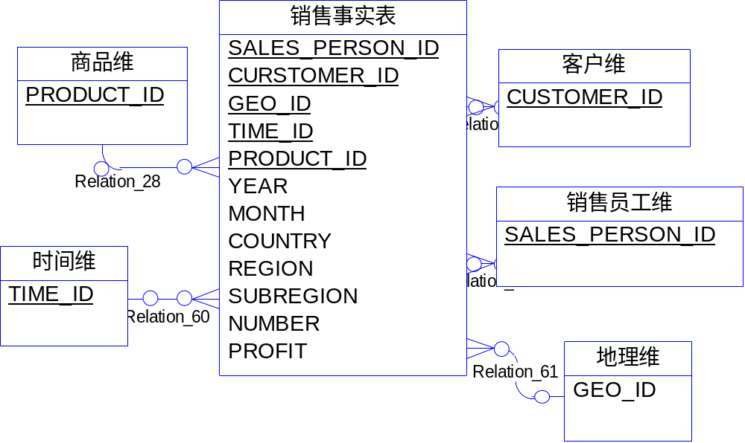
层次信息的位置（一）
将维层次信息放入事实表
  优点：计算极为方便
  缺点：事实表会因此变得极为庞大

Slide 53
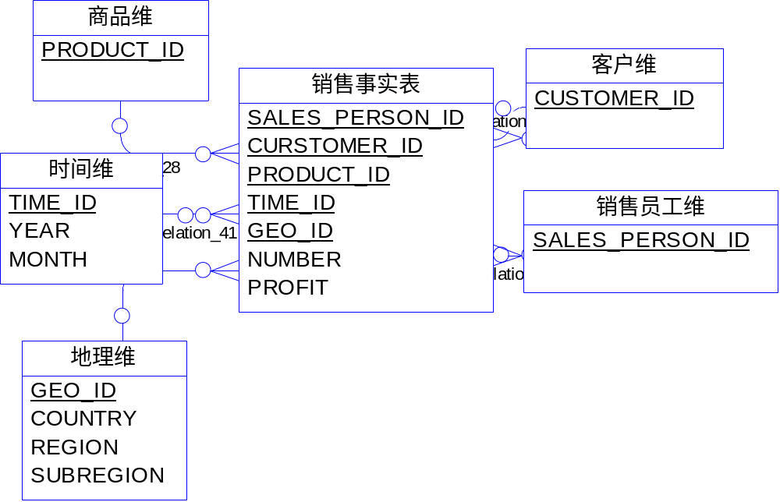
层次信息的位置（二）
将维层次放在各自的维表中，通过主关键字与事实表相连
  优点：减少了事实表的大小
  缺点：OLAP性能比上一种方式差

Slide 54
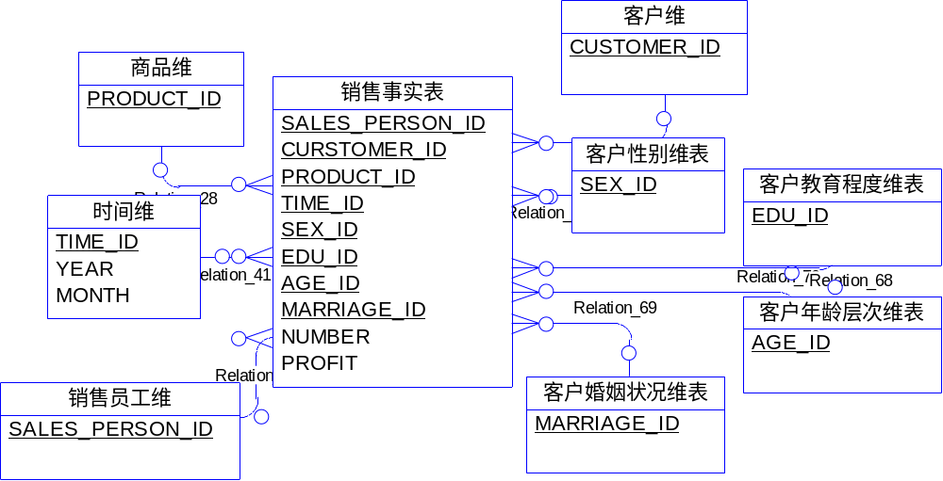
分类信息的位置（一）
在事实表中体现维分类
  优点： OLAP性能好
  缺点： 事实表的字段数和记录数增加

Slide 55
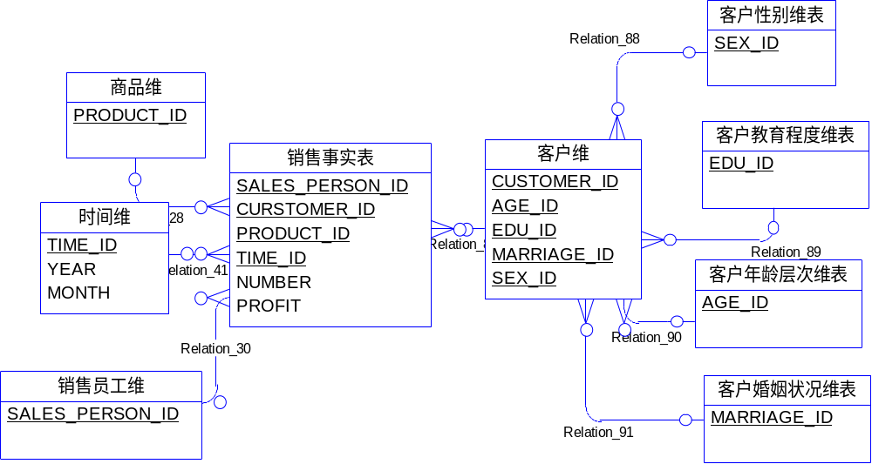
分类信息的位置（二）
在维表中体现维分类

Slide 56
事实表的特征
与维表相比，事实表具有以下特征：
  记录数量非常多
  除了度量外，其他字段都是维表或者中间维表（雪花模型）的关键字
  如果事实相关的维度很多，则事实表的字段数也会比较多
因此应当尽量减小一条记录的长度，才能避免事实表过大而难于管理
数据的粒度是影响事实表大小的关键因素，因而必须认真设计

Slide 57
通用数据和专用数据事实表
对应一个问题通常采用一个事实表，但在特殊情况下，也允许采用多个事实表
例如：超市里出售多种商品，由于商品本身分类不同，因此所采用的量度可能也不相同
  如果将这些量度全部置于一个事实表中，由于某种类型的商品的量度其他商品可能不具备，因此则不可避免将在事实表中造成大量的数据空缺
  解决办法：采用多个事实表，分为通用数据事实表与专用数据事实表加以管理

Slide 58
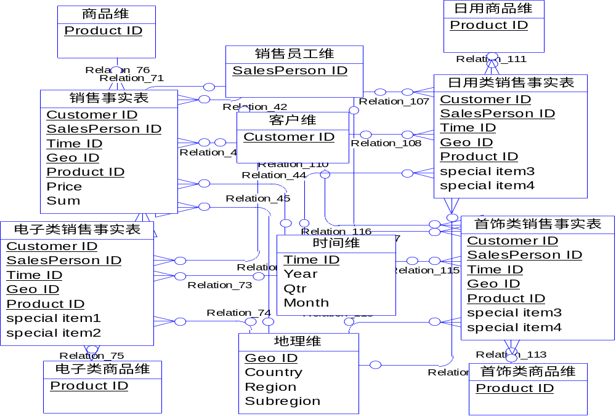
通用数据和专用数据事实表
通用事实表与通用的量度
专用用事实表与专有的量度

Slide 59
Data Warehousing and OLAP Technology
What is a data warehouse?
A multi-dimensional data model
Data warehouse architecture
Data warehouse implementation
  Data warehouse Design
  OLAP Modeling Methods
  Optimization of Logical Model/Physical Model
  Efficient Methods for Data Cube Computation
  Plan and Implementation of Data Warehouse
Further development of data cube technology
From data warehousing to data mining

Slide 60
数据仓库的逻辑模型设计
系统数据量估算
数据粒度的选择
数据的分割
表的合理划分
去除纯操作数据
增加导出字段
定义关系模式
定义元数据存储
定义记录系统

Slide 61

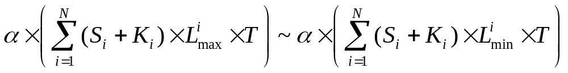

数据仓库的逻辑模型设计
系统数据量估算
  设在概念模型中出现的表的个数为N（这些表中应不包含不会放进数据仓库的表），对于每个表i( ), 计算表的大小S_{i}和表的主关键字大小K_{i}，然后估计每张表i 在单位时间内最大记录数L_{max}和最少记录数L_{min,}则数据仓库的粗略数据量在以下范围:
  其中,T是数据在数据仓库中存在的周期。 是考虑由于数据冗余和数据索引而使数据量增大的冗余因子,通常取1.2~2
  本公式的含义是：
    数据仓库数据量＝{累加[（每张表记录大小＋每张表主关键字大小）*每张表单位时间内记录的数量]*存储时间}*冗余因子
  公式估算出的结果仅能作为参考

Slide 62
数据粒度的选择
数据量较小的情况下使用单一的数据粒度，即直接存储细节数据并定期在细节数据基础上进行数据综合
对于大数据量需要采用双重粒度，对于细节数据只保存近期的数据在数据仓库之中，当保留周期到达时，将距离当前较远的数据导出到磁带或存储设备上
综合数据
综合数据
细节数据
2000/4 | 2000/3 | 2000/2 | 2000/1
…… | …… | …… | ……
1990/4 | 1990/3 | 1990/2 | 1990/1
2000/4
2000/3
2000/2
2000/1
……
保留最近三月数据
存储设备
细节数据
单一数据粒度
多重数据粒度

Slide 63
数据粒度策略
一年内数据量（行） | 五年内数据量（行） | 数据粒度策略
10,000 | 100,000 | 简单的单一粒度策略
100,000 | 1,000,000 | 如果选择单一粒度，则需要认真设计
1,000,000 | 10,000,000 | 最好使用双重粒度
10,000,000 | 20,000,000 | 必须采用双重粒度且认真设计

Slide 64
数据的分割
为何要进行数据分割？
  数据仓库中数据量过大时，检索速度很慢
数据分割是指将数据分散到各自的物理单元里以便能够独立处理，以提高数据处理的效率
数据分割没有固定的标准，分割的方法和粒度应当根据实际情况确定
  通常选择时间、地点、业务等划分
  一般按照时间分割数据分布比较均匀，因此按照时间分割最为常见
中国
各地区
产值
福建
上海
…………
甘肃
江苏

Slide 65
合理的表划分
直接存储字段数目很大的表，会造成以下问题：
  各个字段的更新频率不一，放在一张表里造成数据追加工作的浪费
  各个字段的访问频率不一，放在一张表里影响访问效率
因此需要对表中的内容进行合理的划分
  按数据的稳定性划分
  按业务规则进行表划分(略)

Slide 66
按数据稳定性进行表划分
原始表
几乎不变的数据
有时改变的数据
经常改变的数据
商品ID
数据加载时间
商品名称
商品类型
商品规格
商品质量
主要原料供应商
最后订购时间
最后订购数量
生产成本
商品ID
商品名称
商品类型
商品规格
商品质量
商品ID
主要原料供应商
生产成本
商品ID
数据加载时间
最后订购时间
最后订购数量
避免了整张表记录快速增长的现象，节约了存储空间

Slide 67
删除纯操作数据及增加导出字段
在将业务系统中的数据抽取到数据仓库系统中的过程里，如果发现某些数据对于决策没有作用，属于纯操作型数据,则可以将之删除
  例：“收款人”字段
导出数据本身是冗余的，但是增加导出字段有利于数据以后的使用
  例：在按月综合表中，可以加入“平均价格”，“供货总价”，“供货总数量”等导出字段

Slide 68
Meta Data
What is meta data?
Meta data are data describing data
In data warehouse, there are several data levels:
  meta data
  current detailed data
  older detailed data
  lightly summarized data
  highly summarized data

Slide 69
Meta Data Storage
Meta data is the data defining warehouse objects. It has the following kinds
  Description of the structure of the warehouse
    schema, view, dimensions, hierarchies, derived data definition, data mart locations and contents
  Operational meta-data
    data lineage (history of migrated data and transformation path), currency of data (active, archived, or purged), monitoring information (warehouse usage statistics, error reports, audit trails)
  The algorithms used for summarization
  The mapping from operational environment to the data warehouse
  Business data
    business terms and definitions, ownership of data, charging policies

Slide 70
记录系统的定义
记录系统是操作型元数据的一部分
记录系统指明数据仓库中关系表的各个字段来源于业务数据库何处
  例：
主题 | 表名 | 属性字段 | 源数据库 | 源表名 | 源字段
商品 | 供应表 | 交易ID | 采购 | 采购表 | 交易号
商品 | 供应表 | 商品ID | 采购 | 采购表 | 商品号
商品 | 供应表 | 供应商ID | 采购 | 采购表 | 供应商号
商品 | 供应表 | 供货数量 | 采购 | 采购表 | 供货数量
商品 | 供应表 | 供货价格 | 采购 | 采购表 | 供货价
……… | ……… | ……… | ……… | ……… | ………

Slide 71
数据仓库物理模型设计
确定数据的存储结构
索引策略
数据存储策略与性能优化
  多路聚集优化
  表的归并
  分割表的存放
  按列存储
  存储分配优化
数据装载接口设计
并行优化设计

Slide 72
Define the Storage Structure
一般的数据库数据量相对较小，除非业务要求必须保证数据的安全性和可恢复性，否则可以不采用并行存储结构
数据仓库由于数据的巨量存储，必须采用并行存储结构，例如RAID

Slide 73
Indexing Technology: why not B-tree?
B-tree is a widely-used technology in database
  B-tree indexing has high performance when used to find some records in the database
While B-tree is not a good technology for data warehouse, Why?

Slide 74
B-tree Indexing Technology
Because:
  B-tree demands that the attribute must have many different values, such as itemID, customer ID, etc.
  B-tree demands that the query should have simpler conditions and less results
  The space complexity and time complexity of creating B-tree are huge
Page 324
Albert | 141
Cox | 142
Eddy | 143
……
Page 144
Hunt
Martin
……
……
……
Page 326
Albert | 324
Hunt | 325
……
……
Page 145
Smith
Toms
……
Page 325
Hunt | 144
Smith | 145
Watson | 146
……
Page 146
Watson
Walsh
……

Slide 75
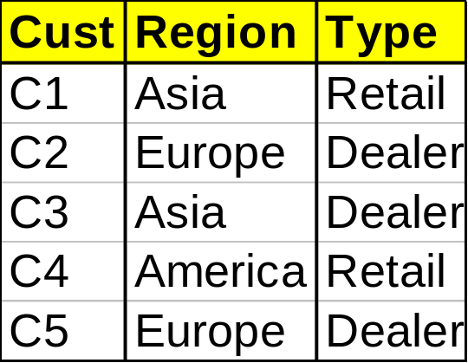
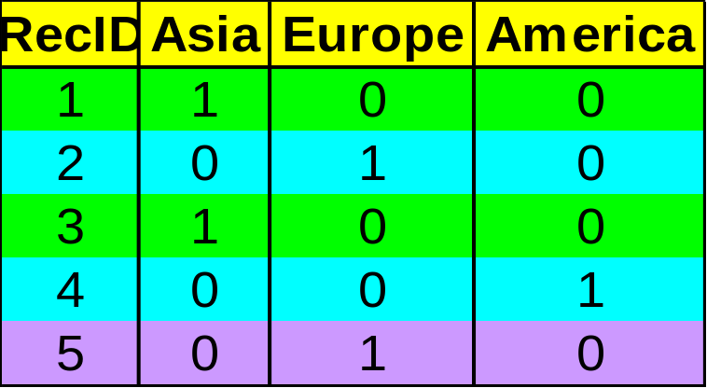

Indexing OLAP Data: Bitmap Index
Index on a particular column
Each value in the column has a bit vector: bit-op is fast
The length of the bit vector: # of records in the base table
The i-th bit is set if the i-th row of the base table has the value for the indexed column
not suitable for high cardinality domains
Base table
Index on Region
Index on Type

Slide 76
Indexing OLAP Data: Join Index
Join index: JI(R-id, S-id) where R (R-id, …)  S (S-id, …)
Traditional indices map the values to a list of record ids
In data warehouses, join index relates the values of the dimensions of a star schema to rows in the fact table.
  E.g. fact table: Sales and two dimensions city and product
    A join index on city maintains for each distinct city a list of R-IDs of the tuples recording the Sales in the city
  Join indices can span multiple dimensions
……
……
T57
……
T238
……
T459
……
T884
……
……
Main Street
……
……
Sony TV
……

Slide 77
Data Storage Strategy
Table Mergence(I)
1
7
3
4
5
6
4
2
3
8
6
8
7
1
2
5
Optimized access orders
Common access orders

Slide 78
Data Storage Strategy
Table Mergence(II)
ID | Storage ID | Amount
1 | 5 | 300
1 | 3 | 35
2 | 3 | 67
2 | 2 | 348
3 | 6 | 20
4 | 1 | 908
ID | NAME | TYPE
1 | Dell PC | Computer
2 | Cisco 2600 | Router
3 | IBM PC | Computer
4 | HP Laserjet 1000 | Printer

Slide 79
Data Storage Strategy
Add Redundancy
ID
Name
Type
Model
Weight
ID
Storage ID
Amount
ID
Name
Type
Model
Weight
ID
Storage ID
Amount
Name
Original tables
Add redundancy

Slide 80
Data Storage Strategy
Dividing Table
  In logical design, big tables can be divided into small tables. When a big table is visited, the table can be substituted with small ones.
  In physical design, distributed storage methods can be used.
  Tables can be stored into a disk array

Slide 81
Data Warehousing and OLAP Technology
What is a data warehouse?
A multi-dimensional data model
Data warehouse architecture
Data warehouse implementation
  Data warehouse Design
  OLAP Modeling Methods
  Optimization of Logical Model/Physical Model
  Efficient Methods for Data Cube Computation
  Plan and Implementation of Data Warehouse
Further development of data cube technology
From data warehousing to data mining

Slide 82
Efficient Methods for Data Cube Computation
Data Cube: High Efficiency Computing
  MutiWay Array Aggregation
  BUC

Slide 83

Data Cube: High Efficiency Computing
Data cube can be viewed as a lattice of cuboids
  The bottom-most cuboid is the base cuboid
  The top-most cuboid (apex) contains only one cell
  How many cuboids in an n-dimensional cube with L levels?
Materialization of data cube
  Materialize every (cuboid) (full materialization), none (no materialization), or some (partial materialization)
  Selection of which cuboids to materialize
    Based on size, sharing, access frequency, etc.

Slide 84
Data Cube Operation
Cube definition and computation in DMQL
    define cube sales[item, city, year]: sum(sales_in_dollars)
    compute cube sales
Transform it into a SQL-like language (with a new operator cube by, introduced by Gray et al.’96)
    SELECT item, city, year, SUM (amount)
    FROM SALES
    CUBE BY item, city, year
Need compute the following Group-Bys
    (date, product, customer),
    (date,product),(date, customer), (product, customer),
    (date), (product), (customer)
    ()
()
(city)
(item)
(year)
city, item)
(city, year)
(item, year)
(city, item, year)

Slide 85

Iceberg Cube
Computing only the cuboid cells whose count or other aggregates satisfying the condition like
      HAVING COUNT(*) >= minsup
Motivation
  Only a small portion of cube cells may be “above the water’’ in a sparse cube
  Only calculate “interesting” cells—data above certain threshold
  Avoid explosive growth of the cube

Slide 86
MutiWay Array Aggregation
Partition arrays into chunks (a small subcube which fits in memory).
Compressed sparse array addressing: (chunk_id, offset)
Compute aggregates in “multiway” by visiting cube cells in the order which minimizes the # of times to visit each cell, and reduces memory access and storage cost.
C
c3
61
62
63
64
c2
45
46
47
48
c1
29
30
31
32
What is the best traversing order to do multi-way aggregation?
c 0
B
60
b3
13
14
15
16
44
9
28
56
b2
B
40
24
52
b1
5
36
20
b0
1
2
3
4
a0
a1
a2
a3
A

Slide 87
MutiWay Array Aggregation
C
c3
61
62
63
64
c2
45
46
47
48
c1
29
30
31
32
c 0
B
60
b3
13
14
15
16
44
B
9
28
56
b2
40
5
24
52
b1
36
20
b0
1
2
3
4
a0
a1
a2
a3
A

Slide 88
MutiWay Array Aggregation
C
c3
61
62
63
64
c2
45
46
47
48
c1
29
30
31
32
c 0
B
60
b3
13
14
15
16
44
B
9
28
56
b2
40
5
24
52
b1
36
20
b0
1
2
3
4
a0
a1
a2
a3
A

Slide 89
MutiWay Array Aggregation
C
c3
61
62
63
64
c2
45
46
47
48
c1
29
30
31
32
c 0
B
60
b3
13
14
15
16
44
B
9
28
56
b2
40
5
24
52
b1
36
20
b0
1
2
3
4
a0
a1
a2
a3
A

Slide 90
MutiWay Array Aggregation
If the dimensions are sorted as:
A: 10, B:100, C: 1000
C
c3
61
62
63
64
For BC plane:
100*1000=100,000
For AC plane:
40*1000=40,000
For AB plane:
40*400=16,000
c2
45
46
47
48
c1
29
30
31
32
c 0
B
60
b3
13
14
15
16
44
B
9
28
56
b2
40
5
24
52
b1
36
20
b0
1
2
3
4
a0
a1
a2
a3
A
The minimal memory required for holding all relevant 2-D planes in chunk memory:
Total: 156,000

Slide 91
MutiWay Array Aggregation
If the dimensions are sorted as:
A: 1000, B:100, C: 10
C
c3
61
62
63
64
For BC plane:
10*100=1,000
For AC plane:
10*4000=40,000
For AB plane:
400*4000=1,600,000
c2
45
46
47
48
c1
29
30
31
32
c 0
B
60
b3
13
14
15
16
44
B
9
28
56
b2
40
5
24
52
b1
36
20
b0
1
2
3
4
a0
a1
a2
a3
A
The minimal memory required for holding all relevant 2-D planes in chunk memory:
Total: 1,641,000

Slide 92
MutiWay Array Aggregation
Method: the planes should be sorted and computed according to their size in ascending order.
  Idea: keep the smallest plane in the main memory, fetch and compute only one chunk at a time for the largest plane
Limitation of the method: computing well only for a small number of dimensions
  If there are a large number of dimensions, iceberg cube computation methods can be explored

Slide 93
Processing OLAP Query Effectively
Determine which operations should be performed on the available cuboids:
  transform drill, roll, etc. into corresponding SQL and/or OLAP operations, e.g, dice = selection + projection
Determine to which materialized cuboid(s) the relevant operations should be applied.
Exploring indexing structures and compressed vs. dense array structures in MOLAP

Slide 94
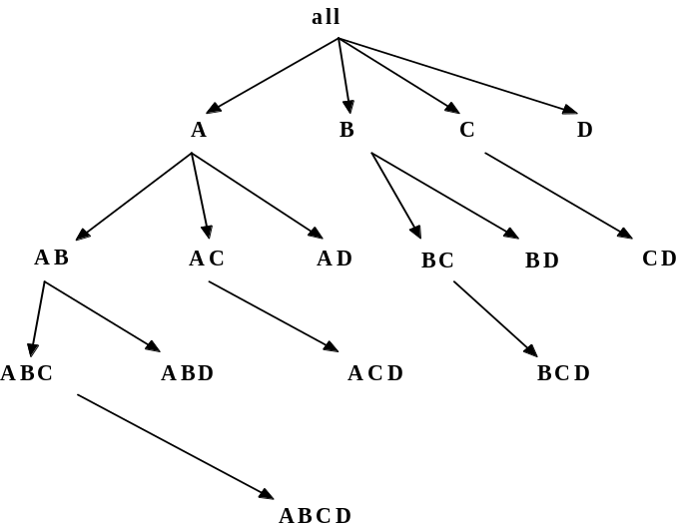
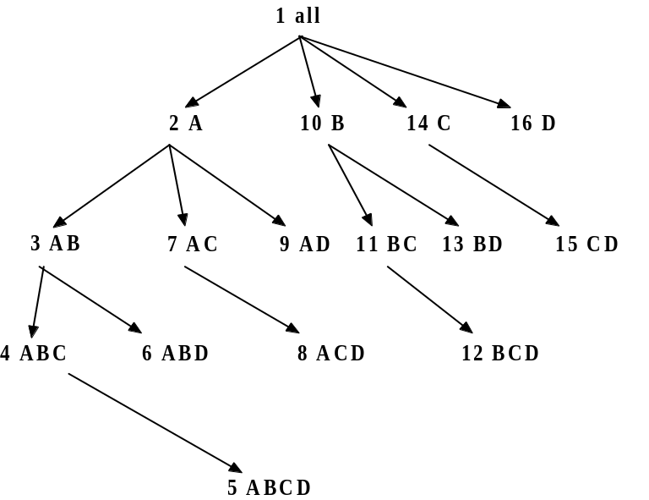
Bottom-Up Computation (BUC)
BUC (Beyer & Ramakrishnan, SIGMOD’99)
Bottom-up cube computation
Divides dimensions into partitions and facilitates iceberg pruning
  If a partition does not satisfy min_sup, its descendants can be pruned
  If minsup = 1 ⇒ compute full CUBE!

Slide 95

BUC: Partitioning
Usually, entire data set can’t fit in main memory
Sort distinct values, partition into blocks that fit

Slide 96
Data Warehousing and OLAP Technology
What is a data warehouse?
A multi-dimensional data model
Data warehouse architecture
Data warehouse implementation
  Data warehouse Design
  OLAP Modeling Methods
  Optimization of Logical Model/Physical Model
  Plan and Implementation of Data Warehouse
Further development of data cube technology
From data warehousing to data mining

Slide 97
数据仓库的投资分析
数据仓库的应用目标
  企业的核心业务
  优化企业内部管理控制
  为企业增加商业机会
建设数据仓库的必要性
企业内部复杂程度
优化企业内部
管理控制
必须建立：
核心业务，
增加商业机会
高
增加商业机会
必要性不强
客户数量
低
低
高
可通过计算ROI（Return of Investment）来衡量投资回报的价值

Slide 98
数据仓库主题的选择和阶段规划
数据仓库的实施是一个极为复杂的长期过程，因此，应选择当前最急需、能在短期内产生效益、业务模型清晰的任务首期实现
选择首期实现主题的参考原则：
  优先实现管理者目前需求最迫切和最关心的主题
  优先选择能在短期内产生效益的主题
  推后选择业务逻辑准备不充分的主题
  推后实施技术难度较大、可实现性较低、投资风险大的主题
维护阶段
  数据仓库的维护极为重要，一般数据仓库在建立完成之后，都需要一至两年的维护
  数据仓库的维护过程就是DSS逐步产生效益的过程

Slide 99
数据仓库后端工具
数据抽取(Data extraction):
  get data from multiple, heterogeneous, and external sources
数据清洗(Data cleaning):
  detect errors in the data and rectify them when possible
数据转换(Data transformation):
  convert data from legacy or host format to warehouse format
数据装载(Load):
  sort, summarize, consolidate, compute views, check integrity, and build indicies and partitions
刷新(Refresh):
  propagate the updates from the data sources to the warehouse

Slide 100
Data Warehousing and OLAP Technology
What is a data warehouse?
A multi-dimensional data model
Data warehouse architecture
Data warehouse implementation
Further development of data cube technology
From data warehousing to data mining

Slide 101
Discovery-Driven Exploration of Data Cubes
Hypothesis-driven: exploration by user, huge search space
Discovery-driven (Sarawagi et al.’98)
  pre-compute measures indicating exceptions, guide user in the data analysis, at all levels of aggregation
  Exception: significantly different from the value anticipated, based on a statistical model
  Visual cues such as background color are used to reflect the degree of exception of each cell
  Computation of exception indicator (modeling fitting and computing SelfExp, InExp, and PathExp values) can be overlapped with cube construction

Slide 102



Examples: Discovery-Driven Data Cubes
Selfexp: Background color; Inexp: Margin;
Pathexp:Which path will lead to an exception?

Slide 103
Data Warehousing and OLAP Technology
What is a data warehouse?
A multi-dimensional data model
Data warehouse architecture
Data warehouse implementation
Further development of data cube technology
From data warehousing to data mining

Slide 104
Data Warehouse Usage
Three kinds of data warehouse applications
  Information processing
    supports querying, basic statistical analysis, and reporting using crosstabs, tables, charts and graphs
  Analytical processing
    multidimensional analysis of data warehouse data
    supports basic OLAP operations, slice-dice, drilling, pivoting
  Data mining
    knowledge discovery from hidden patterns
    supports associations, constructing analytical models, performing classification and prediction, and presenting the mining results using visualization tools.
Differences among the three tasks

Slide 105
From On-Line Analytical Processing to On Line Analytical Mining (OLAM)
Why online analytical mining?
  High quality of data in data warehouses
    DW contains integrated, consistent, cleaned data
  Available information processing structure surrounding data warehouses
    ODBC, OLEDB, Web accessing, service facilities, reporting and OLAP tools
  OLAP-based exploratory data analysis
    mining with drilling, dicing, pivoting, etc.
  On-line selection of data mining functions
    integration and swapping of multiple mining functions, algorithms, and tasks

Slide 106
An OLAM Architecture
Mining query
Mining result
Layer4
User Interface
User GUI API
OLAM
Engine
OLAP
Engine
Layer3
OLAP/OLAM
Data Cube API
Layer2
MDDB
MDDB
Meta Data
Filtering&Integration
Database API
Filtering
Layer1
Data Repository
Data cleaning
Data
Warehouse
Databases
Data integration

Slide 107
Summary
Data warehouse
  A subject-oriented, integrated, time-variant, and nonvolatile collection of data in support of management’s decision-making process
A multi-dimensional model of a data warehouse
  Star schema, snowflake schema, fact constellations
  A data cube consists of dimensions & measures
OLAP operations: drilling, rolling, slicing, dicing and pivoting
OLAP servers: ROLAP, MOLAP, HOLAP
Data warehouse implementation
Efficient computation of data cubes
  Partial vs. full vs. no materialization
  Multiway array aggregation
  Bitmap index and join index implementations
Further development of data cube technology
  Discovery-drive and multi-feature cubes
  From OLAP to OLAM (on-line analytical mining)

Slide 108
References (I)
References
Jiawei Han and Micheline Kamber, Data Mining: Concepts and Techniques. Morgan Kaufmann, 2000.(Including Course Materials)
S. Agarwal, R. Agrawal, P. M. Deshpande, A. Gupta, J. F. Naughton, R. Ramakrishnan, and S. Sarawagi. On the computation of multidimensional aggregates. In Proc. 1996 Int. Conf. Very Large Data Bases, 506-521, Bombay, India, Sept. 1996.
D. Agrawal, A. E. Abbadi, A. Singh, and T. Yurek. Efficient view maintenance in data warehouses. In Proc. 1997 ACM-SIGMOD Int. Conf. Management of Data, 417-427, Tucson, Arizona, May 1997.
R. Agrawal, J. Gehrke, D. Gunopulos, and P. Raghavan. Automatic subspace clustering of high dimensional data for data mining applications. In Proc. 1998 ACM-SIGMOD Int. Conf. Management of Data, 94-105, Seattle, Washington, June 1998.
R. Agrawal, A. Gupta, and S. Sarawagi. Modeling multidimensional databases. In Proc. 1997 Int. Conf. Data Engineering, 232-243, Birmingham, England, April 1997.
K. Beyer and R. Ramakrishnan. Bottom-Up Computation of Sparse and Iceberg CUBEs. In Proc. 1999 ACM-SIGMOD Int. Conf. Management of Data (SIGMOD'99), 359-370, Philadelphia, PA, June 1999.
S. Chaudhuri and U. Dayal. An overview of data warehousing and OLAP technology. ACM SIGMOD Record, 26:65-74, 1997.
OLAP council. MDAPI specification version 2.0. In http://www.olapcouncil.org/research/apily.htm, 1998

Slide 109
References (II)
V. Harinarayan, A. Rajaraman, and J. D. Ullman. Implementing data cubes efficiently. In Proc. 1996 ACM-SIGMOD Int. Conf. Management of Data, pages 205-216, Montreal, Canada, June 1996.
Microsoft. OLEDB for OLAP programmer's reference version 1.0. In http://www.microsoft.com/data/oledb/olap, 1998.
K. Ross and D. Srivastava. Fast computation of sparse datacubes. In Proc. 1997 Int. Conf. Very Large Data Bases, 116-125, Athens, Greece, Aug. 1997.
K. A. Ross, D. Srivastava, and D. Chatziantoniou. Complex aggregation at multiple granularities. In Proc. Int. Conf. of Extending Database Technology (EDBT'98), 263-277, Valencia, Spain, March 1998.
S. Sarawagi, R. Agrawal, and N. Megiddo. Discovery-driven exploration of OLAP data cubes. In Proc. Int. Conf. of Extending Database Technology (EDBT'98), pages 168-182, Valencia, Spain, March 1998.
E. Thomsen. OLAP Solutions: Building Multidimensional Information Systems. John Wiley & Sons, 1997.
Y. Zhao, P. M. Deshpande, and J. F. Naughton. An array-based algorithm for simultaneous multidimensional aggregates. In Proc. 1997 ACM-SIGMOD Int. Conf. Management of Data, 159-170, Tucson, Arizona, May 1997.
林宇等编著,《数据仓库：原理与实践》,人民邮电出版社

Slide 110
Thank you !!!

