Slide 1

Cluster Analysis
Knowledge Discovery in Databases
School of Software, Nanjing University

Slide 2

Cluster Analysis
What is Cluster Analysis?
Types of Data in Cluster Analysis
A Categorization of Major Clustering Methods
Partitioning Methods
Hierarchical Methods
Density-Based Methods
Grid-Based Methods
Model-Based Clustering Methods
Outlier Analysis
Summary

Slide 3
What is Cluster Analysis?
Cluster: a collection of data objects
  Similar to one another within the same cluster
  Dissimilar to the objects in other clusters
Cluster analysis
  Grouping a set of data objects into clusters
Clustering is unsupervised classification: no predefined classes
Typical applications
  As a stand-alone tool to get insight into data distribution
  As a preprocessing step for other algorithms

Slide 4
General Applications of Clustering
Pattern Recognition
Spatial Data Analysis
Image Processing
Economic Science (especially market research)
WWW
  Document classification
  Cluster Weblog data to discover groups of similar access patterns

Slide 5
What Is Good Clustering?
A good clustering method will produce high quality clusters with
  high intra-class similarity
  low inter-class similarity
The quality of a clustering result depends on both the similarity measure used by the method and its implementation.
The quality of a clustering method is also measured by its ability to discover some or all of the hidden patterns.

Slide 6
Clustering----Normal Steps
Preprocessing
  Use a method to transform the records in target database table to the points in the data space.
Dividing and Measurement:
  Use a method to divide the points in the data space into clusters
  Measure the intra-class similarity and the inter-class similarity of these clusters
  In some algorithm, we should iterate the process above when necessary until convergence

Slide 7
Requirements of Clustering in Data Mining
Scalability
Ability to deal with different types of attributes
Discovery of clusters with arbitrary shape
Minimal requirements for domain knowledge to determine input parameters
Able to deal with noise and outliers
High dimensionality
Incorporation of user-specified constraints
Interpretability and usability

Slide 8
Cluster Analysis
What is Cluster Analysis?
Types of Data in Cluster Analysis
A Categorization of Major Clustering Methods
Partitioning Methods
Hierarchical Methods
Density-Based Methods
Grid-Based Methods
Model-Based Clustering Methods
Outlier Analysis
Summary

Slide 9
Question: How to Transform Data to Points?
Name | Cough | Fever | X-ray | …..
Mary | Y | 38.6 | N | …..
Tom | N | 37.0 | P | …..
Cobe | N | 39.8 | P | …..
….. | ….. | ….. | ….. | …..
Cough
Mary
Cobe
X-ray
Tom
Fever

Slide 10


Data Structures
Data matrix（n records with p attributes）
  (two modes)
Dissimilarity matrix
  (one mode)

Slide 11
Measure the Quality of Clustering
Dissimilarity/Similarity metric: Similarity is expressed in terms of a distance function, which is typically metric: d(i, j)
There is a separate “quality” function that measures the “goodness” of a cluster.
The definitions of distance functions are usually very different for interval-scaled, boolean, categorical, ordinal and ratio variables.
Weights should be associated with different variables based on applications and data semantics.
It is hard to define “similar enough” or “good enough”
  the answer is typically highly subjective.

Slide 12

Type of data in clustering analysis
Interval-scaled variables
Binary variables
Nominal, ordinal, and ratio variables
Variables of mixed types

Slide 13


Interval-valued variables
Standardize data
  Calculate the mean absolute deviation:
  where
  Calculate the standardized measurement (z-score)
Using mean absolute deviation is more robust than using standard deviation

Slide 14


Similarity and Dissimilarity Between Objects
Distances are normally used to measure the similarity or dissimilarity between two data objects
Some popular ones include: Minkowski distance:
  where i = (x_{i1}, x_{i2}, …, x_{ip}) and j = (x_{j1}, x_{j2}, …, x_{jp}) are two p-dimensional data objects, and q is a positive integer
If q = 1, d is Manhattan distance

Slide 15

Similarity and Dissimilarity Between Objects (Cont.)
If q = 2, d is Euclidean distance:
  Properties
    d(i,j) ≥ 0
    d(i,i) = 0
    d(i,j) = d(j,i)
    d(i,j) ≤ d(i,k) + d(k,j)
Also one can use weighted distance, parametric Pearson product moment correlation, or other dissimilarity measures.

Slide 16
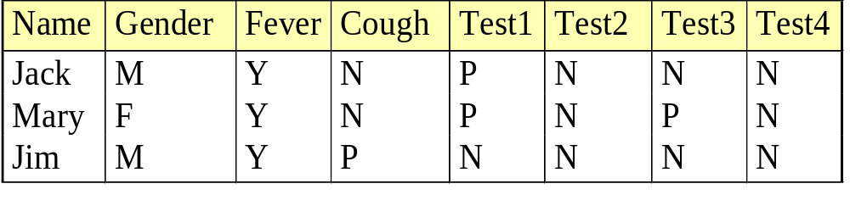



Binary Variables
A contingency table
Simple matching coefficient (invariant, if the binary variable is symmetric):
Jaccard coefficient (noninvariant if the binary variable is asymmetric):
Object j
Object i

Slide 17
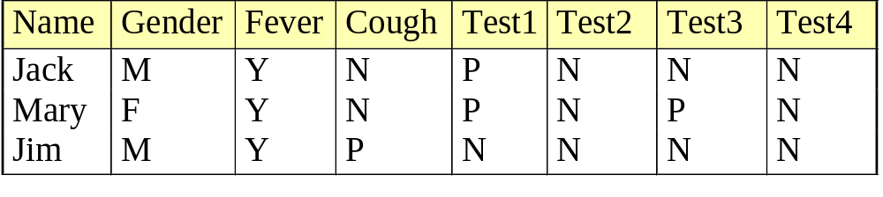

Dissimilarity between Binary Variables
Example
  gender is a symmetric attribute
  the remaining attributes are asymmetric binary
  let the values Y and P be set to 1, and the value N be set to 0

Slide 18

Nominal Variables
A generalization of the binary variable in that it can take more than 2 states, e.g., red, yellow, blue, green
Method 1: Simple matching
  m: # of matches, p: total # of variables
Method 2: use a large number of binary variables
  creating a new binary variable for each of the M nominal states

Slide 19


Ordinal Variables
An ordinal variable can be discrete or continuous
order is important, e.g., rank
Can be treated like interval-scaled
  replacing x_{if} by their rank
  map the range of each variable onto [0, 1] by replacing i-th object in the f-th variable by
  compute the dissimilarity using methods for interval-scaled variables
1
M_{f}
0
1

Slide 20
Ratio-Scaled Variables
Ratio-scaled variable: a positive measurement on a nonlinear scale, approximately at exponential scale, such as Ae^{Bt} or Ae^{-Bt}
Methods:
  treat them like interval-scaled variables — not a good choice! (why?)
  apply logarithmic transformation
y_{if} = log(x_{if})
  treat them as continuous ordinal data or treat their rank as interval-scaled.

Slide 21

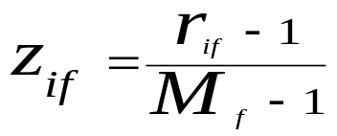
Variables of Mixed Types
A database may contain all the six types of variables
  symmetric binary, asymmetric binary, nominal, ordinal, interval and ratio.
One may use a weighted formula to combine their effects.
  f is binary or nominal:
    d_{ij}^{(f)} = 0 if x_{if} = x_{jf} , or d_{ij}^{(f)} = 1 o.w.
  f is interval-based: use the normalized distance
  f is ordinal or ratio-scaled
    compute ranks r_{if} and
    and treat z_{if} as interval-scaled

Slide 22
Cluster Analysis
What is Cluster Analysis?
Types of Data in Cluster Analysis
A Categorization of Major Clustering Methods
Partitioning Methods
Hierarchical Methods
Density-Based Methods
Grid-Based Methods
Model-Based Clustering Methods
Outlier Analysis
Summary

Slide 23
Major Clustering Approaches
Partitioning algorithms: Construct various partitions and then evaluate them by some criterion
Hierarchy algorithms: Create a hierarchical decomposition of the set of data (or objects) using some criterion
Density-based: based on connectivity and density functions
Grid-based: based on a multiple-level granularity structure
Model-based: A model is hypothesized for each of the clusters and the idea is to find the best fit of that model to each other

Slide 24
Cluster Analysis
What is Cluster Analysis?
Types of Data in Cluster Analysis
A Categorization of Major Clustering Methods
Partitioning Methods
Hierarchical Methods
Density-Based Methods
Grid-Based Methods
Model-Based Clustering Methods
Outlier Analysis
Summary

Slide 25
Partitioning Algorithms: Basic Concept
Partitioning method: Construct a partition of a database D of n objects into a set of k clusters
Given a k, find a partition of k clusters that optimizes the chosen partitioning criterion
  Global optimal: exhaustively enumerate all partitions
  Heuristic methods: k-means and k-medoids algorithms
    k-means (MacQueen’67): Each cluster is represented by the center of the cluster
    k-medoids or PAM (Partition around medoids) (Kaufman & Rousseeuw’87): Each cluster is represented by one of the objects in the cluster

Slide 26
The K-Means Clustering Method
Given k, the k-means algorithm is implemented in 4 steps:
  Randomly select k objects as the centroids of the clusters of the current partition. The centroid is the center (mean point) of the cluster.
  Assign each object to the cluster with the nearest seed point.
  Compute the new centroid of each clusters
  Go back to Step 2, stop when no more new assignment.

Slide 27
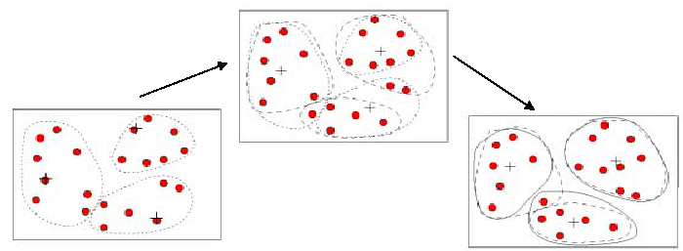
The K-Means Clustering Method
Example

Slide 28
Comments on the K-Means Method
Strength
  Relatively efficient: O(tkn), where n is # objects, k is # clusters, and t is # iterations. Normally, k, t << n.
  Often terminates at a local optimum. The global optimum may be found using techniques such as: deterministic annealing and genetic algorithms
Weakness
  Applicable only when mean is defined, then what about categorical data?
  Need to specify k, the number of clusters, in advance
  Unable to handle noisy data and outliers
  Not suitable to discover clusters with non-convex shapes

Slide 29
The K-Medoids Clustering Method
Find representative objects, called medoids, in clusters
PAM (Partitioning Around Medoids, 1987)
  starts from an initial set of medoids and iteratively replaces one of the medoids by one of the non-medoids if it improves the total distance of the resulting clustering
  PAM works effectively for small data sets, but does not scale well for large data sets
CLARA (Kaufmann & Rousseeuw, 1990)
CLARANS (Ng & Han, 1994): Randomized sampling
Focusing + spatial data structure (Ester et al., 1995)

Slide 30
Cluster Analysis
What is Cluster Analysis?
Types of Data in Cluster Analysis
A Categorization of Major Clustering Methods
Partitioning Methods
Hierarchical Methods
Density-Based Methods
Grid-Based Methods
Model-Based Clustering Methods
Outlier Analysis
Summary

Slide 31
Hierarchical Clustering
Use distance matrix as clustering criteria. This method does not require the number of clusters k as an input, but needs a termination condition
Step 0
Step 1
Step 2
Step 3
Step 4
agglomerative
(AGNES)
a
a b
b
a b c d e
c
c d e
d
d e
e
divisive
(DIANA)
Step 4
Step 3
Step 2
Step 1
Step 0

Slide 32

AGNES (Agglomerative Nesting)
Introduced in Kaufmann and Rousseeuw (1990)
Implemented in statistical analysis packages, e.g., Splus
Use the Single-Link method and the dissimilarity matrix.
Merge nodes that have the least dissimilarity
Go on in a non-descending fashion
Eventually all nodes belong to the same cluster

Slide 33
DIANA (Divisive Analysis)
Introduced in Kaufmann and Rousseeuw (1990)
Implemented in statistical analysis packages, e.g., S+
Inverse order of AGNES
Eventually each node forms a cluster on its own

Slide 34
Cluster Analysis
What is Cluster Analysis?
Types of Data in Cluster Analysis
A Categorization of Major Clustering Methods
Partitioning Methods
Hierarchical Methods
Density-Based Methods
Grid-Based Methods
Model-Based Clustering Methods
Outlier Analysis
Summary

Slide 35
Density-Based Clustering Methods
Clustering based on density (local cluster criterion), such as density-connected points
Major features:
  Discover clusters of arbitrary shape
  Handle noise
  One scan
  Need density parameters as termination condition
Several interesting studies:
  DBSCAN: Ester, et al. (KDD’96)
  OPTICS: Ankerst, et al (SIGMOD’99).
  DENCLUE: Hinneburg & D. Keim (KDD’98)
  CLIQUE: Agrawal, et al. (SIGMOD’98)

Slide 36
Density-Based Clustering: Background
Two parameters:
  Eps: Maximum radius of the neighbourhood
  MinPts: Minimum number of points in an Eps-neighbourhood of that point
N_{Eps}(p): {q belongs to D | dist(p,q) <= Eps}
Directly density-reachable: A point p is directly density-reachable from a point q wrt. Eps, MinPts if
  1) p belongs to N_{Eps}(q)
  2) core point condition:
  |N_{Eps} (q)| >= MinPts
MinPts = 5
Eps = 1 cm
p
q

Slide 37
Density-Based Clustering: Background (II)
Density-reachable:
  A point p is density-reachable from a point q wrt. Eps, MinPts if there is a chain of points p₁, …, p_{n}, p₁ = q, p_{n} = p such that p_{i+1} is directly density-reachable from p_{i}
Density-connected
  A point p is density-connected to a point q wrt. Eps, MinPts if there is a point o such that both, p and q are density-reachable from o wrt. Eps and MinPts.
p
p₁
q
p
q
o

Slide 38
DBSCAN: Density Based Spatial Clustering of Applications with Noise
Relies on a density-based notion of cluster: A cluster is defined as a maximal set of density-connected points
Discovers clusters of arbitrary shape in spatial databases with noise
Outlier
Border
Eps = 1cm
MinPts = 5
Core

Slide 39
DBSCAN: The Algorithm
  Arbitrary select a point p
    If p is a core point, a cluster is formed.
    If p is a border point, no points are density-reachable from p and DBSCAN visits the next point of the database.
  Loop until all of the points have been processed.
  Retrieve all points density-reachable from these core points wrt Eps and MinPts. If needed, combine some clusters into a new one.

Slide 40
Cluster Analysis
What is Cluster Analysis?
Types of Data in Cluster Analysis
A Categorization of Major Clustering Methods
Partitioning Methods
Hierarchical Methods
Density-Based Methods
Grid-Based Methods
Model-Based Clustering Methods
Outlier Analysis
Summary

Slide 41
Grid-Based Clustering Method
Using multi-resolution grid data structure
Several interesting methods
  STING (a STatistical INformation Grid approach) by Wang, Yang and Muntz (1997)
  WaveCluster by Sheikholeslami, Chatterjee, and Zhang (VLDB’98)
    A multi-resolution clustering approach using wavelet method
  CLIQUE: Agrawal, et al. (SIGMOD’98)

Slide 42
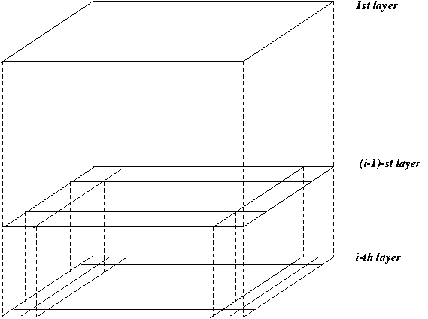
STING: A Statistical Information Grid Approach
Wang, Yang and Muntz (VLDB’97)
The spatial area area is divided into rectangular cells
There are several levels of cells corresponding to different levels of resolution

Slide 43
Cluster Analysis
What is Cluster Analysis?
Types of Data in Cluster Analysis
A Categorization of Major Clustering Methods
Partitioning Methods
Hierarchical Methods
Density-Based Methods
Grid-Based Methods
Model-Based Clustering Methods
Outlier Analysis
Summary

Slide 44
Model-Based Clustering Methods
Attempt to optimize the fit between the data and some mathematical model
Statistical and AI approach
  Conceptual clustering
    A form of clustering in machine learning
    Produces a classification scheme for a set of unlabeled objects
    Finds characteristic description for each concept (class)
  COBWEB (Fisher’87)
    A popular a simple method of incremental conceptual learning
    Creates a hierarchical clustering in the form of a classification tree
    Each node refers to a concept and contains a probabilistic description of that concept

Slide 45

COBWEB Clustering Method
A classification tree

Slide 46
More on Statistical-Based Clustering
Limitations of COBWEB
  The assumption that the attributes are independent of each other is often too strong because correlation may exist
  Not suitable for clustering large database data – skewed tree and expensive probability distributions
CLASSIT
  an extension of COBWEB for incremental clustering of continuous data
  suffers similar problems as COBWEB
AutoClass (Cheeseman and Stutz, 1996)
  Uses Bayesian statistical analysis to estimate the number of clusters
  Popular in industry

Slide 47
Other Model-Based Clustering Methods
Neural network approaches
  Represent each cluster as an exemplar, acting as a “prototype” of the cluster
  New objects are distributed to the cluster whose exemplar is the most similar according to some distance measure
Competitive learning
  Involves a hierarchical architecture of several units (neurons)
  Neurons compete in a “winner-takes-all” fashion for the object currently being presented
Self-organizing feature maps (SOMs)

Slide 48
Cluster Analysis
What is Cluster Analysis?
Types of Data in Cluster Analysis
A Categorization of Major Clustering Methods
Partitioning Methods
Hierarchical Methods
Density-Based Methods
Grid-Based Methods
Model-Based Clustering Methods
Outlier Analysis
Summary

Slide 49
What Is Outlier Discovery?
What are outliers?
  The set of objects are considerably dissimilar from the remainder of the data
Problem
  Find top n outlier points
Applications:
  Credit card fraud detection
  Telecom fraud detection
  Customer segmentation
  Medical analysis

Slide 50

Outlier Discovery: Statistical Approaches
Assume a model underlying distribution that generates data set (e.g. normal distribution)
Use discordancy tests depending on
  data distribution
  distribution parameter (e.g., mean, variance)
  number of expected outliers
Drawbacks
  most tests are for single attribute
  In many cases, data distribution may not be known

Slide 51
Outlier Discovery: Distance-Based Approach
Introduced to counter the main limitations imposed by statistical methods
  We need multi-dimensional analysis without knowing data distribution.
Distance-based outlier: A DB(p, D)-outlier is an object O in a dataset T such that at least a fraction p of the objects in T lies at a distance greater than D from O
Algorithms for mining distance-based outliers
  Index-based algorithm
  Nested-loop algorithm
  Cell-based algorithm

Slide 52
Outlier Discovery: Deviation-Based Approach
Identifies outliers by examining the main characteristics of objects in a group
Objects that “deviate” from this description are considered outliers
Sequential exception technique
  simulates the way in which humans can distinguish unusual objects from among a series of supposedly like objects
OLAP data cube technique
  uses data cubes to identify regions of anomalies in large multidimensional data

Slide 53



Recalling the Examples in OLAP data cube technique

Slide 54
Cluster Analysis
What is Cluster Analysis?
Types of Data in Cluster Analysis
A Categorization of Major Clustering Methods
Partitioning Methods
Hierarchical Methods
Density-Based Methods
Grid-Based Methods
Model-Based Clustering Methods
Outlier Analysis
Summary

Slide 55
Summary
Cluster analysis groups objects based on their similarity and has wide applications
Measure of similarity can be computed for various types of data
Clustering algorithms can be categorized into partitioning methods, hierarchical methods, density-based methods, grid-based methods, and model-based methods
Outlier detection and analysis are very useful for fraud detection, etc. and can be performed by statistical, distance-based or deviation-based approaches
There are still lots of research issues on cluster analysis, such as constraint-based clustering

Slide 56
References (1)
J. Han and M. Kamber. Data Mining: Concepts and Techniques. Morgan Kaufmann, 2000.(Including Materials)
R. Agrawal, J. Gehrke, D. Gunopulos, and P. Raghavan. Automatic subspace clustering of high dimensional data for data mining applications. SIGMOD'98
M. R. Anderberg. Cluster Analysis for Applications. Academic Press, 1973.
M. Ankerst, M. Breunig, H.-P. Kriegel, and J. Sander. Optics: Ordering points to identify the clustering structure, SIGMOD’99.
P. Arabie, L. J. Hubert, and G. De Soete. Clustering and Classification. World Scietific, 1996
M. Ester, H.-P. Kriegel, J. Sander, and X. Xu. A density-based algorithm for discovering clusters in large spatial databases. KDD'96.
M. Ester, H.-P. Kriegel, and X. Xu. Knowledge discovery in large spatial databases: Focusing techniques for efficient class identification. SSD'95.
D. Fisher. Knowledge acquisition via incremental conceptual clustering. Machine Learning, 2:139-172, 1987.
D. Gibson, J. Kleinberg, and P. Raghavan. Clustering categorical data: An approach based on dynamic systems. In Proc. VLDB’98.
S. Guha, R. Rastogi, and K. Shim. Cure: An efficient clustering algorithm for large databases. SIGMOD'98.
A. K. Jain and R. C. Dubes. Algorithms for Clustering Data. Printice Hall, 1988.

Slide 57
References (2)
L. Kaufman and P. J. Rousseeuw. Finding Groups in Data: an Introduction to Cluster Analysis. John Wiley & Sons, 1990.
E. Knorr and R. Ng. Algorithms for mining distance-based outliers in large datasets. VLDB’98.
G. J. McLachlan and K.E. Bkasford. Mixture Models: Inference and Applications to Clustering. John Wiley and Sons, 1988.
P. Michaud. Clustering techniques. Future Generation Computer systems, 13, 1997.
R. Ng and J. Han. Efficient and effective clustering method for spatial data mining. VLDB'94.
E. Schikuta. Grid clustering: An efficient hierarchical clustering method for very large data sets. Proc. 1996 Int. Conf. on Pattern Recognition, 101-105.
G. Sheikholeslami, S. Chatterjee, and A. Zhang. WaveCluster: A multi-resolution clustering approach for very large spatial databases. VLDB’98.
W. Wang, Yang, R. Muntz, STING: A Statistical Information grid Approach to Spatial Data Mining, VLDB’97.
T. Zhang, R. Ramakrishnan, and M. Livny. BIRCH : an efficient data clustering method for very large databases. SIGMOD'96.

Slide 58
Thank you !!!

