Slide 1


Building a Fadecandy Slackbot

Slide 2
Introduction
Mark Hoopes (Xync)
hoopesm@gmail.com, xync@xync.org
@mapkxync
Senior Application Security Engineer
Aspect Security
Never coded professionally
Have written lots of unprofessional code

Slide 3
Goals
Write a Slackbot that will connect to the denhac Slack instance
Write a program that will control the light wall
Combine and mix well

Slide 4
Slackbot Background
Slack provides an API designed to allow programs to listen to Slack channels and send responses.
https://api.slack.com/
Each bot must have a unique ID
This ID must be created by a registered Slack user

Slide 5
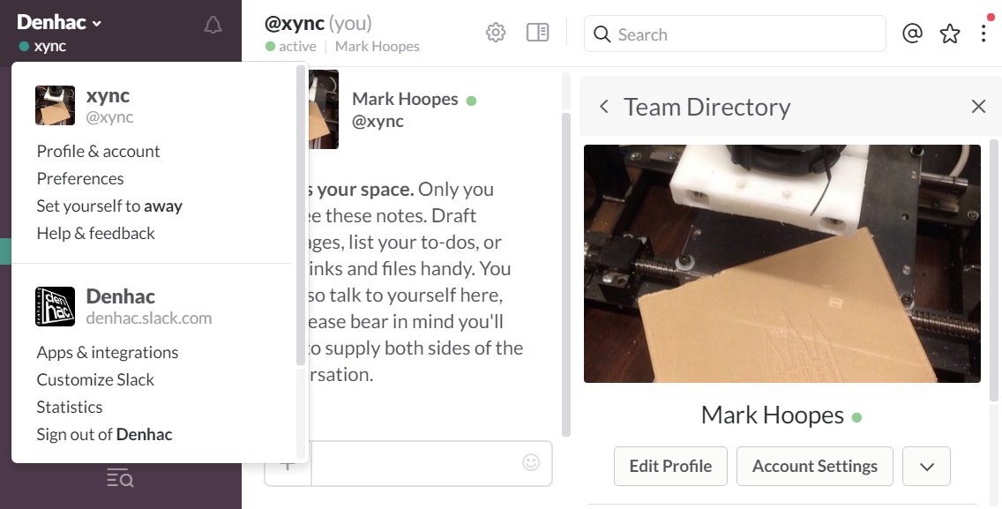
Obtain a Bot Token - Part 1
1
2
3

Slide 6
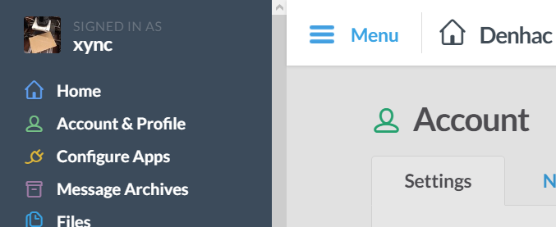
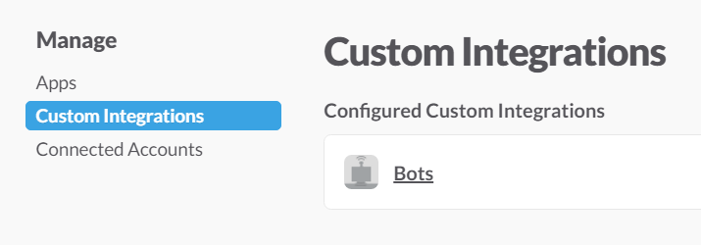
Obtain a Bot Token - Part 2
4
5
6
Skip straight to step 6 by going to https://denhac.slack.com/apps/manage/custom-integrations

Slide 7

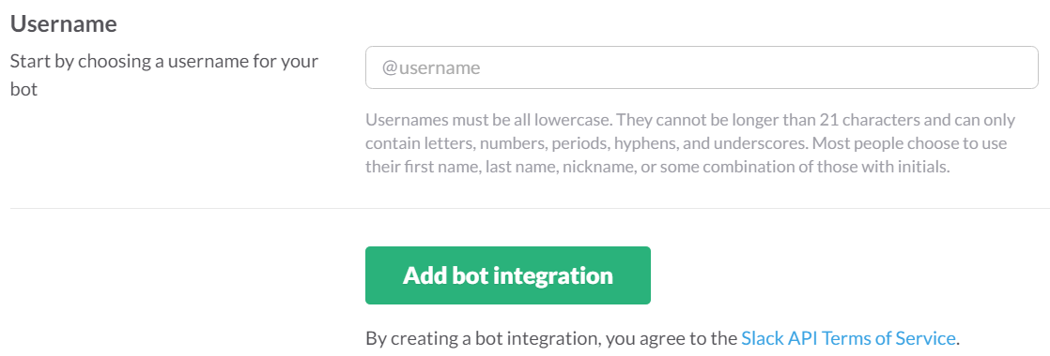
Obtain a Bot Token - Part 3
7
8
9

Slide 8
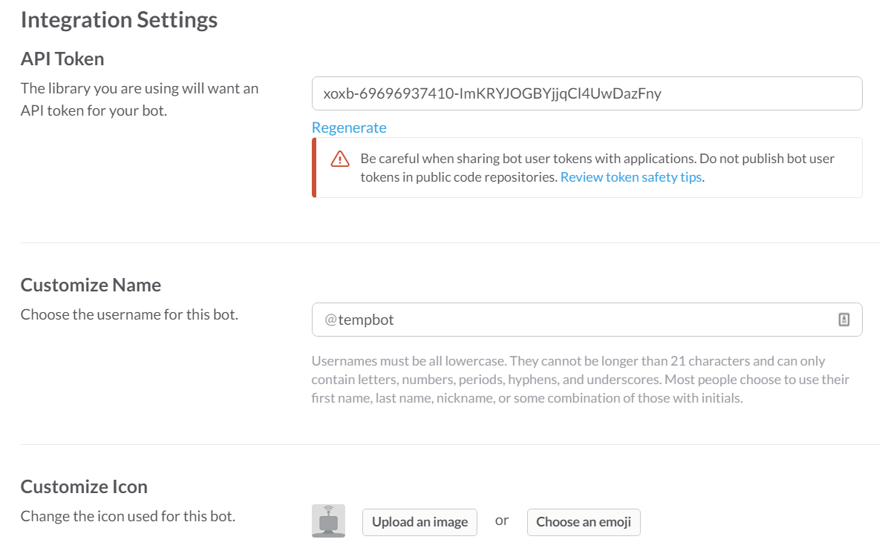
Obtain a Bot Token - Result

Slide 9
Install Python Module
pip install slackclient
Notes:
That's it. Do this.

Slide 10
Slackbot High Level Design
Connect using the Token
Listen to the message stream
Find our trigger phrase
Do something!

Slide 11
Connecting via the API
slack_client = SlackClient(os.environ.get('SLACK_BOT_TOKEN'))
if __name__ == "__main__":
READ_WEBSOCKET_DELAY = 1 # 1 second delay between reading from firehose
if slack_client.rtm_connect():
print("StarterBot connected and running!")
while True:
command, channel = parse_slack_output(slack_client.rtm_read())
if command and channel:
handle_command(command, channel)
time.sleep(READ_WEBSOCKET_DELAY)
else:
print("Connection failed. Invalid Slack token?")

Slide 12
Keys in Environment Not Code
Windows
set SLACK_BOT_TOKEN=[token]
Linux
export SLACK_BOT_TOKEN=[token]

Slide 13
What's in the water?
{u'type': u'presence_change', u'user': u'U1T9YNQKS', u'presence': u'active'}
{u'type': u'user_typing', u'user': u'U0DCKT3KP', u'channel': u'D216A7P2B'}
{u'text': u'Hi lightwall', u'ts': u'1471311719.000002', u'user': u'U0DCKT3KP', u'team': u'T03N7EGN9', u'type': u'message', u'channel': u'D216A7P2B'}
{u'text': u'<@U1T9YNQKS> do something', u'ts': u'1471311921.000005', u'user': u'U0DCKT3KP', u'team': u'T03N7EGN9', u'type': u'message', u'channel': u'D216A7P2B'}
{u'user_profile': {u'avatar_hash': u'25c29ed00b78', u'first_name': None, u'real_name': u'', u'name': u'lightwall', u'image_72': u'https://avatars.slack-edge.com/2016-07-19/61344719975_25c29ed00b78f0c636ca_72.png'}, u'text': u'Sure...write some more code then I can do that!', u'ts': u'1471311923.000006', u'user': u'U1T9YNQKS', u'channel': u'D216A7P2B', u'team': u'T03N7EGN9', u'type': u'message', u'user_team': u'T03N7EGN9', u'bot_id': u'B1T9W2ME2'}

Slide 14
Parsing the Stream
# constants
BOT_ID = "U1T9YNQKS"
AT_BOT = "<@" + BOT_ID + ">" # Current protocol has no ':' after '>'
def parse_slack_output(slack_rtm_output):
# This parses the input stream looking for messages @directed to the bot
# Returns the text of the message for command parsing, and the channel
output_list = slack_rtm_output
if output_list and len(output_list) > 0:
for output in output_list:
if output and 'text' in output and AT_BOT in output['text']:
# return text after the @ mention, whitespace removed
return output['text'].split(AT_BOT)[1].strip().lower(), \
output['channel']
return None, None

Slide 15
What's my Bot ID?
import os
from slackclient import SlackClient
BOT_NAME = 'lightwall'
slack_client = SlackClient(os.environ.get('SLACK_BOT_TOKEN'))
if __name__ == "__main__":
api_call = slack_client.api_call("users.list")
numusers=0
if api_call.get('ok'):
# retrieve all users so we can find our bot
users = api_call.get('members')
for user in users:
numusers = numusers+1
if 'name' in user and user.get('name') == BOT_NAME:
print("Bot ID for '" + user['name'] + "' is " + user.get('id'))
else:
print("could not find bot user with the name " + BOT_NAME)
print ("Scanned %d users." % numusers)

Slide 16
Handle the Command
EXAMPLE_COMMAND = "do"
def handle_command(command, channel):
"""
Receives commands directed at the bot and determines if they
are valid commands. If so, then acts on the commands. If not,
returns back what it needs for clarification.
"""
response = "Not sure what you mean. Use the *" + EXAMPLE_COMMAND + \
"* command with numbers, delimited by spaces."
if command.startswith(EXAMPLE_COMMAND):
response = "Sure...write some more code then I can do that!"
slack_client.api_call("chat.postMessage", channel=channel,
text=response, as_user=True)

Slide 17
So…what do you want to do?
Our goal is to control the light wall.
The light wall is driven by a RaspberryPi running the 'fadecandy' package.
http://www.misc.name/fadecandy/
https://github.com/scanlime/fadecandy
Fadecandy is an implementation of the OPC (Open Pixel Control) protocol.

Slide 18
Setting up Fadecandy Client
Clone git repo
https://github.com/scanlime/fadecandy.git
Copy /examples/python/opc.py to your working directory
OR just download
https://github.com/scanlime/fadecandy/blob/master/examples/python/opc.py

Slide 19
Simple Fadecandy Script
import opc
import time
# Constants
numLEDs = 251
frequency = 0.3
#Connect to light controller
client = opc.Client('10.0.100.6:80')
while True:
# [ (red, green, blue) ]
pixels = [ (255,0,0) ] * numLEDs #creates an array of all the pixels (the whole row)
client.put_pixels(pixels)
time.sleep(frequency)
pixels = [ (0,0,0) ] * numLEDs
client.put_pixels(pixels)
time.sleep(frequency)

Slide 20
New red_alert function
def red_alert():
numLEDs = 251
frequency = 0.5
#Connect to light controller
client = opc.Client('10.0.100.6:80')
for c in range(60):
# [ (red, green, blue) ]
pixels = [ (255,0,0) ] * numLEDs #creates an array of all the pixels (the whole row)
client.put_pixels(pixels)
time.sleep(frequency)
pixels = [ (0,0,0) ] * numLEDs
client.put_pixels(pixels)
time.sleep(frequency)

Slide 21
New handle function
def handle_command(command, channel):
response = "Not sure what you mean. Use the *" + EXAMPLE_COMMAND + \
"* command with numbers, delimited by spaces."
print("Handling")
if command.startswith(EXAMPLE_COMMAND):
response = "Sure...write some more code then I can do that!"
if command.upcase.startswith("red alert"):
response = "Initiating Red Alert!"
red_alert()
slack_client.api_call("chat.postMessage", channel=channel,
text=response, as_user=True)

Slide 22


Slide 23
Code for Everybody!
https://github.com/Denhac/LightWallSlackbot

Slide 24
References
https://www.fullstackpython.com/blog/build-first-slack-bot-python.html
https://github.com/mattmakai/slack-starterbot
http://www.misc.name/fadecandy/
https://github.com/scanlime/fadecandy

