Slide 1
Examples of Raspberry Pi Projects
Krav, Denhac
17 October 2023

Slide 2
So you have a Raspberry Pi
(Or you’re gonna win one shortly)

Slide 3


Slide 4
But what do you do with it?

Slide 5
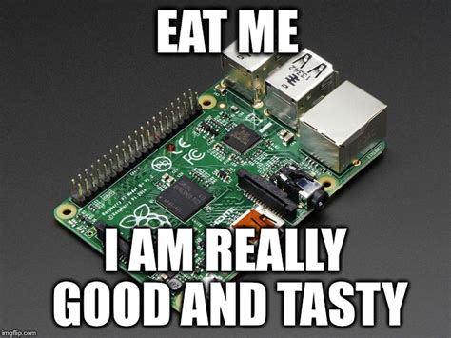
Disclaimer: Do not eat PCBs, ICs, or Electronic Components. Or do. I’m not your mom.

Slide 6


Slide 7
Here’s a couple different things we’ve built/done using an Rpi.

Slide 8
They run our 3D printers

Slide 9
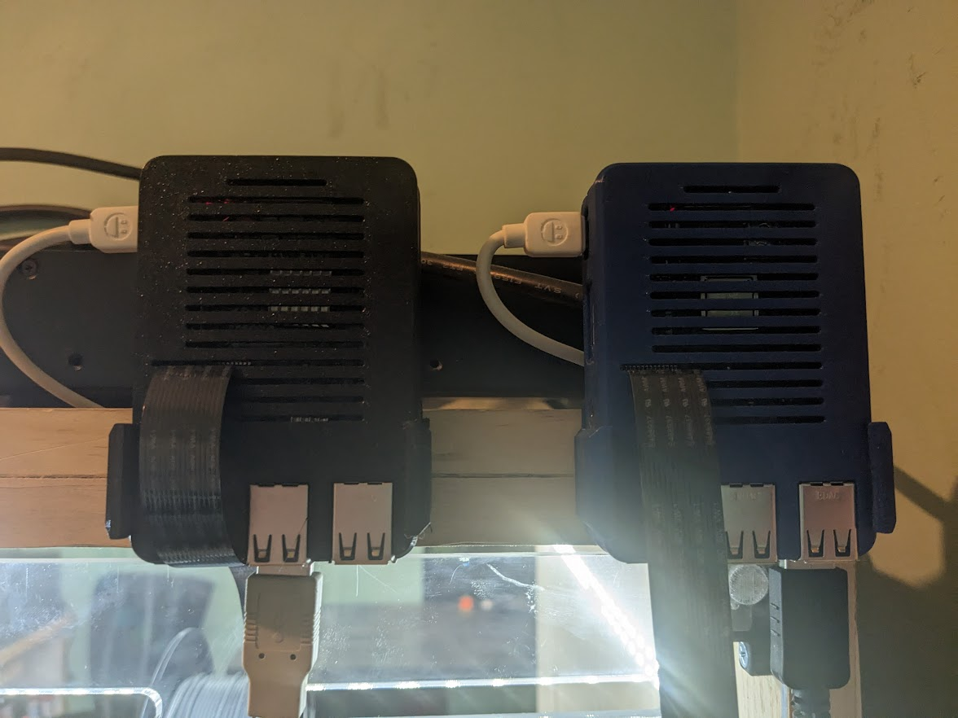

Slide 10
3 Pi 3 B’s (One for each printer)
They all run OctoPrint
Easy to install, manage. Was around before Prusa had their own solution.
Allows not only web management, but also access control.
Will eventually be managed via LDAP.

Slide 11
Run a Traffic Light

Slide 12
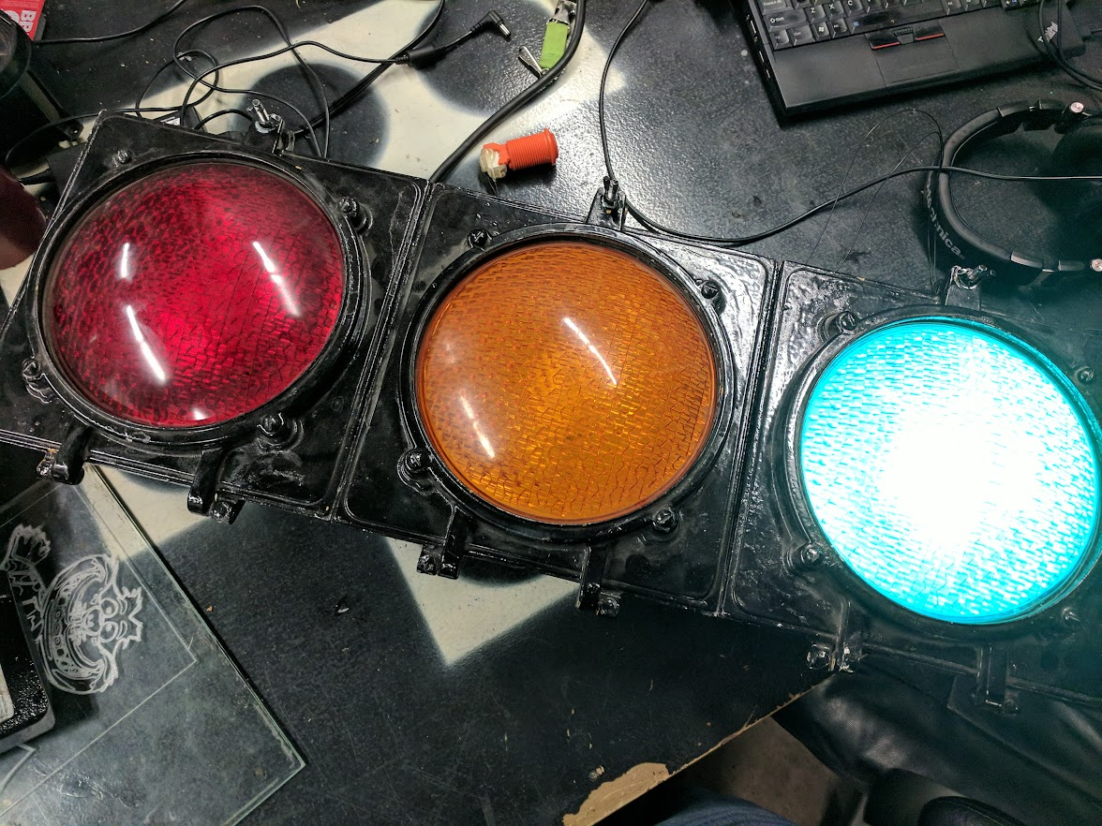

Slide 13
Uses several Sparkfun Beefcake relays to turn on/off lights.
Rpi was added to add internet/web interface.
Sat at denhac for several months before becoming part of previous member Proton’s Twitch stream.

Slide 14
Pwnagotchi

Slide 15
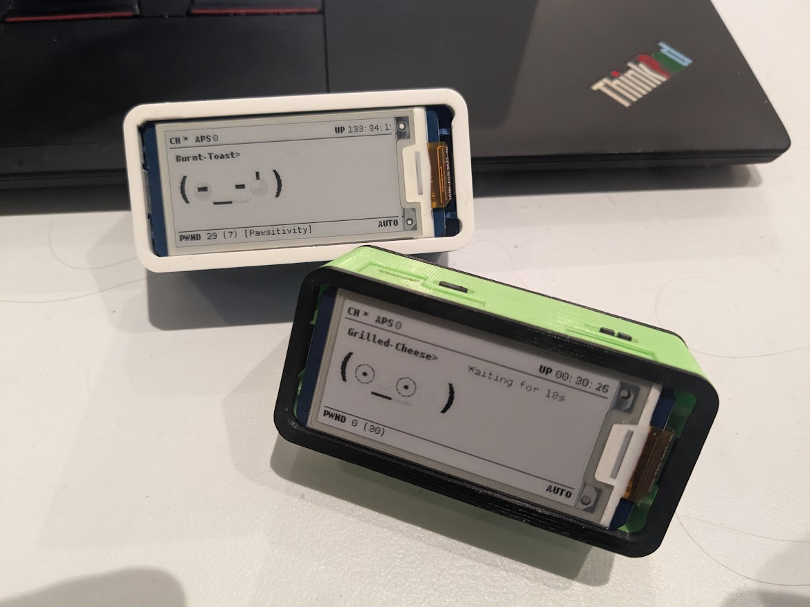

Slide 16
This was a fun side project of the guy who made Bettercap

Slide 17
Both of these were created by me. (They need friends!)
Uses an e-ink display to display the “creature”
Eats Wifi-Handshakes
4-5 hour battery life with a PiSugar battery.
Gets all the neighbors annoyed as it performs deauth attacks.

Slide 18
It’s run our HVAC

Slide 19
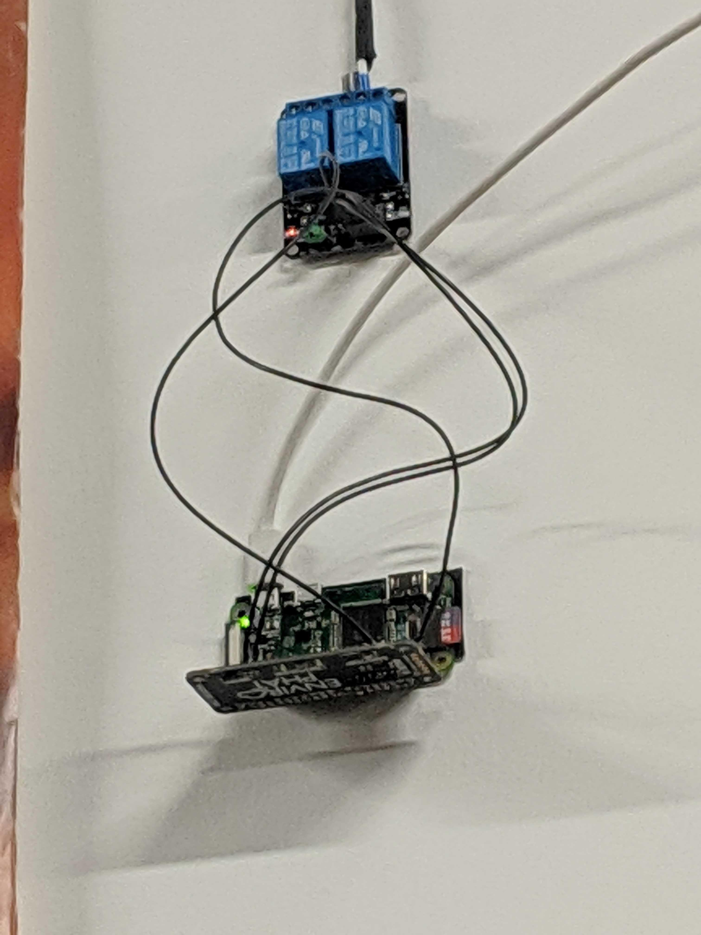

Slide 20
Our Furnace basically used a relay.
  Relay on? Furnace on.
  Relay off? You get the idea.
Combine this with an envirohat for the Pi 0 to measure temperature (and light so you know when people are in the space) and you’ve got a really basic thermostat.
This powered and maintained the heat for the space for several months.

Slide 21
We took them to DEFCON to vend stickers

Slide 22
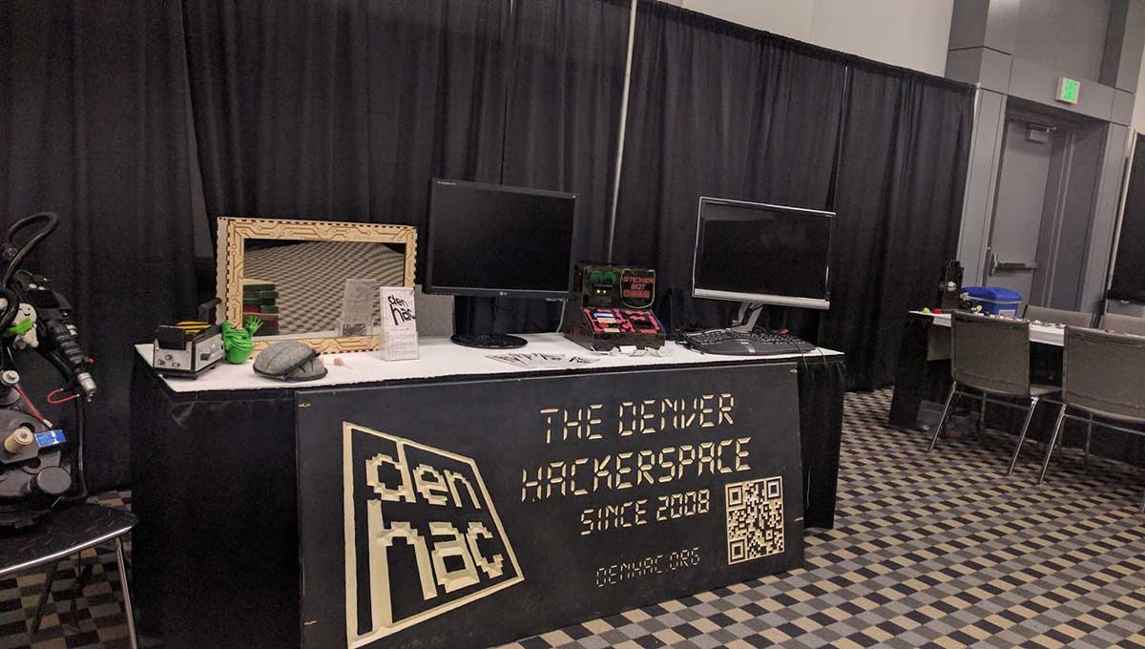

Slide 23
A Kludge of Epic Proportions
We Bitbanged a dollar bill accepter to receive donations.
Got a brother thermal label printer to print stickers
Used a Pi to manage the whole thing and run a web interface for designing your own case.

Slide 24
Other Things
Game System Emulation
Drop Systems (Pentesting!)
Learning Linux! (Cheap system to practice)
Badge Check in for Covid-19
Soda Machine Screen
Cheap Thin Client

Slide 25
So. Why show me all of this?

Slide 26


Slide 27

Adafruit
Creates cool one off stuff on top of being a reseller.
Lots of little components too/microcontrollers.
Guides! Plans! Schemes!

Slide 28

Sparkfun
Located in Scenic Gunbarrel.
Along the same lines as Adafruit, but red instead of black.
Lots of additional tech stuff (and microcontrollers)

Slide 29
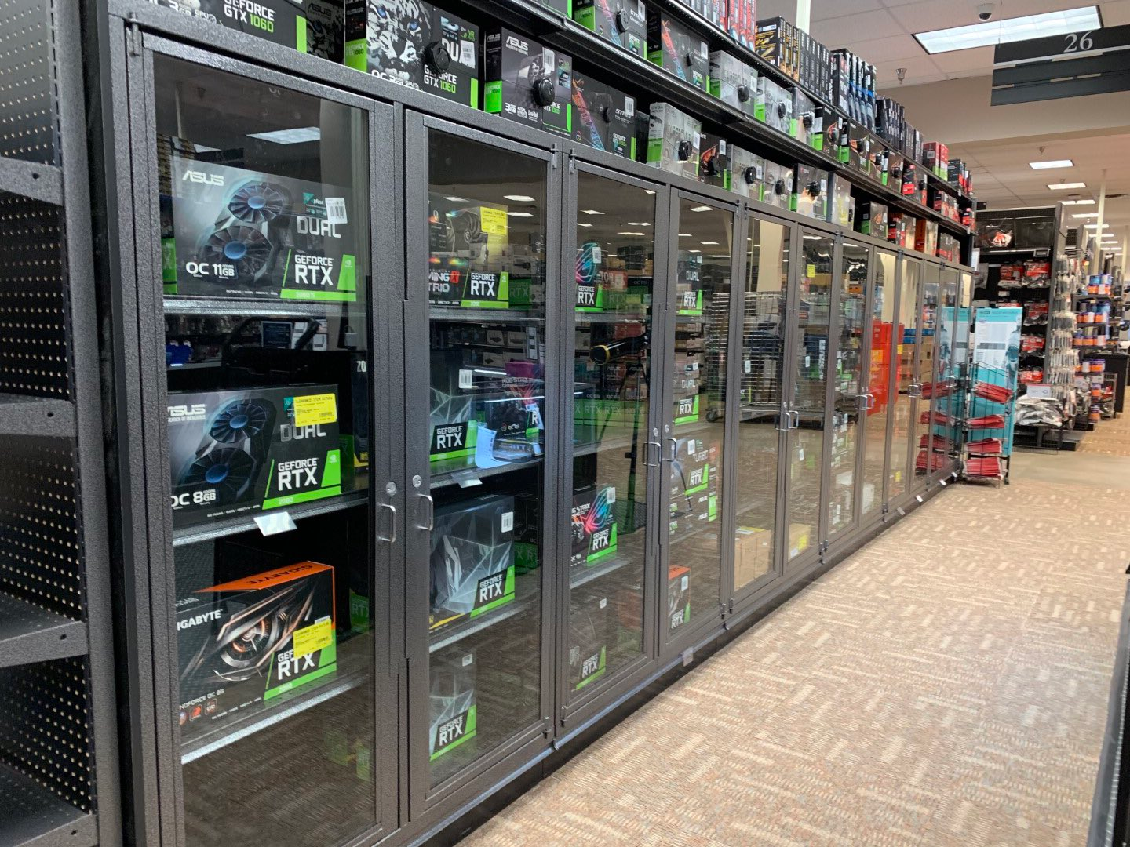
Microcenter
Nerd Mecca.
Easy for same day pickup.
Only a reseller, lots of Adafruit and Sparkfun stuff.

Slide 30
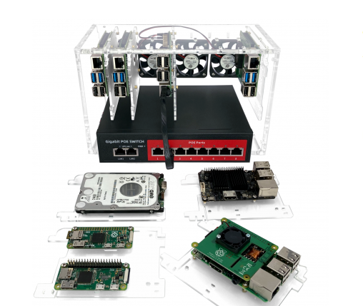
C4 Labs
Cases cases cases!
Small company in the USA
Does some unique stuff like VESA mounts and Cluster cases.

Slide 31
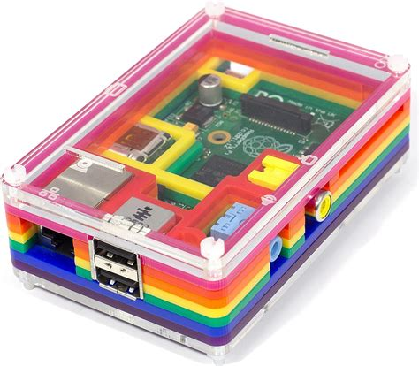
Pimeroni
The OG multi-layer Pi cases.
Now do WAY more. (tri-color e-ink screens!)
Amazing customer service

Slide 32
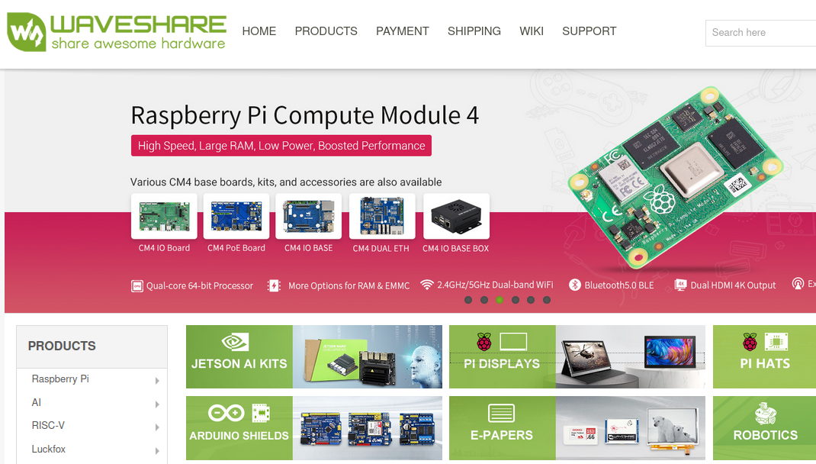
Waveshare
Ships direct from china
Great for displays and hats for cheap

Slide 33
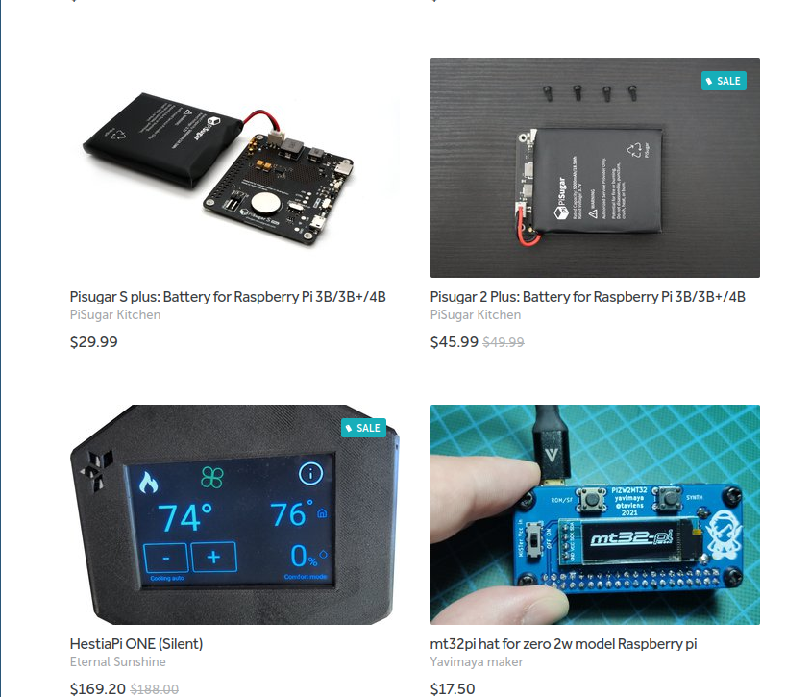
Tindie
All sorts of weird awesome small maker stuff.
Great for stuff like pi-batteries.
Shipping can be a bit odd as it’s handled by the individual maker.

Slide 34
Things to keep in mind
The new RPi5 has a M2 compatability hat. USE it.
  Sdcards die WAY faster than hard drives.
The sky’s the limit. If you can do it with a computer, you can probably do it with a raspberry pi. Push yourself, it’s how you learn things.

Slide 35
Thank you!

