Slide 1


Raspberry Pi Computers
at denhac
oct 17, 2023

Slide 2
New Model Raspberry Pi 5 – Early Preview
Raspberry Pi 5 Launches Monday Oct 23rd
  https://www.raspberrypi.com/news/introducing-raspberry-pi-5/
Weclome to denhac
  Denver’s Hackerspace/Makerspace
  https://denhac.org

Slide 3
Contents
Intro to the Raspberry Pi (RPI)
What’s New about RPI 5
Embedded Prototyping
Community Projects
Pi1541 Project

Slide 4
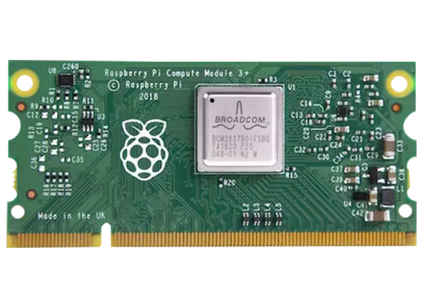
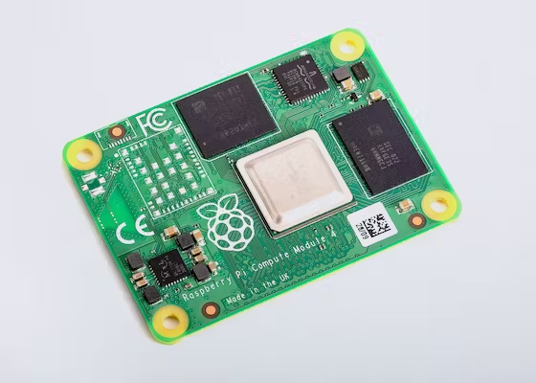
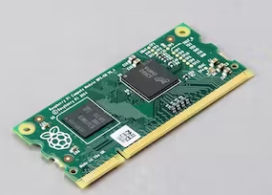
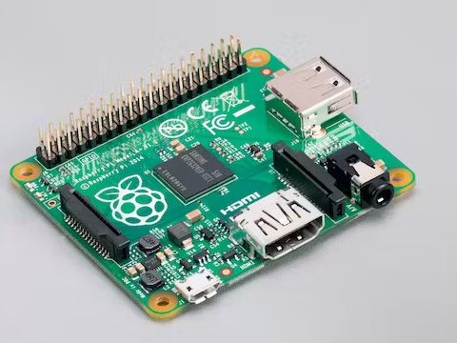
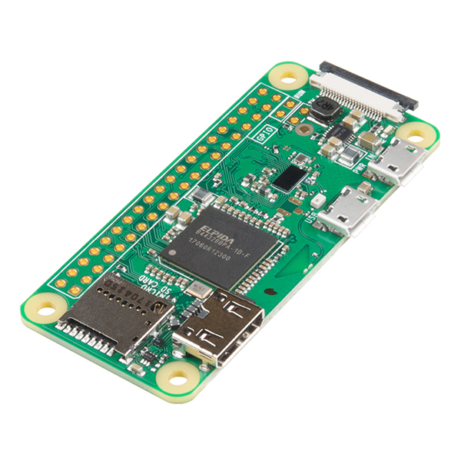
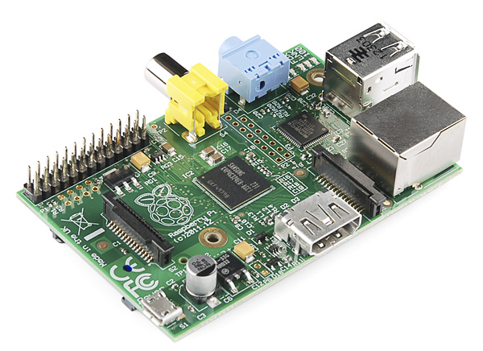
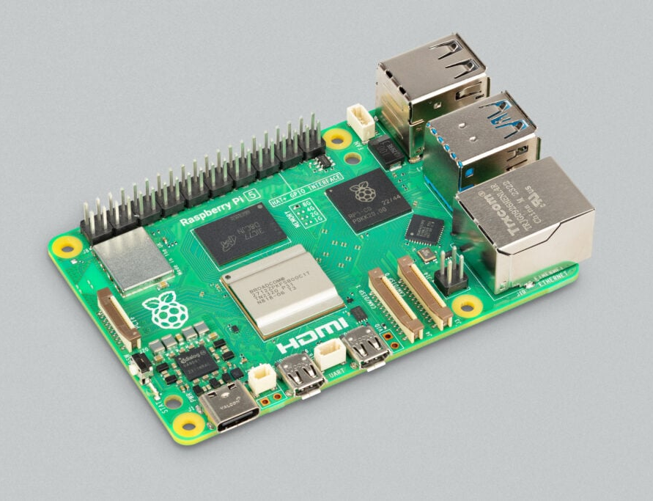
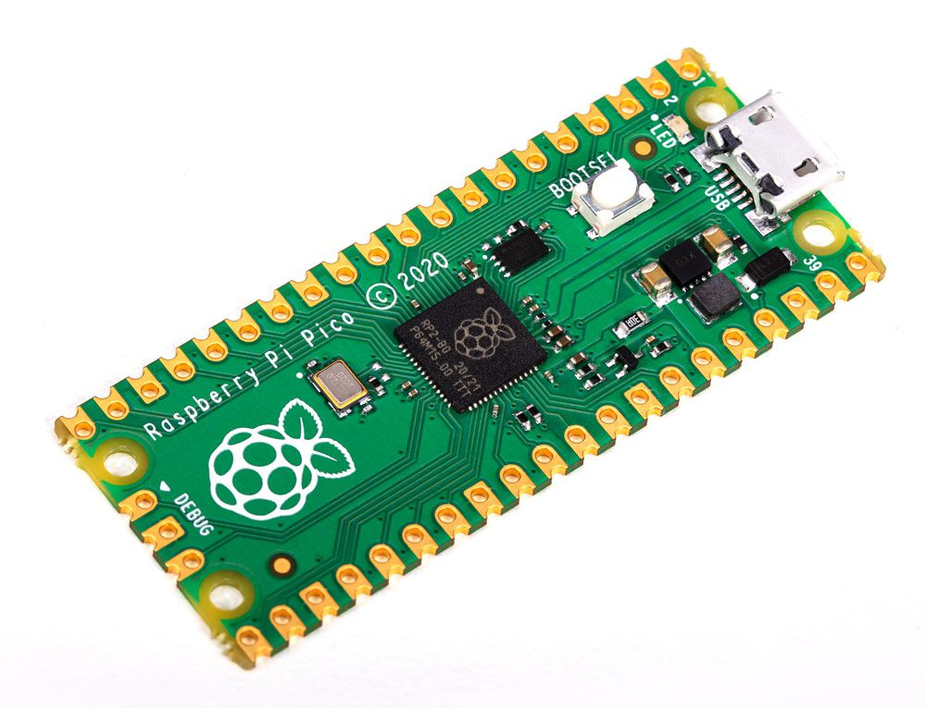
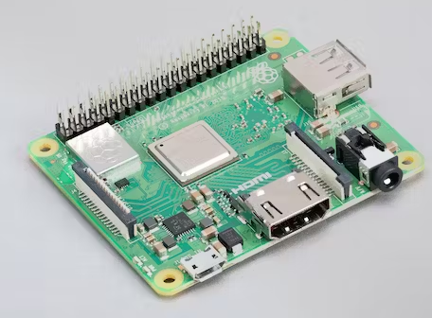
What is a Raspberry Pi?
Credit-card sized single board computer
1A+
Compute 3+
Compute 1
Zero W
Compute 4
Pico
1B
https://www.raspberrypi.com/products/compute-module-4/?variant=raspberry-pi-cm4001000
https://www.mouser.com/new/raspberry-pi/raspberry-pi-cm3plus-compute-modules/
https://www.raspberrypi.com/products/compute-module-1/
https://www.raspberrypi.com/products/raspberry-pi-1-model-a-plus/
https://www.raspberrypi.com/products/raspberry-pi-3-model-a-plus/
https://www.elektor.com/raspberry-pi-pico-rp2040
https://www.sparkfun.com/products/retired/11546
3A+
5

Slide 5
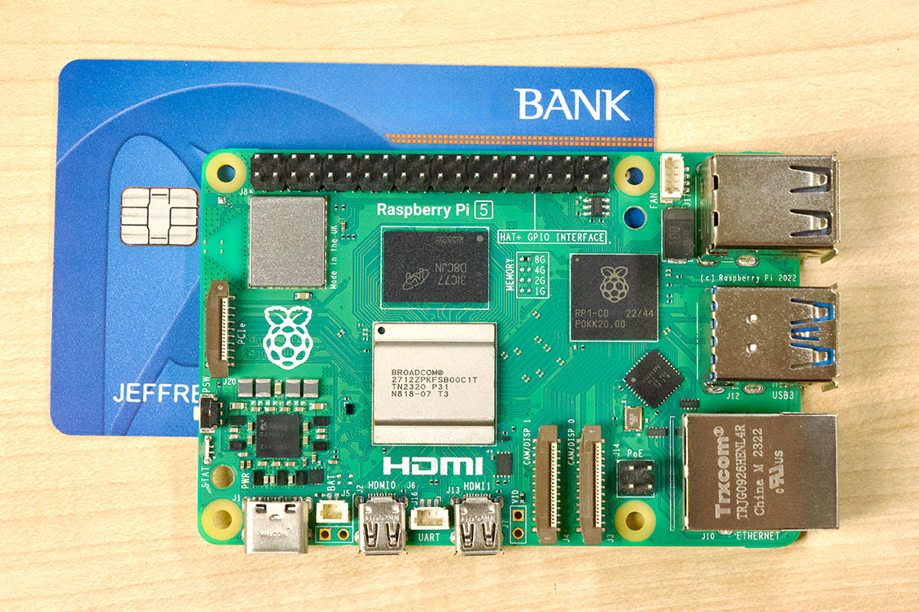
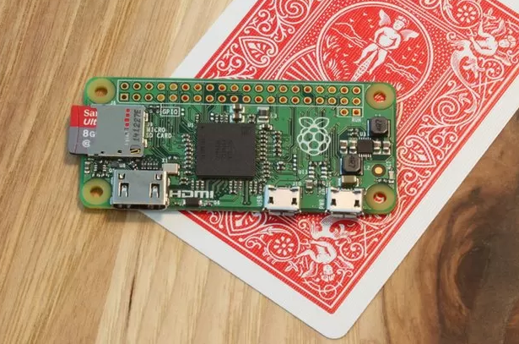
Most Common – B Models & Zeroes
B Models
Zero Models
https://www.jeffgeerling.com/blog/2023/testing-pcie-on-raspberry-pi-5
https://www.bbc.co.uk/news/technology-34922561

Slide 6
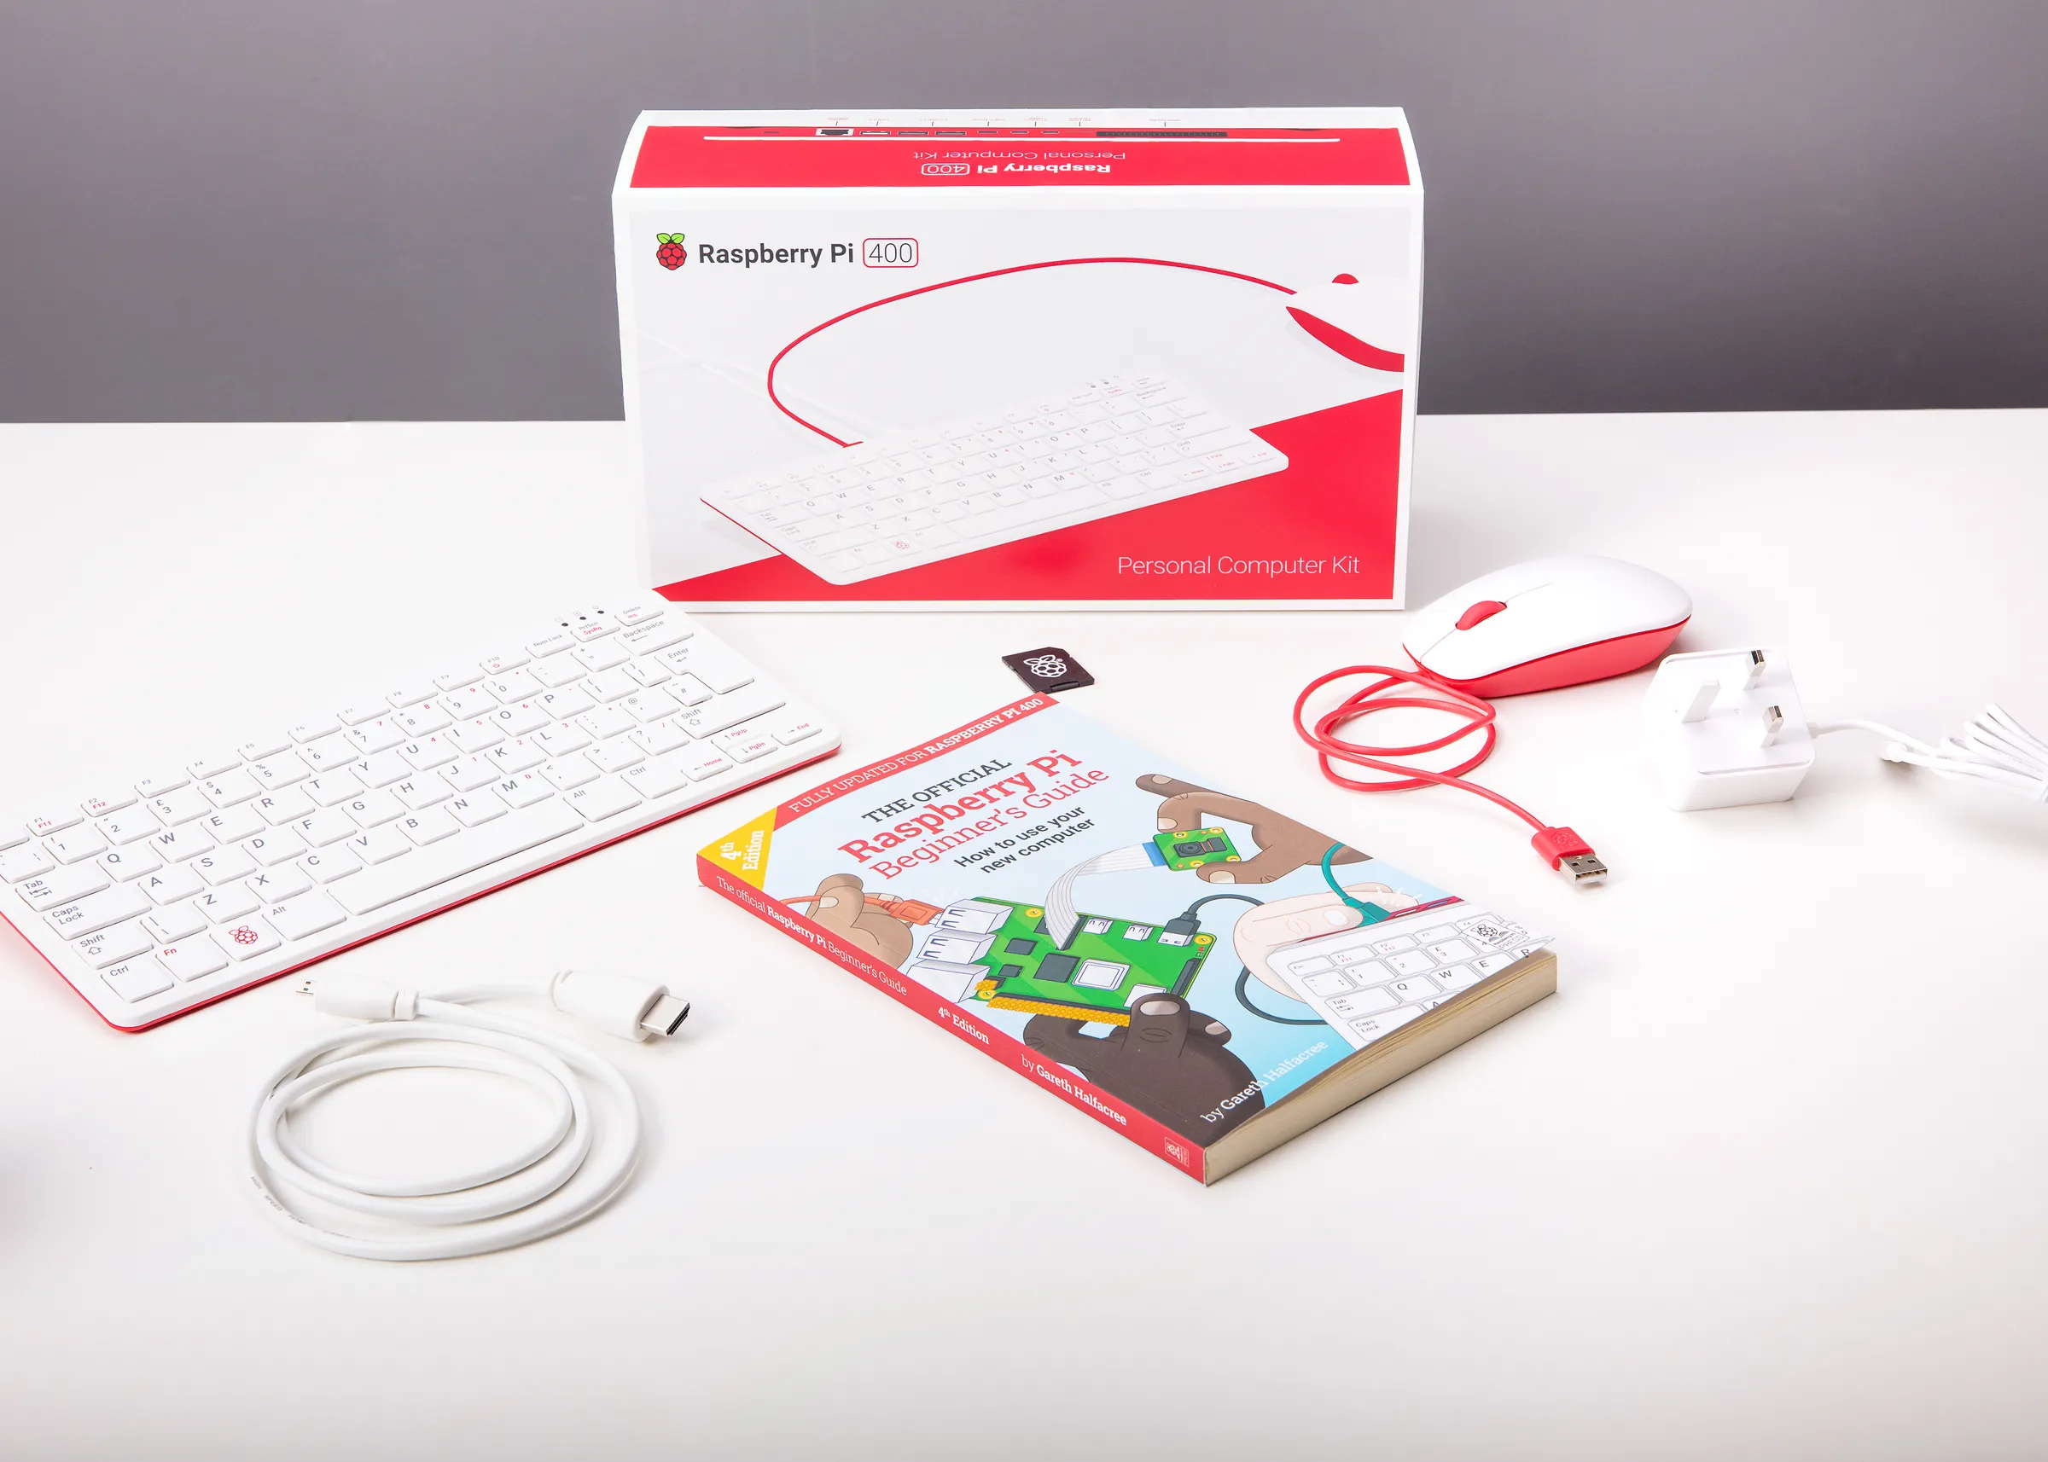
Desktop Computer
https://www.theverge.com/2020/11/2/21542278/raspberry-pi-400-keyboard-computer-arm-release-date-news-features

Slide 7
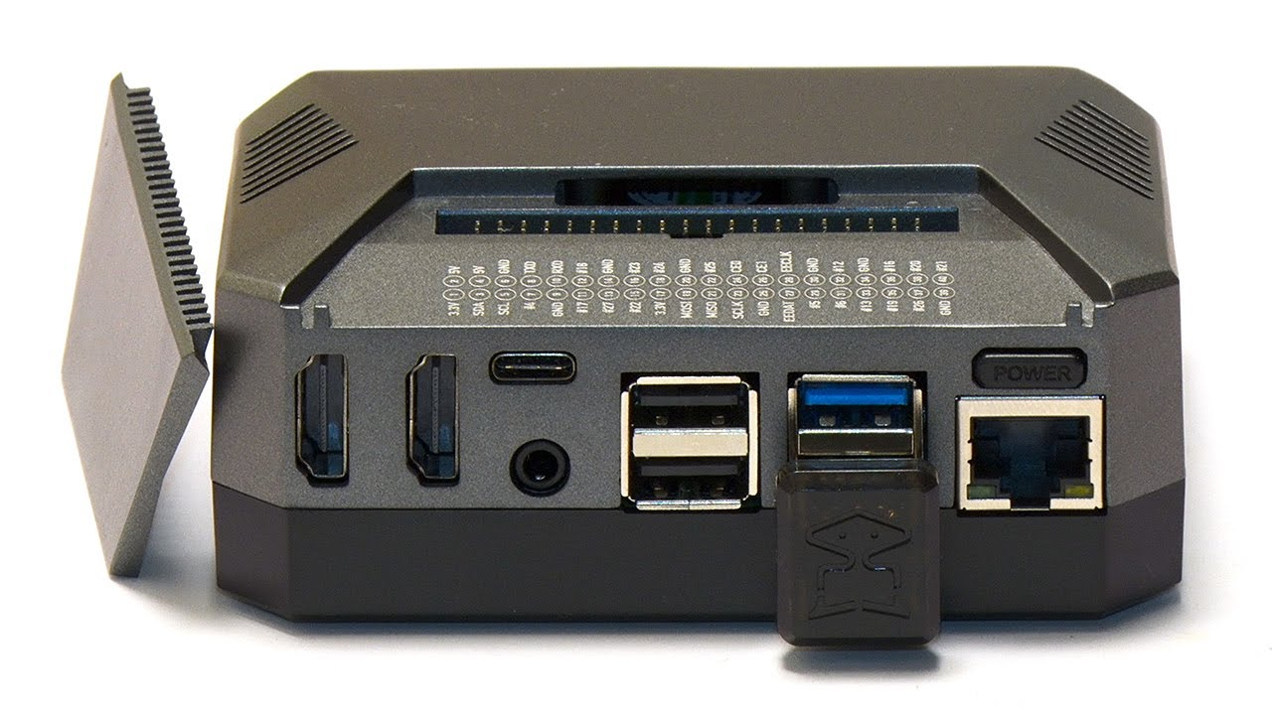

What are the features of a Raspberry Pi?
Low cost platform for software and hardware projects
Tiny Linux system with many types of interfaces
https://argon40.com/products/argon-one-v2-case-for-raspberry-pi-4
https://www.youtube.com/watch?v=Tgrka088ZFk
https://en.wikipedia.org/wiki/Linux

Slide 8
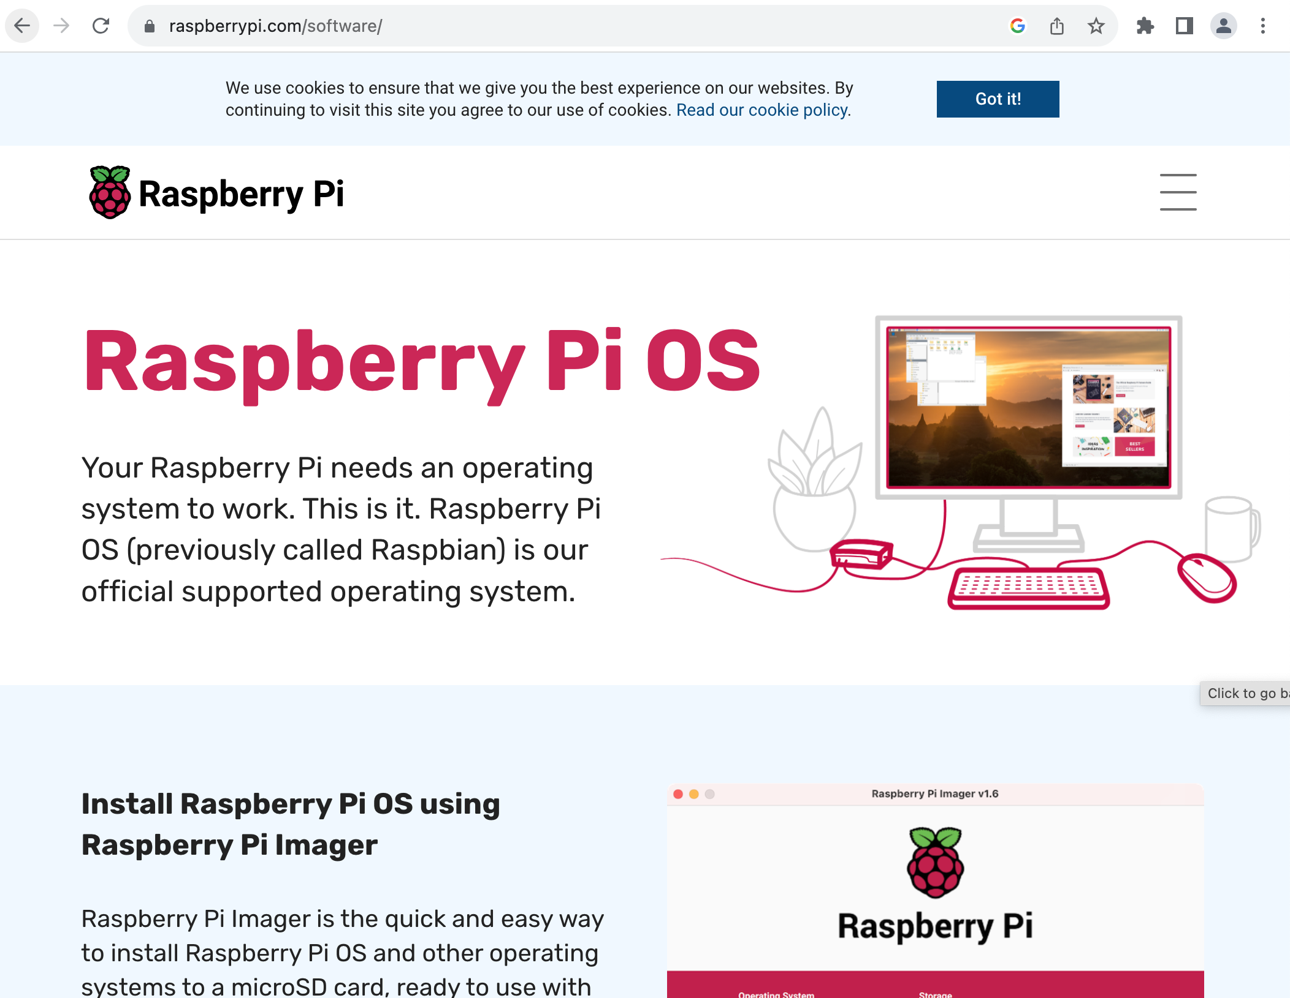
Operating System Provided
https://www.raspberrypi.com/software/

Slide 9



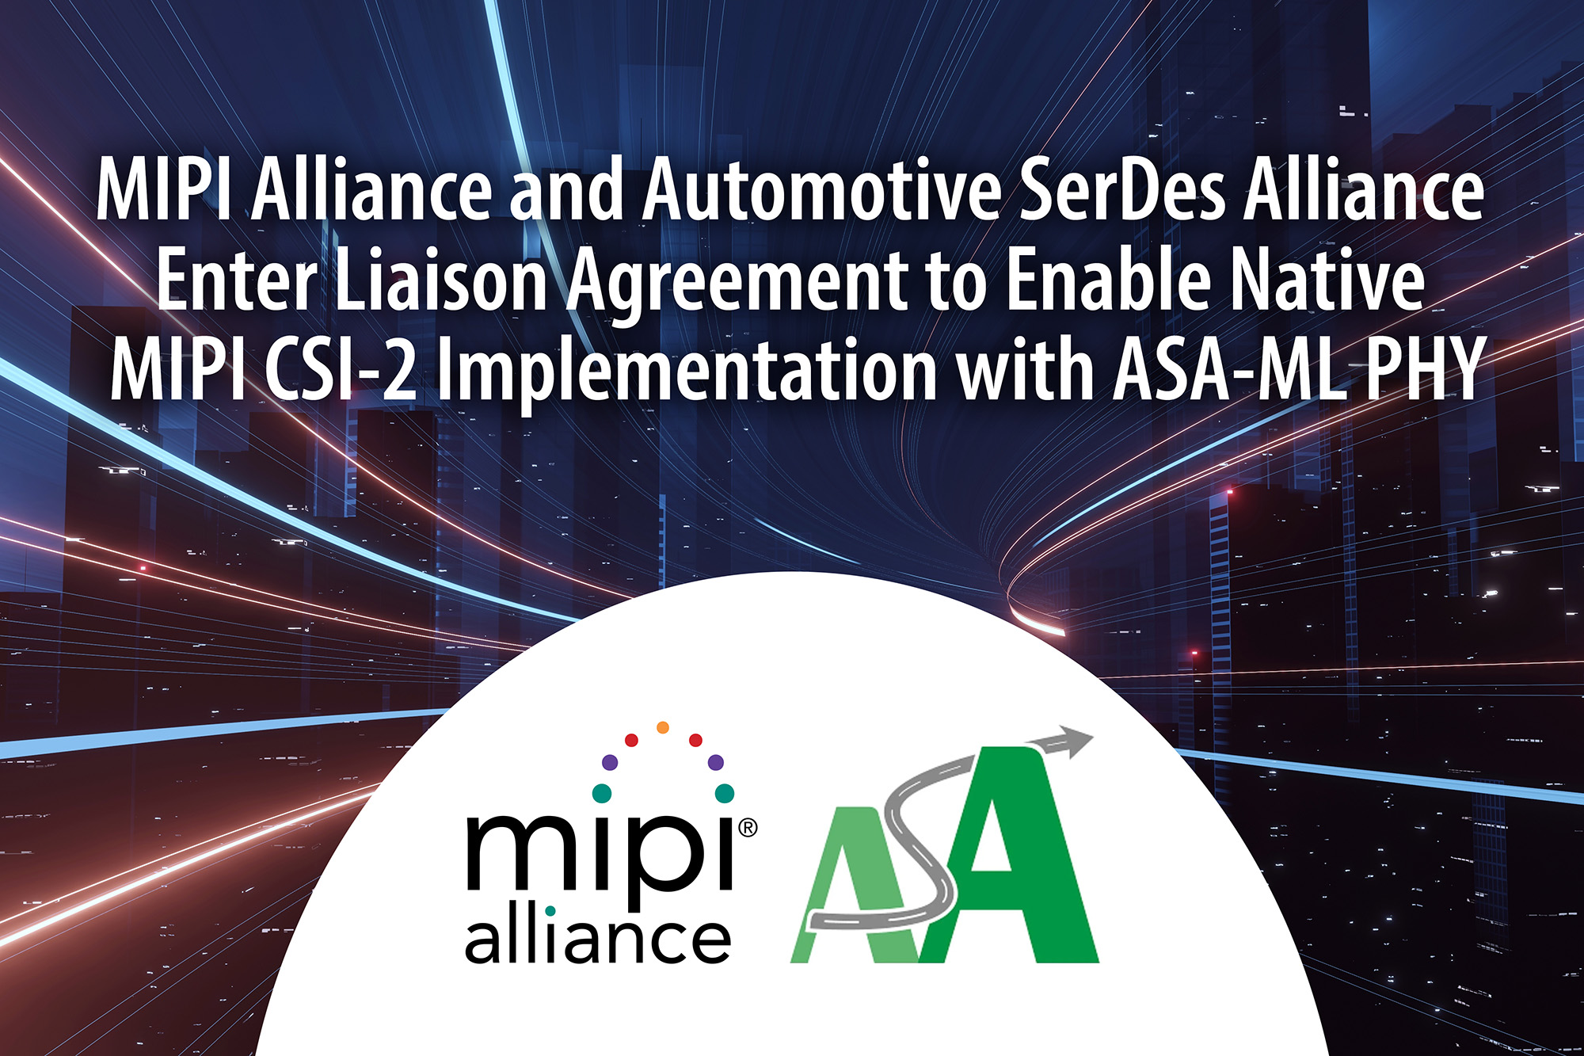
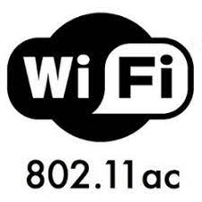
Raspberry Pi Computer Features*
Common Computer Interfaces
  USB 2.0 & 3.0
  Gigabit Ethernet
  WiFi Dual Band (2.4 & 5 GHz)
  Bluetooth
  High speed MIPI CSI-2 for webcam and DSI LCDs
  HDMI
*(Older models don’t have all of these)
https://www.zdnet.com/home-and-office/networking/gigabit-wi-fi-802-11ac-is-here-five-things-you-need-to-know/
https://www.hdmi.org/resource/logos
https://www.mipi.org/press-releases/mipi-asa-enter-liaison-agreement-to-enable-native-mipi-csi-2-implementation
https://en.wikipedia.org/wiki/USB_3.0
https://en.m.wikipedia.org/wiki/File:Bluetooth.svg

Slide 10
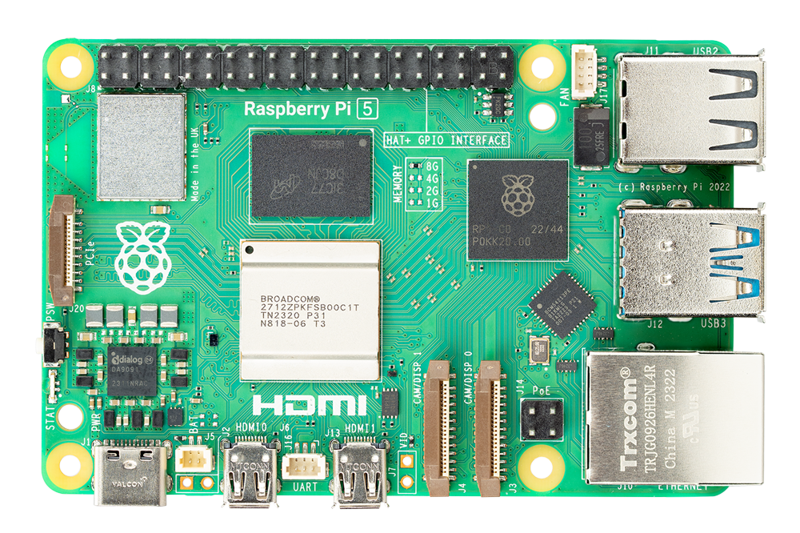
What’s New About the Model 5?
https://www.jeffgeerling.com/sites/default/files/images/Raspberry-Pi-5-Top.png

Slide 11
What’s New About the Model 5?
Newer generation CPU: ARM Cortex-A76 quadcore 2.4 GHz
  Model 4 was a 1.5 GHz quadcore Cortex-A72
  “over twice as fast as its predecessor”
More powerful video processor, open source Mesa drivers
Dual 4Kp60 HDMI Display output
  Model 4 was one, or two 4K at the 30 Hz lower refresh
Faster RAM, 4 GB & 8 GB Models
New I/O Controller – RP1
https://www.raspberrypi.com/news/introducing-raspberry-pi-5/

Slide 12
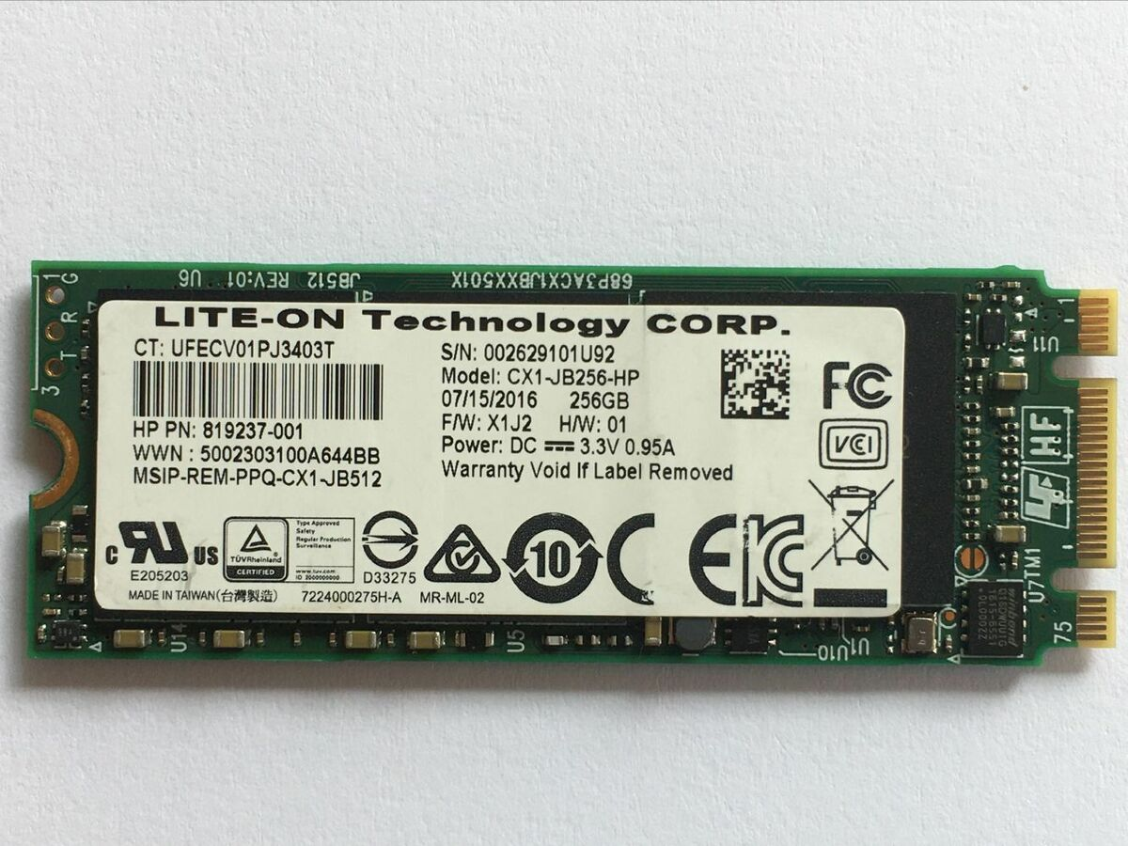
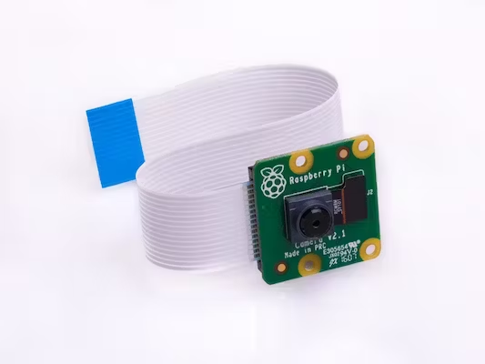
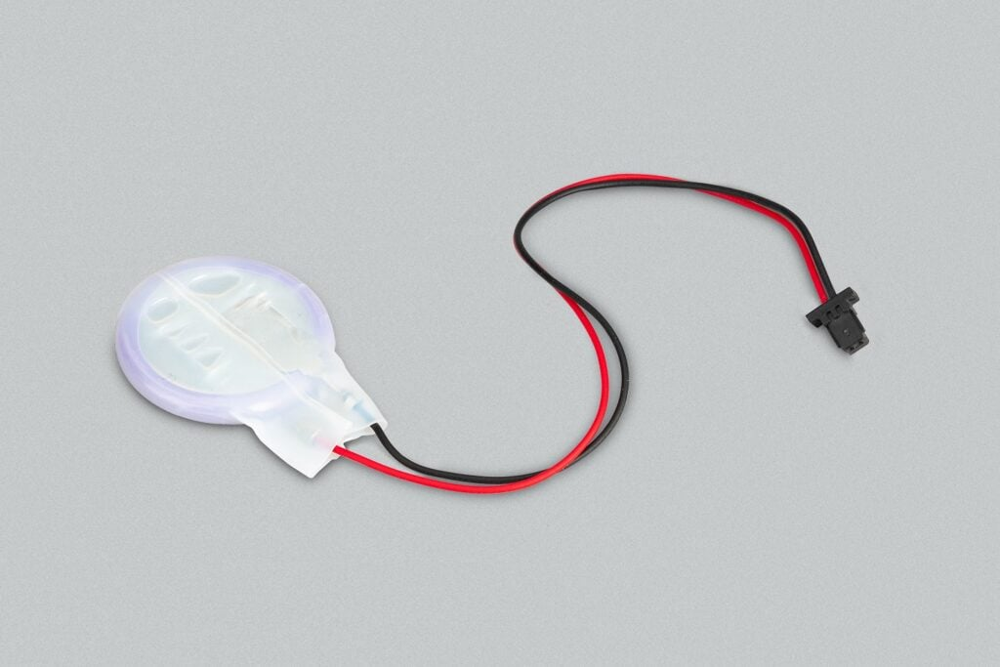
What’s New About the Model 5?
Two high-speed camera/LCD headers
Power over Ethernet+ support
PCI-Express v2.0 x1 Lane header
  M.2 NVMe Hats
Real-time Clock & battery header
Power Button
Heatsink & Fan Mount
https://www.raspberrypi.com/news/introducing-raspberry-pi-5/

Slide 13
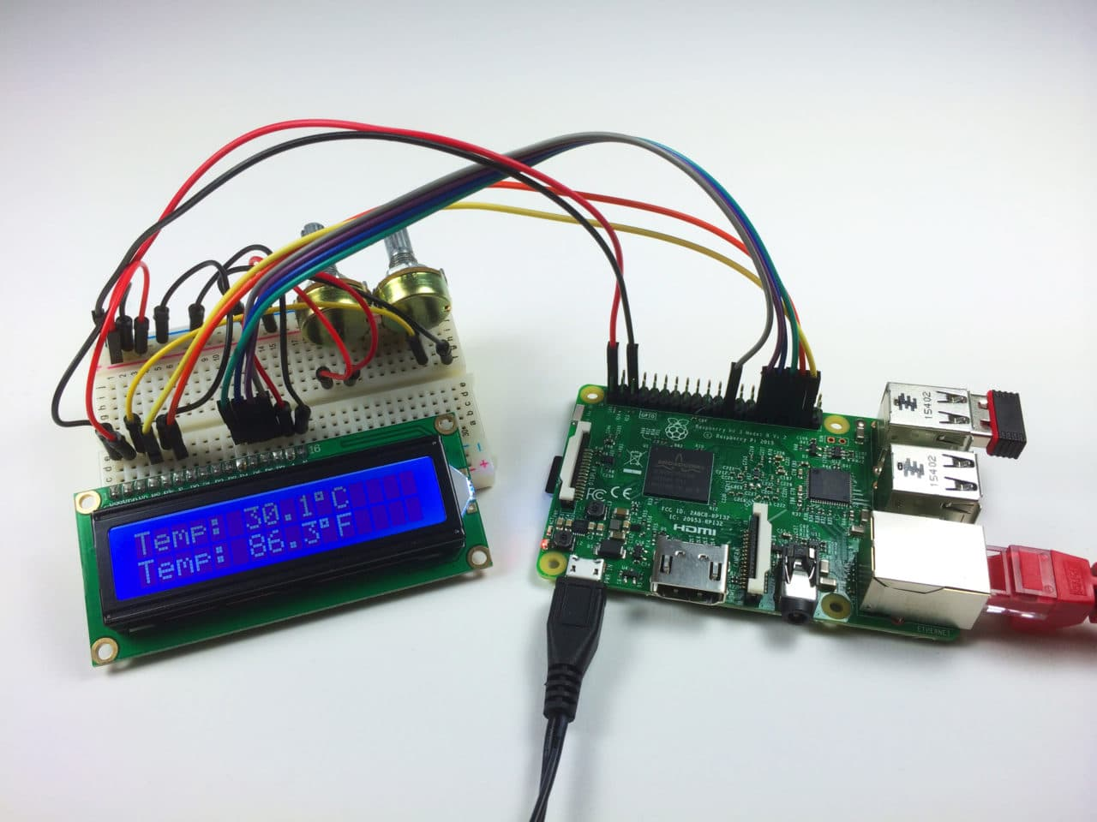
Embedded Prototyping
https://www.circuitbasics.com/raspberry-pi-lcd-set-up-and-programming-in-c-with-wiringpi/

Slide 14
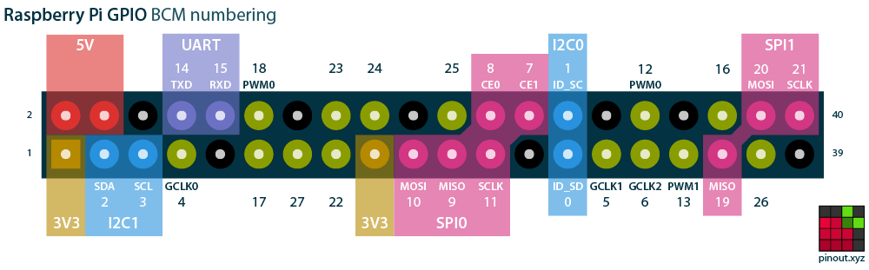
Embedded Systems Interfaces
I2C (de facto)
SPI (also de facto)
I2S (audio)
PWM (some D to A)
UART (async serial)
General Purpose Clock Pulse (sync sources)
GPIO (bit-bang, TTL, etc)
https://pinout.xyz/

Slide 15
Why isn’t everything just USB?
I2C and SPI are much simpler to implement
  Not reliant on more components and complicated protocols
USB has more parts
  Higher cost feature for a featured component
  Was designed for peripherals and not embedded devices
Device drivers are no longer computer-agnostic
  It needs a USB device class, support on each platform, more testing
Many USB devices have a serial UART adapter in-between

Slide 16
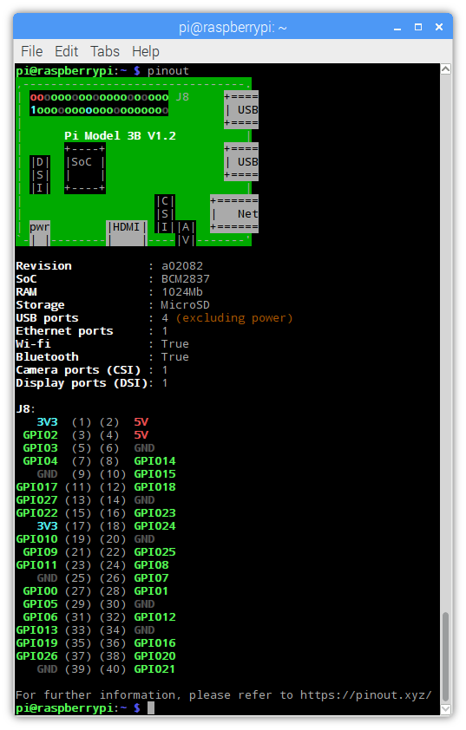
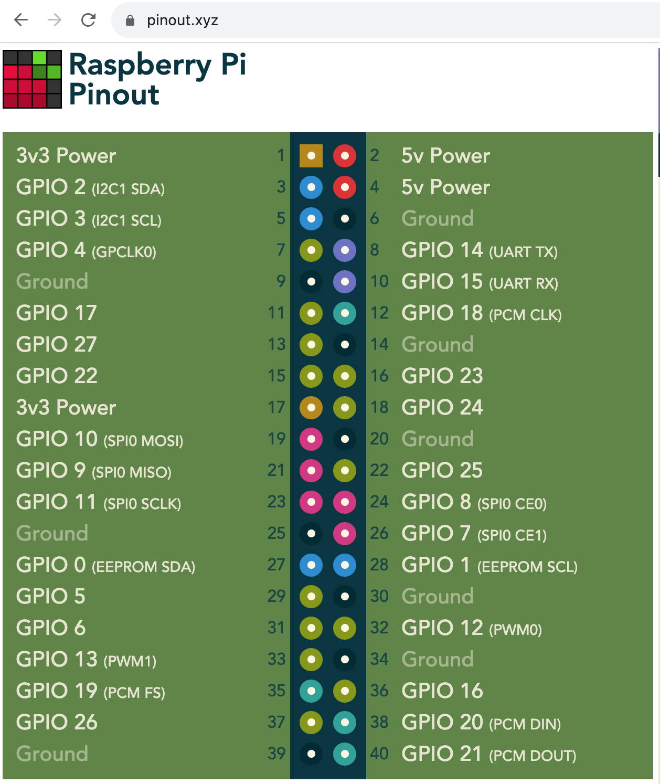
Lots of Tools & Documentation
https://gpiozero.readthedocs.io/en/stable/cli_tools.html

Slide 17
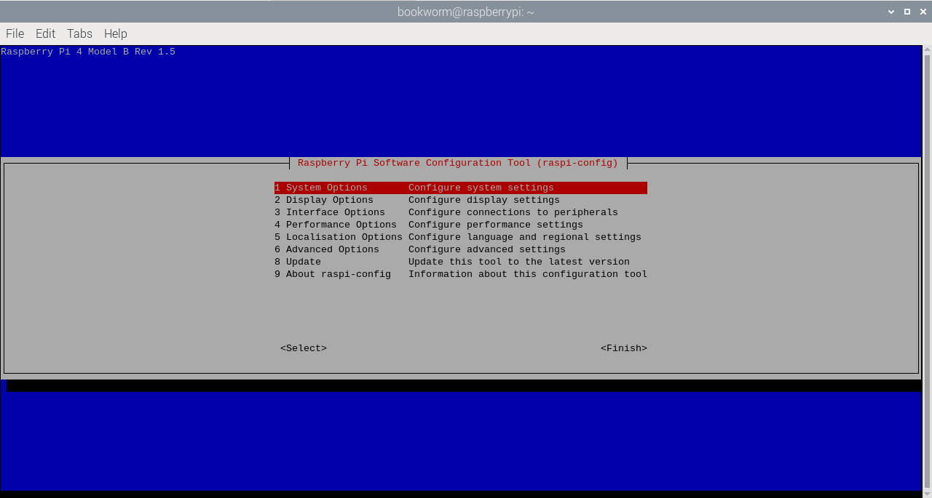
Built-in Device Tree Config Menu
https://www.raspberrypi.com/documentation/computers/configuration.html

Slide 18
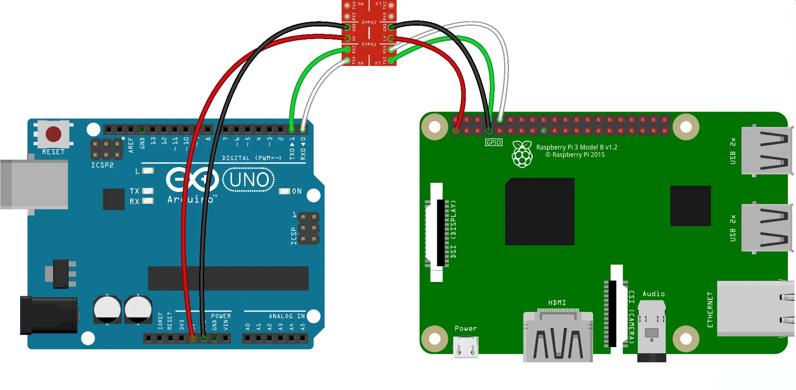
UART Example
https://www.teachmemicro.com/raspberry-pi-serial-uart-tutorial/

Slide 19
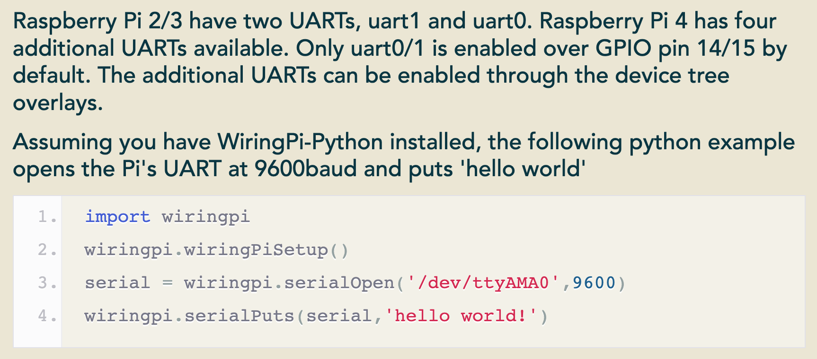
Communicating with UART
https://pinout.xyz/

Slide 20
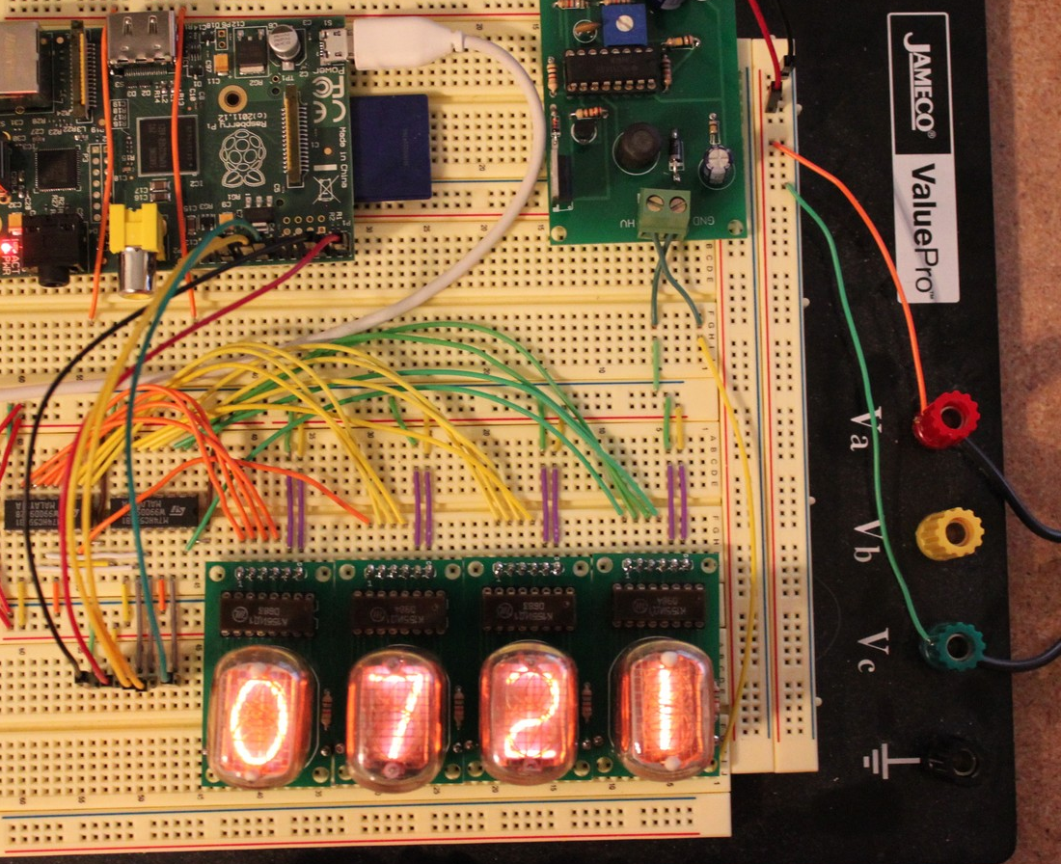
Many Wires
https://www.smbaker.com/raspberry-pi-nixie-tube-clock-prototype

Slide 21
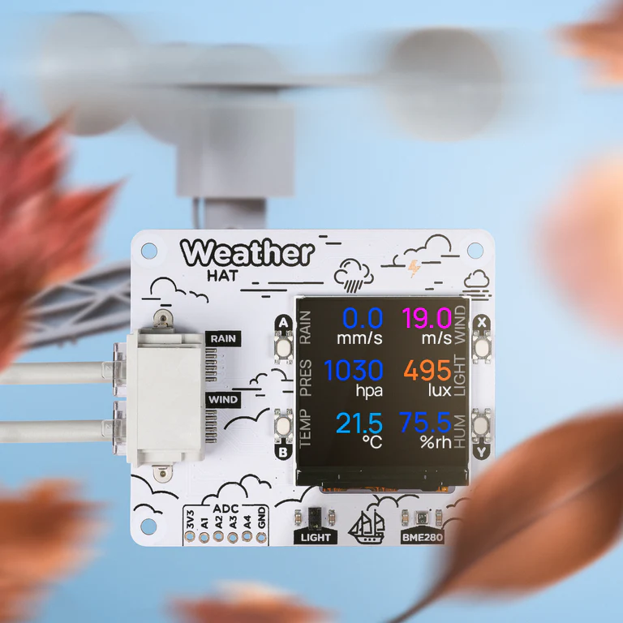
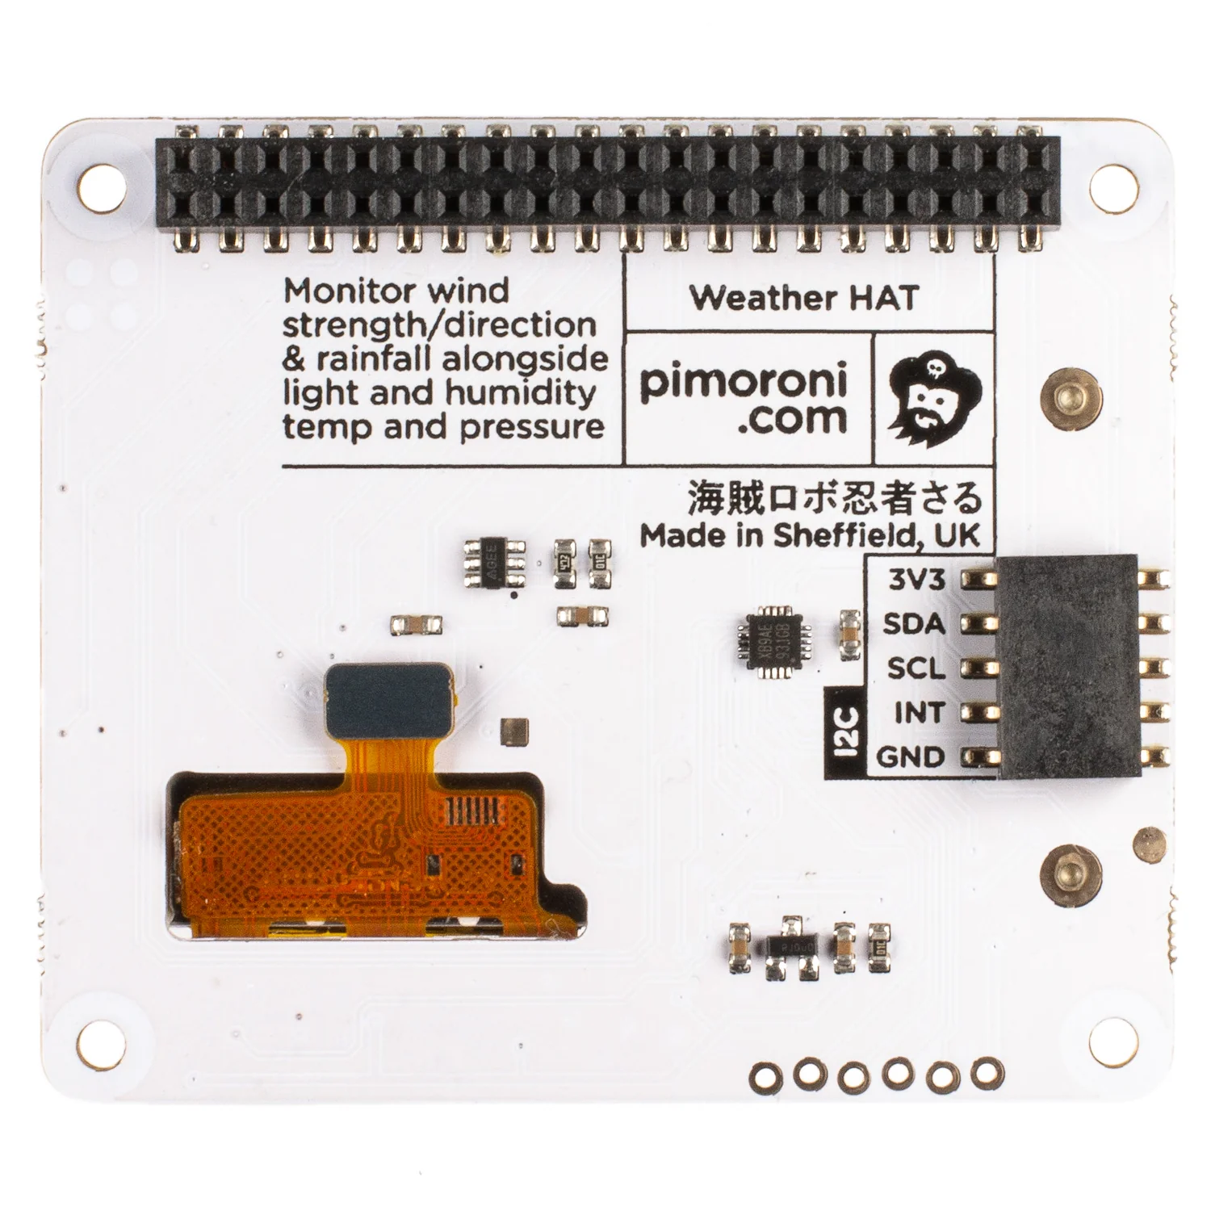
Embedded Hats
https://shop.pimoroni.com/products/weather-hat?variant=39672186765395

Slide 22
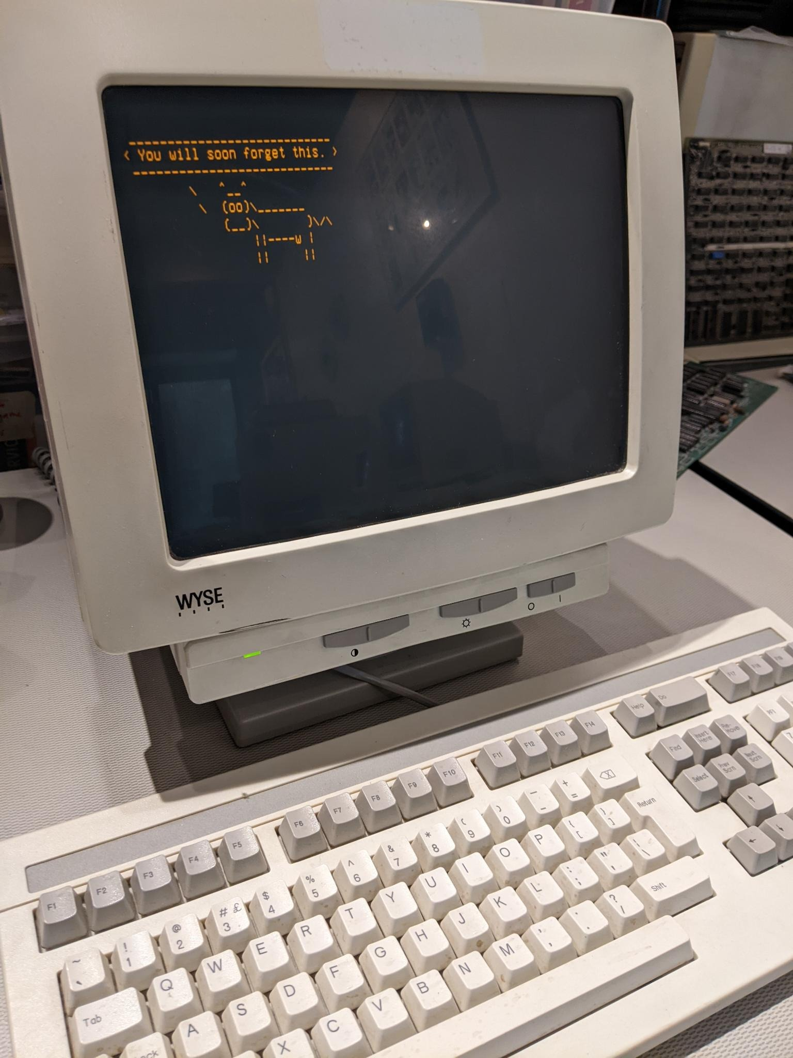
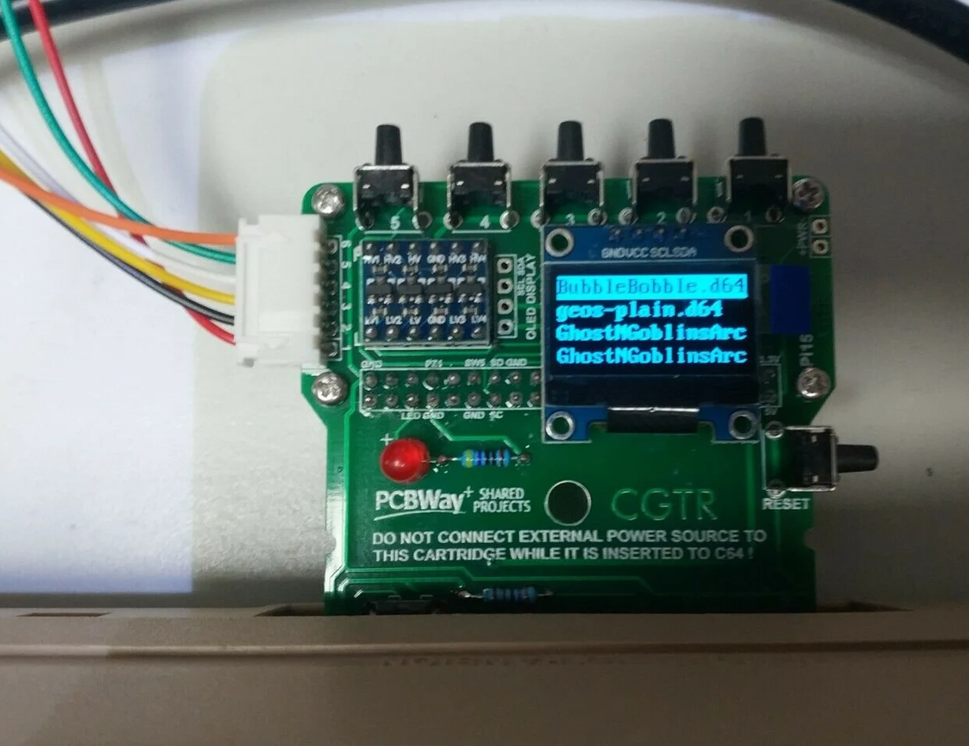
RPIs in the denhac Computer Museum
C64 floppy drive emulator
Wyse Terminal Interface

Slide 23

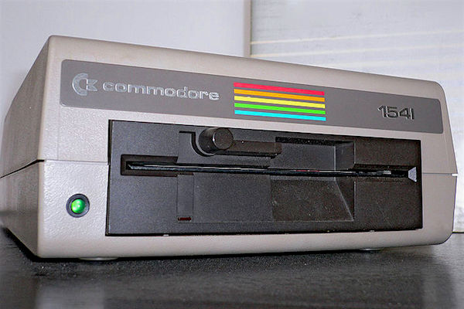
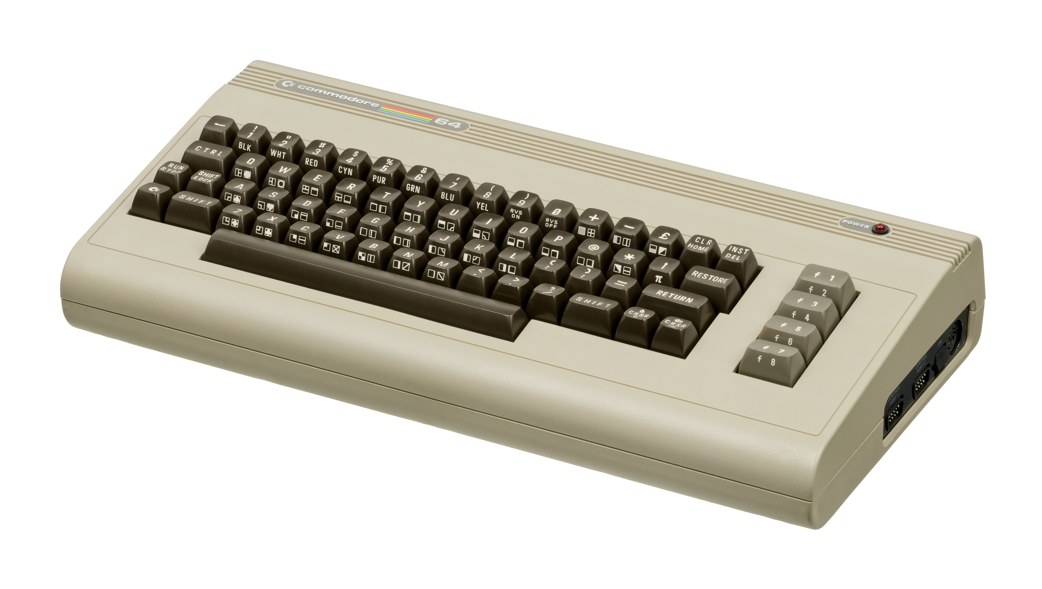
Embedded Hats – Pi1541 Project
August 1982
8-bit Home Computer
https://www.allaboutcircuits.com/news/retro-teardown-commodore-1541-floppy-vs-DVD-drive/
https://en.wikipedia.org/wiki/Commodore_64

Slide 24
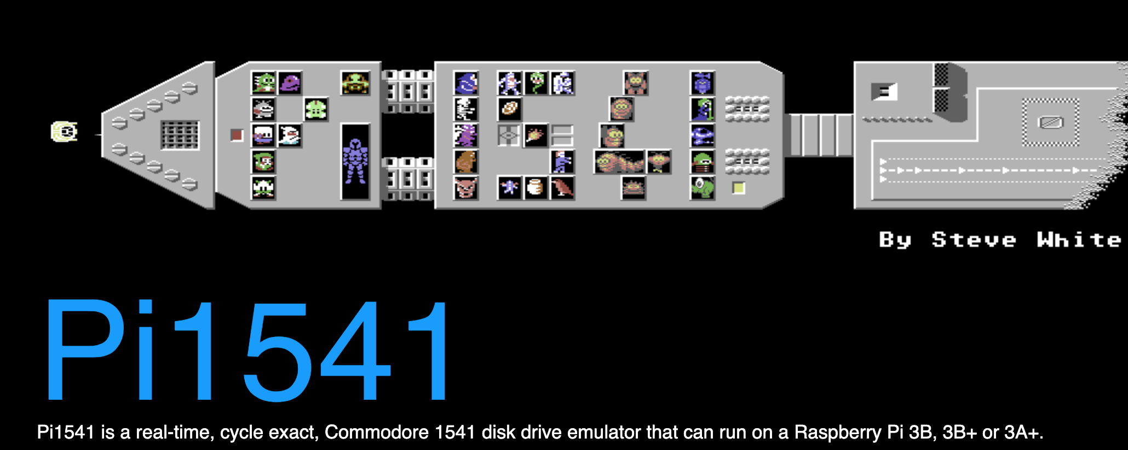
Embedded Hats – Pi1541 Project
https://cbm-pi1541.firebaseapp.com/
https://www.etsy.com/listing/842094841/pi1541-zero-hat-for-pi-zero-floppy-drive
https://en.m.wikipedia.org/wiki/File:Commodore_64.svg

Slide 25
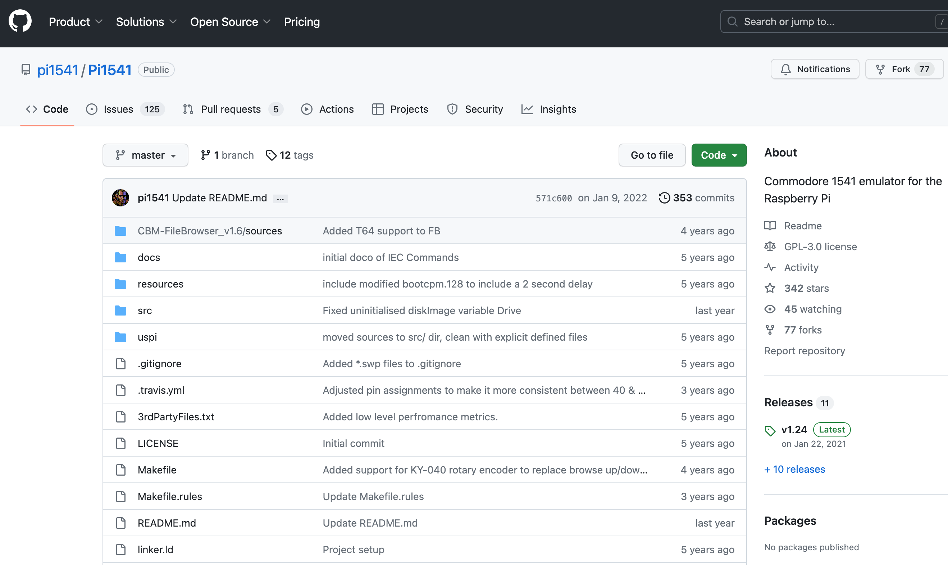



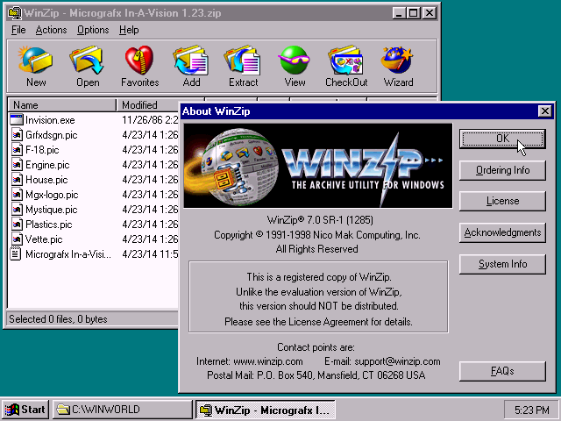
Pi1541 Source Code Provided
https://github.com/pi1541/Pi1541 | https://en.m.wikipedia.org/wiki/File:SourceForge_logo_transparent.svg
https://www.abortretry.fail/p/lz-compression | https://en.wikipedia.org/wiki/File:GitLab_logo_%282%29.svg

Slide 26
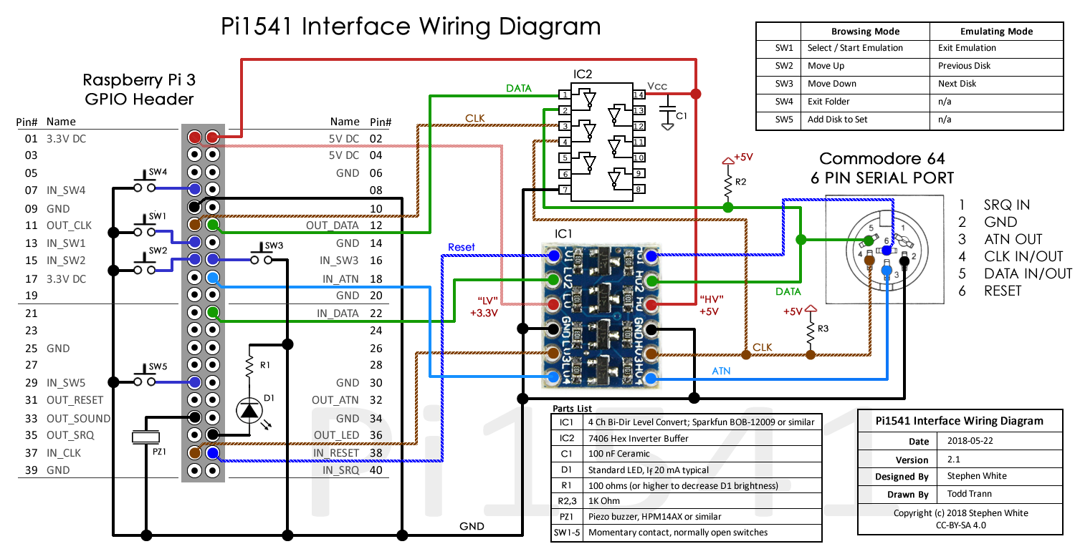
Pi1541 functional circuit

Slide 27
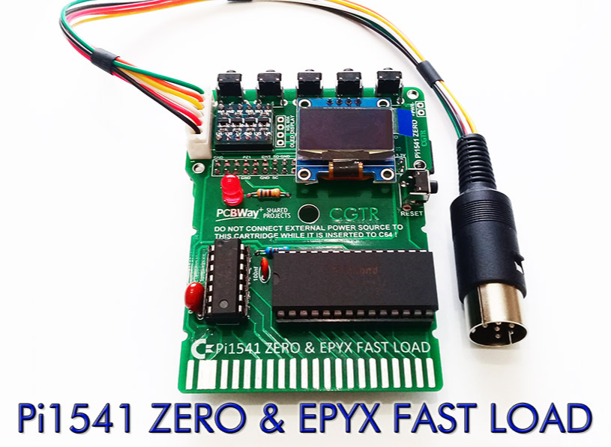
Pi Zero Hat Kit; OLED screen, Level Shifter, C64 Cable
https://www.etsy.com/listing/842094841/pi1541-zero-hat-for-pi-zero-floppy-drive
https://www.pcbway.com/project/shareproject/_DIY__Pi1541___EPYX_FAST_LOAD_CARTRIDGE_for_COMMODORE_64.html

Slide 28
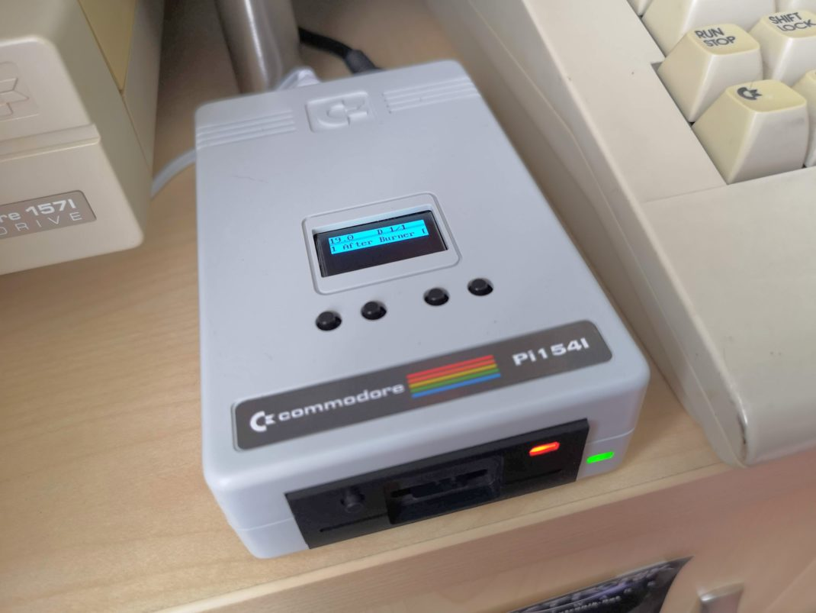
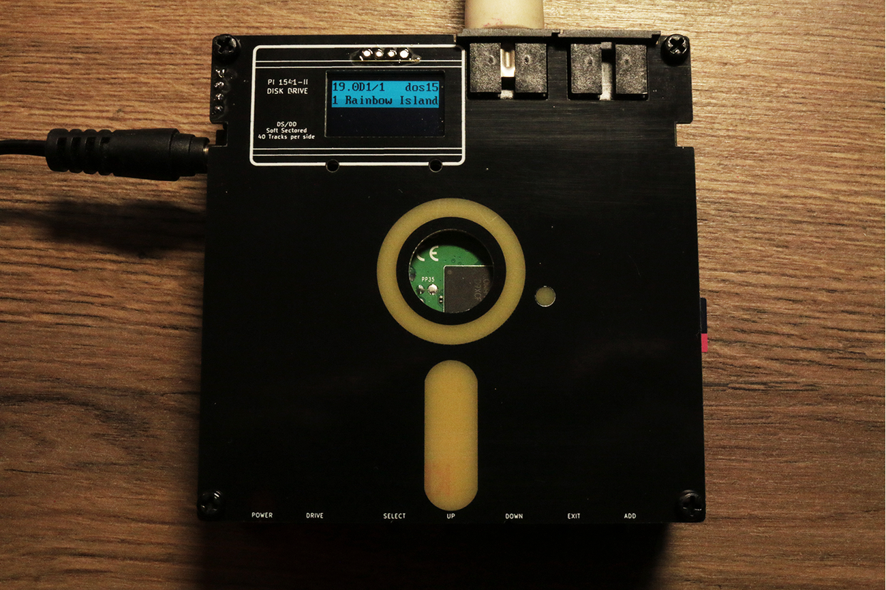
Pi1541 – Community Expands on the Project
https://lyonsden.net/pi1541-disk-drive/
https://www.tindie.com/products/retrofletch/pi1541-option-b-with-case-1541-emulator-for-c64/

Slide 29
The End

Slide 30
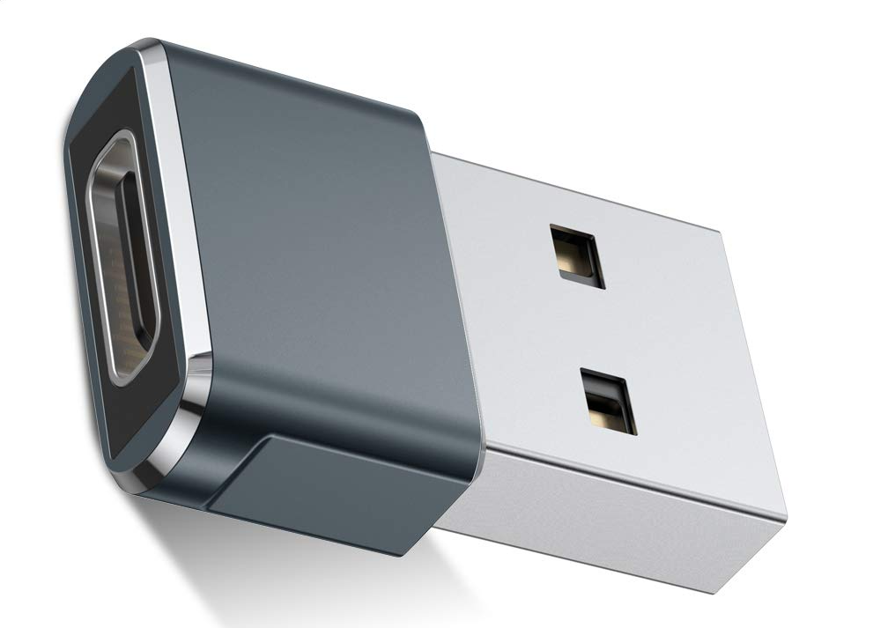
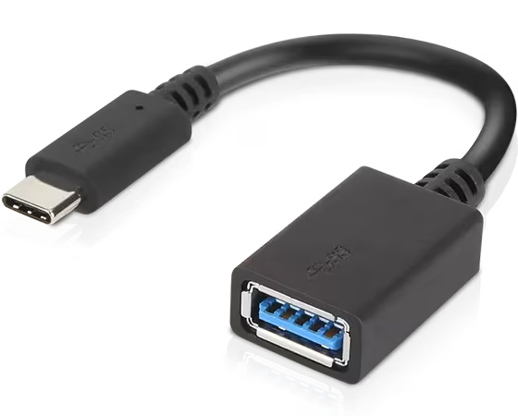
More Time? Talk about USB?
Fully backwards compatible
All devices on the controller share the total bandwidth
V 1.1 (1998)
  Low Speed: 1.5 Mbps
  Full Speed: 12 Mbps
V 2.0 (2001)
  High Speed: 480 Mbps ~ 60 MB/s
  On-the-Go A & B
V 3.2 gen 1 “3.0” (2008)
  SuperSpeed: 5,120 Mbps ~ 640 MB/s
V 3.2 gen 2x1 (2013)
  SuperSpeedPlus: 10,240 Mbps ~ 1280 MB/s
Raspberry Pi
Models 1, 2, 3
Model Zero
Models 4 & 5
https://www.amazon.com/Syntech-Adapter-Thunderbolt-Compatible-MacBook/dp/B07CVX3516
https://www.lenovo.com/us/en/p/accessories-and-software/cables-and-adapters/cables-&-adapters_adapters/4x90q59481

Slide 31
USB OTG
Rpi Zero & Zero W reconfiguration
Boot over USB, PC pushes the boot loader, no SD card used
GPIO Expander
Can become a USB peripheral:
  Serial device
  Ethernet adapter
  Mass storage device
  HID (mouse, keyboard, etc)
  MIDI
  Webcam
https://gpiozero.readthedocs.io/en/stable/pi_zero_otg.html
https://learn.adafruit.com/turning-your-raspberry-pi-zero-into-a-usb-gadget/ethernet-gadget

