Slide 1
Data Structure Course Introduction & Policy
郭桐惟

Slide 2
Data Structure
How to store information in memory?
The less space the better
How to access and manipulate the stored data?
The faster the better
Different applications need different data structures

Slide 3
Objectives
How to implement data structures?
How to analyze data structures?
How to apply data structures?
How to design algorithms (write code) with the help of data structures?
How to analyze algorithms?

Slide 4
Programming
Do I have to write code?
Yes
If I do not know programming, can I take this course?
Yes
Learn programming through the process of learning data structure
In this course, we will use C (and some C++)

Slide 5
Grading
Asking questions 10%
Ask 5 questions to get 60 on this part
Answering questions 10%
Answer 1 question to get 60 on this part
Homework 5*10%
Midterm 15%
Final 15%

Slide 6
Textbook
Reference:
Data Structures and Algorithms Made Easy: Data Structures and Algorithmic Puzzles, Fifth Edition
Elements of Programming Interviews
The Real textbooks:
Youtube
Google
Stack Overflow
…

Slide 7
Basic Computer Organization

Slide 8
What Is A Computer? -From the Perspective of Users
We can use a computer to:
Listen to music
Watch movies
Play games
Store and print pictures
Send messages
Inside a computer, all these activities are achieved by generating appropriate bits from the processor and then sending these bits to appropriate peripherals

Slide 9

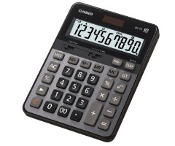
Similarities and Differences Between Computers & Calculators
Similarities:
Have a keyboard and a monitor
Perform arithmetic operations based on user inputs and previous results
Have memory to store intermediate results
Differences:
We can connect peripherals to computers
Computers have larger memory and faster processors (A calculator only needs to store 2 numbers in memory)
Computers can perform arithmetic operations specified in memory
https://www.apple.com/tw/shop/buy-mac/macbook
https://www.casio.com.tw/calc/product/professional

Slide 10
How to Execute Stored Operations? -From the Perspective of a Processor
First, what is a processor?
For a calculator, given
Two input numbers (possibly stored in memory or obtained via keyboard input)
An arithmetic operation (e.g., division, multiplication) obtained via keyboard input
the processor produces an output and stores the output to the memory

Slide 11
How to Execute Stored Operations? -From the Perspective of a Processor
For a computer, given a memory address X, the processor reads the bits stored in X to get:
The inputs, and
The arithmetic operation
The processor then stores the output to some memory address specified in the input
So far, the processor has executed the instruction stored in X
The processor then executes the instruction stored in X+1

Slide 12
A Close Look at Instructions
What does the instruction “3+2” look like?
An instruction is just a sequence of bits specifying
The arithmetic operation
For example, 00->addition, 01->subtraction, 10->multiplication, 11 ->division
The inputs
Contain the operands and the address in which the result is stored
Say we want to store the result to address 1001, then 3+2 may look like 0011101001

Slide 13
A Close Look at Instructions
Recall that, in a calculator, the input number may be the previous result stored in memory
In an instruction, the input may be the previous result of previous instructions
Say we want to perform “the previous result stored in address 0101”+“the previous result stored in address 1011”, and then store the result to address 0110, then the instruction looks like 00010110110110

Slide 14
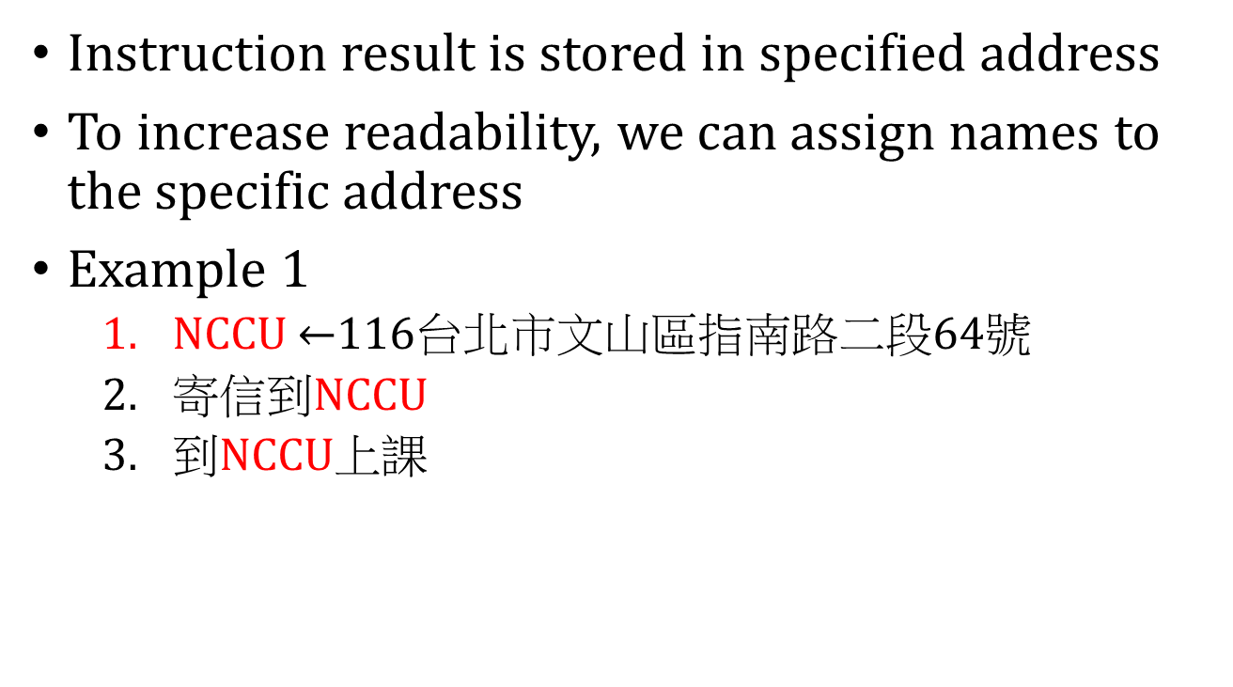
Variable
Instruction result is stored in specified address
To increase readability, we can assign names to the specific address
Example 1
NCCU $←$116台北市文山區指南路二段64號
寄信到NCCU
到NCCU上課

Slide 15
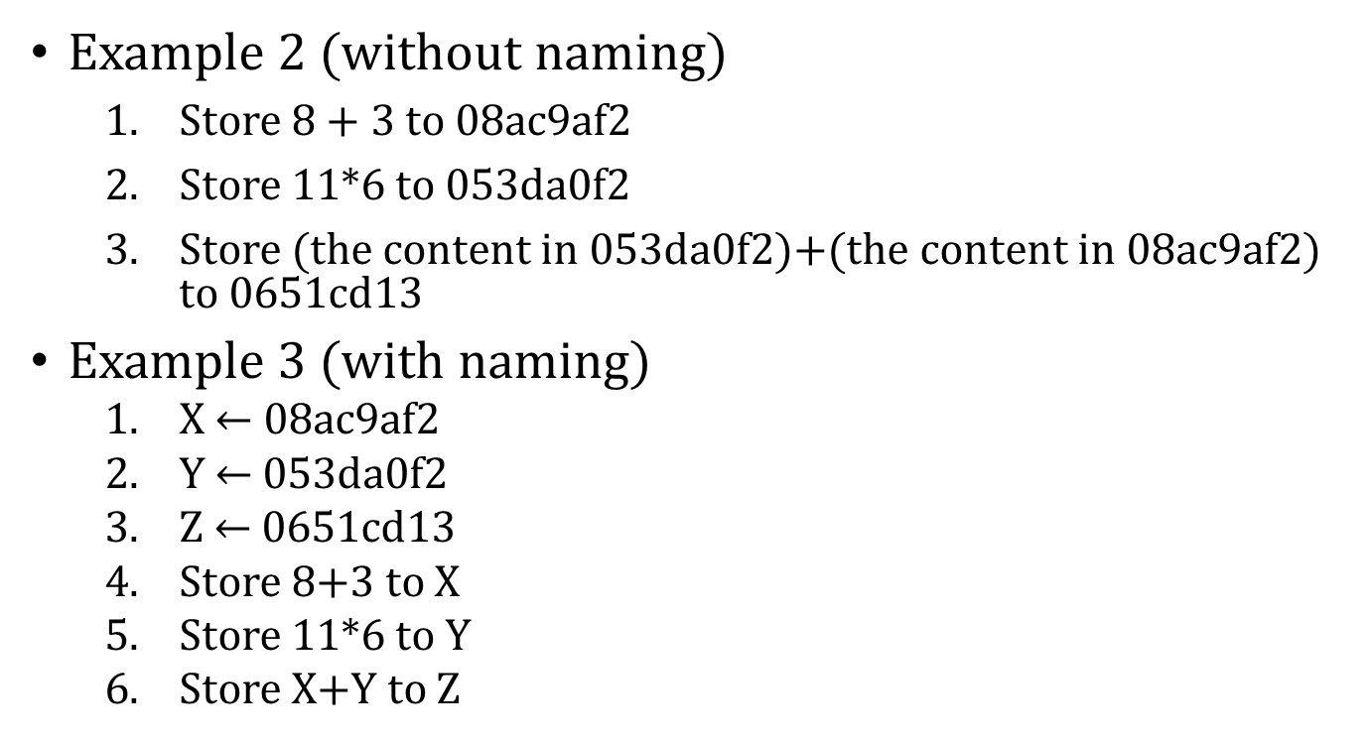
Variable
Example 2 (without naming)
Store 8 + 3 to 08ac9af2
Store 11*6 to 053da0f2
Store (the content in 053da0f2)+(the content in 08ac9af2) to 0651cd13
Example 3 (with naming)
X $←$ 08ac9af2
Y $←$ 053da0f2
Z $←$ 0651cd13
Store 8+3 to X
Store 11*6 to Y
Store X+Y to Z
These 3 lines
declare and initialize
the variables
X, Y, and Z are called variables

Slide 16
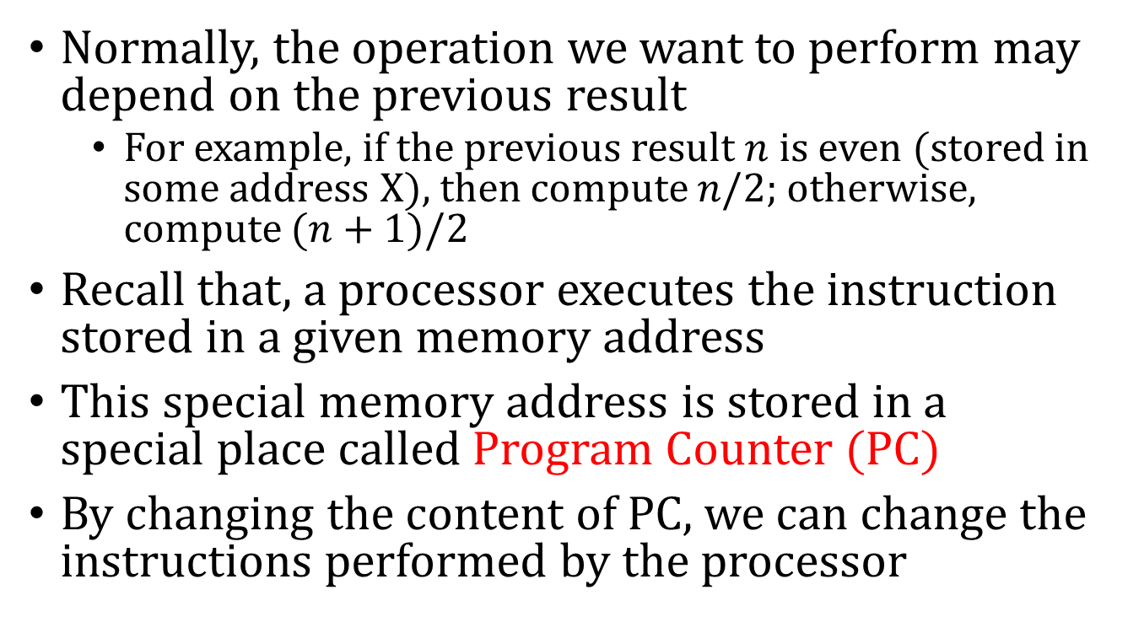
Control Flow Instruction
Normally, the operation we want to perform may depend on the previous result
For example, if the previous result $n$ is even (stored in some address X), then compute $n/2$; otherwise, compute $(n+1)/2$
Recall that, a processor executes the instruction stored in a given memory address
This special memory address is stored in a special place called Program Counter (PC)
By changing the content of PC, we can change the instructions performed by the processor

Slide 17
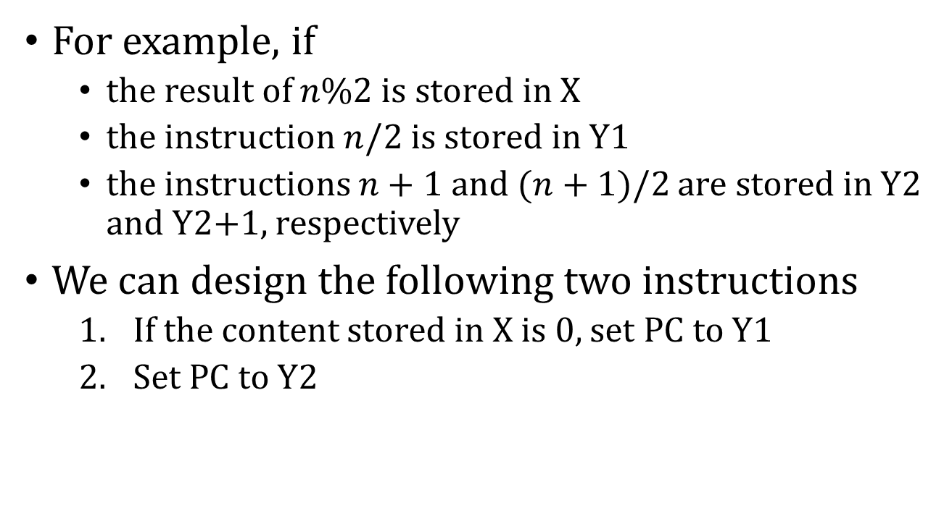
Control Flow Instruction
For example, if
the result of $n\%2$ is stored in X
the instruction $n/2$ is stored in Y1
the instructions $n+1$ and $(n+1)/2$ are stored in Y2 and Y2+1, respectively
We can design the following two instructions
If the content stored in X is 0, set PC to Y1
Set PC to Y2

Slide 18
Interpretation of Memory Content
Say 2 (as an integer) is stored as 00000010
1.8 is also stored as 00000010 (2 as a floating point may be stored as 00001010)
If address X stores 00000010, how to compute 2+2 and 1.8+1.8?
We have two types of addition, one for integer, and one for floating point
The interpretation of the memory content depends on the instruction

Slide 19
Computer Program
A program is a sequence of instructions
What is programming (coding)?
Design a sequence of instructions to obtain the desired output
Luckily, we do not need to program at the instruction level nowadays
We can program in user-friendly language and then use some translator to translate our code to instructions
These translators are called compilers or interpreters
Different languages have different translators

Slide 20
Basic C Programming

Slide 21
Basic C Programming
In instructions, variables store memory address
In C (and other high-level language), variables store content (e.g., 123, “hello”)
Recall that compiler will do the translation
Different variables have different types (and thus different sizes)
C has int, double, char, …
Always give your variables reasonable names

Slide 22
Basic C Programming
Function
Given inputs, a function returns one output
You can implement your own function
int Add(int a, int b){
return a+b;
}
You can call a function like
int x;
x = Add(3,4);
Can we modify the input variable?
C has many built-in functions. How to call them?

Slide 23
Basic C Programming
To call a function, say double x = log(30.1);
The computer needs to know:
Does double log(double) exist?
How to implement log?

Slide 24
Basic C Programming
Does double log(double) exist?
In the code, you need to specify the file that contains the declaration of double log(double)
This type of files, which contains function declaration, is called header file
For example, double log2(double) is in math.h
#include<math.h>
#include simply copy-paste the file
Once you include the file, the computer will find the implementation automatically

Slide 25
Basic C Programming
The collection of built-in functions in C is called C standard library
You can also create your own library
Create header file, e.g., lib.h
Create implementation file, e.g., libImplmentation.c
Say a.c calls a function declared in lib.h
In a.c, #include “lib.h”
Tell the compiler where libImplmentation.c lib.h are

Slide 26
Basic C Programming
Flow control
if, else if, else
while
for
continue
break
Scope of variables
Example: find next prime, find next perfect number, calculate pi

Slide 27
Basic C Programming
==, >=, <=, !=, >, <
&&, ||, !
Variables to store true or false
If the value is equal to 0, it is false
Otherwise, it is true

Slide 28
Basic C Programming
Structure
Combine primitive data type into one data type
For example, a circle specified by the coordinate of the center and radius
typedef
Memory layout

Slide 29
Basic C Programming
Array
Example: sum of an array
Write codes to find out the address
Can be multi-dimensional
Memory layout
Index starts from 0
int matrix[5][2];
matrix[3][1] = 6, matrix[5][1] = 10;

Slide 30
Basic C Programming
String
Array of characters. End with ‘\0’.
Length of a string
String copy
String concatenation
String comparison
Const
char* vs. char []

Slide 31
Tips to Write Code
Copy & Paste is GOOD!
Make sure you understand the code: Use printf
http://a7419.pixnet.net/blog/post/97517305-c-%E5%9B%A0%E6%95%B8%E5%88%86%E8%A7%A3
Keep every function small! (e.g., < 20 lines)
To do so, you have to divide a task into several smaller tasks: Divide and conquer
Feel free to create lots of functions
Keep the main function extremely small!
No matter what code you write, your computer will not explode

Slide 32
What is Constant?
If a number does not change as the input changes, then the number is a constant
For example, 3n, nlogn, and the time to compute n^n are not constant
0, 2^100, n^0, and the time to compute n*n are constant

Slide 33
Running Time Analysis
Why should we care about it?
To predict running time, especially for large input
1st Goal: Given an algorithm and input size, predict the running time in seconds
Unfortunately, the goal is not realistic, since the running time changes as the content of the input changes
For example: what is the best case running time of insertion sort? what is the worst case running time of insertion sort?
What is the running time of insertion sort if the input is almost sorted, i.e., only a constant number of elements in the array are not in the correct position
What is the best case running time of merge sort?

Slide 34
Running Time Analysis
2nd goal: Given an algorithm and input size, predict the worst case running time in seconds
We would like to say something like “the running time is no more than XXX sec”
For example, the running time is no more than 3.19*n^2+6.43n+0.48 sec
That is, we need an upper bound
However, it is difficult to predict the constant coefficients in the upper bound

Slide 35
Running Time Analysis
3rd Goal: We would like to say something like “the running time grows linearly (or polynomially, or exponentially) as the input size grows”
For example, say we apply an algorithm on an input of size 20 and find out that the running time is 0.5 sec. If the running time grows linearly, then the running time for input size 20*50 is roughly 0.5*50 sec
KEY: We do not care about constants

Slide 36
Running Time Analysis
4th goal: We would like to say something like “the running time is no more than c₁n^2+c₂n+c₃ sec, for some constants c₁, c₂, and c₃ that I really don’t care. BTW, this is true no matter how large n is”
This sentence is too long. I will simply write “the running time is UB(n^2+n+1)” to hide the constants
Since n^2 dominates n and 1, I will simply write “the running time is UB(n^2)”

Slide 37
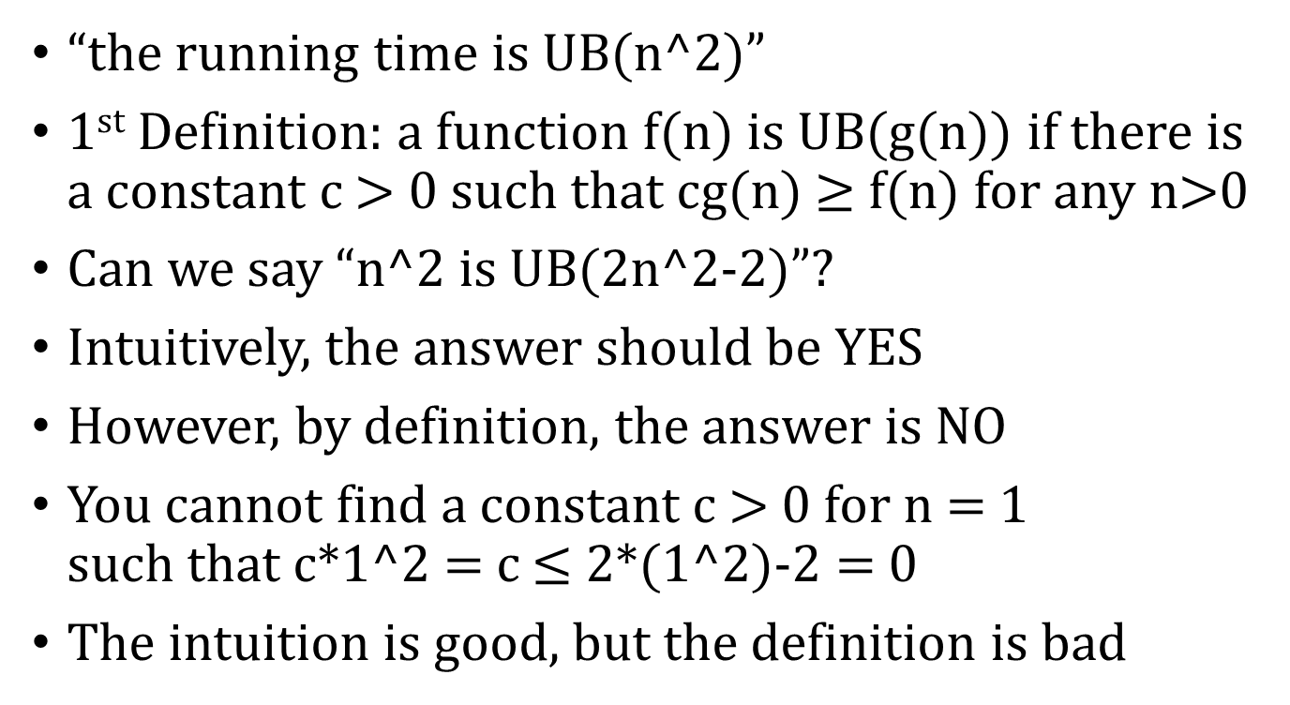
Running Time Analysis
“the running time is UB(n^2)”
1st Definition: a function f(n) is UB(g(n)) if there is a constant c > 0 such that cg(n) $≥$ f(n) for any n>0
Can we say “n^2 is UB(2n^2-2)”?
Intuitively, the answer should be YES
However, by definition, the answer is NO
You cannot find a constant c > 0 for n = 1 such that c*1^2 = c $≤$ 2*(1^2)-2 = 0
The intuition is good, but the definition is bad

Slide 38
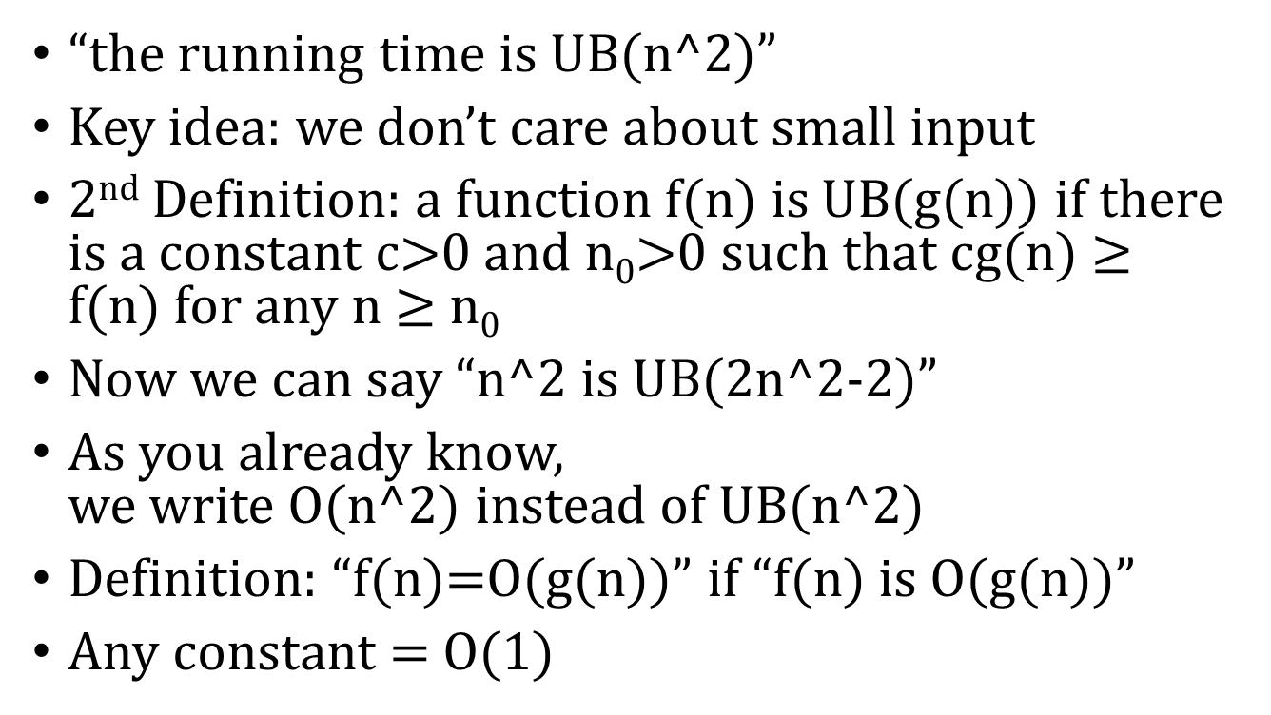
Running Time Analysis
“the running time is UB(n^2)”
Key idea: we don’t care about small input
2nd Definition: a function f(n) is UB(g(n)) if there is a constant c>0 and n₀>0 such that cg(n) $≥$ f(n) for any n $≥$n₀
Now we can say “n^2 is UB(2n^2-2)”
As you already know, we write O(n^2) instead of UB(n^2)
Definition: “f(n)=O(g(n))” if “f(n) is O(g(n))”
Any constant = O(1)

Slide 39
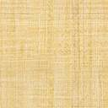
Merge Sort With Slow Merge (but no additional space is needed)
Question: Given an array arr[0…n-1], such that arr[0…n/2-1] and arr[n/2…-1] are sorted, sort the array arr. That is, merge arr[0…n/2-1] and arr[n/2…-1]
We already know how to do it in O(n) time with O(n) additional space
Apply the same idea: maintain two read positions and compare the two readings
New key idea: Swap and insert

Slide 40
Merge Sort With Slow Merge (but no additional space is needed)
Arr = [5 6 7 8 1 2 3 4]
Compare the left reading 5 and the right reading 1
The left reading is bigger, which is bad.
Swap the left reading and the right reading
Arr = [1 6 7 8 5 2 3 4]
Insert 5 to the correct position
Arr = [1 6 7 8 2 3 4 5]
The left reading position++

Slide 41
Merge Sort With Slow Merge (but no additional space is needed)
Arr = [1 6 7 8 2 3 4 5]
Compare the left reading 6 and the right reading 2
The left reading is bigger, which is bad.
Swap the left reading and the right reading
Arr = [1 2 7 8 6 3 4 5]
Insert 6 to the correct position
Arr = [1 2 7 8 3 4 5 6]
The left reading position++

Slide 42
Merge Sort With Slow Merge (but no additional space is needed)
Time complexity to merge:
In worst case, we need to swap and insert 0.5n = O(n) times
In worst case, each insert needs 0.5n = O(n) time
Overall time complexity: O(n^2)

Slide 43
Merge Sort With Slow Merge (but no additional space is needed)
Time complexity of merge sort if this merge algorithm is used:
Let T(n) be the worst case running time of input size n
T(n) = 2*T(0.5n)+O(n^2)
T(n) = O(n^2)

Slide 44
Quick Sort
Step 1: Pick a random element p in the array
Step 2: Examine every elements in the array. If the element is < p, store the element in array LESS. If the element is > p, store the element in array GREATER Otherwise, store the element in array EQ
Step 3: Sort LESS and GREATER by quick sort
Step 4: Concatenate LESS, EQ, and GREATER and store the result in the input array

Slide 45
Quick Sort
What is the worst-case running time of quick sort?
The worst case happens when the picked element is the largest one or the smallest one in the array
T(n) = T(n-1)+O(n)
T(n) = O(n^2)

Slide 46
Quick Sort
What is the expected running time of quick sort?
That is, the average running time
Recall that we pick the element randomly
Key idea: the running time is dominated by the number of comparisons in Step 2
Question: what is the expected number of comparisons of quick sort?

Slide 47
Expectation
Question: Shuffle a deck of cards. What is the expected number of cards that stay in the same position?
Let X be the number of cards that stay in the same position (X is a random variable)
Let Xi = 1 if the ith card stays in the same position, and Xi = 0 otherwise
X = X1+X2+…+X52
E[X] = E[X1+X2+…+X52] = E[X1] + E[X2] + …+E[X52] = 1/52+1/52+1/52+…+1/52 = 52*(1/52) = 1

Slide 48
Quick Sort
Question: what is the expected number of comparisons of quick sort?
Let ei be the ith largest element in the ORIGINAL array
Let X be the number of comparisons of quick sort
Let Xij be the number of times that we compare ei and ej
Key observation: we compare a pair of elements at most once
Hence, Xij can only be 0 or 1

Slide 49
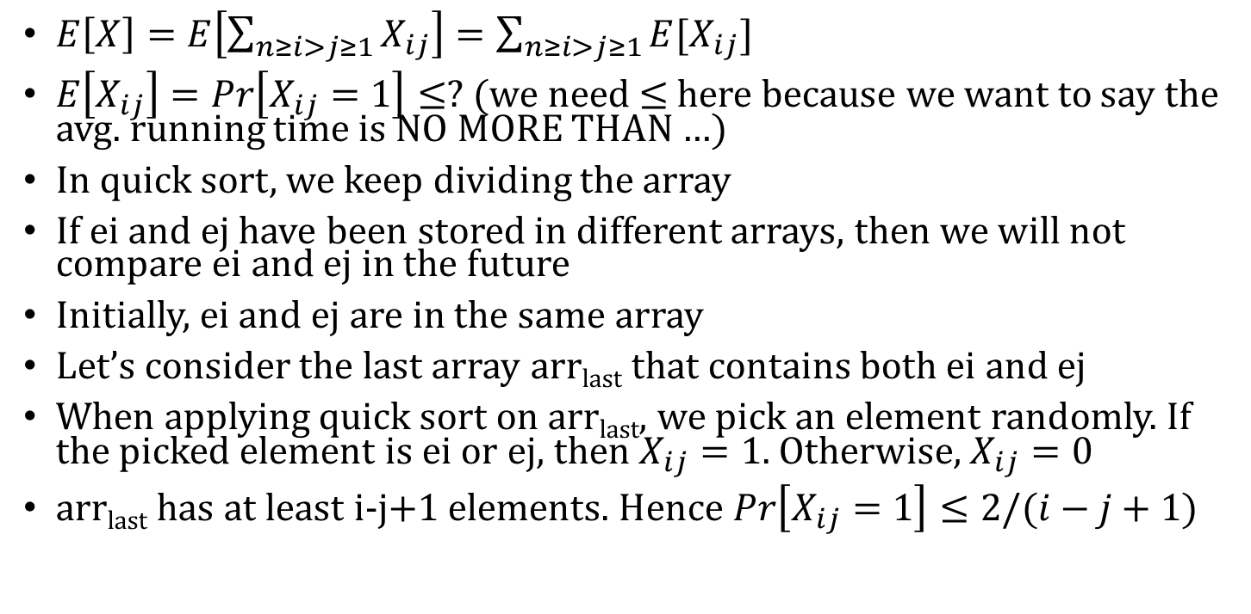
Quick Sort
$E\left[X\right]=E\left[\sum_{n≥i>j≥1}{X_{ij}}\right]=\sum_{n≥i>j≥1}{E[X_{ij}]}$
$E\left[X_{ij}\right]=Pr\left[X_{ij}=1\right]≤?$ (we need $≤$ here because we want to say the avg. running time is NO MORE THAN …)
In quick sort, we keep dividing the array
If ei and ej have been stored in different arrays, then we will not compare ei and ej in the future
Initially, ei and ej are in the same array
Let’s consider the last array arr_{last} that contains both ei and ej
When applying quick sort on arr_{last}, we pick an element randomly. If the picked element is ei or ej, then $X_{ij}=1$. Otherwise, $X_{ij}=0$
arr_{last} has at least i-j+1 elements. Hence $Pr\left[X_{ij}=1\right]≤2/(i−j+1)$

Slide 50
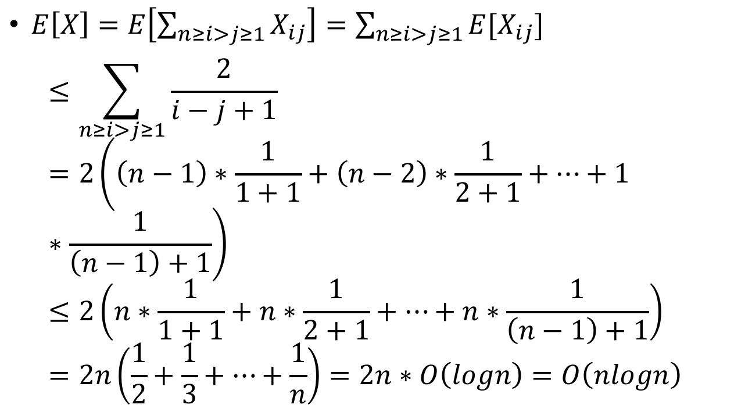
Quick Sort
$E\left[X\right]=E\left[\sum_{n≥i>j≥1}{X_{ij}}\right]=\sum_{n≥i>j≥1}{E[X_{ij}]}$ $≤\sum_{n≥i>j≥1}{\frac{2}{i−j+1}}=2\left(\left(n−1\right)∗\frac{1}{1+1}+\left(n−2\right)∗\frac{1}{2+1}+…+1∗\frac{1}{\left(n−1\right)+1}\right)≤2\left(n∗\frac{1}{1+1}+n∗\frac{1}{2+1}+…+n∗\frac{1}{\left(n−1\right)+1}\right)=2n\left(\frac{1}{2}+\frac{1}{3}+…+\frac{1}{n}\right)=2n∗O\left(logn\right)=O\left(nlogn\right)$

Slide 51
How to Analyze Speed (Time) and Space
int sum(int arr[], int n) {
int ans = 0;
for (int i = 0; i < n; i++) {
ans += arr[i];
}
return ans;
}

Slide 52
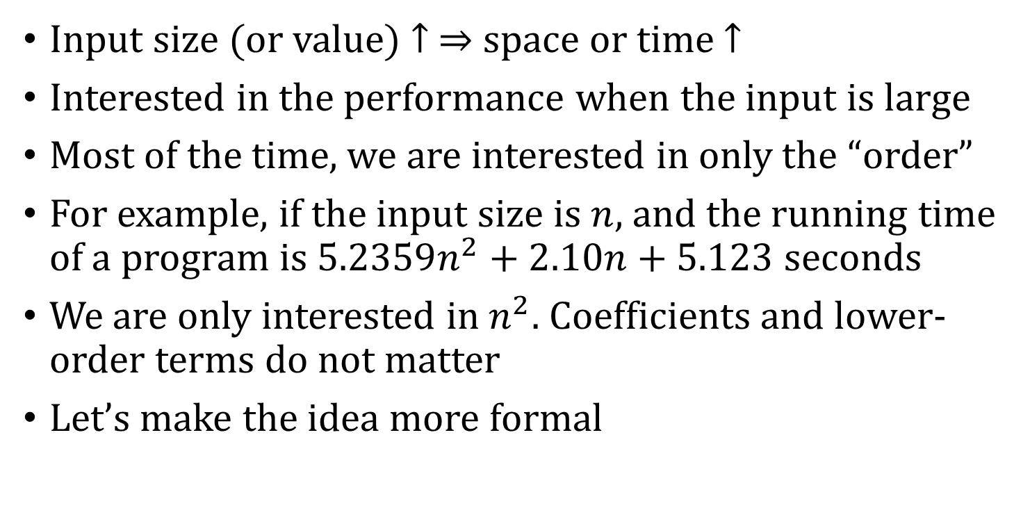
How to Analyze Speed (Time) and Space
Input size (or value) $↑ ⇒$ space or time $↑$
Interested in the performance when the input is large
Most of the time, we are interested in only the “order”
For example, if the input size is $n$, and the running time of a program is $5.2359n^{2}+2.10n+5.123$ seconds
We are only interested in $n^{2}$. Coefficients and lower-order terms do not matter
Let’s make the idea more formal

Slide 53
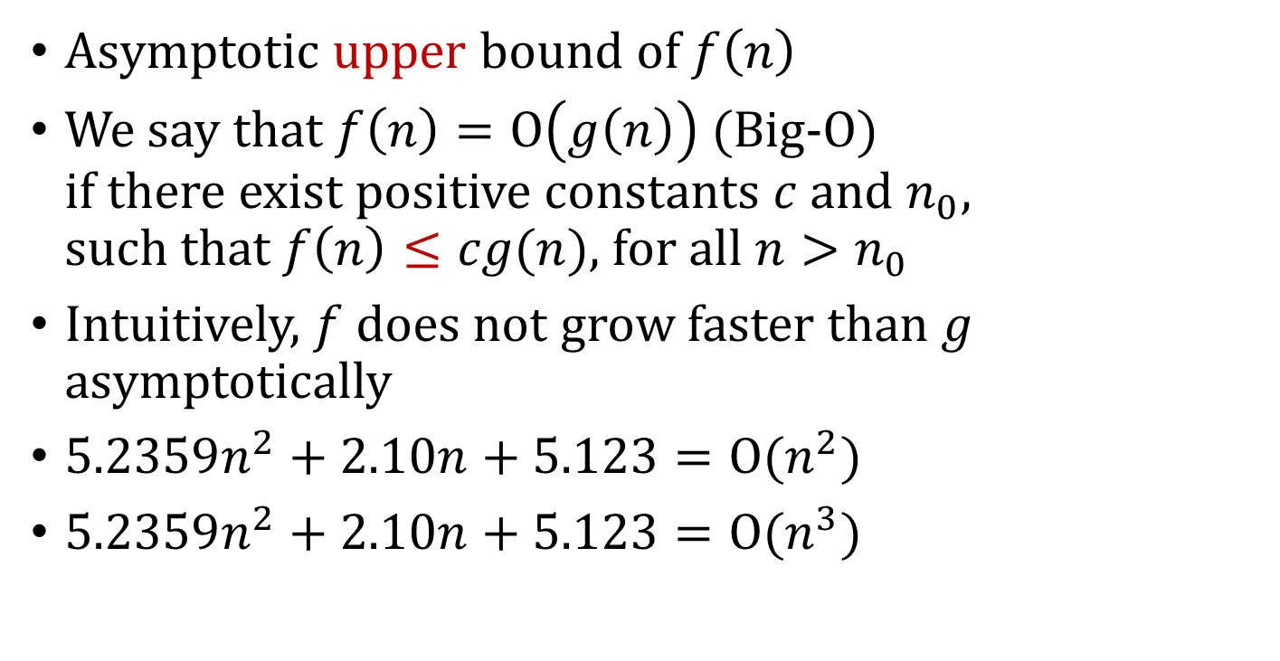
Asymptotic Analysis
Asymptotic upper bound of $f\left(n\right)$
We say that $f\left(n\right)=Ο\left(g\left(n\right)\right)$ (Big-O) if there exist positive constants $c$ and $n_{0}$, such that $f\left(n\right)≤cg(n)$, for all $n>n_{0}$
Intuitively, $f$ does not grow faster than $g$ asymptotically
$5.2359n^{2}+2.10n+5.123=Ο(n^{2})$
$5.2359n^{2}+2.10n+5.123=Ο(n^{3})$

Slide 54
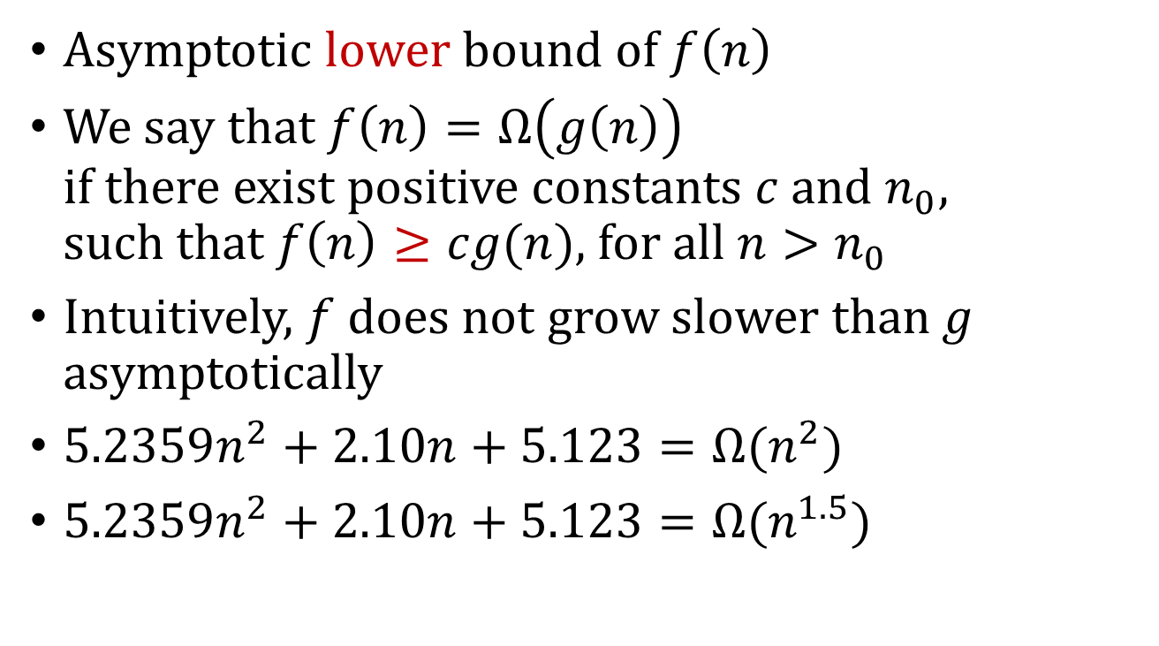
Asymptotic Analysis
Asymptotic lower bound of $f\left(n\right)$
We say that $f\left(n\right)=Ω\left(g\left(n\right)\right)$ if there exist positive constants $c$ and $n_{0}$, such that $f\left(n\right)≥cg(n)$, for all $n>n_{0}$
Intuitively, $f$ does not grow slower than $g$ asymptotically
$5.2359n^{2}+2.10n+5.123=Ω(n^{2})$
$5.2359n^{2}+2.10n+5.123=Ω(n^{1.5})$

Slide 55
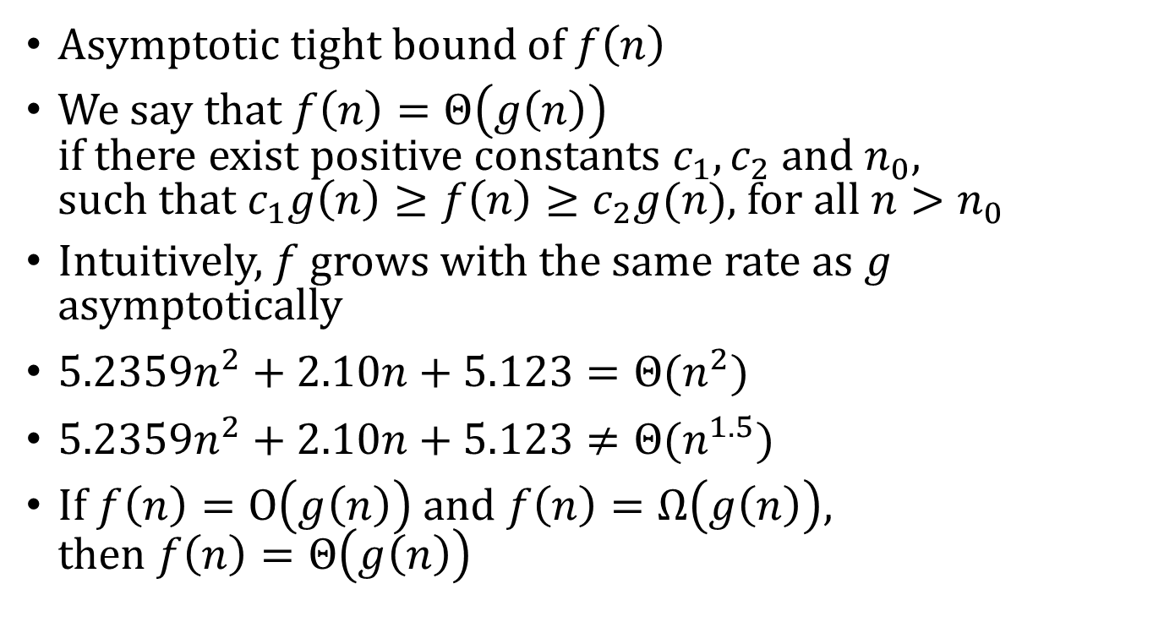
Asymptotic Analysis
Asymptotic tight bound of $f\left(n\right)$
We say that $f\left(n\right)=Θ\left(g\left(n\right)\right)$ if there exist positive constants $c_{1},c_{2}$ and $n_{0}$, such that $c_{1}g\left(n\right)≥f\left(n\right)≥c_{2}g(n)$, for all $n>n_{0}$
Intuitively, $f$ grows with the same rate as $g$ asymptotically
$5.2359n^{2}+2.10n+5.123=Θ(n^{2})$
$5.2359n^{2}+2.10n+5.123≠Θ(n^{1.5})$
If $f\left(n\right)=Ο\left(g\left(n\right)\right)$ and $f\left(n\right)=Ω\left(g\left(n\right)\right)$, then $f\left(n\right)=Θ\left(g\left(n\right)\right)$

Slide 56
Asymptotic Analysis
Usually, we are interested in Big-O notation when analyzing our algorithm or data structure

Slide 57
Asymptotic Analysis
void bubbleSort(int arr[], int n) {
int i, j, temp;
for (i = 0; i < n - 1; i++) {
for (j = 0; j < n - 1 - i; j++) {
if (arr[j] > arr[j + 1]) {
temp = arr[j];
arr[j] = arr[j + 1];
arr[j + 1] = temp;
}
}
}
}

Slide 58
Asymptotic Analysis
void insertionSort(int arr[], int n) {
int i, j;
int temp;
for (i = 1; i < n; i++) {
temp = arr[i];
for (j=i-1; j>=0 && arr[j]>temp; j--) {
arr[j + 1] = arr[j];
}
arr[j + 1] = temp;
}
}

Slide 59
Asymptotic Analysis
int binarySearch(int arr[], int start, int end, int key) {
int mid;
if (start > end)
return -1;
mid = (start + end) / 2;
if (arr[mid] > key)
return binarySearch(arr, start, mid - 1, key);
if (arr[mid] < key)
return binarySearch(arr, mid + 1, end, key);
return mid;
}

Slide 60
Asymptotic Analysis
function merge(a[0,…,n1-1],b[0,…,n2-1])
if a[0]<b[0]:
return the concatenation of a[0] and merge(a[1,…,n1-1],b[0,…,n2-1])
else:
return the concatenation of b[0] and merge(a[0,…,n1-1],b[1,…,n2-1])

Slide 61
Asymptotic Analysis
function mergeSort(a[0,…,n-1])
if n>1:
return merge(mergeSort(a[0,…,n/2]), mergeSort(a[n/2+1,…,n-1]))
if n=1:
return a

Slide 62
Algorithm Design
void reverseArray(int arr[], int n)
void deleteKey(int arr[], int n, int k)
Given an array, update the array so that all occurrence of k have been removed and the remaining elements have been shifted left to fill the emptied indices
void deleteDuplicates(int arr[], int n)
Delete duplicates from a sorted array
buyAndSell(int arr[], int n)
Buy and sell a stock
310, 315, 275, 295, 260, 270, 290, 230, 255, 250

Slide 63
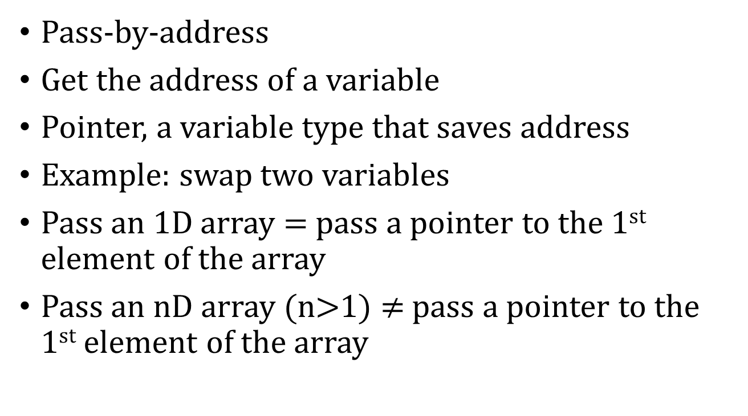
How to Modify Function Input?
Pass-by-address
Get the address of a variable
Pointer, a variable type that saves address
Example: swap two variables
Pass an 1D array = pass a pointer to the 1st element of the array
Pass an nD array (n>1) $≠$ pass a pointer to the 1st element of the array

Slide 64
Function Call & Return
What happens in the memory when you call a function?
What happens in the memory when a function returns?
Do not return a pointer to a local variable (array)

Slide 65
Dynamic Arrays
What if array size is unknown when writing code?
Allocate memory when executing the program
malloc, free
Dynamic multi-dimensional array
Interpret as an array of arrays

Slide 66
Linked List
Some drawbacks of array
Insertion of an element to a given position is slow
Enlarging arrays are not efficient
Linked list comes to help
Pointer to struct

