Slide 1
Current Status
Daniel Sumann

Slide 2
Chromosome encoding - Time
0
1
2
3
4
5
6
7
8
9
10
11
12
13
14
15
16
17
18
19
Action NPC 1
Corresponds to timestep 1 (0.5 seconds)
Action NPC 2
…
Action NPC n
Notes:
Apollo Case Study

Slide 3
Chromosome encoding – Time and NPC
NPC 1
NPC 2
NPC 3
0
1
2
3
4
5
6
7
8
9
0
1
2
3
4
5
6
7
8
9
0
1
2
3
4
5
6
7
8
9
Corresponds to timestep 1 (0.5 seconds)
Action NPC 1

Slide 4
Gene Encoding
Encode as Integer
0 = NoAction
1 = JunctionSelection(straight)
2 = JunctionSelection(left)
3 = JunctionSelection(right)
4 = LaneChange(left, 3)
5 = LaneChange(right, 3)
6 = AbortLaneChange()
7 = LaneOffset(0.9)
8 = LaneOffset(0.5)
9 = LaneOffset(0.0)
10 = LaneOffset(-0.5)
11 = LaneOffset(-0.9)
12 …
+ simple mutation
+ simple encoding
+ smaller search space
Encode as dictionary
Examples:
{"type": "LaneChange", "direction": "left", "duration": 3}
{"type": "JunctionSelection", "junction_selection_angle": "straight"}
{"type": “AbortLaneChange"}
{"type": “LaneOffset“, “offset_percentage“: “0.6”}
+ maps exactly to problem
+ more control over parameters of actions
- larger search space
- genes will have different lengths

Slide 5
Behaviour Tree
Traffic Manger
Genetic Algorithm
World Information
World Information
Action Interface
EGO
NPC 1
NPC 2
…

Slide 6
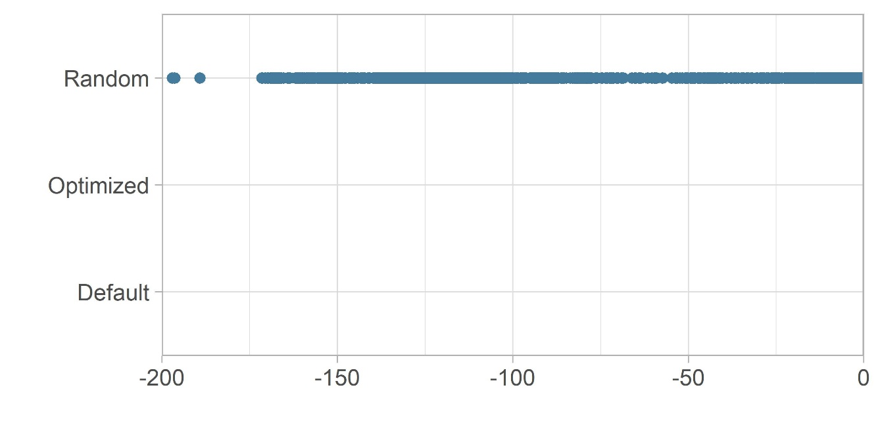
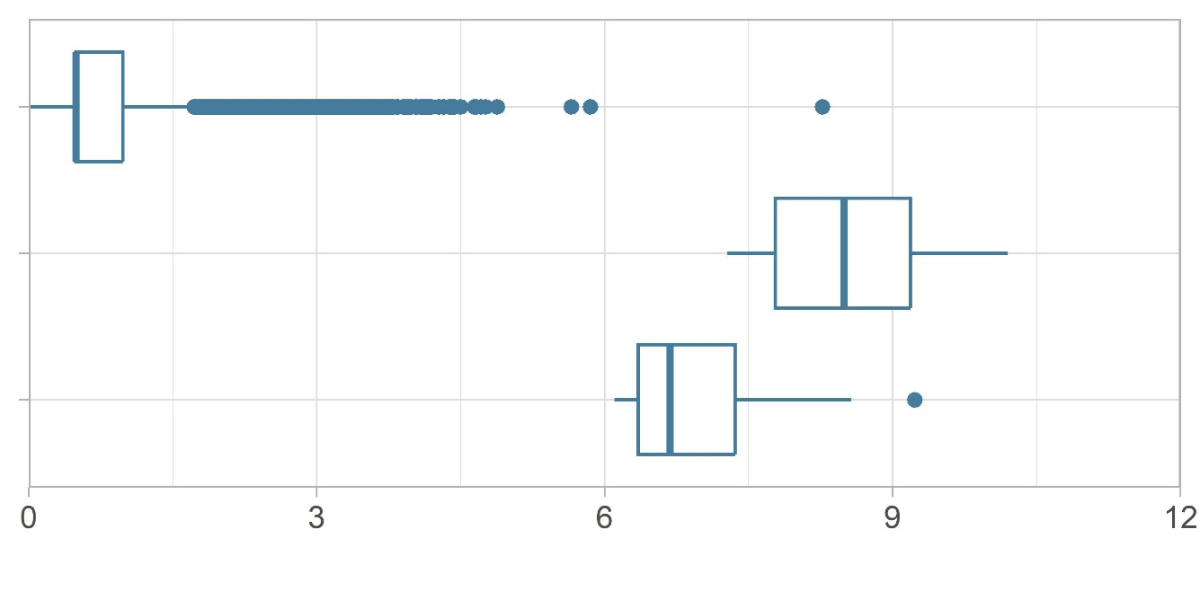
Cumulated Emergency Break Duration

