Slide 1
SCAGO
Scan & go
Team - Purple Cobras

Slide 2

PROBLEM STATEMENT
Morning and afternoon hustle can be man’s worst nightmare for a person to stand in a never ending line or be stuck after a hard day. If work can kill a person’s dream and ruin their start to the day, this is where SCAGO comes in.
Morning and afternoon hustle can be man’s worst nightmare for a person to stand in a never ending line or be stuck after a hard day. If work can kill a person’s dream and ruin their start to the day, this is where SCAGO comes in.

Slide 3
WHAT IS SCAGO ?
What SCAGO basically does is create a virtual ticket/e-ticket based on the current location of the passenger and the user details that is initially provided during account creation.

Slide 4
The money for the ticket is debited from the wallet in the app.
Also the passenger has to maintain a minimum balance in the wallet and the wallet can be recharged using an method.etro station.

Slide 5
The destination can either be given or there is an option where the passenger can travel any distance based on the amount of money left in the wallet .
Then the app creates a QR code which can be scanned at the .corresponding metro station.

Slide 6
CONTROL FLOW

Slide 7
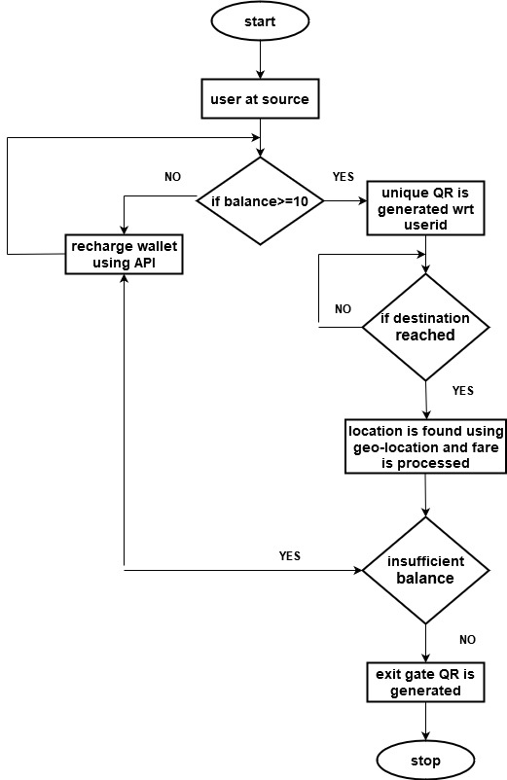

Slide 8
ADVANTAGES
Paperless
Easy payment
User-friendly UI
Time-saving
Flexible
Cost-efficient

Slide 9
Thank You

