Slide 1
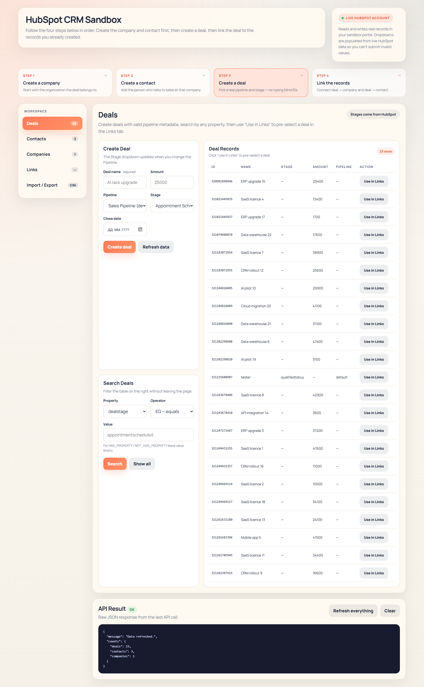
CANDIDATE PRESENTATION
HubSpot CRM 整合展示
HubSpot CRM Integration Demo
這份簡報不是單純介紹畫面，而是用一個可運作的系統來說明我如何處理 CRM 流程、資料驗證、API 整合與後續擴充。
This deck is not just a screen tour. It shows how I approach CRM workflow design, data validation, API integration, and practical next-step thinking.
C# Backend
HubSpot API
CRM Workflow
CSV Validation
SQL-ready Next Step
Live
4
Role
真實 HubSpot 測試環境
核心流程區塊
對應 CRM / Integration 職缺
Live HubSpot sandbox
Core workflow areas
Aligned to CRM / Integration roles
重點不是把畫面做滿，而是證明我能把業務流程翻譯成可運作、可說明、可延伸的系統。
The point is not to decorate a UI. The point is to show I can turn a business workflow into a working, explainable, extensible system.
右側畫面來自真實 HubSpot sandbox，並非靜態 mockup。
The screen on the right is connected to a live HubSpot sandbox, not a static mockup.

Slide 2
BUSINESS SCENARIO
這個系統解決什麼問題
What Business Problem It Solves
如果公司希望用 CRM 管理客戶、窗口、商機與匯入資料，系統的重點就是資料正確、流程清楚、後續整合容易。
If a company wants CRM to manage accounts, contacts, opportunities, and batch updates, the real priorities are clean data, clear workflow, and easier downstream integration.
對 HR 與主管的意義
Why this matters to HR and a hiring manager
實際 CRM 作業流程
A
這不是單一 CRUD 畫面，而是完整 CRM 物件思維。
Practical CRM operating flow
This is not a single CRUD page. It shows complete CRM object thinking.
1
先建立公司主資料，避免商機沒有所屬組織。
Create company master data first so the deal belongs to a real organization.
B
它反映我能理解業務流程，不只是寫 API。
2
再建立聯絡人，對應實際窗口與溝通對象。
It reflects that I understand business workflow, not just endpoints.
Then create the contact so communication is tied to a real person.
C
它也保留了下一步做 SQL staging / audit 的空間。
3
建立商機並指定 pipeline / stage，讓銷售狀態可追蹤。
It also leaves a clean next step for SQL staging and audit capability.
Create the deal with pipeline and stage so the sales process becomes trackable.
4
用關聯與 CSV 流程把資料串起來，為後續整合做準備。
這份作品的價值在於：它既能展示實作能力，也能展示系統思考。
Use associations and CSV workflow to connect records and prepare for future integration.
The value of this work is that it shows both implementation ability and systems thinking.

Slide 3
WHAT I BUILT
我實際完成的能力範圍
What I Actually Built
我把這個作品整理成可以面試展示的版本，重點不是功能堆疊，而是每個功能都對應到 CRM / integration 的核心能力。
I shaped this into an interview-ready working prototype. The focus is not feature count, but whether each feature maps to a real CRM / integration capability.
1
真實物件操作：Company / Contact / Deal。
Live object handling for companies, contacts, and deals.
2
受控輸入與驗證：pipeline、stage、industry 來自 HubSpot。
Controlled validation where pipeline, stage, and industry come from HubSpot metadata.
3
商機關聯：把 deal 與 company / contact 串起來。
Association workflow that links deals to companies and contacts.
4
CSV 匯入匯出：樣板、匯出、預覽、套用。
CSV import/export with template, export, preview, and apply steps.

Slide 4
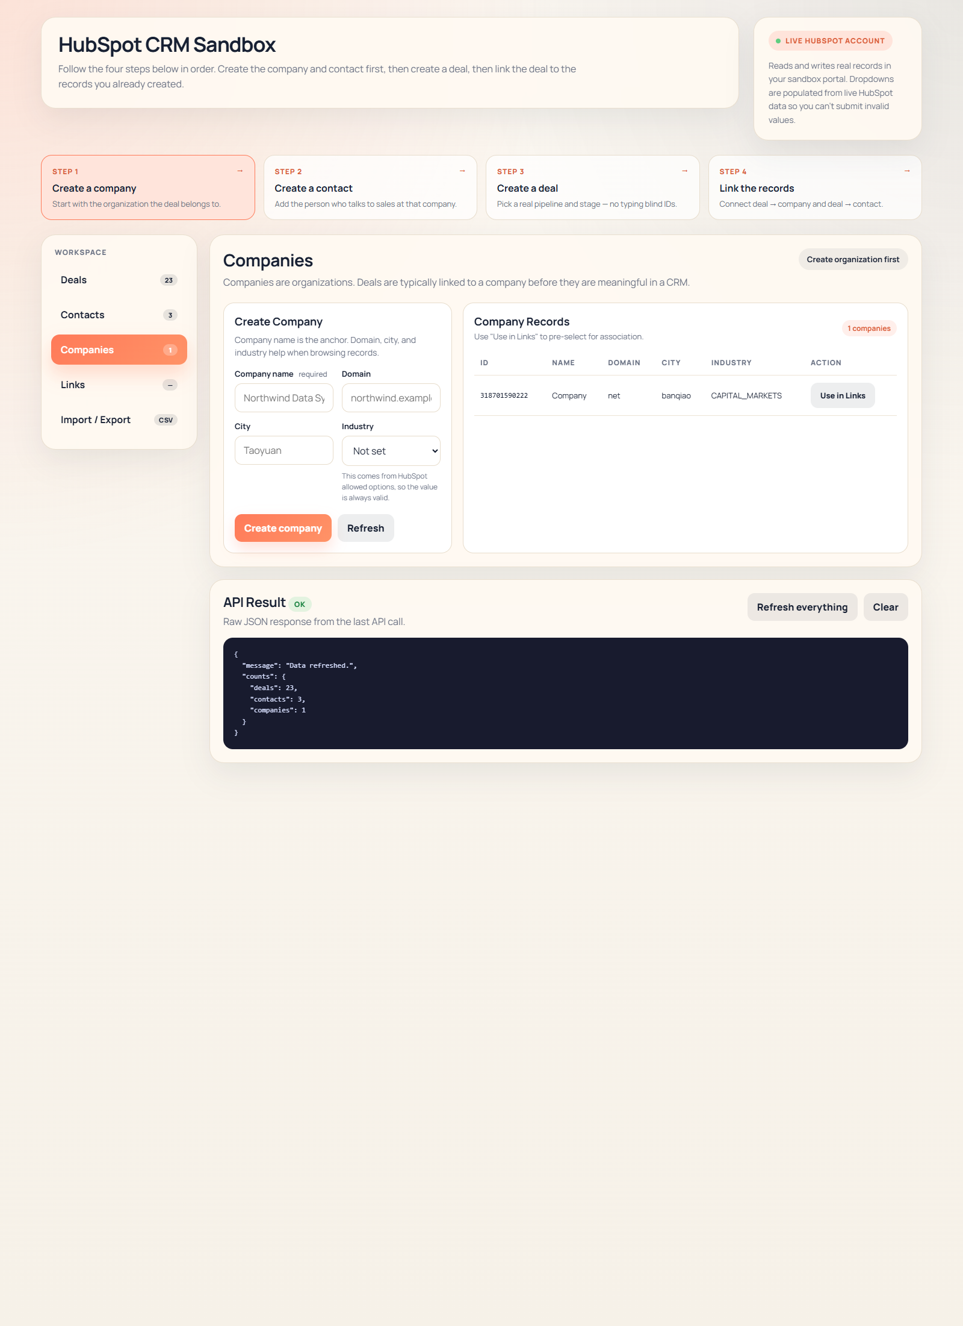
KEY SCREENS
核心畫面一：主資料與商機
Key Screens: Master Data and Deals
這兩個畫面最能說明我對 CRM 基礎結構的理解：先有主資料，再有商機，避免資料孤立。
These two screens best show my CRM foundation thinking: master data first, deal second, so records do not become isolated.
A
公司資料不是裝飾，而是商機、聯絡人與後續同步的基礎。
B
商機畫面同時支援建立、查詢與結果檢視。
C
下拉選單直接讀取 HubSpot 規則，減少無效輸入。
Company data is the base for deals, contacts, and later synchronization.
The deal screen combines creation, search, and result inspection in one place.
Dropdowns reflect live HubSpot rules and reduce invalid submissions.

Slide 5
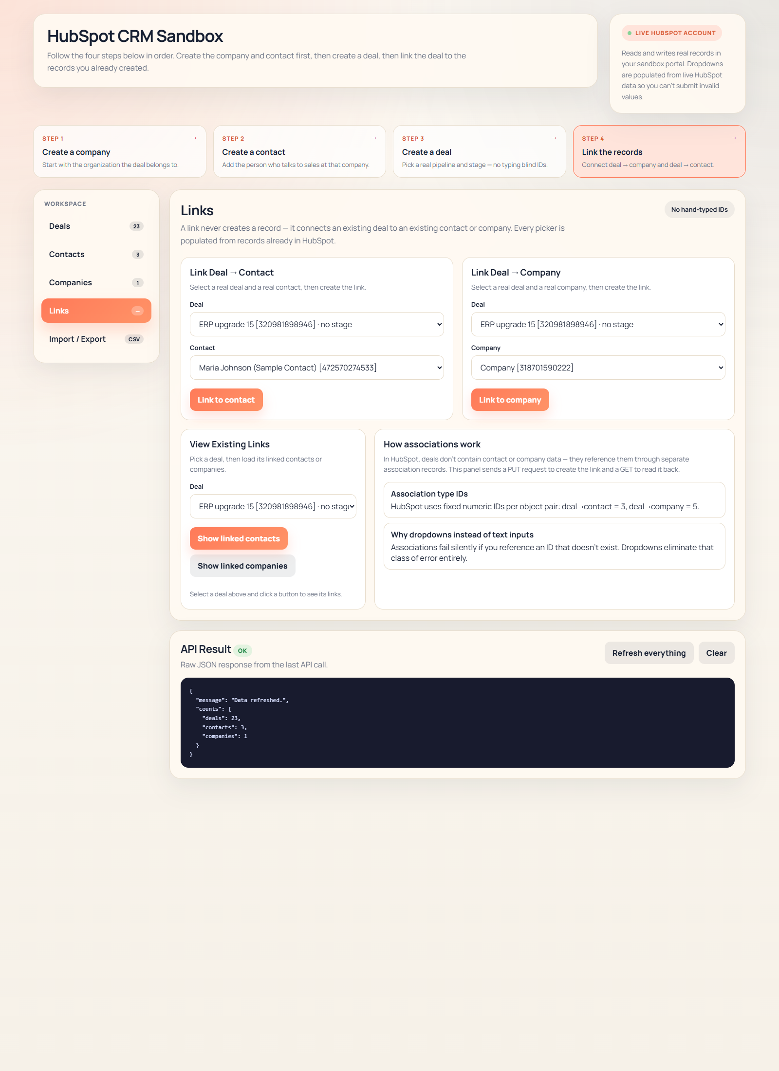
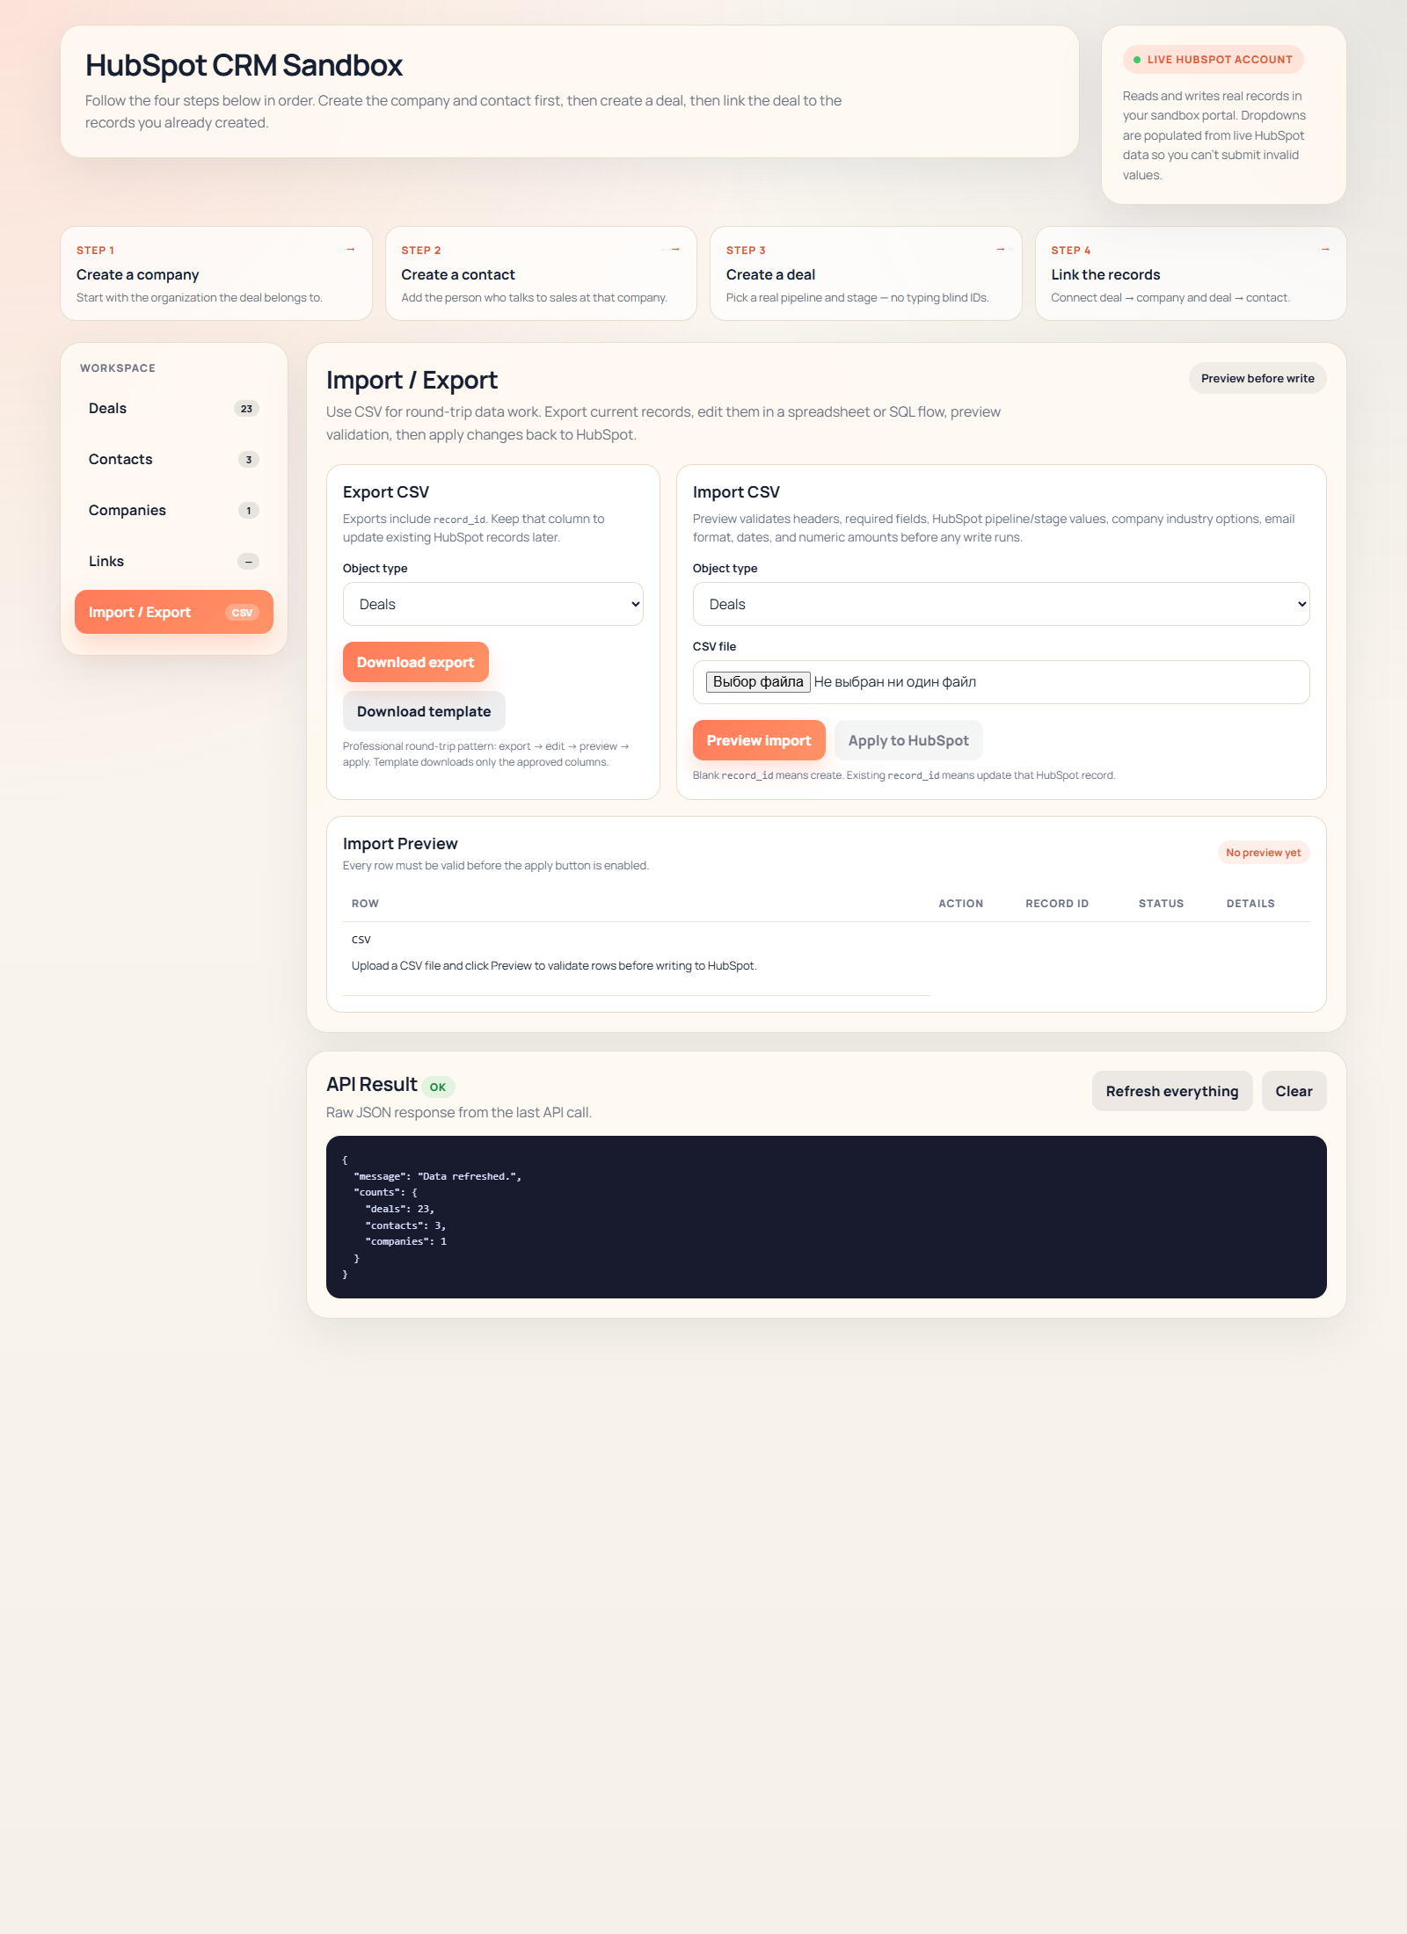
INTEGRATION FLOW
核心畫面二：關聯與匯入流程
Key Screens: Linking and Import Workflow
如果要讓主管看到我不是只會做表單，這一頁最重要：它證明我理解資料關係與批次資料流程。
If I want a hiring manager to see that I am more than a form builder, this slide matters most. It proves I understand data relationships and batch data workflow.
1
Links 畫面說明 deal 不該孤立存在，必須連到真實公司與窗口。
2
Import 畫面把 CSV 變成可驗證、可預覽、可說明的流程。
3
這部分最接近 CRM / ERP integration 職位會在意的能力。
The links screen shows that a deal should be connected to a real company and real contact.
The import screen turns CSV into a workflow that can be validated, previewed, and explained.
This is the part closest to what CRM / ERP integration roles usually care about.

Slide 6
TECHNICAL VIEW
技術設計與專業化方向
Technical Design and Next Professional Step
目前版本是可展示、可運作的 prototype；如果往專業 CRM integration 方向走，下一步就是加入 SQL staging、audit 與 import history。
The current version is a working prototype suitable for interviews. The next professional step is SQL staging, audit logging, and import history.
目前架構
下一步專業化
Current structure
Next step toward production-like integration
瀏覽器 UI
A
加入 SQLite / SQL staging，先存再驗證再套用。
Browser UI
Add SQLite / SQL staging so import can be stored, validated, and then applied.
↓
ASP.NET Core API
保留 import job、row-level error、audit trail。
ASP.NET Core demo layer
B
↓
Keep import jobs, row-level errors, and audit trail.
驗證與 CSV 服務
Validation and CSV workflow
C
支援 retry、deduplication、history 查詢。
↓
Support retry, deduplication, and history lookup.
HubSpot Sandbox
Live HubSpot sandbox data
這會把作品從 demo 提升到更像真實內部系統或 CRM integration stand。
This is what would move the work from a demo toward a more realistic internal system or CRM integration stand.

Slide 7
ROLE FIT
為什麼我適合這類職位
Why I Fit This Type of Role
如果面試職位是 C#、HubSpot、API、CRM/ERP integration、import/export、SQL-ready 思維，這份作品正好能作為一個具體說明。
If the role asks for C#, HubSpot, API integration, CRM/ERP workflow, import/export, and SQL-ready thinking, this project gives a concrete way to explain that fit.
我能帶來的能力
主管最可能想知道
Capability I bring
What a manager is most likely to care about
1
用 C# / ASP.NET Core 快速做出可運作原型。
A
我不是只做畫面，而是把流程與資料關係做清楚。
I can build a working prototype quickly in C# / ASP.NET Core.
I am not only building screens; I am structuring workflow and data relationships.
2
理解 CRM 物件模型：company、contact、deal、association。
I understand the CRM object model: company, contact, deal, association.
B
我能展示 working solution，也能誠實說明目前邊界。
I can show a working solution and also explain its current boundaries honestly.
3
知道何時該做前端控制，何時該做後端驗證。
I know when to use front-end control and when to enforce server-side validation.
這讓作品更像成熟候選人的展示，而不是單純作業。
C
能把 CSV / API / validation 串成實際業務流程。
That makes the presentation feel closer to a mature candidate deck than a classroom assignment.
4
I can turn CSV, API, and validation into a practical business workflow.
5
也清楚下一步如何往 SQL / audit / staging 擴展。
一句話總結：我可以把 CRM 需求落地成系統，並知道怎麼把它往更專業的方向推進。
I also understand the next step toward SQL, audit, and staging capability.
One-line summary: I can turn CRM requirements into a working system and know how to push it toward a more professional solution.

