Slide 2
Goals of the project
Familiarizing with energy datasets
Visualization and exploratory data analysis
Identifying relevant machine learning algorithms
Identifying relevant meta-learning algorithms
Simulation and experimental validations

Slide 3
Steps
Literature review for household consumption prediction
Choosing a dataset
Performing EDA
Implementing a model for a single household consumption prediction
Literature review for state of art meta-learning algorithms
Implementing a meta-learning model
Analyze the results

Slide 4
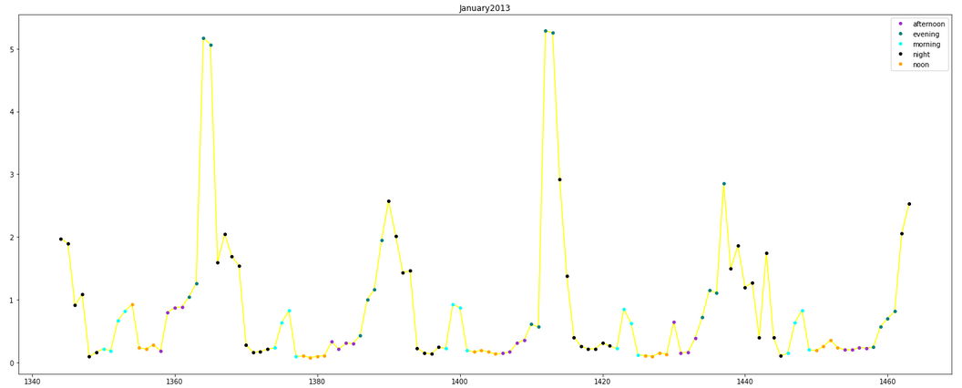
Dataset
Smart meters in London Kaggle
  Half-hourly household energy consumption
  Hourly weather reports
  ACORN household details
  Bank holidays calendar

Slide 5
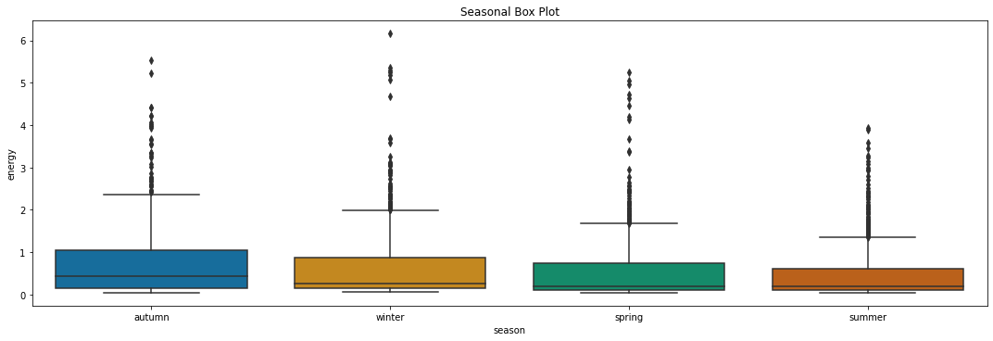
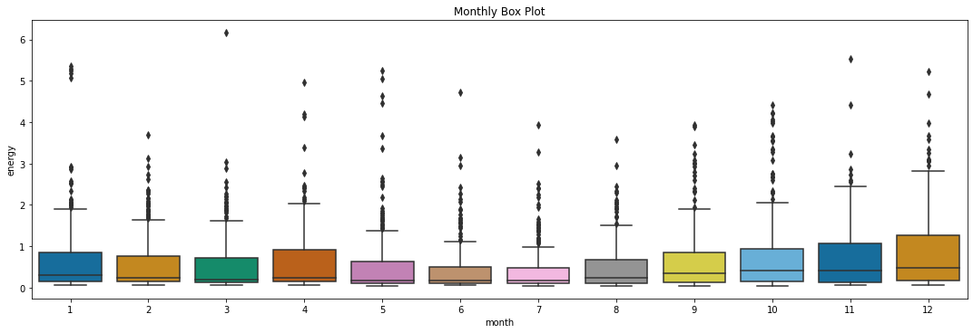
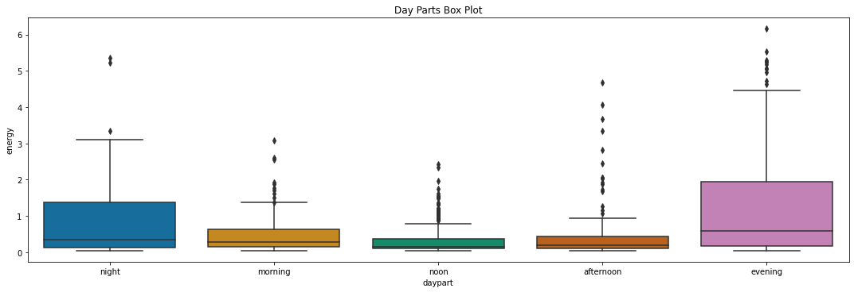
Dataset

Slide 6
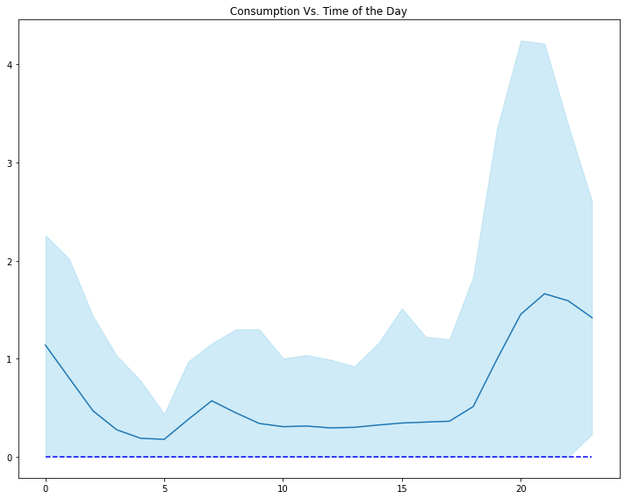
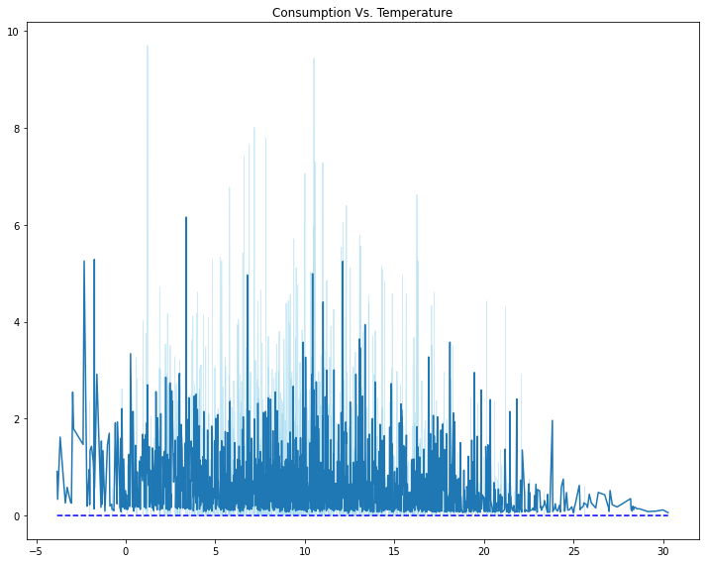
Dataset

Slide 7
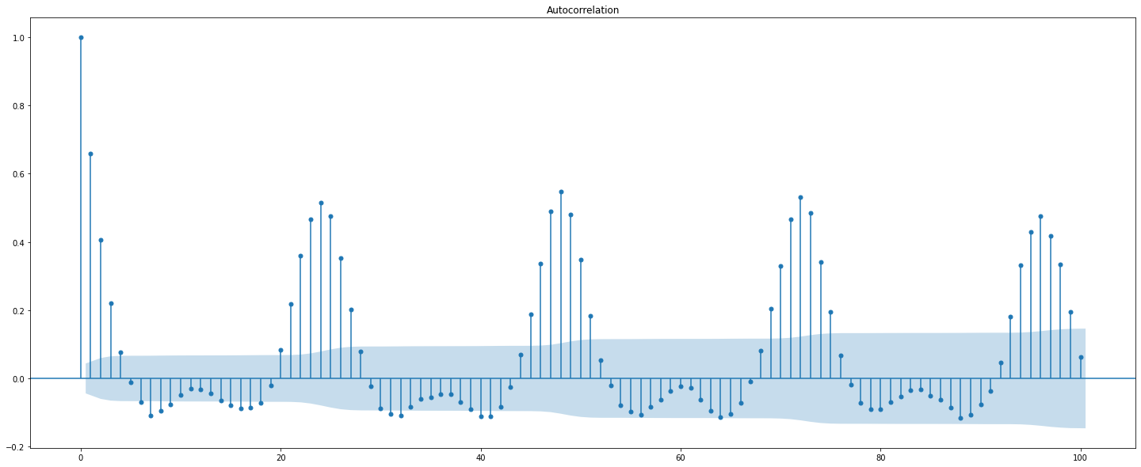
Pre-processing
Single household with the highest amount of data taken
Kbest algorithm to select most important features
  Metric used: Mutual Information
Autocorrelation plots for lags extraction
Wednesday selected
Hourly outliers are cut
Dayparts are One-hot encoded
Hour of day transformed into sinusoidal function

Slide 8
Model features
Inputs
  Numerical inputs
    Temperature
    Humidity
    Hour
    Minute
    Month
    Lags
  Binary inputs
    Holiday indicator
    Daypart
Output
  Energy consumption prediction

Slide 9
Modelling
Nu-SVR
  Based on support vectors
  Hyperparameters: Nu, C, Polynomial degree
GPR
  Based on prior probability estimation
  Outputs confidence intervals
  Hyperparameters: Kernel type, length scale for RBF kernel, level of white noise
XGBoost
  Regularizing gradient boosting
  Squared error loss function

Slide 10
Evaluation metrics
MAE
MSE
MDA
  Mean directional accuracy: compares the forecast direction to the actual realized direction.
R2

Slide 11
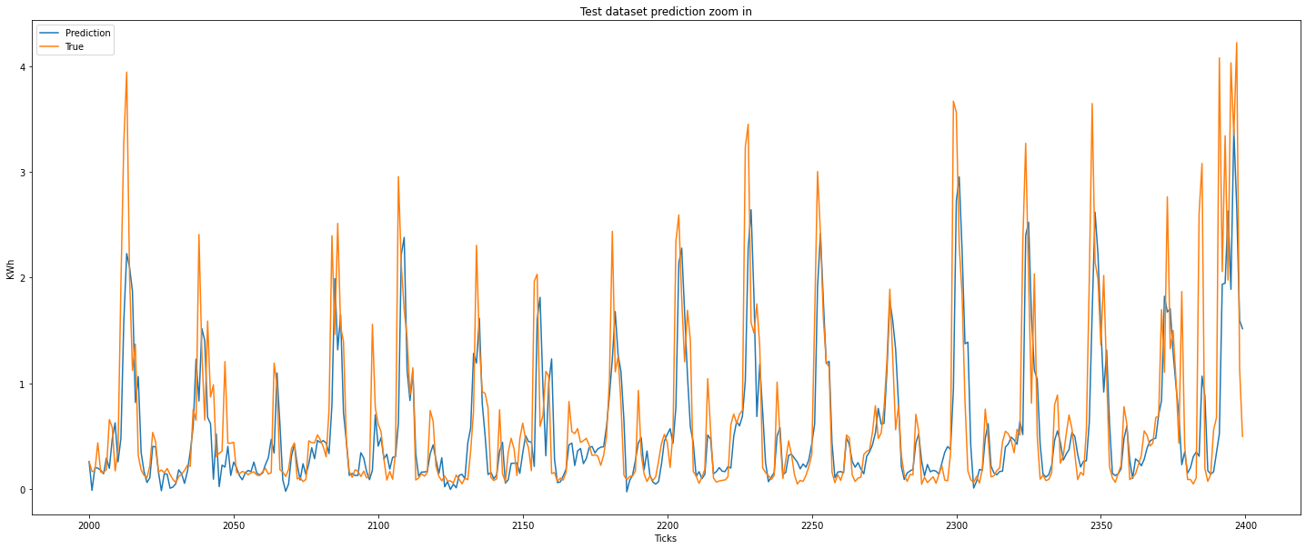
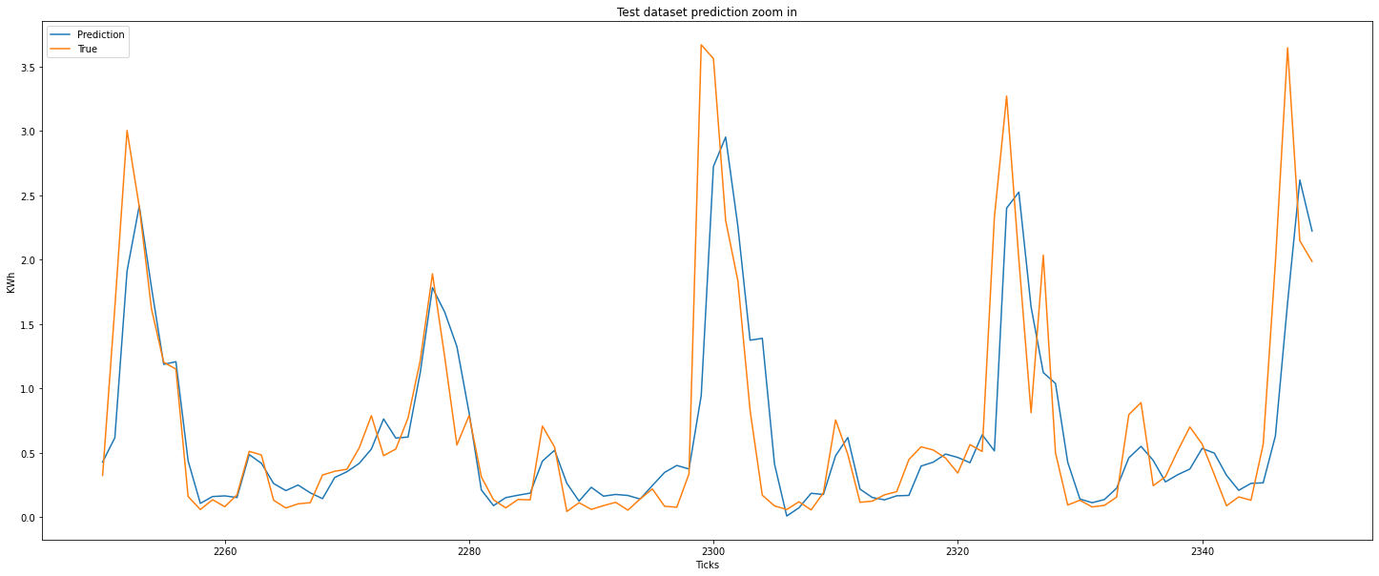
Results SVR

Slide 12
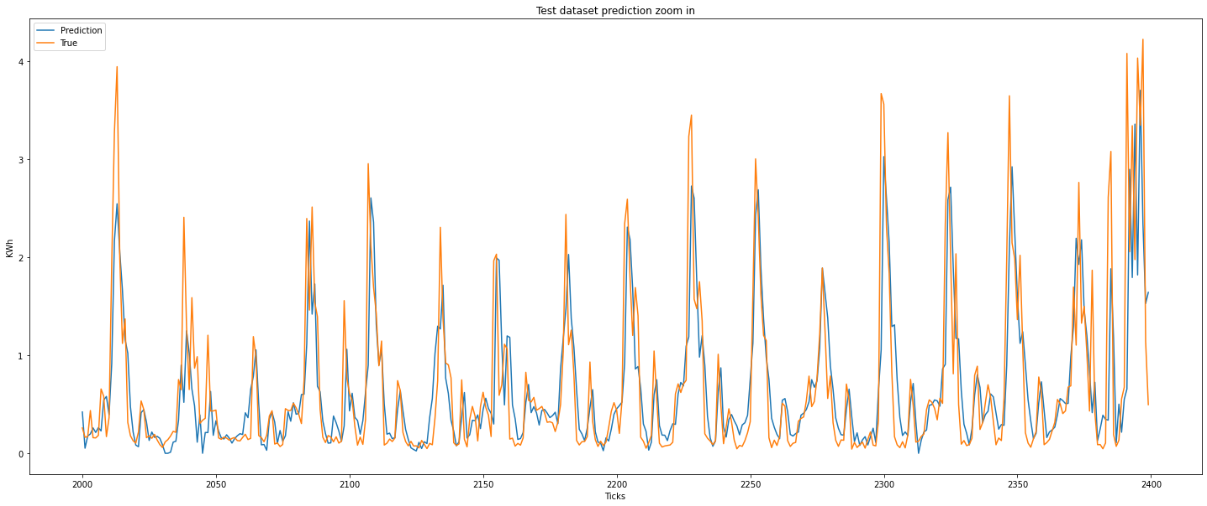
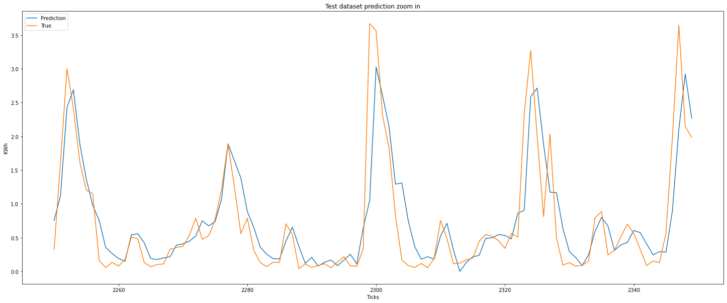
Results GPR

Slide 13
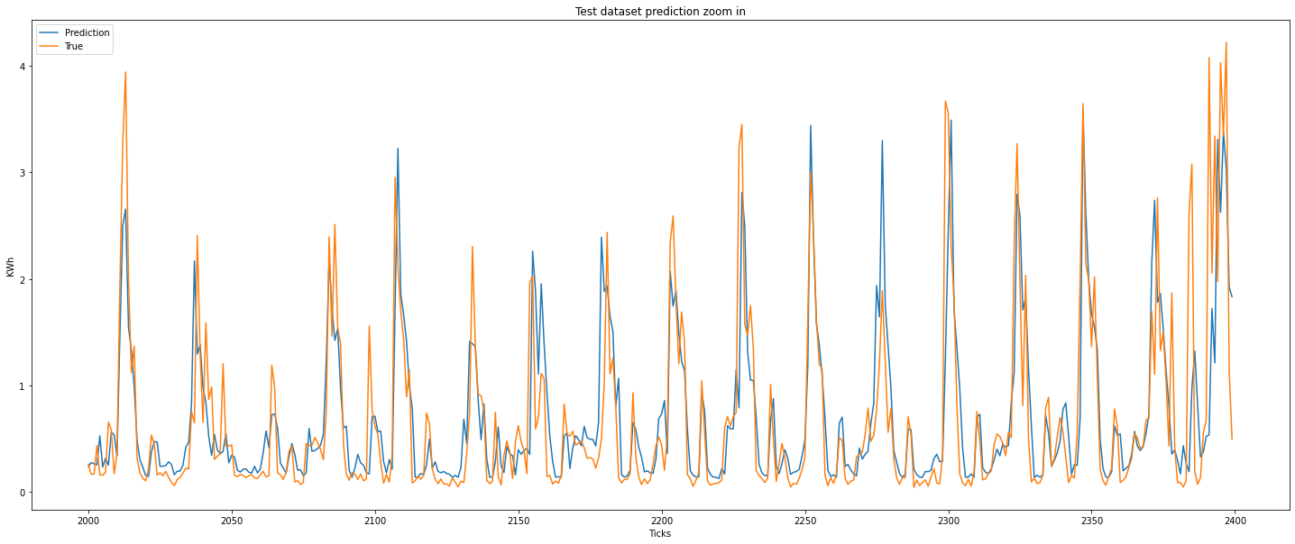
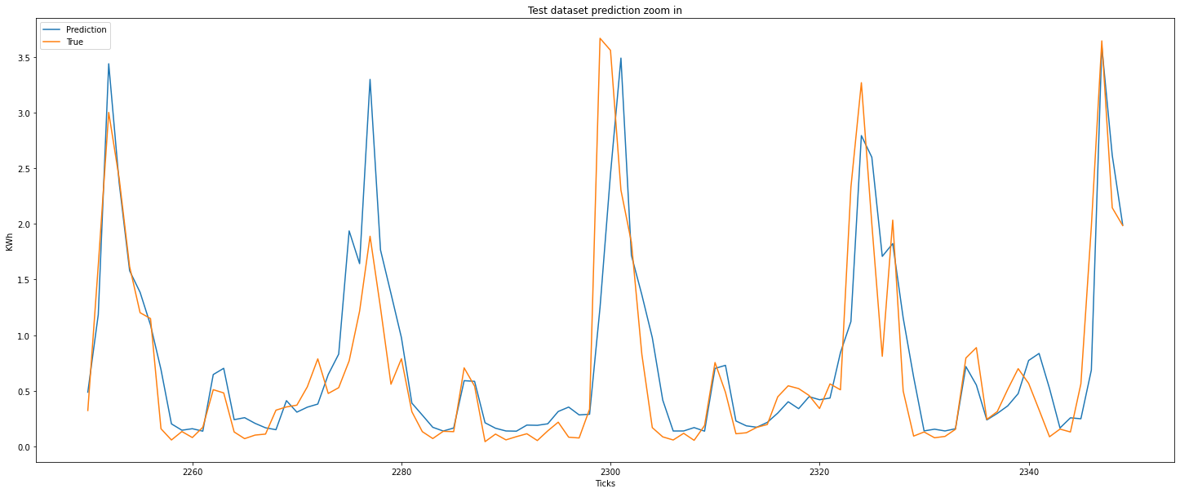
Results XGBoost

