Slide 1

Meta Learning in Smart Grids
Semester Project
Kravtsov Denis
Supervisor: Mahrokh Ghoddousiboroujeni
Prof. Giancarlo Ferrari Trecate

Slide 2
Table of contents
Project Description
Dataset
Pre-processing
Modelling
Results
Next Steps

Slide 3
Table of contents
Project Description
Dataset
Pre-processing
Modelling
Results
Next Steps

Slide 4
Goals of the project
  Familiarizing with energy datasets
  Visualization and exploratory data analysis
  Identifying relevant machine learning algorithms
  Identifying relevant meta-learning algorithms
  Simulation and experimental validations

Slide 5
Steps
Literature review for household consumption prediction
Choosing a dataset
Performing EDA
Implementing a model for a single household consumption prediction
Literature review for state of art meta-learning algorithms
Implementing a meta-learning model
Analyze the results

Slide 6
Table of contents
Project Description
Dataset
Pre-processing
Modelling
Results
Next Steps

Slide 7
Dataset
Smart meters in London Kaggle Dataset
  Half-hourly household energy consumption
  Hourly weather reports
  ACORN household details
  Bank holidays calendar

Slide 8
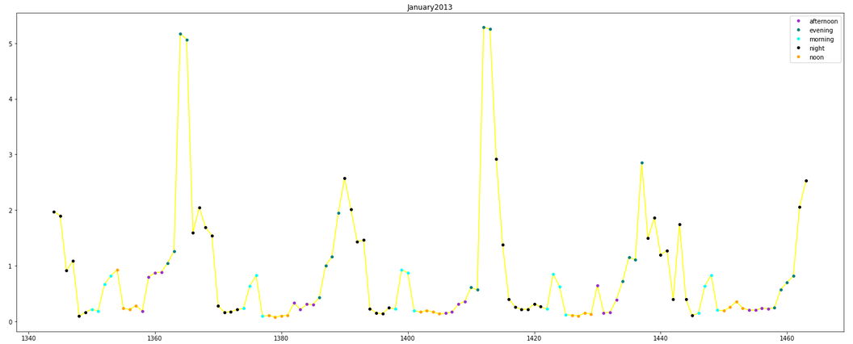
Consumption Distribution

Slide 9
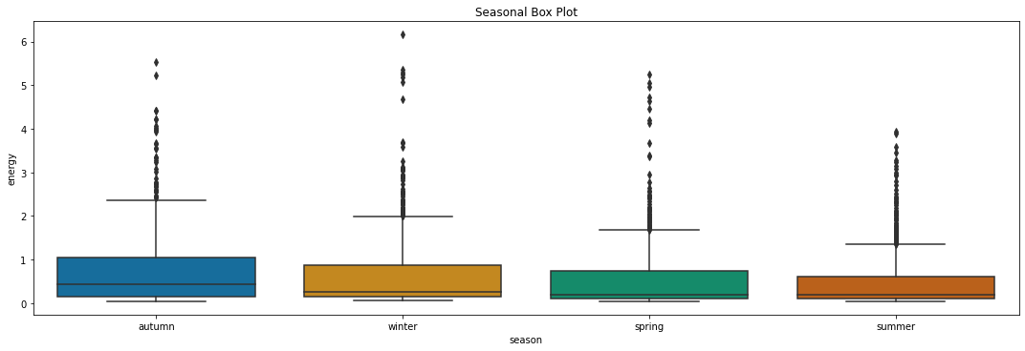
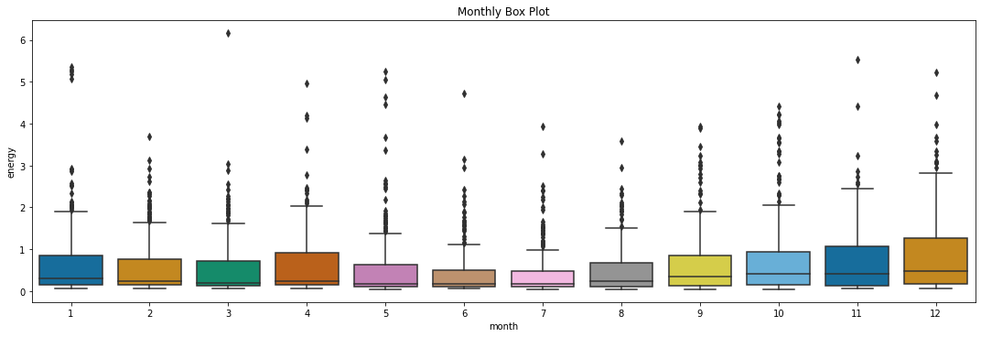
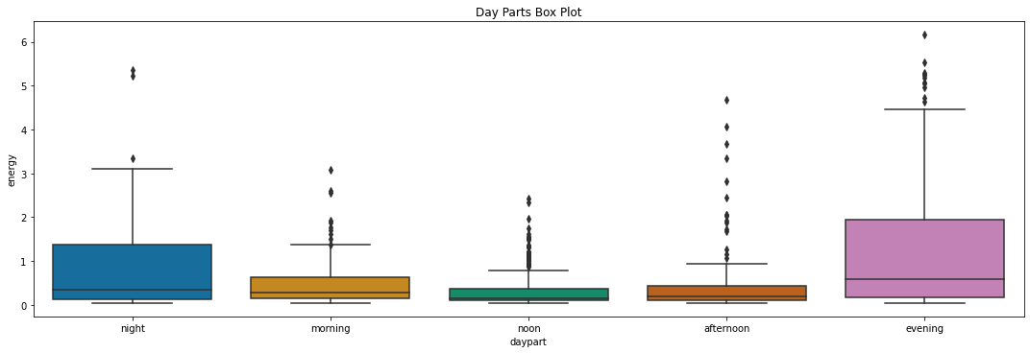

Slide 10
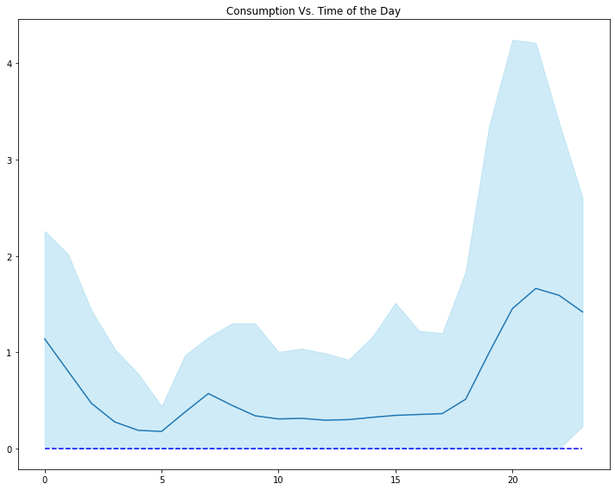
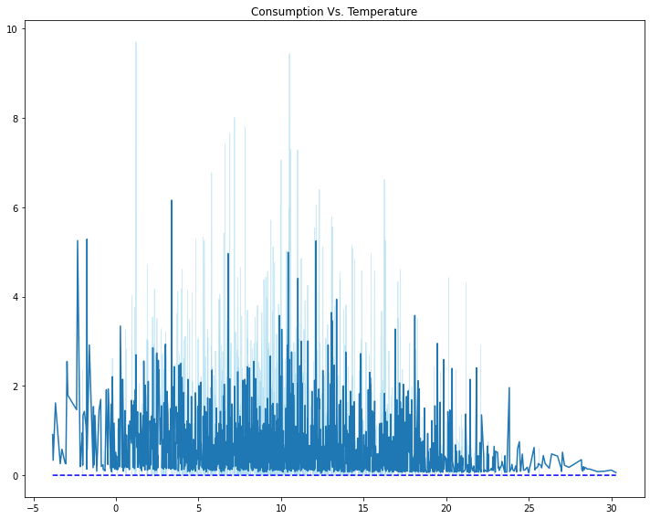

Slide 11
Table of contents
Project Description
Dataset
Pre-processing
Modelling
Results
Next Steps

Slide 12
Pre-processing
  Single household with the highest data span examined
  Kbest algorithm to select most important features
    Metric used: Mutual Information
  Autocorrelation plots for lags extraction
  Wednesday selected
  Hourly outliers are cut
  Dayparts are One-hot encoded
  Hour of day transformed into sinusoidal function

Slide 13
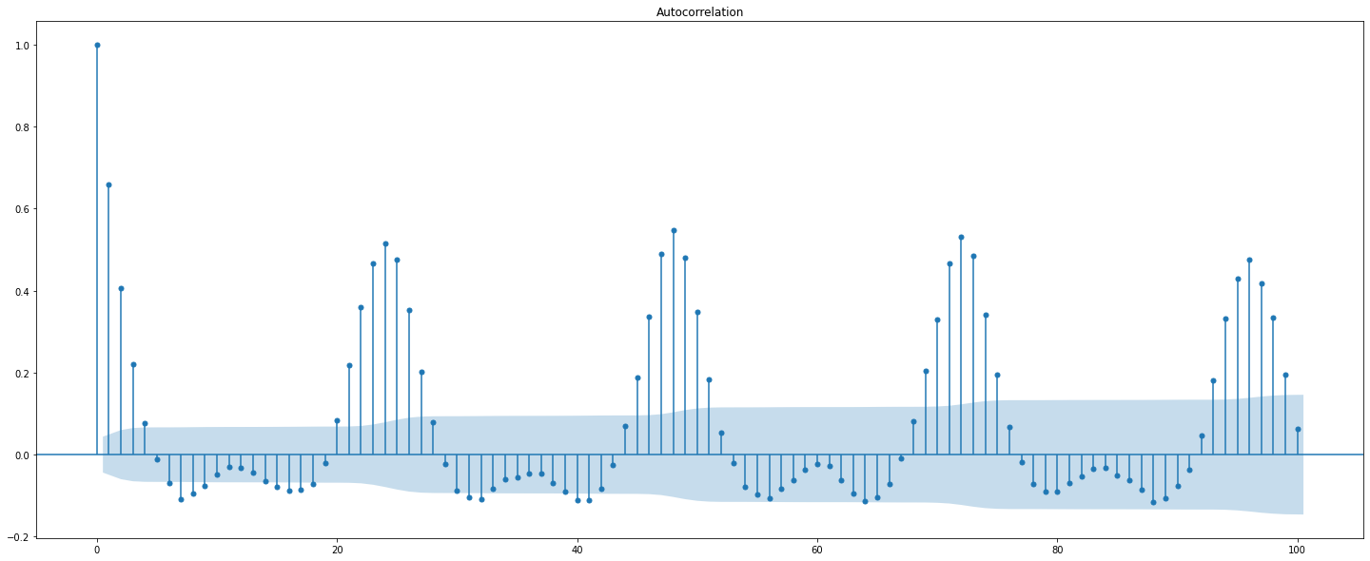
Autocorrelation plot

Slide 14
Model features
Inputs
  Numerical inputs
    Temperature
    Humidity
    Time
    Month
    Lags
  Binary inputs
    Holiday indicator
    Daypart
Output
  Energy consumption prediction

Slide 15
Table of contents
Project Description
Dataset
Pre-processing
Modelling
Results
Next Steps

Slide 16
Modelling
Nu-SVR
  Based on support vectors
  Hyperparameters: Nu, C, Polynomial degree
GPR
  Based on prior probability estimation
  Outputs confidence intervals
  Hyperparameters: Kernel type, length scale for RBF kernel, level of white noise
XGBoost
  Regularizing gradient boosting
  Squared error loss function

Slide 17
Evaluation Metrics
Metrics
  MAE
  MSE
  MDA
      Mean directional accuracy: compares the forecast direction to the actual realized direction.
  R2

Slide 18
Table of contents
Project Description
Dataset
Pre-processing
Modelling
Results
Next Steps

Slide 19
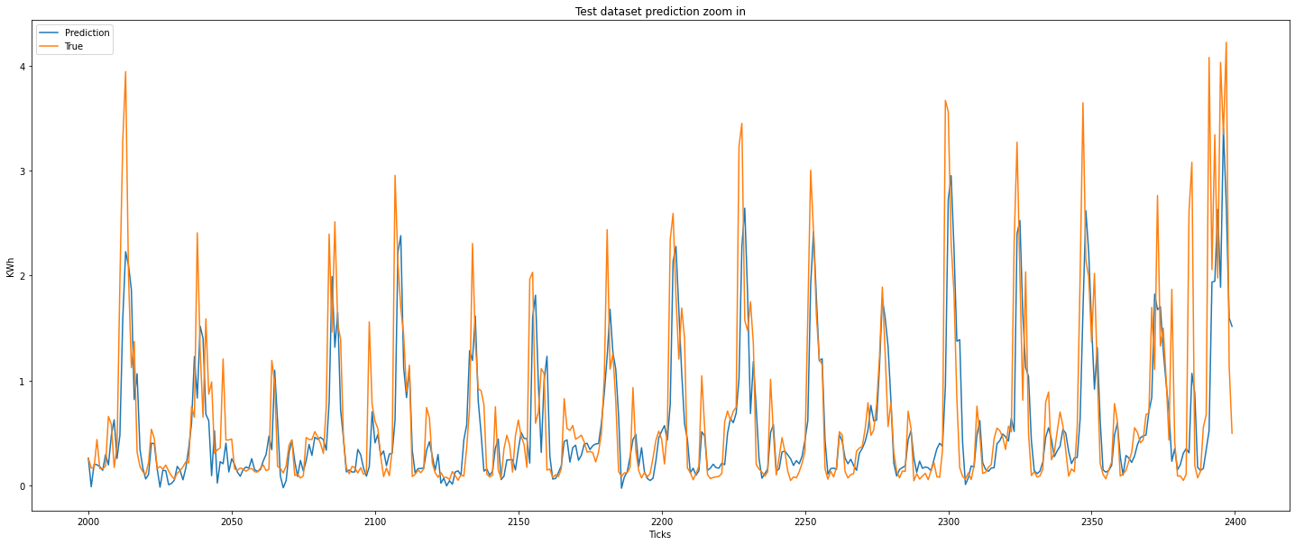
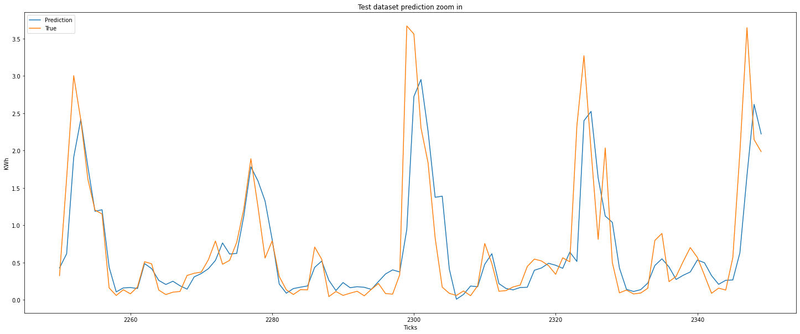
Results SVR

Slide 20
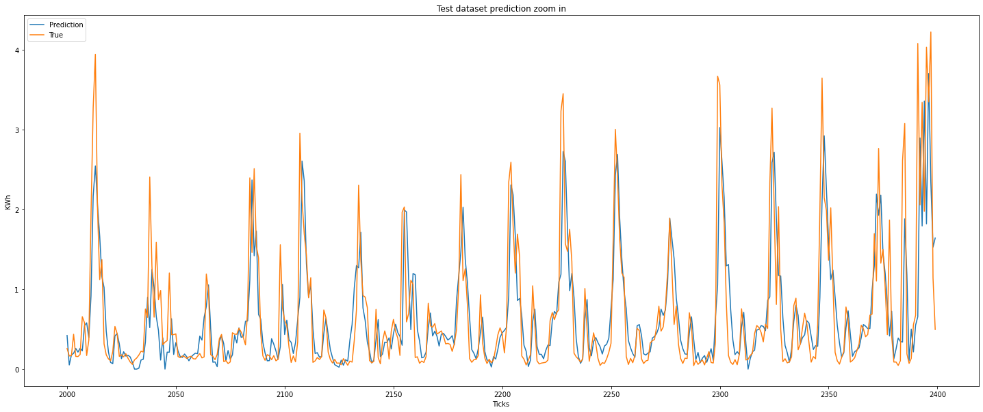
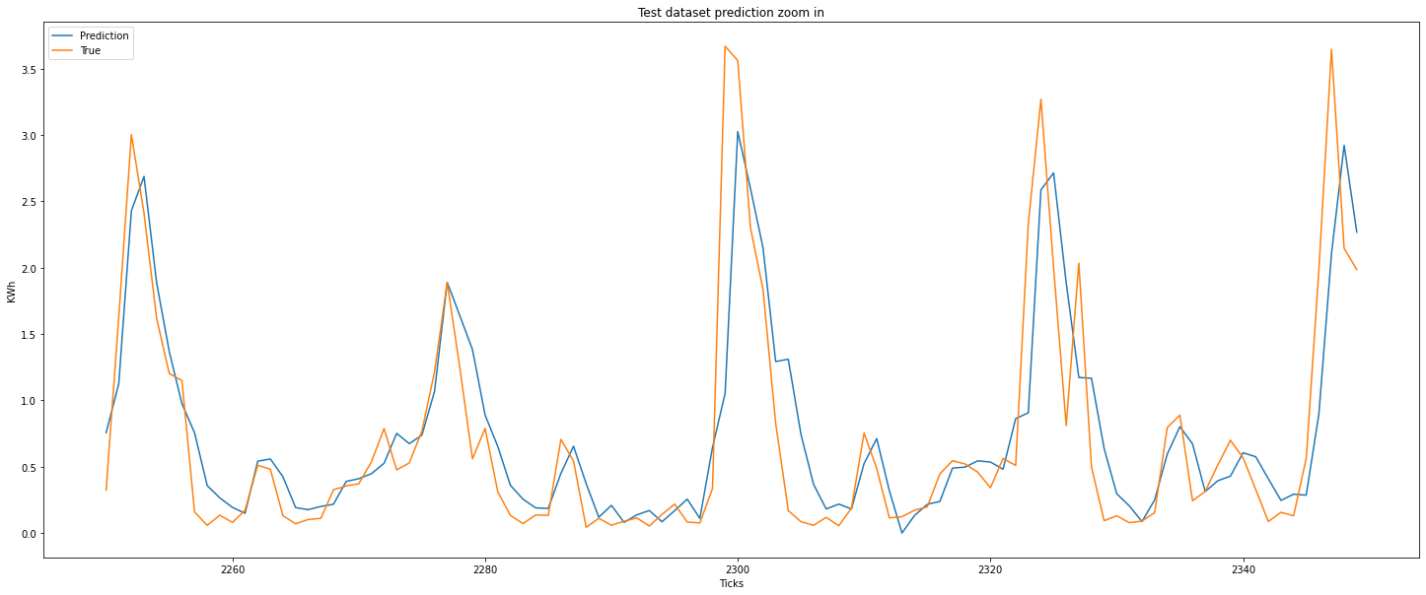
Results GPR

Slide 21
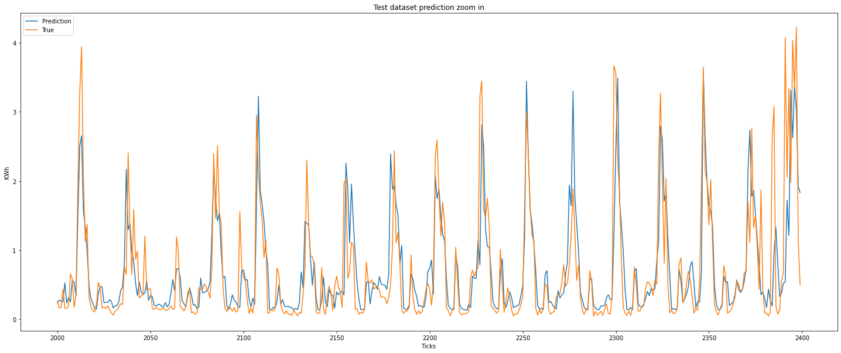
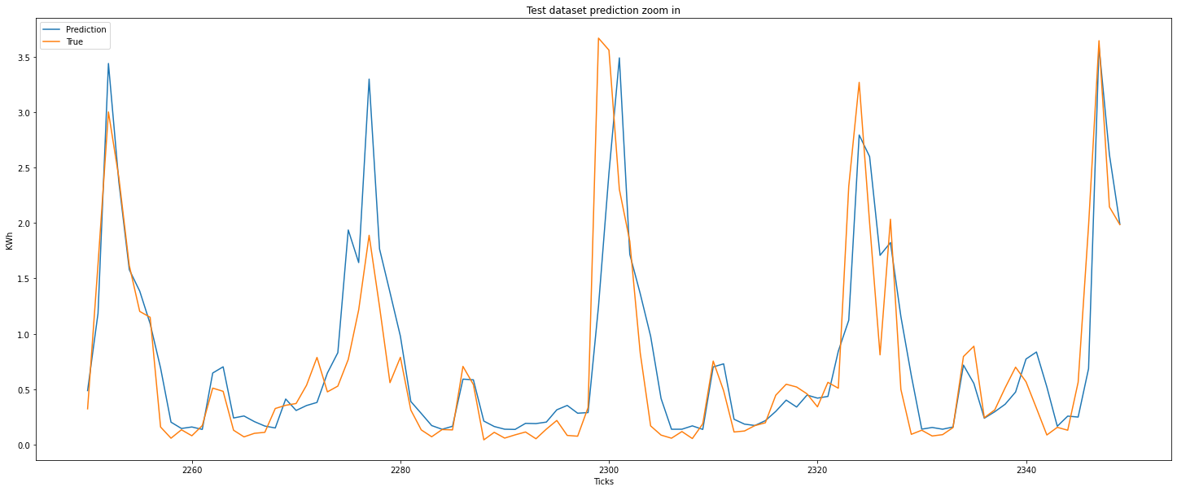
Results XGBoost

Slide 22
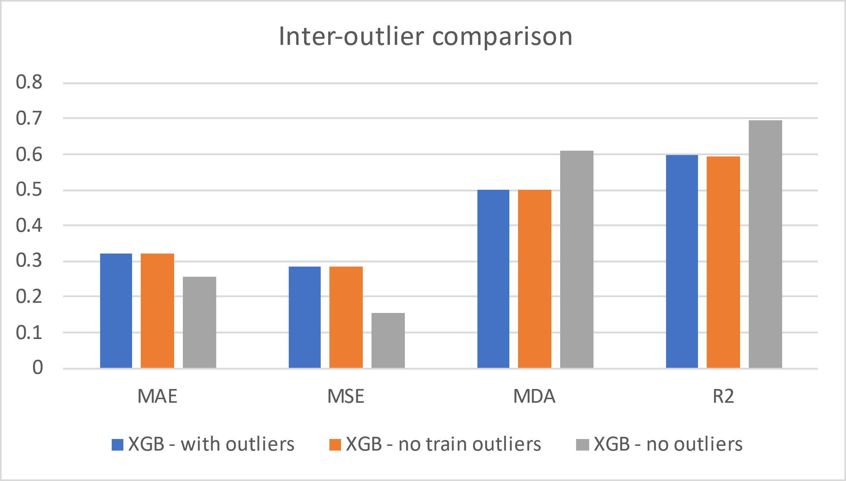
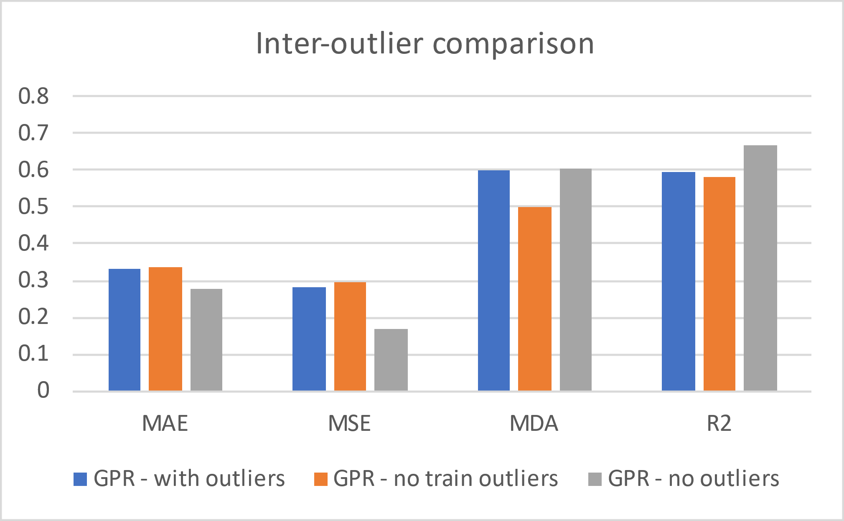
Results

Slide 23
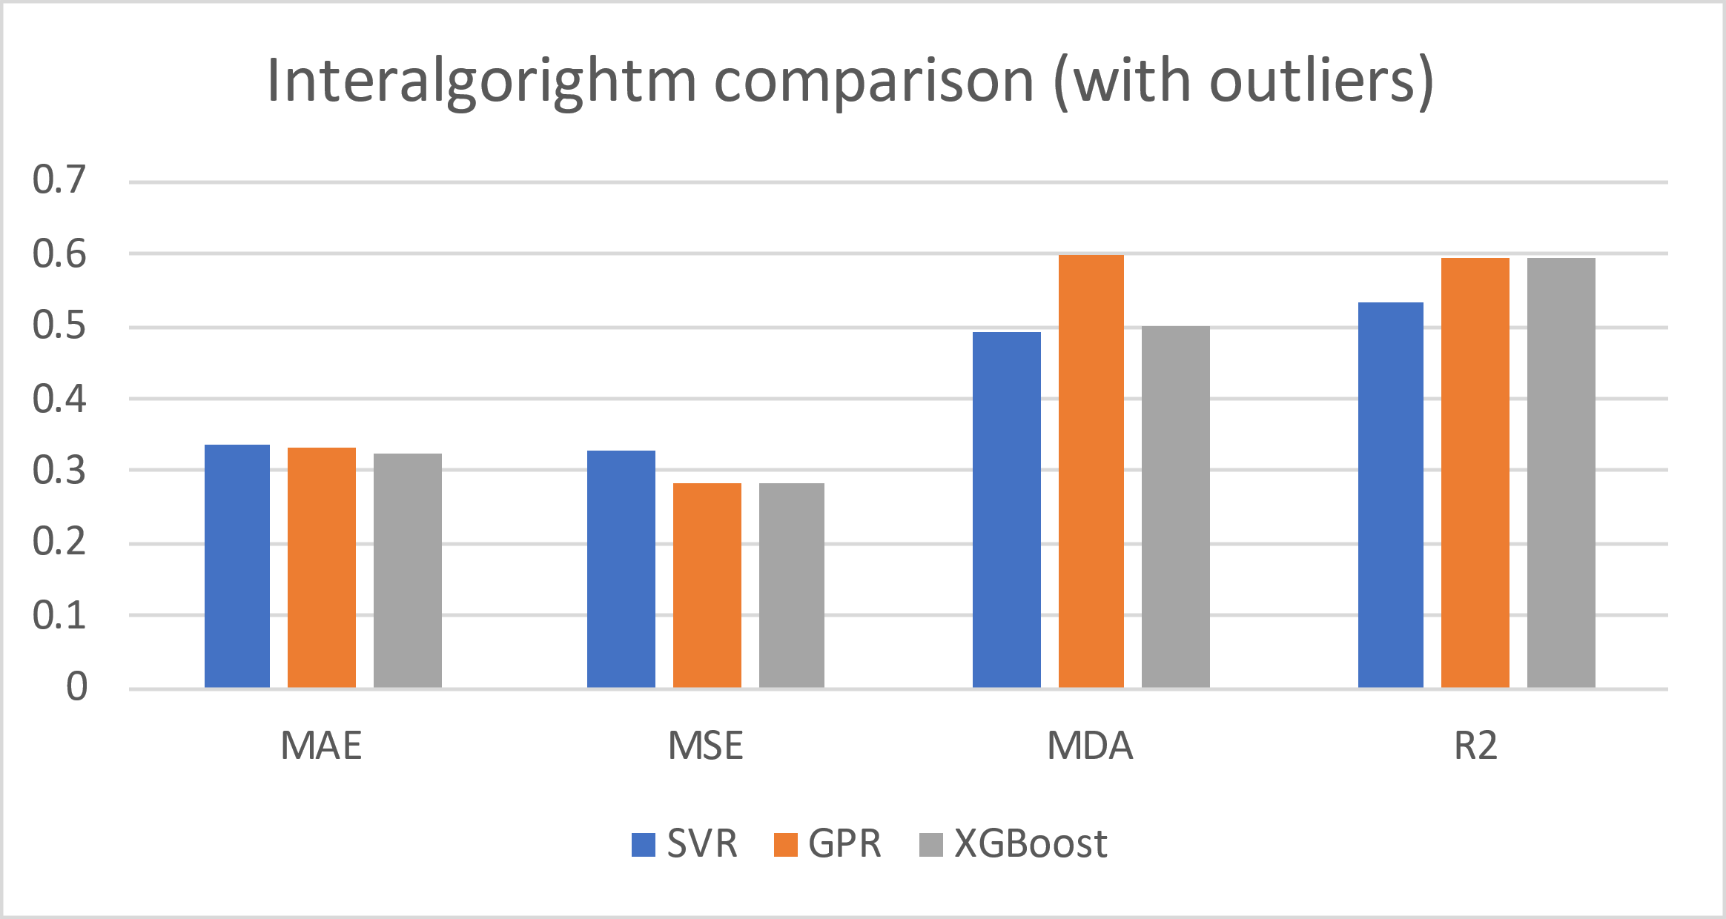
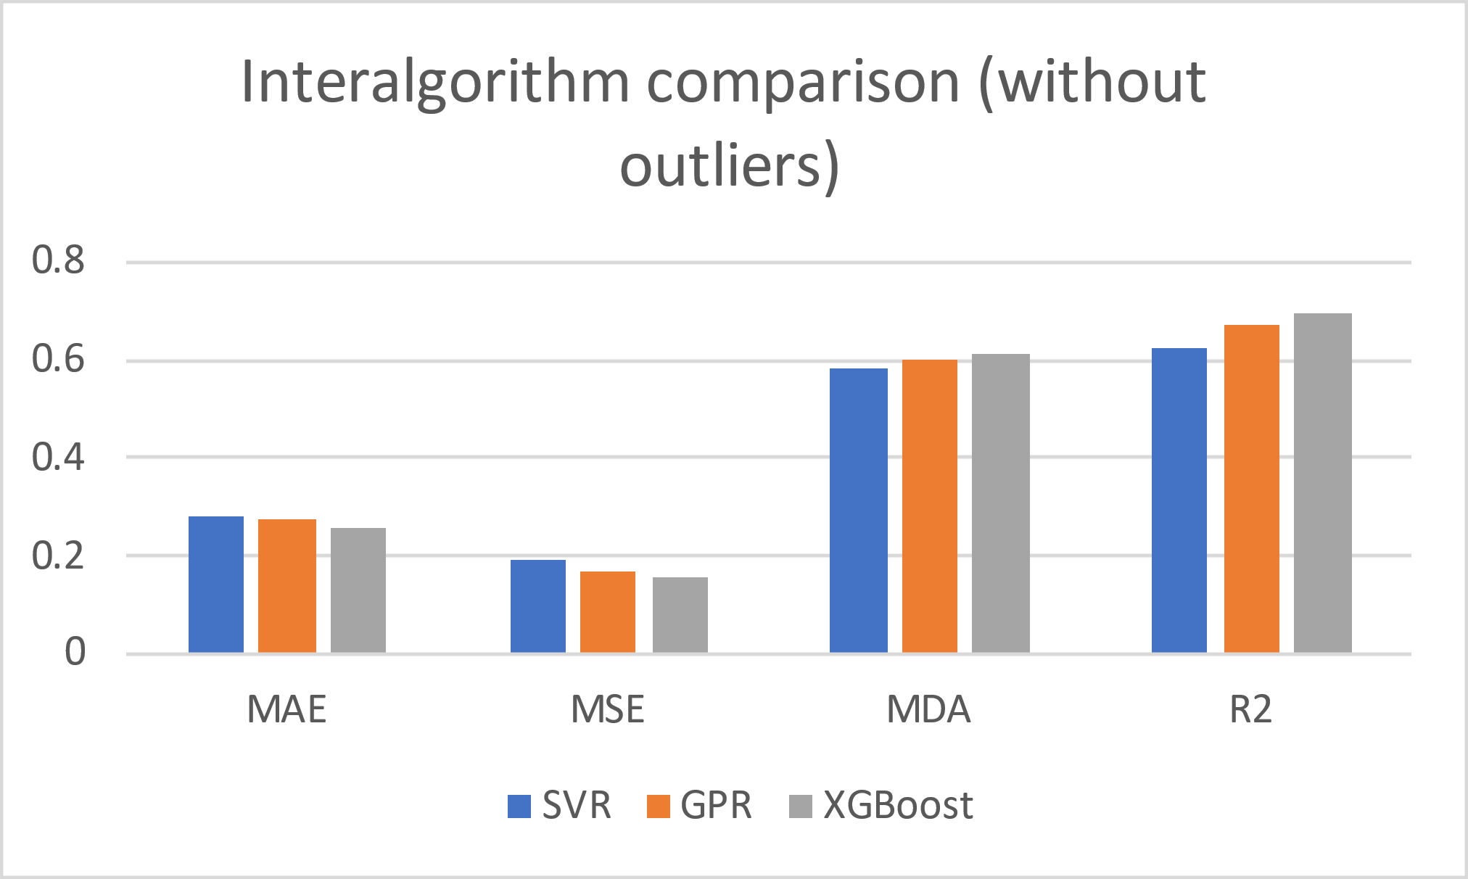
Results

Slide 24
Table of contents
Project Description
Dataset
Pre-processing
Modelling
Results
Next Steps

Slide 25
Next steps
Start implementing Meta-Learning algorithms
  MaML and Reptile model agnostic algorithms
Obtain results for various households
Analyze the results
Fine-tune the models

