Slide 1
Goals
The teacher should be able to define a custom remote host
(by giving host, port, usernames/ passwords)
The student/user should be able to login to the remote host with the given username and password by the teacher
https://github.com/maellak/edx-seminar/issues/7

Slide 2
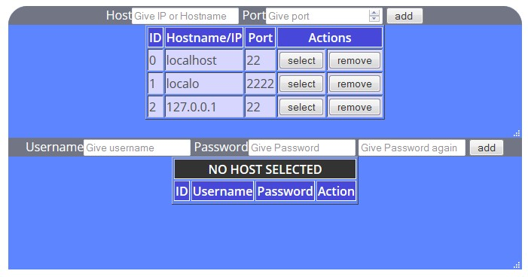
STUDIO_VIEW 1/2

Slide 3
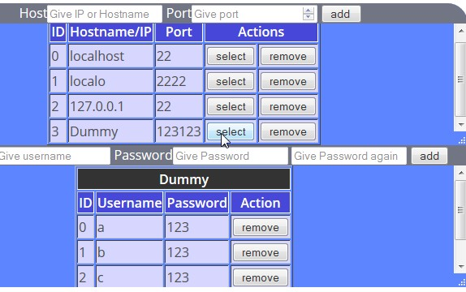
STUDIO_VIEW 2/2
The teacher can add a new host with the port
And manage the usernames and passwords by selecting the host

Slide 4
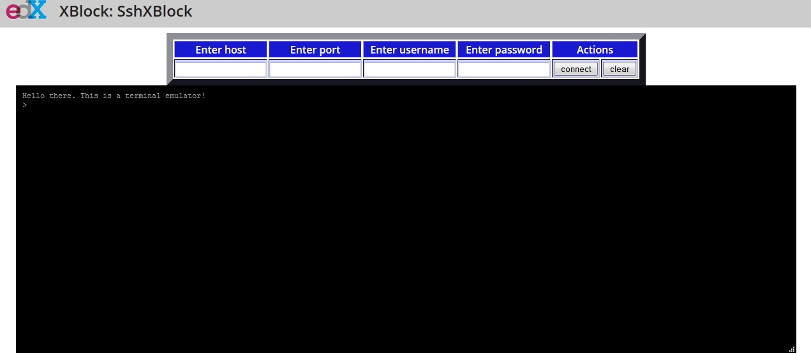
STUDENT_VIEW 1/5

Slide 5

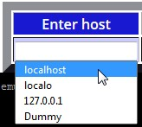

STUDENT_VIEW 2/5
The student logins with the given username
The system shows all available host and usernames for specific host
The user is now connected

Slide 6
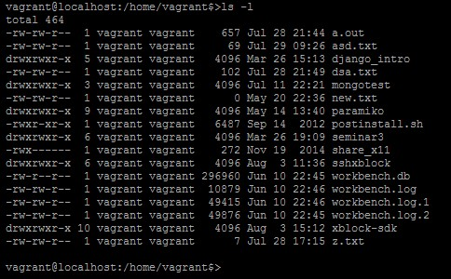
STUDENT_VIEW 3/5
The user can type simple commands like ls

Slide 7
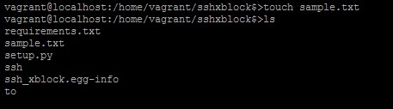
STUDENT_VIEW 4/5
The cd command
Text creation
And edit
(all commands like vi,edit,gedit,nano,pico invoke a modal window to edit)

Slide 8
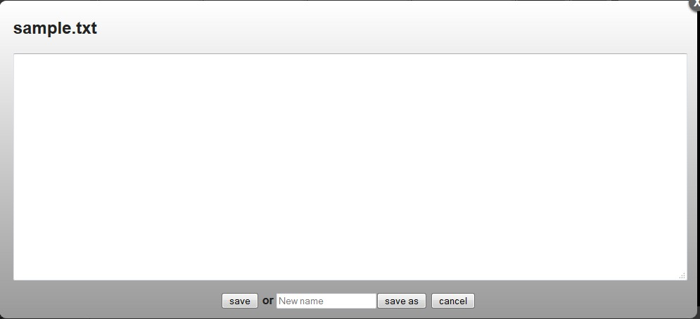
STUDENT_VIEW 5/5
Modal window for edit(user can write,save and save as)

Slide 9
CREDITS
paramiko:it is a python library that implements the ssh protocol in order to connect to the server https://github.com/paramiko/paramiko
Jquery terminal is a plugin for the jquery in order to use the terminal http://terminal.jcubic.pl/.
Generally all the commands are sent with ajax to the server and the responses are returned in JSON type

