Slide 1
Food Tracking System Phase 2
Denis Keselj, Marko Obsivac, Gabriel Muskaj 05.04.2026

Slide 2
01
02
03
Food system
Exercise system
Log system

Slide 3
Introduction
Problem: Many people struggle to track daily food intake and exercise
Puropse: Design and implement a food and exercise tracking application.
What it does:
Monitor daily nutritional intake
Track physical activity
Define custom foods and recipes
Log daily consumption
Record exercise
Track calorie balance over time
Goal: Provide users with a clear overview of their eating habits

Slide 4
Strengths and Weaknesses
Strenghts:
Clean separation between Food, Exercise, and Log systems
Repository Pattern for centralized data storage (FoodCollection, ExerciseCollection)
CSV loading and saving works correctly for all three files
Regualar communication via WhatsApp
Command Pattern - enables Undo/Redo for adding food and exercise
Weaknesses:
JavaFX configuration issues
CSV problems- skipping header line
BartChart not fully implemented, left for end
Code duplication - FoodCollection and ExerciseCollection have almost identical code

Slide 5
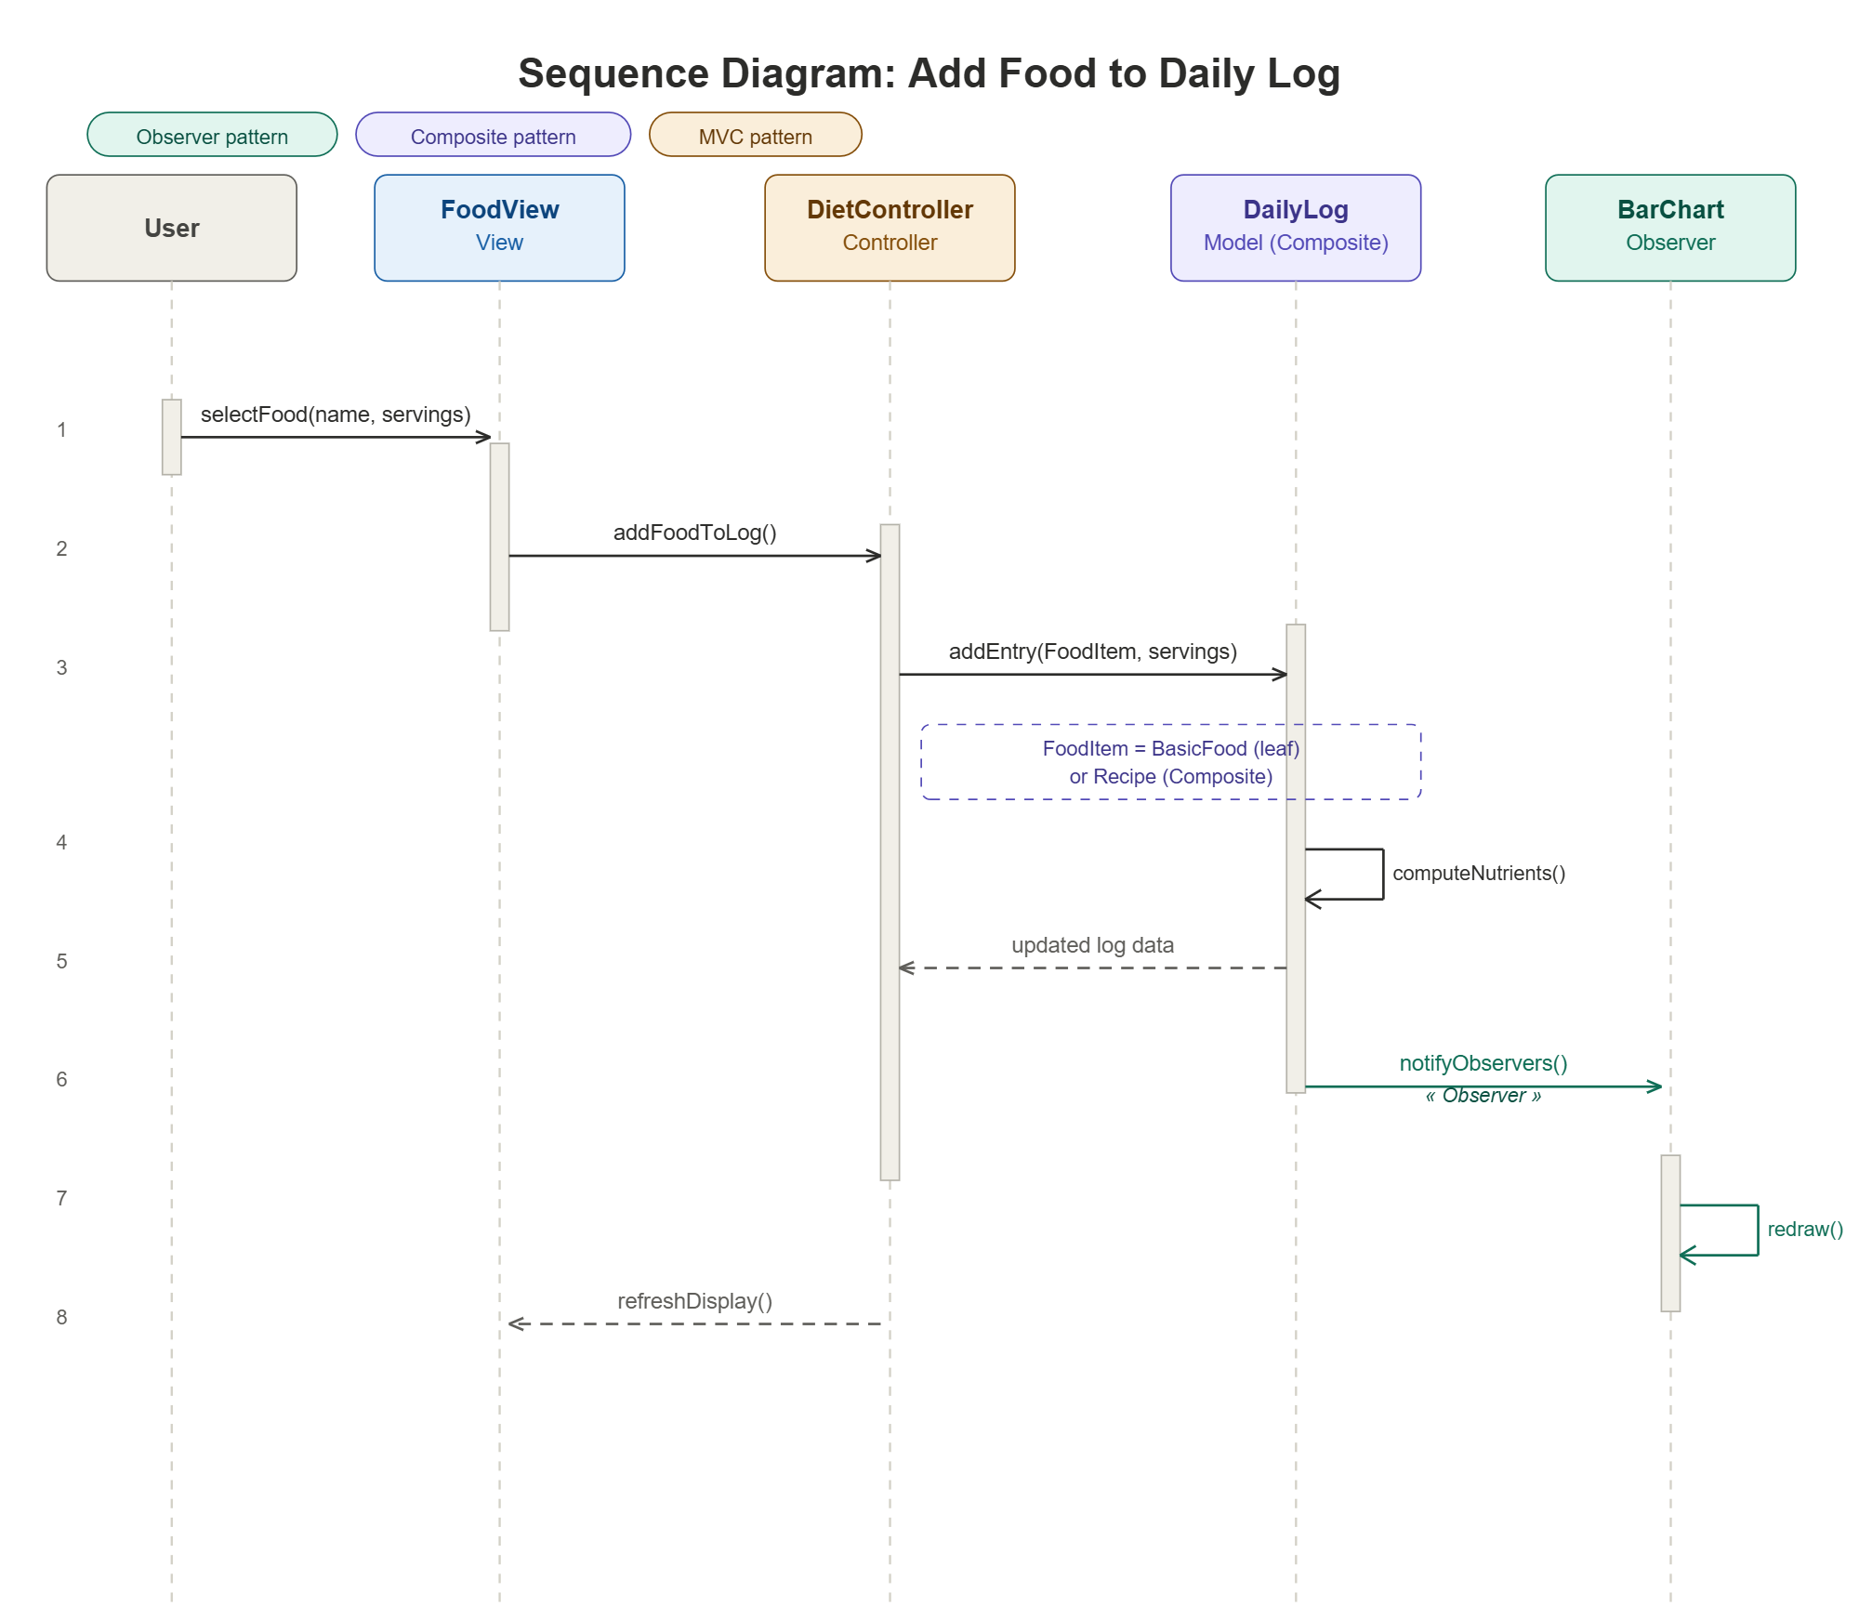
Food system
Stores and manages all food items. Allows users to add foods, search by name,
and calculate calories and nutrients for each serving.
FoodItem:
Represents a single basic food (Apple, Bread, Chicken)
Stores name, calories, fat, carbs, protein
Provides getters to access nutritional data
FoodCollection:
Manages all FoodItem objects in a HashMap
Key is food name, value is FoodItem
addFood() - adds new food to collection

Slide 6
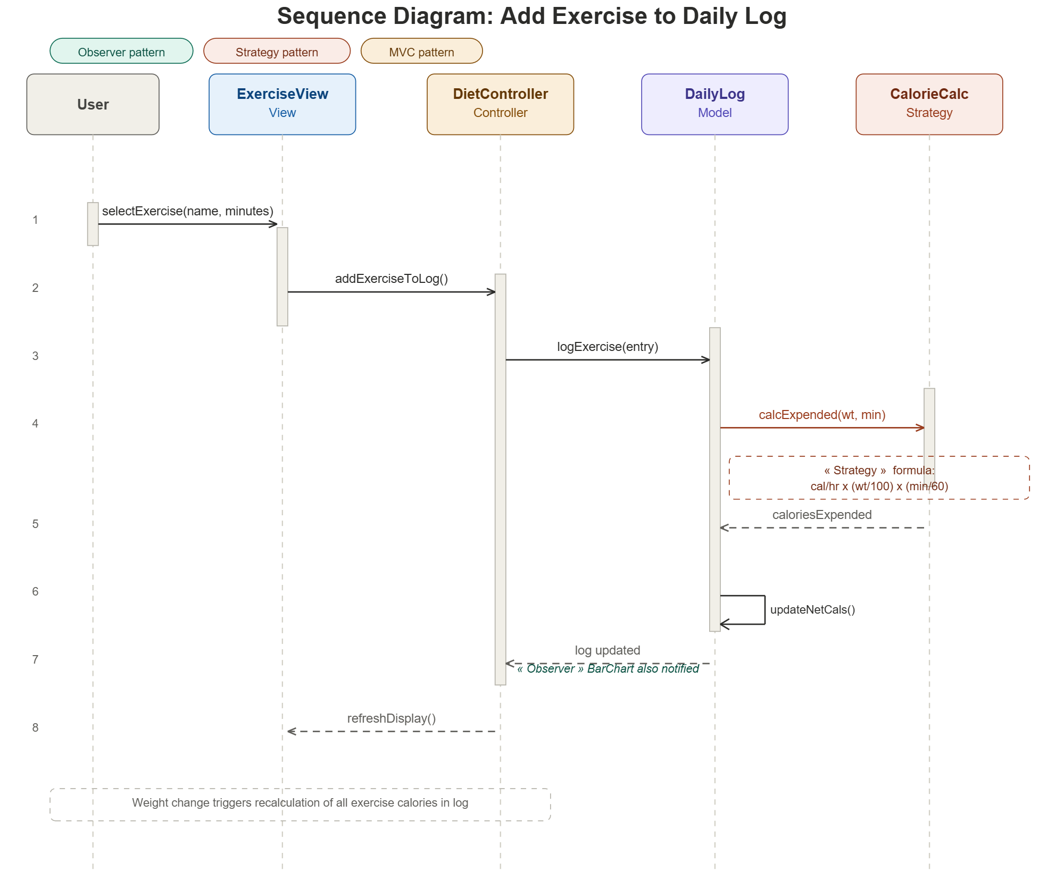
Exercise system
Stores exercise activities and calculates how many calories a user burns
based on their weight and how long they exercise.
Exercise:
Represents a physical activity (Gardening, Jogging, Swimming)
Stores name and burnRate (calories per hour for 100 pound person)
ExerciseCollection:
Manages all Exercise objects in a HashMap
Key is exercise name (lowercase), value is Exercise
ExerciseEntry: Connects an Exercise with a number of minutes

Slide 7
Log system
Tracks all user activities for a specific date. Combines food intake and
exercise, calculates totals, and shows if user meets calorie goals.
DailyLog:
Represents one single day
Stores list of LogEntry and ExerciseEntry
Stores weight and calorieLimit for that day
LogManager:
Manages all DailyLog objects in a HashMap
Key is LocalDate, value is DailyLog
Nutrients:
Stores total fat, carbs, protein in grams
Calculates percentages for display

Slide 8
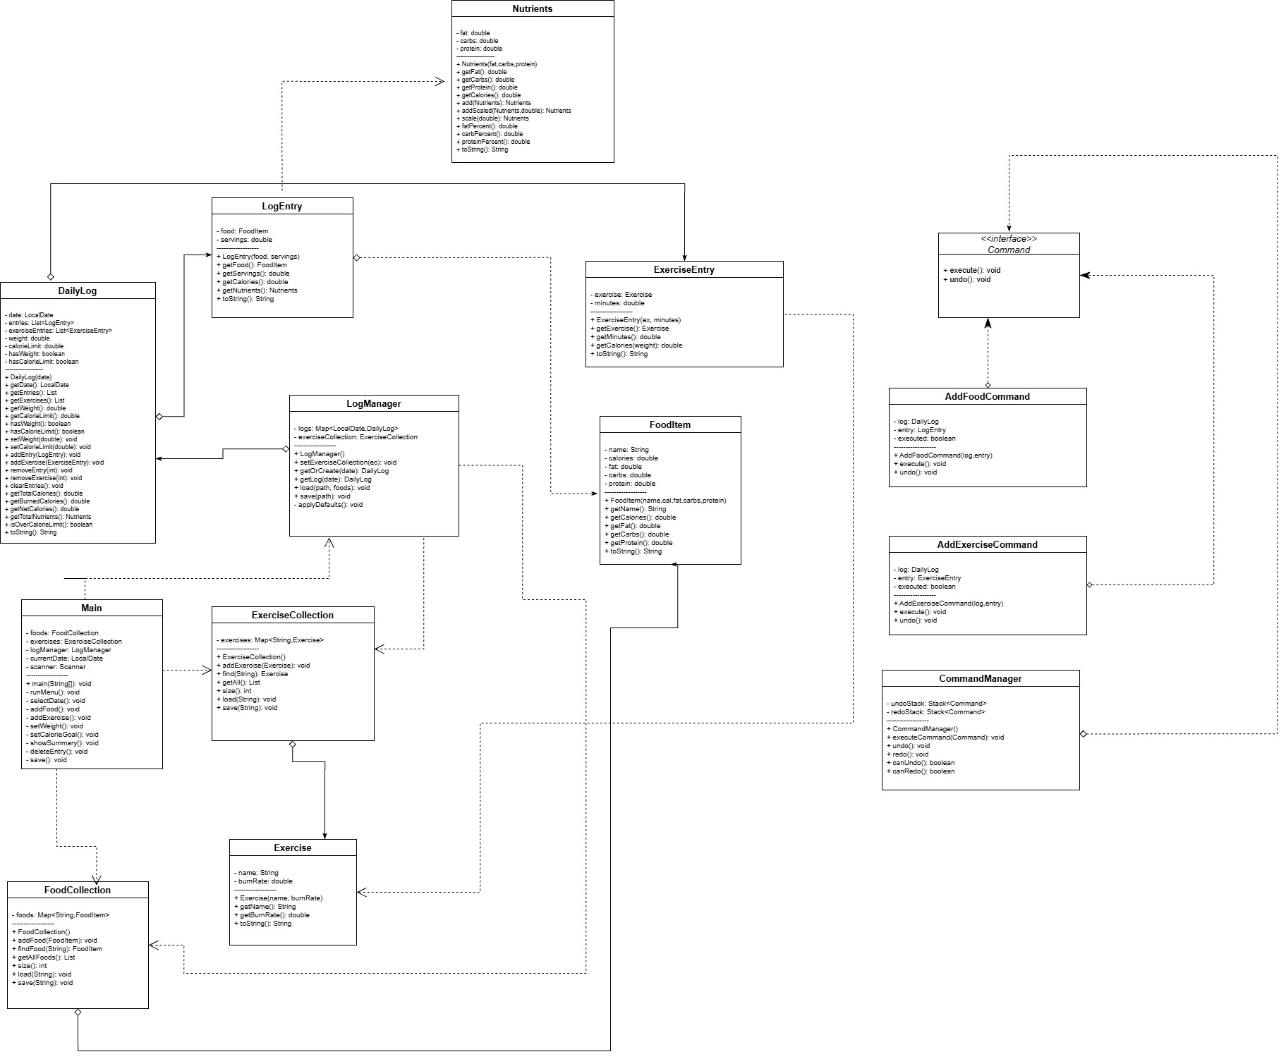

Slide 9
Thank you for your attention!!!

