Slide 1
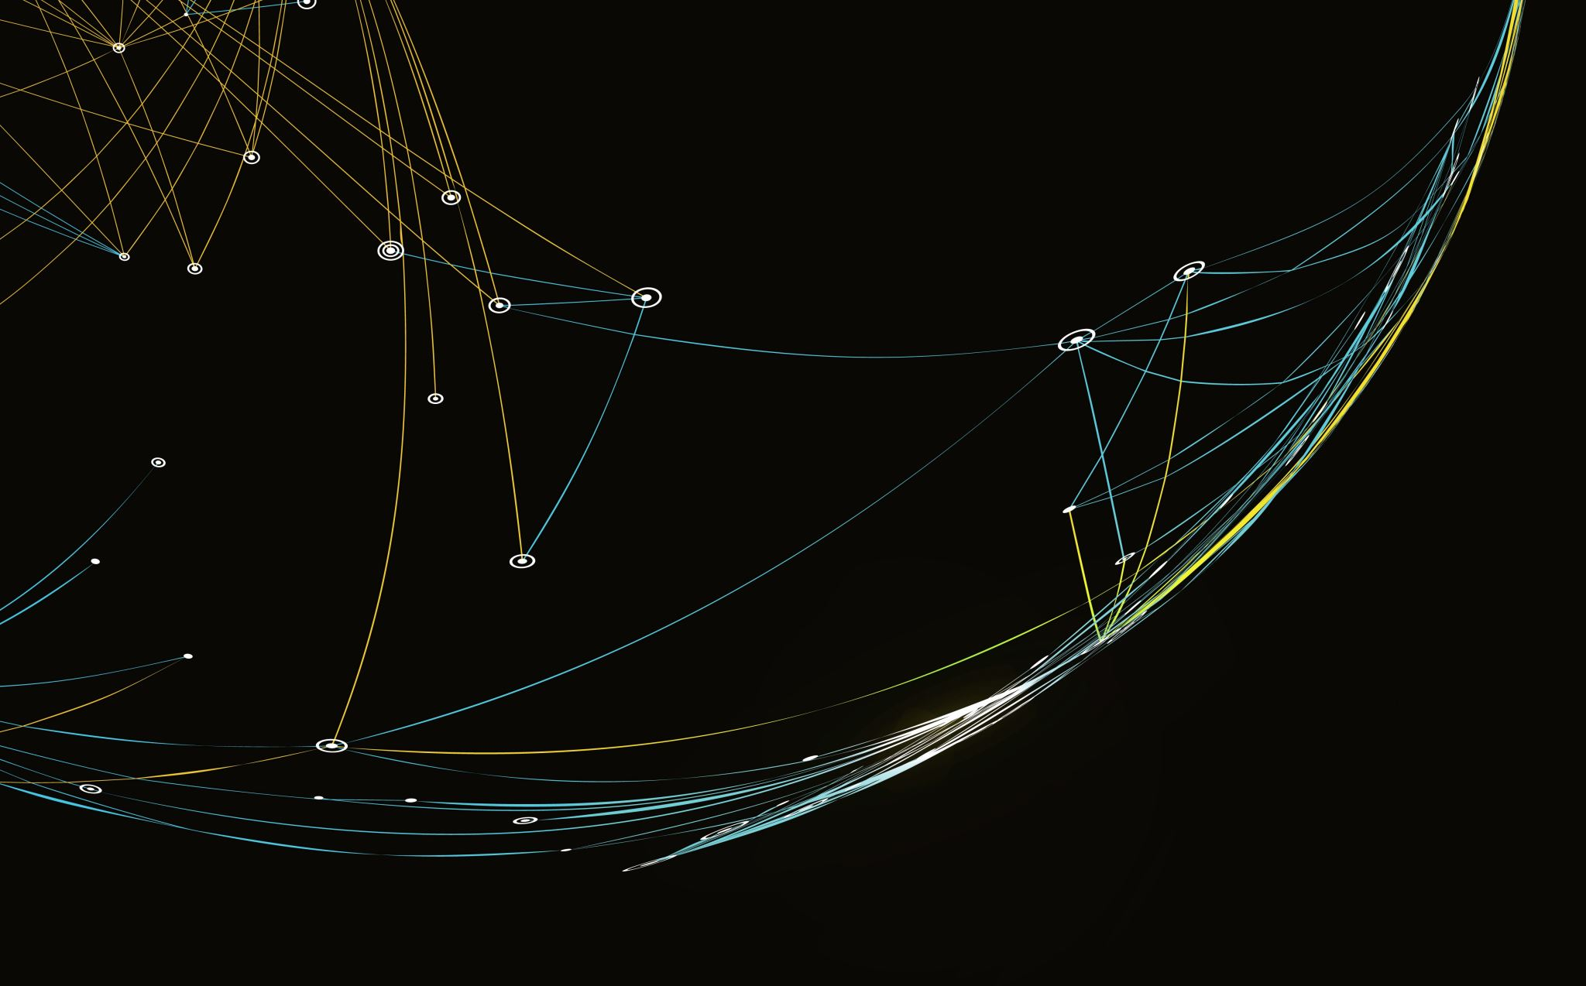
Food Tracking System Phase 1
Made by: Denis Keselj, marko obsivac and gabriel muskaj

Slide 2
Introduction: What Is the Food Tracking System?
What the app does:
Lets users build a personal food database — adding basic foods and multi-ingredient recipes
Tracks daily food intake by logging meals with serving sizes
Calculates total calories and macronutrient breakdown (fat, carbs, protein) for any given day
Persists all data between sessions using two CSV files — no database required

Slide 3
Composite Pattern: Class Structure
FoodItem (interface) — defines the shared contract: getName(), getCalories(), getNutrients()
BasicFood (leaf) — stores fat, carbs, protein, calories directly as fields
Recipe (composite) — holds a List<FoodItem, Double> of ingredients; delegates all calculations recursively to its children
Nutrients — value object used by both; addScaled() returns a new object rather than mutating
FoodCollection — manages all foods in a LinkedHashMap to preserve insertion order, which ensures no forward references
when saving/reloading CSV

Slide 4
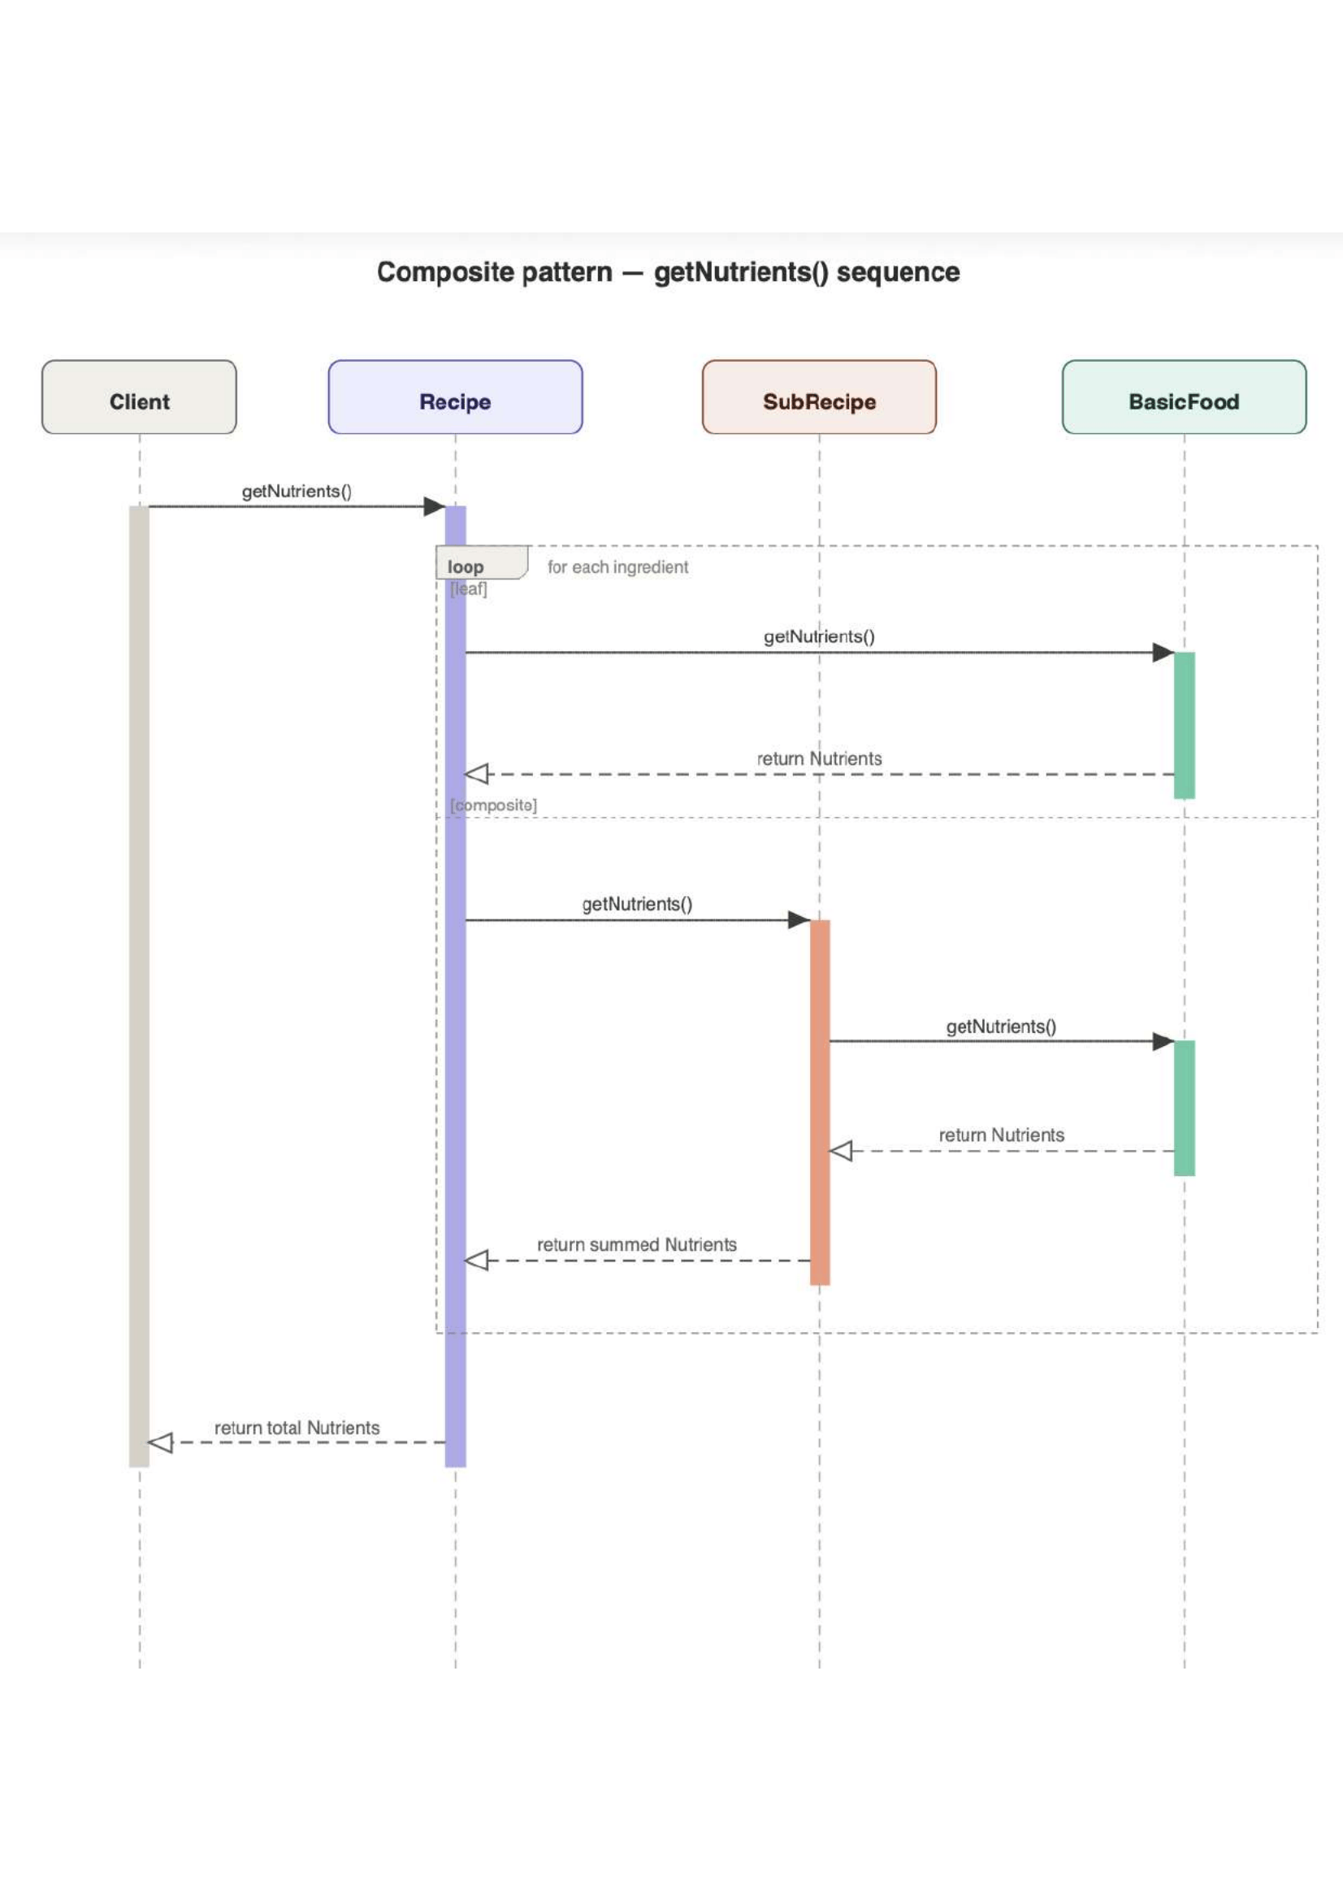
Composite Sequence: getNutrients()
Client calls getNutrients() on a Recipe
Recipe enters a loop — for each ingredient:
leaf case calls getNutrients() directly on BasicFood → gets back a simple Nutrients object
composite case calls getNutrients() on SubRecipe → SubRecipe repeats the same loop internally, asks its own BasicFood for nutrients, then returns a summed Nutrients up to Recipe
Recipe accumulates all results and returns the final total Nutrients to the Client

Slide 5
FoodCollection — Managing All Foods
Central storage for all food items
Loads data from foods.csv
Allows searching food by name, and provide acess to a food data
Provides FoodItem objects to the rest of the app
Used by AppController to add food to logs

Slide 6
FoodItem and BasicFood
FoodItem - defines common behavior for all food types
Methods: getName(), getCalories(), getNutrients()
Used by all food-related classes
BasicFood – represents simple food items (e.g. apple, bread)
It is a leaf object, and it implements FoodItem interface
Stores fixed nutritional values
Implements FoodItem interface

Slide 7
AppController
Central controller of the application
Connects key components: FoodCollection (food data) and LogManager (daily logs)
Responsibilities: handles user input, processes commands, and managing current date
It takes the food from FoodCollection, then gets DailyLog from LogManager, and then it stores o nright date

Slide 8
LogEntry
LogEntry represents a single food entry in the system
It contains a reference to a FoodItem and a quantity value
It is responsible for calculating total calories based on quantity
It acts as the basic data unit within the logging module

Slide 9
DailyLog
DailyLog represents a collection of LogEntry objects for a specific date
It aggregates all entries to represent total daily intake
It provides methods for calculating total calories and nutrients
It may also store additional metadata such as weight and calorie limits

Slide 10
LogManager
DailyLog represents a collection of LogEntry objects for a specific date
It aggregates all entries to represent total daily intake
It provides methods for calculating total calories and nutrients
It may also store additional metadata such as weight and calorie limits

Slide 11
Thanks for your attention!!!

