Slide 1
UpMeet
By Biwot Denis Kipkoech

Slide 2
Background
The rise of office-less jobs and companies and collaboration tools.(e.g GitHub)
We cannot completely eliminate offices
UpMeet provides such companies or people (freelancers) a way of acquiring office space for the period they require (as short as a day) without having to pay a full month’s rent. (Reduce overhead costs)
The system is mobile based to utilize the use of mobile specific features like GPS, availability, STK intergration and push notifications.
Impact of COVID-19 (Adaptation)

Slide 3
Problem definition
Change in viable business models mean office spaces and facilities are not as crucial as they were before.
A means for facility lease for a shorter period is required to ensure reduction of overhead costs on employees, freelancers and companies.

Slide 4
Project Objectives
The main goal of this undertaking is to allow for reservation and payment of cataloged meeting and office facilities for a period shorter than a month by developing an application that:
Enables venue owners to add their venues and corresponding facilities
Enable facility seekers to find appropriate venues based on prices and appearance and location.
Allow owners to add their venue locations and populate on the map using Google Places API

Slide 5
Project Objectives - Continued
Create a system that …
Acquires seekers location and displays venues closest to him/her
Enable seekers to reserve space and
Integrates with Daraja M-pesa for easy mobile payment
Provide the user with support navigating the application

Slide 6
Literature Review
Experts believe the future of offices is no offices at all. Employees won’t have to go to work every day as it is in the current workplace setup. Employees could be anywhere in the world but still fulfil their stipulated obligations.
Similar Systems
Picktime
Skedda
Planning pod

Slide 7
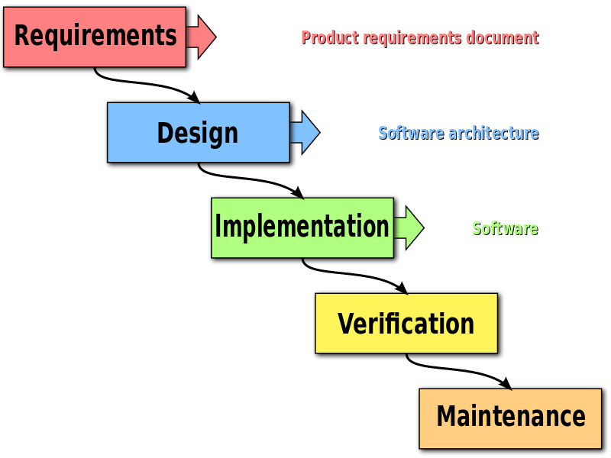
Methodology
Waterfall model used for development
Incremental approach

Slide 8
Win-Win
The system has two users and both benefit from the system.
Venue Owner
Exposure
Marketing
Reservation (Revenue generation)
Venue Seeker
Reduced overhead costs
Easy search (Catalog)
Easy reservation and payment

Slide 9

Thankyou
Demo incoming

