Slide 1
CC2_EXTRAPOLATED BODY
Control a generative medium using the body as a reference

Slide 2
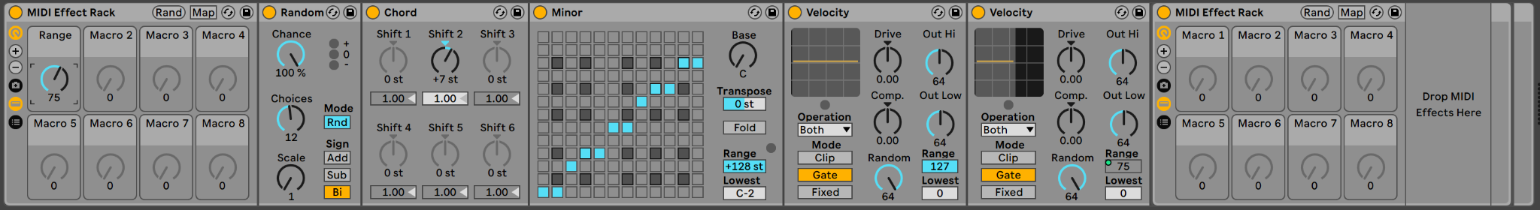
Generative Audio Composition in Ableton Live
Using built in Live’s MIDI FX, I was able to create a probability ensemble that generates audio using a trigger which is a single midi note.
Transforms the written MIDI note into others
Makes sure all notes harmonically fit in the composition
Velocity Object is used in GATE function to act as a MIDI note filter. The first one passes thru all the notes and the second Velocity object filters them. This link can be nested further and transformed into chains covering different spectrum areas or as desired.
Increases the probability and generated content

Slide 3
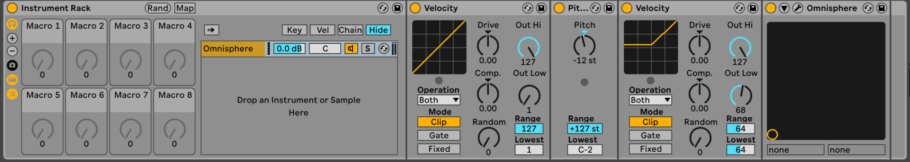
Soundsource
Here, velocity is used in the traditional way, increasing or decreasing the note amplitude

Slide 4
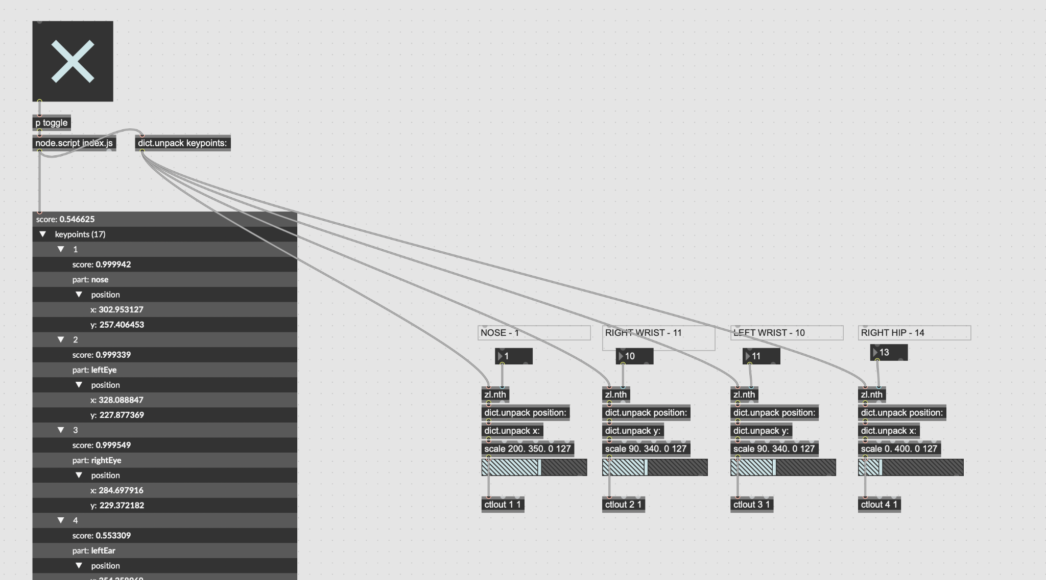
Body Interaction
As for the interaction, I use MAX MSP to reference the skeleton key points with POSENET, specifically the nose, right wrist, left wrist and the right hip. The musical reaction can be seen in the performance video in the next slide.

Slide 5
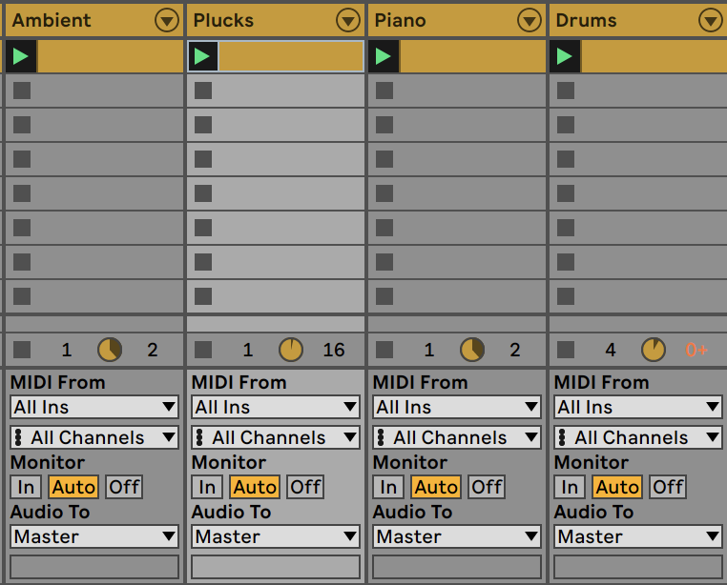
Skeleton - Composition Interactivity
Here in the Live’s session view you can see the one note midi clips being played. The nose controlled the ambient, the left hand played the piano, the right hand played the plucks and my right hip played the drums. All in all, this created a generative ensemble.

Slide 6

Performance

