Slide 1
Who Wrote This Tweet? Detecting Human vs. LLM-Generated Text on TweepFake
Denis Malasi Deep learning 24/25
Notes:
Good morning everyone, I’m Denis Malasi, and today I’ll present my project that consists on detecting human versus bot tweets. We’ll start with classical machine‑learning using an SVM, move on to a character‑level CNN with internal probes, and finally explore a Transformer‑based approach with BERT. By the end, you’ll see how each model performs, where they excel, and what their limitations are in distinguishing real users from automated accounts.

Slide 2
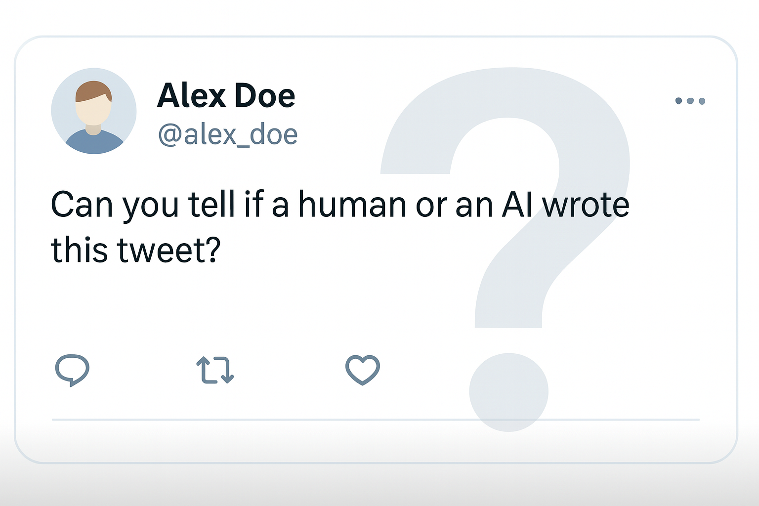
Motivation & Problem
LLM text is everywhere on social media
Trust, moderation, and spam are at risk
Need to tell human vs AI reliably
Tweets are short, noisy → weak signals
Notes:
Large language models now generate huge amounts of text online, including tweets. That raises issues for platform trust, content moderation, and spotting coordinated spam or misinformation. Our task is a binary classification: human-written vs AI-generated. However, tweets are short, informal, and full of noise—URLs, emojis, slang—so the signal for detection is weak. Moreover, models keep improving, so any detector must be robust and adaptable.

Slide 3
Project goals
Use the TweepFake English tweet dataset
Train & compare SVM, CNN, Transformer
Main metrics: Accuracy & F1-score
Interpretability: top discriminative words
Notes:
I work on the TweepFake dataset of English tweets. I compare three models: an SVM with TF‑IDF, a CNN, and a BERT-base-uncased transformer. I tune hyperparameters for all three so the comparison is fair. Since the classes are balanced, I focus on Accuracy and F1 as main metrics. For interpretability, I look at the top words/features that push the prediction towards human or bot

Slide 4
Dataset

Slide 5
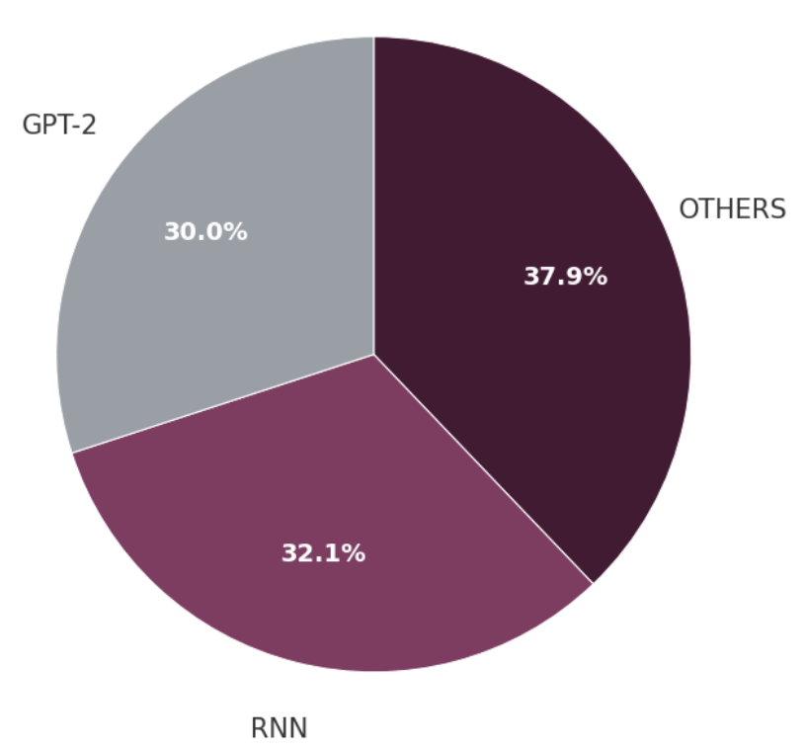
TweepFake: How It’s Built
17 real Twitter users (English) selected as targets
Their tweets scraped → human class
LLM / text models (GPT‑2, RNN, Markov, LSTM…) trained on those tweets to mimic the style
23 bot accounts posted the generated tweets
Notes:
TweepFake was built in a pretty specific way. First, the authors selected 17 real English‑speaking Twitter users—these are our human references. They scraped their tweets to form the human class. Then, they trained a set of LLMs and other text models—like GPT‑2, RNNs, Markov chains, LSTMs—on each user’s tweets to mimic that person’s style. Those models didn’t just stay offline: 23 separate bot accounts were created and actually posted the generated tweets on Twitter. Finally, all of these tweets—human and bot—were collected into one dataset. That’s how we get a balanced corpus of real versus machine-generated tweets.

Slide 6
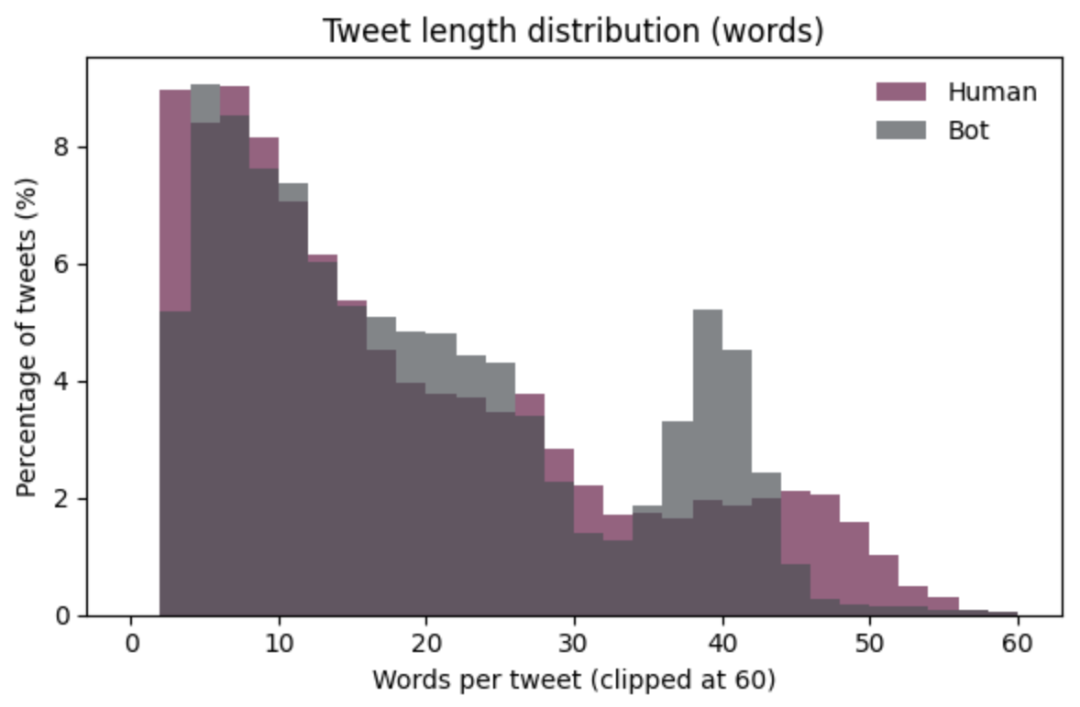
TweepFake: Stats & Splits
25,572 tweets → Perfectly balanced
Avg words: 18.4 (H) vs 18.8 (B)
Avg chars: 117.5 (H) vs 104.5 (B)
81 / 9 / 10 (Train/Val/ Test)
Balanced in each set
Notes:
Il dataset conta 25.572 tweet, perfettamente bilanciati: metà umani e metà bot. Ho mantenuto lo split ufficiale 81/9/10 per train, validation e test, e ogni split rimane bilanciato. In media i tweet sono molto brevi: circa 18 parole; gli umani usano leggermente più caratteri. Nel grafico vedete la distribuzione delle lunghezze (clippata a 60 parole): le due curve si sovrappongono parecchio, segnale che la sola lunghezza non basta a distinguere le classi. Questo giustifica l’uso di feature più ricche e modelli diversi. Passiamo quindi a… (preprocessing / modelli).

Slide 7
Structural Differences (Human vs Bot)
Feature | Human | Bot | Human/Bot ratio
Links | 0.43 / tweet | 0.03 / tweet | 17.5× more
Mentions | 0.49 / tweet | 0.13 / tweet | 3.8× more
Hashtags | 0.08 / tweet | 0.045 / tweet | 1.8× more
Emoijs | 0.31 / tweet | 0.18 / tweet | 1.7× more
Punctuation Marks | 6.2 / tweet | 3.8 / tweet | 1.6× more
Uppercase Words | 0.43 / tweet | 0.32 / tweet | 1.3× more
Lexical Diversity | 0.95 | 0.92 | +3%
Notes:
“This table compares simple structural cues in human vs bot tweets; higher values mean ‘more of that thing per tweet’. The last column is how many times more humans use it compared to bots.”
“Humans drop links a lot—roughly one every two tweets—while bots almost never do. Bots were auto‑posting text, not sharing URLs.”
“Humans talk to each other; bots don’t @-reply much. So social interaction features are strong signals.”
“Humans show more expressive markers—emojis, punctuation bursts—while bots stay plainer.”
“There’s a small bump in fully uppercase words for humans; still minor compared to links/mentions.”
“Humans use slightly richer vocabulary—tiny effect.”
“Bots repeat words more often—expected for model-generated text.”
“Lexical diversity is the share of unique tokens;”
I measure lexical diversity as the ratio of unique words to total words. When applied to the entire dataset

Slide 8
SVM

Slide 9
TF‑IDF & Linear SVM
TF‑IDF
TF = term frequency in the current tweet
IDF = rarity across all tweets
TF‑IDF = TF × IDF → distinctive terms ↑, ubiquitous terms ↓
Linear SVM
Margin‑based linear separator on sparse TF‑IDF vectors
Hinge loss + C regularization → large margin, good generalization
Notes:
TF‑IDF turns each tweet into a sparse vector: TF says how often a term appears in this tweet, IDF down‑weights terms that everyone uses. Multiply them and you boost distinctive words while common ones vanish. Then I feed those vectors to a linear SVM, which just finds the widest possible margin between the two classes, using hinge loss and a regularization term C. The nice part is that most well‑separated points drop out of the loss, so the model focuses on the hard boundary. Together, TF‑IDF + SVM is a fast, strong combo for short, noisy text and it stays interpretable.

Slide 10
Text Cleaning & Normalization
Lowercase + HTML unescape + Compress multiple spaces
Replace URLs → __url__, mentions → __user_mention__
Remove “#” but keep the hashtag word
Raw: "OMG!!! Check this out: https://t.co/xYz @John #AI #DeepLearning"
Clean: "omg !!! check this out __url__ __user_mention__ ai deeplearning"
Notes:
Lowercase and HTML-unescape to avoid duplicated tokens. I replace URLs and @mentions with special tokens — __url__ and __user_mention__ — so the model sees a stable marker instead of thousands of unique links and handles. I remove only the ‘#’ symbol but keep the hashtag word to preserve meaning. Finally, I compress multiple spaces. This cleaning matches the TweepFake baseline preprocessing and is applied consistently to train, validation, and test.

Slide 11
Hyperparameter Tuning (5-fold CV)
5-fold stratified CV on Train+Val:
TF-IDF: (1,3) n-grams with 25.000 features
Linear SVM: C=1, hinge loss and no stopwords removal
Mean CV accuracy: 82.5%
N-Gram Range | CV accuracy
(1,1) | 81.3%
(1,2) | 81.5%
(1,3) | 82.5%
(1,4) | 82.4%
Notes:
We performed a grid search over TF‑IDF and SVM hyperparameters using 5‑fold stratified CV on our combined Train+Validation set—keeping Test completely untouched. We tested various settings but found the biggest gain came from using 1–3 word n‑grams (top 25 k features). The optimal classifier was a linear SVM with C = 1 and hinge loss, and we kept all words (no stopword removal). This setup achieved an average CV accuracy of 82.5%, which we’ll now evaluate on the held‑out Test set.

Slide 12
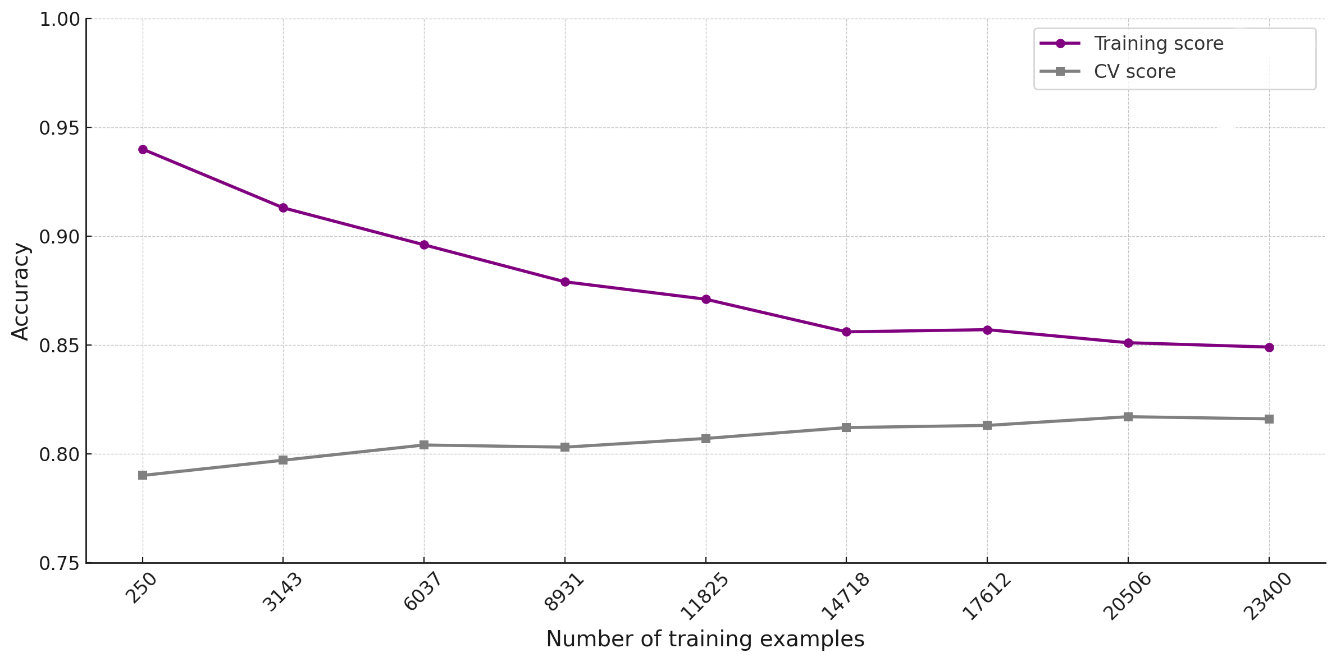
SVM Learning Curve: Training vs. CV Score
Notes:
On this slide you can see the learning curve of our SVM classifier, with the purple line showing the training score (shifted up slightly for clarity) and the gray line the 5‑fold cross‑validation score. We vary the number of training examples from 250 all the way up to 23 400—note that the TF‑IDF feature space (25 000 n‑grams) stays fixed throughout.
At small sample sizes the training score is very high because the model can almost memorize the limited data. As we add more examples, the training performance drops to a more realistic level and stabilizes, converging toward the CV score. The fact that the gap between these two curves remains small and consistent indicates that our model is generalizing well and not overfitting.

Slide 13
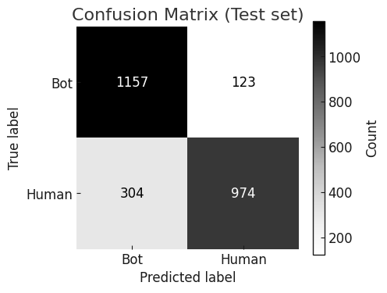
Final Test Performance
Metric | Bot | Human
Precision | 79.2% | 88.8%
Recall | 90.4% | 76.2%
F1-score | 84.4% | 82.0%
Final Accuracy on test set: 83.3%
High bot recall (90.4%) → few missed bots
Human precision high (88.8%) → few false alarms
Notes:
Questa è la performance finale dello SVM sul test set: otteniamo l’83,3 % di accuracy e un macro‑F1 di circa l’83 %. Guardando più in dettaglio, per i bot raggiungiamo un recall elevato (90,4 %), quindi perdiamo pochi bot reali, ma la precisione è leggermente più bassa (79,2 %) perché qualche tweet umano viene scambiato per bot. Al contrario per gli umani abbiamo precisione alta (88,8 %) ma un recall più basso (76,2 %), quindi siamo cauti nel chiamare “human” un testo dubbio. La confusion matrix mostra graficamente questi trade‑off (in alto a sinistra e in basso a destra i valori più alti). Nel complesso il modello è ben bilanciato e generalizza sul dato mai visto

Slide 14
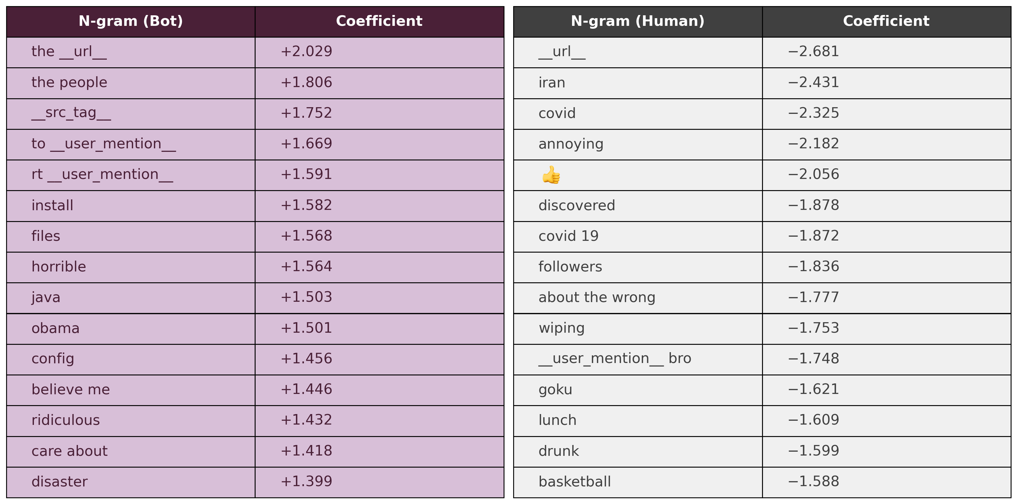
Top 15 Predictive N‑grams for Bot vs. Human Tweets
Notes:
Let’s compare the linguistic patterns captured by our SVM in human‑written versus bot‑generated tweets.
Human tweets tend to feature colloquial, personal and topical language:
Words like impeachment, iran, covid and covid 19 reflect genuine discussion of current events and personal experiences.
Terms such as annoying, lunch, drunk or basketball point to informal, everyday life moments and emotions.
Tokens like discovered or followers reveal narrative, exploratory or social‑network contexts that typical users share.
Bot tweets, by contrast, rely heavily on technical, promotional and templated constructs:
Frequent use of placeholders and links—e.g. the __url__, __src_tag__, rt __user_mention__—indicates automated retweets and feed‑push templates.
Action‑oriented words like install, files, config show bots pushing software or downloads.
Sensational or persuasive phrases such as horrible, believe me, ridiculous are common in click‑bait or promo scripts.
A final note on URLs:
The standalone __url__ token is actually more common in human tweets (negative coefficient), because genuine users tend to paste or share links in a “clean” context.
In contrast, bots often embed URLs inside templated phrases like the __url__, which carries a strong positive coefficient for the Bot class—signaling automatic call‑to‑action constructs rather than natural link sharing.
In short, human tweets exhibit organic, conversational vocabulary, whereas bot tweets display structured, goal‑driven terminology—a clear distinction our model exploits to tell them apart.

Slide 15
Example Tweets & Prediction Outcomes
True Human:
'hahah 😄 👍 __url__' → score: -2.578
True Bot
'I thank the government in the people of the development is the programme of the republic of mangal for the state' → score: +2.852
False Positive (human predicted as bot)
'I am seeking 250k investment in exchange for 10 equity' → score: +0,882
False Negative (bot predicted as human)
'old pinned tweet __url__' → score: -1.558
Notes:
You see a negative decision score (–2.578), meaning the model is confident it’s human‑authored. The casual laughter and emoji usage (😄, 👍) plus a simple link placeholder are hallmarks of genuine tweets.
Here the high positive score (+2.852) correctly flags a bot: notice the stilted phrasing, repetitive template (the people of the development …), classic signs of automated messaging.
È un tweet business-oriented, scritto in modo freddo e professionale, senza elementi “umani” evidenti come emoji o opinioni.
Il modello è stato tratto in inganno perché manca di segnali umani forti e il linguaggio sembra "costruito".
Questo esempio mostra uno dei limiti del modello: fatica con contenuti professionali o promozionali scritti da umani.
__url__ è un forte indicatore umano (−2.681), e probabilmente ha pesato molto nella decisione.
Tuttavia, la struttura è molto generica e neutrale, poco personalizzata.
Questo esempio mostra che i bot possono usare anche frasi semplici e ingannevoli che imitano l’umano, e quindi trarre in inganno il modello.

Slide 16
SVM Classifier – Limitations
Uneven performance by bot type:
GPT‑2: 76.0%
RNN: 94.7%
Others: 95.1%
Ambiguous or overly formal/promotional tweets often misclassified
Generic phrasing reduces discrimination in edge cases
Notes:
Uneven performance by bot type We see that GPT‑2–generated tweets are the hardest to catch, with only 76 percent accuracy, whereas RNN and ‘other’ bots are detected much more reliably. This suggests our feature set is better tuned to older or simpler generation patterns, and struggles with more fluent, transformer‑based output.
Ambiguous or overly formal/promotional tweets Tweets written in a business‑style or promotional tone—despite being human—often lack the social markers like emoji or colloquial phrasing that our model uses to flag humans. As a result, these messages can be mistaken for bot output.
Generic phrasing reduces discrimination in edge cases Very short or neutral statements—such as “old pinned tweet url”—don’t carry enough unique linguistic signals, so the model defaults toward the stronger n‑gram indicators, leading to occasional misclassifications.

Slide 17
CNN

Slide 18
Char‑CNN Overview
Input: raw tweet as a sequence of characters
Embedding: character embedding layer
Convolutions: multiple 1D filters to capture local character patterns
Activation: tanh applied after each convolution
Pooling: global max‑over‑time to extract the strongest feature per filter
Dropout: regularization to prevent overfitting
Classification: bot vs. human prediction
Notes:
Questa slide mostra il flusso generale della nostra Char‑CNN. Partiamo dal tweet in input, che trattiamo come una semplice sequenza di caratteri — senza tokenizzazione a livello di parola. Ogni carattere viene trasformato in un vettore tramite uno strato di embedding addestrabile, che impara rappresentazioni dense dei simboli più informativi. Su questi vettori applichiamo filtri convoluzionali unidimensionali di diverse lunghezze per catturare pattern locali — ad esempio prefissi, emoticon o sequenze specifiche di caratteri. Dopo ogni convoluzione usiamo una funzione di attivazione tanh e poi un pooling globale “max‑over‑time”, per estrarre il segnale più forte da ogni filtro su tutto il tweet. Infine, applichiamo dropout per regolarizzare e prevenire l’overfitting, concatenando le uscite dei pooling e inviandole a uno strato lineare che decide se si tratta di un bot o di un umano. Tutto il modello — embedding, convoluzioni e classificatore — viene addestrato end‑to‑end sui dati di tweet etichettati.

Slide 19
Preprocessing & Hyperparameter Tuning
Text cleaning:
Lowercase, HTML unescape, compress multiple spaces
Parameters explored:
Embedding dimension, max lenght, convolution kernel sizes, number of filters, dropout probability, learning rate, batch size
Tuning strategy:
Grid search with 5‑fold stratified cross‑validation on train+val
Early stopping (patience = 5 epochs) within each fold
Notes:
On this slide, we outline our preprocessing and tuning setup. First, we clean each tweet by lowercasing, unescaping HTML entities, and collapsing extra whitespace to standardize the input. Next, we list the hyperparameters we explored—embedding dimension, maximum sequence length, convolutional kernel sizes, number of filters, dropout probability, learning rate, and batch size. We ran a full grid search over these combinations using 5‑fold stratified cross‑validation on the training set—each fold preserves the bot/human ratio. Within each fold, we applied early stopping with a patience of five epochs to avoid overfitting. Finally, we chose the configuration that achieved the highest average validation accuracy across all folds.

Slide 20
Char‑CNN Final Setup
Parameter | Value
Embedding dimension | 64
Max lenght | 280
Convolution kernel size | [3,4]
Number of filters | 128
Dropout | 0.6
Learning rate | 5x10⁻⁴
Batch size | 128
Optimizer | Adam
Loss | CrossEntropy
Mean 5‑Fold CV Accuracy: 84.24 %
Kernel | Accuracy
[3] | 83.6%
[3, 4] | 84.2%
[3, 4, 5] | 84.0%
[4, 5, 6] | 84.1%
[1, 2, 3] | 83.9%

Slide 21
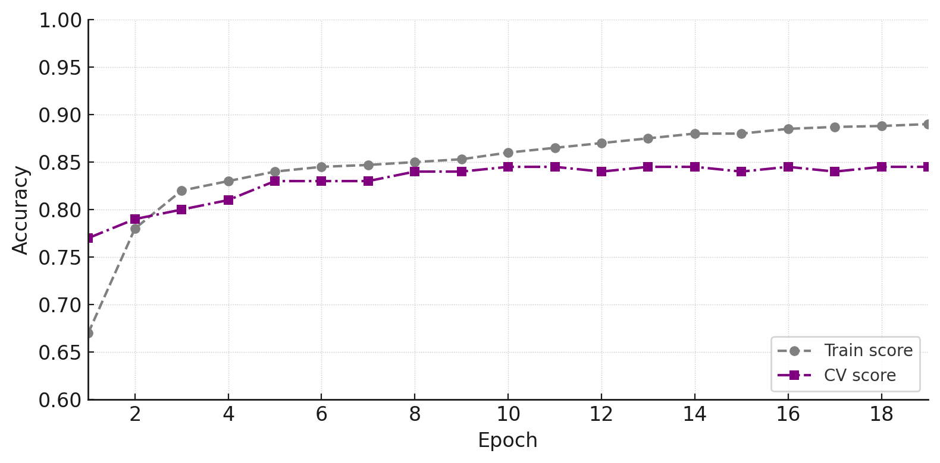
Learning Curves: Training vs. CV Score
Notes:
“This chart plots training (grey) and 5‑fold CV accuracy (purple) over 18 epochs. We see both curves rising in tandem and ultimately plateauing at roughly 89–90% for training and 84–85% for validation. The small, steady gap between them—with no widening over time—indicates that the model is not overfitting. Instead, it’s learning useful generalizable features: performance on unseen folds continues to improve alongside the training score.”

Slide 22
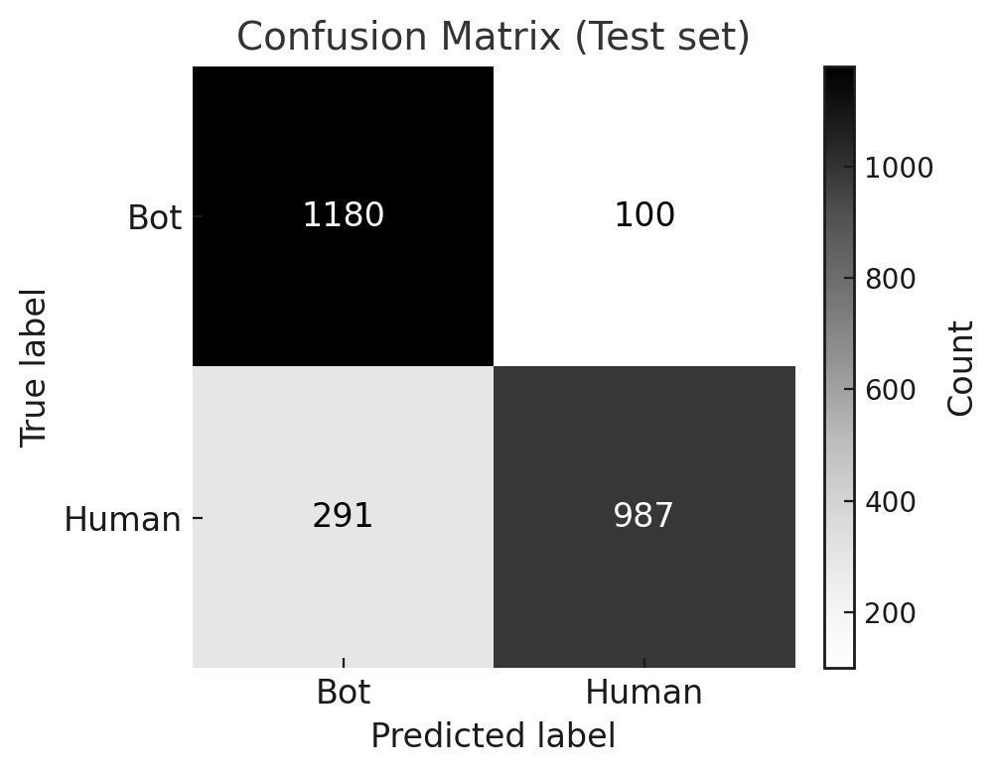
Final Test Performance
Metric | Bot | Human
Precision | 80.2% | 90.8%
Recall | 92.2% | 77.2%
F1-score | 85.8% | 83.4%
Final Accuracy on test set: 84.7%
High bot recall (92.2%) → few missed bots
Human precision high (90.8%) → few false alarms
Notes:
High recall on bots -> + false positives

Slide 23
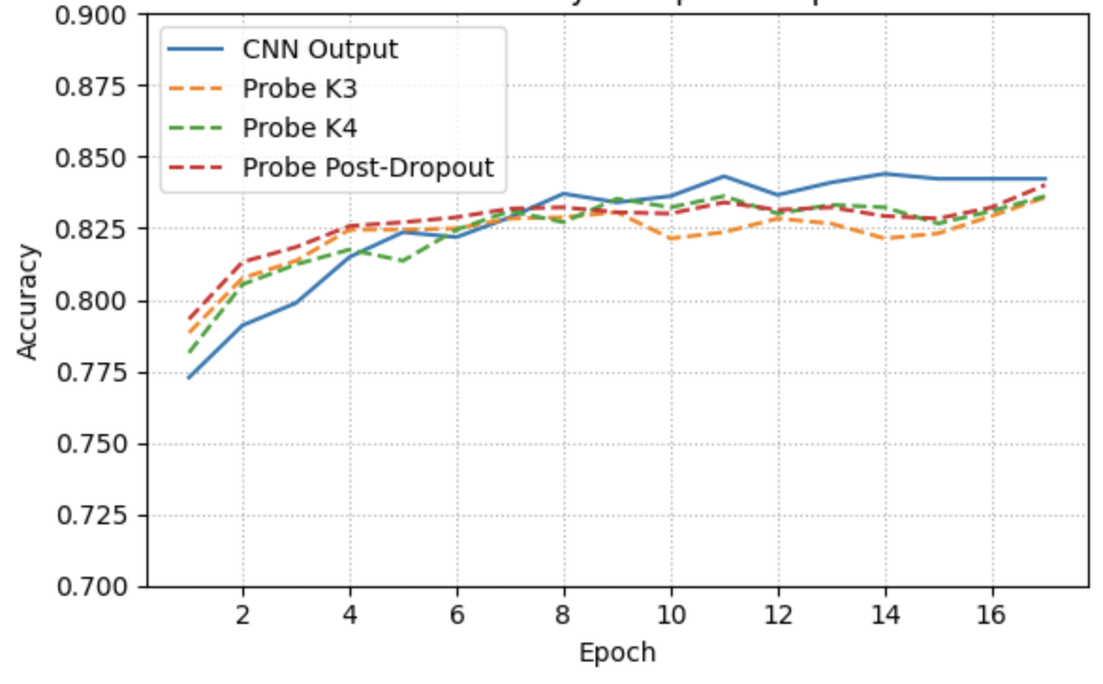
Intermediate Representation Probes
Three probes placed at:
After Conv1 (kernel=3)
After Conv2 (kernel=4)
Post‑Dropout
Even first conv layers are discriminative
Post‑dropout nearly matches full model
Notes:
On this slide we explore where the Char‑CNN builds its class‑signal, using three simple probes. We hook into the network at three points—after the first conv (kernel 3), after the second conv (kernel 4), and post‑dropout—capture the activations, apply tanh and global max‑pooling, and then train a small logistic regression on each set of features. The resulting validation accuracies show that even right after Conv1 we already get over 83% accuracy, rising slightly after Conv2, and by the time we hit post‑dropout we’re almost at the full model’s 85%. This demonstrates that strong discriminative patterns are learned early, and that the network’s deeper layers simply refine an already robust signal.

Slide 24
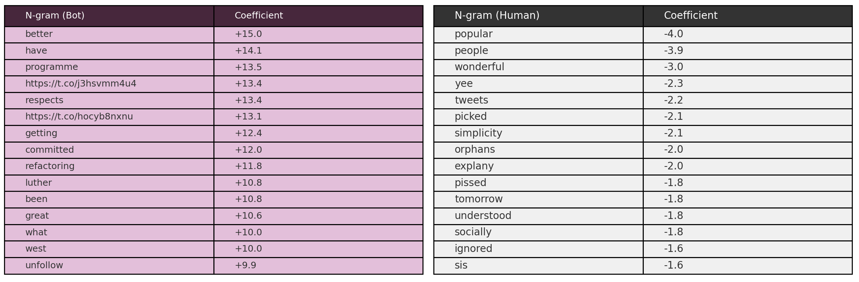
Top 15 Predictive words for Bot vs. Human Tweets
Notes:
Bot‑biased vocabulary
Formulaic / informational: words like programme, refactoring, committed, respects and heavy URL presence (three of the top 15 are links) suggest bots often post automated announcements, development updates or promotional content.
Technical / domain‑specific: terms such as refactoring and programme point to code‑related or organizational tweets—characteristic of accounts sharing software news or press releases.
Transactional tone: verbs like have, getting, unfollow hint at calls‑to‑action or status‑announcements, again typical of bot behavior (e.g. subscription prompts, link-driven engagement).
Human‑biased vocabulary
Colloquial / emotional: words such as wonderful, pissed, popular, and shared convey personal feelings or social reactions.
Everyday context: terms like people, tweets, tomorrow, and socially reflect normal conversation—discussing events, plans or opinions.
Slang / casual interjections: “yee” or “sis” further underline a more conversational, informal register unique to human users.
Key pattern:
Bots favor formal, topic‑driven language with URLs and domain‑specific jargon, aiming to broadcast information or drive clicks.
Humans use informal, emotionally‑colored words and social references, reflecting genuine conversation and personal engagement.

Slide 25
CNN – Limitations & Improvements over SVM
Bot‑type performance (Test):
GPT‑2: 82.3% (vs. 76.0% SVM) → significant improvement
RNN: 96.4% (vs. 94.7% SVM)
Others: 95.7% (vs. 95.1% SVM)
Improvements over SVM → better handling of fluent, GPT‑2 text
Limitations:
Lower human accuracy: humans still misclassified more often than bots (≈77% recall)
Higher compute cost compared to lightweight SVM + TF‑IDF

Slide 26
Transformer‑Based Classifier (BERT)

Slide 27
Transformer‑Based Classifier (BERT)
Model: BERT‑base‑uncased (12 encoder layers, 768‑dim hidden)
Input: WordPiece tokens with special [CLS] and [SEP] markers
Core layers: 12 Transformer encoders using self‑attention to capture context across the tweet
Representation: use the final [CLS] token embedding as a summary of the entire tweet
Classification head: dropout + linear layer → bot vs. human prediction
Notes:
We leverage BERT‑base‑uncased, a 12‑layer Transformer with 768‑dimensional hidden states, pre‑trained on massive text corpora. Input tweets are tokenized into WordPiece subwords, framed by special [CLS] and [SEP] markers, and truncated to 128 tokens. BERT’s core encoder stack uses multi‑head self‑attention to build rich contextual embeddings for every token. We take the final [CLS] embedding—a pooled summary of the entire tweet—and feed it through a small classification head (dropout at 0.6 followed by a linear layer) to predict bot vs. human.

Slide 28
Fine‑Tuning Setup & Hyperparameters
Input: max 128 WordPiece tokens ([CLS] + text + [SEP])
Batch size: 16
Epochs: 5
Learning rate: 2 × 10⁻⁵ (AdamW)
Weight decay: 0.05
Dropout (classification head): 0.6
Layer freezing:
Frozen: all BERT parameters except encoder layers 10–11, pooler, and classifier head
Notes:
For fine‑tuning, we batch 16 tweets at a time and train for 5 epochs using the AdamW optimizer with a low learning rate of 2e‑5 and a weight decay of 0.05 to prevent overfitting. We apply a 0.6 dropout in the classification head to further regularize. To speed up training and retain general language understanding, we freeze most of BERT’s parameters—only the last two encoder layers, the pooler, and the classifier head are updated.

Slide 29
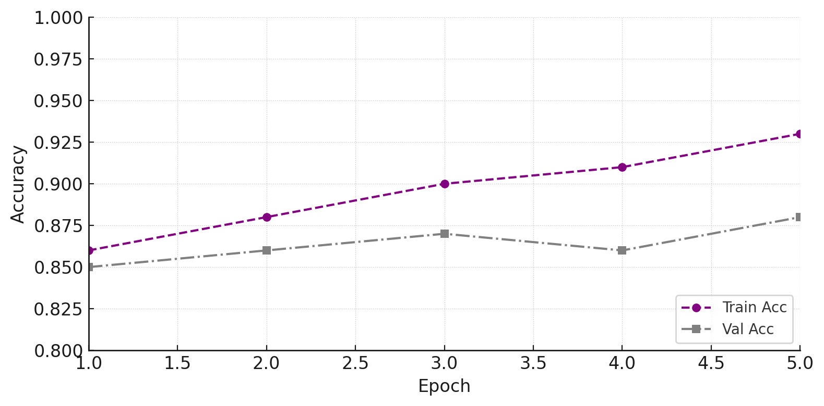
Learning Curves: Training vs. Validation accuracy
Notes:
Steady improvement: training accuracy climbs from ~86% to ~93% over 5 epochs, showing the model is successfully fitting the data.
Validation trend: validation accuracy rises from ~85% to ~88%, with only a small dip at epoch 4 before recovering—indicating robust generalization.
No severe overfitting: the gap between train and val remains moderate (≈5 points), and val doesn’t collapse as train rises, so our dropout, weight decay, and layer freezing effectively regularize.
Early stopping candidate: plateauing at epoch 5 suggests that further epochs yield diminishing returns; one could stop around here to save compute.

Slide 30
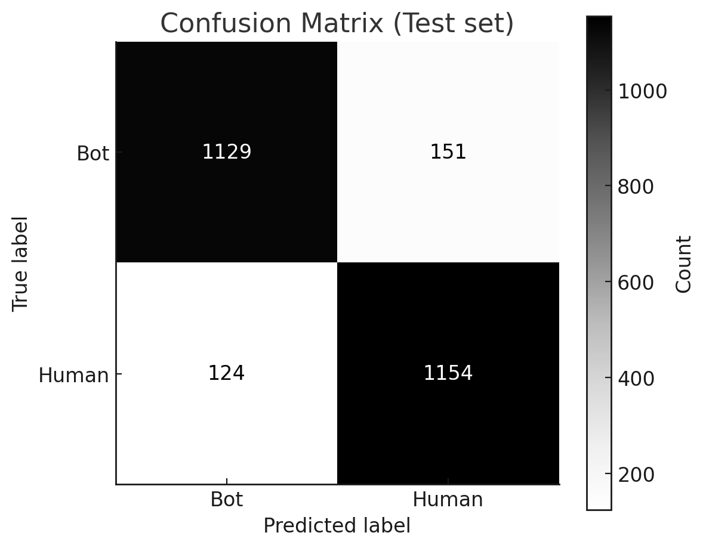
Final Test Performance
Metric | Bot | Human
Precision | 90.1% | 88.4%
Recall | 88.2% | 90.3%
F1-score | 89.1% | 89.4%
Final Accuracy on test set: 89.2%
Bot precision jumps nearly 10 points → fewer false alarms
Human recall improves over 13 points → fewer missed humans

Slide 31
BERT – Improvements over Char‑CNN & Remaining Limitations
Improvements over Char‑CNN:
Overall accuracy + 4.5 % (84.7% → 89.2%)
Better on GPT‑2 bots: from 82.3% → 83.5%
Deep contextual understanding
Minimal feature engineering
Remaining Limitations:
Compute & memory cost
Rare/unseen tokens: WordPiece may split unknown slangs

