Slide 1

UNIVERSITY OF CRAIOVA • FACULTY OF AUTOMATION, COMPUTERS AND ELECTRONICS
Analysis of Stock Market Prediction Algorithms based on Deep Learning Models
A comprehensive comparative research of LSTM and GRU Recurrent Neural Networks in modern digital business frameworks, analyzed across diverse equity classes (AAPL, NVDA, JPM) over a 12-year window (2014-2026).
Student
Andrei-Denis NEDELCU
Coordinator
Catalin-Constantin CERBULESCU
Session
July 2026

Slide 2

Predictive Intelligence in E-Business
The Data Landscape
Deep Learning Power
E-business environments generate vast volumes of chaotic transaction and financial stream logs in real time.
Traditional limits: Classical statistical approaches fail to process high-volatility scenarios, non-linear relationships, and structural shifts typical of modern digital assets.
Recurrent Neural Networks (RNNs) are designed specifically to process sequential data by remembering past states.
Research Purpose: Building an end-to-end parallel system to train, optimize, and blindly test LSTM and GRU models to verify their predictive capability.

Slide 3

Linear Models vs. Random Walk
ARIMA (Linear Baseline)
Random Walk (The Drunk Walk)
Like drawing a straight line through past dots on a graph and hoping the line continues the same way forever. ARIMA focuses on short-term local fluctuations but gets completely lost during sudden macro-regime shifts or hyper-growth cycles.
Like predicting the path of a highly intoxicated person on the street—every single step is random and independent of the last. This theory argues that prices react instantly to random news, meaning past prices cannot help predict tomorrow's values.

Slide 4
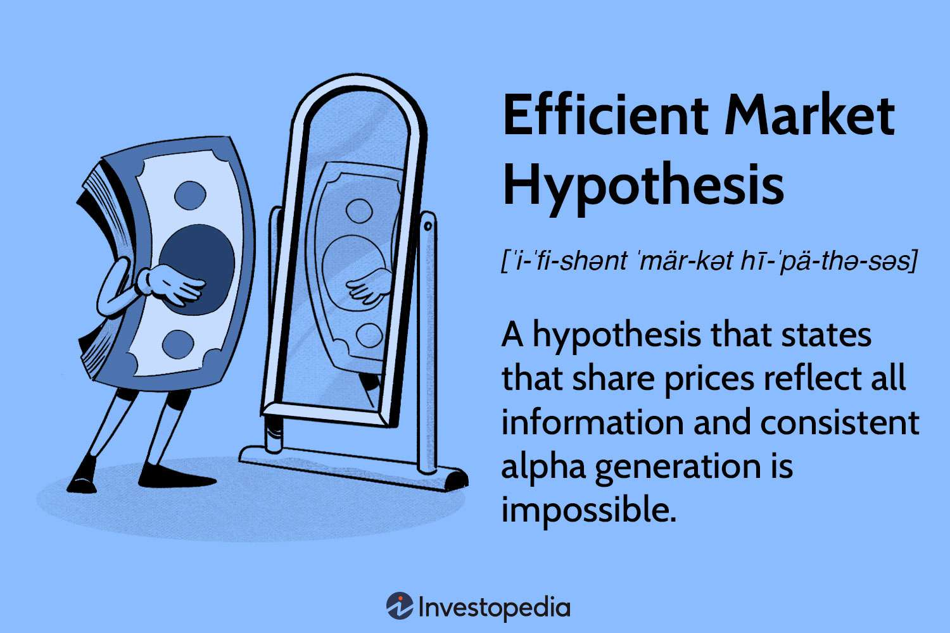
Efficient Market Hypothesis (EMH)
The EMH Theory: Claims markets are perfectly efficient. All information is priced in, making consistent above-average profits highly unlikely.
Micro-Structural Windows: Digital trading desk loops and modern algorithm setups create temporary patterns (inefficiencies) that recur across trading hours.
System Objective: Exploring these micro-patterns using sequential learning structures trained directly on robust volume-weighted metrics.

Slide 5
Data Engineering & VWAP Pipeline
VWAP (Volume Weighted Price)
The Pipeline Setup
Simple Analogy: Like school grading where final exam scores carry a higher weight than simple pop quizzes.
VWAP measures the average price but scales it by trade volume. This neutralizes speculative, a-volume end-of-day price manipulation.
Inflow Layer: Programmatically extracted 12 years of historical daily logs (2014-2026) directly from the Yahoo Finance API.
Window Structuring: Re-segmented the sequential multi-feature arrays into 60-day sliding lookback windows to model market momentum.

Slide 6
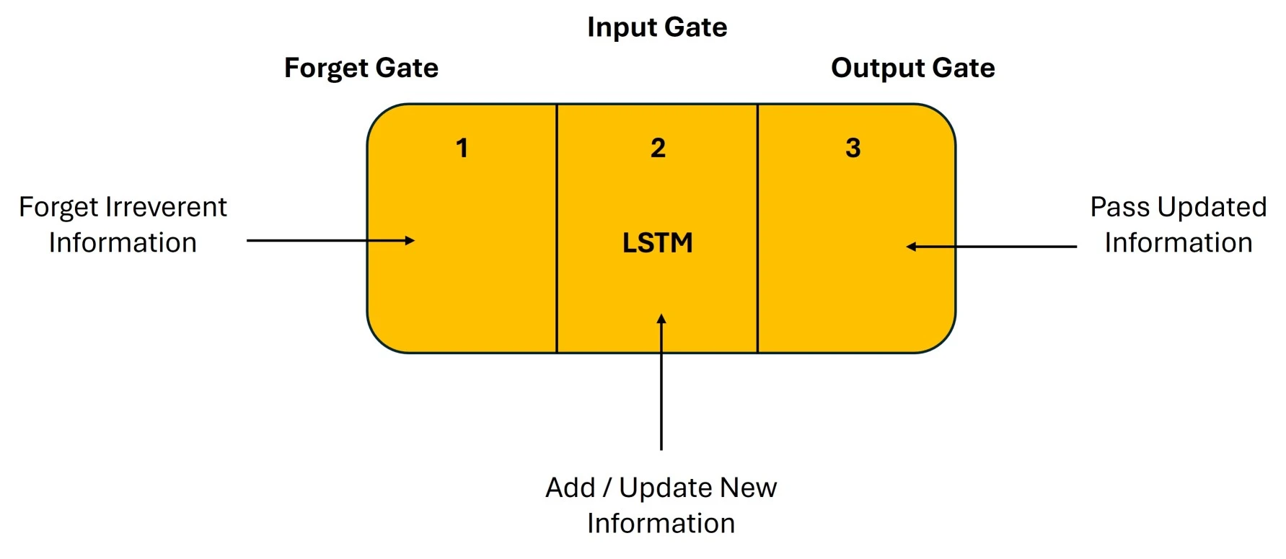
LSTM. Complex Memory
Long Short-Term Memory (LSTM) utilizes a dedicated linear cell state that protects historical information from fading over hundreds of steps.
Forget Gate: Decides what irrelevant past trends to throw away.
Input Gate: Selects what new data from today to write to memory.
Output Gate: Controls the final hidden signal sent forward.

Slide 7
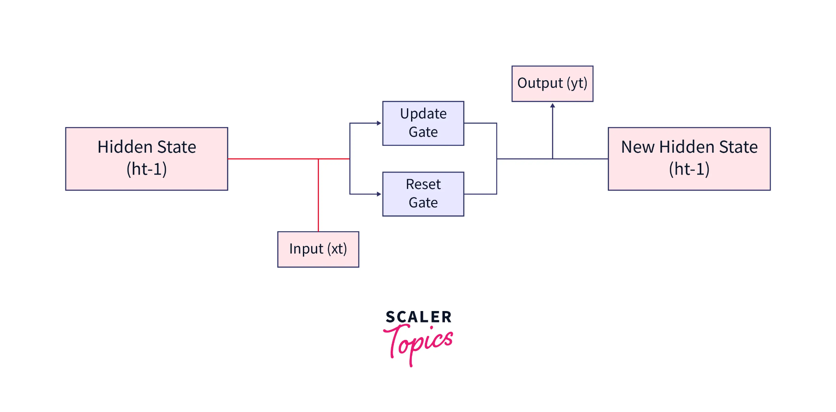
GRU. Agile Design
The Gated Recurrent Unit (GRU) simplifies the sequential memory flow by merging cell and hidden states directly, accelerating calculation speed.
Reset Gate: Determines how much of past market momentum to ignore when a sharp trend change happens.
Update Gate: Operates simultaneously as forget and input gate.
Speed Optimization: Significantly fewer weights to compute, making GRU models highly agile on volatile datasets.

Slide 8
Robust Experimental Design
Eliminating Data Leakage
Split Configuration
Many quantitative studies use random splits that amestec (mix) past and future data, leading to inflated accuracy.
Solution: Enforced a hard calendar-based split at December 31, 2022. The model is completely blinded from any future test-phase events.
Training Phase (2014-2022): Over 3,200 continuous market days used to train neural weights on both architectures.
Stress Test Phase (2023-2026): Out-of-sample test window capturing the chaotic artificial intelligence boom cycle.

Slide 9
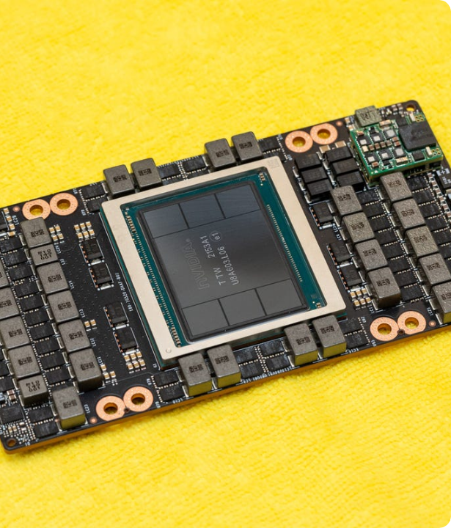
NVIDIA (NVDA) Results
NVIDIA represents a extreme momentum asset, driven by intense institutional and retail speculation during the AI chip boom.
On this highly volatile and non-linear trend, the agile GRU model achieved an exceptional 6.78% error (MAPE).
The heavier LSTM model lagged behind, recording a 9.15% error due to memory retention overhead during sharp price adjustments.

Slide 10

Apple Inc. (AAPL) Results
AAPL represents a highly liquid, stable technology asset with long, consistent trend lines. Since Apple displays highly structured macro-trends without erratic intraday swings, it serves as an ideal baseline for evaluating sequential memory performance.
LSTM Advantage: Thanks to its complex memory cell state, the LSTM model excelled in tracking long-term stable lines, achieving a 3.42% MAPE compared to GRU's 5.19%.

Slide 11

JPMorgan Chase (JPM) Results
JPM represents a traditional, cyclical financial company heavily affected by interest rate policies. Its market price is strongly tied to central bank monetary tightening cycles, liquidity updates, and national rate regimes, resulting in distinct cyclical support bounds rather than parabolic growth.
GRU Accuracy: The GRU model managed the cyclical support levels with maximum efficiency, registering the lowest overall error of the study at 1.97% MAPE.

Slide 12
Consolidated Metrics Synthesis
Target Asset Class (Ticker) | Neural Network Architecture | RMSE (USD) | MAE (USD) | MAPE (%)
Apple Inc. (AAPL) | LSTM (Long Short-Term Memory) | 10.5215 | 7.8771 | 3.42% (Optimal AAPL)
Apple Inc. (AAPL) | GRU (Gated Recurrent Unit) | 12.5198 | 11.2480 | 5.19%
NVIDIA Corporation (NVDA) | LSTM (Long Short-Term Memory) | 16.8560 | 12.6648 | 9.15%
NVIDIA Corporation (NVDA) | GRU (Gated Recurrent Unit) | 11.1918 | 8.6621 | 6.78% (Optimal NVDA)
JPMorgan Chase & Co. (JPM) | LSTM (Long Short-Term Memory) | 16.9901 | 13.1803 | 5.27%
JPMorgan Chase & Co. (JPM) | GRU (Gated Recurrent Unit) | 6.2322 | 4.6315 | 1.97% (Study Peak Accuracy)

Slide 13
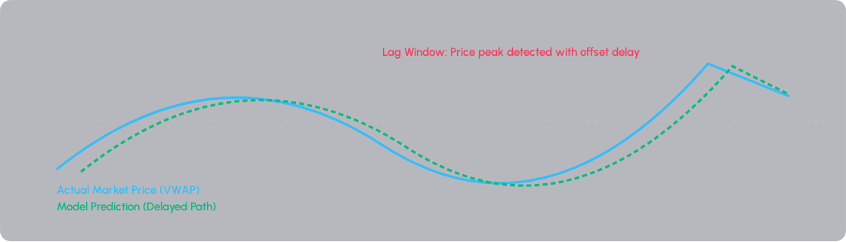
The Lag Effect Anomaly
The neural models optimize errors by taking a mathematical shortcut: copying yesterday's price with minor edits. This creates a time-phase delay at major trend shifts.

Slide 14

Conclusions and Future Work
Architectural Trade-offs
Future Enhancements
No model is globally superior. LSTM excels under linear stability (Apple), while GRU dominates volatile regimes (NVIDIA) and cycles with lower training costs.
Hybrid Systems: Introducing Wavelets to clear high-frequency market noise.
Multimodal NLP: Integrating live sentiment scores from financial feeds to react instantly to economic policy shifts.
Thank You!

