Slide 1
Tsutomu Yamaguchi
The Man Who Survived Two Atomic Bombs

Slide 2
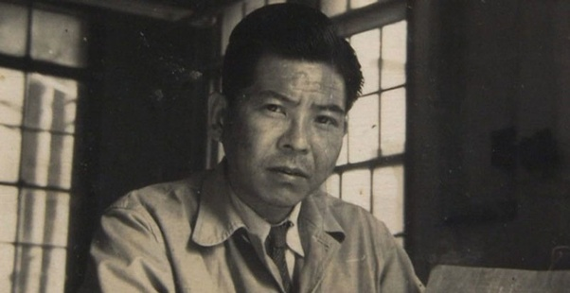
Tsutomi, when he worked in Mitsubishi

Slide 3
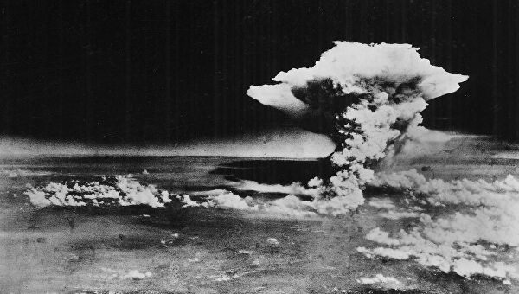
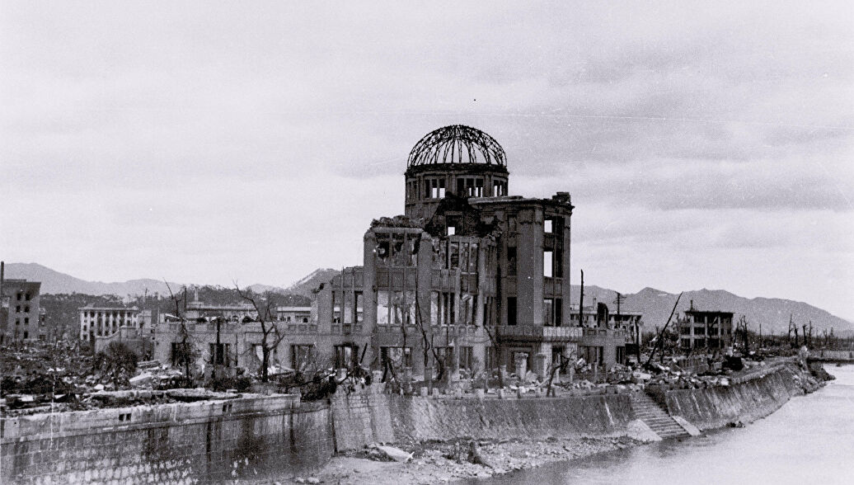
Moment of Hiroshima explosion and debris of buildings

Slide 4
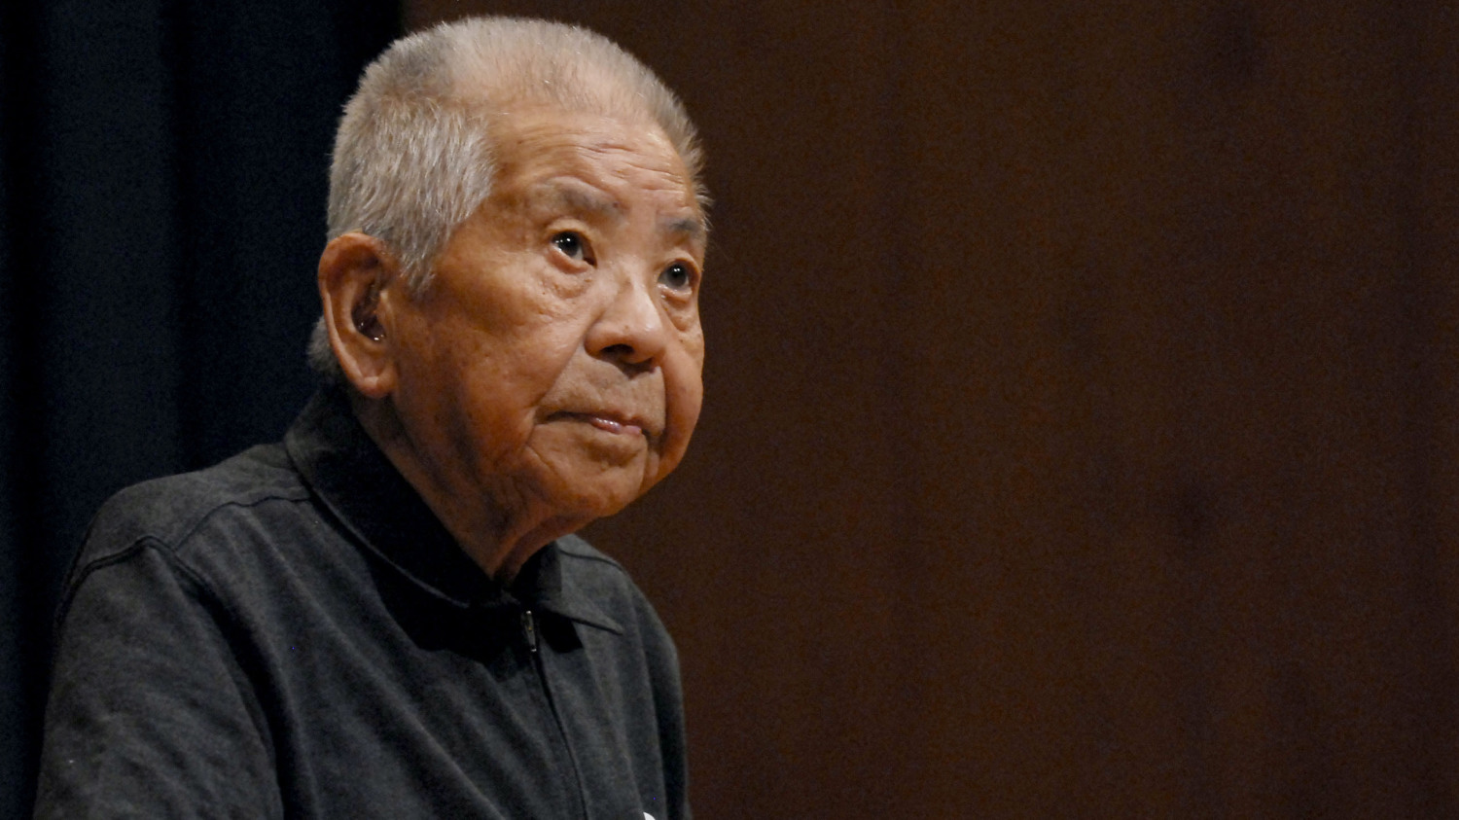
Later he told The Times his impressions about first explosion. “I think I fainted for a while. When I opened my eyes, everything was dark, and I couldn’t see much. It was like the start of a film at the cinema, before the picture has begun when the blank frames are just flashing up without any sound”

Slide 5
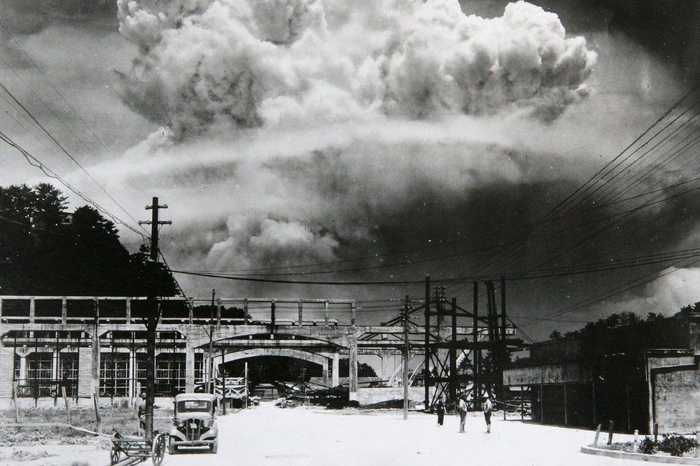
Nagasaki explosion

Slide 6
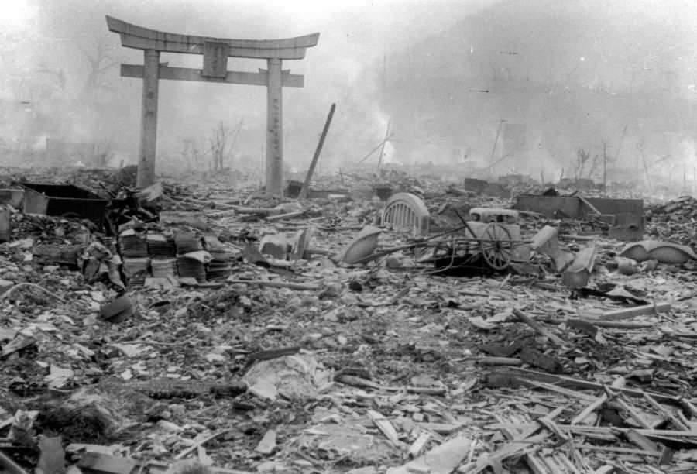
Remains of destroyed city

Slide 7
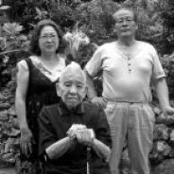
Tsutomi Yamaguchi with his family

Slide 8
References
https://www.britannica.com/biography/Tsutomu-Yamaguchi
https://www.history.com/news/the-man-who-survived-two-atomic-bombs
https://en.wikipedia.org/wiki/Tsutomu_Yamaguchi

