Slide 1
Design Patterns
CONFIDENTIAL | © 2019 EPAM Systems, Inc.

Slide 2
Design Patterns
Introduction
CONFIDENTIAL | © 2019 EPAM Systems, Inc.

Slide 3
Definition
In software engineering, a software design pattern is a general, reusable solution to a commonly occurring problem within a given context in software design.
CONFIDENTIAL | © 2019 EPAM Systems, Inc.

Slide 4
Roots
The idea was introduced by the architect Christopher Alexander and has been adapted for
various other disciplines, most notably computer science.
CONFIDENTIAL | © 2019 EPAM Systems, Inc.

Slide 5
The elements of this (architechture) language are entities called patterns. Each pattern describes a problem that occurs over and over again in our environment, and then describes the core of the solution to that problem, in such a way that you can use this solution a million times over, without ever doing it the same way twice. — Christopher Alexander
<number>

Slide 6
Christopher Alexander is the architect who ﬁrst studied patterns in buildings and communications and developed "pattern language" for generating them. His work has inspired us time and again. There are many ways in which our work is like Alexander’s. Both are based on observing existing systems and looking for patterns in them. Both have templates for describing patterns. Both rely on natural language and lots of examples to described patterns rather than formal languages, and both give rationales for each pattern. — Design Patterns.— GoF
<number>

Slide 7
Why do I need to study patterns
Reusability;
The use of common terminology;
Design patterns provide us with an abstract, high-level view of both the problem and the whole process of object-oriented development;
Design patterns allow a developer or a group of developers to ﬁnd design solutions for complex problems without creating a cumbersome class inheritance hierarchy.
<number>

Slide 8
Other advantages
Eﬃciency improvement of single developers and whole group of developers;
The use of many design patterns also allows you to create more modiﬁable and ﬂexible software;
Properly studied design patterns greatly assist in a common understanding of the basic principles of object-oriented design.
<number>

Slide 9
Design Patterns
UML reminder
CONFIDENTIAL | © 2019 EPAM Systems, Inc.

Slide 10
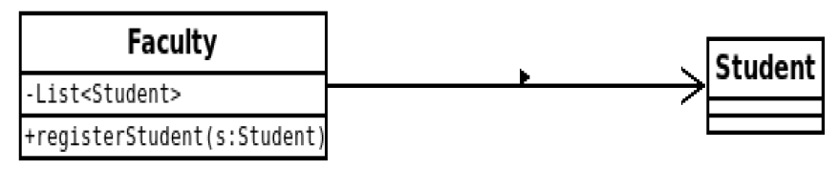
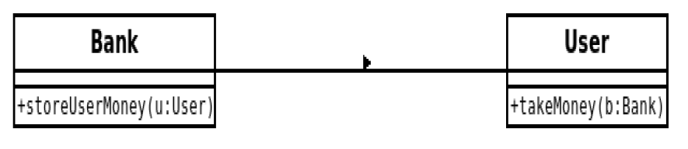
Association
Unidirectional association example
If two classes in a model need to communicate with each other, there must be link between them, and that can be represented by an association (connector). We can define a one-to-one, one-to-many, many-to-one and many-to-many relationship among objects.
Bidirectional association example
<number>

Slide 11
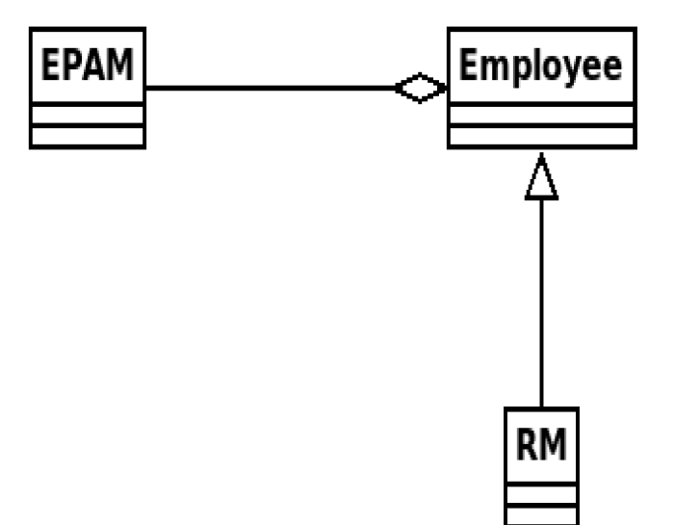
Aggregation
Aggregation implies a relationship where the child can exist independently of the parent.
<number>

Slide 12
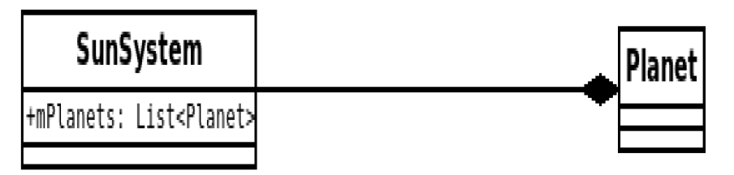
Composition
Composition implies a relationship where the child cannot exist independent of the parent. Example: House (parent) and Room (child). Rooms don't exist separate to a House.
<number>

Slide 13
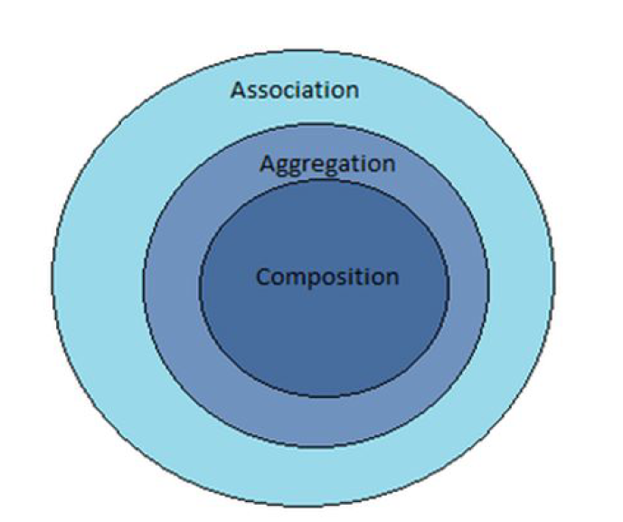
Association, aggregation, composition
Actually, Aggregation and Composition are subsets of association meaning they are specific cases of association
<number>

Slide 14
Design Patterns
Structural Patterns
CONFIDENTIAL | © 2019 EPAM Systems, Inc.

Slide 15
Definition
Structural patterns are concerned with how classes and objects are composed to
form larger structures. Structural class patterns use inheritance to compose
interfaces or implementations. Structural object patterns describe ways to
compose objects to realize new functionality.
CONFIDENTIAL | © 2019 EPAM Systems, Inc.

Slide 16
Design Patterns
Facade
CONFIDENTIAL | © 2019 EPAM Systems, Inc.

Slide 17
Intent
Provide a uniﬁed interface to a set of interfaces in a subsystem.
Facade deﬁnes a higher-level interface that makes the subsystem
easier to use.
CONFIDENTIAL | © 2019 EPAM Systems, Inc.

Slide 18
Motivation
Structuring a system into subsystems helps reduce complexity. A
common design goal is to minimize the communication and
dependencies between subsystems. One way to achieve this goal is
to introduce a facade object that provides a single, simpliﬁed
interface to the more general facilities of a subsystem.
CONFIDENTIAL | © 2019 EPAM Systems, Inc.

Slide 19
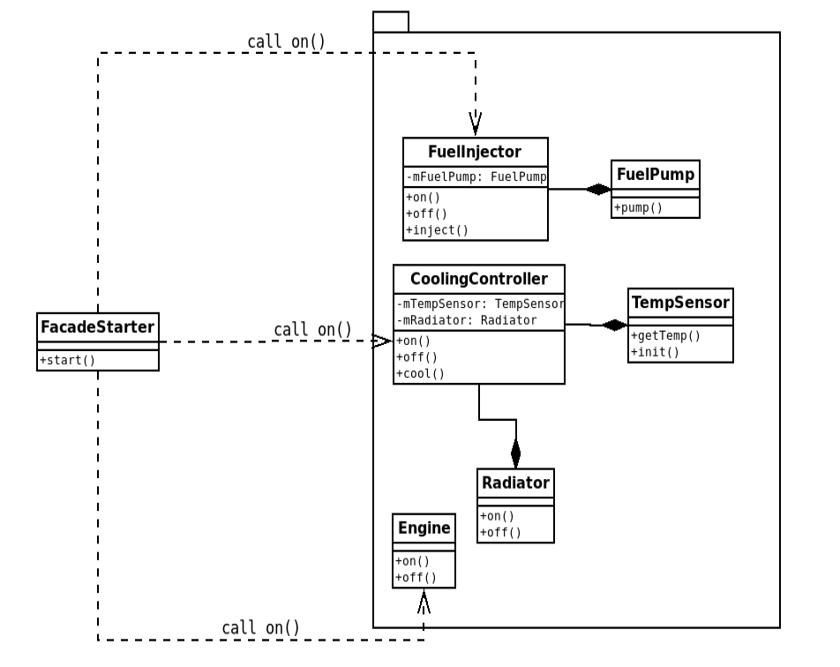
Example. Facade for starting a car system
<number>

Slide 20
Applicability
you want to provide a simple interface to a complex subsystem;
there are many dependencies between clients and the implementation classes of an abstraction;
you want to layer your subsystems.
<number>

Slide 21
Design Patterns
Adapter (wrapper)
CONFIDENTIAL | © 2019 EPAM Systems, Inc.

Slide 22
Intent
Convert the interface of a class into another interface clients expect. Adapter lets classes
work together that couldn’t otherwise because of incompatible interfaces.
CONFIDENTIAL | © 2019 EPAM Systems, Inc.

Slide 23
Motivation
Sometimes a toolkit class that’s designed for reuse isn’t reusable only because its interface doesn’t
match the domain-specific interface an application requires.
CONFIDENTIAL | © 2019 EPAM Systems, Inc.

Slide 24
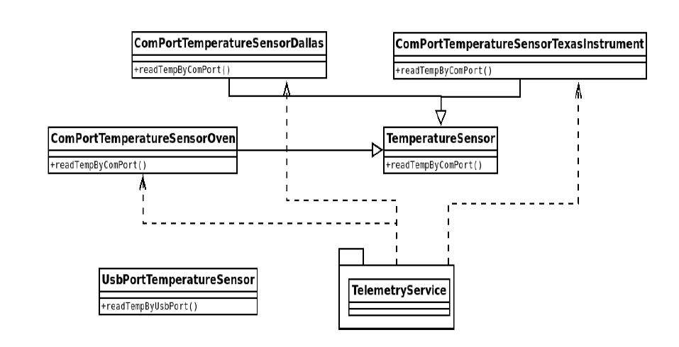
Example. The task
<number>

Slide 25
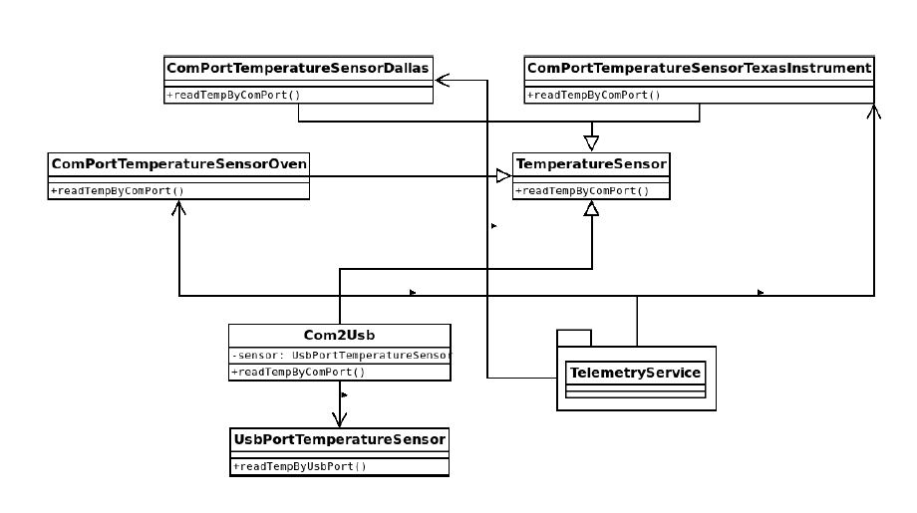
Example. The task resolution
<number>

Slide 26
Two types of adapter realization
object realization via composition;
class realization via inheritance.
CONFIDENTIAL | © 2019 EPAM Systems, Inc.

Slide 27
Applicability
you want to use an existing class, and its interface does not match the one you need.
you want to create a reusable class that cooperates with unrelated or unforeseen classes, that is, classes that don’t necessarily have compatible interfaces.
(object adapter only) you need to use several existing subclasses, but it’s unpractical to adapt their interface by subclassing every one. An object adapter can adapt the interface of its parent class.
<number>

Slide 28
Design Patterns
Bridge
CONFIDENTIAL | © 2019 EPAM Systems, Inc.

Slide 29
Intent
Decouple an abstraction from its implementation so that the two can vary independently
CONFIDENTIAL | © 2019 EPAM Systems, Inc.

Slide 30
Motivation
When an abstraction can have one of several possible implementations, the usual
way to accommodate them is to use inheritance. But this approach isn't always flexible enough.
Inheritance binds an implementation to the abstraction permanently, which makes it difficult to modify,
extend, and reuse abstractions and implementations independently.
CONFIDENTIAL | © 2019 EPAM Systems, Inc.

Slide 31
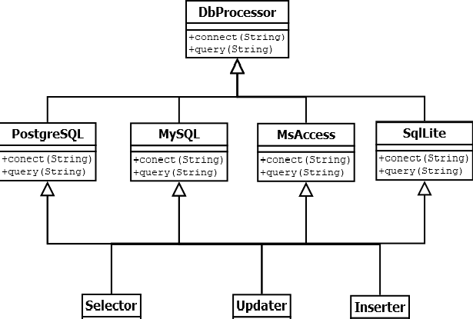
Example. The task
<number>

Slide 32
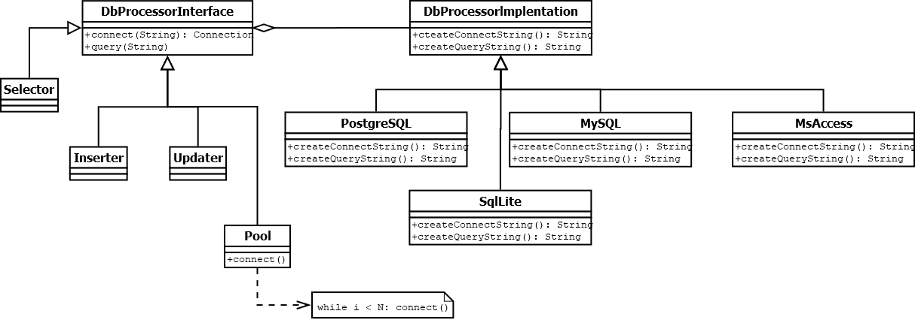
Example. The task resolution
<number>

Slide 33
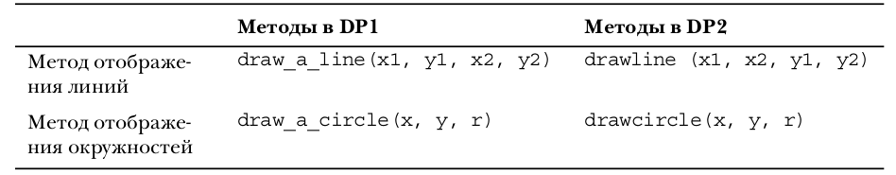
Example. The task
<number>

Slide 34
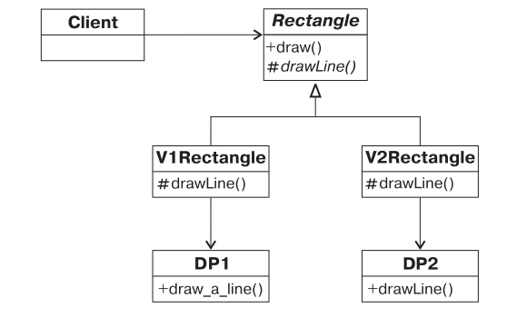
Example. Task and non-optimal solution
<number>

Slide 35
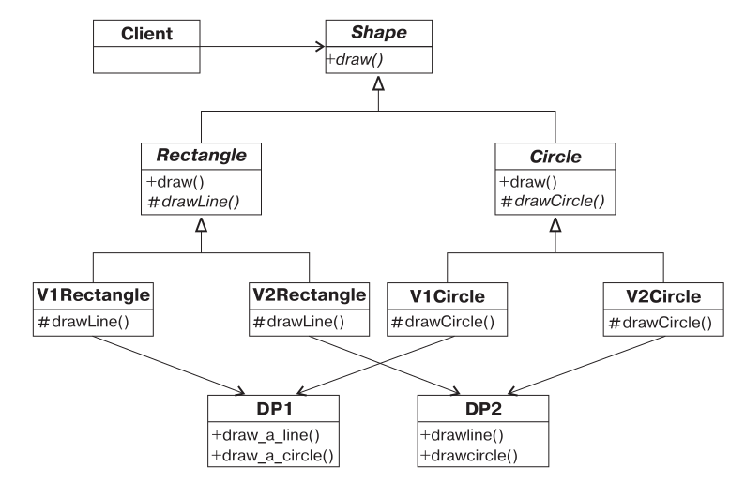
Example. Task complication and non-optimal solution
<number>

Slide 36
Solution problem
Each class represents a particular type of shape, must know exactly which of the existing graphics programs he uses.
High grow of the number of subclasses
<number>

Slide 37
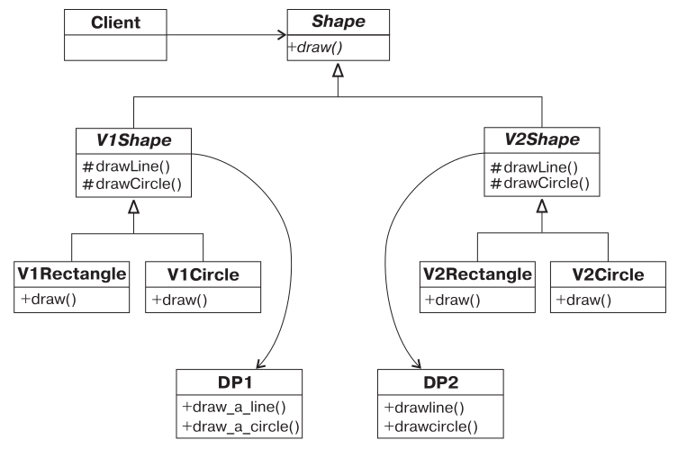
Example. Task complication and non-optimal solution
<number>

Slide 38
Two strategies of design practice
1. Find what changes and encapsulate it.
2. Preferably use composition instead of inheritance.
<number>

Slide 39
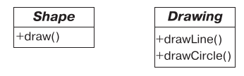
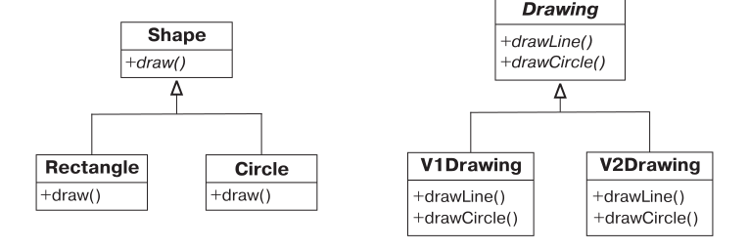
Task analysis
Changeable entities
Implementation of specific variations
<number>

Slide 40
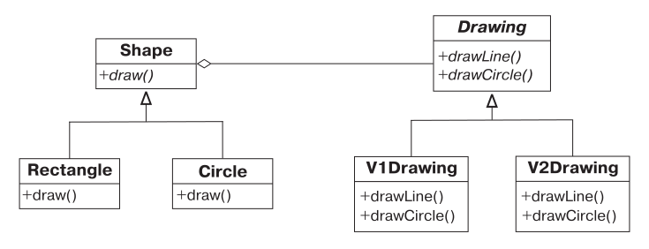
Classes linkage
<number>

Slide 41
Applicability
you want to avoid a permanent binding between an abstraction and its implementation. For example, when the implementation must be selected at run-time;
both the abstractions and their should be extensible by subclassing;
changes in the implementation of an abstraction should have no impact on clients;
<number>

Slide 42
Design Patterns
Decorator
CONFIDENTIAL | © 2019 EPAM Systems, Inc.

Slide 43
Intent
Attach additional responsibilities to an object dynamically. Decorators provide a flexible
alternative to subclassing for extending functionality.
CONFIDENTIAL | © 2019 EPAM Systems, Inc.

Slide 44
Motivation
Sometimes we want to add responsibilities to individual object, not an entire class
CONFIDENTIAL | © 2019 EPAM Systems, Inc.

Slide 45
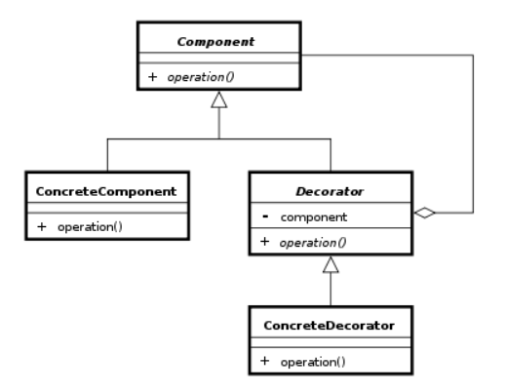
Decorator scheme
<number>

Slide 46
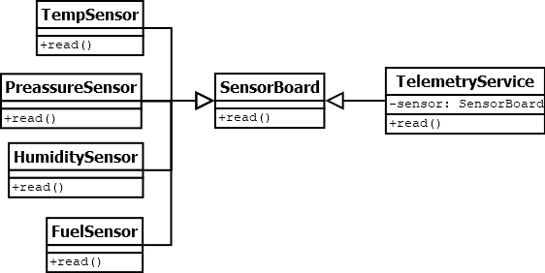
Example
<number>

Slide 47
Applicability
to add responsibilities to individual objects dynamically and transparently, that is, without affecting other objects;
for responcibilities that can be withdrawn;
When extension with is impractical.
<number>

Slide 48
Design Patterns
Proxy
CONFIDENTIAL | © 2019 EPAM Systems, Inc.

Slide 49
Intent
Provide a surrogate or placeholder for another object to
control access to it.
CONFIDENTIAL | © 2019 EPAM Systems, Inc.

Slide 50
Motivation
One reason for controlling access to an object is to defer the full cost of its
creation and initialization until we actually need to use it.
There are situations in which a client does not or can not reference an Object
directly, but wants to still interact with the object.
CONFIDENTIAL | © 2019 EPAM Systems, Inc.

Slide 51
Example
Consider a document editor that can embed graphical objects in a document.
Some graphical objects, like large raster images, can be expensive to create. But
opening a document should be fast, so we should avoid creating all the expensive
objects at once when the document is opened. This isn't necessary anyway,
because not all of these objects will be visible in the document at the same time.
CONFIDENTIAL | © 2019 EPAM Systems, Inc.

Slide 52
Decorator scheme
<number>

Slide 53
Example
<number>

Slide 54
Applicability
to add responsibilities to individual objects dynamically and transparently, that is, without affecting other objects;
for responcibilities that can be withdrawn;
When extension with is impractical.
<number>

