Slide 1

How can corruption and alcohol abuse affect suicides worldwide?
By Denis Prokhoda

Slide 2


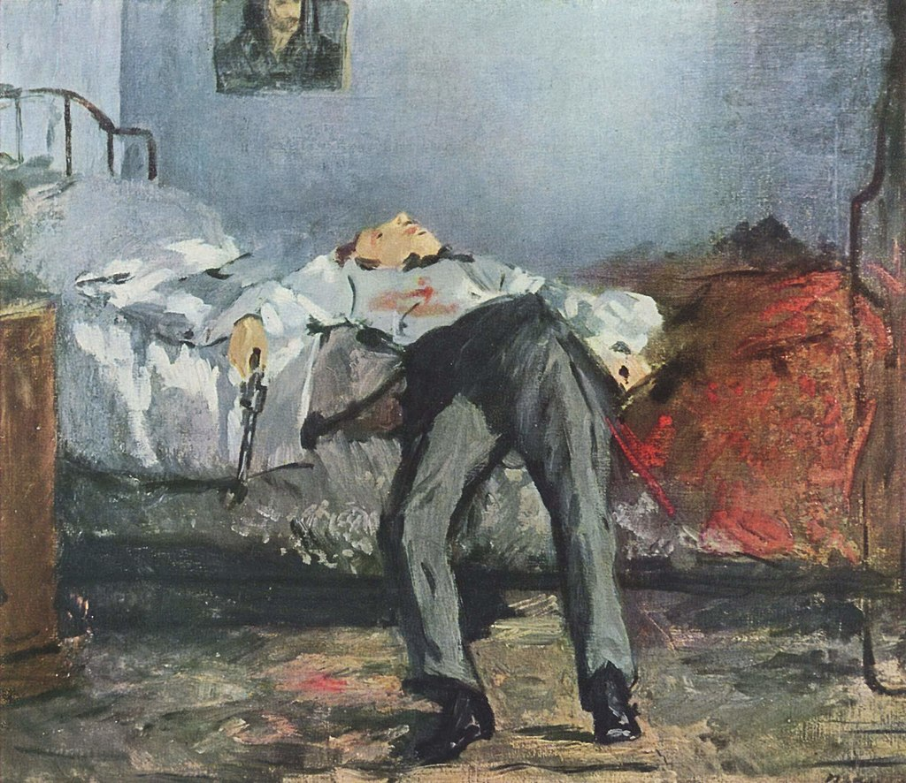
Why is it so important?
According to WHO (World Health Organization) almost 800 000 people die due to suicide every year, which is one person every 40 seconds.
There are thousands of reasons why do people end their lives. Unfortunately, in much of the world, suicide is stigmatized and condemned for religious or cultural reasons. But we should not turn the blind eye on this problem.
In this project I want to have a closer look to the potential reasons such as high levels of corruption in the country and alcohol abuse to see how can they lead a person to the decision to take their own life.
The Suicide by Édouard Manet
I will be using three different datasets from years 2010 – 2018 to see if there any direct correlation between those two factors.
Suicide accounted for 1.4% of all deaths worldwide, making it the 18th leading cause of death.

Slide 3

Hypothesis
Is there a connection between suicide rate and alcohol abuse in different countries?
Would we see the correlation between suicide rate and corruption perceptional index (CPI)?

Slide 4
Data used
Corruption level for years 2010 and 2018 where countries have Corruption Perception Index (CPI) from 0 to 100. Where 0 represents the most corrupted countries and 100 the least corrupted countries.
Alcohol consumption for years 2010 and 2018 where consumption of alcohol measured in liters of pure alcohol per capita.
Suicide rate for years 2010 and 2018 where suicide is reported as number of deaths per 100,000 people.

Slide 5
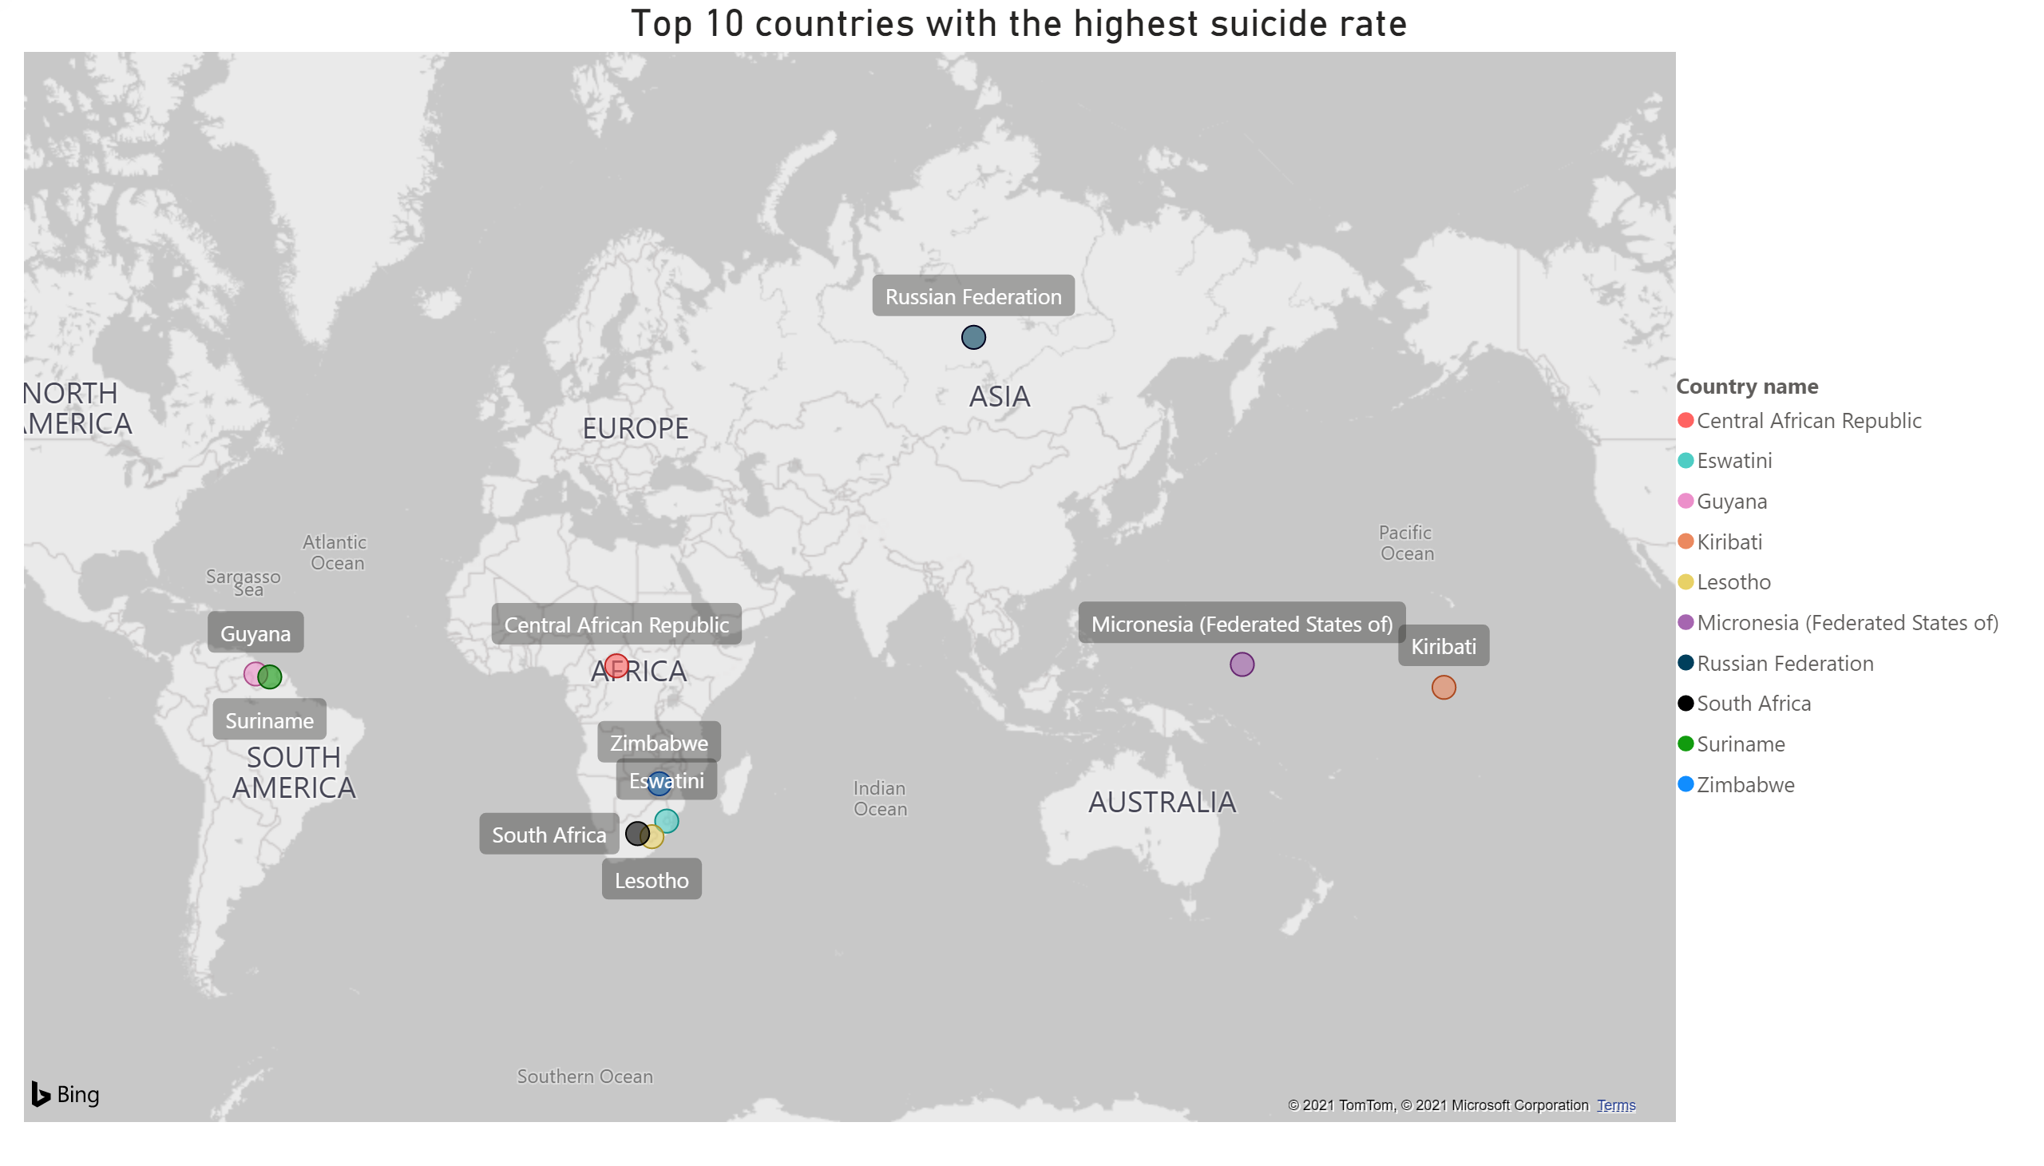
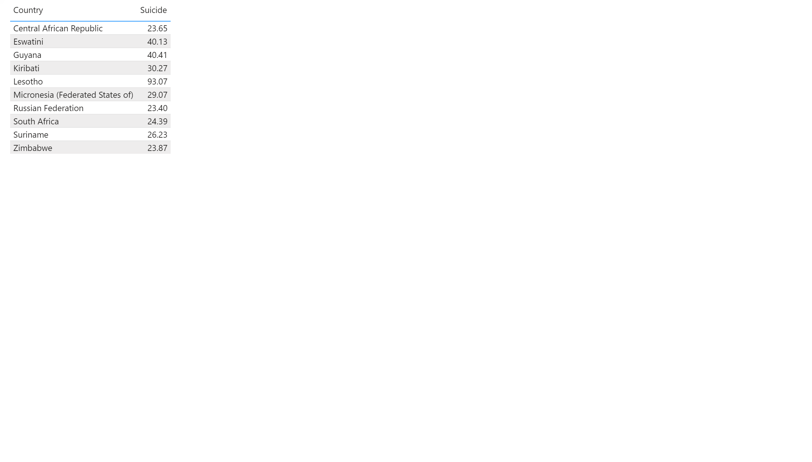
map - top highest suicide
Country name
Suicides per 100 000
Notes:
Top 10 countries with the highest suicide rate
I want to begin this presentation with showing the map of ten countries with the highest suicide rate. As you can see, Lesotho heads the list with the largest number of suicides – 93 people out of 100,000 end their lives every year. Other two leaders are Guyana with almost 40 people out of 100,000 and Eswatini – also 40 people out of 100,000 each year. This numbers are terrifying, aren’t they? Now let's go ahead and see their alcohol consumption.

Slide 6
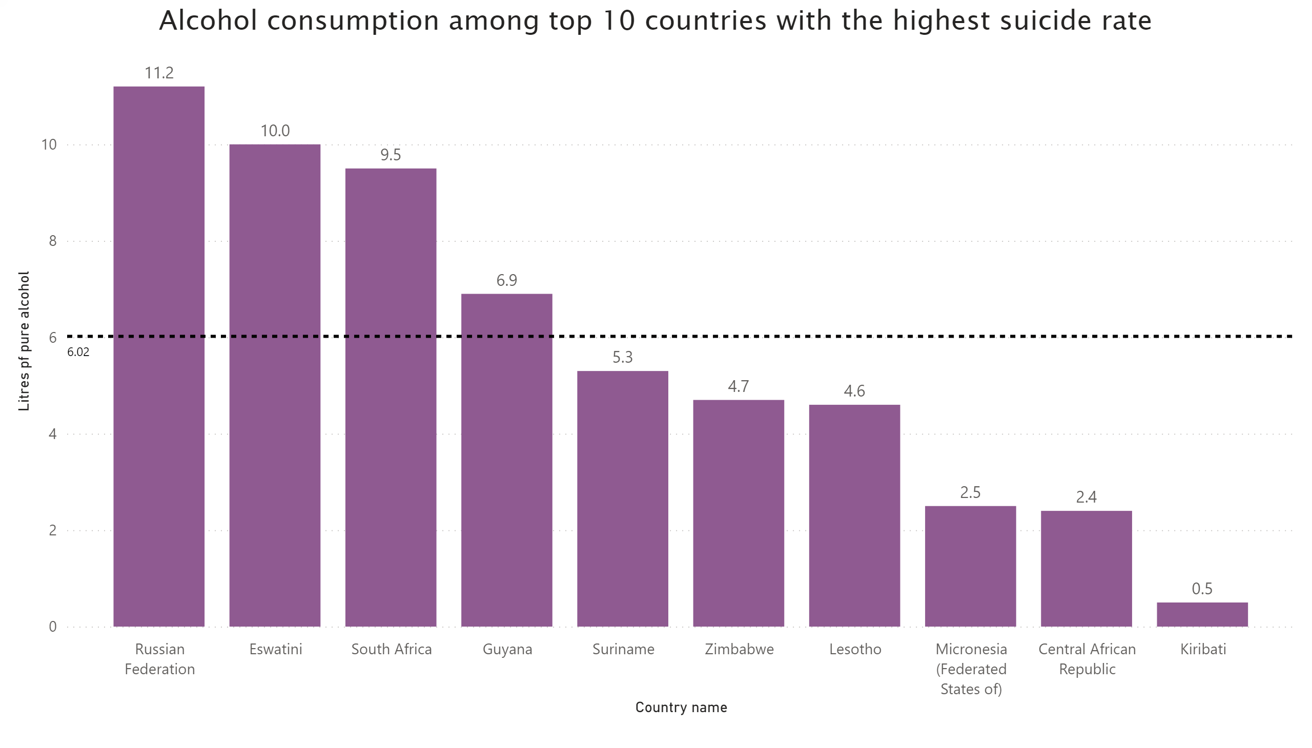
suicide/alcohol top 10
Notes:
The dotted line shows the average of alcohol consumption in liters of pure alcohol per capita among the all presented countries in the dataset.
As we can see, Russian Federation has the number of 11.2 liters of pure alcohol which is almost twice the average. Eswatini, South Africa and Guyana also show numbers above average.
As you remember, Eswatini and Guyana are among the first three countries with the highest suicide rate. Alcohol consumption is these two countries, as you can see, is also quite high. This gives us a first connection between suicide rate and alcohol abuse in the country.
But let's move on and see if we can find the same trend with corruption.

Slide 7
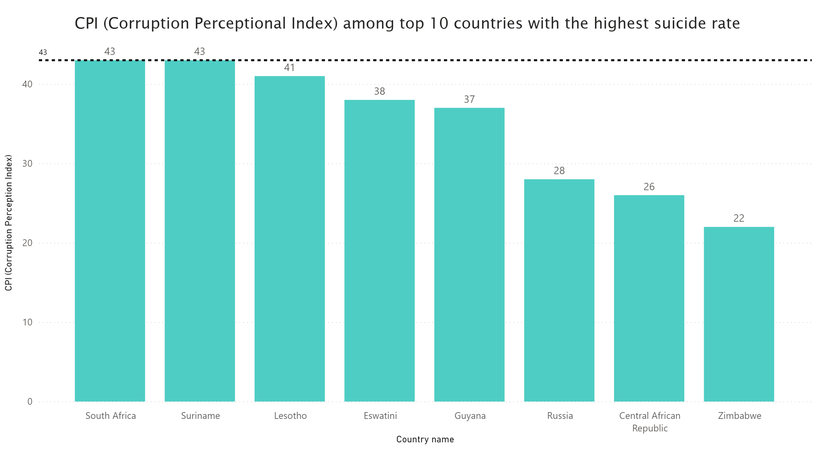
top 10 suicides /corruption and average
Notes:
CPI stands for corruption Perceptional Index, where 100 is very clean and 0 is highly corrupt.
Dotted line shows the average number of corruption among all countries presented in the dataset. Unfortunately, we do not have any data for Kiribati and Micronesia. However, all eight presented countries, that have high suicide rate, show very bad trend – according to the shown numbers we can say that corruption is common in these countries, because their CPIs are quite low – 43 and below - according to the scale.
To get the better understanding on how corruption and alcohol abuse are connected to the suicide rate let’s move on to the next slide.

Slide 8
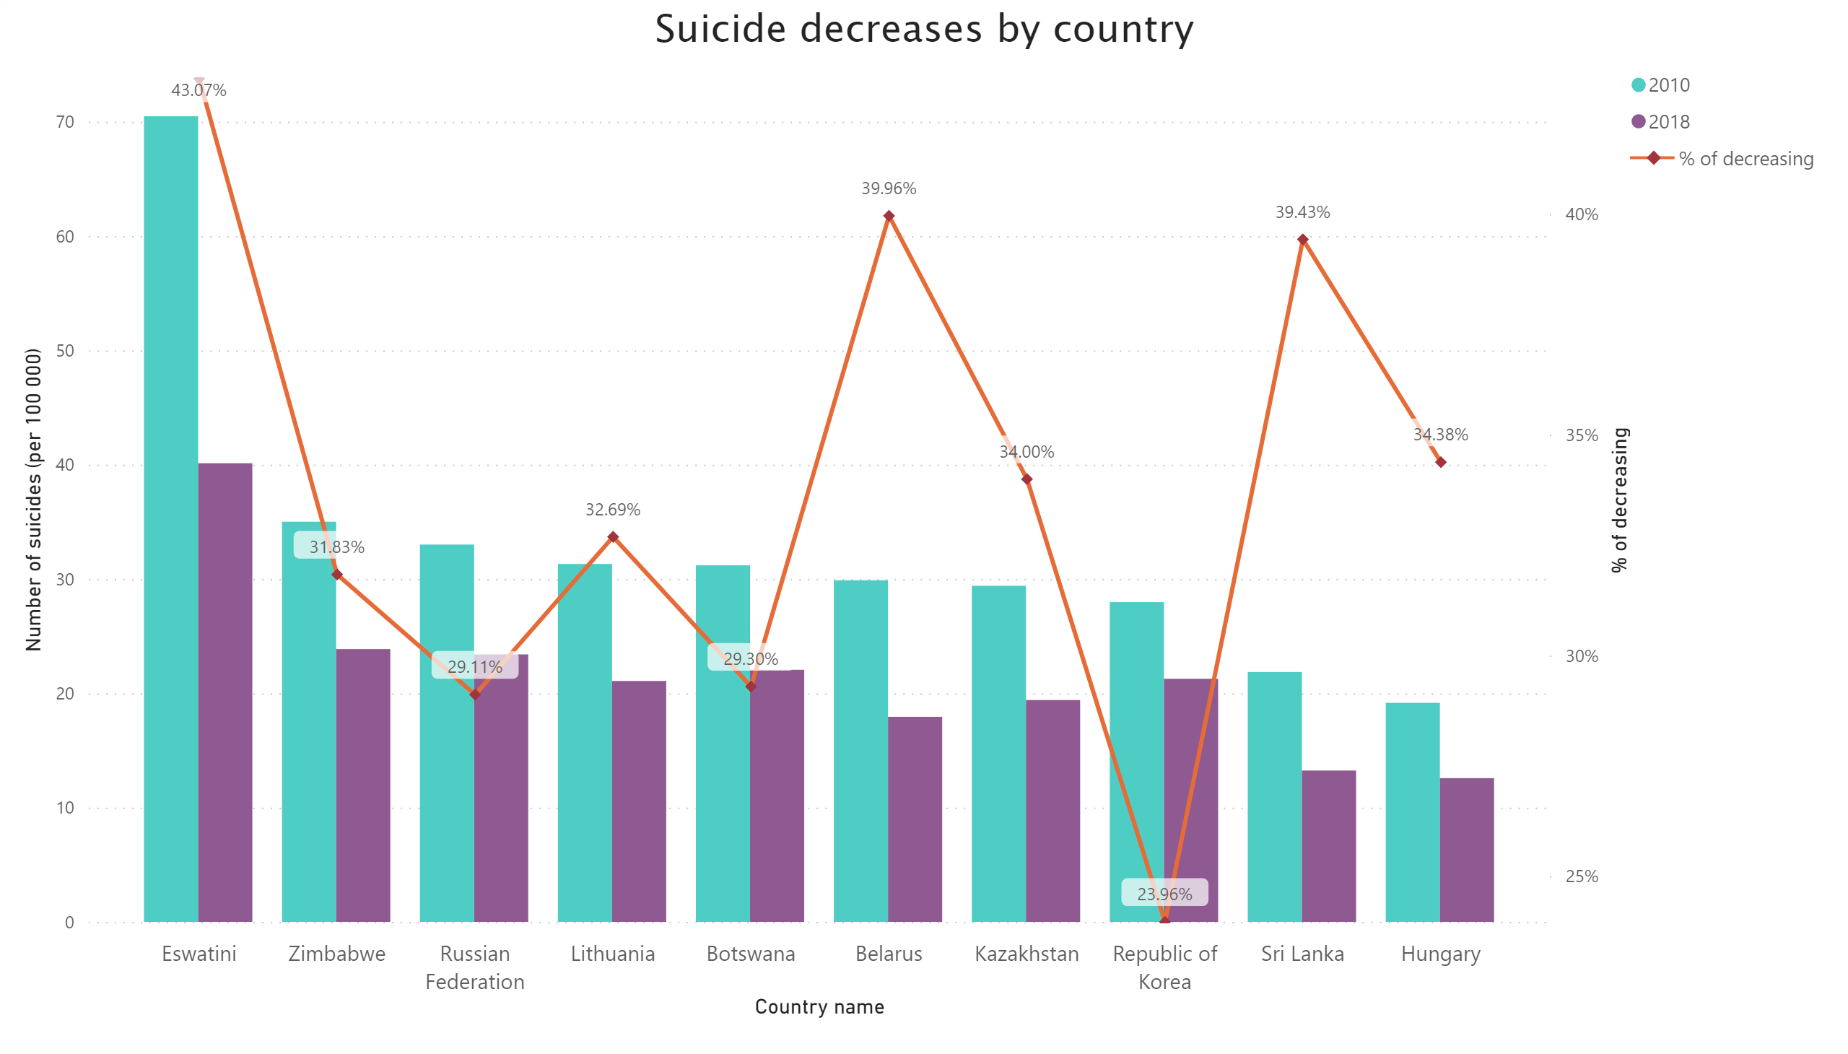
SUICIDE DECREASE BY COUNTRY
Notes:
Suicide decreases by country.
Here we will look at another top 10 countries that shows positive trend in suicide rate – from years 2010 to 2018 their suicide rate dramatically decreased.
The blue bar shows the number of suicides per 100.000 people in 2010, the purple bar shows the number of suicides per 100.000 people in 2018 and the orange line shows us the percentage of suicide decrease among these countries between 2010 and 2018.
Eswatini shows the best result – 43% of decrease. Where Republic of Korea shows only 24% of decrease.
Now we will analyze if decrease of suicides has any connection with alcohol consumption in those ten countries.

Slide 9
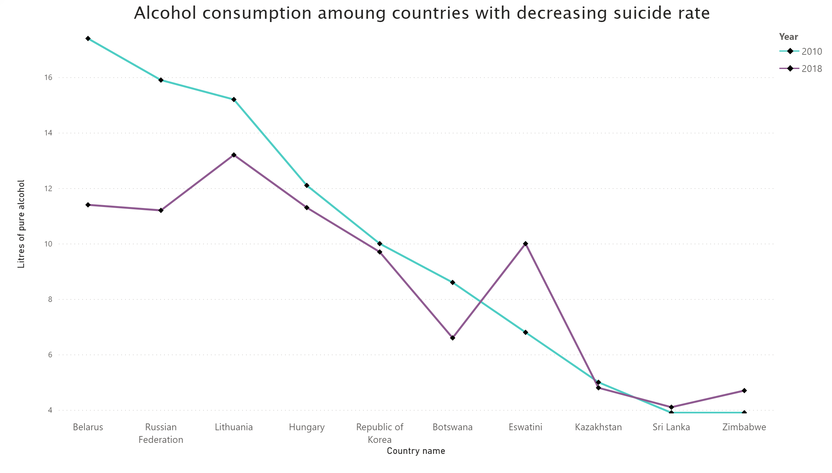
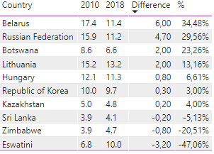
alcohol consumption decrease suicide
Alcohol Consumption among countries with decreasing suicide rate
Notes:
Alcohol consumption among countries with decreasing suicide rate
On this slide we see a chart where blue line represents alcohol consumption in 2010 and purple line – in 2018. If purple line is below the blue one – alcohol consumption decreased.
To better understand this chart let’s look on the right side of the slide where we can see the table shows comparison numbers. If consumption of alcohol decreased in 2018, we will see the positive numbers in difference and percentage columns. Seven countries out of ten showed decrease in alcohol consumption.

Slide 10
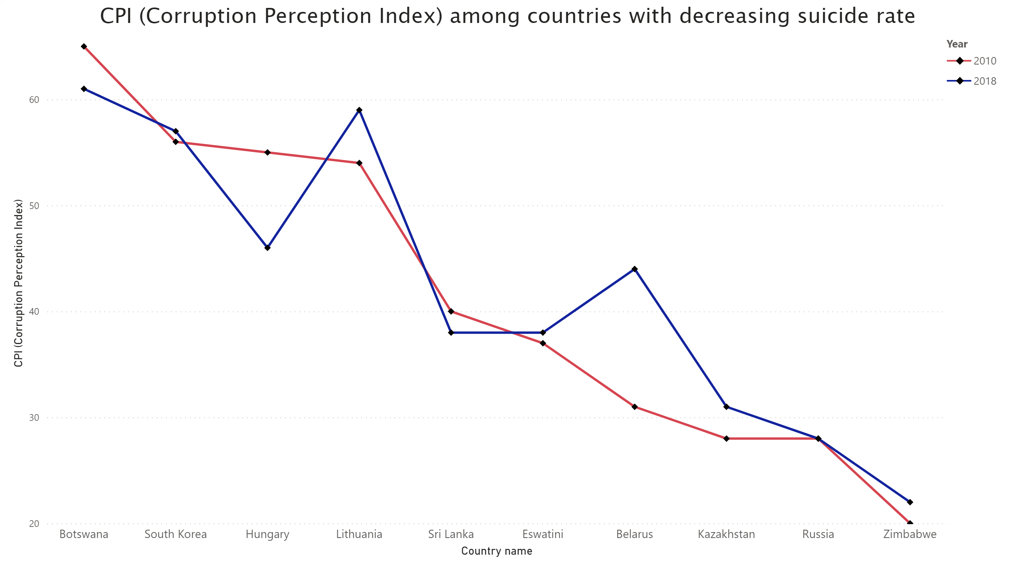
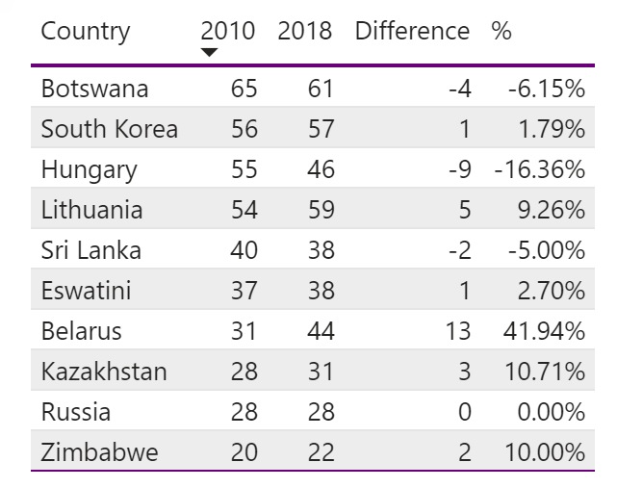
suicide decrease corruption
CPI among countries with decreasing suicide rate
Notes:
CPI (Corruption Perception Index) among countries with decreasing suicide rate
On this slide we see CPI among countries with decreasing suicide rate. Red line shows the change of CPI in 2010, blue line – in 2018. If the blue line is above the red line, it represents the positive trend.
Again, for better understanding on the right-hand side we see the table that shows the difference in those two years. All positive numbers in difference and percentage columns show improvement of CPI. Six countries out of ten have positive trend, and Russia stayed the same.

Slide 11
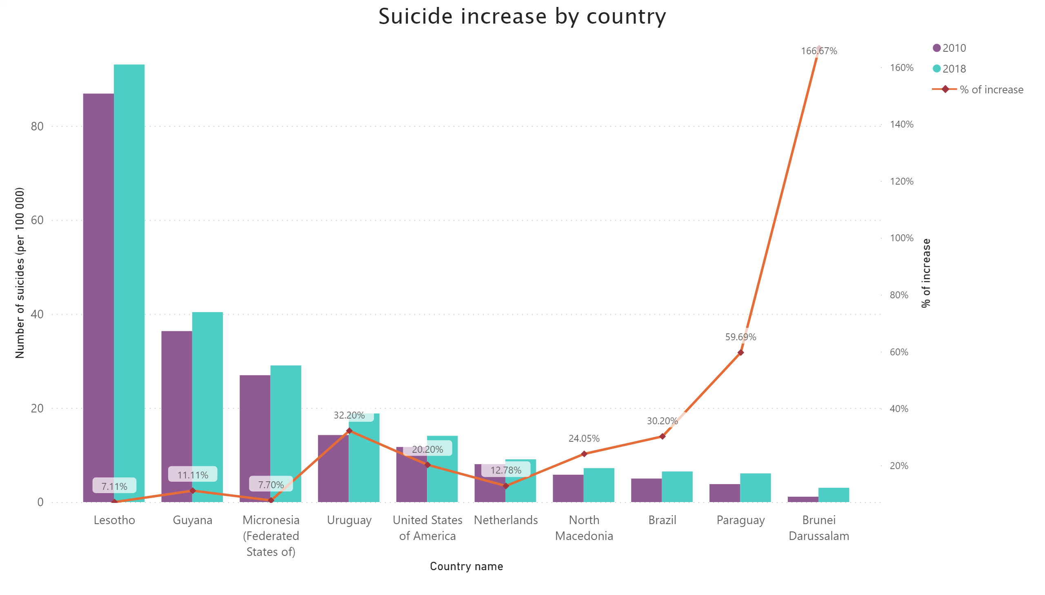
SUICIDE INCREASE BY COUNTRY
Notes:
Suicide increase by country
No alt text provided.

Slide 12
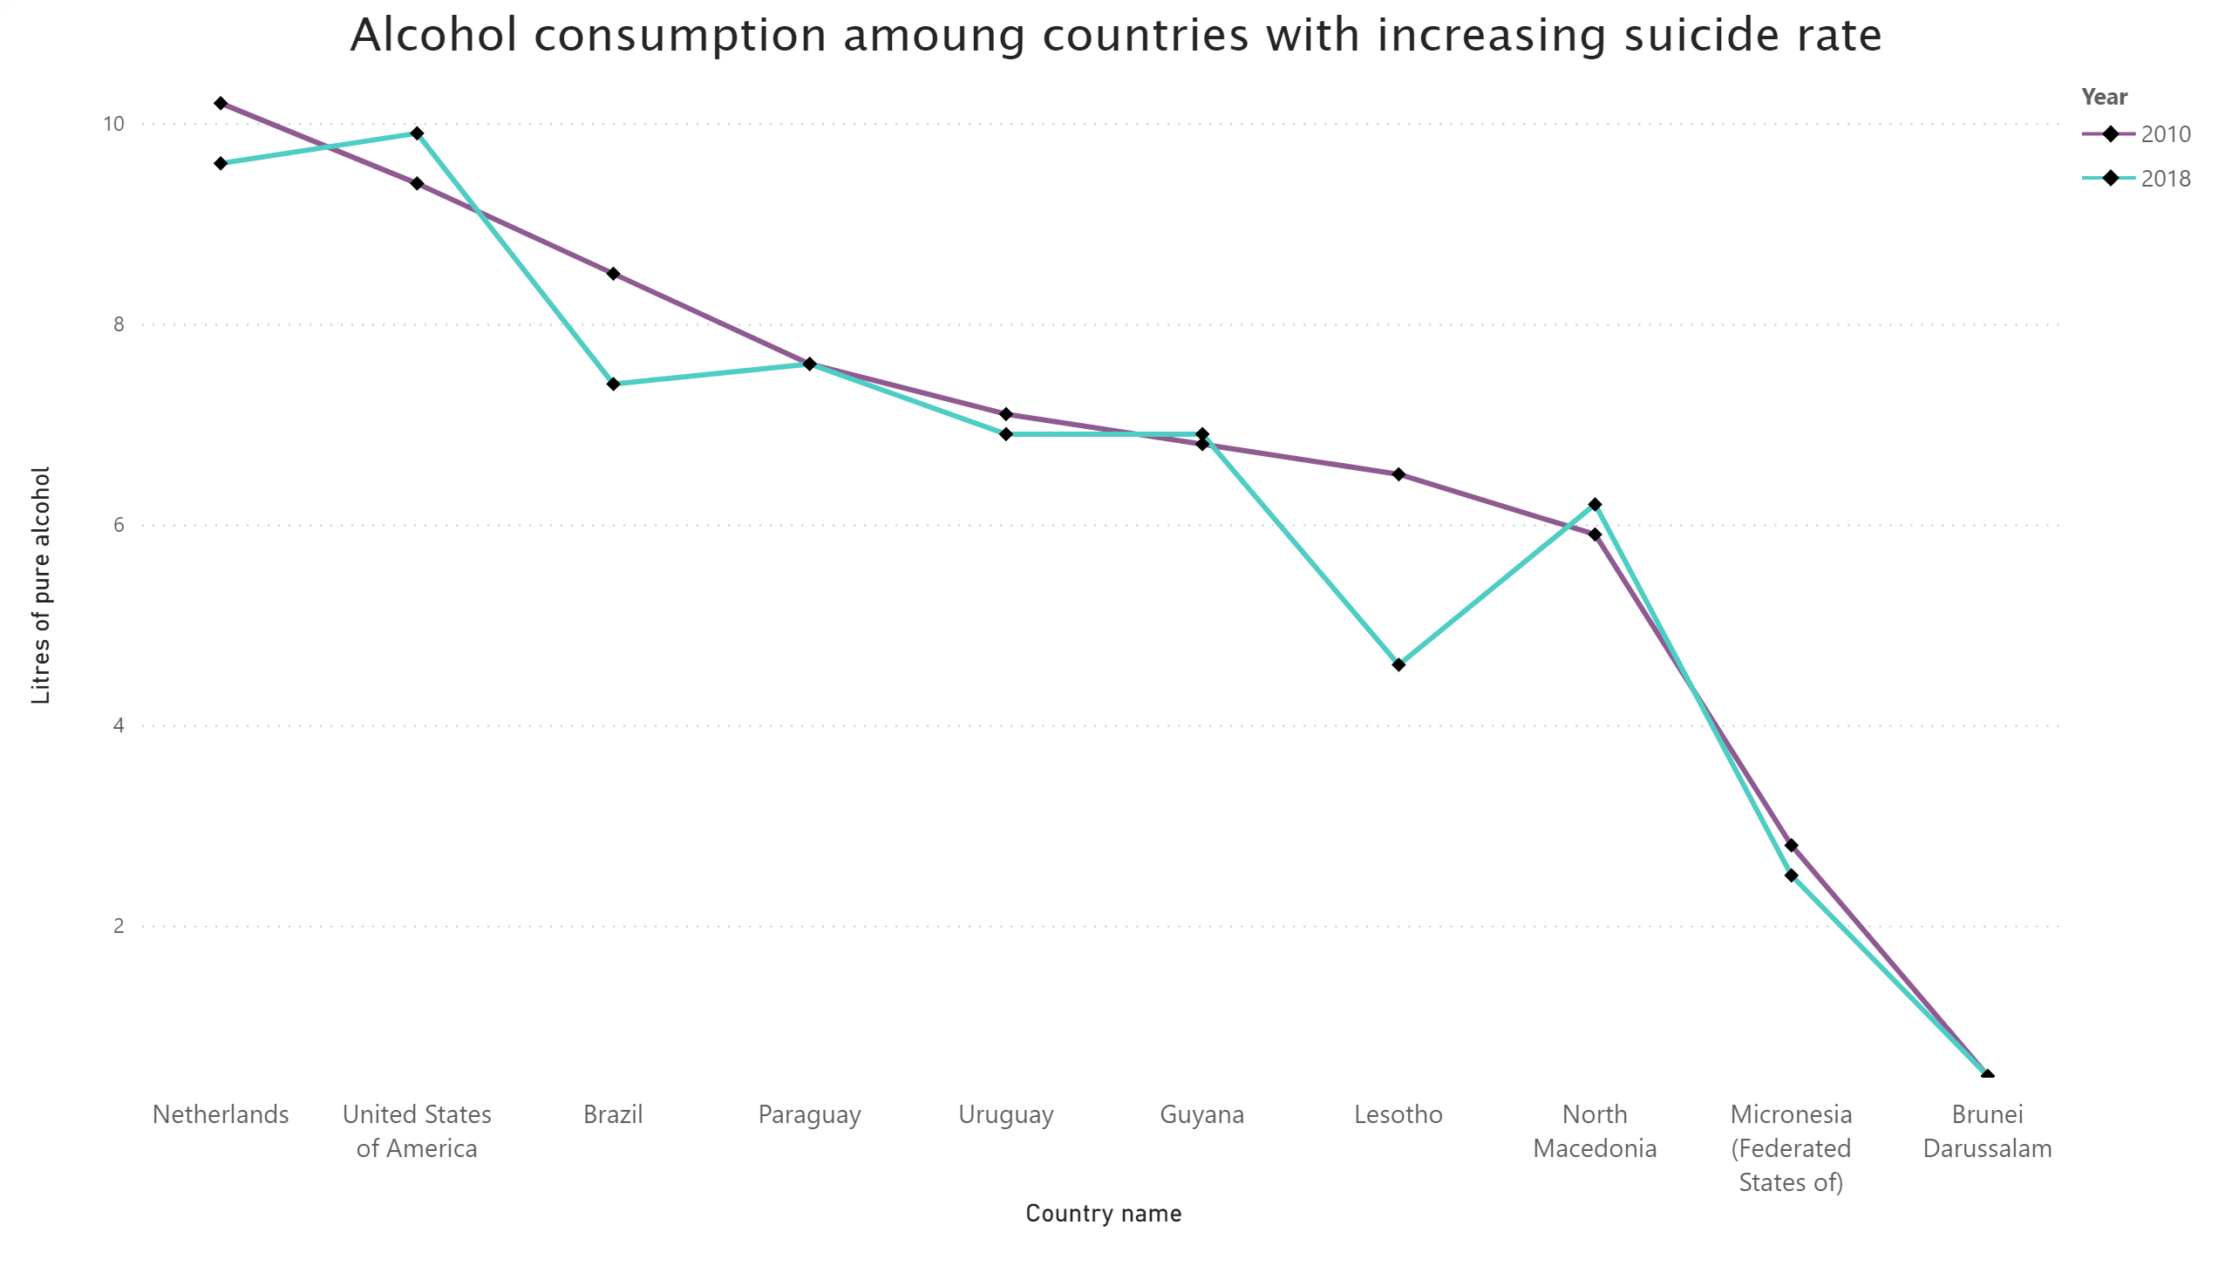
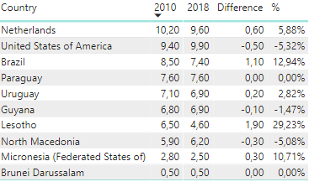
Increase of suicide alcohol
Alcohol Consumption among countries with increasing suicide rate
Notes:
Alcohol consumption amoung countries with increasing suicide rate
No alt text provided.

Slide 13
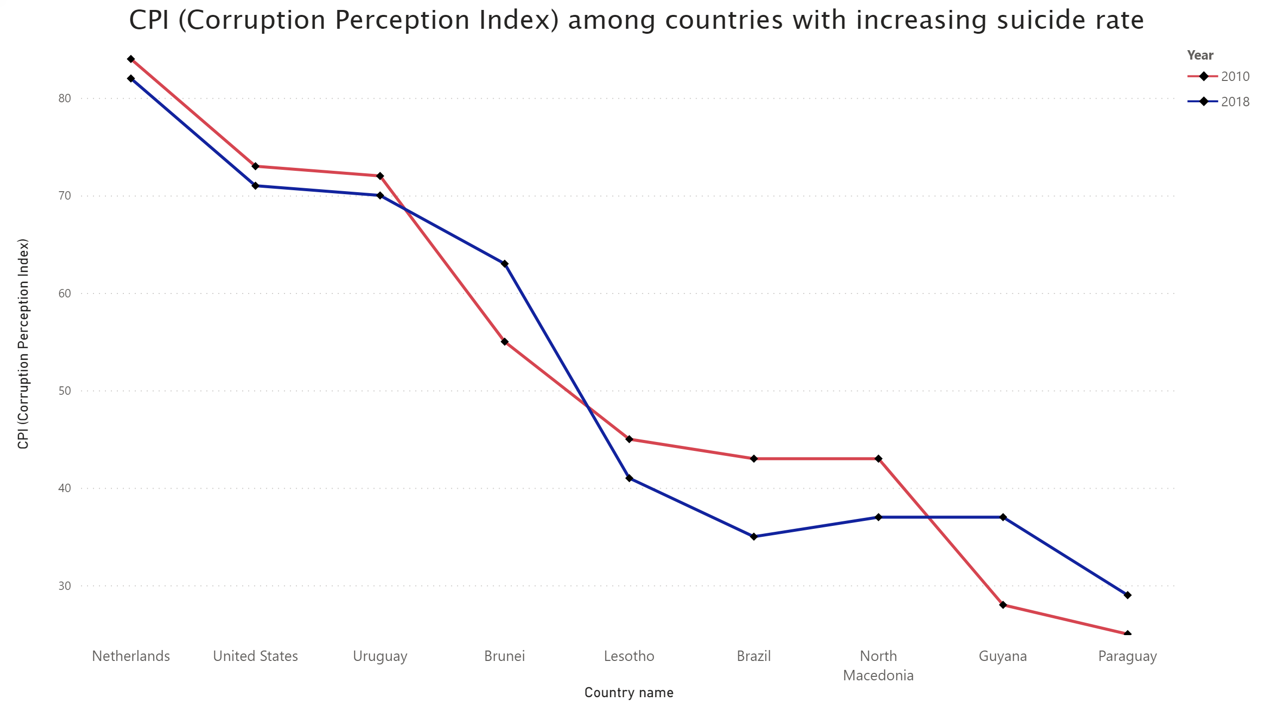
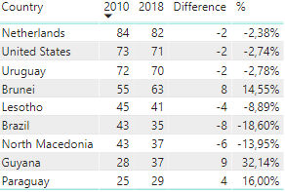
suicide growth coruption
CPI among countries with increasing suicide rate
Notes:
CPI (Corruption Perception Index) among countries with increasing suicide rate
No alt text provided.

Slide 14
Conclusion: Alcohol consumption
Is there a connection between suicide rate and alcohol abuse in different countries?
Our research showed that 2 out of 3 countries with the highest suicide rate had high level of alcohol consumption as well.
Among countries with decreasing suicide rate, 7 out of 10 countries showed also decrease in alcohol consumption.
Furthermore, among countries with increasing suicide rate, 3 countries out of 10 showed increase of alcohol consumption and for 2 countries there were no improvement.
All this facts imply that there is a connection between suicide rate and alcohol abuse.

Slide 15
Conclusion: CPI
Would we see the correlation between suicide rate and corruption perceptional index (CPI)?
All 10 countries with the highest suicide rate had CPI below average.
Among countries with decreasing suicide rate, 6 out of 10 countries showed improvement in CPI, 1 country’s CPI stayed the same.
Among countries with increasing suicide rate, 6 out of 9 countries showed negative trend in their CPIs.
As we see, this facts show that there is a correlation between suicide rate and corruption perceptional index (CPI).

Slide 16


QUESTIONS

