Slide 1
New York VS Toronto
Venues

Slide 2


•Person: What venues are available to you in a new city? •Business: What venues are lacking in a new city?
Moving?

Slide 3

• FourSquare API: FourSquare.com, consists of one of the largest databases of venues. • New York Data: https://geo.nyu.edu/catalog/nyu_2451_34572, consists of New York neighborhood names and coordinates. • Toronto Data: https://en.wikipedia.org/wiki/List_of_postal_codes_of_Canada:_M, consists of New York neighborhoods. We will have to use https://cocl.us/Geospatial_data to get the coordinates.
Data Acquisition

Slide 4
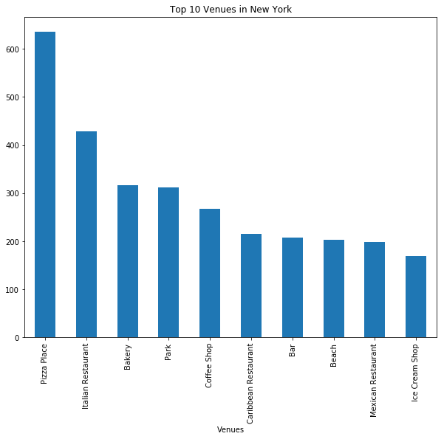
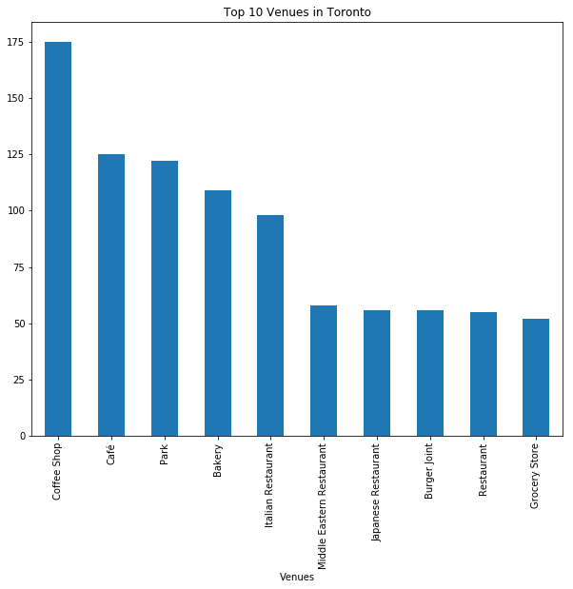
Top Ten Venue Comparison

Slide 5
Conclusion
From the data compiled by this report, it seems that New York is for more outgoing people. There are a lot of venues to hang out at and visit. Toronto on the other hand, might be more suitable for businesses to expand into to take advantage of lacking amount of venues. However, as I mentioned in the discussion, more research is needed to find out weather such a move would be wise or not.

