Slide 1
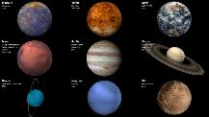
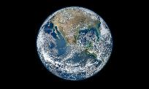
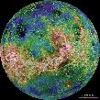

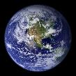
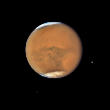
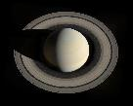
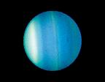
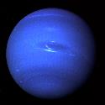
https://creativecommons.org/licenses/by-nc/2.0/?ref=ccsearch
NASA
https://solarsystem.nasa.gov/resources/490/our-solar-system/
https://solarsystem.nasa.gov/resources/771/colors-of-the-innermost-planet-view-1/
https://www.nasa.gov/sites/default/files/images/750778main_earth_lg-300dpi.jpg
https://solarsystem.nasa.gov/resources/486/hemispheric-view-of-venus/?category=planets_venus
https://search.creativecommons.org/photos/843789cc-1bbc-4dd2-8ddd-bece88367ea5
https://solarsystem.nasa.gov/resources/611/neptune-full-disk-view/?category=planets_neptune
https://solarsystem.nasa.gov/resources/786/blue-marble-2002/?category=planets_earth
https://solarsystem.nasa.gov/resources/948/hubbles-close-up-view-of-mars-dust-storm/?category=planets_mars
https://solarsystem.nasa.gov/resources/2486/hubbles-new-portrait-of-jupiter/?category=planets_jupiter
https://solarsystem.nasa.gov/resources/15899/high-above-saturn/?category=planets_saturn
https://solarsystem.nasa.gov/resources/454/hubbles-uranus/?category=planets_uranus
https://solarsystem.nasa.gov/planets/overview/
https://solarsystem.nasa.gov/planets/mercury/overview/
https://solarsystem.nasa.gov/planets/venus/overview/
https://solarsystem.nasa.gov/planets/earth/overview/

Slide 2







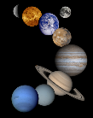

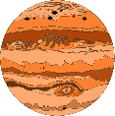


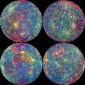
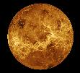
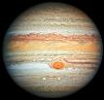
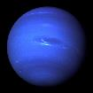
https://search.creativecommons.org/photos/1cfdf156-6a62-47d5-860e-cda9e76dca17
https://search.creativecommons.org/photos/dadc9350-aa4c-4d70-9abd-5b45174247d2
https://freesvg.org/solar-system-with-rocket-and-spaceman
https://search.creativecommons.org/photos/7fb25329-a9d7-4136-b65f-e17c0789e6aa
https://freesvg.org/earth-emoji
https://publicdomainvectors.org/en/free-clipart/Decorative-glowing-sun-with-spokes-vector-clip-art/30159.html
https://commons.wikimedia.org/wiki/File:Three_stars.svg
https://freesvg.org/solar-system-montage
http://www.freestockphotos.biz/stockphoto/16906
https://www.publicdomainpictures.net/en/view-image.php?image=280865&picture=color-stars
https://www.flickr.com/photos/gsfc/9103296900/in/photostream/
https://www.needpix.com/photo/334383/jupiter-astronomy-space-solar-planetary
https://commons.wikimedia.org/wiki/File:Unmasking_the_Secrets_of_Mercury.jpg
https://en.wikipedia.org/wiki/Venus#/media/File:Venus_globe.jpg
https://commons.wikimedia.org/wiki/File:Jupiter,_image_taken_by_NASA%27s_Hubble_Space_Telescope,_June_2019_-_Edited.jpg
https://en.wikipedia.org/wiki/File:Neptune_Full.jpg

Slide 3
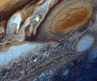
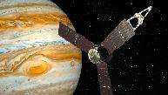
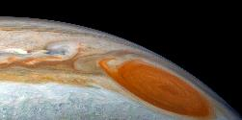
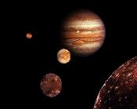
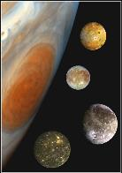
https://www.needpix.com/photo/745938/jupiter-planet-space-probe-spacecraft-juno-technique-technology-science-research
https://en.wikipedia.org/wiki/File:Jupiter_from_Voyager_1.jpg
https://upload.wikimedia.org/wikipedia/commons/8/8a/Jupiter_family.jpg
https://www.flickr.com/photos/kevinmgill/47116525732
https://picryl.com/media/family-portrait-of-jupiter-great-red-spot-and-the-galilean-satellites-aea0ae

