Slide 1
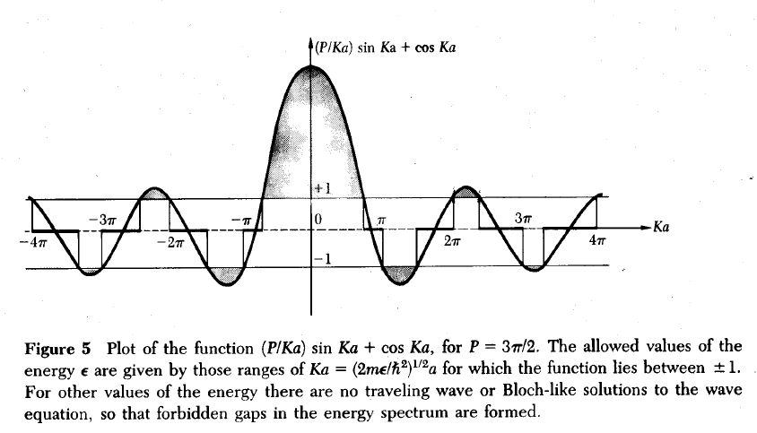
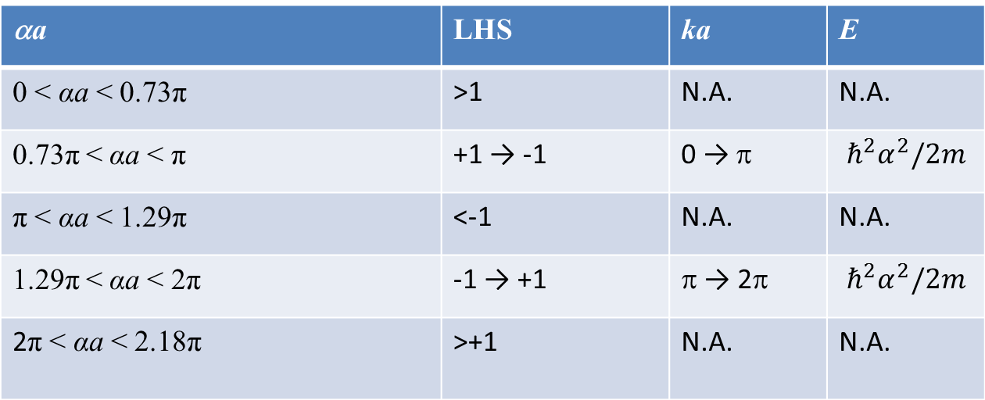

Kronig-Penny Model
$$E=\frac{ℏ^{2}α^{2}}{2m}$$
αa
P = 2
αa | LHS | ka | E
0 < αa < 0.73π | >1 | N.A. | N.A.
0.73π < αa < π | +1 → -1 | 0 → π | $$ℏ^{2}α^{2}/2m$$
π < αa < 1.29π | <-1 | N.A. | N.A.
1.29π < αa < 2π | -1 → +1 | π → 2π | $$ℏ^{2}α^{2}/2m$$
2π < αa < 2.18π | >+1 | N.A. | N.A.

Slide 2
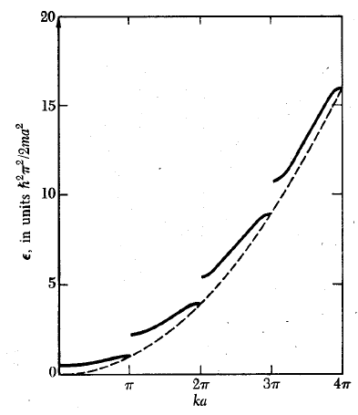
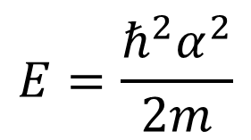
Energy versus ka for Kronig Penny Model
$$E=\frac{ℏ^{2}α^{2}}{2m}$$
αa

Slide 3
Kronig-Penny Model
αa
P = 2
αa | LHS | ka | E
0 < αa < 0.73π
0.73π < αa < π
π < αa < 1.29π
1.29π < αa < 2π
2π < αa < 2.18π

Slide 4
Energy versus ka for Kronig Penny Model
$$E=\frac{ℏ^{2}α^{2}}{2m}$$
αa

