Slide 1
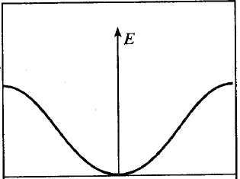
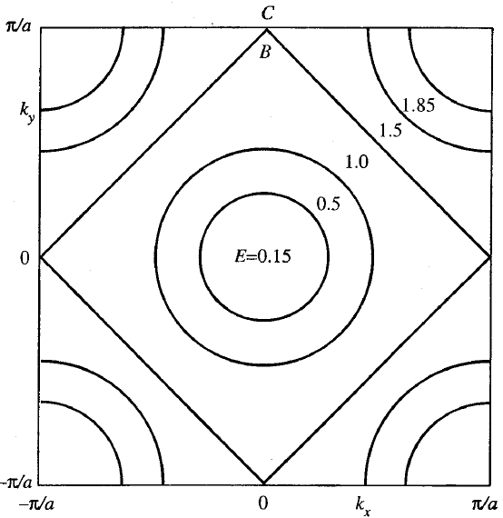
Band Filling in 2-D
E=1.0, 1.5
@ k_{y}=π/a
1.5
C
D
1.0
B
k_{y}
2.0
D
k_{xy}

Slide 2
E
E
Valence
Band
f(E)
f(E)
Filled States
Empty States

