Slide 1
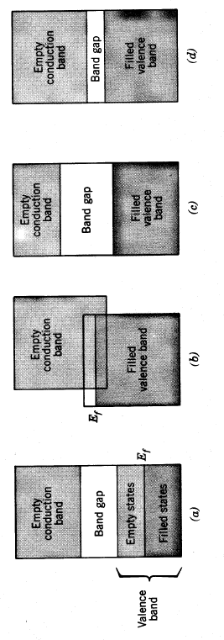
Classes of Band-Structures
metal
semi-metal
insulator
semiconductor

Slide 2
E
Conduction
Band
E
Conduction
Band
n
T=0
T >>0
Energy
Gap
Energy
Gap
E_{f}
p
Valence
Band
Valence
Band
f(E)
f(E)
Filled States
Empty States

Slide 3
Direct and Indirect-Gap Semiconductors
Conduction
Band
E
E_{c}
E
E_{c}
E_{g}
E_{g}
k
k
Valence
Band
E_{v}
E_{v}
DIRECT (e.g. GaAs)
INDIRECT (e.g. Si)

Slide 4
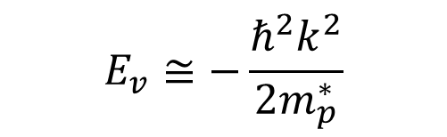
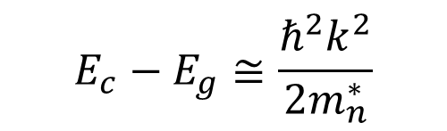
Energies of Electrons in Bands
Conduction Band
Positive effective mass,
negative charge
E
$$E_{c}−E_{g}≅\frac{ℏ^{2}k^{2}}{2m_{n}^{∗}}$$
E_{c}
E_{g}
k
Valence Band
Negative effective mass,
positive charge
$$E_{v}≅−\frac{ℏ^{2}k^{2}}{2m_{p}^{∗}}$$
E_{v}

Slide 5
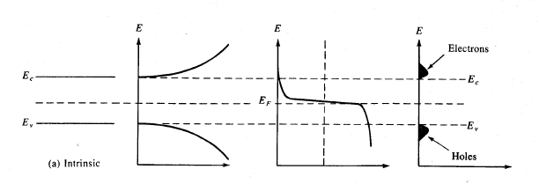
Occupied States at Finite Temperature
Density of States
Occupation
Product

Slide 6
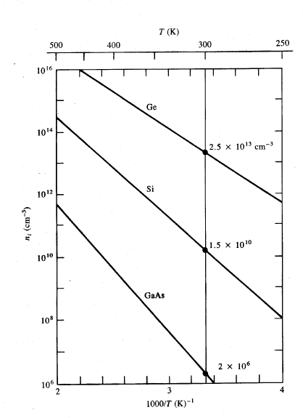
Intrinsic Carrier Concentration vs. T

Slide 7
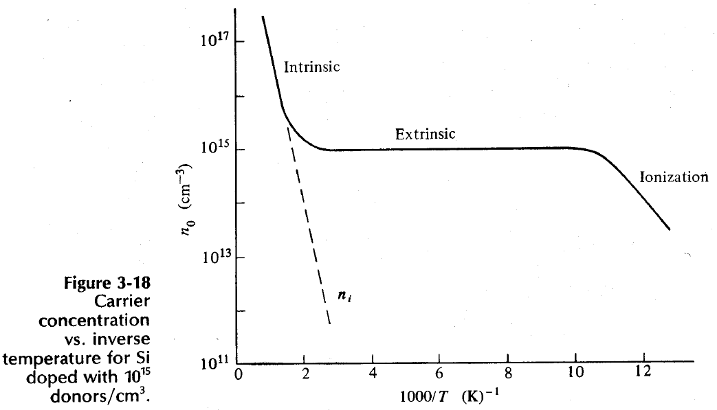
Regimes of Conduction

Slide 8
Classes of Band-Structures

Slide 9
Direct and Indirect-Gap Semiconductors

Slide 10
Energies of Electrons in Bands
Conduction Band
E
E_{c}
E_{g}
k
Valence Band
E_{v}

Slide 11
Occupied States at Finite Temperature
Density of States
Occupation
Product

