Slide 1
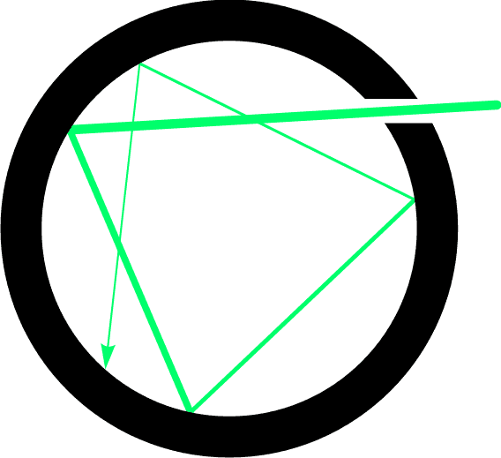
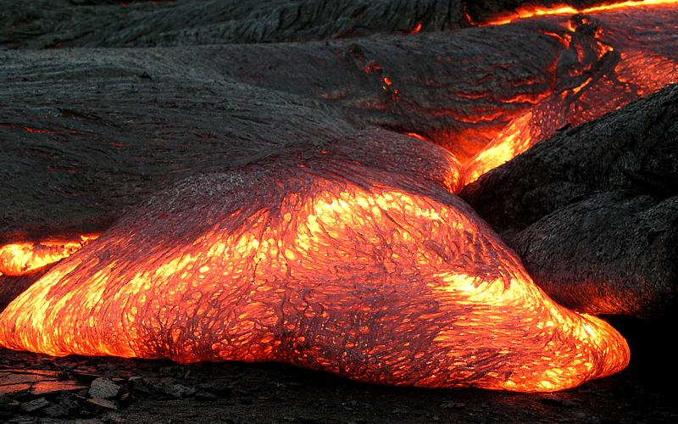
Blackbody
Perfect absorber/emitter
light
R(λ,T)
ρ(λ,T)
Light in cavity is in equilibrium with the blackbody
Light coming from hole has spectral distribution ρ(λ,t)
Source: wikipedia

Slide 2
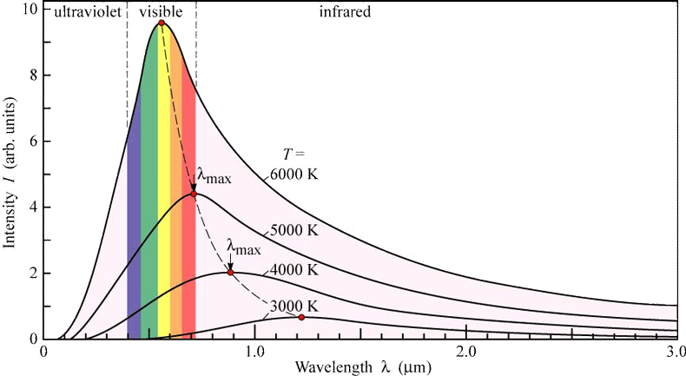
Blackbody Radiation
R(λ,t)
E. F. Schubert, Light-Emitting Diodes, Cambridge Univ. Press

Slide 3
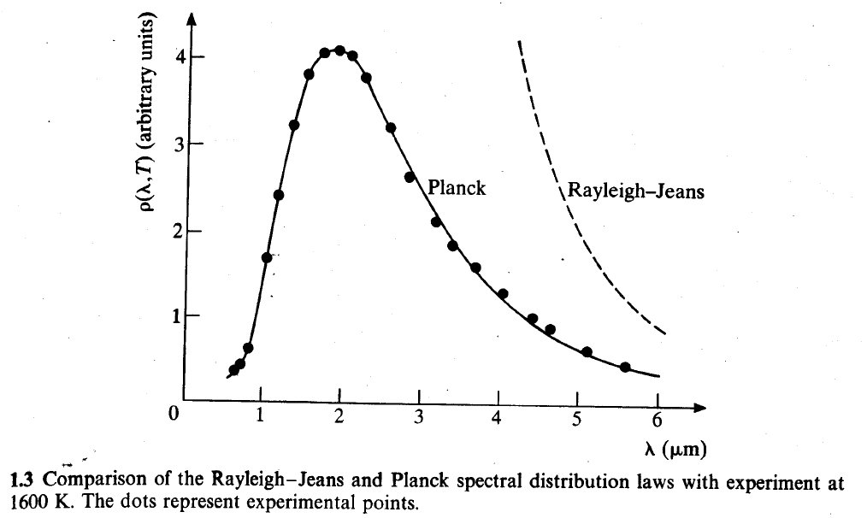
Comparison of forms for ρ(λ,T)

Slide 4
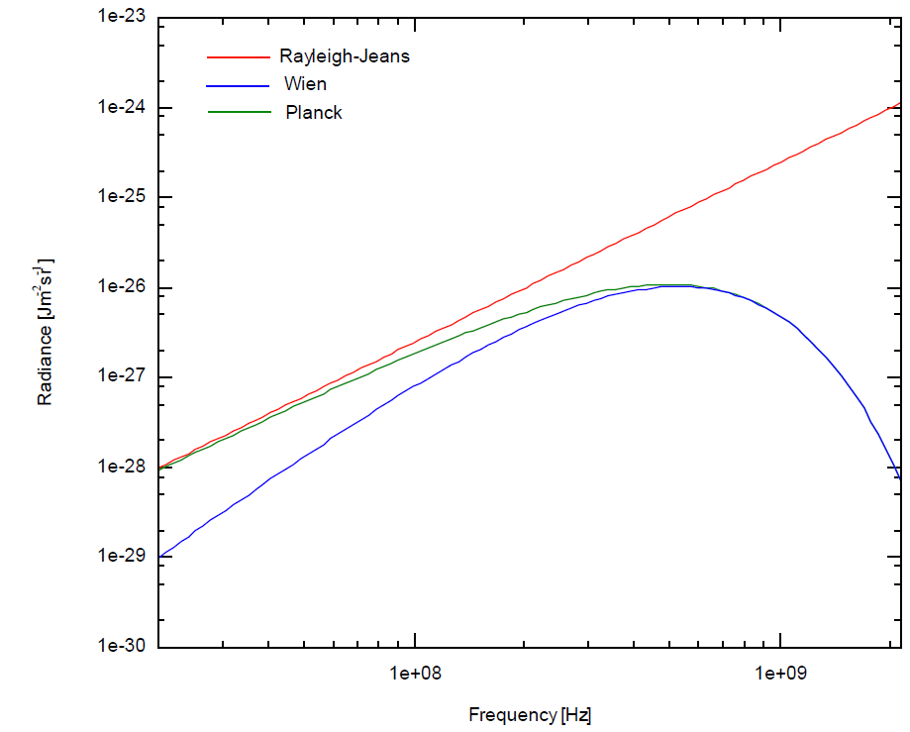
Comparison of forms for R(λ,T)
Shorter λ
Source: wikipedia

