Slide 1
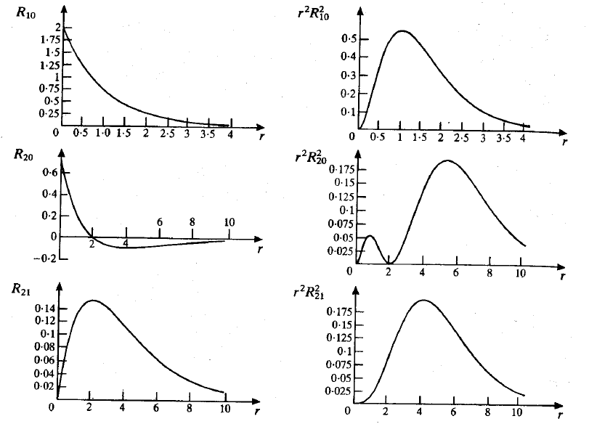
Radial Wavefunctions
# nodes = n-l-1
n=1
l=0
n=2
l=0
l=1
n=2

Slide 2
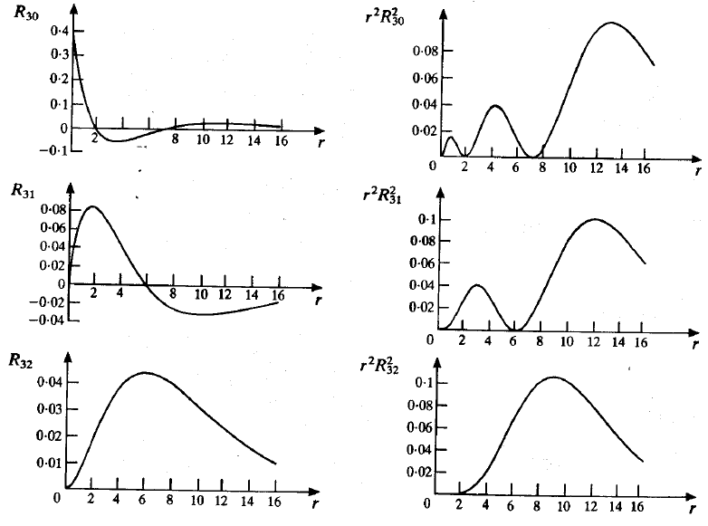
Radial Wavefunctions
# nodes = n-l-1
n=3
l=0
n=3
l=1
l=2
n=3

Slide 3
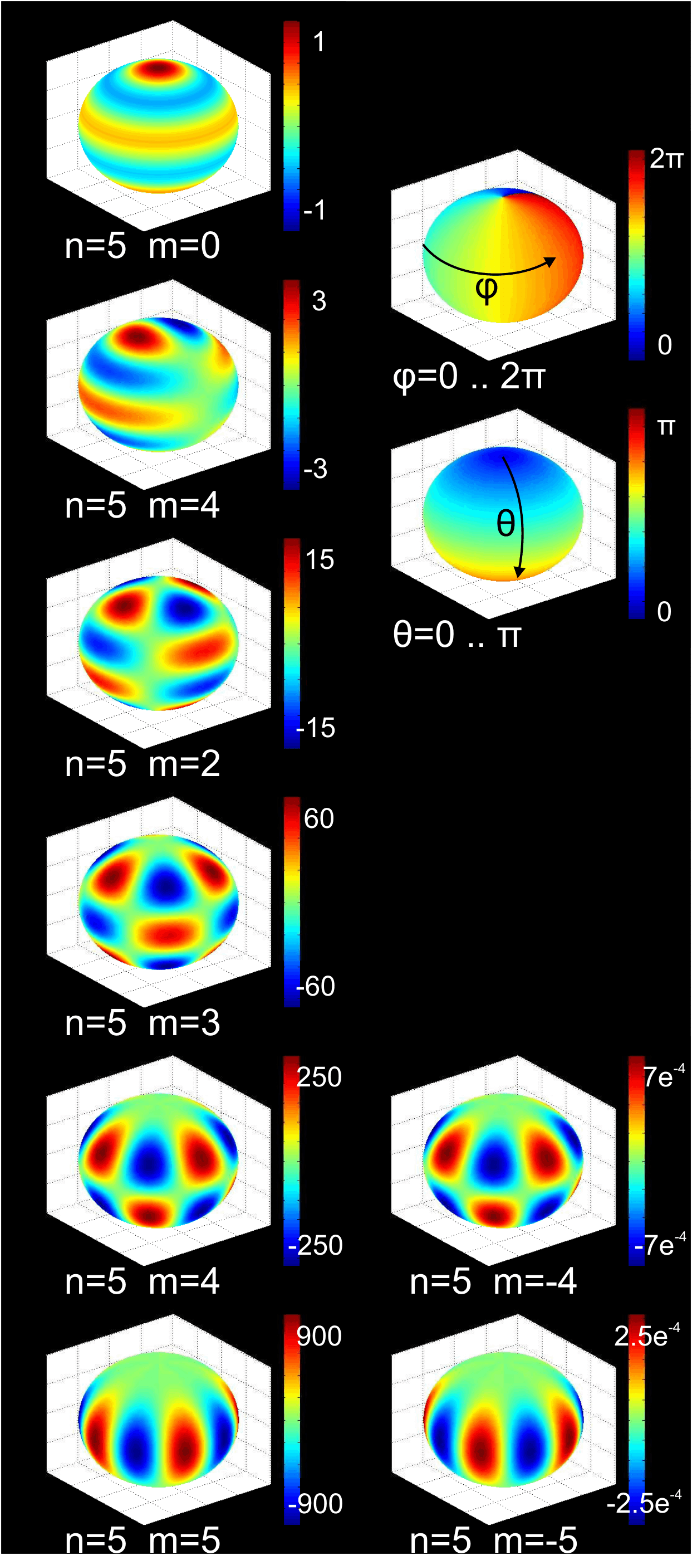
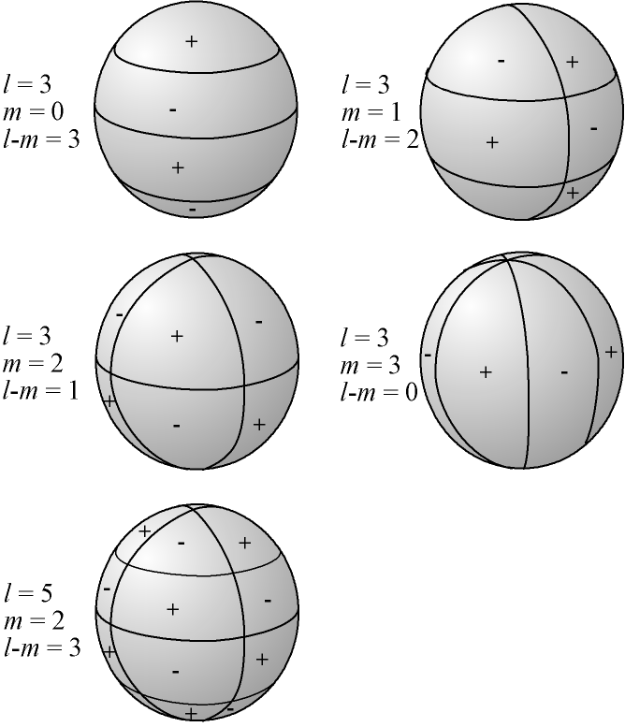
Example Spherical Harmonics
http://en.wikipedia.org/wiki/Spherical_harmonics

Slide 4
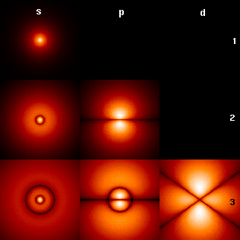

Hydrogen Atom Probability Densities
http://cat.sckans.edu/physics/hydrogenic.htm
l=0
l=1
l=2
n=1
n=2
n=3
http://en.wikipedia.org/wiki/Hydrogen_atom

Slide 5
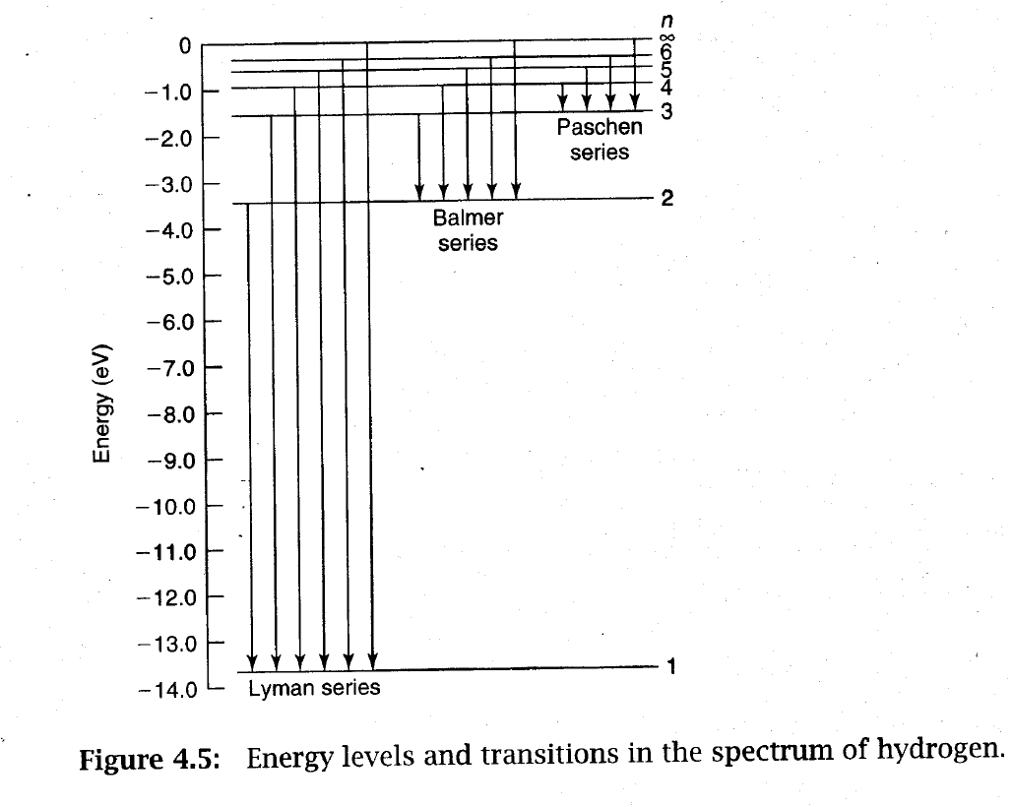
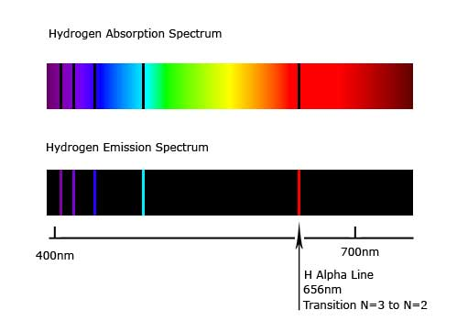
Hydrogen Spectrum
IR
VIS
UV
http://en.wikipedia.org/wiki/Hydrogen_spectral_series

Slide 6
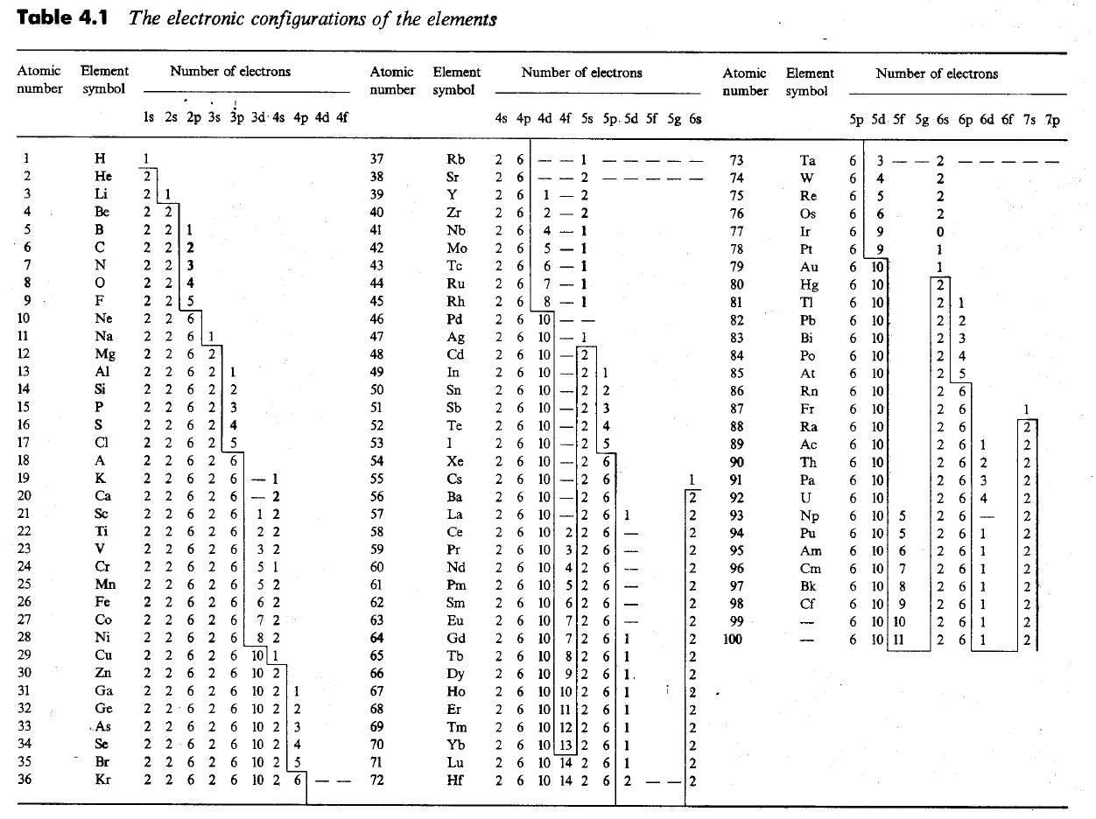

Slide 7
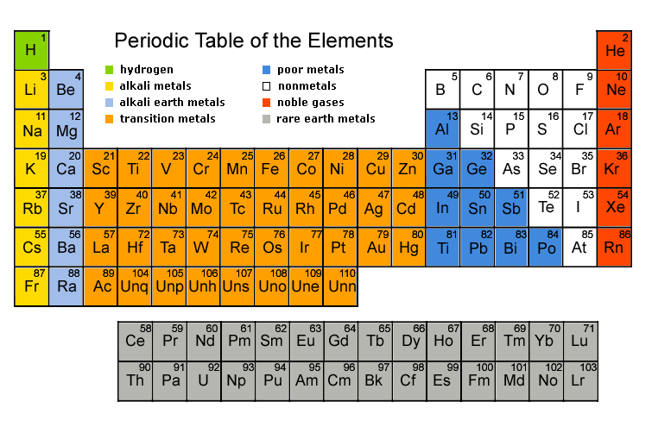
http://www.elementsdatabase.com/

