Slide 1
Linear Algebra with Python
O’Reilly Media
Thomas Nield

Slide 2
Overview

Slide 3
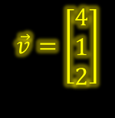
Agenda
Here is what we will do for the next 3 hours:
1
Introduction to Linear Algebra
2
Where linear algebra is used
$$\vec{v}=\left[\begin{matrix}4 \\ 1 \\ 2\end{matrix}\right]$$
3
Vector operations using NumPy Arrays
2
1
4
Matrix operations using NumPy Arrays
4
5
Solving systems of equations
6
Eigenvalues and Eigenvectors

Slide 4
Why Learn Linear Algebra?
Linear algebra can be found in many areas of science, technology, engineering, and data science.
Computers can more efficiently model data as vectors and matrices and perform operations more effectively.
It is also the backbone of machine learning, data management, graphical modeling, and other computer science areas.
If you want to advance your knowledge in machine learning, statistical modeling, or other areas in computer science then linear algebra is a must!
$$\vec{v}=\left[\begin{matrix}4 \\ 1 \\ 2\end{matrix}\right]$$
2
1
4

Slide 5
I. Vectors, Combination, and Scaling

Slide 6


What Are Vectors?
Vectors are an arrow in space, with a specific direction and length.
This can mean different things to different disciplines.
Physics – Direction and magnitude.
Computer science – An array of numbers storing data
Math – A direction and scale on an XY plane.
To truly understand linear algebra, you must first think of a vector as an arrow (top right) or a point in space (bottom right).
$$\vec{v}$$
$$\vec{v}$$

Slide 7
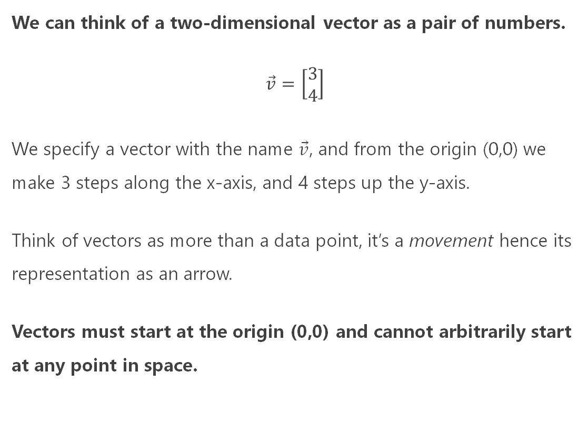

Vectors as Numbers
We can think of a two-dimensional vector as a pair of numbers.
$$\vec{v}=\left[\begin{matrix}3 \\ 4\end{matrix}\right]$$
We specify a vector with the name $\vec{v}$, and from the origin (0,0) we make 3 steps along the x-axis, and 4 steps up the y-axis.
Think of vectors as more than a data point, it’s a movement hence its representation as an arrow.
Vectors must start at the origin (0,0) and cannot arbitrarily start at any point in space.
$\vec{v}$ = $\left[\begin{matrix}3 \\ 4\end{matrix}\right]$
4
3

Slide 8






Some Vector Examples
$$\vec{v}=\left[\begin{matrix}−3 \\ 2\end{matrix}\right]$$
$\vec{v}$ = $\left[\begin{matrix}3 \\ 4\end{matrix}\right]$
2
4
4
-3
-4
-4
3
$$\vec{v}=\left[\begin{matrix}−4 \\ −4\end{matrix}\right]$$
$\vec{v}$ = $\left[\begin{matrix}3 \\ 4\end{matrix}\right]$
$\vec{v}$ = $\left[\begin{matrix}−3 \\ 2\end{matrix}\right]$
$\vec{v}$ = $\left[\begin{matrix}−4 \\ −4\end{matrix}\right]$

Slide 9


Quick Quiz
What is the numerical value for the vector $\vec{v}$ ?
$\vec{v}$ = $\left[\begin{matrix}3 \\ 2\end{matrix}\right]$
$\vec{v}$ = $\left[\begin{matrix}2 \\ 3\end{matrix}\right]$
$\vec{v}$ = $\left[\begin{matrix}−2 \\ 3\end{matrix}\right]$
$\vec{v}$ = $\left[\begin{matrix}2 \\ −3\end{matrix}\right]$
$$\vec{v}$$

Slide 10


Quick Quiz
What is the numerical value for the vector $\vec{v}$ ?
$\vec{v}$ = $\left[\begin{matrix}3 \\ 2\end{matrix}\right]$
$\vec{v}$ = $\left[\begin{matrix}2 \\ 3\end{matrix}\right]$
$\vec{v}$ = $\left[\begin{matrix}−2 \\ 3\end{matrix}\right]$
$\vec{v}$ = $\left[\begin{matrix}2 \\ −3\end{matrix}\right]$
$\vec{v}$ = $\left[\begin{matrix}2 \\ 3\end{matrix}\right]$
3
2

Slide 11

Quick Quiz
Is this a valid vector on the right?
$$\vec{v}$$

Slide 12
Quick Quiz
Is this a valid vector on the right?
No! A vector must start at the origin (0,0) and cannot start anywhere else.
$$\vec{v}$$

Slide 13


Quick Quiz
Is this a valid vector on the right?
No! A vector must start at the origin (0,0) and cannot start anywhere else.
$$\vec{v}$$

Slide 14
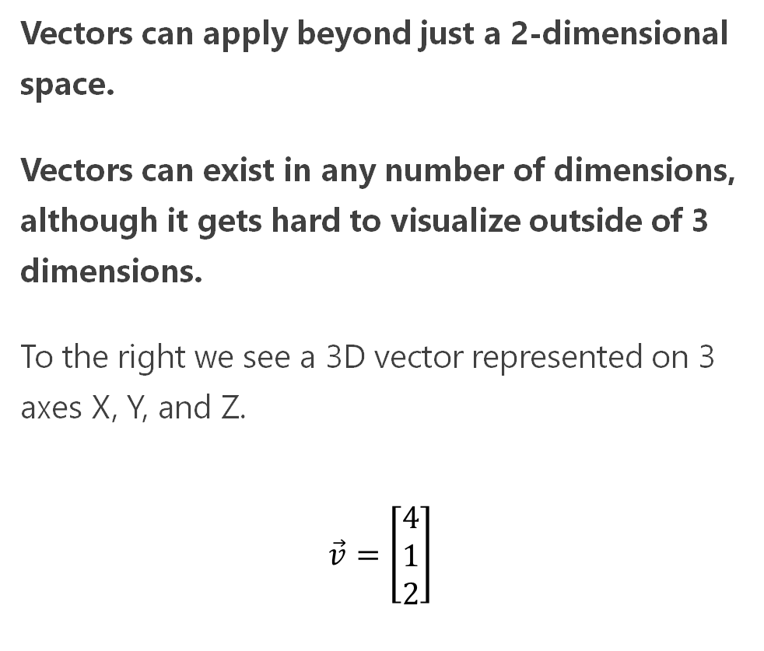
3D Vectors and Beyond
Vectors can apply beyond just a 2-dimensional space.
Vectors can exist in any number of dimensions, although it gets hard to visualize outside of 3 dimensions.
To the right we see a 3D vector represented on 3 axes X, Y, and Z.
$$\vec{v}=\left[\begin{matrix}4 \\ 1 \\ 2\end{matrix}\right]$$
$$\vec{v}=\left[\begin{matrix}4 \\ 1 \\ 2\end{matrix}\right]$$
2
1
4

Slide 15
Declaring Vectors in Python
In Python, you will typically represent a vector using NumPy’s ndarray.
To the right we declare a 3-dimensional vector (holding 3 elements) in Python using a 1-dimensional array in NumPy.
from numpy import array data = [4.0, 1.0, 2.0] v = array(data) # display vector print(v)
$$\vec{v}=\left[\begin{matrix}4 \\ 1 \\ 2\end{matrix}\right]$$
2
OUTPUT:
[4. 1. 2.]
1
4

Slide 16
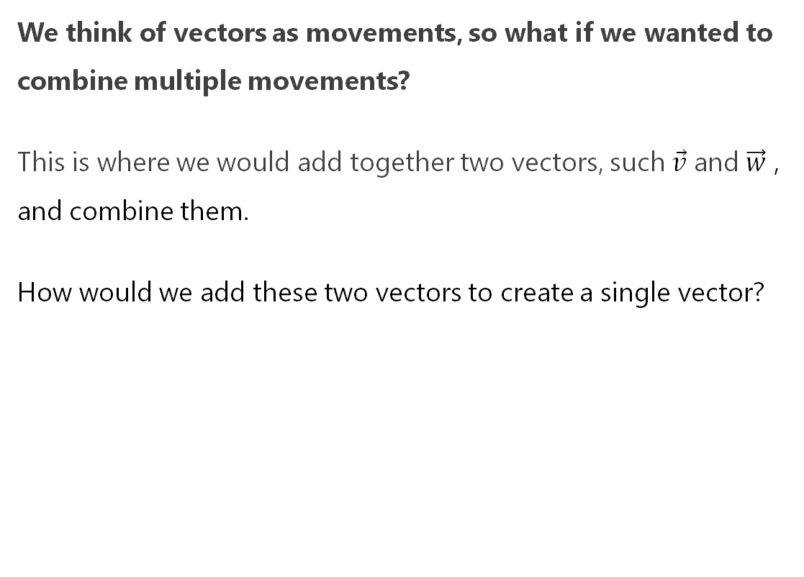


Adding/Combining Vectors
We think of vectors as movements, so what if we wanted to combine multiple movements?
This is where we would add together two vectors, such $\vec{v}$ and $\vec{w}$ , and combine them.
How would we add these two vectors to create a single vector?
$$\vec{v}=\left[\begin{matrix}3 \\ 2\end{matrix}\right]$$
$$\vec{w}=\left[\begin{matrix}2 \\ −1\end{matrix}\right]$$

Slide 17


Adding/Combining Vectors
To visually add these two vectors together, connect one vector after the other and walk to the tip of the last vector.
$$\vec{w}$$
$$\vec{v}$$

Slide 18
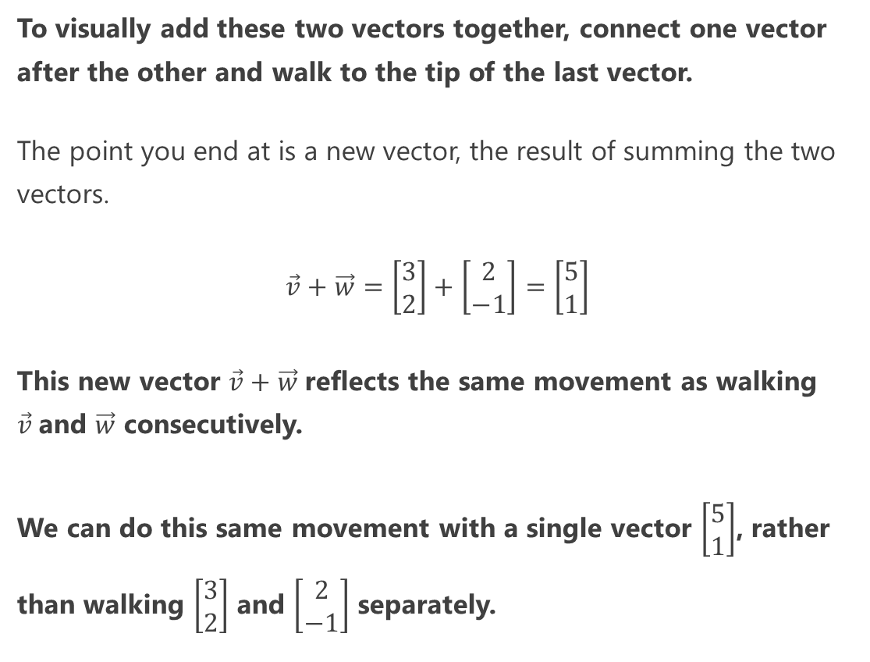

Adding/Combining Vectors
To visually add these two vectors together, connect one vector after the other and walk to the tip of the last vector.
The point you end at is a new vector, the result of summing the two vectors.
$$\vec{v}+\vec{w}=\left[\begin{matrix}3 \\ 2\end{matrix}\right]+\left[\begin{matrix}2 \\ −1\end{matrix}\right]=\left[\begin{matrix}5 \\ 1\end{matrix}\right]$$
This new vector $\vec{v}+\vec{w}$reflects the same movement as walking $\vec{v}$and $\vec{w}$ consecutively.
We can do this same movement with a single vector $\left[\begin{matrix}5 \\ 1\end{matrix}\right]$, rather than walking $\left[\begin{matrix}3 \\ 2\end{matrix}\right]$ and $\left[\begin{matrix}2 \\ −1\end{matrix}\right]$ separately.
$$\vec{w}$$
$$\vec{v}$$
$$\vec{v}+\vec{w}$$

Slide 19
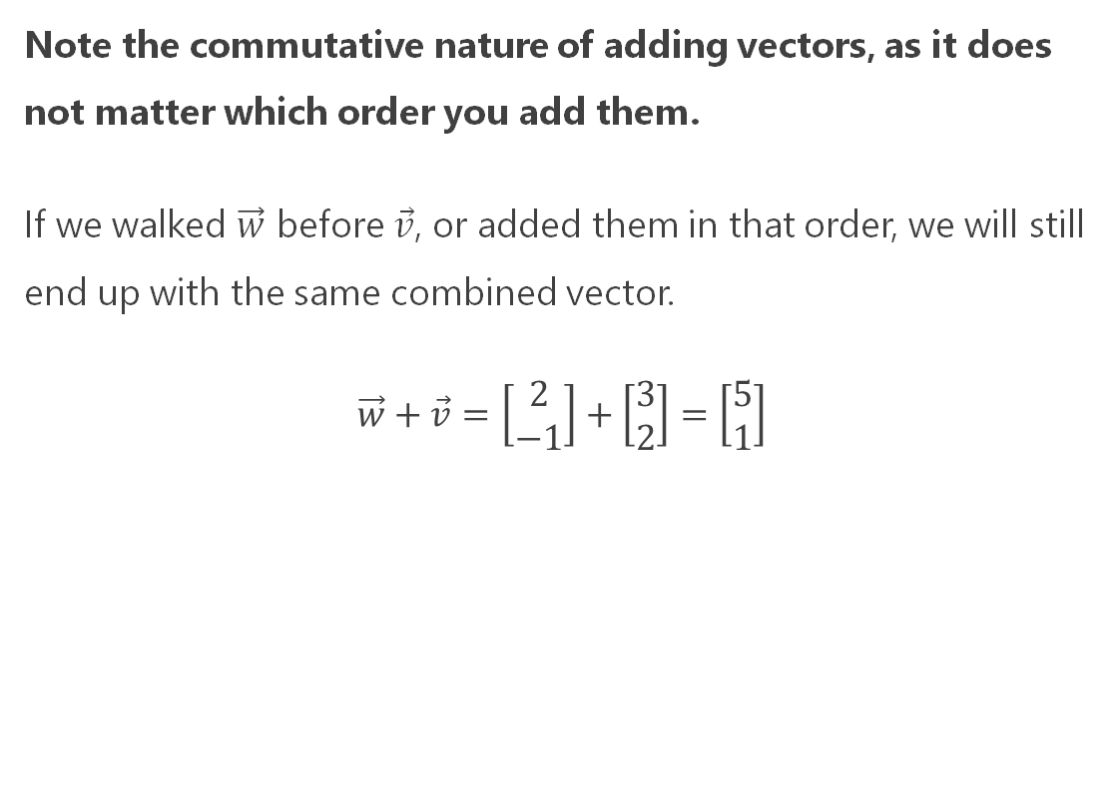


Adding/Combining Vectors
Note the commutative nature of adding vectors, as it does not matter which order you add them.
If we walked $\vec{w}$ before $\vec{v}$, or added them in that order, we will still end up with the same combined vector.
$$\vec{w}+\vec{v}=\left[\begin{matrix}2 \\ −1\end{matrix}\right]+\left[\begin{matrix}3 \\ 2\end{matrix}\right]=\left[\begin{matrix}5 \\ 1\end{matrix}\right]$$
$$\vec{v}+\vec{w}$$
$$\vec{v}$$
$$\vec{w}$$

Slide 20





Adding/Combining Vectors in Python
Summing vectors in Python with NumPy should be straightforward.
Declare the vectors as NumPy arrays and use the + operator to sum the vectors.
from numpy import array v = array([3,2]) w = array([2,-1]) # sum the vectors v_plus_w = v + w # display summed vector print(v_plus_w)
$$\vec{v}=\left[\begin{matrix}3 \\ 2\end{matrix}\right]$$
$$\vec{w}=\left[\begin{matrix}2 \\ −1\end{matrix}\right]$$
OUTPUT:
[5 1]
$$\vec{w}$$
$$\vec{v}$$
$$\vec{v}+\vec{w}$$

Slide 21
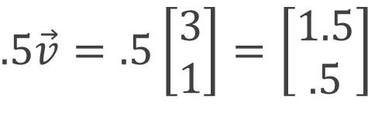

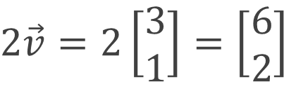




Multiplying/Scaling Vectors
You can also grow/shrink a vector by multiplying or scaling it with a scalar value.
To the right are two examples, the top doubles the length of the vector while and the bottom halves the vector.
$$\vec{v}=\left[\begin{matrix}3 \\ 1\end{matrix}\right]$$
$$2\vec{v}$$
$$2\vec{v}=2\left[\begin{matrix}3 \\ 1\end{matrix}\right]=\left[\begin{matrix}6 \\ 2\end{matrix}\right]$$
$$\vec{v}$$
$$.5\vec{v}=.5\left[\begin{matrix}3 \\ 1\end{matrix}\right]=\left[\begin{matrix}1.5 \\ .5\end{matrix}\right]$$
$$\vec{v}$$
$$.5\vec{v}$$

Slide 22
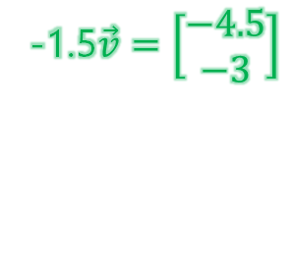


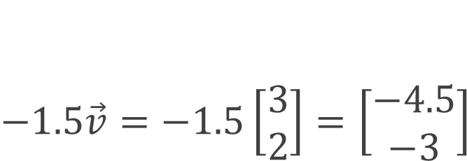
Multiplying/Scaling Vectors
When you multiply/scale a vector with a negative number, it will flip the vector in the opposite direction.
Note that multiplying/scaling a vector only grows or shrinks a vector.
Scaling does not change a vector’s direction except for a negative scalar which flips its direction.
$$\vec{v}=\left[\begin{matrix}3 \\ 2\end{matrix}\right]$$
-1.5$\vec{v}=\left[\begin{matrix}−4.5 \\ −3\end{matrix}\right]$
$$\vec{v}=\left[\begin{matrix}3 \\ 2\end{matrix}\right]$$
$$−1.5\vec{v}=−1.5\left[\begin{matrix}3 \\ 2\end{matrix}\right]=\left[\begin{matrix}−4.5 \\ −3\end{matrix}\right]$$

Slide 23
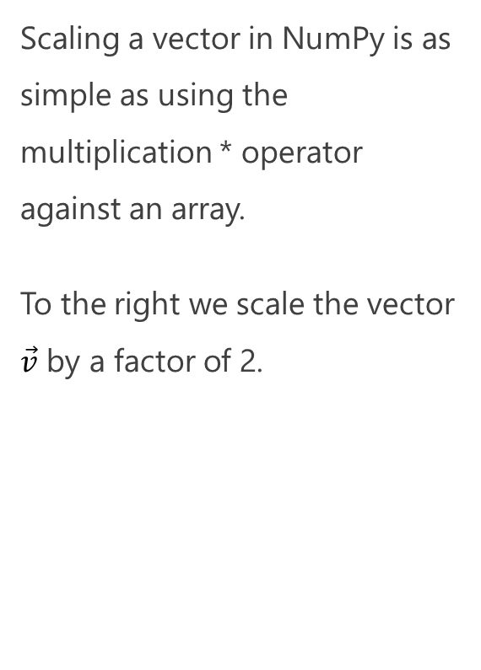
Multiplying/Scaling Vectors in Python
Scaling a vector in NumPy is as simple as using the multiplication * operator against an array.
To the right we scale the vector $\vec{v}$ by a factor of 2.
from numpy import array v = array([3,1]) # scale the vector scaled_v = 2.0 * v # display scaled vector print(scaled_v)
$$2\vec{v}$$
$$\vec{v}$$
OUTPUT:
[6. 2.]

Slide 24
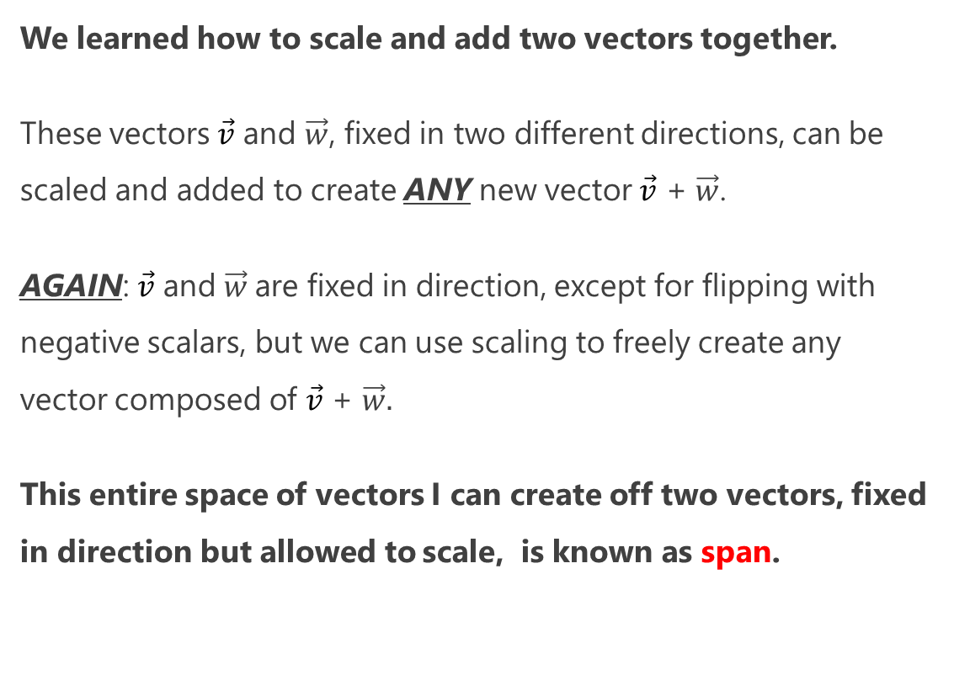



Scaling and Adding Vectors
We learned how to scale and add two vectors together.
These vectors $\vec{v}$ and $\vec{w}$, fixed in two different directions, can be scaled and added to create ANY new vector $\vec{v}$ + $\vec{w}$.
AGAIN: $\vec{v}$ and $\vec{w}$are fixed in direction, except for flipping with negative scalars, but we can use scaling to freely create any vector composed of $\vec{v}$ + $\vec{w}.$
This entire space of vectors I can create off two vectors, fixed in direction but allowed to scale, is known as span.
$$\vec{v}$$
$$\vec{v}+\vec{w}$$
$$\vec{w}$$

Slide 25
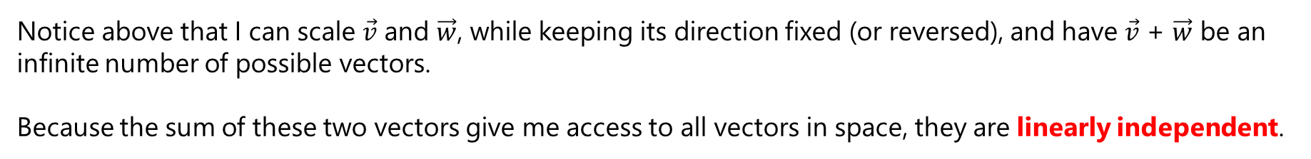









Span – Linearly Independent
$$\vec{v}+\vec{w}$$
$$\vec{v}$$
$$\vec{v}+\vec{w}$$
$$\vec{v}$$
$$\vec{v}+\vec{w}$$
$$\vec{v}$$
$$\vec{w}$$
$$\vec{w}$$
$$\vec{w}$$
Notice above that I can scale $\vec{v}$ and $\vec{w}$, while keeping its direction fixed (or reversed), and have $\vec{v}$ + $\vec{w}$ be an infinite number of possible vectors.
Because the sum of these two vectors give me access to all vectors in space, they are linearly independent.

Slide 26









Span – Linearly Independent
$$\vec{w}$$
$$\vec{v}$$
$$\vec{v}+\vec{w}$$
$$\vec{v}+\vec{w}$$
$$\vec{w}$$
$$\vec{v}$$
$$\vec{v}$$
$$\vec{w}$$
$$\vec{v}+\vec{w}$$
$\vec{v}$ + $\vec{w}$ can reach any point in space just by scaling these two vectors and summing them; there is no changing direction for $\vec{v}$ or $\vec{w}$ except for reversing through negative scalars.

Slide 27







Span – Linearly Dependent
$$\vec{v}=\left[\begin{matrix}4.5 \\ 3\end{matrix}\right]$$
$$\vec{v}=\left[\begin{matrix}3 \\ 2\end{matrix}\right]$$
$$\vec{v}=\left[\begin{matrix}3 \\ 2\end{matrix}\right]$$
$$\vec{w}=\left[\begin{matrix}1.5 \\ 1\end{matrix}\right]$$
$$\vec{w}=\left[\begin{matrix}3 \\ 2\end{matrix}\right]$$
$$\vec{w}=\left[\begin{matrix}−4.5 \\ −3\end{matrix}\right]$$
Is there an unlimited span for $\vec{v}$ + $\vec{w}$ when $\vec{v}$ and $\vec{w}$ share a straight line?
Nope! In this unlucky case, we can only create vectors on their shared straight line.
Because these vectors share a common direction, they are linearly dependent.

Slide 28
Span – Linear Dependence in 3D or More
With a 3D vector space, if two vectors are linearly dependent (share a direction) but the third vector is linearly independent from the other two, the span will be a flat sheet in space.
If all three vectors were linearly dependent, their span would only be a line in space.
This concept applies to any number of dimensions, not just 2 or 3.

Slide 29
Discovering Linear Transformations
This concept of adding two vectors with fixed direction, but scaling them to get different combined vectors, is hugely important.
This combined vector, except in cases of linear dependence, can point in any direction and have any length we choose.
This sets up an intuition for linear transformations, where we use a vector to transform another vector in a functional-like manner.
$$\vec{v}$$
$$\vec{v}+\vec{w}$$
$$\vec{w}$$

Slide 30
II. Transformations and Matrices

Slide 31
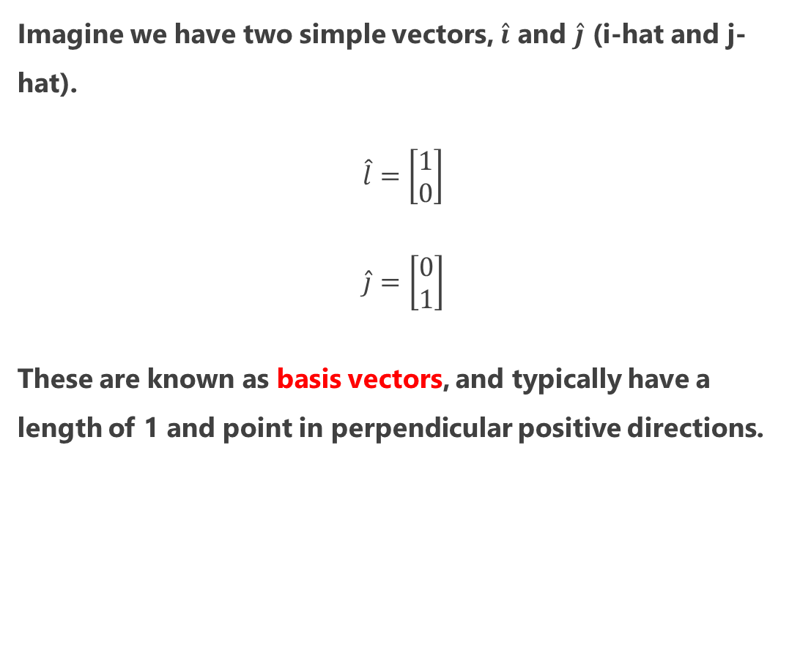



$\hat{i}$ and $\hat{j}$ (i-hat and j-hat)
Imagine we have two simple vectors, $\hat{i}$ and $\hat{j}$ (i-hat and j-hat).
$$\hat{l}=\left[\begin{matrix}1 \\ 0\end{matrix}\right]$$
$$\hat{j}=\left[\begin{matrix}0 \\ 1\end{matrix}\right]$$
These are known as basis vectors, and typically have a length of 1 and point in perpendicular positive directions.
$$\hat{j}$$
$$\hat{l}$$

Slide 32
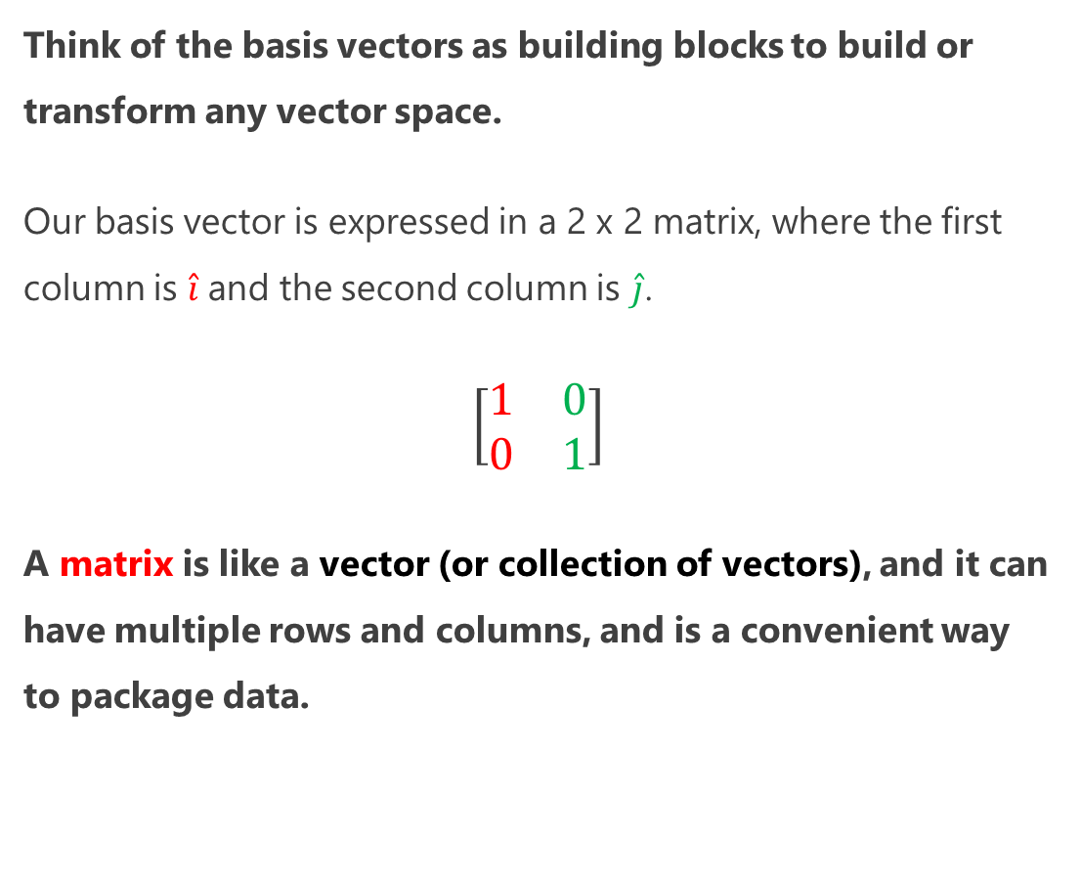

$\hat{i}$ and $\hat{j}$ (i-hat and j-hat)
Think of the basis vectors as building blocks to build or transform any vector space.
Our basis vector is expressed in a 2 x 2 matrix, where the first column is $\hat{i}$and the second column is $\hat{j}$.
$$\left[\begin{matrix}1 & 0 \\ 0 & 1\end{matrix}\right]$$
A matrix is like a vector (or collection of vectors), and it can have multiple rows and columns, and is a convenient way to package data.
$$\hat{j}$$
$$\hat{l}$$

Slide 33

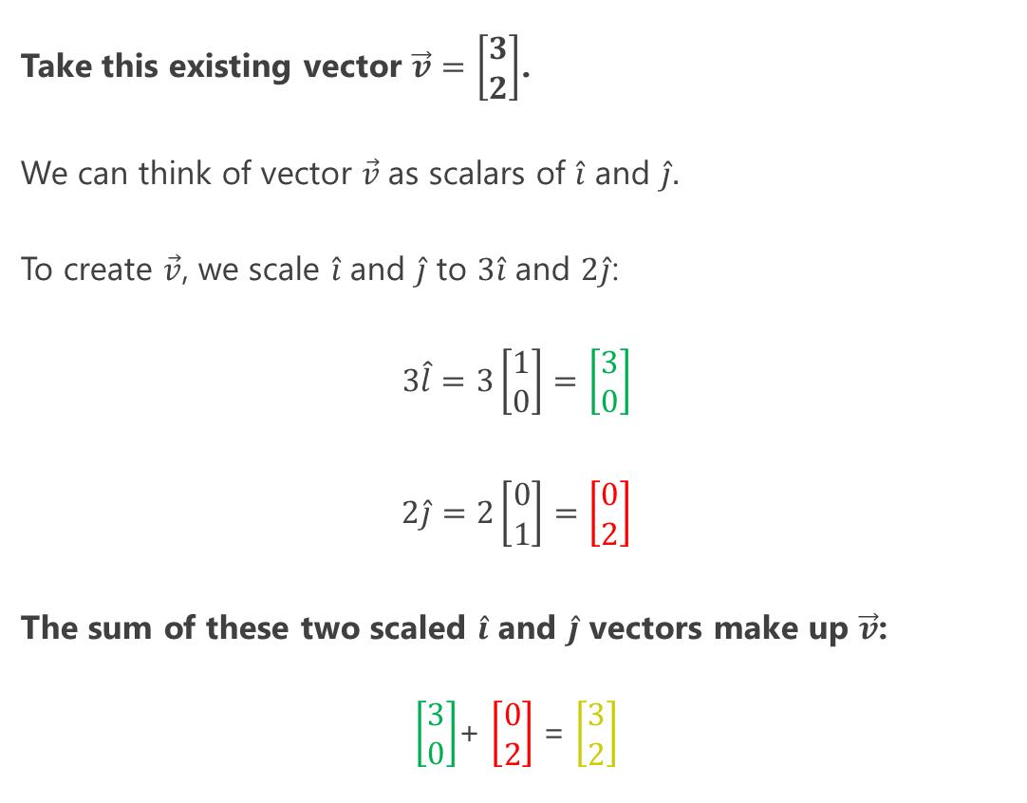





$\hat{i}$ and $\hat{j}$ (i-hat and j-hat)
Take this existing vector $\vec{v}=\left[\begin{matrix}3 \\ 2\end{matrix}\right]$.
We can think of vector $\vec{v}$as scalars of $\hat{i}$ and $\hat{j}.$
To create $\vec{v}$, we scale $\hat{i}$ and $\hat{j}$ to $3\hat{i}$ and $2\hat{j}$:
$$3\hat{l}=3\left[\begin{matrix}1 \\ 0\end{matrix}\right]=\left[\begin{matrix}3 \\ 0\end{matrix}\right]$$
$$2\hat{j}=2\left[\begin{matrix}0 \\ 1\end{matrix}\right]=\left[\begin{matrix}0 \\ 2\end{matrix}\right]$$
The sum of these two scaled $\hat{i}$ and $\hat{j}$ vectors make up $\vec{v}$:
$\left[\begin{matrix}3 \\ 0\end{matrix}\right]$+ $\left[\begin{matrix}0 \\ 2\end{matrix}\right]$ = $\left[\begin{matrix}3 \\ 2\end{matrix}\right]$
$$\vec{v}$$
$$\hat{j}$$
$$\hat{l}$$
$$\vec{v}$$
$$2\hat{j}$$
$$3\hat{l}$$

Slide 34
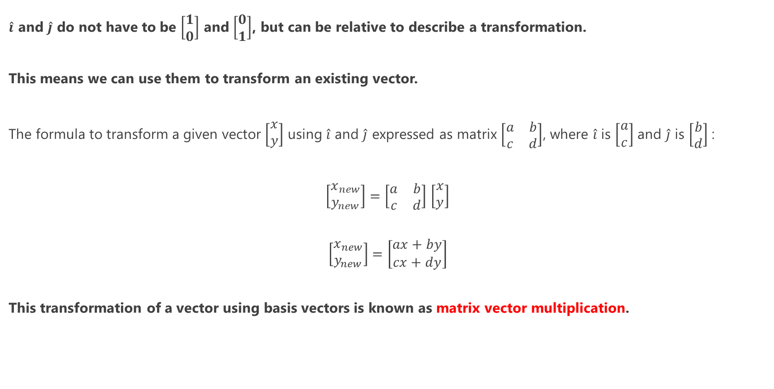
Matrix Vector Multiplication
$\hat{i}$ and $\hat{j}$ do not have to be $\left[\begin{matrix}1 \\ 0\end{matrix}\right]$ and $\left[\begin{matrix}0 \\ 1\end{matrix}\right]$, but can be relative to describe a transformation.
This means we can use them to transform an existing vector.
The formula to transform a given vector $\left[\begin{matrix}x \\ y\end{matrix}\right]$ using $\hat{i}$ and $\hat{j}$ expressed as matrix $\left[\begin{matrix}a & b \\ c & d\end{matrix}\right]$, where $\hat{i}$ is $\left[\begin{matrix}a \\ c\end{matrix}\right]$ and $\hat{j}$ is $\left[\begin{matrix}b \\ d\end{matrix}\right]$ :
$\left[\begin{matrix}x_{new} \\ y_{new}\end{matrix}\right]=\left[\begin{matrix}a & b \\ c & d\end{matrix}\right]$ $\left[\begin{matrix}x \\ y\end{matrix}\right]$
$$\left[\begin{matrix}x_{new} \\ y_{new}\end{matrix}\right]=\left[\begin{matrix}ax+by \\ cx+dy\end{matrix}\right]$$
This transformation of a vector using basis vectors is known as matrix vector multiplication.

Slide 35

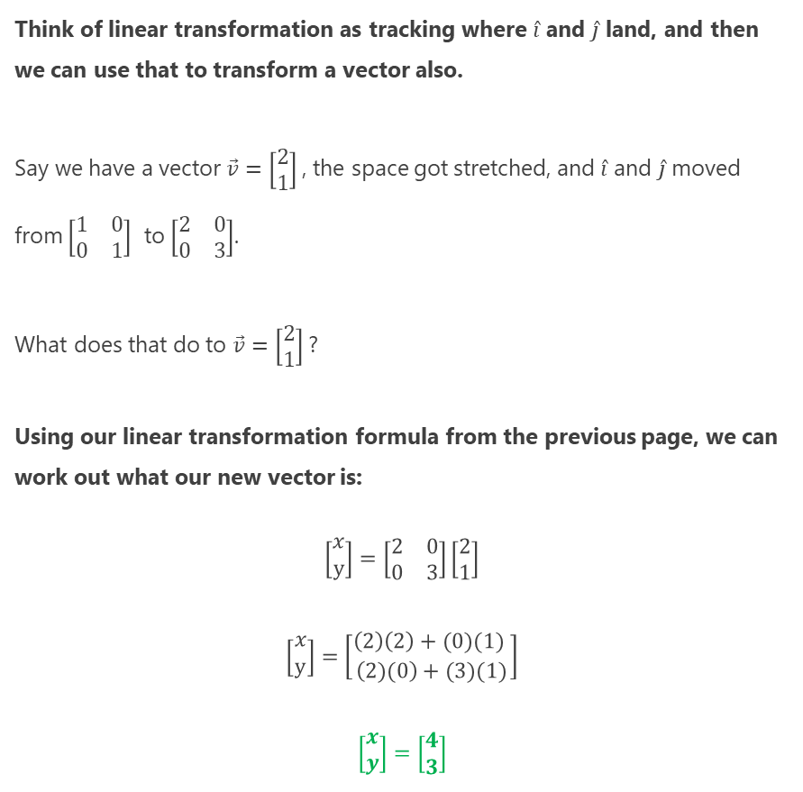
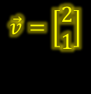




Matrix Vector Multiplication
Think of linear transformation as tracking where $\hat{i}$ and $\hat{j}$ land, and then we can use that to transform a vector also.
Say we have a vector $\vec{v}=\left[\begin{matrix}2 \\ 1\end{matrix}\right]$, the space got stretched, and $\hat{i}$ and $\hat{j}$ moved from $\left[\begin{matrix}1 & 0 \\ 0 & 1\end{matrix}\right]$ to $\left[\begin{matrix}2 & 0 \\ 0 & 3\end{matrix}\right]$.
What does that do to $\vec{v}=\left[\begin{matrix}2 \\ 1\end{matrix}\right]$?
Using our linear transformation formula from the previous page, we can work out what our new vector is:
$$\left[\begin{matrix}x \\ y\end{matrix}\right]=\left[\begin{matrix}2 & 0 \\ 0 & 3\end{matrix}\right]\left[\begin{matrix}2 \\ 1\end{matrix}\right]$$
$$\left[\begin{matrix}x \\ y\end{matrix}\right]=\left[\begin{matrix}\left(2\right)\left(2\right)+(0)(1) \\ \left(2)(0\right)+(3)(1)\end{matrix}\right]$$
$$\left[\begin{matrix}x \\ y\end{matrix}\right]=\left[\begin{matrix}4 \\ 3\end{matrix}\right]$$
from numpy import array i_hat = array([2,0]) j_hat = array([0,3]) basis = array([i_hat, j_hat]).transpose() v = array([2,1]) w = basis.dot(v) print(w)
$$\vec{v}=\left[\begin{matrix}2 \\ 1\end{matrix}\right]$$
$$\hat{j}$$
$$\hat{l}$$
$$\vec{v}=\left[\begin{matrix}4 \\ 3\end{matrix}\right]$$
$$\hat{j}$$
$$\hat{l}$$

Slide 36
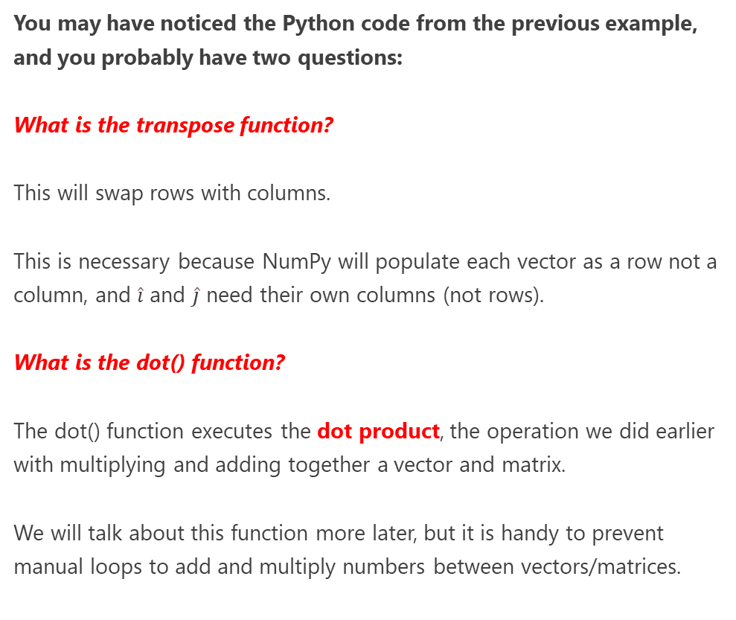
Matrix Vector Multiplication in Python
from numpy import array # Declare i-hat and j-hat i_hat = array([2, 0]) j_hat = array([0, 3]) # compose basis matrix using i-hat and j-hat # also need to transpose rows into columns basis = array([i_hat, j_hat]).transpose() # declare vector v 0 v = array([2,1]) # create new vector w # by transforming v with dot product w = basis.dot(v) print(w)
You may have noticed the Python code from the previous example, and you probably have two questions:
What is the transpose function?
This will swap rows with columns.
This is necessary because NumPy will populate each vector as a row not a column, and $\hat{i}$ and $\hat{j}$ need their own columns (not rows).
What is the dot() function?
The dot() function executes the dot product, the operation we did earlier with multiplying and adding together a vector and matrix.
We will talk about this function more later, but it is handy to prevent manual loops to add and multiply numbers between vectors/matrices.

Slide 37
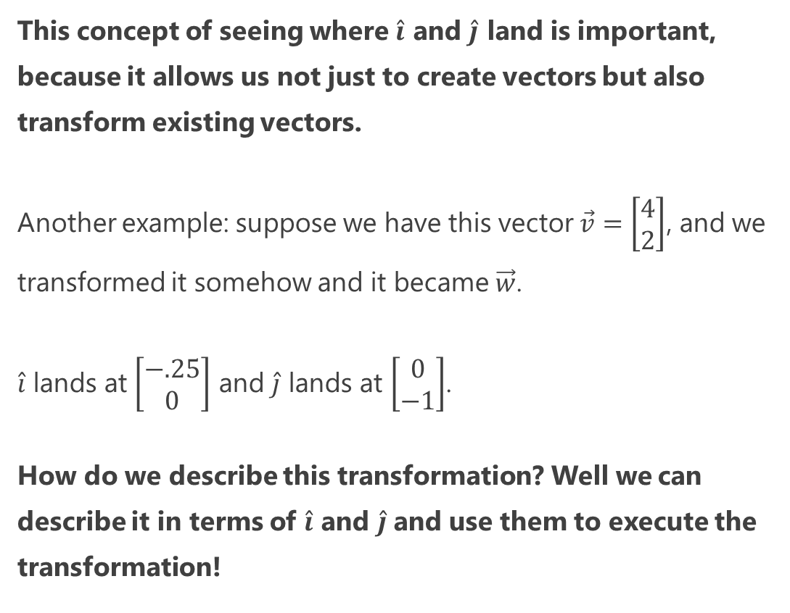





Transforming Vectors with $\hat{i}$ and $\hat{j}$
This concept of seeing where $\hat{i}$ and $\hat{j}$ land is important, because it allows us not just to create vectors but also transform existing vectors.
Another example: suppose we have this vector $\vec{v}=\left[\begin{matrix}4 \\ 2\end{matrix}\right]$, and we transformed it somehow and it became $\vec{w}$.
$\hat{i}$ lands at $\left[\begin{matrix}−.25 \\ 0\end{matrix}\right]$ and $\hat{j}$ lands at $\left[\begin{matrix}0 \\ −1\end{matrix}\right]$.
How do we describe this transformation? Well we can describe it in terms of $\hat{i}$ and $\hat{j}$and use them to execute the transformation!
$$\vec{v}=\left[\begin{matrix}4 \\ 2\end{matrix}\right]$$
$$\hat{l}$$
$$\hat{j}$$
$$\vec{w} =\left[\begin{matrix}? \\ ?\end{matrix}\right]$$

Slide 38
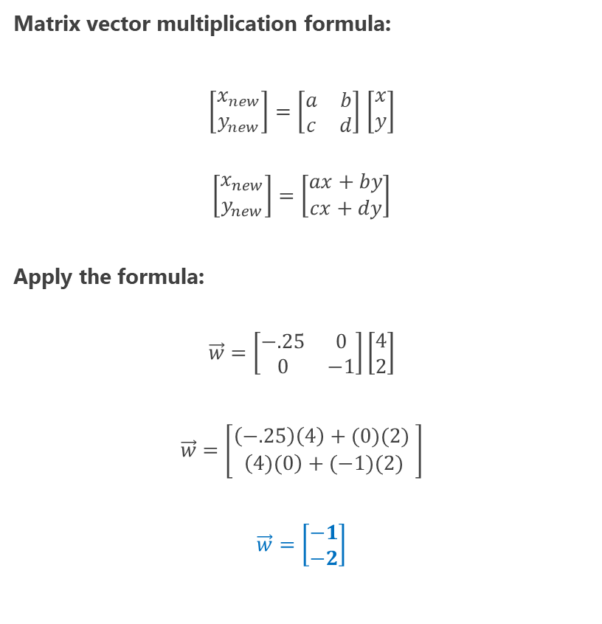


Transforming Vectors with $\hat{i}$ and $\hat{j}$
Matrix vector multiplication formula:
$\left[\begin{matrix}x_{new} \\ y_{new}\end{matrix}\right]=\left[\begin{matrix}a & b \\ c & d\end{matrix}\right]$ $\left[\begin{matrix}x \\ y\end{matrix}\right]$
$$\left[\begin{matrix}x_{new} \\ y_{new}\end{matrix}\right]=\left[\begin{matrix}ax+by \\ cx+dy\end{matrix}\right]$$
Apply the formula:
$$\vec{w}=\left[\begin{matrix}−.25 & 0 \\ 0 & −1\end{matrix}\right]\left[\begin{matrix}4 \\ 2\end{matrix}\right]$$
$$\vec{w}=\left[\begin{matrix}\left(−.25\right)\left(4\right)+(0)(2) \\ \left(4)(0\right)+(−1)(2)\end{matrix}\right]$$
$$\vec{w}=\left[\begin{matrix}−1 \\ −2\end{matrix}\right]$$
from numpy import array i_hat = array([-.25, 0]) j_hat = array([0, -1]) basis = array([i_hat, j_hat]).transpose() v = array([4,2]) w = basis.dot(v) print(w)
$$\vec{v}=\left[\begin{matrix}4 \\ 2\end{matrix}\right]$$
$$\hat{l}$$
$$\hat{j}$$
$$\vec{w} =\left[\begin{matrix}−1 \\ −2\end{matrix}\right]$$

Slide 39




Sheers, Rotations, and Inversions
We can do more than simply scale with linear transformations.
We can also do sheers, rotations and inversions which stretch, turn, and flip our vector space respectively.
To the right we sheer and rotate our space simply using a change to $\hat{i}$ and $\hat{j}$, and turn $\vec{v}$ into $\vec{w}$:
$$\vec{w}=\left[\begin{matrix}1 & −4 \\ 2 & −1\end{matrix}\right]\left[\begin{matrix}1 \\ 1\end{matrix}\right]$$
$$\vec{w}=\left[\begin{matrix}\left(1\right)\left(1\right)+(−4)(1) \\ \left(2)(1\right)+(−1)(1)\end{matrix}\right]$$
$$\vec{w}=\left[\begin{matrix}−3 \\ 1\end{matrix}\right]$$
Linear transformations must be linear, so you cannot do nonlinear, curvy, or variable scaling and transformations.
from numpy import array i_hat = array([1, 2]) j_hat = array([-4, -1]) basis = array([i_hat, j_hat]).transpose() v = array([1,1]) w = basis.dot(v) print(w)
$$\vec{v}$$
$$\hat{j}$$
$$\hat{l}$$
$$\vec{w}$$

Slide 40



Basis Vectors in 3D and More
Peeking into beyond more than 2 dimensions, the basis vector concept can be extended beyond $\hat{i}$ and $\hat{j}$ with $\hat{k}$, and as many additional dimensions you need.
$$\vec{v}$$

Slide 41





Quick Quiz #1
To the right we have vector $\vec{v}=\left[\begin{matrix}1 \\ 2\end{matrix}\right]$, but then we perform a transformation and$\hat{i}$ lands at $\left[\begin{matrix}2 \\ 0\end{matrix}\right]$and $\hat{j}$ lands at $\left[\begin{matrix}0 \\ 1.5\end{matrix}\right]$.
Where does $\vec{v}$ land now after this transformation?
$$\vec{v}$$
$$\hat{j}$$
$$\hat{l}$$
$$1.5\hat{j}$$
$$?$$
$$2\hat{l}$$

Slide 42




Quick Quiz #1
from numpy import array i_hat = array([2, 0]) j_hat = array([0, 1.5]) basis = array([i_hat, j_hat]).transpose() v = array([1,2]) w = basis.dot(v) print(w)
To the right we have vector $\vec{v}=\left[\begin{matrix}1 \\ 2\end{matrix}\right]$, but then we perform a transformation and$\hat{i}$ lands at $\left[\begin{matrix}2 \\ 0\end{matrix}\right]$and $\hat{j}$ lands at $\left[\begin{matrix}0 \\ 1.5\end{matrix}\right]$.
Where does $\vec{v}$ land now after this transformation?
$$\vec{v}$$
$$\hat{j}$$
$$\hat{l}$$
$$\vec{v}$$
$$2.5\hat{j}$$
$$\left[\begin{matrix}x \\ y\end{matrix}\right]=\left[\begin{matrix}2 & 0 \\ 0 & 1.5\end{matrix}\right]\left[\begin{matrix}1 \\ 2\end{matrix}\right]$$
$$\left[\begin{matrix}x \\ y\end{matrix}\right]=\left[\begin{matrix}\left(2\right)\left(1\right)+(0)(2) \\ \left(1)(0\right)+(1.5)(2)\end{matrix}\right]$$
$$\left[\begin{matrix}x \\ y\end{matrix}\right]=\left[\begin{matrix}2 \\ 3\end{matrix}\right]$$
$\left[\begin{matrix}x_{new} \\ y_{new}\end{matrix}\right]=\left[\begin{matrix}a & b \\ c & d\end{matrix}\right]$ $\left[\begin{matrix}x \\ y\end{matrix}\right]$
$$\left[\begin{matrix}x_{new} \\ y_{new}\end{matrix}\right]=\left[\begin{matrix}ax+by \\ cx+dy\end{matrix}\right]$$
$$2\hat{l}$$

Slide 43




Quick Quiz #2
To the right we have vector $\vec{v}=\left[\begin{matrix}1 \\ 2\end{matrix}\right]$, but then we perform a transformation and$\hat{i}$ lands at $\left[\begin{matrix}−2 \\ 1\end{matrix}\right]$and $\hat{j}$ lands at $\left[\begin{matrix}1 \\ −2\end{matrix}\right]$.
Where does $\vec{v}$ land now after this transformation?
$$\vec{v}$$
$$\hat{j}$$
$$\hat{l}$$
$$\hat{l}$$
$$?$$
$$\hat{j}$$

Slide 44


Quick Quiz #2
To the right we have vector $\vec{v}=\left[\begin{matrix}1 \\ 2\end{matrix}\right]$, but then we perform a transformation and$\hat{i}$ lands at $\left[\begin{matrix}−2 \\ 1\end{matrix}\right]$and $\hat{j}$ lands at $\left[\begin{matrix}1 \\ −2\end{matrix}\right]$.
Where does $\vec{v}$ land now after this transformation?
from numpy import array i_hat = array([-2, 1]) j_hat = array([1, -2]) basis = array([i_hat, j_hat]).transpose() v = array([1,2]) w = basis.dot(v) print(w)
$$\vec{v}$$
$$\hat{j}$$
$$\hat{l}$$
$$\hat{l}$$
$$\left[\begin{matrix}x \\ y\end{matrix}\right]=\left[\begin{matrix}−2 & 1 \\ 1 & −2\end{matrix}\right]\left[\begin{matrix}1 \\ 2\end{matrix}\right]$$
$$\left[\begin{matrix}x \\ y\end{matrix}\right]=\left[\begin{matrix}\left(−2\right)\left(1\right)+(1)(2) \\ \left(1)(1\right)+(−2)(2)\end{matrix}\right]$$
$$\left[\begin{matrix}x \\ y\end{matrix}\right]=\left[\begin{matrix}0 \\ −3\end{matrix}\right]$$
$\left[\begin{matrix}x_{new} \\ y_{new}\end{matrix}\right]=\left[\begin{matrix}a & b \\ c & d\end{matrix}\right]$ $\left[\begin{matrix}x \\ y\end{matrix}\right]$
$$\left[\begin{matrix}x_{new} \\ y_{new}\end{matrix}\right]=\left[\begin{matrix}ax+by \\ cx+dy\end{matrix}\right]$$
$$\hat{j}$$
$$\vec{v}$$

Slide 45

The Determinant
When we perform linear transformations, we sometimes “expand” or “squish” space and the degree this happens can be helpful.
Take a sampled area from the vector space to the right: what happens to it after we scaled $\hat{i}$ and $\hat{j}$?
$$\hat{j}$$
$$\hat{l}$$
$$2\hat{j}$$
$$3\hat{l}$$

Slide 46





The Determinant
from numpy.linalg import det from numpy import array i_hat = array([3, 0]) j_hat = array([0, 2]) basis = array([i_hat, j_hat]).transpose() determinant = det(basis) print(determinant) # prints 6.0
When we perform linear transformations, we sometimes “expand” or “squish” space and the degree this happens can be helpful.
Take a sampled area from the vector space to the right: what happens to it after we scaled $\hat{i}$ and $\hat{j}$?
It increases in area by a factor of 6.0, and this factor is known as a determinant.
Determinants describe how much a sampled area in a vector space changes in scale with linear transformations, and this can provide helpful information about the transformation.
$$\hat{j}$$
$$\hat{l}$$
$$2\hat{j}$$
$$3\hat{l}$$

Slide 47



Determinant Behaviors
Simple sheers should not change the determinant.
But scaling will increase or decrease the determinant, as that will increase/decrease the sampled area.
When the orientation flips ($\hat{i}$ and $\hat{j}$ swap clockwise positions) then the determinant will be negative.
from numpy.linalg import det from numpy import array i_hat = array([1, 0]) j_hat = array([1, 1]) basis = array([i_hat, j_hat]).transpose() determinant = det(basis) print(determinant) # prints 1.0
$$\hat{j}$$
$$\hat{l}$$
from numpy.linalg import det from numpy import array i_hat = array([-2, 1]) j_hat = array([1, 2]) basis = array([i_hat, j_hat]).transpose() determinant = det(basis) print(determinant) # prints -5.0
$$\hat{j}$$
$$\hat{l}$$

Slide 48


Zero Determinants
from numpy.linalg import det from numpy import array i_hat = array([-1, 1]) j_hat = array([1, -1]) basis = array([i_hat, j_hat]).transpose() determinant = det(basis) print(determinant) # prints 0.0
When a determinant is 0, that means the transformation is linearly dependent, and has squished all of space into a line.
Testing for a 0 determinant is highly helpful to determine if a transformation has linear dependence.
$$\hat{j}$$
$$\hat{l}$$

Slide 49








Determinants in 3D
Of course, the determinant extends to 3 or more dimensions.
It becomes a matter of visualizing a sampled volume scaling, rotating, sheering, and flipping.
To figure out if a 3D space has flipped, use the hand rule.
If you cannot relatively orient $\hat{i}$, $\hat{j}$, and $\hat{k}$ like my hand to the right, the orientation has flipped, and you should have a negative determinant.
$$\hat{k}$$
$$\hat{j}$$
$$\hat{j}$$
$$\hat{i}$$
$$\hat{i}$$
$$\hat{k}$$

Slide 50




Quick Quiz #3
To the right we have a transformation where$\hat{i}$ lands at $\left[\begin{matrix}1 \\ 0\end{matrix}\right]$and $\hat{j}$ lands at $\left[\begin{matrix}2 \\ 2\end{matrix}\right]$.
What is the determinant of this transformation?
$$\hat{j}$$
$$\hat{l}$$
$$\hat{j}$$
$$?$$
$$\hat{l}$$

Slide 51




Quick Quiz #3
from numpy.linalg import det from numpy import array i_hat = array([1, 0]) j_hat = array([2, 2]) basis = array([i_hat, j_hat]).transpose() determinant = det(basis) print(determinant) # prints 2.0
To the right we have a transformation where$\hat{i}$ lands at $\left[\begin{matrix}1 \\ 0\end{matrix}\right]$and $\hat{j}$ lands at $\left[\begin{matrix}2 \\ 2\end{matrix}\right]$.
What is the determinant of this transformation?
The determinant is 2.0
$$\hat{l}$$
$$\hat{j}$$
$$\hat{j}$$
$$\hat{l}$$

Slide 52





Matrix Multiplication
We learned how to multiply a vector and matrix, but what exactly does multiplying two matrices accomplish?
Think of matrix multiplication as applying multiple transformations to a vector space.
Think of each transformation matrix as a function, where we apply from the inner-most and then outwards.
Here is how we apply a rotation and then a sheer to any vector $\left[\begin{matrix}x \\ y\end{matrix}\right]$.
$$\left[\begin{matrix}1 & 1 \\ 0 & 1\end{matrix}\right]\left[\begin{matrix}0 & −1 \\ 1 & 0\end{matrix}\right]\left[\begin{matrix}x \\ y\end{matrix}\right]=\left[\begin{matrix}1 & −1 \\ 1 & 0\end{matrix}\right]\left[\begin{matrix}x \\ y\end{matrix}\right]$$
from numpy import array # Transformation 1 i_hat1 = array([0, 1]) j_hat1 = array([-1, 0]) transform1 = array([i_hat1, j_hat1]).transpose() # Transformation 2 i_hat2 = array([1, 0]) j_hat2 = array([1, 1]) transform2 = array([i_hat2, j_hat2]).transpose() # Combine Transformations combined = transform2.dot(transform1) print(combined)
$$\hat{l}$$
$$\hat{j}$$
1) Rotation
$$\hat{l}$$
$$\hat{j}$$
2) Sheer

Slide 53

Matrix Multiplication
We typically apply transformations right to left, and the order does matter!
$$\left[\begin{matrix}a & b \\ c & d\end{matrix}\right]\left[\begin{matrix}ⅇ & f \\ g & h\end{matrix}\right]=\left[\begin{matrix}ae+bg & af+bh \\ ce+dy & cf+dh\end{matrix}\right]$$
We can chain together as many transformations as we want, but we always apply them from right to left.
$$\hat{l}$$
$$\hat{j}$$
1) Rotation
$$\hat{l}$$
$$\hat{j}$$
2) Sheer

Slide 54
Quick Quiz #4
Can applying two or more transformations be done in a single transformation? Why or why not?
$$\hat{l}$$
$$\hat{j}$$
1) Rotation
$$\hat{l}$$
$$\hat{j}$$
2) Sheer

Slide 55

Quick Quiz #4
Can applying two or more transformations be done in a single transformation? Why or why not?
We can do any number of transformations as a single transformation.
$\left[\begin{matrix}1 & 1 \\ 0 & 1\end{matrix}\right]\left[\begin{matrix}0 & −1 \\ 1 & 0\end{matrix}\right]\left[\begin{matrix}x \\ y\end{matrix}\right]$ is no different than applying $\left[\begin{matrix}1 & −1 \\ 1 & 0\end{matrix}\right]\left[\begin{matrix}x \\ y\end{matrix}\right]$, as both achieve the same result.
$$\left[\begin{matrix}1 & 1 \\ 0 & 1\end{matrix}\right]\left[\begin{matrix}0 & −1 \\ 1 & 0\end{matrix}\right]\left[\begin{matrix}x \\ y\end{matrix}\right]=\left[\begin{matrix}1 & −1 \\ 1 & 0\end{matrix}\right]\left[\begin{matrix}x \\ y\end{matrix}\right]$$
$$\hat{l}$$
$$\hat{j}$$
1) Rotation
$$\hat{l}$$
$$\hat{j}$$
2) Sheer

Slide 56



Quick Quiz #5
Is this linear transformation to the right valid? Why or why not?
$$\hat{l}$$
$$\hat{j}$$
$$\vec{v}$$

Slide 57
Quick Quiz #5
Is this linear transformation to the right valid? Why or why not?
Linear transformations must be linear and only scale, sheer, rotate, or flip space.
Curvy and variable transformations are not linear and outside the scope of linear algebra.
$$\hat{l}$$
$$\hat{j}$$
$$\vec{v}$$

Slide 58
III. Dot Products

Slide 59



What is the Dot Product?
You may have seen the dot product, an operation that does a multiply/add operation between elements in vectors and matrices.
$$\left[\begin{matrix}3 \\ 2\end{matrix}\right]⋅\left[\begin{matrix}2 \\ −1\end{matrix}\right]$$
($3 ∗2)+(2 ∗−1)=4.0$
We have already seen the dot product when we combine multiple transformations, but what exactly does it mean?
What is this weird numerical operation accomplishing?
$$\vec{v}$$
$$\vec{w}$$

Slide 60
Discovering the Dot Product
Think of the dot product as taking one vector’s length, and projecting another vector onto it and multiplying that resulting vector’s length.
$$\vec{v}$$
$$\vec{w}$$

Slide 61

Discovering the Dot Product
Think of the dot product as taking one vector’s length, and projecting another vector onto it and multiplying that resulting vector’s length.
First, let’s project $\vec{w}$ directly onto $\vec{v}$like so.
This new vector that is linearly dependent to $\vec{v}$ (and portrayed as a dashed green line) has a length of 1.1094003924504583.
You can calculate this using basic algebra to find intersections and trigonometry to compute lengths.
$$\vec{v}$$
$$\vec{v}$$
1.109
$$\vec{w}$$
$$\vec{w}$$

Slide 62

Discovering the Dot Product
This new vector that is linearly dependent to $\vec{v}$ (and portrayed as a dashed green line) has a length of 1.1094003924504583.
Now let’s calculate the length of $\vec{v}$ which is 3.606.
The dot product is the multiplication of these two length values:
3.606 × 1.1094003924504583 $≈$ 4.0
3.606
$$\vec{v}$$
1.109
$$\vec{w}$$

Slide 63

Discovering the Dot Product
The dot product is the multiplication of these two length values:
3.606 × 1.1094003924504583 $≈$ 4.0
This dot product formula is the shorthand we use to compute it:
$$\left[\begin{matrix}a \\ b\end{matrix}\right]⋅\left[\begin{matrix}c \\ d\end{matrix}\right]=ac+bd$$
$\left[\begin{matrix}3 \\ 2\end{matrix}\right]⋅\left[\begin{matrix}2 \\ −1\end{matrix}\right]=$($3 ∗2)+(2 ∗−1)=4.0$
3.606
$$\vec{v}$$
1.109
$$\vec{w}$$
from numpy import array v = array([3, 2]) w = array([2,-1]) dot_product = v.dot(w) print(dot_product) # prints 4.0

Slide 64


Discovering the Dot Product
Note that geometrically this also works in the reverse direction.
If we projected $\vec{v}$ onto $\vec{w}$ instead of $\vec{w}$ onto $\vec{v}$ , we would still end up with the same dot product.
1.7888543819998317 * 2.236 = $4.0$
$$\vec{v}$$
2.236
from numpy import array v = array([3, 2]) w = array([2,-1]) dot_product = w.dot(v) print(dot_product) # prints 4.0
$$\vec{w}$$
1.788

Slide 65



What About Matrix Dot Products?
The dot product is the means of executing linear transformations, by means of several projections.
We use dot products to transform with matrices, as we have seen many examples already.
$$\hat{j}$$
$$\hat{l}$$
from numpy import array, dot i_hat = array([-1, 2]) j_hat = array([3, 1]) basis = array([i_hat, j_hat]).transpose() v = array([1, 1]) dot_product = basis.dot(v) print(dot_product) # prints [2, 3]
$$\vec{v}$$
.4472
$$2.236$$
1.26491
$$3.162$$

Slide 66

Over and Down! Over and Down!
To avoid doing a whole bunch of projection work, it is much easier to calculate matrix dot products by hand using the “over and down!” pattern.
$\left[\begin{matrix}3 & 1 \\ 2 & 0\end{matrix}\right]\left[\begin{matrix}1 & 2 & 0 \\ 3 & 1 & 1\end{matrix}\right]=\left[\begin{matrix}3∗1+1∗3 & 3∗2+1∗1 & 3∗0+1∗1 \\ 2∗1+0∗3 & 2∗2+0∗1 & 2∗0+0∗1\end{matrix}\right]$
$$=\left[\begin{matrix}6 & 7 & 1 \\ 2 & 4 & 0\end{matrix}\right]$$
from numpy import array v = array([[3, 1], [2, 0]]) w = array([[1, 2, 0], [3, 1, 1]]) dot_product = v.dot(w) print(dot_product)

Slide 67

Over and Down! Over and Down!
To avoid doing a whole bunch of projection work, it is much easier to calculate matrix dot products by hand using the “over and down!” pattern.
$\left[\begin{matrix}3 & 1 \\ 2 & 0\end{matrix}\right]\left[\begin{matrix}1 & 2 & 0 \\ 3 & 1 & 1\end{matrix}\right]=\left[\begin{matrix}3∗1+1∗3 & 3∗2+1∗1 & 3∗0+1∗1 \\ 2∗1+0∗3 & 2∗2+0∗1 & 2∗0+0∗1\end{matrix}\right]$
$$=\left[\begin{matrix}6 & 7 & 1 \\ 2 & 4 & 0\end{matrix}\right]$$
from numpy import array v = array([[3, 1], [2, 0]]) w = array([[1, 2, 0], [3, 1, 1]]) dot_product = v.dot(w) print(dot_product)

Slide 68

Over and Down! Over and Down!
To avoid doing a whole bunch of projection work, it is much easier to calculate matrix dot products by hand using the “over and down!” pattern.
$\left[\begin{matrix}3 & 1 \\ 2 & 0\end{matrix}\right]\left[\begin{matrix}1 & 2 & 0 \\ 3 & 1 & 1\end{matrix}\right]=\left[\begin{matrix}3∗1+1∗3 & 3∗2+1∗1 & 3∗0+1∗1 \\ 2∗1+0∗3 & 2∗2+0∗1 & 2∗0+0∗1\end{matrix}\right]$
$$=\left[\begin{matrix}6 & 7 & 1 \\ 2 & 4 & 0\end{matrix}\right]$$
from numpy import array v = array([[3, 1], [2, 0]]) w = array([[1, 2, 0], [3, 1, 1]]) dot_product = v.dot(w) print(dot_product)

Slide 69

Over and Down! Over and Down!
To avoid doing a whole bunch of projection work, it is much easier to calculate matrix dot products by hand using the “over and down!” pattern.
$\left[\begin{matrix}3 & 1 \\ 2 & 0\end{matrix}\right]\left[\begin{matrix}1 & 2 & 0 \\ 3 & 1 & 1\end{matrix}\right]=\left[\begin{matrix}3∗1+1∗3 & 3∗2+1∗1 & 3∗0+1∗1 \\ 2∗1+0∗3 & 2∗2+0∗1 & 2∗0+0∗1\end{matrix}\right]$
$$=\left[\begin{matrix}6 & 7 & 1 \\ 2 & 4 & 0\end{matrix}\right]$$
from numpy import array v = array([[3, 1], [2, 0]]) w = array([[1, 2, 0], [3, 1, 1]]) dot_product = v.dot(w) print(dot_product)

Slide 70

Over and Down! Over and Down!
To avoid doing a whole bunch of projection work, it is much easier to calculate matrix dot products by hand using the “over and down!” pattern.
$\left[\begin{matrix}3 & 1 \\ 2 & 0\end{matrix}\right]\left[\begin{matrix}1 & 2 & 0 \\ 3 & 1 & 1\end{matrix}\right]=\left[\begin{matrix}3∗1+1∗3 & 3∗2+1∗1 & 3∗0+1∗1 \\ 2∗1+0∗3 & 2∗2+0∗1 & 2∗0+0∗1\end{matrix}\right]$
$$=\left[\begin{matrix}6 & 7 & 1 \\ 2 & 4 & 0\end{matrix}\right]$$
from numpy import array v = array([[3, 1], [2, 0]]) w = array([[1, 2, 0], [3, 1, 1]]) dot_product = v.dot(w) print(dot_product)

Slide 71

Over and Down! Over and Down!
To avoid doing a whole bunch of projection work, it is much easier to calculate matrix dot products by hand using the “over and down!” pattern.
$\left[\begin{matrix}3 & 1 \\ 2 & 0\end{matrix}\right]\left[\begin{matrix}1 & 2 & 0 \\ 3 & 1 & 1\end{matrix}\right]=\left[\begin{matrix}3∗1+1∗3 & 3∗2+1∗1 & 3∗0+1∗1 \\ 2∗1+0∗3 & 2∗2+0∗1 & 2∗0+0∗1\end{matrix}\right]$
$$=\left[\begin{matrix}6 & 7 & 1 \\ 2 & 4 & 0\end{matrix}\right]$$
from numpy import array v = array([[3, 1], [2, 0]]) w = array([[1, 2, 0], [3, 1, 1]]) dot_product = v.dot(w) print(dot_product)

Slide 72

Over and Down! Over and Down!
To avoid doing a whole bunch of projection work, it is much easier to calculate matrix dot products by hand using the “over and down!” pattern.
$\left[\begin{matrix}3 & 1 \\ 2 & 0\end{matrix}\right]\left[\begin{matrix}1 & 2 & 0 \\ 3 & 1 & 1\end{matrix}\right]=\left[\begin{matrix}3∗1+1∗3 & 3∗2+1∗1 & 3∗0+1∗1 \\ 2∗1+0∗3 & 2∗2+0∗1 & 2∗0+0∗1\end{matrix}\right]$
$$=\left[\begin{matrix}6 & 7 & 1 \\ 2 & 4 & 0\end{matrix}\right]$$
Multiply and sum each row with each respective column, and this will quickly and efficiently apply a series of transformations,
from numpy import array v = array([[3, 1], [2, 0]]) w = array([[1, 2, 0], [3, 1, 1]]) dot_product = v.dot(w) print(dot_product)

Slide 73
IV. Systems of Linear Equations and Inverse Matrices

Slide 74

Solving Systems of Equations
Let’s say you have a system of equations like this:
$$4x+2y+4z=44$$
$$5x+3y+7z=56$$
$$9x+3y+6z=72$$
We need to solve for x, y, and z. First let’s declare the equations above as three matrices:
$\begin{matrix}A=\left[\begin{matrix}4 & 2 & 4 \\ 5 & 3 & 7 \\ 9 & 3 & 6\end{matrix}\right] B=\left[\begin{aligned}44 \\ 56 \\ 72\end{aligned}\right] \\ \end{matrix}$ $X=\left[\begin{matrix}x \\ y \\ z\end{matrix}\right]$

Slide 75

Solving Systems of Equations.
We need to transform matrix $A$ with some other matrix $X$ that will result in matrix $B$.
$$AX = B$$
$$\begin{matrix}\left[\begin{matrix}4 & 2 & 4 \\ 5 & 3 & 7 \\ 9 & 3 & 6\end{matrix}\right]\left[\begin{matrix}x \\ y \\ z\end{matrix}\right]=\left[\begin{aligned}44 \\ 56 \\ 72\end{aligned}\right] \\ \end{matrix}$$
We can isolate X by multiplying each side with the inverse of matrix $A$, which we will call A⁻¹.
$$A^{−1}AX =A^{−1}B$$
$$X =A^{−1}B$$

Slide 76

Inverse Matrixes
To calculate the inverse of matrix A, we should probably use a computer rather than searching for solutions by hand (this is tedious!)
To the right we use NumPy to calculate the inverse of matrix A, and we get this result:
$$A^{−1}=\left[\begin{matrix}−\frac{1}{2} & 0 & \frac{1}{3} \\ 5.5 & −2 & \frac{4}{3} \\ −2 & 1 & \frac{1}{3}\end{matrix}\right]$$
from numpy import array from numpy.linalg import inv A = array([ [4, 2, 4], [5, 3, 7], [9, 3, 6] ]) print(inv(A))

Slide 77

Inverse Matrixes
When we multiply a matrix by its inverse, we get an identity matrix which cancels out and effectively identifies x, y, an z.
$$A=\left[\begin{matrix}4 & 2 & 4 \\ 5 & 3 & 7 \\ 9 & 3 & 6\end{matrix}\right] A^{−1}=\left[\begin{matrix}−\frac{1}{2} & 0 & \frac{1}{3} \\ 5.5 & −2 & \frac{4}{3} \\ −2 & 1 & \frac{1}{3}\end{matrix}\right]$$
$$A ∗A^{−1} = \left[\begin{matrix}1 & 0 & 0 \\ 0 & 1 & 0 \\ 0 & 0 & 1\end{matrix}\right]$$
from numpy import array from numpy.linalg import inv A = array([ [4, 2, 4], [5, 3, 7], [9, 3, 6] ]) identity = inv(A).dot(A) print(identity)

Slide 78


Solving Systems of Equations
$A=\left[\begin{matrix}4 & 2 & 4 \\ 5 & 3 & 7 \\ 9 & 3 & 6\end{matrix}\right] B=\left[\begin{aligned}44 \\ 56 \\ 72\end{aligned}\right]$ $A^{−1}=\left[\begin{matrix}−\frac{1}{2} & 0 & \frac{1}{3} \\ 5.5 & −2 & \frac{4}{3} \\ −2 & 1 & \frac{1}{3}\end{matrix}\right]$ $X = \left[\begin{matrix}x \\ y \\ z\end{matrix}\right]$
Now we have all the pieces we need to solve for $X$!
$$A^{−1}B = X$$
$\left[\begin{matrix}−\frac{1}{2} & 0 & \frac{1}{3} \\ 5.5 & −2 & \frac{4}{3} \\ −2 & 1 & \frac{1}{3}\end{matrix}\right]$ $\left[\begin{aligned}44 \\ 56 \\ 72\end{aligned}\right]$ = $\left[\begin{matrix}2 \\ 34 \\ −8\end{matrix}\right]$
So $x = 2$, $y = 34$, and $z = −8$.
Inverse matrices and this method of solving systems of equations is used for linear programming and other areas.

Slide 79
Solving Systems of Equations
from numpy import array from numpy.linalg import inv # 4x + 2y + 4z = 44 # 5x + 3y + 7z = 56 # 9x + 3y + 6z = 72 A = array([ [4, 2, 4], [5, 3, 7], [9, 3, 6] ]) B = array([ 44, 56, 72 ]) X = inv(A).dot(B) print(X)

Slide 80


Quiz #6: Solve the System of Equations
What is $x$, $y$, and $z$?
$$3x+1y+0z=54$$
$$2x+4y+1z=12$$
$$3x+1y+8z=6$$

Slide 81




Quiz #6: Solve the System of Equations
from numpy import array from numpy.linalg import inv # 3x + 1y + 0z = 54 # 2x + 4y + 1z = 12 # 3x + 1y + 8z = 6 A = array([ [3, 1, 0], [2, 4, 1], [3, 1, 8] ]) B = array([ 54, 12, 6 ]) X = inv(A).dot(B) print(X)
$$3x+1y+0z=54$$
$$2x+4y+1z=12$$
$$3x+1y+8z=6$$
$\begin{matrix}A=\left[\begin{matrix}3 & 1 & 0 \\ 2 & 4 & 1 \\ 3 & 1 & 8\end{matrix}\right] B=\left[\begin{aligned}54 \\ 12 \\ 6\end{aligned}\right] \\ \end{matrix}$ $X=\left[\begin{matrix}x \\ y \\ z\end{matrix}\right]$
$$AX = B$$
$$A^{−1}AX =A^{−1}B$$
$$X =A^{−1}B$$
$$X = \left[\begin{matrix}19.8 \\ −5.4 \\ −6\end{matrix}\right]$$

Slide 82
V. Eigenvectors and Eigenvalues

Slide 83





Matrix Decomposition
Matrix decomposition is breaking up a matrix into its basic components, much like factoring numbers (e.g. 10 can be factored to 2 x 5).
Matrix decomposition is helpful for tasks like finding inverse matrices, calculating determinants, as well as linear regression.
There are many ways to decompose a matrix, but the most common method is eigendecomposition, which is often used for machine learning and Principal Component Analysis (PCA).
At this level, just know eigendecomposition is helpful for breaking up a matrix into components that are easier to work with in different machine learning tasks.
$$\left[\begin{matrix}1 & 2 \\ 4 & 5\end{matrix}\right]$$
$$\left[\begin{matrix}−0.464 \\ 6.464\end{matrix}\right]$$
$$\left[\begin{matrix}0.806 & 0.343 \\ 0.59 & −0.939\end{matrix}\right]$$
$$λ$$
$$v$$

Slide 84


Eigendecomposition
If we have a square matrix $A$, it has the following eigenvalue equation:
$$Av=λv$$
If $A$ is the parent matrix, it has eigenvector $v$ and eigenvalue $λ$ (lambda).
There is one eigenvector and eigenvalue for each dimension of the parent matrix, and not all matrices can be decomposed into an eigenvector and eigenvalue.
Sometimes complex (imaginary) numbers will result!
To the right is how we calculate eigenvectors and eigenvalues in NumPy for a given matrix $A$.
from numpy import array, diag from numpy.linalg import eig, inv A = array([ [1, 2], [4, 5] ]) eigenvals, eigenvecs = eig(A) print("EIGENVALUES") print(eigenvals) print("\nEIGENVECTORS") print(eigenvecs)

Slide 85







Eigendecomposition
So how do we rebuild matrix $A$ from the eigenvectors and eigenvalues?
Recall this equation:
$$Av=λv$$
We need to make a few tweaks to the formula to reconstruct $A$:
$A=QΛQ^{−1}$
Where $Q$ is the eigenvectors, $Λ$ is the eigenvalues in diagonal form, and $Q^{−1}$ is the inverse matrix of $Q$.
$$\left[\begin{matrix}1 & 2 \\ 4 & 5\end{matrix}\right]$$
$$\left[\begin{matrix}−0.464 \\ 6.464\end{matrix}\right]$$
$$\left[\begin{matrix}0.806 & 0.343 \\ 0.59 & −0.939\end{matrix}\right]$$
$$λ$$
$$v$$
$Q$ = $\left[\begin{matrix}0.806 & 0.343 \\ 0.59 & −0.939\end{matrix}\right]$
$Λ$ = $\left[\begin{matrix}−0.464 & 0 \\ 0 & 6.464\end{matrix}\right]$
$Q^{−1}$= $\left[\begin{matrix}−0.977 & 0.357 \\ −0.614 & −0.839\end{matrix}\right]$

Slide 86


Rebuilding from Eigenvectors/Eigenvalues
Rebuilding a matrix from the eigenvectors and eigenvalues requires a few transformational steps as shown to the right.
You can dot product all the components to rebuild matrix $A$ again.
$Q$ = $\left[\begin{matrix}0.806 & 0.343 \\ 0.59 & −0.939\end{matrix}\right]$
$Λ$ = $\left[\begin{matrix}−0.464 & 0 \\ 0 & 6.464\end{matrix}\right]$
$Q^{−1}$= $\left[\begin{matrix}−0.977 & 0.357 \\ −0.614 & −0.839\end{matrix}\right]$
$A=QΛQ^{−1}$ =$\left[\begin{matrix}1 & 2 \\ 4 & 5\end{matrix}\right]$
from numpy import array, diag from numpy.linalg import eig, inv A = array([ [1, 2], [4, 5] ]) eigenvals, eigenvecs = eig(A) print("EIGENVALUES") print(eigenvals) print("\nEIGENVECTORS") print(eigenvecs) print("\nREBUILD MATRIX") Q = eigenvecs R = inv(Q) L = diag(eigenvals) B = Q.dot(L).dot(R) print(B)

Slide 87
Appendix

Slide 88
Resources
3Blue1Brown – Linear Algebra
https://www.youtube.com/watch?v=fNk_zzaMoSs&list=PLZHQObOWTQDPD3MizzM2xVFitgF8hE_ab
Python for Data Analysis (O’Reilly)
https://learning.oreilly.com/library/view/python-for-data/9781491957653

